Slide 1
DriveShare
Core Features
Peer-to-Peer Car Rental Platform
• Registration & recovery
• Car listing & booking
• Notifications & messaging
• Payment simulation
Design Pattern Integration & Code Deep Dive
Presented by Idris, Zaid, and Jason
June 16, 2026
Turo-inspired rental workflow
DriveShare - Peer-to-Peer Car Rental Platform
1

Slide 2
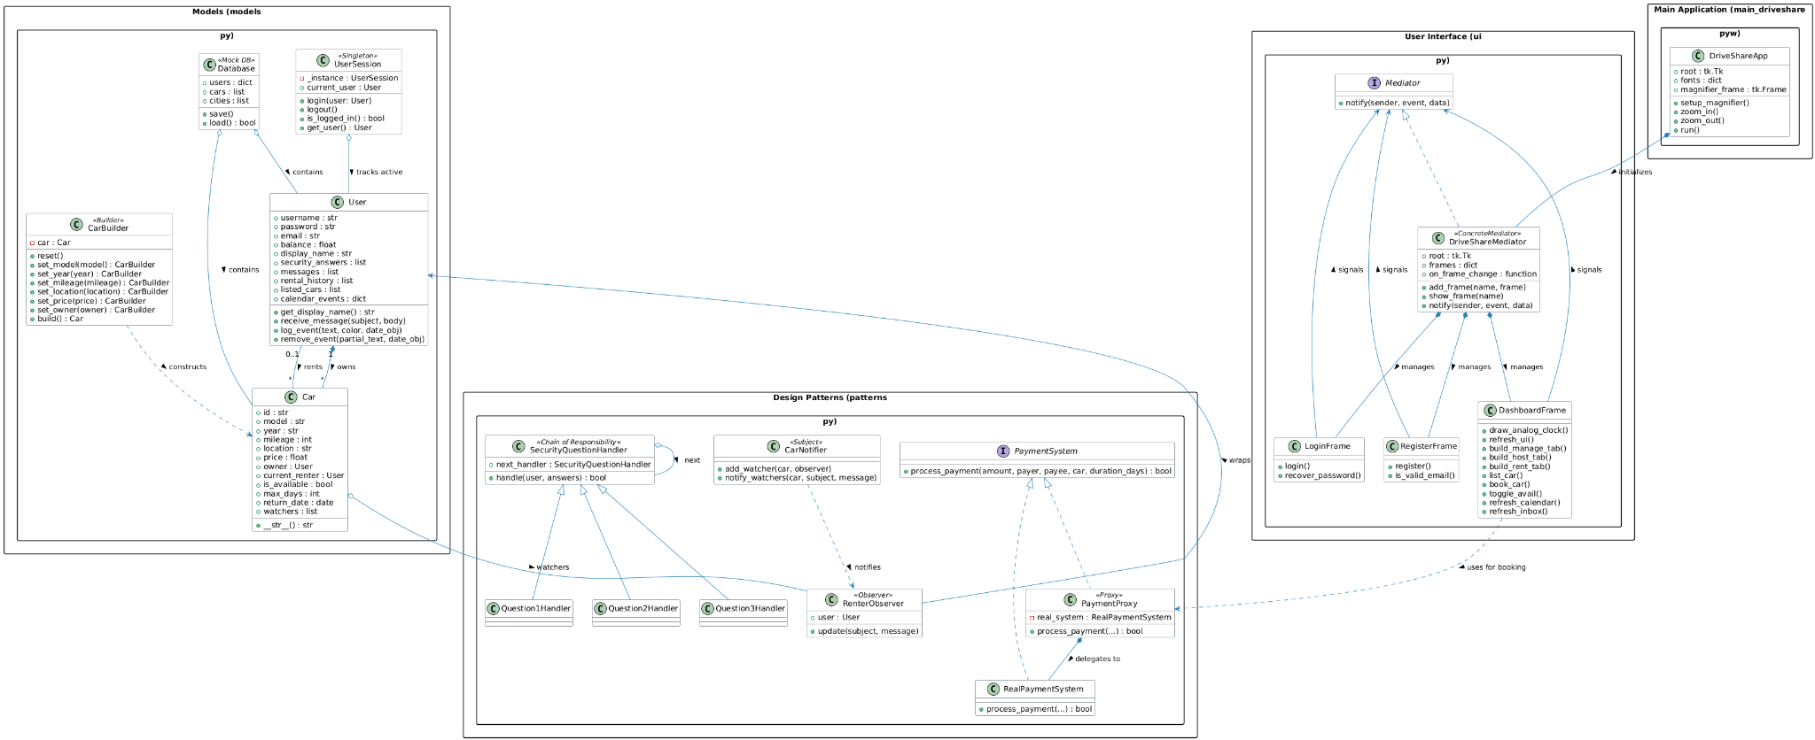
ARCHITECTURE
Design Patterns Integration
UML diagram as the main architecture view for DriveShare.
DriveShare - Peer-to-Peer Car Rental Platform
2

Slide 3
CODE DEEP DIVE
1. The Builder Pattern Done by Idris (models.py)
Car listing creation uses chained setter methods to safely assemble a Car object one field at a time.
class CarBuilder:
def __init__(self):
self.reset()
def reset(self):
self.car = Car()
def set_model(self, model):
self.car.model = model
return self
def set_year(self, year):
self.car.year = year
return self
def set_mileage(self, mileage):
self.car.mileage = mileage
return self
def set_location(self, location):
self.car.location = location
return self
def set_price(self, price):
self.car.price = price
return self
def set_owner(self, owner):
self.car.owner = owner
return self
def build(self):
built_car = self.car
self.reset()
return built_car
Key
Takeaways
IDRIS
• Allows step-by-step object construction.
• Enables clean method chaining, such as .set_model().set_year().
• The reset() function protects memory states and prevents duplicate data bugs.
DriveShare - Peer-to-Peer Car Rental Platform
3

Slide 4
CODE DEEP DIVE
2. The Chain of Responsibility Pattern Done by Zaid (patterns.py)
Password recovery is split into small handlers, each validating one security question before passing control forward.
class SecurityQuestionHandler:
def __init__(self, next_handler=None):
self.next_handler = next_handler
def handle(self, user, answers):
if self.next_handler:
return self.next_handler.handle(user, answers)
return True
class Question1Handler(SecurityQuestionHandler):
def handle(self, user, answers):
if user.security_answers[0].lower().strip() == answers[0].lower().strip():
return super().handle(user, answers)
return False
Key
Takeaways
ZAID
• Decouples security steps into independent handlers.
• Input is sanitized with .strip().lower() before validation.
• Failing any single handler immediately stops the process.
Flow: Question 1 passes -> next handler checks -> failure stops the chain immediately
DriveShare - Peer-to-Peer Car Rental Platform
4

Slide 5
CODE DEEP DIVE
3. The Mediator Pattern Done by Jason (UI.py)
The UI sends event strings to one mediator instead of every frame directly importing and controlling other frames.
class DriveShareMediator(Mediator):
# Concrete Mediator managing UI frame transitions and interactions.
def __init__(self, root):
self.root = root
theme(self.root)
self.frames = {}
self.current_frame = None
self.on_frame_change = None
def addFrame(self, name, frame):
self.frames[name] = frame
frame.grid(row=0, column=0, sticky="nsew")
def chooseFrame(self, sender, event, data=None):
if event == "GO_TO_REGISTER":
self.showFrame("RegisterFrame")
elif event == "GO_TO_LOGIN":
self.showFrame("LoginFrame")
elif event == "LOGIN_SUCCESS":
self.frames["DashboardFrame"].refresh_ui()
self.showFrame("DashboardFrame")
elif event == "LOGOUT":
UserSession().logout()
self.showFrame("LoginFrame")
def showFrame(self, name):
frame = self.frames.get(name)
if frame:
frame.tkraise()
self.current_frame = frame
if self.on_frame_change:
self.on_frame_change()
Key
Takeaways
JASON
• Centralizes complex UI routing and communication.
• Eliminates circular dependencies between Tkinter frames.
• chooseFrame evaluates events and updates UI states safely.
DriveShare - Peer-to-Peer Car Rental Platform
5

Slide 6
TEAM
Team Member Responsibilities
Each member owned a focused slice of DriveShare while collaborating on the shared UI implementation.
IDRIS
models.py & ui.py
• Architected core data models (User, Car) and the Singleton UserSession.
• Built the .pkl Database saving/loading mechanics.
• Co-developed ui.py, focusing on the Dynamic Calendar grid and event rendering.
ZAID
patterns.py & ui.py
• Programmed all design patterns (Proxy, Observer, Chain of Responsibility).
• Managed the complex payment routing and Inbox messaging systems.
• Co-developed ui.py, focusing on Rent/Host forms and cancellation penalty alerts.
JASON
main_driveshare.pyw & ui.py
• Wrote the master bootstrapper and dummy data population script.
• Engineered the global dynamic font scaling (Zoom Engine).
• Co-developed ui.py, focusing on the Mediator router and Flat UI styling.
DriveShare - Peer-to-Peer Car Rental Platform
6

