Slide 1
Performance Analysis of Password Vault
Created By: Jason Vail, Baris Izar, Emre Isiktekiner
for CS240: Data Structures and Algorithms

Slide 2
Things to Note
We analyze the doubly linked list implementation in the worst case since our code allows us to identify the last element in the linked list to search for / remove.
We analyze the hash table implementation in the average case since it is quite difficult to determine which element will suffer from the worst clusters given our double hashing implementation.
Each data point in this presentation representing an average was calculated based off at least 30 data points.

Slide 3
Time Complexity of Add Operation for Hash Table Implementation (with double hashing) in the Average Case

Slide 4
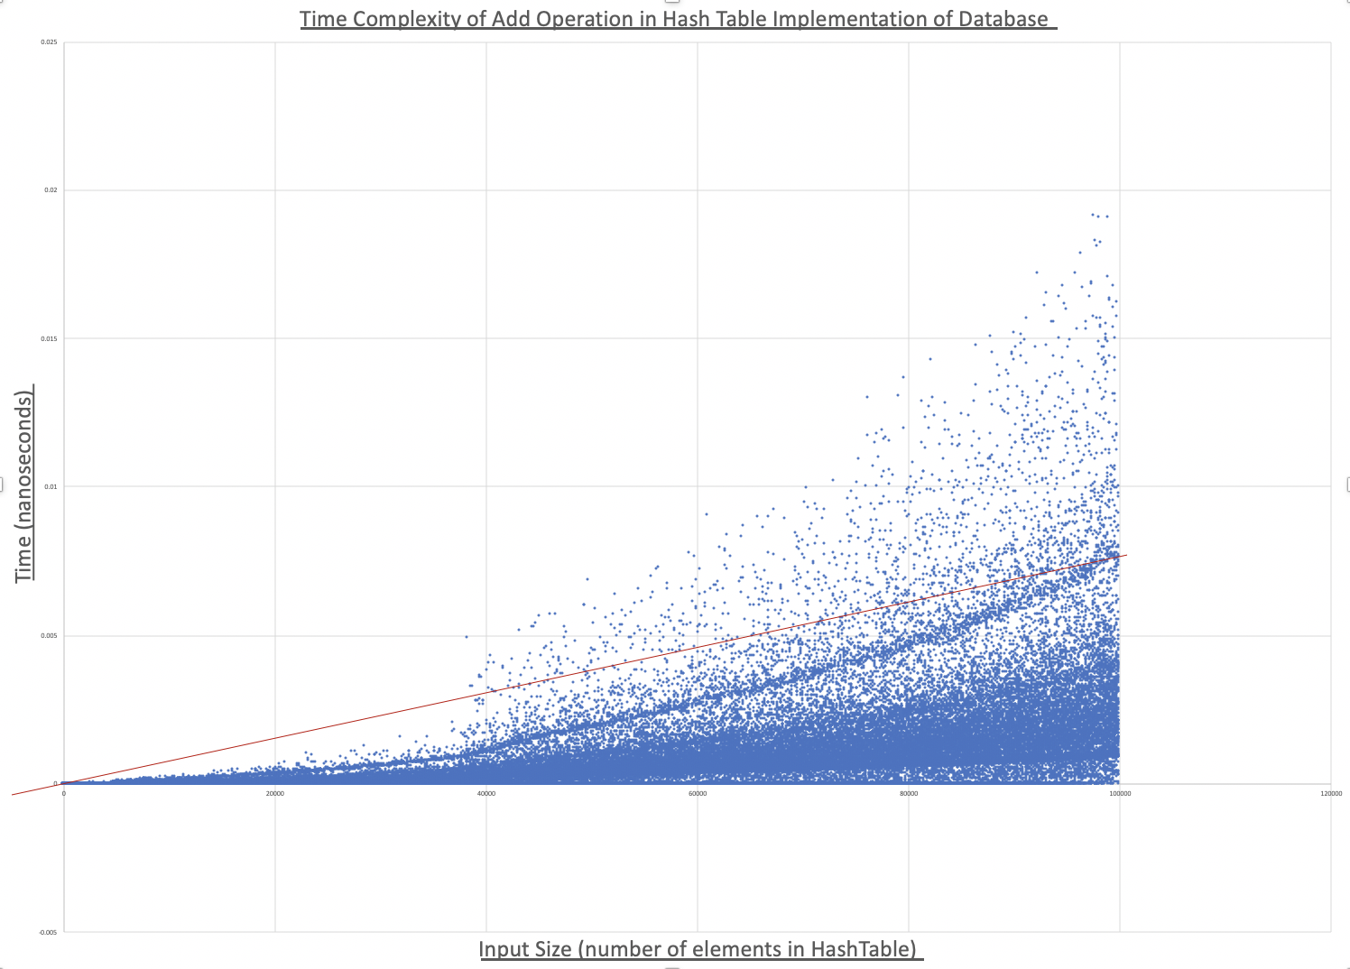
- We see that the Hash table implementation of the database requires O(n) time in the worst case.
99.15% of 100,000 input sizes (of 1 – 100,000 elements in the hash table) fall below the linear line with the equation:
T(n) = (7.8 x 10⁻⁸)(n)
Where T(n) is time in nanoseconds and n is the input size.

Slide 5
Time Complexity of Add Operation for Unsorted Doubly Linked List Implementation in the Worst Case

Slide 6
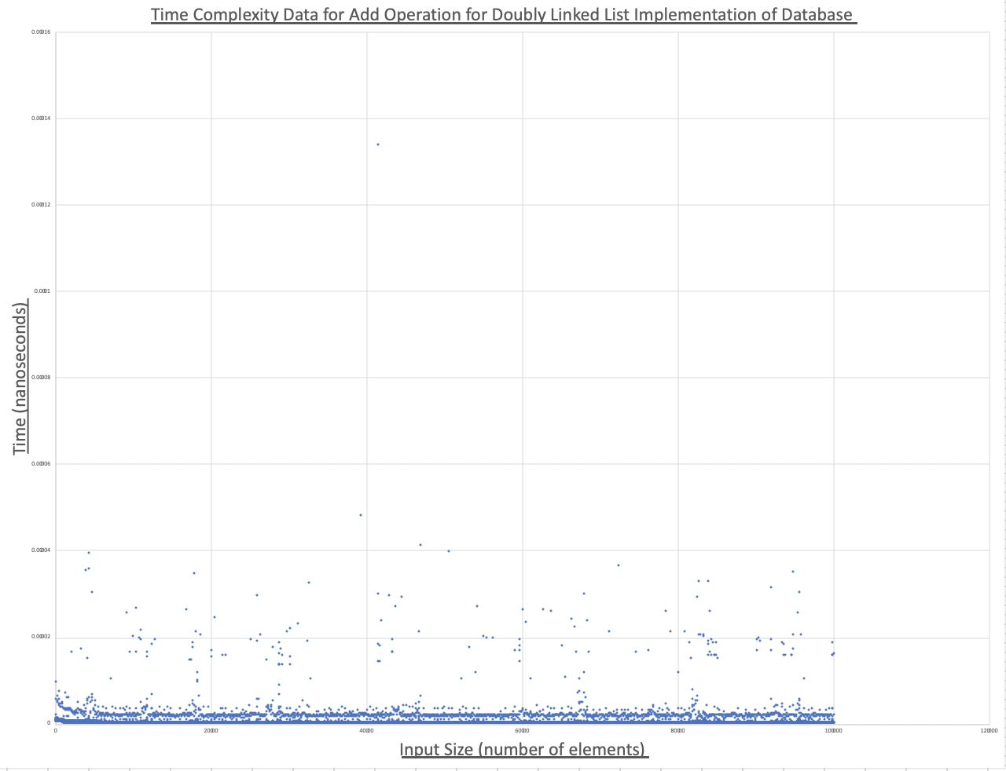
We see that the unsorted doubly linked list implementation of the database requires Ѳ(1) time for the add operation in the worse case.
Over 99.5% of all test input data confirm that the operation takes constant time.
The add operation takes .000000326 nanoseconds on average in the worst case

Slide 7
Alternative View of Data Shown in Previous Slide

Slide 8
Time Complexity of Search Operation for Hash Table Implementation (with double hashing) in the Average Case

Slide 9
We see that the Hash Table implementation requires O(log(n)) time for search in the average case.
Since the Hash table is designed such that it is always about half empty, and it implements double hashing, there are close to no clusters.
Element with given key is always found within a few probes.

Slide 10
Time Complexity of Search Operation for Unsorted Doubly Linked List Implementation in the Worst Case

Slide 11
- Linear line equation:
T(n) = (7x10⁻⁸)(n) + 4x10⁻⁵
- We see that the unsorted doubly linked list implementation of the database requires Ѳ(n) time for the search operation in the worse case.

Slide 12
Time Complexity of Remove Operation for Hash Table Implementation in the Average Case

Slide 13
We see that the time complexity of the remove operation for the Hash Table implementation is almost identical to that of its search operation, since each operation behaves very similarly.
Requires O(log(n)) time for search in the average case.
Element with given key is always found within a few probes.

Slide 14
Time Complexity of Remove Operation for Unsorted Doubly Linked List Implementation in the Worst Case

Slide 15
- Linear line equation:
T(n) = (8x10⁻⁸)(n) + 5x10⁻⁵
- We see that the unsorted doubly linked list implementation of the database requires Ѳ(n) time for the remove operation in the worse case.

Slide 16
Conclusion
The doubly linked list implementation provides for much faster insertion, requiring Ѳ(1) time. This implementation also wastes much less space than the hash table implementation, but still requires Ѳ(n) space.
While the hash table requires O(n) time for insertion – slower than doubly linked list -, and wastes a lot of space, it is incredibly faster for searching and removing – requiring O(log(n)) time - which is very important for the application.
Since the slowness associated with the hash table’s insertion operation only becomes apparent when hash table contains over 20,000 passwords, and that the keys - names for the passwords - will likely be well distributed over the set of possible words, the hash table is the best option for this application.

