Slide 1
Performance Analysis of Password Vault
Created By: Jason Vail, Baris Izar, Emre Isikte
for CS240: Data Structures and Algorithms

Slide 2
Time Complexity of Add Operation in the Worst Case for Hash Table Implementation (with double hashing) of Database

Slide 3
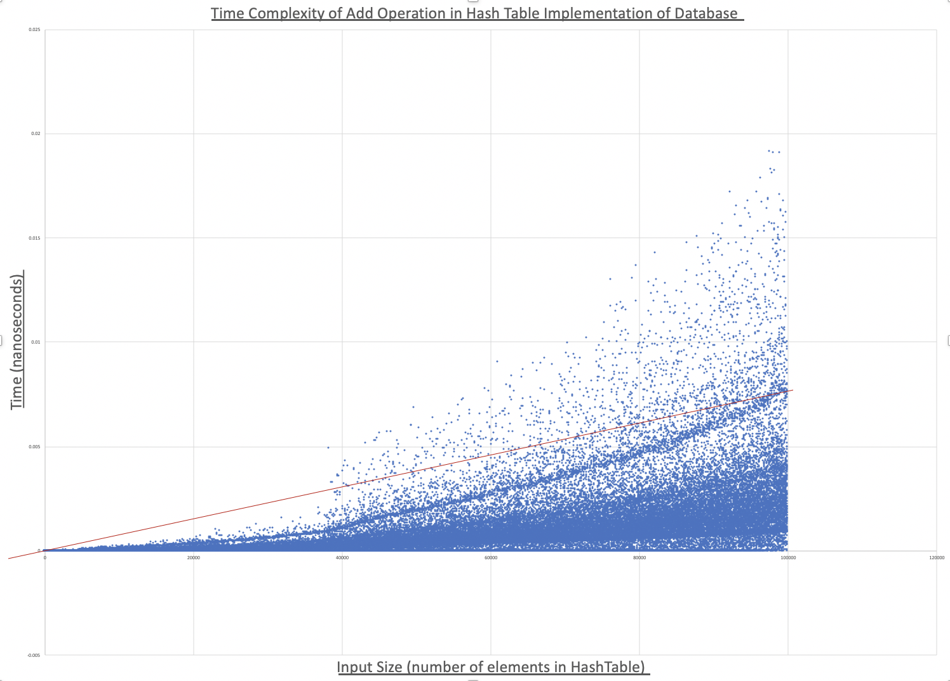
- We see that Hash table implementation of the database requires O(n) time in the worst case.
99.15% of 100,000 input sizes (of 1 – 100,000 elements in the hash table) fall below the linear line with the equation:
T(n) = (7.8 x 10⁻⁸)(n)
Where T(n) is time in nanoseconds and n is the input size.

Slide 4
Time Complexity of Add Operation in the Worst Case for Unsorted Doubly Linked List Implementation of Database

Slide 5
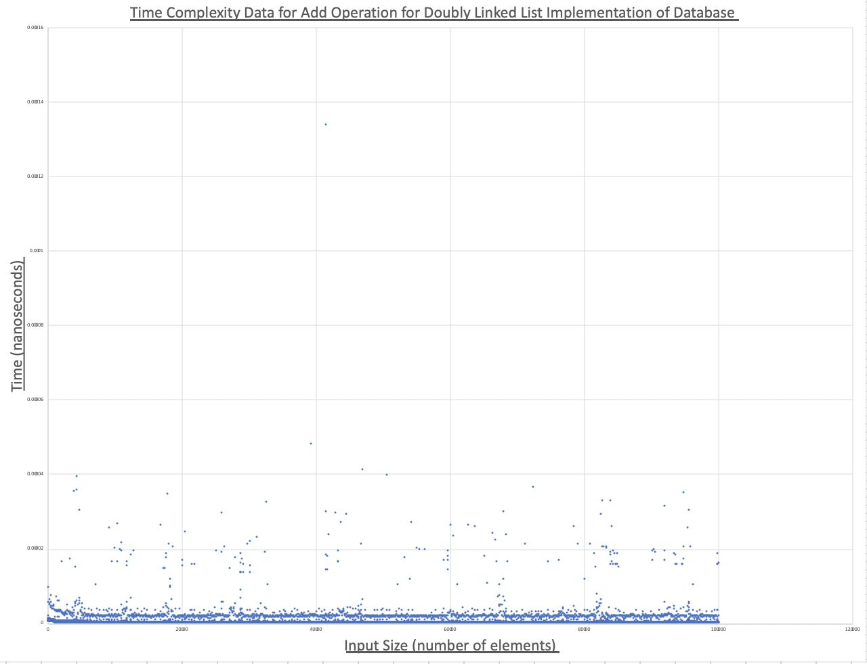
We see that the unsorted doubly linked list implementation of the database requires Ѳ(1) time for the add operation in the worse case.
Over 99.5% of all test input data confirm that the operation takes constant time.
The add operation takes.000000326 nanoseconds on average in the worst case

Slide 6
Alternative View of Data Shown in Previous Slide

Slide 7
Time Complexity of Search Operation in the Worst Case for Hash Table (with double hashing) Implementation of Database

Slide 8
- Linear line equation:
T(n) = (7x10⁻⁹)(n) + 2x10⁻⁵
- We see that the hash table implementation of the database requires Ѳ(n) time for the search operation in the worse case.

Slide 9
Time Complexity of Search Operation in the Worst Case for Unsorted Doubly Linked List Implementation of Database

Slide 10
- Linear line equation:
T(n) = (7x10⁻⁸)(n) + 4x10⁻⁵
- We see that the unsorted doubly linked list implementation of the database requires Ѳ(n) time for the search operation in the worse case.

Slide 11
Time Complexity of Remove Operation in the Worst Case for Hash Table Implementation of Database

Slide 12
- Linear line equation:
T(n) = (7x10⁻⁹)(n) + 6x10⁻⁶
- We see that the unsorted doubly linked list implementation of the database requires Ѳ(n) time for the remove operation in the worse case.

Slide 13
Time Complexity of Remove Operation in the Worst Case for Unsorted Doubly Linked List Implementation of Database

Slide 14
- Linear line equation:
T(n) = (8x10⁻⁸)(n) + 5x10⁻⁵
- We see that the unsorted doubly linked list implementation of the database requires Ѳ(n) time for the remove operation in the worse case.

Slide 15
Conclusion
The doubly linked list implementation provides for much faster insertion, requiring Ѳ(1) time
While both implementations required Ѳ(n) time for search and remove, the Hash Table implementation proved to preform these operations 10x faster.
The time required by the Hash Table for these operations be reduced if the amount of extra space allocated in the hash table grew with the size of elements, however this would cause the overhead space complexity to become Ѳ(n).
The hash table also provides for better space complexity when the storage gets large, since the overhead space complexity for the doubly linked list implement requires Ѳ(n) space while the overhead space complexity for the hash table table requires Ѳ(1) space.

