Slide 1

Terraform

Slide 2
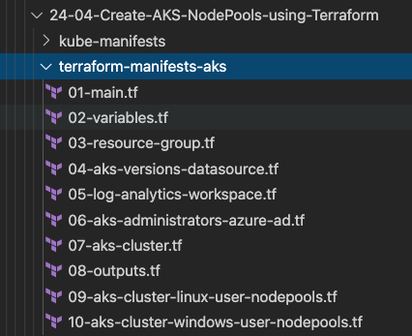
Terraform Language Basics – Files
Terraform Working Directory
Code in the Terraform language is stored in plain text files with the .tf file extension.
We can call the files containing terraform code as Terraform Configuration Files or Terraform Manifests
Terraform Configuration Files ending with .tf as extension

Slide 3
Terraform Workflow
init
validate
plan
apply
destroy
1
2
3
4
5
terraform init
terraform validate
terraform plan
terraform apply
terraform destroy

Slide 4
Terraform Workflow
init
validate
plan
apply
destroy
1
2
3
4
5
Used to Initialize a working directory containing terraform config files
This is the first command that should be run after writing a new Terraform configuration
Downloads Providers
Validates the terraform configurations files in that respective directory to ensure they are syntactically valid and internally consistent.
Creates an execution plan
Terraform performs a refresh and determines what actions are necessary to achieve the desired state specified in configuration files
Used to apply the changes required to reach the desired state of the configuration.
By default, apply scans the current directory for the configuration and applies the changes appropriately.
Used to destroy the Terraform-managed infrastructure
This will ask for confirmation before destroying.

Slide 5
Terraform Installation
Terraform CLI
AWS CLI
VS Code Editor
Terraform plugin for VS Code
Mac OS
Windows OS

Slide 6
Terraform Language Basics – Configuration Syntax
Blocks
Arguments
HCL – HashiCorp Language
Terraform
Identifiers
Comments

Slide 7
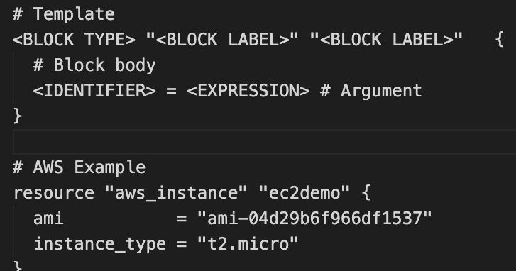
Terraform Language Basics – Configuration Syntax
Block Labels
Block Type
Based on Block Type block labels will be 1 or 2
Example: Resource – 2 labels
Variables – 1 label
Top Level & Block inside Blocks
Top Level Blocks: resource, provider
Arguments
Block Inside Block: provisioners, resource specific blocks like tags

Slide 8
Terraform Language Basics – Configuration Syntax
Argument Name
[or]
Identifier
Argument Value
[or]
Expression

Slide 9
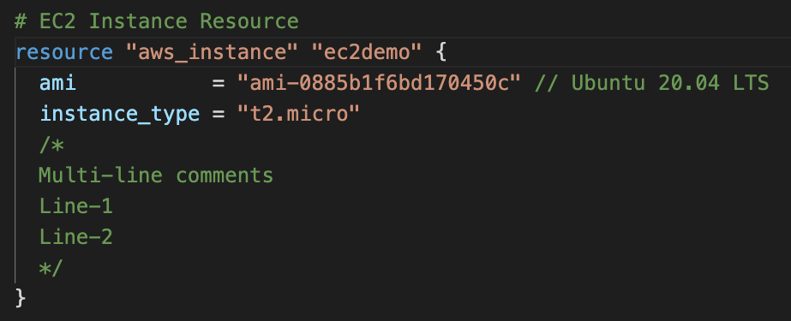
Terraform Language Basics – Configuration Syntax
Single Line Comments with # or //
Multi-line comment

Slide 10
Terraform
Top-Level
Blocks
Most of Terraform's features are implemented as top-level blocks.
Terraform Block
Input Variables Block
Data Sources Block
Providers Block
Output Values Block
Modules Block
Resources Block
Local Values Block
Fundamental Blocks
Variable Blocks
Calling / Referencing Blocks

Slide 11
Terraform
Fundamental Blocks

Slide 12
Terraform Fundamental Blocks
Terraform
Block
Provider
Block
Resource
Block
Special block used to configure some behaviors
HEART of Terraform
Each Resource Block describes one or more Infrastructure Objects
Required Terraform Version
Terraform relies on providers to interact with Remote Systems
Resource Syntax:
How to declare Resources?
List Required Providers
Declare providers for Terraform to install providers & use them
Resource Behavior: How Terraform handles resource declarations?
Terraform Backend
Provider configurations belong to Root Module
c1-versions.tf
c2-resource-name.tf

Slide 13
Terraform
Block

Slide 14
Terraform Block
This block can be called in 3 ways. All means the same.
Terraform Block
Terraform Settings Block
Terraform Configuration Block
Terraform block can contain a number of settings related to Terraform's behavior.

Slide 15
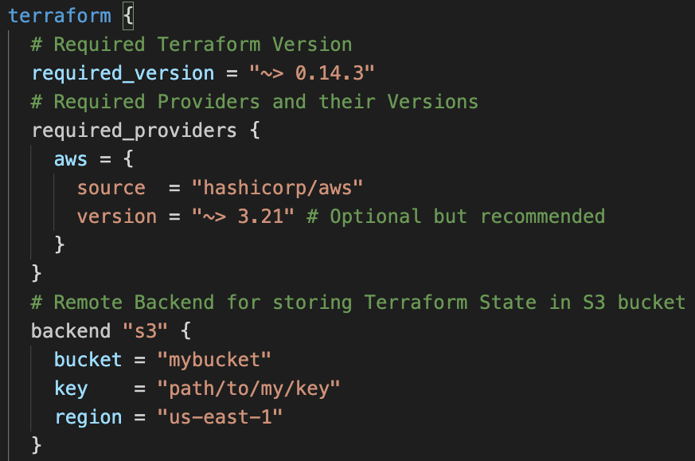
Terraform Block
Required Terraform Version
Provider Requirements
Terraform Block
Terraform Backend

Slide 16
Provider Block

Slide 17








Terraform Providers
Providers are HEART of Terraform
Every Resource Type (example: EC2 Instance), is implemented by a Provider
Without Providers Terraform cannot manage any infrastructure.
Terraform Admin
Providers are distributed separately from Terraform and each provider has its own release cycles and Version Numbers
Terraform Registry is publicly available which contains many Terraform Providers for most major Infra Platforms
Local Desktop
1
AWS Cloud
terraform init
Terraform CLI
VPC
Download Provider
Terraform Registry
Public subnet
Terraform AWS
Provider
4
terraform apply
AWS
APIs
5
terraform destroy
EC2 Instance
2
terraform validate
3
terraform plan

Slide 18
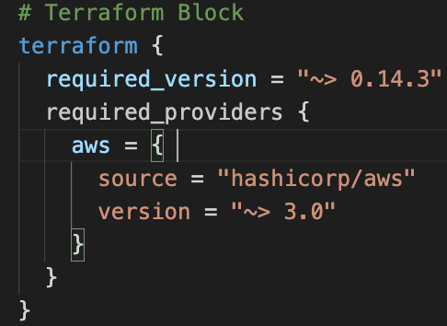
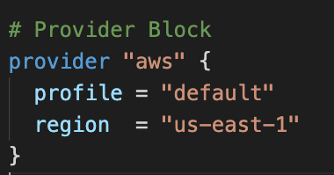
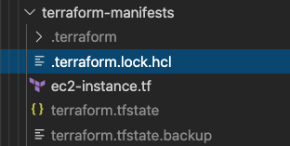
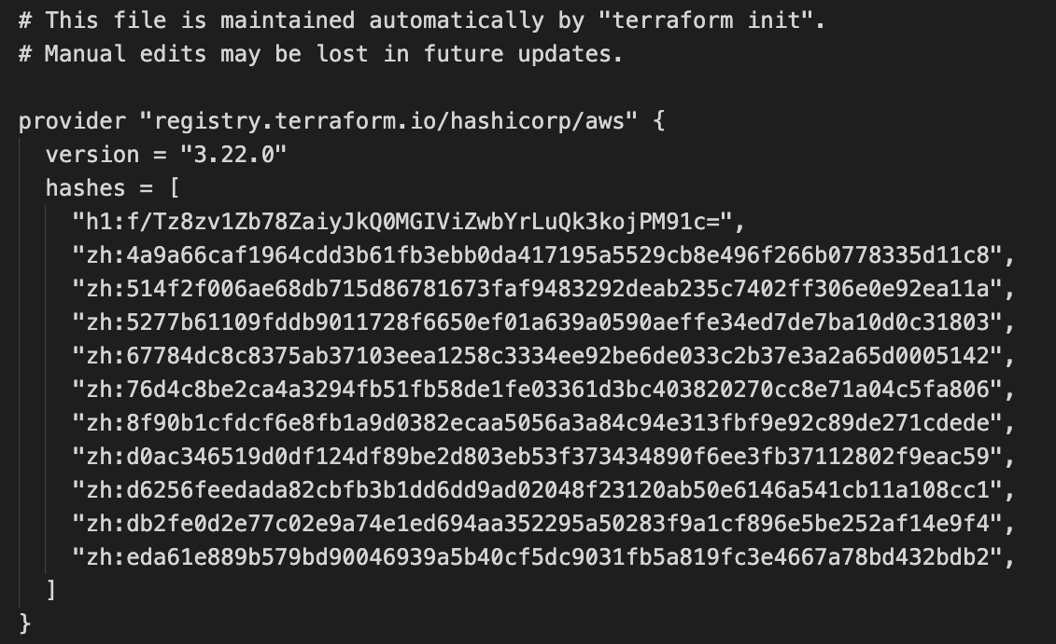
Terraform
Providers
Provider Requirements
Provider Configuration
Dependency Lock File

Slide 19
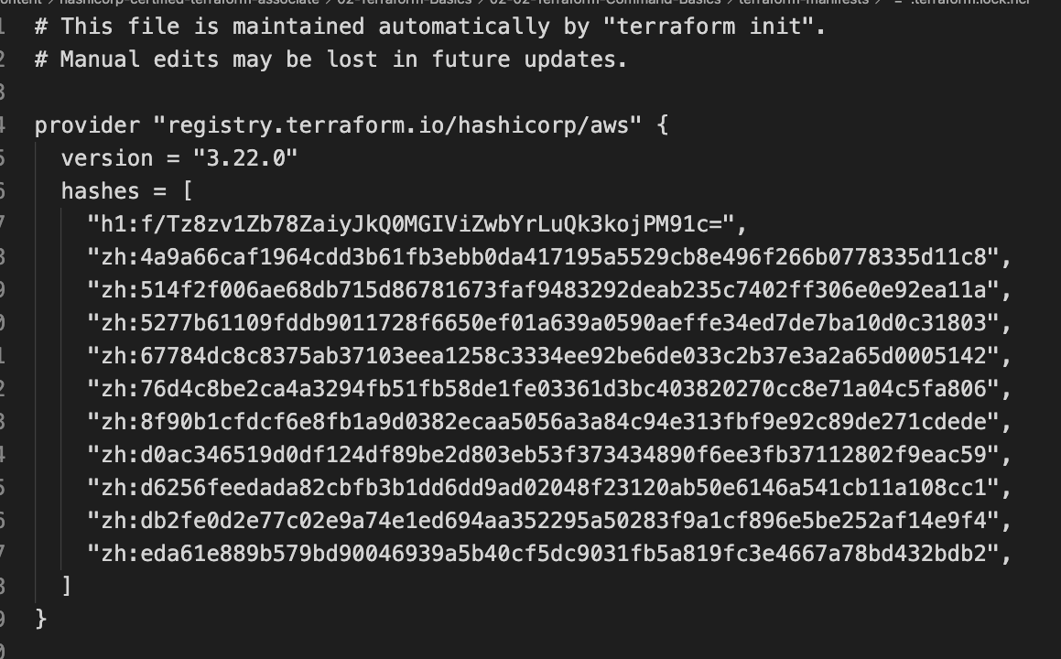
Dependency Lock File

Slide 20
Required Providers
Local Names
Local Names are Module specific and should be unique per-module
Terraform configurations always refer to local name of provider outside required_provider block
Users of a provider can choose any local name for it (myaws, aws1, aws2).
Recommended way of choosing local name is to use preferred local name of that provider (For AWS Provider: hashicorp/aws, preferred local name is aws)
Source
It is the primary location where we can download the Terraform Provider
Source addresses consist of three parts delimited by slashes (/)
[<HOSTNAME>/]<NAMESPACE>/<TYPE>
registry.terraform.io/hashicorp/aws
Registry Name is optional as default is going to be Terraform Public Registry

Slide 21




Terraform Registry
Terraform Provider Registry
Providers
registry.terraform.io
Modules
Provider Badges
These are owned and maintained by HashiCorp
Provider Documentation
These are owned and maintained by third-party technology partners. HashiCorp has verified the authenticity of the Provider’s publisher
Community providers are published to the Terraform Registry by individual maintainers, groups of maintainers, or other members of the Terraform community.
Archived Providers are Official or Verified Providers that are no longer maintained by HashiCorp or the community.

Slide 22
Terraform
Resources
Introduction

Slide 23
Terraform Language Basics – Configuration Syntax
Block Labels
Block Type
Based on Block Type block labels will be 1 or 2
Example: Resource – 2 labels
Variables – 1 label
Top Level & Block inside Blocks
Top Level Blocks: resource, provider
Arguments
Block Inside Block: provisioners, resource specific blocks like tags

Slide 24
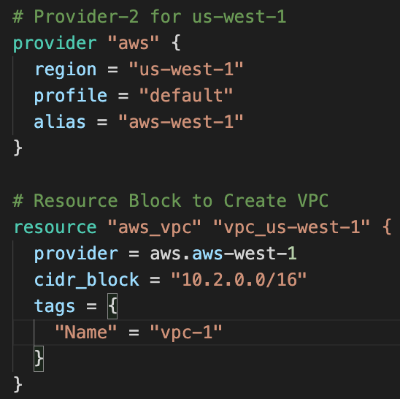
Resource Syntax
Resource Type: It determines the kind of infrastructure object it manages and what arguments and other attributes the resource supports.
Resource Local Name: It is used to refer to this resource from elsewhere in the same Terraform module, but has no significance outside that module's scope.
The resource type and name together serve as an identifier for a given resource and so must be unique within a module
Resource Arguments: Will be specific to resource type. Argument Values can make use of Expressions or other Terraform Dynamic Language Features

Slide 25
Terraform
State

Slide 26
Resource Behavior
Create Resource
Create resources that exist in the configuration.
Destroy Resource
Destroy resources that exist in the state.
Terraform Resource
Update in-place Resources
Update in-place resources whose arguments have changed.
Destroy and re-create
Destroy and re-create resources whose arguments have changed but which cannot be updated in-place due to remote API limitations.
Terraform State

Slide 27

Terraform State
Terraform must store state about your managed infrastructure and configuration
Terraform
Admin
This state is used by Terraform to map real world resources to your configuration (.tf files), keep track of metadata, and to improve performance for large infrastructures.
Local Desktop
This state is stored by default in a local file named "terraform.tfstate", but it can also be stored remotely, which works better in a team environment.
1
terraform init
AWS Cloud
Terraform CLI
VPC
Download Provider
Terraform Registry
Public subnet
Terraform AWS
Provider
4
terraform apply
AWS
APIs
5
terraform destroy
EC2 Instance
2
terraform validate
3
terraform plan
The primary purpose of Terraform state is to store bindings between objects in a remote system and resource instances declared in your configuration.
Terraform State
File
terraform.tfstate
When Terraform creates a remote object in response to a change of configuration, it will record the identity of that remote object against a particular resource instance, and then potentially update or delete that object in response to future configuration changes.

Slide 28
Terraform
Input Variables
Datasources
Outputs

Slide 29



What are we going to learn ?
Terraform
Concepts
AWS Services
Terraform Input Variables
AWS Cloud
Default VPC
Terraform Output Values
Public subnet
Security group
EC2 Instance
VPC-SSH
Security group
EC2 Key Pair
VPC-Web
Terraform Datasources
Dynamically get latest AMI ID

