Slide 1
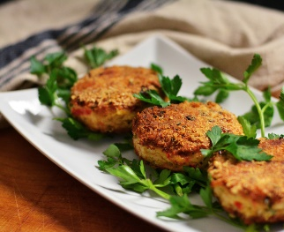


12:38
lifestyle > lifelist > meal
Tuna Cakes
20 Minutes
Tuna cakes are a quick, protein-rich, and delicious option.
Ingredients:
1 Tbls Ground Flax seed
5oz Tuna
1 Tbls Coconut oil
1 Egg

Slide 2

12:38
lifestyle > lifelist
Tuna Cakes
9999+ Followers
Tuna cakes are a quick, protein-rich, and delicious option.
Ingredients:
1 Tbls Ground Flax seed
5oz Tuna
1 Tbls Coconut oil
1 Egg

Slide 3
12:38
Summer & Beach
S
M
T
W
T
F
S
29
20
Oct
1
2
3
4
5
6
7
8
9
10
11
12
Today ● Friday, October 4th
Morning
9am
Next Meal
Afternoon
Evening

