Slide 1
Capstone Project
“Date-A-Scientist”
Machine Learning Fundamentals
Jeroen van Renen
slack: @jpvrenen
cohort-sep-18-2018

Slide 2
Contents
Exploring the dataset – Part 1
Exploring the dataset – Part 2
Question to answer
Can we predict, if someone has kids? KNN - Part 1
Can we predict, if someone has kids? KNN - Part 2
Can we predict, if someone has kids? KNN - Part 3
Can we predict, if someone has kids? K-means - Part 1
Can we predict, if someone has kids? K-means - Part 2
Conclusions

Slide 3
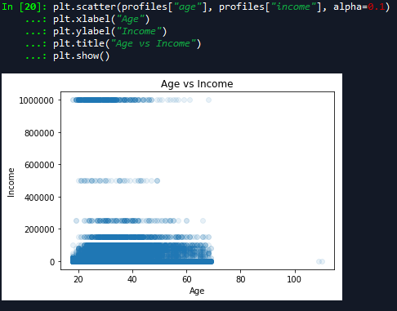
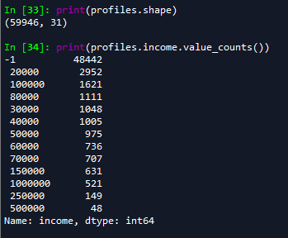
Exploring the dataset – Part 1
Lets take a look at some columns:
What about age vs income, lets create a scatter plot:
Looking at the available ‘income’ data out of 59946 rows 48442 rows are without data. in it's current state it is all over the place. I was thinking (in terms of linear regression) perhaps define a new income set but make sure the data is only relevant for a particular job perhaps in combination with some other feature.

Slide 4
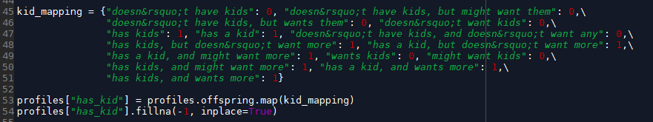
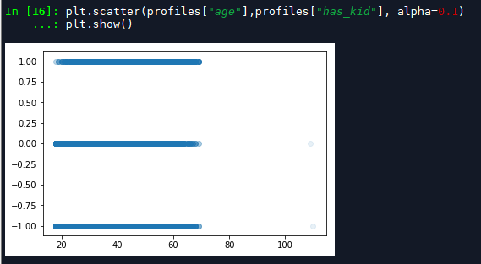

Exploring the dataset – Part 2
What about age vs ‘has kid(s)’, lets first create an extra field ‘has_kid’
scatterplot:
The plot appears to shows we have people in all ages with kids, we have 35561 unfilled entries but still a considerable amount of data to potentially work with.

Slide 5
Question to answer
During lunch one of my co-workers said there are 2 types of people:
1 - people that have kids
2 - people that don’t have kids
Question:
Can we predict, using this dataset, if someone has kids?
Let’s start by using the following features:
age, drinks, drugs, smokes, religion
We will create labels from ‘has_kids’.

Slide 6
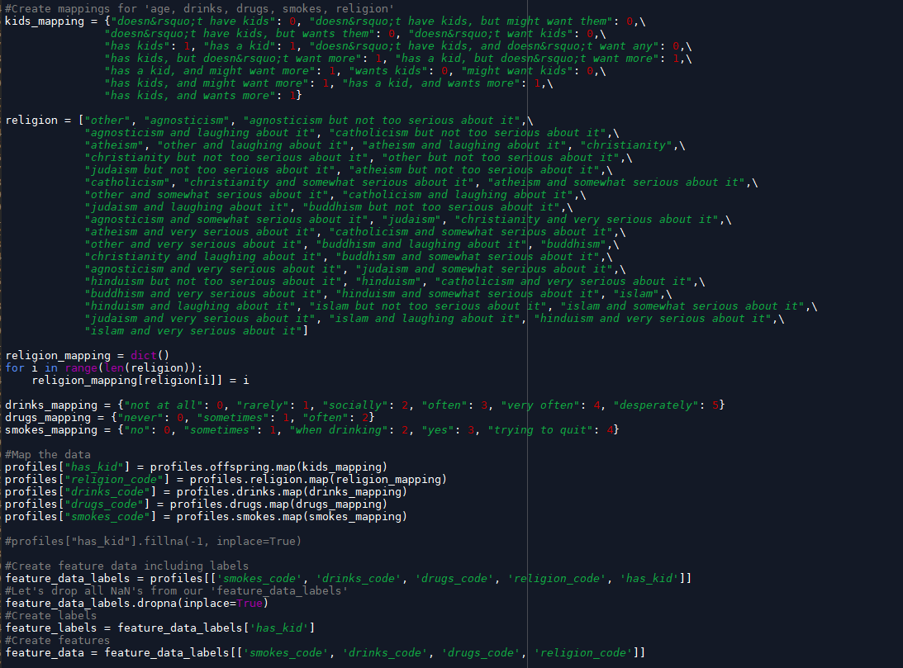
Can we predict, if someone has kids?
KNN - Part 1
- we make sure to map the data and create ‘feature_data’ (including labels)
– remove all rows that have NaN values
– separate ‘feature_data’ and ‘feature_labels’

Slide 7
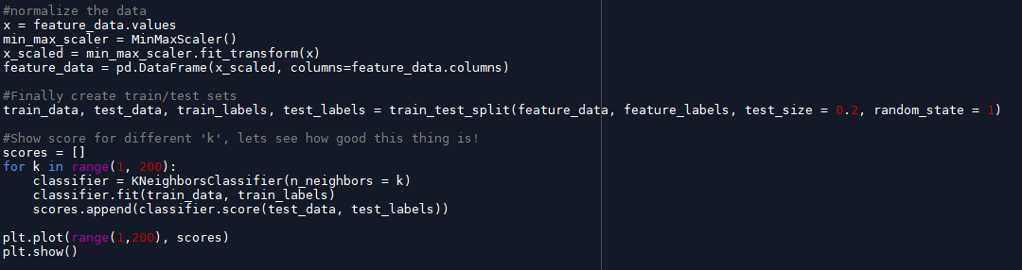
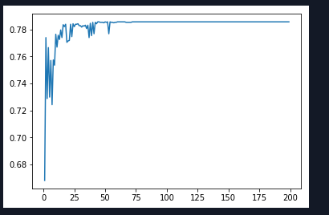
Can we predict, if someone has kids?
KNN - part 2
- normalize the data
- create train / test data, and train our classifier, I used KNN for this
- Lets also graph the score against ‘k’
With this set we score 0.785663841807909
Not Bad, well at least it appears to be accurate!
We probably need to dig a little further to find out how good or bad our solution is.

Slide 8

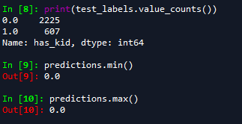
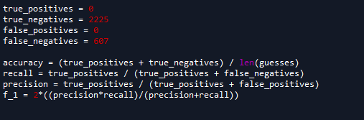
Can we predict, if someone has kids?
KNN - part 3
So we found a score of 0.785663841807909 but that only tells us something about accuracy, it doesn’t mean the predictive
capabilities are good, and after all that is what we are looking for!
Lets take a look at what this model actually predicts using the test_data:
Resulting in:
Oeps!! Turns out the score of our is based on the percentage of ‘0’’s in the test_data!! It’s predictive capabilities are also ‘0’ not 1 true positive was discovered… not what we were looking for. :(
So with all that in mind our ‘F1 score’ based on the test_data also becomes ‘0’

Slide 9
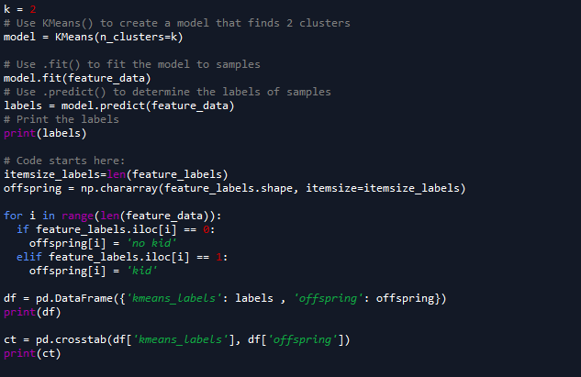

Can we predict, if someone has kids?
K-means - part 1
Now let’s try to feed our data into k-means
outcome of k-means
So using k-means this also shows that the predictive capabilities using these features are not that good.

Slide 10
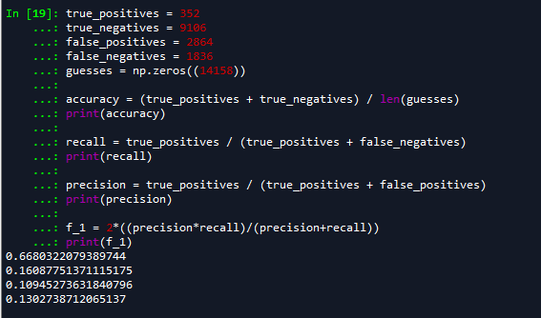
Can we predict, if someone has kids?
K-means - part 2
with these numbers we can calculate f1 score:
Again high accuracy but very low predictive capabilities!

Slide 11
Conclusions:
We have tried using KNN and K-means to answer our question, can we separate people with or without kids based on given features?
The outcome is that with our model we were unable to effectively make predictions! Both KNN and K-means show low predictive capability. Perhaps using more features will give us better results.
I have not used any of the essay features perhaps there is a way to incorporate these features in our model. Something to perhaps consider is to use a different dataset similar to the sentiment exercise and use that on the essay’s.

