Slide 1
Reward Effects on Cognitive Control and Attention: a reach tracking investigation (RECCA)
James Wilmott
PhD student, Brown University

Slide 2

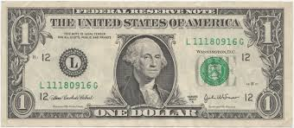
How does reward modulate cognitive processing?

Slide 3
Reward modulates proactive cognitive control processes
Proactive adjustments in cognitive control are thought to underlie the efficiency and success of cognitive processing and response selection (Botvinick et al. 2001; Shenhav et al. 2013)
‘Conflict adaptation’ is one way this has been shown
When a high conflict task is performed immediately after another high conflict task, performance is better than when a high conflict task is performed after a low conflict task
Thought to stem from proactive prioritization of task-relevant information processing

Slide 4
(Positive) reward modulates attentional allocation
Visual features that have previously been associated with reward automatically attract attention
Reward primes attentional capture by a visual stimulus if was rewarded was administered on the previous trial (Hickey et al. 2010A, B; 2011)
Visual features (shapes and colors) that were previously rewarded capture attention during unrelated tasks performed at a later time, up to 21 days later (Della Libera & Chelazzi, 2009; Anderson et al. 2011A, B; Anderson, 2013)
Learned reward-stimulus associations may increase the effective salience of the stimulus independent of task-related search strategies (Hickey et al., 2010A; Anderson et al. 2011)

Slide 5
Reward may be dissociable from value
Peck et al. (2009)

Slide 6
Hypotheses
Both positive and negative reward-stimulus associations are learned and affect processing in subsequent tasks
Both the valence of the learned association and the subsequent task context will determine how processing is affected

Slide 7
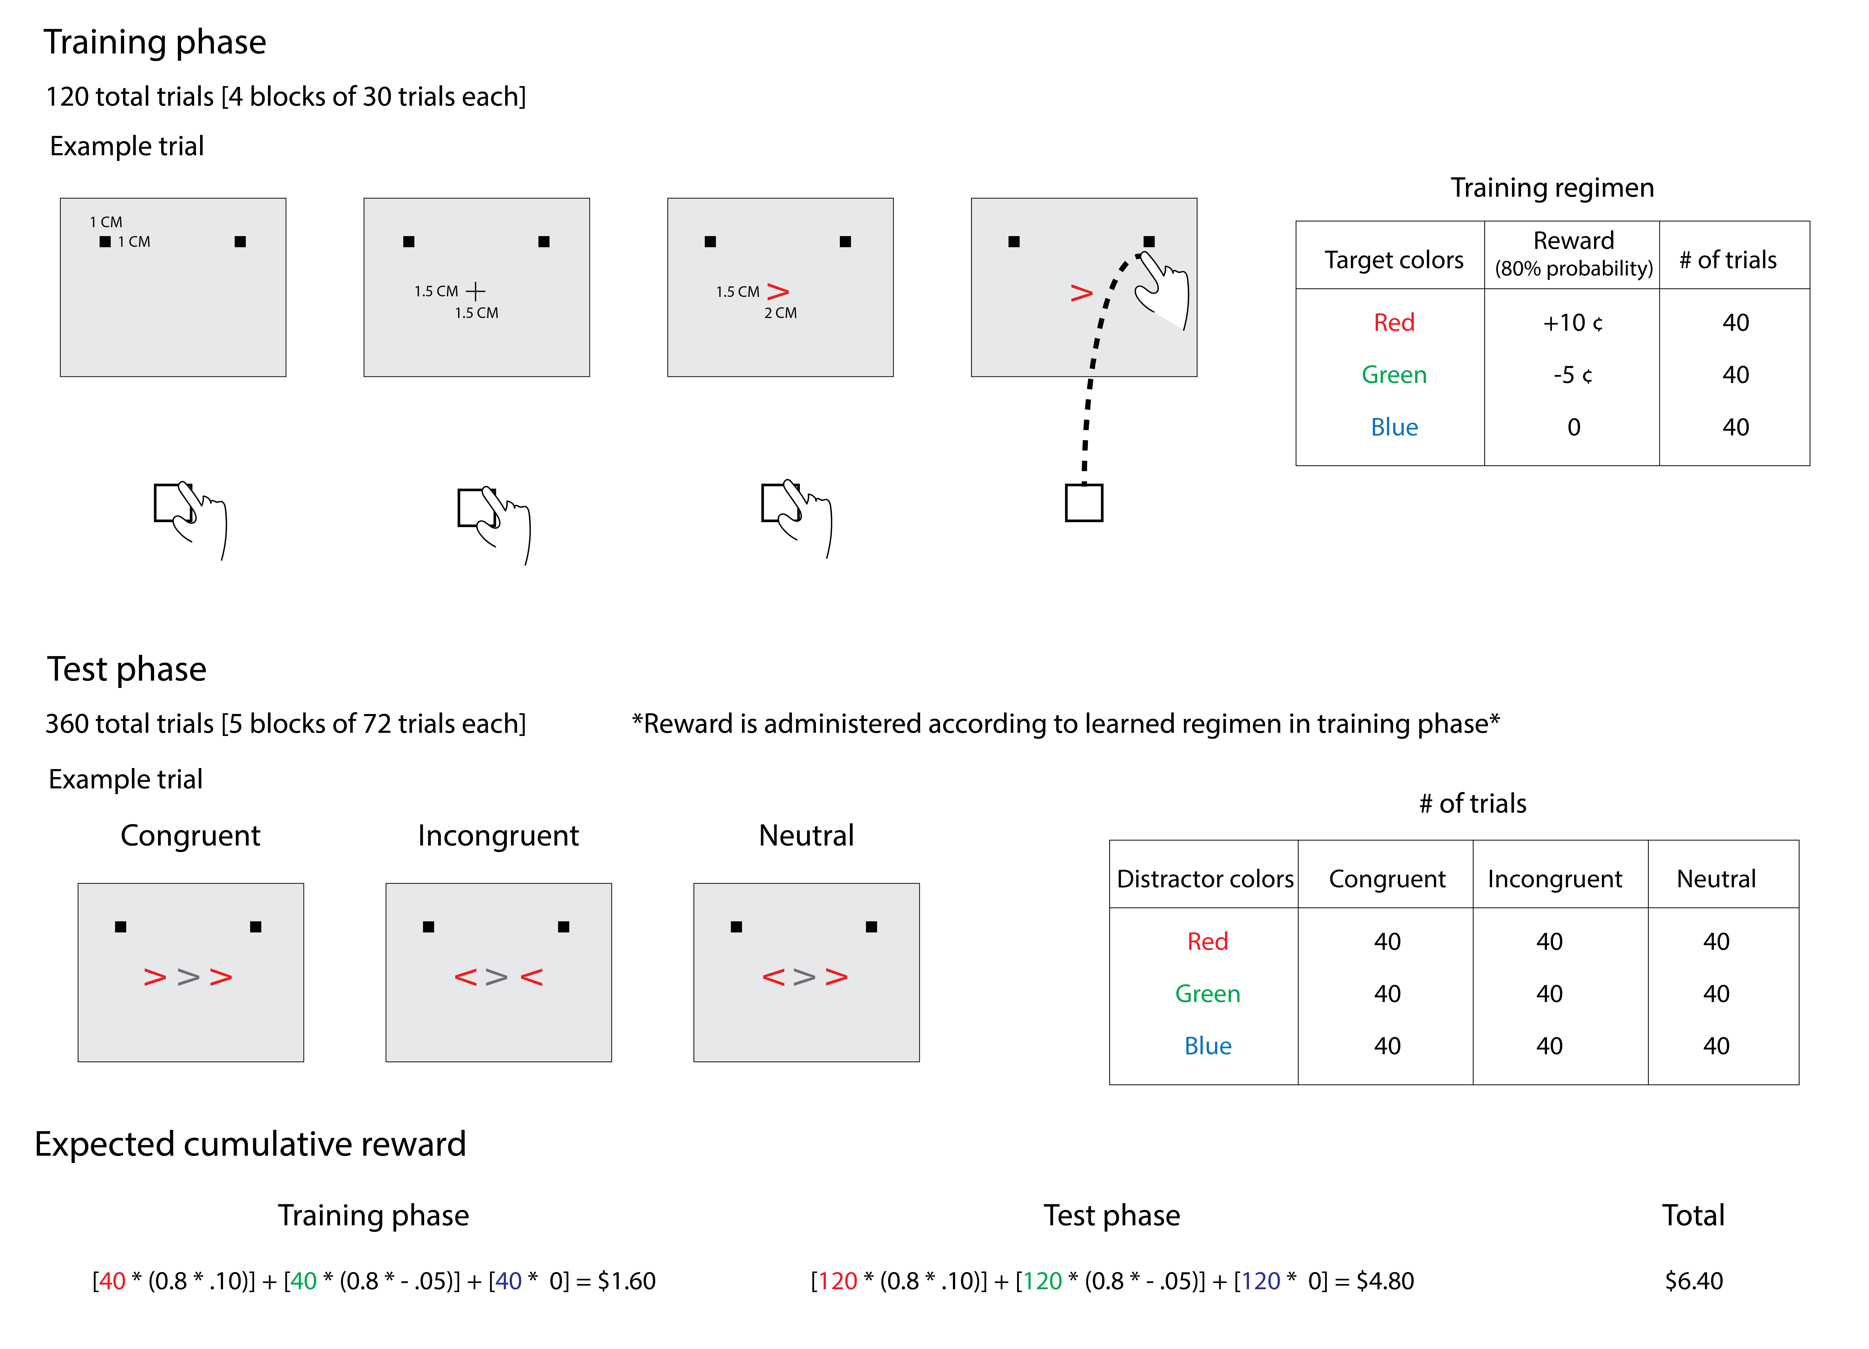
Experiment 1 – Does valence modulate reward-stimulus-dependent cognitive control?
Notes:
This gets us 20 trials for each direction (left and right) and keeps us for ~$17 TOTAL per participants (assuming probabilistic rewards and rounding up)
Training: 5 trials each direction and color for each block
Test: 4 trials each direction, color, congruency for each block
Randomize which color is rewarded with which level of reward
Equiluminance space in colors (where to find?) – Ask Leslie for three different colors that are spaced equally in color space
Pilot test – how many trials during training? Jeff didn’t have the information about how long training took, but I’ll go through his data
Baseline – Blue colors in training phase? What else might be the baseline?
Total number of trials for Chris Erb’s paper: 24 + 12 practice + 6 * 48 = 288 = 324 total
Jeff’s total training: 50 practice and then 60*4 = 240 training trials, with another 240 trials for search (test phase) = 530 total

Slide 8
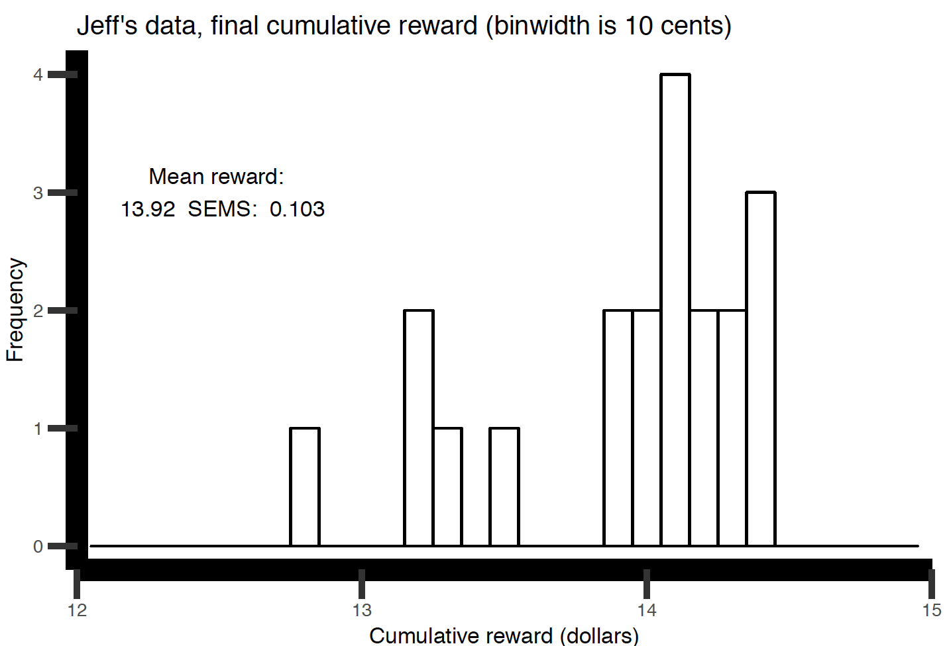
Jeff’s data: Total accumulated reward during reward training phase
Notes:
Jeff’s original data, cumulative reward accumulated
This is in addition to the 8 or 10 dollars given to participants for participating (according to Jeff)

Slide 9
Predictions for effect of reward and current trial congruency
Notes:
Initiation latency is thought to reflect an adaptive response adjustment thresholding process that is sensitive to pre-trial processes (e.g., previous trial congruency)
Curvature is thought to reflect controlled response selection (target selection)
We might expect an interaction between reward and stimulus congruency, where response facilitation (congruency) is smallest for learned negative associations (distractors are green) than neutral or positive, and response interference (incongruency) is largest for learned positive associations (distractors are red).

Slide 10
Predictions for effects of previous trial reward and congruency, 1/3
Notes:
If previous reward trial reward associations affect current trial processing, we might expect that conflict adaptation (smaller difference between iI and iC conditions than cI and CC in curvature) would be modulated by reward. That is, we’d expect a previous reward by previous trial congruency by current trial congruency three-way interaction.
Possibly a main effect of previous trial reward as well?
*Braem et al 2012 Cognition found increased conflict adaptation for reward over no reward trials in a Flanker task*
PREVIOUS TRIAL NEUTRAL REWARD
Greater conflict adaptation for positive reward than neutral, then negative reward (slope of current incongruent condition [solid line] steeper for red than blue or green)

Slide 11
Predictions for effects of previous trial reward and congruency
Notes:
PREVIOUS TRIAL NEUTRAL REWARD
Might not predict differences in conflict adaptation between reward conditions

Slide 12
Predictions for effects of previous trial reward and congruency
Notes:
PREVIOUS TRIAL NEGATIVE REWARD
Less conflict adaptation for negatively rewarded stimulus from previous trial than for the other two conditions (consistent with the notion that negatively learned associations would not facilitate pre-trial adjustments in cognitive control because they were of negative valence)

Slide 13
Experiment 2 – Do previously learned, task-irrelevant reward-stimulus associations affect cognitive control processes?
Experiment 1 test phase characterizes the role of reward-stimulus associations that are relevant for the current task
What about reward-stimulus associations that are task–irrelevant?
Previous studies have shown stimuli that have previously been associated with reward attract attention even when currently irrelevant for the given task (e.g., Anderson et al., 2011; Anderson, 2013)
Notes:
MAKE THE REWARD-STIMULUS ASSOCIATIONS TASK-IRRELEVANT BY STOPPING REWARDING DURING THE TEST PHASE

Slide 14
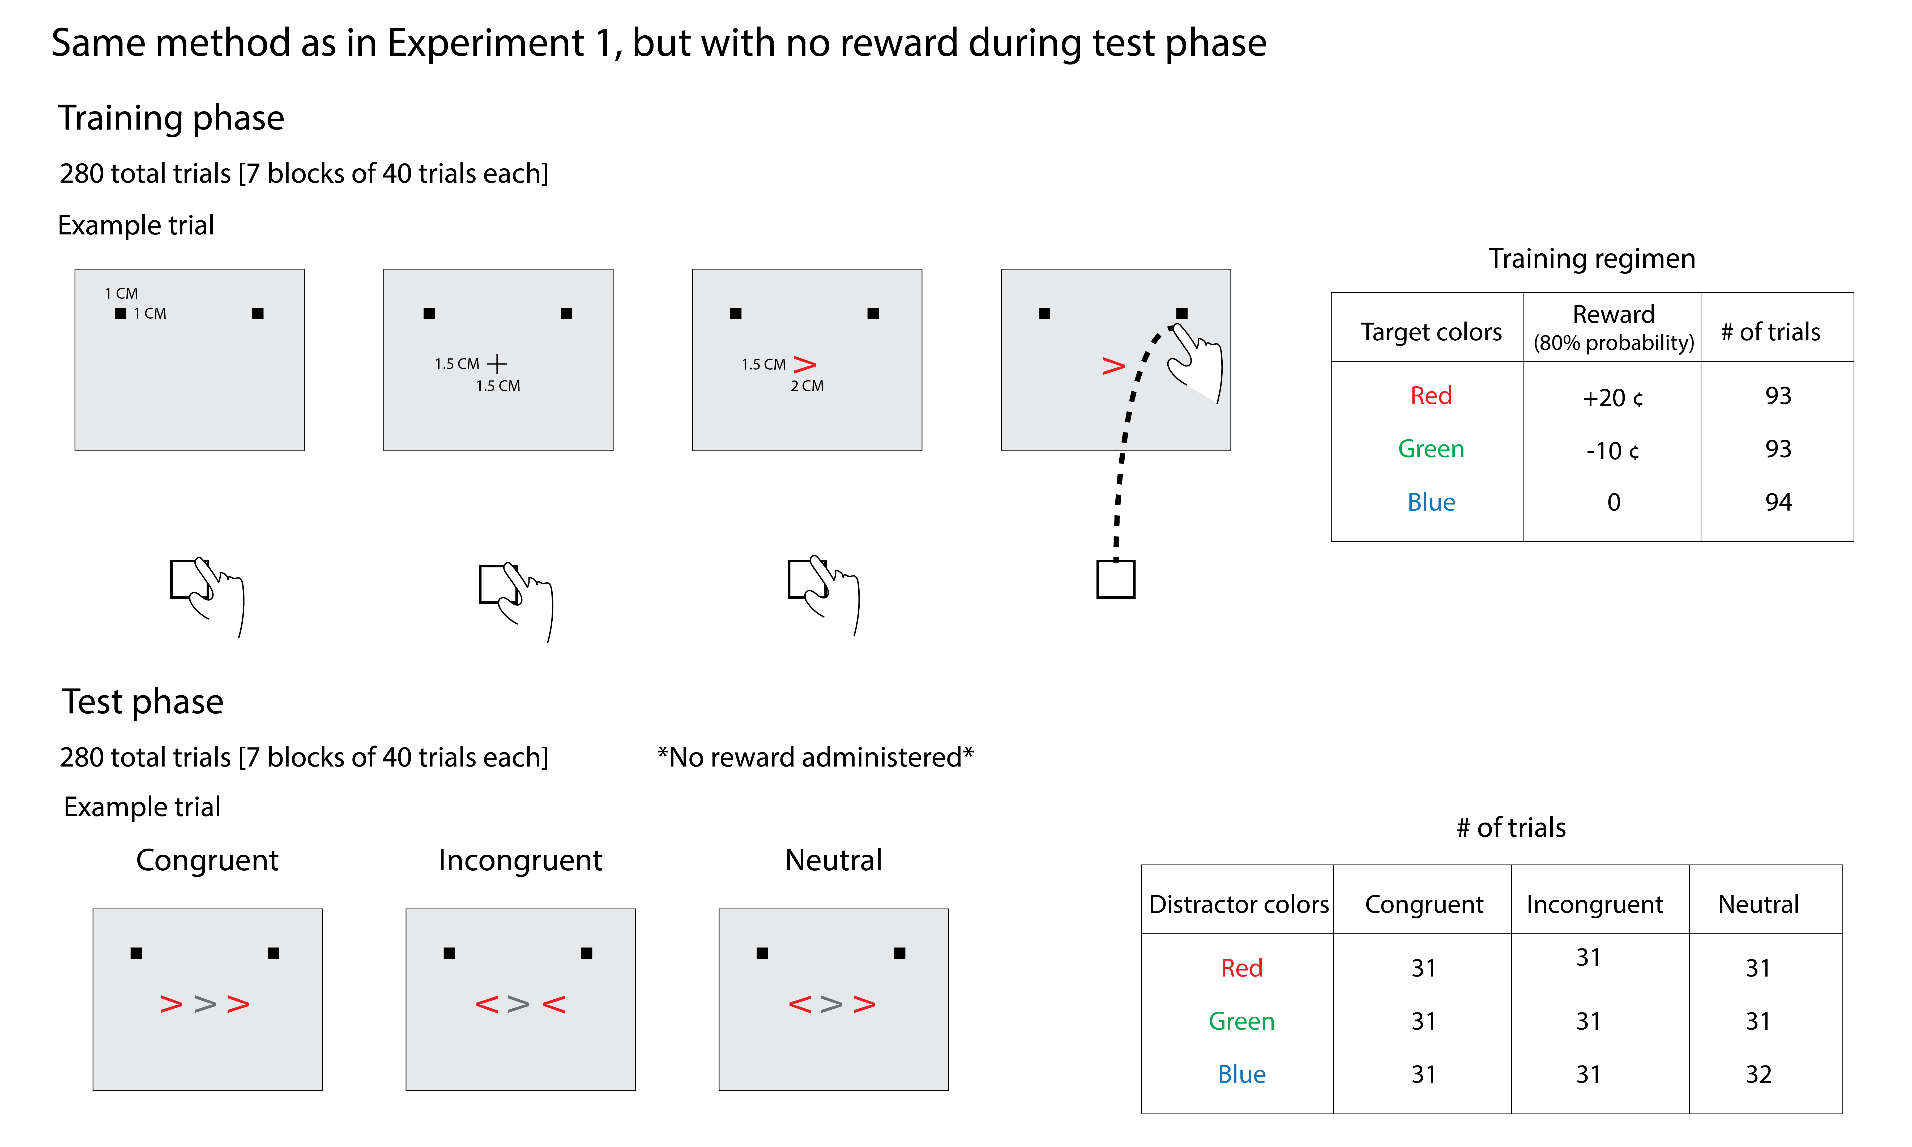

Slide 15
Experiment 3 – Does task difficulty affect reward-based modulations of cognitive control?
Theoretical accounts of the role on motivation in cognitive processing propose that increasing reward increases the efficiency of cognitive effort, while increasing task difficulty decreases cognitive effort (e.g., Chiew & Braver, 2011)
Flanker tasks become harder as the number of flankers increases (e.g., Erb et al. 2017)
Manipulation of the number of flankers allows us to test difficulty modulations of reward-stimulus associations
Notes:
MAKE THE REWARD-STIMULUS ASSOCIATIONS TASK-IRRELEVANT BY STOPPING REWARDING DURING THE TEST PHASE

Slide 16
