Slide 1
CRET: Eyetracking data analysis
James Wilmott

Slide 3
In this dataset, we have many missing data points as some subject do not choose a substance. Here, I take a linear mixed-effects model (LMM) approach to analyze the data using a restricted maximum likelihood (REML) fitting technique. This approach allows us to fit individual slopes for each subject using the estimates from the overall group in cases where participants do not have a score. All analyses are conducted in R unless otherwise stated.
Model to be tested:
Dependent measure ~ experimental variables + subject random effect
Notation: fixed effects will be presented in red
****My interpretations of the analyses are included in the ‘notes section’ of this presentation

Slide 4
The following control variables were included in a subsequent analyses:
Time from last cigarette, CLPS session
History of depression
Baseline alcohol craving
Age
Gender
CAAS session 1st (boolean)
ADS scale
FTND scale
Drinks/week
Cigarettes/day
Self-reported preference (alcohol or cigarette)
Dependent measure ~ control variables + experimental variables + subject random effects
However, the LMM analyses conducted here drops some of these variables and subjects when included in the analyses due to ‘rank deficiency of the fixed effects matrix’. From what I can tell, this arises due to correlations among the control variables. Any suggestions on how to deal with these correlations are greatly appreciated. I have included these analyses here but note that I am not confident the results of these analyses as currently conducted reflect real effects.

Slide 5
Proportion of trials choosing an item

Slide 6
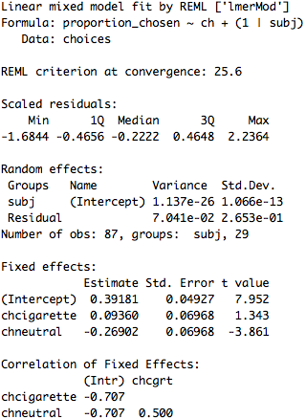
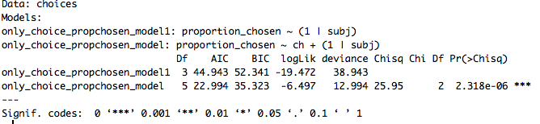
Proportion of trials chosen: experimental variables in analysis only
(1) Proportion of trials chosen ~ chosen item + subject random effect
Model comparison:
N = 29
Notes:
There seems to be a clear effect of choice on proportion chosen, as the t values associated with the change in neutral from alcohol has a large t-value. The package used to build the LMM does not provide p-values, as the degrees of freedom in the LMM are not straightforward to calculate and are under some theoretical debate (e.g., what is the appropriate degrees of freedom for an arbitrary LMM? -> https://stat.ethz.ch/pipermail/r-sig-mixed-models/2008q2/000904.html).
However, we can run a model comparison against a model that just fits the random effect of subject (only_choice_propchosen_model1). There is a clear difference between those models (according to the p-value of the chisquare test) and the AIC is smaller for the model with the choice fixed effect, implying this model is a good fit.

Slide 7
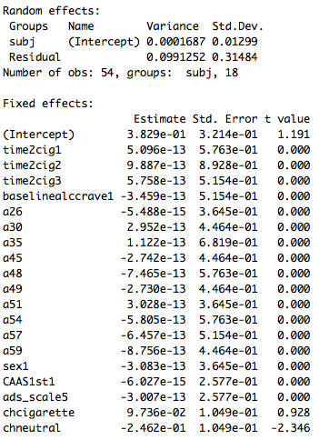
Proportion of trials chosen: experimental variables and control variables
(2) Proportion of trials chosen ~ chosen item + control variables + subject random effect
N = 29
Notes:
Each of these variables corresponds to specific instances of CHANGES of the fixed effect variable from the first instance, e.g., time2cig1 = 1 unit of time change from 0 (the first value) since last cigarette, time2cig2 = 2 units of time, etc.
Notice that the control variables are assigned t-values of 0 when including them in this model. From my research it seems as if the correlative structure of the control variables in conjunction with the very small number of subjects that actually selected the neutral item lead to many data points being dropped from the analysis in this instance, preventing estimates of those effects. The model DID converge, but it’s unclear whether this analysis currently constructed actually reflects the effects of these covariates. Any suggestions on how to tackle this problem would be greatly appreciated

Slide 8
Reaction time

Slide 9
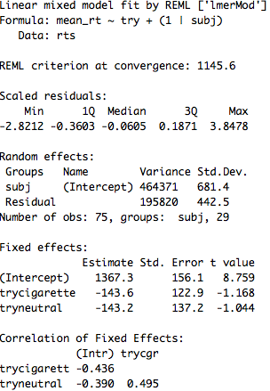
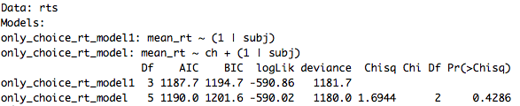
Reaction time: experimental variables in analysis only
(1A) RT ~ chosen item + subject random effect
Model comparison:
N = 29
Notes:
(1A) the trycigarette and tryneutral model params represent the change in RT from alcohol to cigarette and then to neutral. Neither of these effects are very large (judging by the t-values, although we do not get pvalues because it is unclear what the appropriate degrees of freedom are for an arbitrary MM).
Model comparison against a model without the choice fixed effect (only subject random effect) leads to no difference, implying that chosen item does not explain RT.

Slide 10
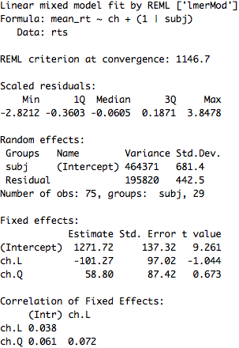
Reaction time: experimental variables in analysis only, polynomial contrasts
(1B) RT ~ chosen item linear + chosen item quadratic + subject random effect
Model comparison (doesn’t change from the previous comparison):
N = 29
Notes:
As there was no effect of chocie on RT, but there eems to be a linear effect, I re-ran the RT analysis with polynomial contrasts to determine if this was meaningful.
(1B) ch.L is the linear effect of RT choice, ordered alcohol, cigarette, and neutral. Ch.Q is the quadratic effect. Neither is a meaningful t-value
Model comparison is the same as before; therefore, I interpret that there is not a meaningful linear trend in this data (even though it really looks like it)

Slide 11
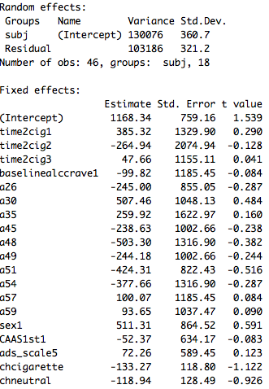
Reaction time: experimental variables and control variables
(2) RT ~ chosen item + control variables + subject random effect
N = 29
Notes:
(2) Again, each of these variables corresponds to specific instances of CHANGES of the fixed effect variable from the first instance, e.g., time2cig1 = 1 unit of time change from 0 (the first value) since last cigarette, time2cig2 = 2 units of time, etc.
None of the control variable parameters that were able to fit, as well as the choice parameters (chcigarette and chneutral) are seemingly meaningful (small t-values)
When running this analysis with the polynomial contrasts, the results do not change.

Slide 12
Proportion of time spent looking at each item

Slide 13
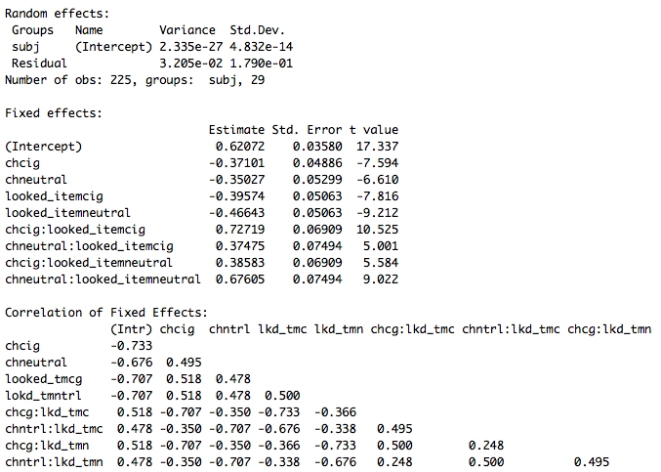
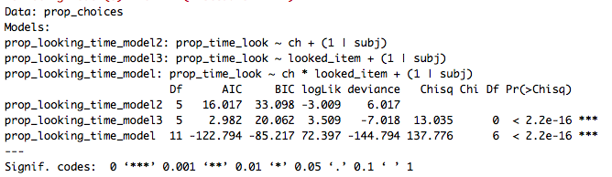
Proportion of looking time: experimental variables in analysis only
Proportion looking time ~ looked at item * chosen item + subject random effect
Model comparison:
Looked at item:
N = 29
Notes:
There is a clear effect of looked at item and a chosen item by looked at item interaction.
The best fitting model includes the interaction term (and both choice and looked at item variables) compared to either model without
Note that inclusion of the control variables results in a model that does not converge when incorporating the chosen item by looked at item interaction. Future work will be done to resolve this problem.

Slide 14
Breaking down by trial type

Slide 15
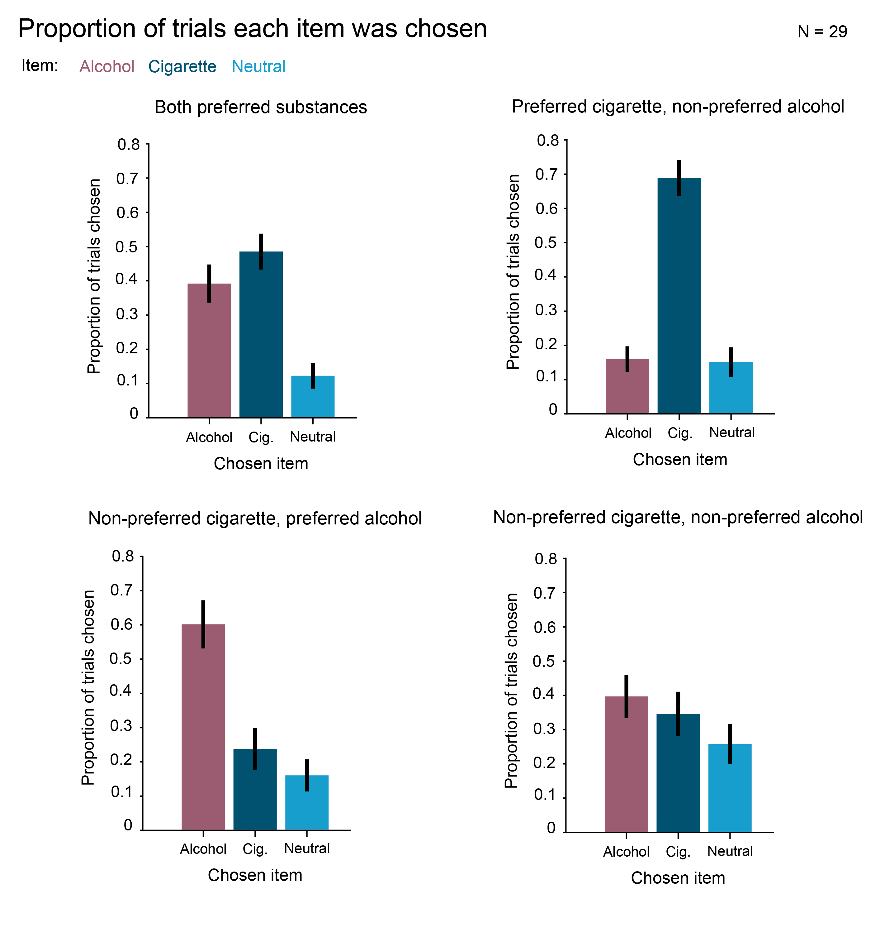

Slide 16
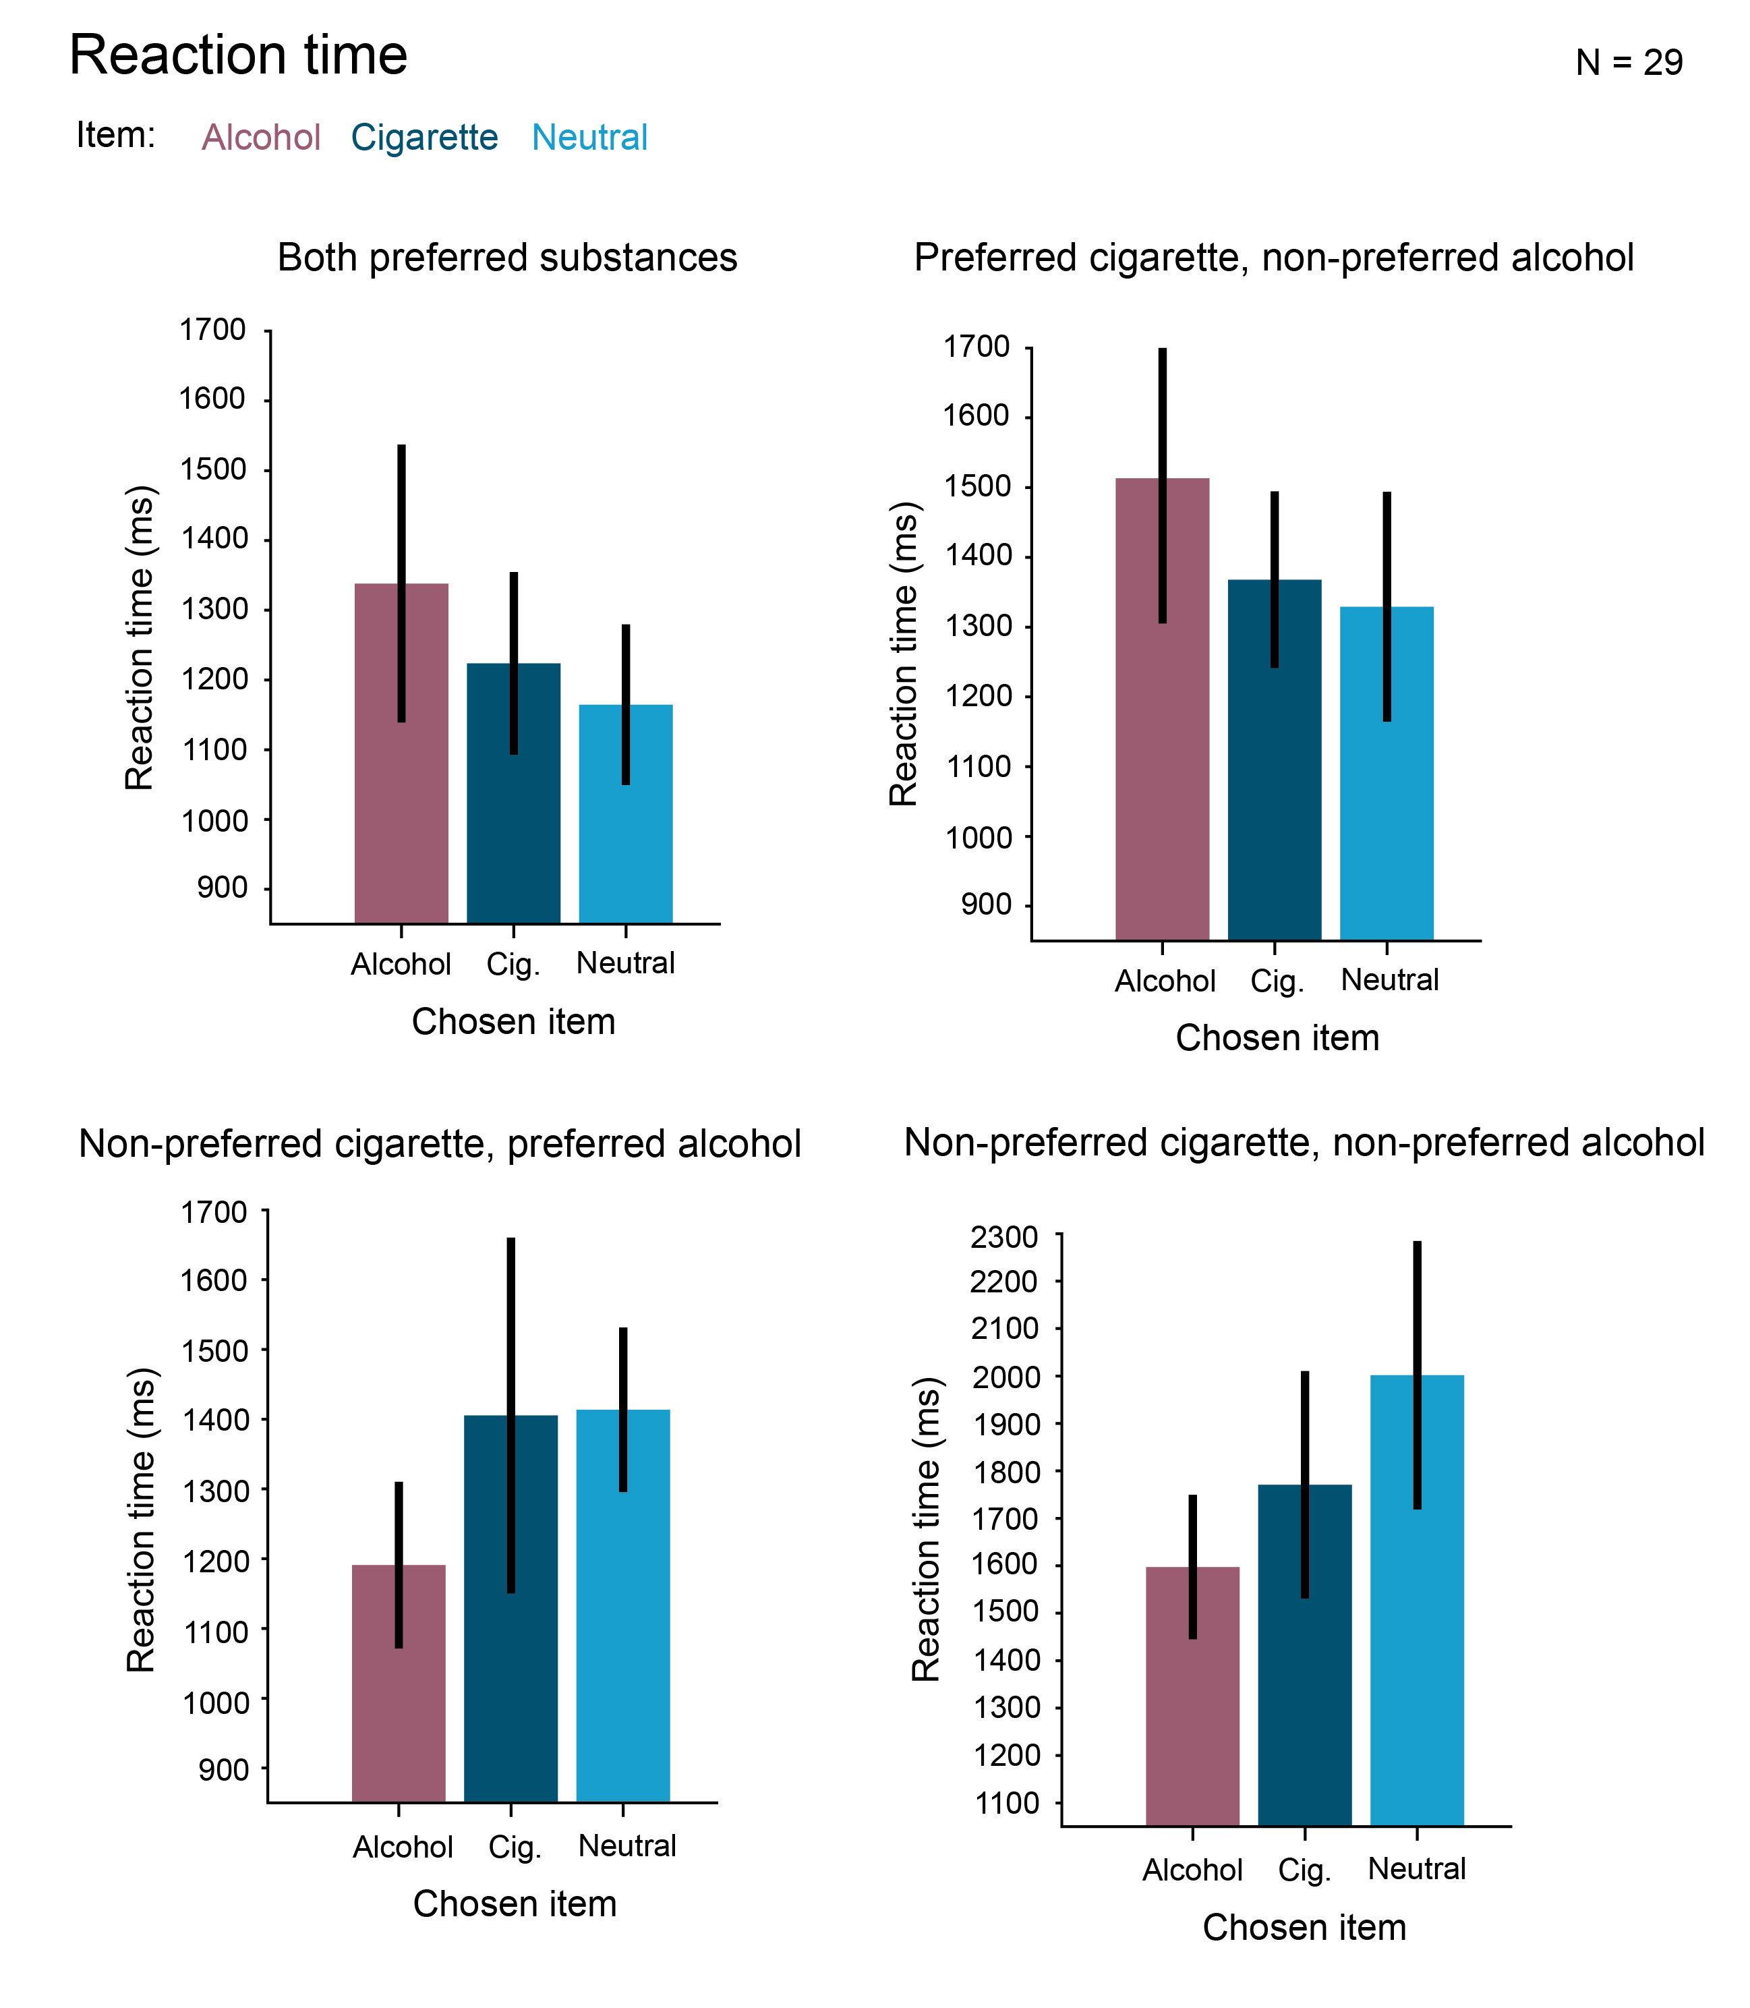

Slide 17
