Slide 1


Modeling the Dynamics of
Conversational Failure
...
...
...
Jonathan P. Chang
A Exam – July 20, 2020
Committee: Cristian Danescu-Niculescu-Mizil (chair), Tom Ristenpart, Julia Markovits
...
?
?
!
Content warning: This talk discusses issues surrounding online content moderation. Some behavior depicted may be considered offensive or disturbing.

Slide 2
1999: “The Internet is becoming the town square for the global village of tomorrow” - Bill Gates
Present Day:
Wow, you’ve lost all touch with reality...you have your head up your a**. An encyclopedia is for people to use, think about that, a******.
Prior work: what marks this comment as rude/toxic/insulting (“antisocial behavior”)?
Yin et al., 2009
Nobata et al., 2016
Davidson et al., 2017
Wulczyn et al., 2017
And many more…
Existing approaches to computer-aided moderation: Detect potentially toxic comments
Reddit AutoModerator (rule-based)
Wikipedia ORES (traditional ML)
Alphabet Perspective API (neural net)

Slide 3

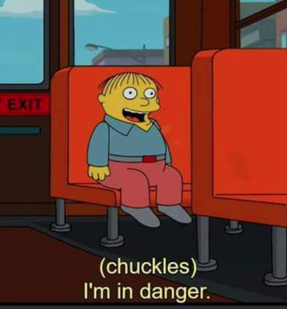
Wikipedia Talk: Awesome TV Show
Isn't the updated plot synopsis too explicit now? Anyone reading this article prior to watching the series will immediately find out the plot twist.
Wikipedia policy is to not use spoiler warnings in articles, nor to remove or omit significant information about a work of fiction.
Conversational Failure
Wow, you’ve lost all touch with reality...you have your head up your a**. An encyclopedia is for people to use, think about that, a******.
Please remove the spoilers. Policy aside, I feel like I've been robbed of the enjoyment of watching the series.
Please remove the spoilers. Policy aside, I feel like I've been robbed of the enjoyment of watching the series.
The process of a conversation (in a particular social context) derailing into antisocial behavior
No. This is an encyclopedia, all articles are there to be full and complete.
No. This is an encyclopedia, all articles are there to be full and complete.

Slide 4
Wikipedia Talk: Awesome TV Show
Isn't the updated plot synopsis too explicit now? Anyone reading this article prior to watching the series will immediately find out the plot twist.
Wikipedia policy is to not use spoiler warnings in articles, nor to remove or omit significant information about a work of fiction.
Conversational Failure
Please remove the spoilers. Policy aside, I feel like I've been robbed of the enjoyment of watching the series.
The process of a conversation (in a particular social context) derailing into antisocial behavior
No. This is an encyclopedia, all articles are there to be full and complete.
Wow, you’ve lost all touch with reality...you have your head up your a**. An encyclopedia is for people to use, think about that, a******.

Slide 5
Linguistic signals in conversation (ACL ‘18, EMNLP ‘19)
Speaker-conditioned linguistic signals (ongoing)
What is said?
Conversational Failure
Moderation Pipeline
Where is it said?
Who said it?
Reactions to moderation actions (WWW ‘19)
Modeling speaker intentions (WWW ’20)
How can moderators and/or end users make effective and responsible use of this information? (future work)

Slide 6
Signals from Pragmatic Devices
Proof of concept: can we find concrete linguistic features whose usage in the beginning (opening exchange) of a conversation correlates with future incivility?
Please remove the spoilers. Policy aside, I feel like I've been robbed of the enjoyment of watching the series.
General signals
No. This is an encyclopedia, all articles are there to be full and complete.
Domain-specific signals
Wikipedia policy is to not use spoiler warnings in articles, nor to remove or omit significant information about a work of fiction.
J. Zhang, J. P. Chang, C. Danescu-Niculescu-Mizil, L. Dixon, Y. Hua, N. Thain, and D. Taraborelli. Conversations Gone Awry:
Detecting Early Signs of Conversational Failure. In Proceedings of ACL, 2018.

Slide 7
Signals from Pragmatic Devices
Politeness Strategies (Brown and Levinson, 1987)
Prompt Types
(Zhang et al., 2017)
Direct Question
Apologizing
2nd person start
Indirectness
Hedging
1st person plural
and many more...
Moderation
Coordination
Casual Remark
Factual Check
Action Statement
Opinion
What is your native language?
I’m going to maybe do a rewrite of the article.
You have been changing the picture repeatedly.
The census is not talking about families here.
I assume it’s as reliable as any other mainstream news.
It is hard to address both of these issues.
J. Zhang, J. P. Chang, C. Danescu-Niculescu-Mizil, L. Dixon, Y. Hua, N. Thain, and D. Taraborelli. Conversations Gone Awry:
Detecting Early Signs of Conversational Failure. In Proceedings of ACL, 2018.

Slide 8
Signals from Pragmatic Devices
Direct question
2nd person start
Factual check
2nd person
occurrence in
first comment
second comment
1st person start
Coordination
Gratitude
Hedge
Opinion
Greetings
Figure courtesy of Justine Zhang
More likely to occur in derailing conversation
-1
log odds
1
J. Zhang, J. P. Chang, C. Danescu-Niculescu-Mizil, L. Dixon, Y. Hua, N. Thain, and D. Taraborelli. Conversations Gone Awry:
Detecting Early Signs of Conversational Failure. In Proceedings of ACL, 2018.

Slide 9
Challenge 1:
Conversations are dynamic
Challenge 2:
Conversations have unknown horizon
Isn't the updated plot synopsis too explicit now? Anyone reading this article prior to watching the series will immediately find out the plot twist.
Is this a good time to make a prediction?
Wikipedia policy is to not use spoiler warnings in articles, nor to remove or omit significant information about a work of fiction.
Please remove the spoilers. Policy aside, I feel like I've been robbed of the enjoyment of watching the series.
Please remove the spoilers. Policy aside, I feel like I've been robbed of the enjoyment of watching the series.
How about now?
No. This is an encyclopedia, all articles are there to be full and complete.
No. This is an encyclopedia, all articles are there to be full and complete.
Wow, you’ve lost all touch with reality...you have your head up your a**. An encyclopedia is for people to use, think about that, a******.
How about now… oops, overshot!
Wow, you’ve lost all touch with reality...you have your head up your a**. An encyclopedia is for people to use, think about that, a******.

Slide 10
Challenge 1:
Conversations are dynamic
Challenge 2:
Conversations have unknown horizon
Isn't the updated plot synopsis too explicit now? Anyone reading this article prior to watching the series will immediately find out the plot twist.
f(context(t₀)) = P(failure | context(t₀))
“Wikipedia policy is...”
Wikipedia policy is to not use spoiler warnings in articles, nor to remove or omit significant information about a work of fiction.
It’s a chatbot!
f(context(t₁)) = P(failure | context(t₁))
“Please remove the...”
Please remove the spoilers. Policy aside, I feel like I've been robbed of the enjoyment of watching the series.
Architecture: hierarchical recurrent networks (Sordoni et al., 2015; Serban et al., 2016)
f(context(t₂)) = P(failure | context(t₂))
“No. This is an...”
No. This is an encyclopedia, all articles are there to be full and complete.
f(context(t₃)) = P(failure | context(t₃))
“Wow, you’ve lost...”
Wow, you’ve lost all touch with reality...you have your head up your a**. An encyclopedia is for people to use, think about that, a******.

Slide 11
Towards Practical Online Modeling
High-level design:
Learn a model of conversational dynamics using an unsupervised dialog generation (chatbot) objective
Train a classifier of future incivility that leverages the pre-trained conversational representation
J. P. Chang and C. Danescu-Niculescu-Mizil. Trouble on the Horizon: Forecasting the Derailment of Online Conversations as they Develop. In Proceedings of EMNLP, 2019.

Slide 12
Towards Practical Online Modeling
CRAFT: Conversational Recurrent Architecture for ForecasTing
Generative objective
Prediction objective
Please
explain
p_{event}
Decoder
Predictor MLP
Context Encoder
Utt. Encoder
Utt. Encoder
Utt. Encoder
Let’s
fix
it
I
agree
I
don’t
Comment 1
Comment 2
Comment 3
J. P. Chang and C. Danescu-Niculescu-Mizil. Trouble on the Horizon: Forecasting the Derailment of Online Conversations as they Develop. In Proceedings of EMNLP, 2019.

Slide 13
Towards Practical Online Modeling
CRAFT: Conversational Recurrent Architecture for ForecasTing
Generative objective
Prediction objective
Step 1: pre-train on large amounts of unlabeled conversational data
Please
explain
p_{event}
Decoder
Predictor MLP
Context Encoder
Utt. Encoder
Utt. Encoder
Utt. Encoder
Let’s
fix
it
I
agree
I
don’t
Comment 1
Comment 2
Comment 3
J. P. Chang and C. Danescu-Niculescu-Mizil. Trouble on the Horizon: Forecasting the Derailment of Online Conversations as they Develop. In Proceedings of EMNLP, 2019.

Slide 14
Towards Practical Online Modeling
CRAFT: Conversational Recurrent Architecture for ForecasTing
Generative objective
Prediction objective
Please
explain
Step 2: fine-tune classifier layers on labeled data
p_{event}
Decoder
Predictor MLP
Context Encoder
Utt. Encoder
Utt. Encoder
Utt. Encoder
Let’s
fix
it
I
agree
I
don’t
Comment 1
Comment 2
Comment 3
J. P. Chang and C. Danescu-Niculescu-Mizil. Trouble on the Horizon: Forecasting the Derailment of Online Conversations as they Develop. In Proceedings of EMNLP, 2019.

Slide 15
Towards Practical Online Modeling
CRAFT achieves:
Stable predictive power across two domains (69.8 F1 on Wikipedia talk pages; 67.9 F1 on Reddit r/changemyview), beating static feature sets
Median 3 hours of advance warning
J. P. Chang and C. Danescu-Niculescu-Mizil. Trouble on the Horizon: Forecasting the Derailment of Online Conversations as they Develop. In Proceedings of EMNLP, 2019.

Slide 16
Linguistic signals in conversation (ACL ‘18, EMNLP ‘19)
Speaker-conditioned linguistic signals (ongoing)
What is said?
Moderation Pipeline
Conversational Failure
Where is it said?
Who said it?
Reactions to moderation actions (WWW ‘19)
Modeling speaker intentions (WWW ’20)
How can moderators and/or end users make effective and responsible use of this information? (future work)

Slide 17


Reactions to Moderation
Temporarily blocked!
Redemption
What factors underlie this “fork in the road”?
Recidivism
Penalized individual’s level of involvement with the community?
Their attitudes towards community norms and moderation practices?
Departure
Halfaker et al., 2011; Danescu-Niculescu-Mizil et al., 2013; Cheng et al., 2017; Ribeiro et al., 2018
Corbett-Davies et al., 2017; Tonry, 2008; Makkai and Braithwaite, 1994; Grasmik and Bryjak, 1980
J. P. Chang and C. Danescu-Niculescu-Mizil. Trajectories of Blocked Community Members: Redemption, Recidivism and Departure. In Proceedings of WWW, 2019.

Slide 18
Making Meaningful Comparisons
“Natural” departure
Staying in community
Departing during block
vs.
Matching lets us make nontrivial comparisons between departure and redemption...
...and second level of matching ensures those comparisons are specific to block departures
Experimental Pair
Control Pair
D
(departs during block)
R
(blocked around same time as D; reforms)
N
(never blocked; departs around same time as D)
C
(never blocked; active around D’s departure)
Analogous procedure for recidivist vs. reformed users
J. P. Chang and C. Danescu-Niculescu-Mizil. Trajectories of Blocked Community Members: Redemption, Recidivism and Departure. In Proceedings of WWW, 2019.

Slide 19
Reactions to Moderation
Temporarily blocked!
Redemption
What factors underlie this “fork in the road”?
Recidivism
Penalized individual’s level of involvement with the community?
Their attitudes towards community norms and moderation practices?
Departure
Halfaker et al., 2011; Danescu-Niculescu-Mizil et al., 2013; Cheng et al., 2017; Ribeiro et al., 2018
Corbett-Davies et al., 2017; Tonry, 2008; Makkai and Braithwaite, 1994; Grasmik and Bryjak, 1980
J. P. Chang and C. Danescu-Niculescu-Mizil. Trajectories of Blocked Community Members: Redemption, Recidivism and Departure. In Proceedings of WWW, 2019.

Slide 20

Community Involvement vs. Outcomes
Measures of community involvement:
Received activity level:
Total number of comments received
Received activity spread:
Total number of users interacted with
Total number of comments received
J. P. Chang and C. Danescu-Niculescu-Mizil. Trajectories of Blocked Community Members: Redemption, Recidivism and Departure. In Proceedings of WWW, 2019.

Slide 21
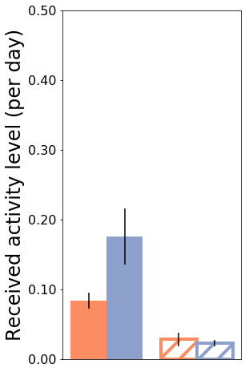
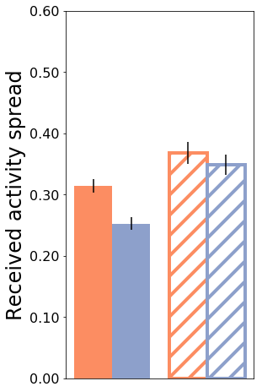
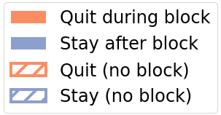
Community Involvement vs. Outcomes
Blocked individuals who depart tend to have...
Lower received activity level
Intuition: less involvement → less reason to stay
Higher received activity spread
Intuition: less tightly integrated into social circle
J. P. Chang and C. Danescu-Niculescu-Mizil. Trajectories of Blocked Community Members: Redemption, Recidivism and Departure. In Proceedings of WWW, 2019.

Slide 22
Reactions to Moderation
Temporarily blocked!
Redemption
What factors underlie this “fork in the road”?
Recidivism
Penalized individual’s level of involvement with the community?
Their attitudes towards community norms and moderation practices?
Departure
Halfaker et al., 2011; Danescu-Niculescu-Mizil et al., 2013; Cheng et al., 2017; Ribeiro et al., 2018
Corbett-Davies et al., 2017; Tonry, 2008; Makkai and Braithwaite, 1994; Grasmik and Bryjak, 1980
J. P. Chang and C. Danescu-Niculescu-Mizil. Trajectories of Blocked Community Members: Redemption, Recidivism and Departure. In Proceedings of WWW, 2019.

Slide 23
Attitudes Towards Moderation
Literature on offline law compliance presents two theories of repeat offense:
Likelihood of repeat offense depends on...
...severity of the punishment
...offender’s perception of punishment as fair
Grasmick and Bryjack (1980); Klepper and Nagin (1989)
Makkai and Braithwaite (1994); Paternoster et al. (1997); Williams (2005); Tonry (2008)
J. P. Chang and C. Danescu-Niculescu-Mizil. Trajectories of Blocked Community Members: Redemption, Recidivism and Departure. In Proceedings of WWW, 2019.

Slide 24
Attitudes Towards Moderation
Two perspectives: blocked individual’s and moderator’s
What can blocked people do to signal they view block as (un)fair?
Replies to blocking moderator
What can moderator do to signal that rules are fair?
Clemency (manual unblocks)
J. P. Chang and C. Danescu-Niculescu-Mizil. Trajectories of Blocked Community Members: Redemption, Recidivism and Departure. In Proceedings of WWW, 2019.

Slide 25
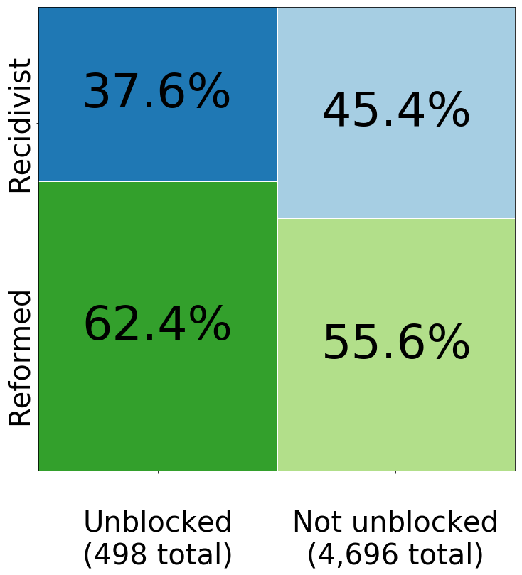
Moderator’s perspective: Unblocks
J. P. Chang and C. Danescu-Niculescu-Mizil. Trajectories of Blocked Community Members: Redemption, Recidivism and Departure. In Proceedings of WWW, 2019.
Notes:
Show right side first

Slide 26
Moderator’s perspective: Unblocks
J. P. Chang and C. Danescu-Niculescu-Mizil. Trajectories of Blocked Community Members: Redemption, Recidivism and Departure. In Proceedings of WWW, 2019.
Notes:
Show right side first

Slide 27
Blocked person’s perspective: Perceived fairness
3 linguistic indicators of blocked individual’s perception of fairness in comments:
Apologizing (suggests they acknowledge fairness of block)
e.g., “I am deeply sorry for not understanding the whole situation, and ask for your forgiveness.”
Direct questioning (hostile; suggests they are fighting back)
e.g., “So what policy, precisely have I violated?”
Explicit mentions of “unfairness” and related phrases
e.g., “i have alerted another administrator about your blatent [sic] and unwarranted abuse of power”
J. P. Chang and C. Danescu-Niculescu-Mizil. Trajectories of Blocked Community Members: Redemption, Recidivism and Departure. In Proceedings of WWW, 2019.

Slide 28
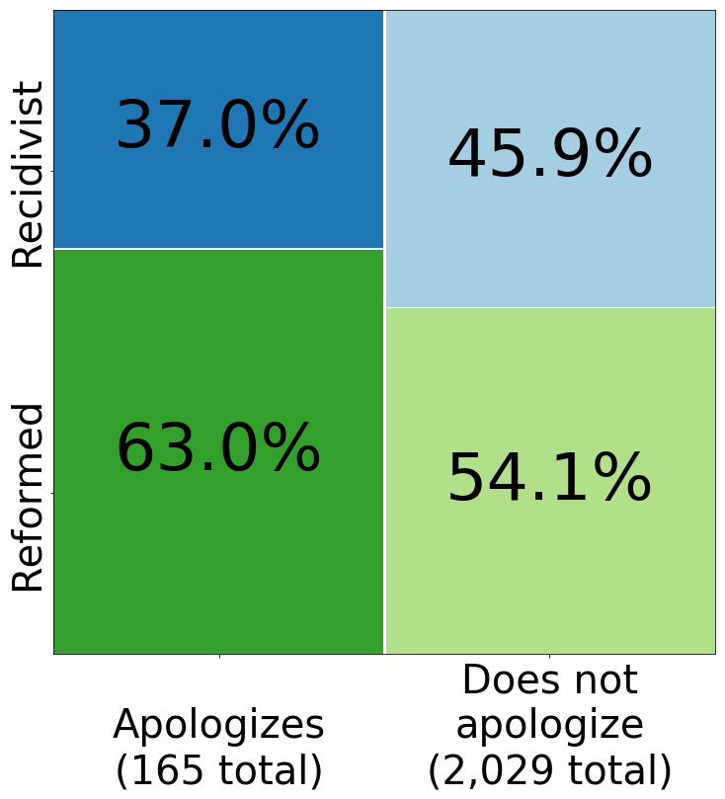
Blocked person’s perspective: Perceived fairness
Likelihood of recidivism is lower for users who apologize
J. P. Chang and C. Danescu-Niculescu-Mizil. Trajectories of Blocked Community Members: Redemption, Recidivism and Departure. In Proceedings of WWW, 2019.
Notes:
Show dq/lexicon separately from apologize

Slide 29
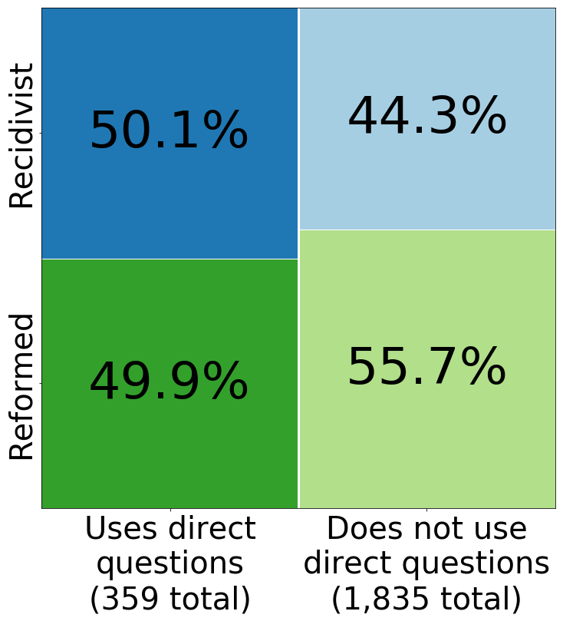
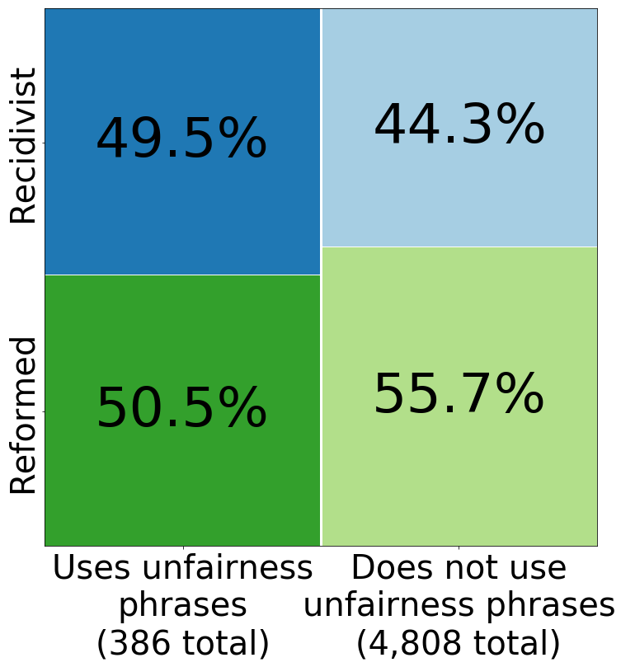
Blocked person’s perspective: Perceived fairness
Likelihood of recidivism is higher for users who use unfairness phrases or direct questioning
J. P. Chang and C. Danescu-Niculescu-Mizil. Trajectories of Blocked Community Members: Redemption, Recidivism and Departure. In Proceedings of WWW, 2019.
Notes:
Show dq/lexicon separately from apologize

Slide 30

Attitudes Towards Moderation
Literature on offline law compliance presents two theories of repeat offense:
Likelihood of repeat offense depends on...
...severity of the punishment
...offender’s perception of punishment as fair
Grasmick and Bryjack (1980); Klepper and Nagin (1989)
Makkai and Braithwaite (1994); Paternoster et al. (1997); Williams (2005); Tonry (2008)
J. P. Chang and C. Danescu-Niculescu-Mizil. Trajectories of Blocked Community Members: Redemption, Recidivism and Departure. In Proceedings of WWW, 2019.

Slide 31
Linguistic signals in conversation (ACL ‘18, EMNLP ‘19)
Speaker-conditioned linguistic signals (ongoing)
What is said?
Moderation Pipeline
Conversational Failure
Where is it said?
Who said it?
Reactions to moderation actions (WWW ‘19)
Modeling speaker intentions (WWW ’20)
How can moderators and/or end users make effective and responsible use of this information? (future work)

Slide 32
The Story of a Conversation
...
...
...
...
...
outcome
Intention
Perception
Grosz and Sidner, 1986; Clark, 1996; Tannen, 2002; Tannen, 2005; McKee, 2002
J. P. Chang, J. Cheng, and C. Danescu-Niculescu-Mizil. Don’t Let Me Be Misunderstood: Comparing Intentions and Perceptions in Online Discussions. In Proceedings of WWW, 2020.

Slide 33
The Story of a Conversation
...
...
...
...
...
outcome
Intention
Perception
J. P. Chang, J. Cheng, and C. Danescu-Niculescu-Mizil. Don’t Let Me Be Misunderstood: Comparing Intentions and Perceptions in Online Discussions. In Proceedings of WWW, 2020.

Slide 34
...
...
Fact
Opinion
Intentions and perceptions aligned
Intentions and perceptions misaligned
(We’ll also refer to this as misperception, though this is not meant to make any claim about which side is “correct”)
This kind of misperception has been commonly observed in news media¹
...
...
How does misalignment between intentions and perceptions of facts and opinions play out in the conversational domain?
¹Pew Research: “Distinguishing Between Factual and Opinion Statements in the News” https://www.journalism.org/2018/06/18/distinguishing-between-factual-and-opinion-statements-in-the-news/
J. P. Chang, J. Cheng, and C. Danescu-Niculescu-Mizil. Don’t Let Me Be Misunderstood: Comparing Intentions and Perceptions in Online Discussions. In Proceedings of WWW, 2020.

Slide 35
Challenge: Getting Intention Data
I intended this comment as a fact
I perceived this comment as an opinion
...
We also survey these people for ground truth perception data
To get reliable ground truth intention data, we must survey this person.
J. P. Chang, J. Cheng, and C. Danescu-Niculescu-Mizil. Don’t Let Me Be Misunderstood: Comparing Intentions and Perceptions in Online Discussions. In Proceedings of WWW, 2020.

Slide 36
Survey Design: Questions
 | Facts | Opinions
Sharing | Fact Sharing | Opinion Sharing
Seeking | Fact Seeking | Opinion Seeking
Content Type
4 conversational goals that can be intended or perceived
Direction
5-point response scale: 1 = Definitely did not intend/perceive this goal, to 5 = Definitely intended/perceived this goal
J. P. Chang, J. Cheng, and C. Danescu-Niculescu-Mizil. Don’t Let Me Be Misunderstood: Comparing Intentions and Perceptions in Online Discussions. In Proceedings of WWW, 2020.

Slide 37
Misperception and Conversational Failure
Intended
Perceived
Incivility tends to follow
Why this difference?
Fact sharing
Opinion sharing
Fact seeking
Opinion seeking
Hypothesis: Intended fact sharing contributes to conversational failure only when it is misperceived as opinion sharing
Observations:
Opinion sharing correlates with future incivility
Facts and opinions are often confused
Incivility tends not to follow
No relation with future incivility
J. P. Chang, J. Cheng, and C. Danescu-Niculescu-Mizil. Don’t Let Me Be Misunderstood: Comparing Intentions and Perceptions in Online Discussions. In Proceedings of WWW, 2020.

Slide 38
Misperception and Conversational Failure
Conversational data
Subset with fact-sharing intention
Split data by perception label
(Mis)perceived as opinion sharing
(Correctly) perceived as fact sharing
Our hypothesis predicts: this subset is more likely to lead to incivility
Finding: misperceived subset has significantly (p < 0.001) higher future incivility
Null hypothesis: both subsets equally likely to lead to incivility
J. P. Chang, J. Cheng, and C. Danescu-Niculescu-Mizil. Don’t Let Me Be Misunderstood: Comparing Intentions and Perceptions in Online Discussions. In Proceedings of WWW, 2020.

Slide 39
Linguistic signals in conversation (ACL ‘18, EMNLP ‘19)
Speaker-conditioned linguistic signals (ongoing)
What is said?
Moderation Pipeline
Conversational Failure
Where is it said?
Who said it?
Reactions to moderation actions (WWW ‘19)
Modeling speaker intentions (WWW ’20)
How can moderators and/or end users make effective and responsible use of this information? (future work)

Slide 40
In a debate about subsidizing higher education:
I don't understand why people send their children to school. We could stop devaluation in education by not teaching people how to read and stuff like that. Shooting for just above mediocre would lead to net benefits. Let's face it, education should be left to the select few.
I mean, what has a more educated society even done for us ? Nothing. If anything, we're worst off now than we were five hundred years ago.
How did other people in the conversation react?
How did...
...the left-leaning person react?
...the right-leaning person react?
I like you. Heh.
[comment removed]

Slide 41
Linguistic signals in conversation (ACL ‘18, EMNLP ‘19)
Speaker-conditioned linguistic signals (ongoing)
What is said?
Moderation Pipeline
Conversational Failure
Where is it said?
Who said it?
Reactions to moderation actions (WWW ‘19)
Modeling speaker intentions (WWW ’20)
How can moderators and/or end users make effective and responsible use of this information? (future work)

Slide 42

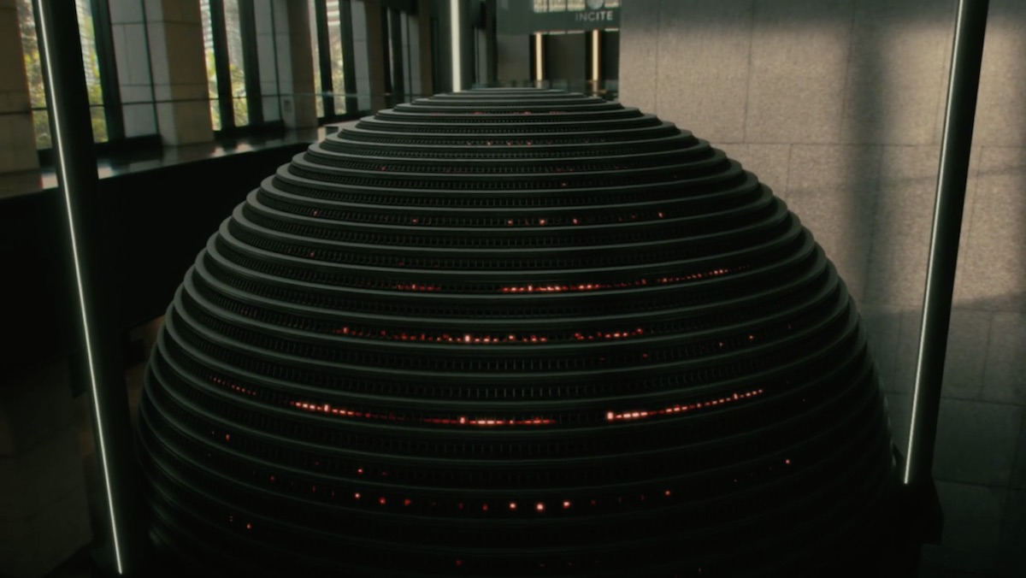
Conversation Failure Models for Moderators?
What can mods do with information about conversational failure?
Triaging (i.e., prioritizing conversations to monitor)?¹
Proactive intervention (e.g., a de-escalating comment)?^{2,3}
How reliable a model is needed?
What should they do?
Potential concerns: blurred scope of rules,⁴ “tone policing”,⁴ unequal distribution of moderator attention⁵
Potential benefits: less overtly toxic content posted → better community interaction & reduced mental strain on mods⁶
¹Chandrasekharan et al., 2018; ²Kiesler et al., 2012; ³Munger, 2017; ⁴Gillespie, 2018; ⁵Davidson et al., 2017; ⁶Butler et al., 2002

Slide 43
Conversation Failure Models for Moderators?
Proposed study: Moderator survey
Existing moderation practices: how do you find rule-violating comments? Does automation play a role?
Attitude towards conversational failure: Can you intuitively tell when conversations are going badly?¹ What do you do about it? How certain do you need to be?
System mockup (conversation + model output): Is this helpful? Do you agree with the model? How relevant is the information shown? Are you comfortable with the model?
¹The Atlantic: “Inside r/relationships, the Unbearably Human Corner of Reddit” https://www.theatlantic.com/technology/archive/2019/10/reddit-moderation-relationships-subreddit-memes/600322/

Slide 44

Power to the People?
Empowering end users to make informed decisions about conflict avoidance is another (oft-overlooked) approach to moderation¹
Idea: User-facing tool that alerts the user if the thread they’re replying to is currently in a state of high risk/tension
Potential pros: offers sense of control,² lifts some burden from moderators
Potential cons: self-censorship,³ possibility of backfire⁴
It looks like you’re trying to comment in a contentious thread
¹Jhaver et al., 2018; ²Chandrasekharan et al., 2018; ³Gillespie, 2018; ⁴Chancellor et al., 2016

Slide 45
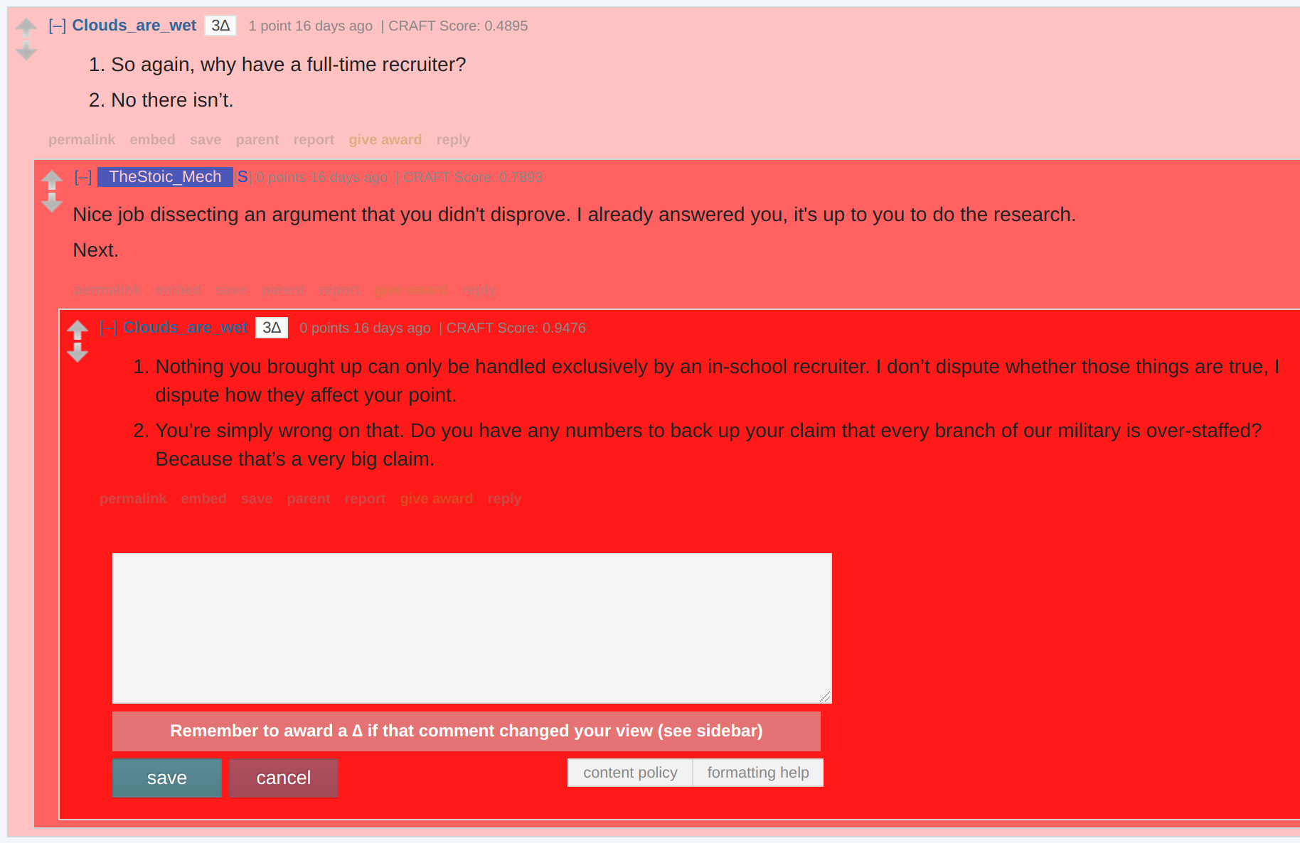
Power to the People?
Proposed user study:
Does informing the user about the risk level of the conversation prompt them to think differently about their reply...
...perhaps reflected by changes in politeness, sentiment, etc...
Control groups: Static rule reminder (Matias, 2019); toxicity-based trigger
...or simply more time spent before hitting submit (or cancel)?

Slide 46
Where We’ve Been; Where We’re Going
So far, we’ve...
Defined conversation failure and argued a case for studying it
Built models for different dimensions of conversational failure
We still need to...
Refine our models and explore other parts of the problem space
Understand how our models might be used in practice
Some particular open questions:
How to explicitly model interactions of different dimensions?
How to make this useful for moderators? For users? For others?
How to best measure impact on platforms/society?

Slide 47
Acknowledgements
Cornell
Cristian Danescu-Niculescu-Mizil, Lillian Lee, Karen Levy, Justine Zhang, Liye Fu, Yiqing Hua, Andrew Z. Wang, Caleb Chiam, Aditya Jha, Jack Schugler, Lucas Van Bramer
Facebook
Justin Cheng, Israel Nir, Lada Adamic
Wikimedia Foundation
Dario Taraborelli, Leila Zia
Jigsaw / Alphabet
Lucas Dixon, Nithum Thain, Jeffrey Sorensen
And all the members of NLP seminar for their helpful feedback over the years

Slide 48
Questions? Comments? Suggestions?
Linguistic signals in conversation (ACL ‘18, EMNLP ‘19)
Speaker-conditioned linguistic signals (ongoing)
What is said?
Moderation Pipeline
Conversational Failure
Where is it said?
Who said it?
Reactions to moderation actions (WWW ‘19)
Modeling speaker intentions (WWW ’20)
How can moderators and/or end users make effective and responsible use of this information? (future work)

Slide 49
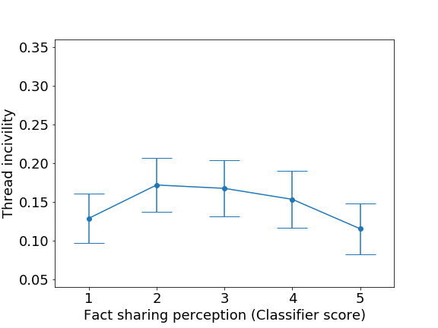
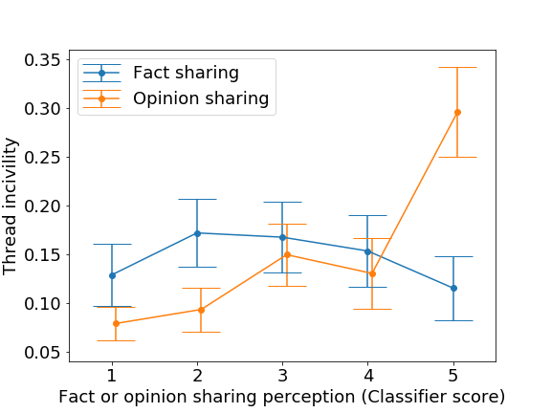
Misperception and Conversational Failure
Conversational data
Subset with fact-sharing intention
Split data by perception label
(Mis)perceived as opinion sharing
(Correctly) perceived as fact sharing
Finding: misperceived subset has significantly (p < 0.001) higher future incivility
Our hypothesis predicts: this subset is more likely to lead to incivility
Null hypothesis: both subsets equally likely to lead to incivility
Fact-sharing perception score
Fact- or opinion-sharing perception score
J. P. Chang, J. Cheng, and C. Danescu-Niculescu-Mizil. Don’t Let Me Be Misunderstood: Comparing Intentions and Perceptions in Online Discussions. In Proceedings of WWW, 2020.

