Slide 1
Modeling the Dynamics of Conversational Failure
Jonathan P. Chang
Cornell University

Slide 2

Wikipedia Talk: Awesome TV Show
Isn't the updated plot synopsis too explicit now? Anyone reading this article prior to watching the series will immediately find out the plot twist.
Antisocial Behavior
What marks this comment as rude/toxic/insulting?
(Yin et al., 2009; Nobata et al., 2016; Davidson et al., 2017; Wulczyn et al., 2017; and many more…)
Conversational Failure
What is the (conversation- and community-level) process by which this initially civil conversation turned toxic/uncivil?
Wikipedia policy is to not use spoiler warnings in articles, nor to remove or omit significant information about a work of fiction.
You have lost all touch with reality...you have your head so far up your a** that nothing I say will ever get through. An encyclopedia is for people to use...think about that, a******.
Please remove the spoilers, I feel like I've been robbed of the enjoyment of watching the series. It’s asinine to keep this in the article.
No, sorry but this is an encyclopedia. All articles are there to be full and complete.
You have lost all touch with reality...you have your head so far up your a** that nothing I say will ever get through. An encyclopedia is for people to use...think about that, a******.

Slide 3
Try It Yourself!

Slide 4
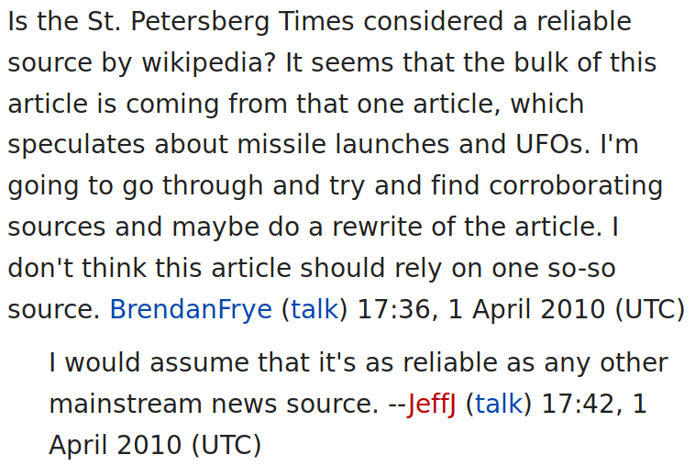
Try It Yourself!
Conversation A

Slide 5
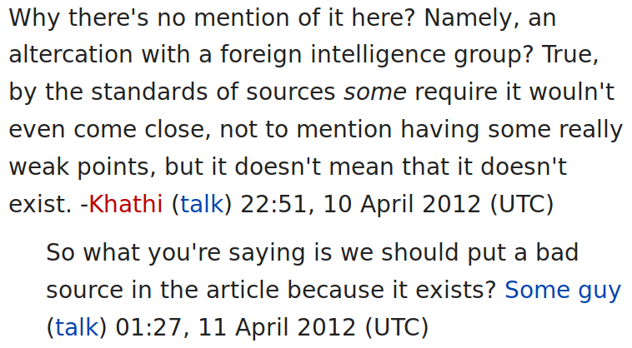
Try It Yourself!
Conversation A
Conversation B

Slide 6
Try It Yourself!
Conversation A
Conversation B
Which one leads to: “Wow, you’re coming off as a total d**k...what the hell is wrong with you?”

Slide 7
Try It Yourself!
Conversation A
Conversation B

Slide 8
Try It Yourself!
Conversation A
Conversation B

Slide 9
Try It Yourself!
Conversation A
Conversation B
More examples (quiz): http://awry.infosci.cornell.edu/

Slide 10
Signals from Pragmatic Devices
Politeness Strategies (Brown and Levinson, 1987)
Prompt Types
(Zhang et al., 2017)
Direct Question
Apologizing
2nd person start
Indirectness
Hedging
1st person plural
and many more...
Moderation
Coordination
Casual Remark
Factual Check
Action Statement
Opinion
What is your native language?
I’m going to maybe do a rewrite of the article.
You have been changing the picture repeatedly.
The census is not talking about families here.
I assume it’s as reliable as any mainstream news source.
It is hard to address both of these issues.
J. Zhang, J. P. Chang, C. Danescu-Niculescu-Mizil, L. Dixon, Y. Hua, N. Thain, and D. Taraborelli. Conversations Gone Awry:
Detecting Early Signs of Conversational Failure. In Proceedings of ACL, 2018.

Slide 11
Signals from Pragmatic Devices
Direct question
2nd person start
Factual check
2nd person
occurrence in
first comment
second comment
1st person start
Coordination
Gratitude
Hedge
Opinion
Greetings
More likely to occur in derailing conversation
-1
log odds
1
J. Zhang, J. P. Chang, C. Danescu-Niculescu-Mizil, L. Dixon, Y. Hua, N. Thain, and D. Taraborelli. Conversations Gone Awry:
Detecting Early Signs of Conversational Failure. In Proceedings of ACL, 2018.

Slide 12
Isn't the updated plot synopsis too explicit now? Anyone reading this article prior to watching the series will immediately find out the plot twist.
Wikipedia policy is to not use spoiler warnings in articles, nor to remove or omit significant information about a work of fiction.
Please remove the spoilers, I feel like I've been robbed of the enjoyment of watching the series. It’s asinine to keep this in the article.
No, sorry but this is an encyclopedia. All articles are there to be full and complete.
You have lost all touch with reality...you have your head so far up your a** that nothing I say will ever get through. An encyclopedia is for people to use...think about that, a******.

Slide 13
Isn't the updated plot synopsis too explicit now? Anyone reading this article prior to watching the series will immediately find out the plot twist.
Is this a good time to make a prediction?
Wikipedia policy is to not use spoiler warnings in articles, nor to remove or omit significant information about a work of fiction.
Please remove the spoilers, I feel like I've been robbed of the enjoyment of watching the series. It’s asinine to keep this in the article.
No, sorry but this is an encyclopedia. All articles are there to be full and complete.
You have lost all touch with reality...you have your head so far up your a** that nothing I say will ever get through. An encyclopedia is for people to use...think about that, a******.

Slide 14
Isn't the updated plot synopsis too explicit now? Anyone reading this article prior to watching the series will immediately find out the plot twist.
Wikipedia policy is to not use spoiler warnings in articles, nor to remove or omit significant information about a work of fiction.
How about now?
Please remove the spoilers, I feel like I've been robbed of the enjoyment of watching the series. It’s asinine to keep this in the article.
No, sorry but this is an encyclopedia. All articles are there to be full and complete.
You have lost all touch with reality...you have your head so far up your a** that nothing I say will ever get through. An encyclopedia is for people to use...think about that, a******.

Slide 15
Isn't the updated plot synopsis too explicit now? Anyone reading this article prior to watching the series will immediately find out the plot twist.
Wikipedia policy is to not use spoiler warnings in articles, nor to remove or omit significant information about a work of fiction.
Please remove the spoilers, I feel like I've been robbed of the enjoyment of watching the series. It’s asinine to keep this in the article.
How about now...oops, overshot!
No, sorry but this is an encyclopedia. All articles are there to be full and complete.
You have lost all touch with reality...you have your head so far up your a** that nothing I say will ever get through. An encyclopedia is for people to use...think about that, a******.

Slide 16
Isn't the updated plot synopsis too explicit now? Anyone reading this article prior to watching the series will immediately find out the plot twist.
context(t₀) → P(failure | context(t₀))
Wikipedia policy is to not use spoiler warnings in articles, nor to remove or omit significant information about a work of fiction.
context(t₁) → P(failure | context(t₁))
Please remove the spoilers, I feel like I've been robbed of the enjoyment of watching the series. It’s asinine to keep this in the article.
context(t₂) → P(failure | context(t₂))
No, sorry but this is an encyclopedia. All articles are there to be full and complete.
context(t₃) → P(failure | context(t₃))
You have lost all touch with reality...you have your head so far up your a** that nothing I say will ever get through. An encyclopedia is for people to use...think about that, a******.

Slide 17
Isn't the updated plot synopsis too explicit now? Anyone reading this article prior to watching the series will immediately find out the plot twist.
context(t₀) →
Wikipedia policy is to not use spoiler warnings in articles, nor to remove or omit significant information about a work of fiction.
context(t₁) →
Please remove the spoilers, I feel like I've been robbed of the enjoyment of watching the series. It’s asinine to keep this in the article.
context(t₂) →
No, sorry but this is an encyclopedia. All articles are there to be full and complete.
context(t₃) →
You have lost all touch with reality...you have your head so far up your a** that nothing I say will ever get through. An encyclopedia is for people to use...think about that, a******.

Slide 18
Isn't the updated plot synopsis too explicit now? Anyone reading this article prior to watching the series will immediately find out the plot twist.
context(t₀) → “Wikipedia policy is…”
Wikipedia policy is to not use spoiler warnings in articles, nor to remove or omit significant information about a work of fiction.
context(t₁) → “Please remove the…”
Please remove the spoilers, I feel like I've been robbed of the enjoyment of watching the series. It’s asinine to keep this in the article.
context(t₂) → “No, sorry but this…”
No, sorry but this is an encyclopedia. All articles are there to be full and complete.
context(t₃) → “You have lost all…”
You have lost all touch with reality...you have your head so far up your a** that nothing I say will ever get through. An encyclopedia is for people to use...think about that, a******.

Slide 19
Isn't the updated plot synopsis too explicit now? Anyone reading this article prior to watching the series will immediately find out the plot twist.
context(t₀) → “Wikipedia policy is…”
Wikipedia policy is to not use spoiler warnings in articles, nor to remove or omit significant information about a work of fiction.
context(t₁) → “Please remove the…”
It’s a chatbot!
Architecture: hierarchical recurrent networks (Sordoni et al., 2015; Serban et al., 2016)
Please remove the spoilers, I feel like I've been robbed of the enjoyment of watching the series. It’s asinine to keep this in the article.
context(t₂) → “No, sorry but this…”
No, sorry but this is an encyclopedia. All articles are there to be full and complete.
context(t₃) → “You have lost all…”
You have lost all touch with reality...you have your head so far up your a** that nothing I say will ever get through. An encyclopedia is for people to use...think about that, a******.

Slide 20
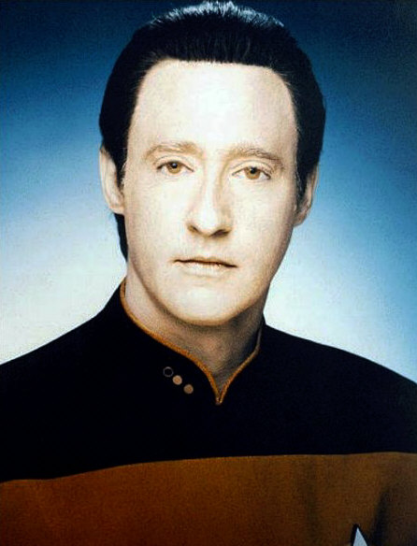
Generation

Slide 21
Generation
Prediction

Slide 22
Towards Practical Online Forecasting
CRAFT: Conversational Recurrent Architecture for ForecasTing
Generative objective
Prediction objective
Please
explain
p_{event}
Decoder
Predictor MLP
Context Encoder
Utt. Encoder
Utt. Encoder
Utt. Encoder
Let’s
fix
it
I
agree
I
don’t
Comment 1
Comment 2
Comment 3
J. P. Chang and C. Danescu-Niculescu-Mizil. Trouble on the Horizon: Forecasting the Derailment of Online Conversations as they Develop. In Proceedings of EMNLP, 2019.

Slide 23
Towards Practical Online Forecasting
CRAFT: Conversational Recurrent Architecture for ForecasTing
Generative objective
Prediction objective
Step 1: pre-train on large amounts of unlabeled conversational data
Please
explain
p_{event}
Decoder
Predictor MLP
Context Encoder
Utt. Encoder
Utt. Encoder
Utt. Encoder
Let’s
fix
it
I
agree
I
don’t
Comment 1
Comment 2
Comment 3
J. P. Chang and C. Danescu-Niculescu-Mizil. Trouble on the Horizon: Forecasting the Derailment of Online Conversations as they Develop. In Proceedings of EMNLP, 2019.

Slide 24
Towards Practical Online Forecasting
CRAFT: Conversational Recurrent Architecture for ForecasTing
Generative objective
Prediction objective
Please
explain
Step 2: fine-tune classifier layers on labeled data
p_{event}
Decoder
Predictor MLP
Context Encoder
Utt. Encoder
Utt. Encoder
Utt. Encoder
Let’s
fix
it
I
agree
I
don’t
Comment 1
Comment 2
Comment 3
J. P. Chang and C. Danescu-Niculescu-Mizil. Trouble on the Horizon: Forecasting the Derailment of Online Conversations as they Develop. In Proceedings of EMNLP, 2019.

Slide 25
Towards Practical Online Forecasting
CRAFT: Conversational Recurrent Architecture for ForecasTing
Generative objective
Prediction objective
Please
explain
p_{event}
Decoder
CRAFT achieves:
State of the art performance on two conversational failure datasets, beating static feature sets (67% accuracy, 70% F1)
An average of 3 hours prior warning of conversational failure
Predictor MLP
Context Encoder
Utt. Encoder
Utt. Encoder
Utt. Encoder
Let’s
fix
it
I
agree
I
don’t
Comment 1
Comment 2
Comment 3
J. P. Chang and C. Danescu-Niculescu-Mizil. Trouble on the Horizon: Forecasting the Derailment of Online Conversations as they Develop. In Proceedings of EMNLP, 2019.

Slide 26
Isn't the updated plot synopsis too explicit now? Anyone reading this article prior to watching the series will immediately find out the plot twist.
Wikipedia policy is to not use spoiler warnings in articles, nor to remove or omit significant information about a work of fiction.
Please remove the spoilers, I feel like I've been robbed of the enjoyment of watching the series. It’s asinine to keep this in the article.
No, sorry but this is an encyclopedia. All articles are there to be full and complete.
You have lost all touch with reality...you have your head so far up your a** that nothing I say will ever get through. An encyclopedia is for people to use...think about that, a******.

Slide 27
Wikipedia Talk: Awesome TV Show
Isn't the updated plot synopsis too explicit now? Anyone reading this article prior to watching the series will immediately find out the plot twist.
Wikipedia policy is to not use spoiler warnings in articles, nor to remove or omit significant information about a work of fiction.
Please remove the spoilers, I feel like I've been robbed of the enjoyment of watching the series. It’s asinine to keep this in the article.
No, sorry but this is an encyclopedia. All articles are there to be full and complete.
You have lost all touch with reality...you have your head so far up your a** that nothing I say will ever get through. An encyclopedia is for people to use...think about that, a******.

Slide 28


Attitudes Towards Moderation
Redemption
Recidivism
What factors underlie this “fork in the road”?
Departure
J. P. Chang and C. Danescu-Niculescu-Mizil. Trajectories of Blocked Community Members: Redemption, Recidivism and Departure. In Proceedings of WWW, 2019.

Slide 29
Attitudes Towards Moderation
More likely to reoffend
More likely to reform
J. P. Chang and C. Danescu-Niculescu-Mizil. Trajectories of Blocked Community Members: Redemption, Recidivism and Departure. In Proceedings of WWW, 2019.

Slide 30
Attitudes Towards Moderation
Direct questioning
“Unfair…”
More likely to reoffend
More likely to reform
J. P. Chang and C. Danescu-Niculescu-Mizil. Trajectories of Blocked Community Members: Redemption, Recidivism and Departure. In Proceedings of WWW, 2019.

Slide 31
Attitudes Towards Moderation
Direct questioning
“Unfair…”
Apologies
Moderator acts of clemency
More likely to reoffend
More likely to reform
J. P. Chang and C. Danescu-Niculescu-Mizil. Trajectories of Blocked Community Members: Redemption, Recidivism and Departure. In Proceedings of WWW, 2019.

Slide 32
Attitudes Towards Moderation
Lower perception of moderator fairness
Higher perception of moderator fairness
Direct questioning
“Unfair…”
Apologies
Moderator acts of clemency
More likely to reoffend
More likely to reform
J. P. Chang and C. Danescu-Niculescu-Mizil. Trajectories of Blocked Community Members: Redemption, Recidivism and Departure. In Proceedings of WWW, 2019.

Slide 33

[Under review] Conversational Intents
...
...
...
...
Misperception of information
Sharing information is good (negatively correlated with derailment)...but it’s bad when it gets perceived as sharing an opinion (positively correlated with derailment)
How does this intent, and the way it gets (mis)perceived, relate to the outcome of the conversation?

Slide 34
Future Work
Finer grained forecasting of conversational outcomes. First step: predict conversation recovery
Beyond already-penalized users: capture general attitudes towards a community’s rules and moderation
Effects of moderation (or lack thereof) on the victim
Turning this into a practical tool for users and/or moderators

Slide 35
Thank You!
Data and code available through ConvoKit: convokit.cornell.edu

