Slide 1

Biostatistics DAY 2: Getting Data
Justin Whalley

Slide 2
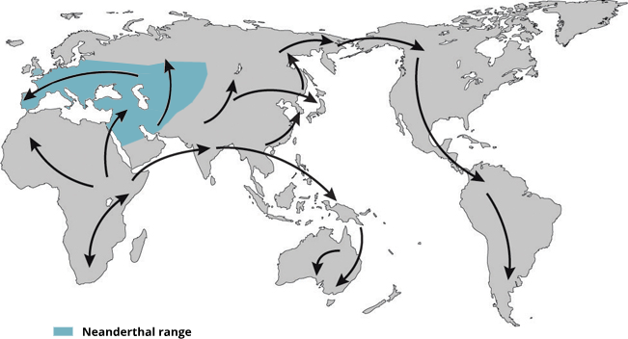
Modern non-African humans contain Neanderthal DNA fragments in their genomes
Interbreeding
~50,000 years ago
Neanderthal
African
Non-African
1.5~4%
Neanderthal
ancestry
Slide from Shiyao Ke
Map adapted from Mafessoni, F. (2019). Nat. Ecol. Evol. 3:14–15.
Notes:
Map adapted from Mafessoni, F. (2019). Encounters with archaic hominins. Nature Ecology & Evolution. 3, 14–15. (https://www.nature.com/articles/s41559-018-0729-6)

Slide 3
Multiple testing – Bonferroni-holm method
Suppose you have m p-values, sorted into order lowest-to-highest P₁ , … , P_{m}, and their corresponding hypotheses H₁ , … , H_{m} .
Choose a significance level α (e.g. 0.05).
Is P₁ < α / m ? If so, reject H₁ and continue to the next step, otherwise EXIT.
Is P₂ < α / m-1 ? If so, reject H₂ and continue to the next step, otherwise EXIT.
…
And so on: for each P value, test whether P_{k} < α / m + 1 − k

Slide 4
Multiple testing – Benjamini-Hochberg method
For given α let k find the largest k such that P_{(k)} ≤ (k/m) α
and reject null hypothesis H_{i} for i=1,..,k

Slide 5
miRNA in Rat TBI models compared to Human TBI
Do the differences in miRNA for rat models of TBI translate to humans?
Do the biofluids of the rats or humans matter for miRNA measurement?
Does data from male rats comparable to sex differences in humans?
Does the type of TBI injury matter?
Does the timing of the sampling matter? (Age effects)?

Slide 6
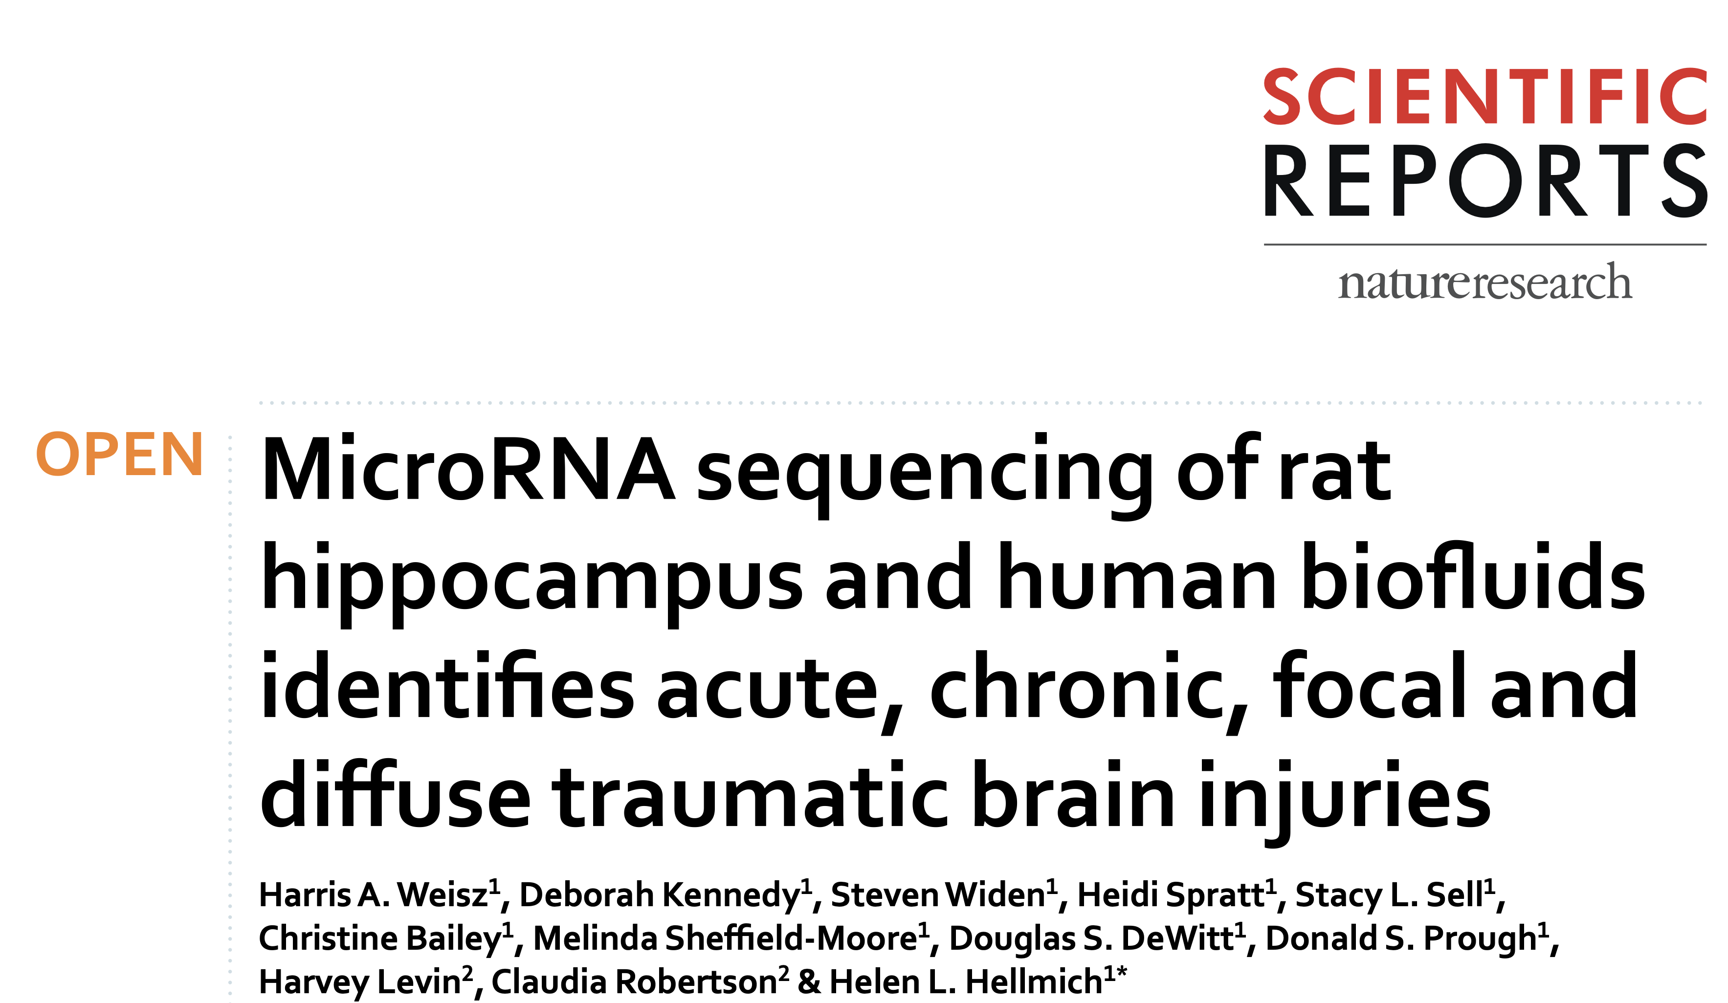
Comparing miRNA in rats to humans
2020, Texas, Galveston

Slide 7
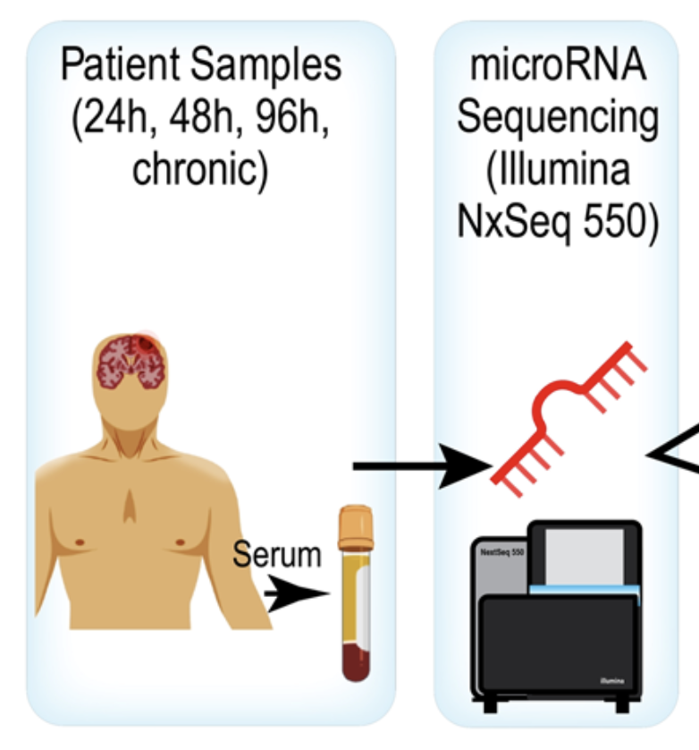
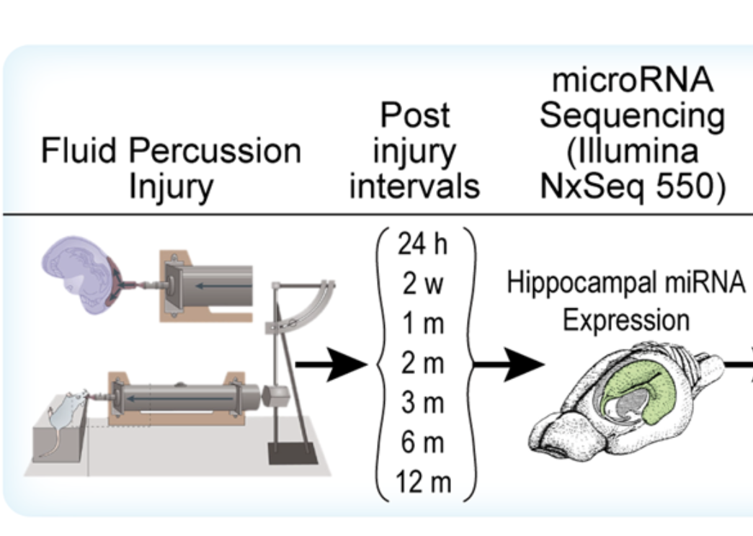
Comparing miRNA in rats to humans
56 samples by 270 miRNA genes
61 samples by 542 miRNA genes

Slide 8
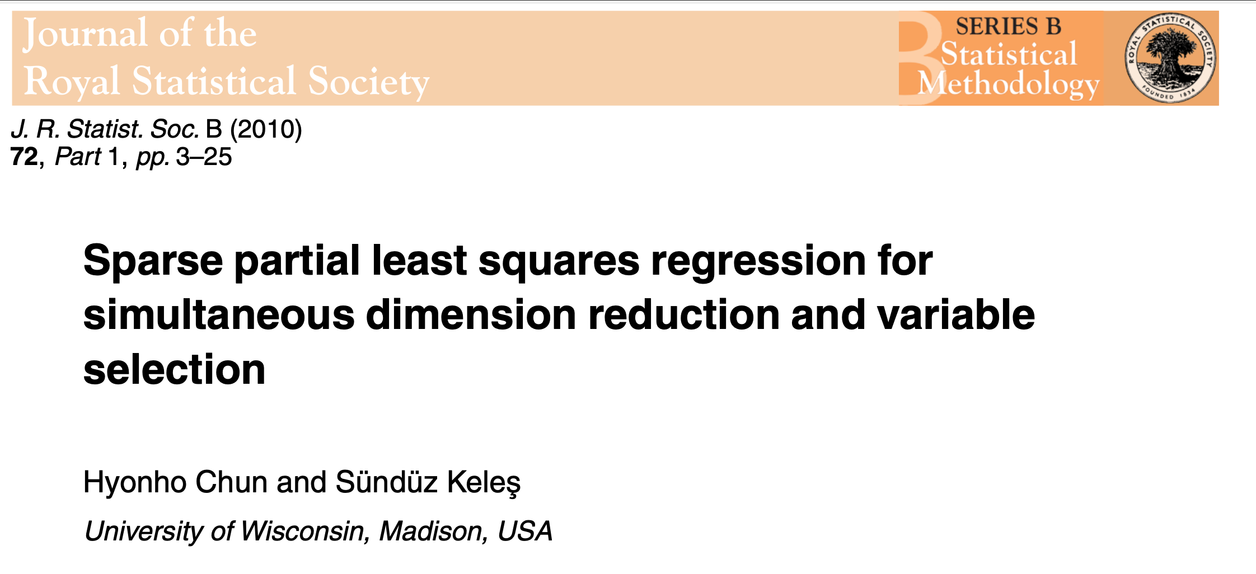
Comparing miRNA in rats to humans

Slide 9
PLS of Rats miRNA for sham surgery vs TBI: sampled at 24 hours post surgery

Slide 10
Gene weightings applied to human data (Rats after 24 hr)

Slide 11
miRNA in Rat TBI models compared to Human TBI
Do the differences in miRNA for rat models of TBI translate to humans? YES
Do the biofluids of the rats or humans matter for miRNA measurement?
Does data from male rats comparable to sex differences in humans?
Does the type of TBI injury matter?

Slide 12
Gene weightings applied to human data (Saliva)

Slide 13
miRNA in Rat TBI models compared to Human TBI
Do the differences in miRNA for rat models of TBI translate to humans? YES
Do the biofluids of the rats or humans matter for miRNA measurement? IT DEPENDS
RATS: BRAIN or PLASMA fine / Humans: SERUM Fine, SALIVA No
Does data from male rats comparable to sex differences in humans?
Does the type of TBI injury matter?

Slide 14
Gene weightings applied to human data Sex differences?

Slide 15
miRNA in Rat TBI models compared to Human TBI
Do the differences in miRNA for rat models of TBI translate to humans? YES
Do the biofluids of the rats or humans matter for miRNA measurement? IT DEPENDS
RATS: BRAIN or PLASMA fine / Humans: SERUM Fine, SALIVA No
Does data from male rats comparable to sex differences in humans? NO?
Does the type of TBI injury matter?

Slide 16
Gene weightings applied to human data Type of injury?

Slide 17
miRNA in Rat TBI models compared to Human TBI
Do the differences in miRNA for rat models of TBI translate to humans? YES
Do the biofluids of the rats or humans matter for miRNA measurement? IT DEPENDS
RATS: BRAIN or PLASMA fine / Humans: SERUM Fine, CSF & SALIVA No
Does data from male rats comparable to sex differences in humans? NO?
Does the type of TBI injury matter? YES
From RAT miRNA: FOCAL can be predicted, DIFFUSE not (due to type of RAT injury)?

