Slide 1
Welcome to the Day 2 Session on Machine Learning

Slide 2
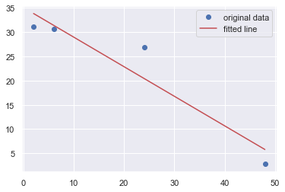
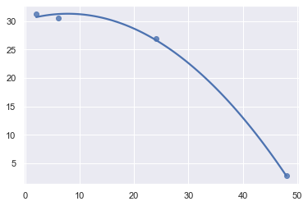
Machine Learning - Linear Regression
y = b₀ + b₁x + e
y = b₀ + b₁x + b₂x² + e
Notes:
My plots – gene expression of TNF over time

Slide 3

Machine Learning - Logistic Regression
https://www.statology.org/logistic-regression-vs-linear-regression/
Notes:
From https://www.statology.org/logistic-regression-vs-linear-regression/

Slide 4
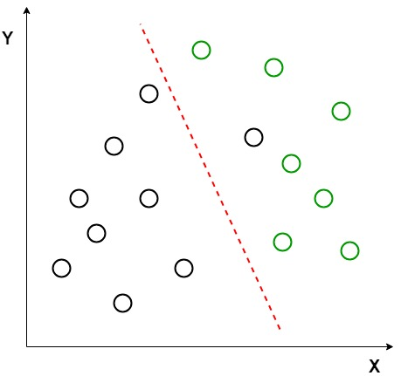
Machine Learning - Linear Discrimination Analysis
Also see Principal Component Analysis on day 3
https://www.geeksforgeeks.org/ml-linear-discriminant-analysis/
Notes:
From https://www.geeksforgeeks.org/ml-linear-discriminant-analysis/

Slide 5
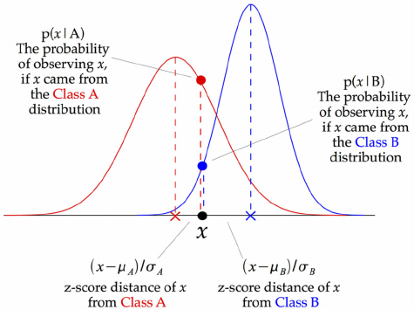
Machine Learning - Gaussian Naive Bayes
https://iq.opengenus.org/gaussian-naive-bayes/
Notes:
From https://iq.opengenus.org/gaussian-naive-bayes/

Slide 6
Machine Learning - K Neighbors Classifier
Also see K-means clustering on day 3
Notes:
My figures

Slide 7
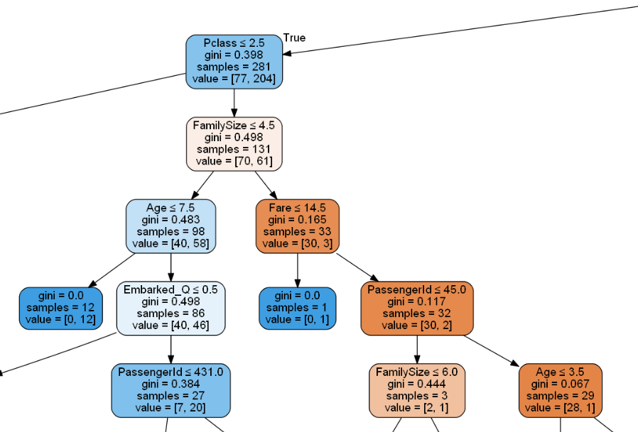
Machine Learning - Decision Tree Classifier
https://udaypratapyati.github.io/MachineLearningBlogs/decision%20tree/dt/machinelearning/ml/datascience/2021/08/10/DecisionTreesTitanicDataset.html
Notes:
From https://udaypratapyati.github.io/MachineLearningBlogs/decision%20tree/dt/machinelearning/ml/datascience/2021/08/10/DecisionTreesTitanicDataset.html

Slide 8
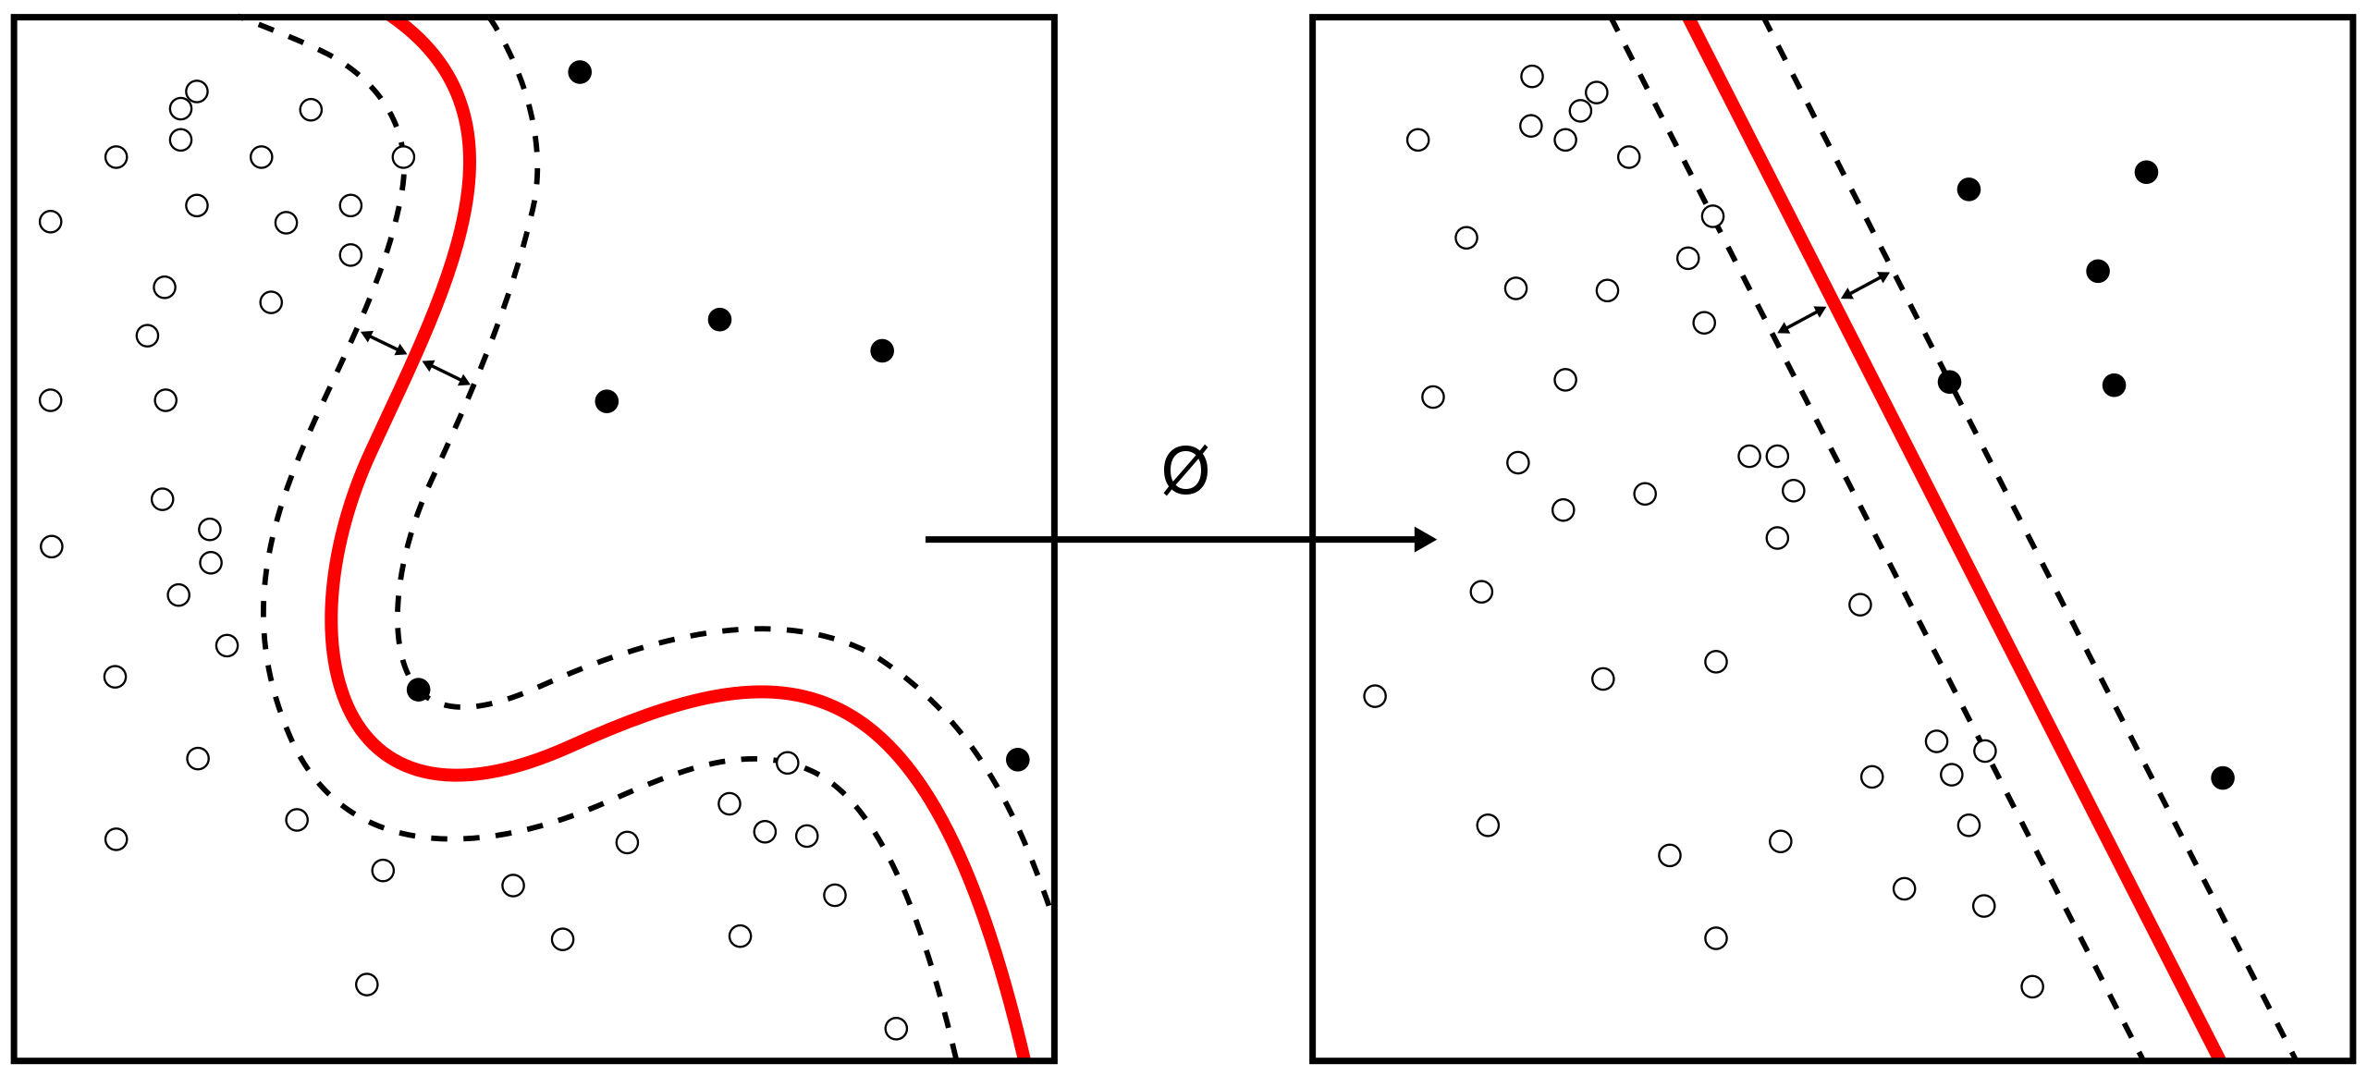
Machine Learning - Support-vector machine
https://en.wikipedia.org/wiki/Support-vector_machine
Notes:
From https://en.wikipedia.org/wiki/Support-vector_machine

