Slide 1
Welcome to the Day 4 Session on Neural Networks

Slide 2
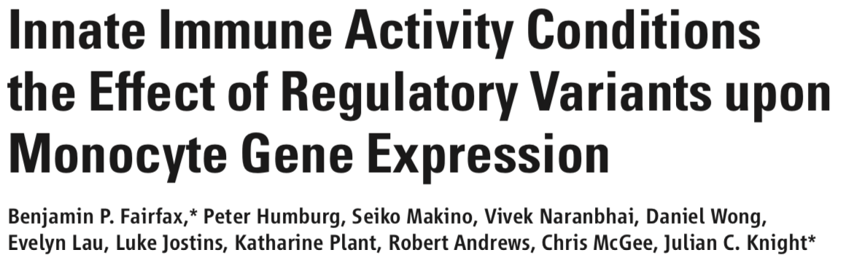
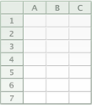

Whole genome gene expression
414 donors
367 donors
13,198 genes
261 donors
322 donors
Naive
IFNγ 24h
Treatment
LPS 2h
LPS 24h
Notes:
I am currently working with an interesting dataset which measures how healthy volunteers’ genes react to bacterial toxins and signalling proteins.
Within this dataset, I am looking to classify the volunteers into high and low responders based on their genes’ expression.
In doing so, I can start to look for various genetic variants unique to these volunteers which may be governing how their bodies react to infection, or in this case, to experimental proxies of bacterial toxins and signalling proteins.
Data set: expression for each of 13 000 genes for 432 donors under different treatments – interferon gamma, lipopolysaccharide.

Slide 3
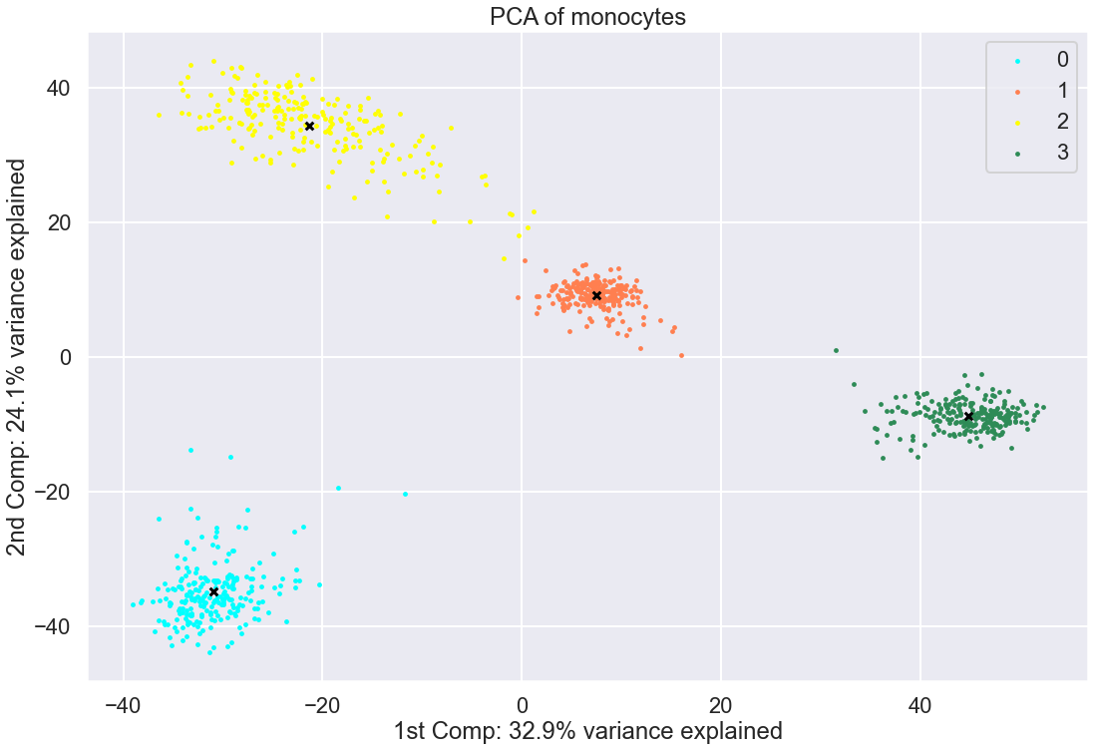
Clustering of gene expression dataset
Notes:
Plot of PCA, each point corresponds to one our samples and is coloured by what treatment is undergone.

Slide 4
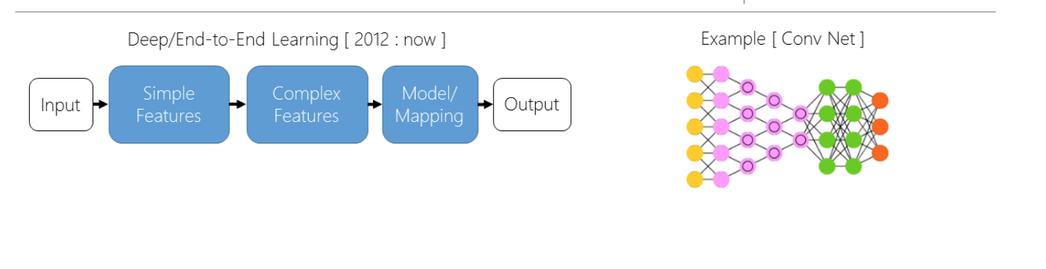
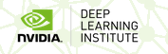
Can we classify the normalized data?
Notes:
Deep Learning – at least one hidden layer between the inputs and the outputs.

Slide 5
Can we classify the normalized data?
Notes:
Deep Learning – at least one hidden layer between the inputs and the outputs.

Slide 6


1st Neural Network
4
Outputs
Dense
Layer
Dense
Layer
Dense
Layer
17867
inputs
Using 684 samples for input and 228 samples for evaluation over 30 epochs
Notes:
Two dense layers of nodes between the inputs and the outputs of 100 and 50 nodes, all interconnected.
Send the training data forward and backward the network, correcting the parameters in each backward iteration depending on how accurate the network was on the previous forward iteration.
Perfect classification.
Can I find which regions of the genome are really driving this classification - no!
Improve the network.

Slide 7
1st Neural Network
relu - Rectified Linear Unit (ReLU).
softmax is a generalization of logistic regression that can be used for multi-class classification.
Cross entropy loss function is an optimization function which is used in case of training a classification model which classifies the data by predicting the probability of whether the data belongs to one class or the other class.
Adam is an optimization algorithm
Using 684 samples for input and 228 samples for evaluation over 20 epochs
Notes:
the loss function is used to compute the quantity that the the model should seek to minimize during training.
Improve the network.

Slide 8
1st Neural Network
Layer (type) Output Shape Param #
=================================================================
layer_1 (Dense) (None, 50) 770550
_________________________________________________________________
layer_2 (Dense) (None, 100) 5100
_________________________________________________________________
layer_3 (Dense) (None, 50) 5050
_________________________________________________________________
dense_3 (Dense) (None, 4) 204
=================================================================
Total params: 780,904
Trainable params: 780,904
Non-trainable params: 0
_________________________________________________________________
Notes:
First neural network
Layer_1 1510 probes by 50 nodes.
Layer_2 50 nodes by 100 nodes
Layer_3 100 nodes by 50 nodes
Output 50 nodes by 4 ouputs.
In total we have 10,540,440 data points (17867 * 684)

Slide 9
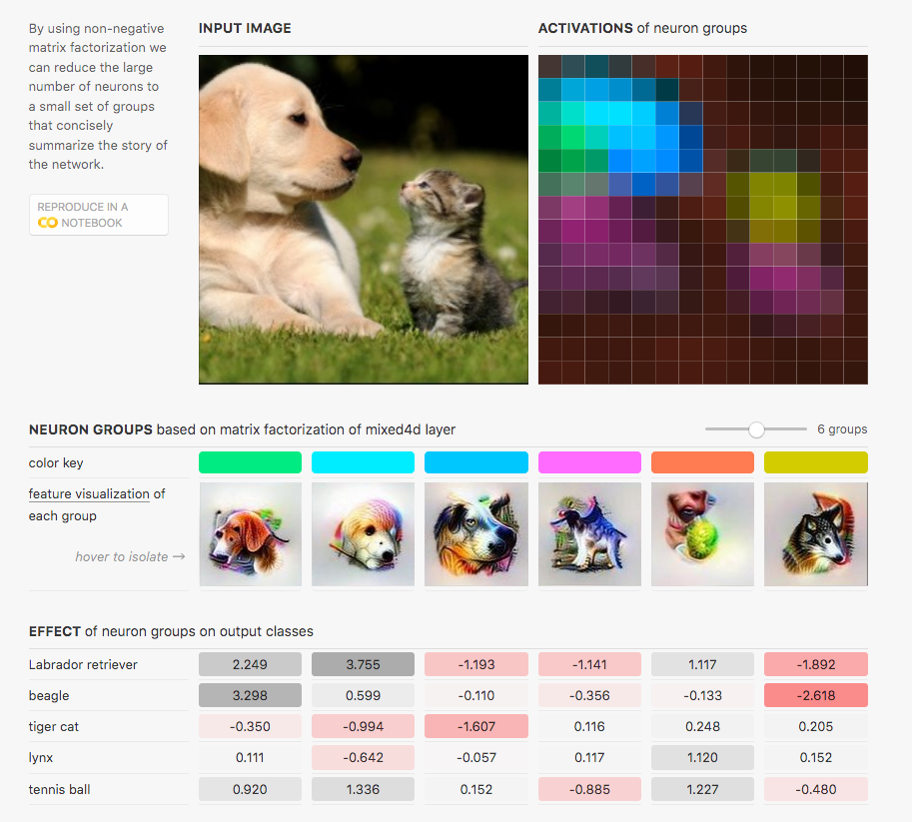
Convolutional layers
Olah, et al., "The Building Blocks of Interpretability", Distill, 2018.
Notes:
Convolutional layers - taken from image classification.
Divide the data into sections. Pool together the strongest signals to help with classification.

Slide 10
2nd Neural Network with loss
4
Outputs
Dense
Layer
17867
inputs
Convolutional
Layer
Using 684 samples for input and 228 samples for evaluation over 30 epochs
with 20% loss at each layer
Notes:
By adding in loss, so after each layer 50% of the connections are randomly lost.
Really force the network to learn better.
Once again 100% accuracy classification.
This can still work when I halve the genome and feed that it. However...

Slide 11
2nd Neural Network with loss
_________________________________________________________________
Layer (type) Output Shape Param #
=================================================================
conv1d_1 (Conv1D) (None, 17867, 32) 352
_________________________________________________________________
max_pooling1d_1 (MaxPooling1 (None, 77, 32) 0
_________________________________________________________________
flatten_1 (Flatten) (None, 2464) 0
_________________________________________________________________
dropout_1 (Dropout) (None, 2464) 0
_________________________________________________________________
dense_1 (Dense) (None, 100) 246500
_________________________________________________________________
dropout_2 (Dropout) (None, 100) 0
_________________________________________________________________
dense_2 (Dense) (None, 4) 404
=================================================================
Total params: 247,256
Trainable params: 247,256
Non-trainable params: 0
_________________________________________________________________
Notes:
Convolutional Layer 1 – 32 * 11
Max Pooling layer 1 – group into 77 segments of 200 probes each
Flatten – 77 by 32
Dense Layer – 2464 *100
Output – 100 * 4
In total we have 10,540,440 data points (17867 * 684)

Slide 12
Future Work
4
Outputs
More
layers /
harsher loss
functions
More
inputs
Look into the
convolutional
layers
Notes:
Augment the data - bigger data, images are inverted, translated. For me add in more probes?
Like the example of the puppy and kitten, look to see the strongest signals from the convolutional layers.
More layers? Too many parameters.
Harsher loss functions? Lose accuracy

