Slide 1

Genomics Medicine and Statistics Start at 9.50am
Justin Whalley

Slide 2
Genomics Medicine and Statistics DAY 1: Introduction to Statistics for Genomics
Justin Whalley

Slide 3

Recommended reading
Notes:
The Art of Statistics – David Speigelhalter

Slide 4
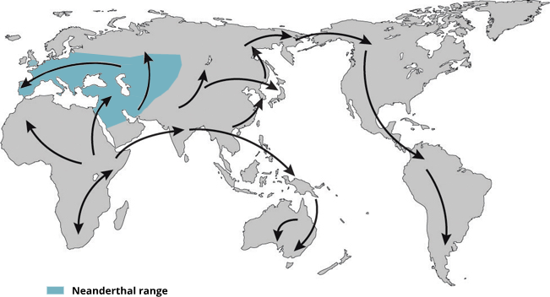
Modern non-African humans contain Neanderthal DNA fragments in their genomes
Interbreeding
~50,000 years ago
Neanderthal
African
Non-African
1.5~4%
Neanderthal
ancestry
Slide from Shiyao Ke
Map adapted from Mafessoni, F. (2019). Nat. Ecol. Evol. 3:14–15.
Notes:
Map adapted from Mafessoni, F. (2019). Encounters with archaic hominins. Nature Ecology & Evolution. 3, 14–15. (https://www.nature.com/articles/s41559-018-0729-6)

Slide 5
Data for investigating Neanderthal introgression in modern humans
Have genome coordiantes of introgressed sequences from Altai Neanderthal in modern humans.
Have crossed these with the 1000 genome project, to get the minor allele frequency in different populations:
European super population: neanderthal_snps_european_maf_1000genome.tsv
African super population: neanderthal_snps_african_maf_10000genome.tsv
All super populations: neanderthal_snps_maf_10000genome.tsv
African specific populations: neanderthal_snps_african_specific_maf_10000genome.tsv
Notes:
Neanderthal SNPs from:
Dannemann M, Prufer K & Kelso J. Functional implications of Neandertal introgression in modern humans. Genome Biol 2017 18:61.
Simonti CN et al. The phenotypic legacy of admixture between modern humans and Neandertals. Science 2016 351:737-41.
Minor allele frequencies from:
1000 genomes
With five super populatuions and 26 specific populations

Slide 7
Genomics Medicine and Statistics Start at 1.40Pm
Justin Whalley

Slide 8
Post lunch teaser
In a cohort of women; - 0.8% have cancer - The probability they have a positive mammogram given they have breast cancer is 90% - The probability they have a positive mammogram given they do not have breast cancer is 7% If you get a positive mammogram what is the probability you have breast cancer?
Notes:
Answer is ~ 9%

Slide 9
Utilizing an iPSC derived macrophage model to look at Ankylosing Spondylitis relevant enhancers: TNFRSF1A
Work from Dr Julie Osgood

Slide 10
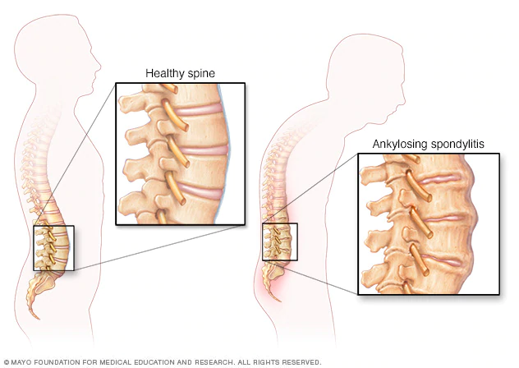
Ankylosing Spondylitis
Chronic inflammatory disorder
inflammation and osteoproliferation of the spine and sacroiliac joints
Age of onset 20-30
Affects men 2x more
Prevalence is 0.1-2%
Affects ~63000 in UK
Complex genetic disorder
Parent-child recurrence risk 7.9%
Heritability of 90%
HLA-B27
Multiple GWAS
48 loci currently associated
Treatments are often ineffective
Brown et al. Arthritis Rheum . 1997
Ellinghaus et al. Nat Genet. 2016
Linda et al. Rheumatology. 2014
Palla et al. Clin Exp Rheumatol. 2012
Pedersen et al. Scand J Rheumatol. 2008
Raychaudhuri & Deodhar . J Autoimmun. 2014
Notes:
Brown et al. Arthritis Rheum . 1997
Ellinghaus et al. Nat Genet. 2016
Linda et al. Rheumatology. 2014
Palla et al. Clin Exp Rheumatol. 2012
Pedersen et al. Scand J Rheumatol. 2008
Raychaudhuri & Deodhar . J Autoimmun. 2014

Slide 11
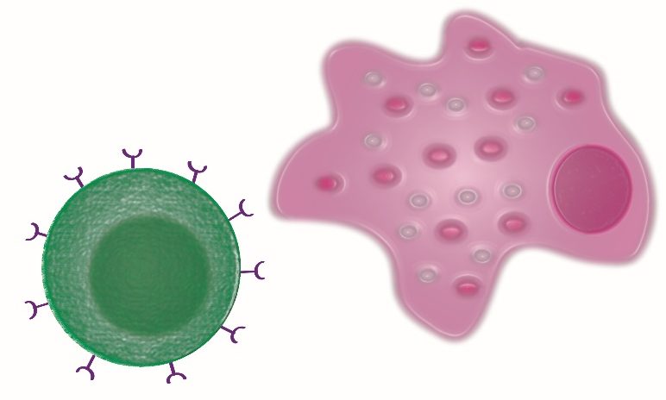

iPSC Derived Macrophages as a Model
Many immune cell types are implicated in disease
Unsure which is the most relevant
Strong evidence for monocytes/macrophages and T cells
Primary immune cells difficult to culture and edit
Limon-Camacho et al. J Rheumatol 2012
Wright et al. Ann Rheum Dis 2009
Zambrano-Zaragoza et al. Int J Inflam.2013
Notes:
Stem cells could be differentiated into other cell types down the line
Monocytes are the precursors for macrophages and dendritic cells, which are all involved in antigen presentation. Studies have found that monocytes in arthritis patients exhibit an upregulation of genes involved in essential inflammation pathways (101–103). One study used label-free quantitative expression profiling to examine protein expression (103). They noted upregulation in AS monocytes in proteins involved in leukocyte recruitment, and important signalling pathways such as, VEGF, JAK/STAT, and toll-like receptor (TLR). Moreover, there was shown to be an upregulation of genes in the ubiquitin proteasome pathway (UPP) in AS monocytes (103). This pathway is involved in the formation of peptides to be presented by HLA ClassI proteins, like HLA-B27.
One theory of AS pathogenesis, known as the arthritogenic
peptide hypothesis, relies on the involvement of CD8þT cells
[99, 100]. This hypothesis suggests that the self-peptides displayed
by HLA-B27 bear a resemblance to peptides produced by
foreign microbes and become the target of autoreactive CD8þT
cells. These cells then initiate an immune response and inflammation
ensues.
Moreover, it was found that CD4þT cells express
KIR3DL2, which is a receptor that recognizes homodimers
of HLA-B27 but does not recognize heterodimers of HLA-B27
The binding of KIR3DL2 to HLA-B27 homodimers could
trigger an immune response and lead to inflammation, and it is
also suggested that binding triggers Th17 responses
Monocytes in spondyloarthritis
patients exhibit an upregulation of genes involved in
essential inflammation pathways.

Slide 12
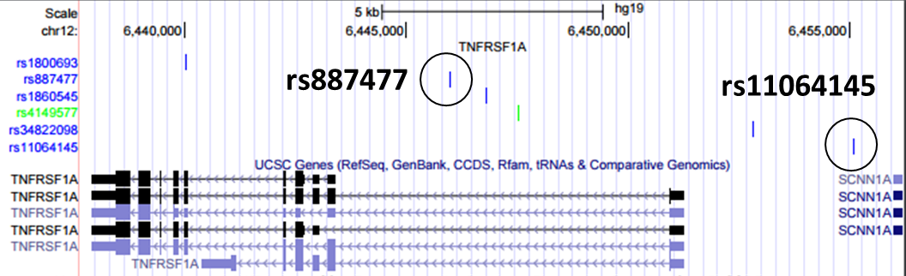
TNFRSF1A
Main TNF receptor
Fine mapped to 6 SNPs
rs887477 and rs11064145
In regions of open chromatin and predicted enhancers
KO TNFRSF1A, two enhancers
Notes:
Not experimentally validated

Slide 13
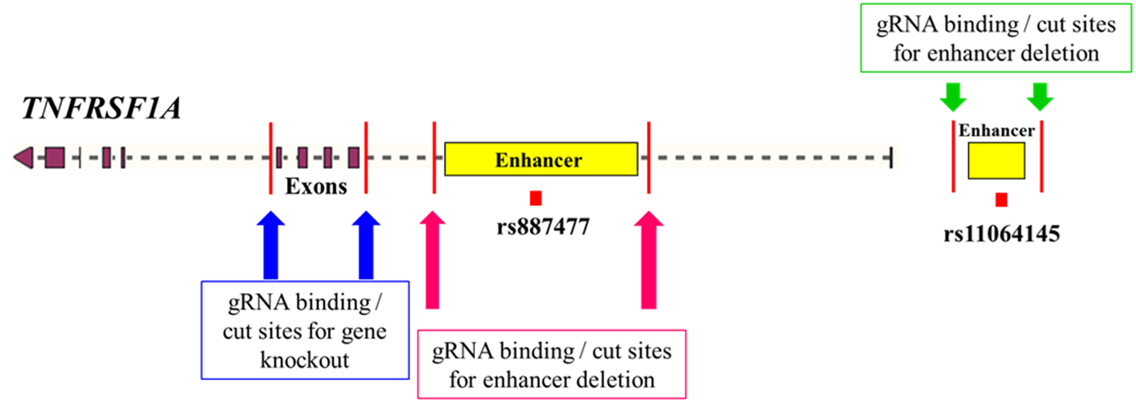
Designing guide RNAs: KO Strategy

Slide 14
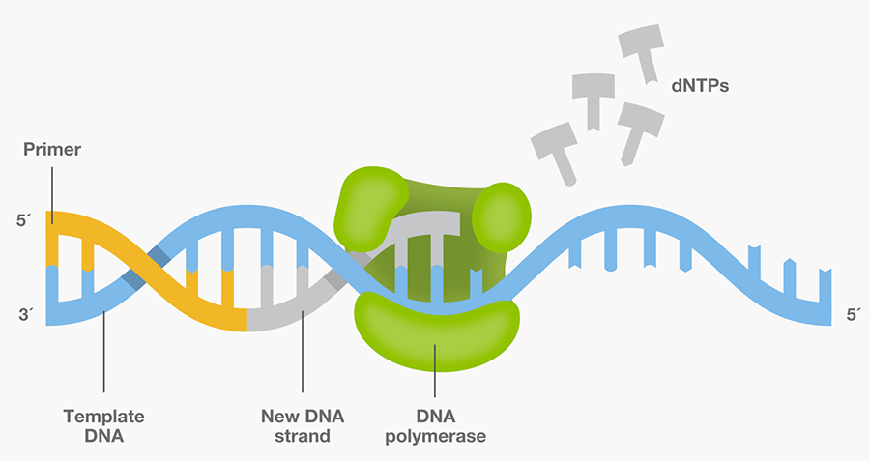



PCR amplification
DNA strand made of nucleotides
Primers (forward and reverse)
Taq DNA polymerase (enzyme)

