Slide 1
def …
某函數式
剪刀石頭布期末專題程式設計範例說明
def …
某函數式
def …
某函數式
def …
def …
yyy=Tk()…
…
…
另開視窗
Xxx=Tk()
…
…
主視窗

Slide 2
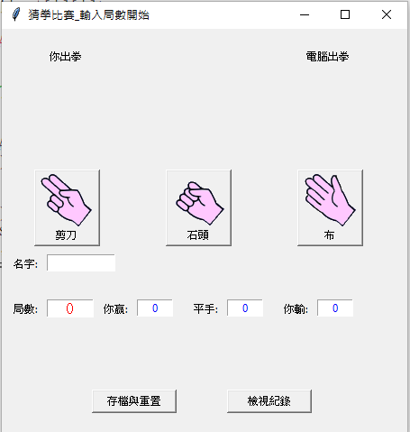
0 1 2
window = Tk()
window.geometry(“450x450”) # 視窗大小、 window.title("猜拳比賽_輸入局數開始") # 視窗標題
game0=["剪刀","石頭","布"] # 陣列
Label(window,width=20,height=10,text="").grid(row=1,column = 1) …
l1=Label(window,text="你出拳") # 以固定位置標上"電腦出拳"…
l2=Label(window,text="電腦出拳") # 以固定位置標上"電腦出拳"，…
imagelist=[] # 相片陣列
for xxx in game0: imagelist.append(PhotoImage(file=xxx +".gif"))
Button(window,text=game0[0],width=65,image=imagelist[0],compound=TOP,command=lambda:showFinal(0)).grid(row=2,column = 1)
…
namex=[0,1,2]
lb = Label(window, text='')
lb.place(x=10,y=350)
pg=[]
g1= IntVar() #局數、w0=IntVar() # 你贏數、ev0=IntVar() # 平手數、lo0=IntVar() # 你輸數
n0=StringVar() # 名字、lb0=StringVar()、g1.set(0)、w0.set(0)、ev0.set(0)、lo0.set(0)、lb0.set("")
temp0=""
name0_label = Label(window, text='名字:’)…
games_label = Label(window, text='局數:’)…
games_text=Entry(window,width=6,textvariable=g1,justify="center",fg='red',font=10)…
win_label = Label(window, text='你贏:’)…
win0_text=Entry(window,width=6,textvariable=w0,justify="center",fg='blue’)…
even_label = Label(window, text='平手:’)…
even0_text=Entry(window,width=6,textvariable=ev0,justify="center",fg='blue’)…
lose_label = Label(window, text='你輸:’)…
lose0_text=Entry(window,width=6,textvariable=lo0,justify="center",fg='blue’)…
lb = Label(window, textvariable=lb0,fg='red',justify="center")…
btn3=Button(window,text="存檔與重置",width=12,compound=TOP,command=show3)…
btn4=Button(window,text="檢視紀錄",width=12,compound=TOP,command=show4)…
window.mainloop()
# Rock paper scissors.py
from tkinter import *
import random
import time
import os
主視窗

Slide 3
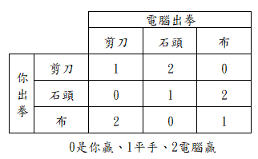
判定每把的輸贏與記錄的函數(任意猜拳啟動此函數)
例如:Button(window,text=game0[0],width=65,image=imagelist[0],compound=TOP,command=lambda:showFinal(0)).grid(row=2,column = 1) #剪刀
def showFinal(i):
matchmapping=[[1,2,0],[0,1,2],[2,0,1]] # 列是你出拳，行是電腦出拳，0是你贏，1平手，2電腦贏
matchlist=[["你獲勝",1,0,0],["雙方平手",0,1,0],["電腦獲勝",0,0,1]] # ["xxx",你贏加一筆，平手加一筆，你輸加一筆]
Label(image=imagelist[i],text=game0[i],compound=TOP).grid(row=1,column = 1) # 顯示:你出拳
cpx=random.randint(0,2) # 電腦隨機出拳
Label(font="24",width=8,text=matchlist[matchmapping[i][cpx]][0]).grid(row=1,column = 2) #依表查出輸贏
Label(text=game0[cpx],image=imagelist[cpx],compound=TOP).grid(row=1,column = 3) # 顯示:電腦出拳
g1.set(g1.get()-1)
w0.set(w0.get()+matchlist[matchmapping[i][cpx]][1]) # 你贏數
ev0.set(…..# 平手數
lo0.set(….. # 你輸數
if g1.get() == 0:
k0=(w0.get()+ev0.get()+lo0.get())
temp0 = time.asctime()+" "+str(n0.get())+" 玩" + str(k0) +"場. 贏" +str(w0.get()) +"場. 平手" +str(ev0.get())+"場. 輸"+ str(lo0.get())+"場."
lb0.set(temp0)
def show3(): # 存檔與重置
file0=open("rock.txt", mode="a")
print(lb0.get(),file=file0)
file0.close()
n0.set("")
g1.set(0)
w0.set(0)
ev0.set(0)
lo0.set(0)
lb0.set("")

Slide 4
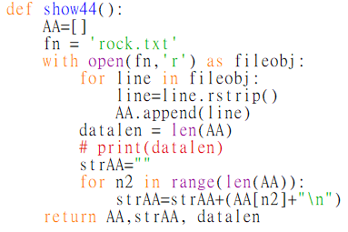
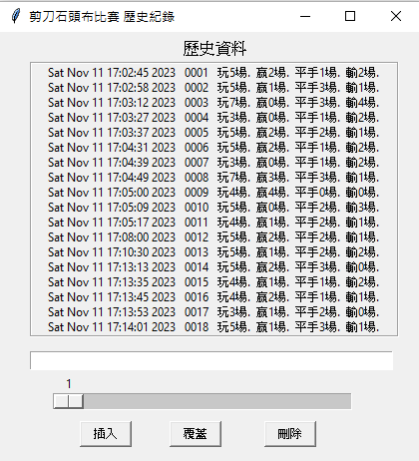
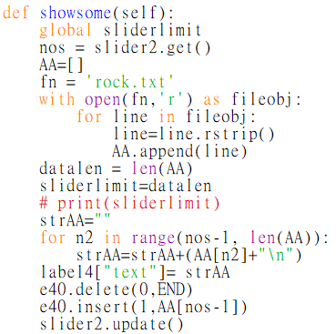
載入資料
主視窗的檢視紀錄按鈕開啟新視窗
def show4(): # 另開視窗顯示歷史資料
…
def show44():
…
Def showsome():
….
rec = Tk()
rec.geometry("420x430") # 視窗大小
content0=StringVar()
sliderlimit=IntVar()
sliderlimit.set(20)
rec.title("剪刀石頭布比賽 歷史紀錄") # 視窗標題
labelTop= Label(rec,text="歷史資料",font=14)
labelTop.place(x=180, y=5)
e40 = Entry(rec,width=60,justify="center",fg="red")
e40.place(x=30,y=320)
data0, wholedata, sliderlimit =show44() #載入資料，建立串列data0、全文字檔 wholedata與滑軌上限
label4 = Label(rec,width=52,height=18,anchor= "n",text=wholedata,relief="groove")
label4.place(x=30,y=30)
slider2 = Scale(rec,from_=1,to=sliderlimit, orient=HORIZONTAL,length=300,command=showsome)
slider2.place(x=50,y=340)
btn1 =Button(rec,width=6,height=1,text="插入",command = lambda:editdata("插入", data0,slider2.get()))
btn1.place(x=80,y=390)
btn2 =Button(rec,width=6,height=1,text="覆蓋",command = …)
btn2.place(x=170,y=390)
btn3 =Button(rec,width=6,height=1,text="刪除",…)
btn3.place(x=265,y=390)
滑軌移動
資料重現

Slide 5
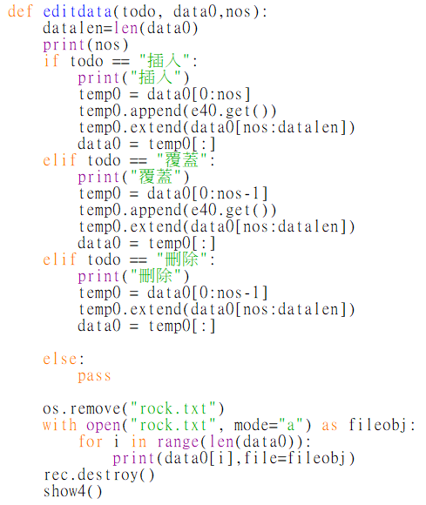
btn1 =Button(rec,width=6,height=1,text="插入",command = lambda:editdata("插入", data0,slider2.get()))
btn1.place(x=80,y=390)
新視窗插入、覆蓋與刪除按鈕，啟動右邊函數

