Slide 1
Accelerator-based Confidential Computing for Privacy-preserving Large Language Model Inference
Master Thesis
2024. 06. 13.
Pyo, Jinwon
Advisor: Jaehyuk Huh

Slide 2
Contents
Introduction
Background
Motivation
Thesis Statement
Design
Evaluation
Future Work
Conclusion
2/51

Slide 3
Contents
Introduction
Background
Motivation
Thesis Statement
Design
Evaluation
Future Work
Conclusion
3/51

Slide 4



Large Langue Models
Since the publication of “Attention Is All You Need” in 2017, various LLMs are developed and actively used
4/51

Slide 5
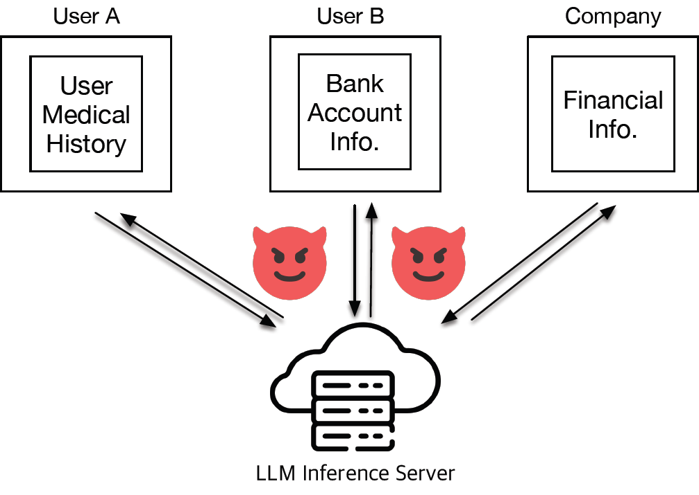
Privacy Preserving LLM Inference
User LLM inference requests processed in cloud servers for large computating resource
Privacy Issue: User private information can leak
5/51

Slide 6
Contents
Introduction
Background
Motivation
Thesis Statement
Design
Evaluation
Future Work
Conclusion
6/51

Slide 7
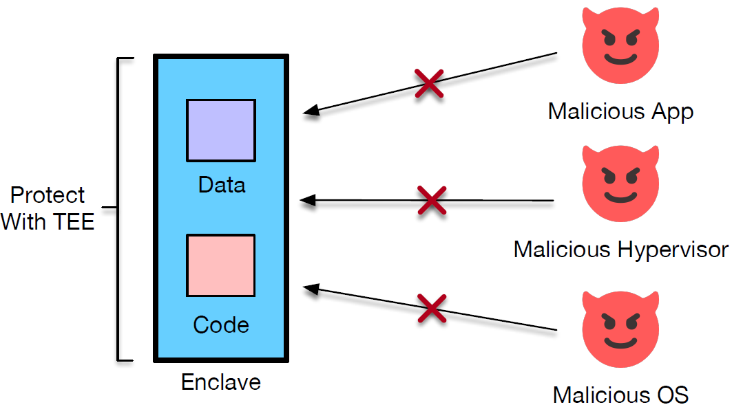
Trusted Execution Environment (TEE)
Confidentiality: No leak of information to attackers
Integrity: No modification of information by attackers
CPU TEE = secure area in CPU in which code and data are protected to ensure confidentiality and integrity
7/51
Notes:
Conf, integrity, 뭔지 입으로 설명

Slide 8
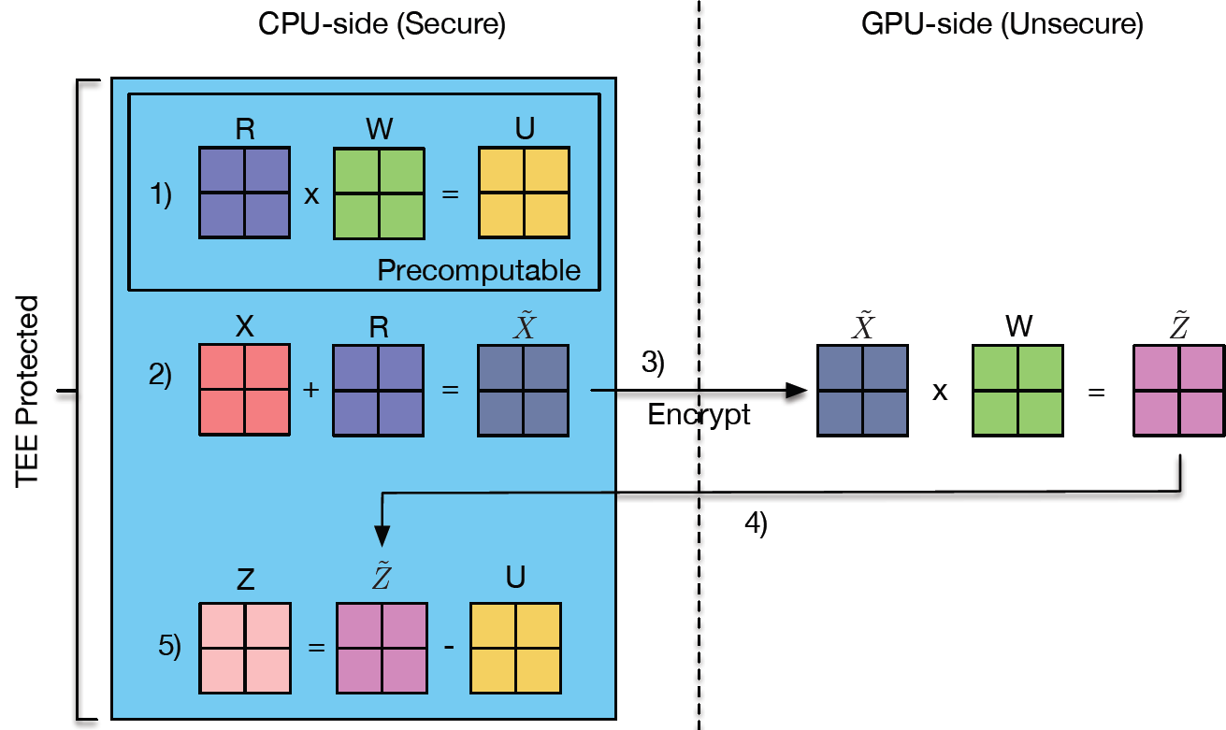
Previous Work for Input Privacy
Slalom utilizes both CPU TEE and untrusted accelerator for CNN inference using additive cipher
8/51

Slide 9
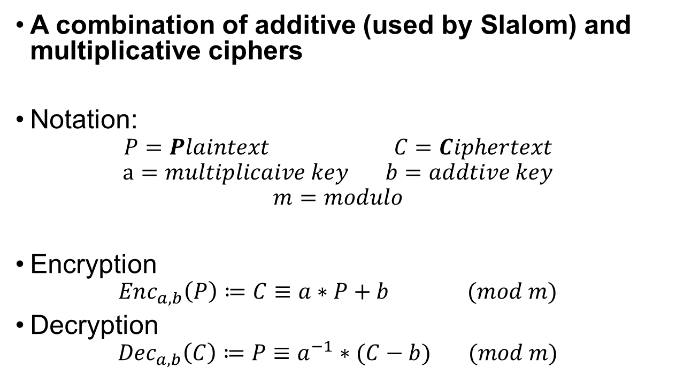
Affine Cipher
A combination of additive (used by Slalom) and multiplicative ciphers
Notation:
$$P=Plaintext C=Ciphertext$$
$$a=multiplicaive key b=addtive key$$
$$m=modulo$$
Encryption
$$Enc_{a,b}\left(P\right)≔C≡a∗P+b (mod m)$$
Decryption
$$Dec_{a,b}\left(C\right)≔P≡a^{−1}∗(C−b) (mod m)$$
9/51
Notes:
Simple encryption way
- module indentation

Slide 10
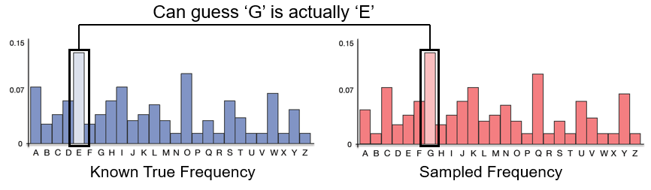


Possible Attacks
Known-plaintext Attack is possible when at least two Plaintext-Ciphertext pairs with same keys are known
Frequency Analysis Attack is when a frequency of a plaintext set is known and same keys are reused
Pair 1:
$$C_{1}=Enc_{a,b}\left(P_{1}\right)$$
(P, C) Pairs are known
Pair 2:
$$C_{2}=Enc_{a,b}\left(P_{2}\right)$$
Same key set is used
10/51

Slide 11
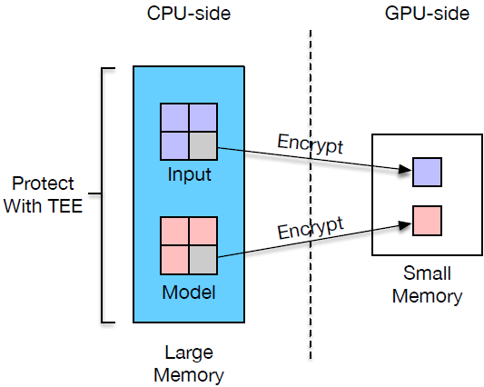
CPU TEE-based LLM Inference System
Data protected inside CPU TEE
Data encrypted before GPU offloading
11/51

Slide 12
Threat Model
Our Trusted Computing Base (TCB)
CIA Triads
Our Trusted Computing Base (TCB)
Hardware-side | Intel CPU Hardware Package Boundary
Software-side | TEE with Intel Scalable SGX
CIA Triads
Confidentiality | ○
Integrity | △
Availability | X
12/51
Our Trusted Computing Base (TCB)
HW-side: Intel CPU hardware package boundary
SW-side: TEE supported by Intel Scalable SGX
CIA Triads
Confidentiality: Our model ensures confidentiality
Integrity: Our model ensures data validity but not replay attack (Intel Scalable SGX does not support Merkle Tree-based replay attack prevention)
Availability: Our model does not ensure availability since OS is in charge of CPU schedule
Other attacks that are out of scope to our model
Bus-snooping Attack
Modification of external DRAM content
Side-channel Attack
Notes:
그림 활용하고,

Slide 13
Contents
Introduction
Background
Motivation
Thesis Statement
Design
Evaluation
Future Work
Conclusion
x/x
13/51

Slide 14
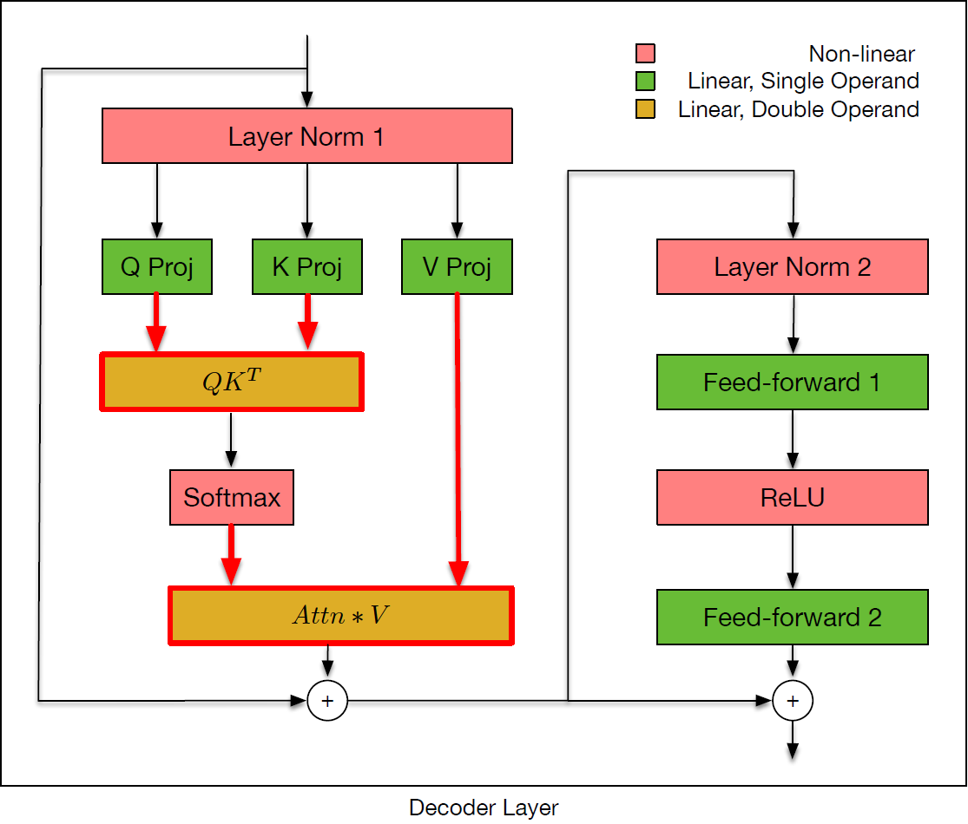
Characteristics of LLM
Both inputs are derived from user input
14/51
Notes:
파란색 강조 안보임
PV 연산이

Slide 15
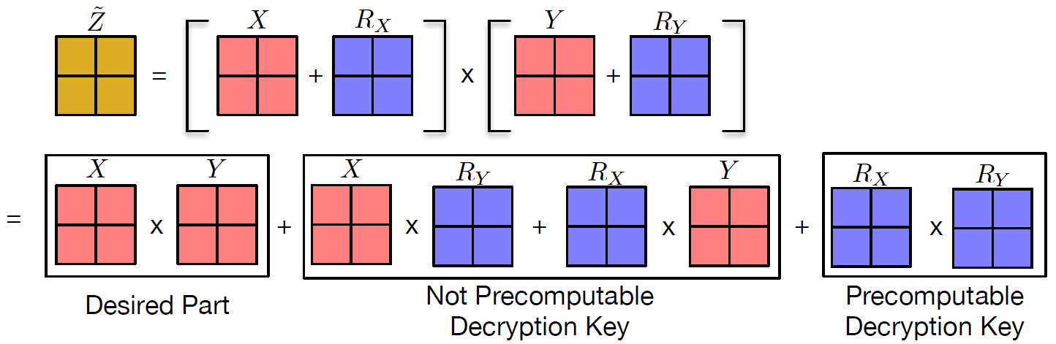

Direct Application of Slalom Scheme
Slalom scheme does not work in this case
Decryption key generation requires $O\left(N^{3}\right)$ at runtime
15/51
Notes:
X와 Y가 미리 알려져잇지 않다

Slide 16
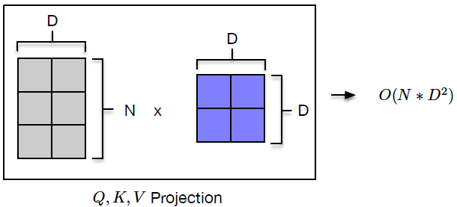
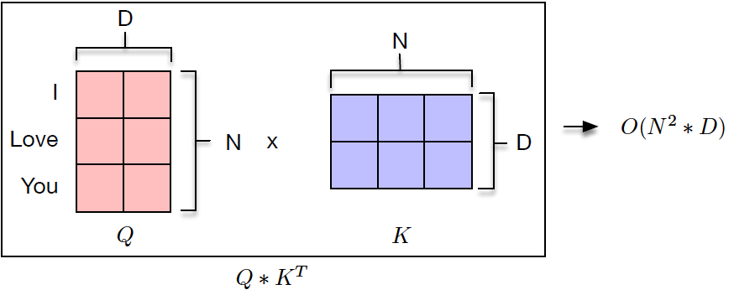
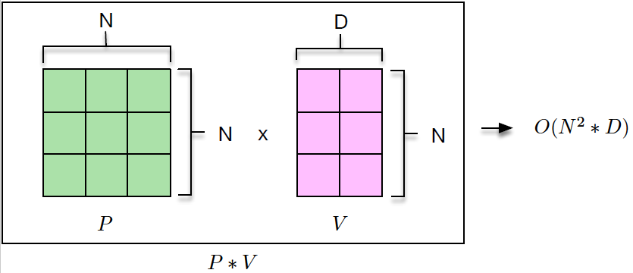
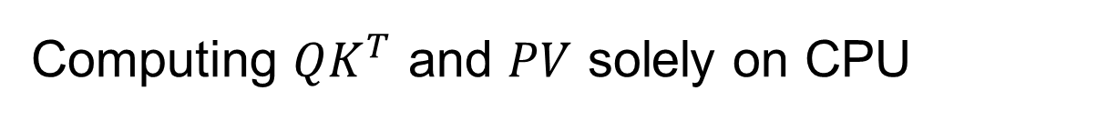

Computing $QK^{T}$ and $PV$ solely on CPU
Typical linear layers are linearly proportional to input / output token lengths
$QK^{T}$ and $PV$ are squarely proportional to input / output token lengths
16/51
Notes:
N, D가 무엇인지 설명

Slide 17
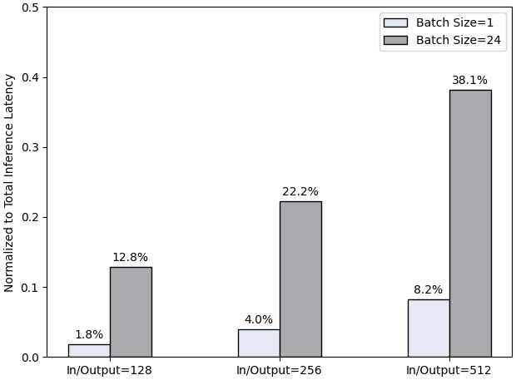
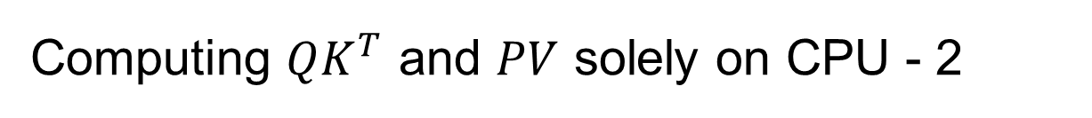

Computing $QK^{T}$ and $PV$ solely on CPU - 2
Dominance of $QK^{T}$ and $PV$ over total inference time
17/51
Notes:
높아진다
어텐션이라는 말로 퉁치기

Slide 18
Contents
Introduction
Background
Motivation
Thesis Statement
Design
Evaluation
Future Work
Conclusion
18/51

Slide 19
Main Challenges
Challenge 1: Need for a new cipher scheme that allows the encryption, decryption key generation, and decryption operations to be practically performed on the CPU
Challenge 2: Need to verify that the newly designed cipher scheme ensures sufficient confidentiality even when using untrusted accelerators
Challenge 3: Need to ensure that the newly designed cipher scheme is efficiently implemented reflecting the nature of the accelerator
19/51

Slide 20
Thesis Statement
Thesis Statement: This research aims to design and validate a new cipher scheme for secure matrix multiplication, thereby enabling secure and efficient LLM inference on untrusted accelerators
20/51
Notes:
한줄로
그림 넣기s
Scure llm 구축이 목표
위해서는 효율적임
Kv cache

Slide 21
Contents
Introduction
Background
Motivation
Thesis Statement
Design
Evaluation
Future Work
Conclusion
21/51

Slide 22
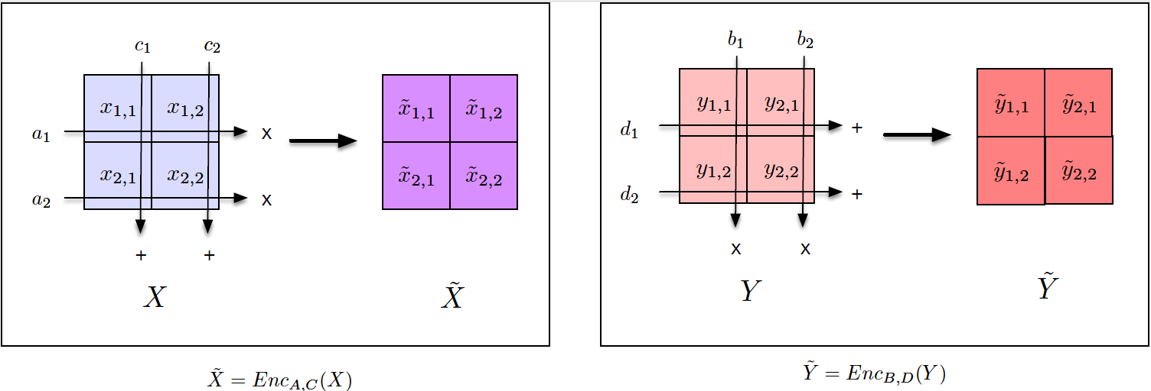
Secure LLM Inference System
Propose: Modified affine cipher with row- and column-wisely shared secret keys for Secure matrix multiplication
22/51
Notes:
중요한 부분만 텍스트로 남기기

Slide 23
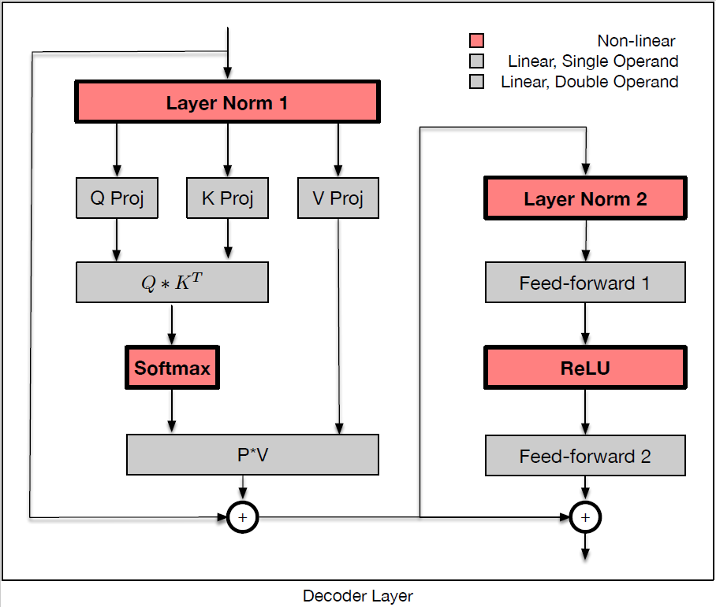
Non-linear Operation Scheme
Non-linear operations are done on CPU-side; they are not recoverable with conventional cipher schemes
23/51
Notes:
일반적인 섭스티튜션

Slide 24
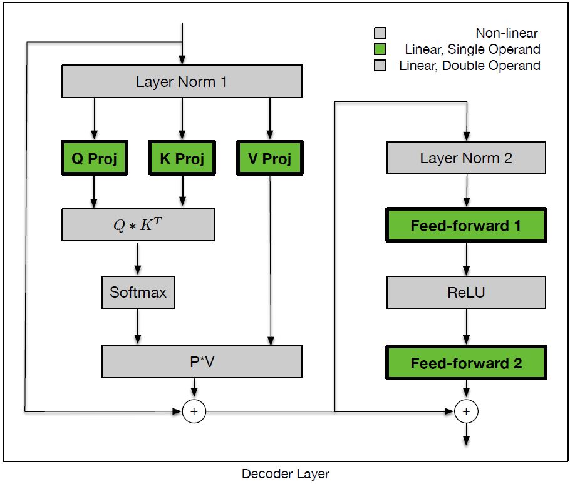
Single-sided Linear Operation Scheme
Slalom way applied to single-sided linear operations
24/51

Slide 25
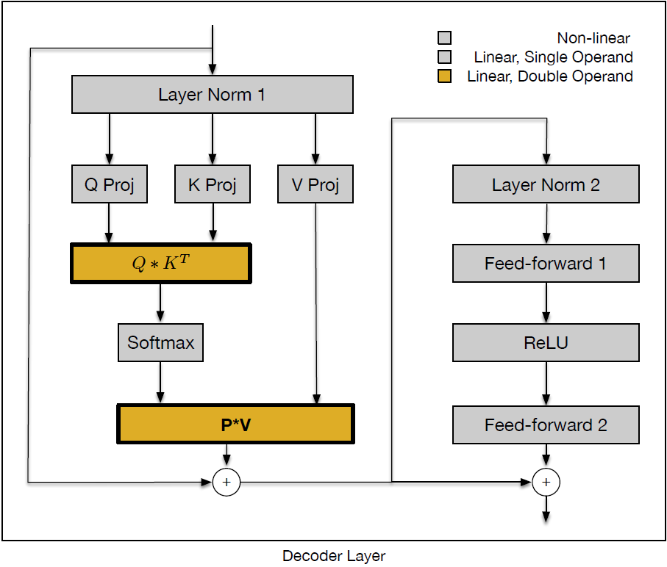

Double-sided Linear Operation Scheme
For double-sided linear operations such as $QK^{T}$ and $PV$, our proposed scheme is applied
25/51
Notes:
그림 합치기

Slide 26

Encryption of Double-sided Inputs
Encrypt each element with row-wisely shared multiplicative key and column-wisely shared additive key, $O\left(N^{2}\right)$
26/51

Slide 27
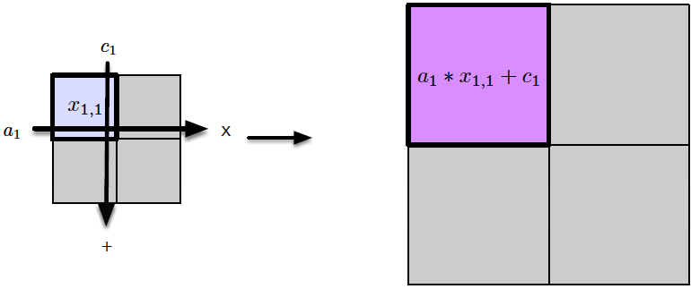



Encryption Example
Encrypt $x_{1,1}$ with $a_{1}$ and $c_{1}$
$$X$$
$$\tilde{X}$$
27/51

Slide 28
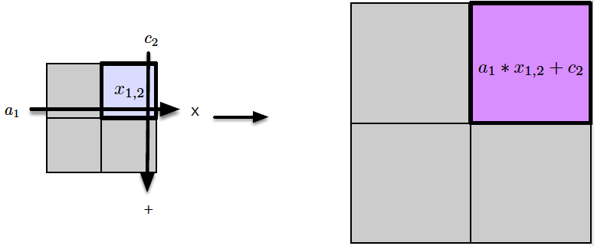

Encryption Example - 2
Encrypt $x_{1,2}$ with $a_{1}$ and $c_{2}$
$$X$$
$$\tilde{X}$$
28/51

Slide 29
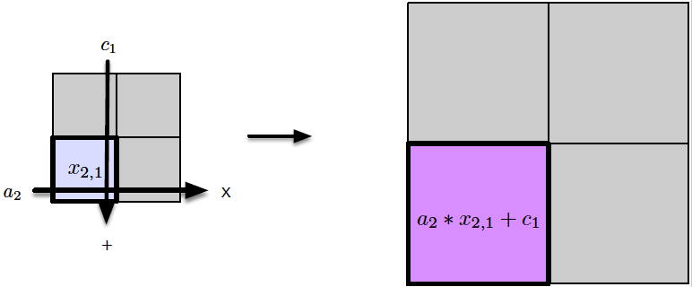

Encryption Example - 3
Encrypt $x_{2,1}$ with $a_{2}$ and $c_{1}$
$$X$$
$$\tilde{X}$$
29/51

Slide 30
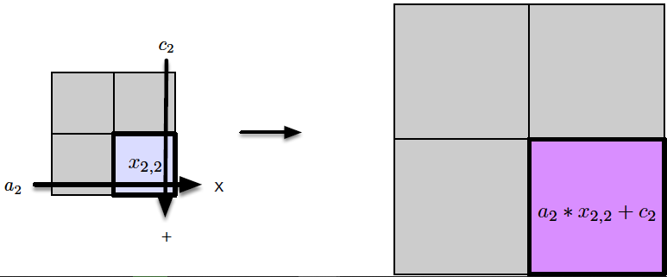

Encryption Example - 4
Encrypt $x_{2,2}$ with $a_{2}$ and $c_{2}$
$$X$$
$$\tilde{X}$$
30/51

Slide 31
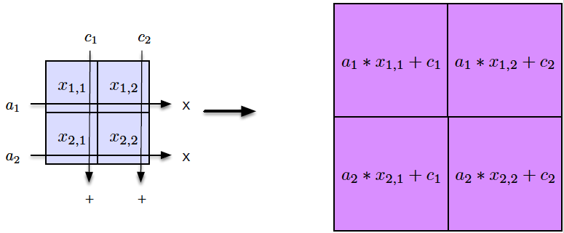

Encryption Example - 5
Encrypting $X$ to $\tilde{X}$ is complete
Encrypting $Y$ to $\tilde{Y}$ is similar
$$X$$
$$\tilde{X}$$
31/51

Slide 32
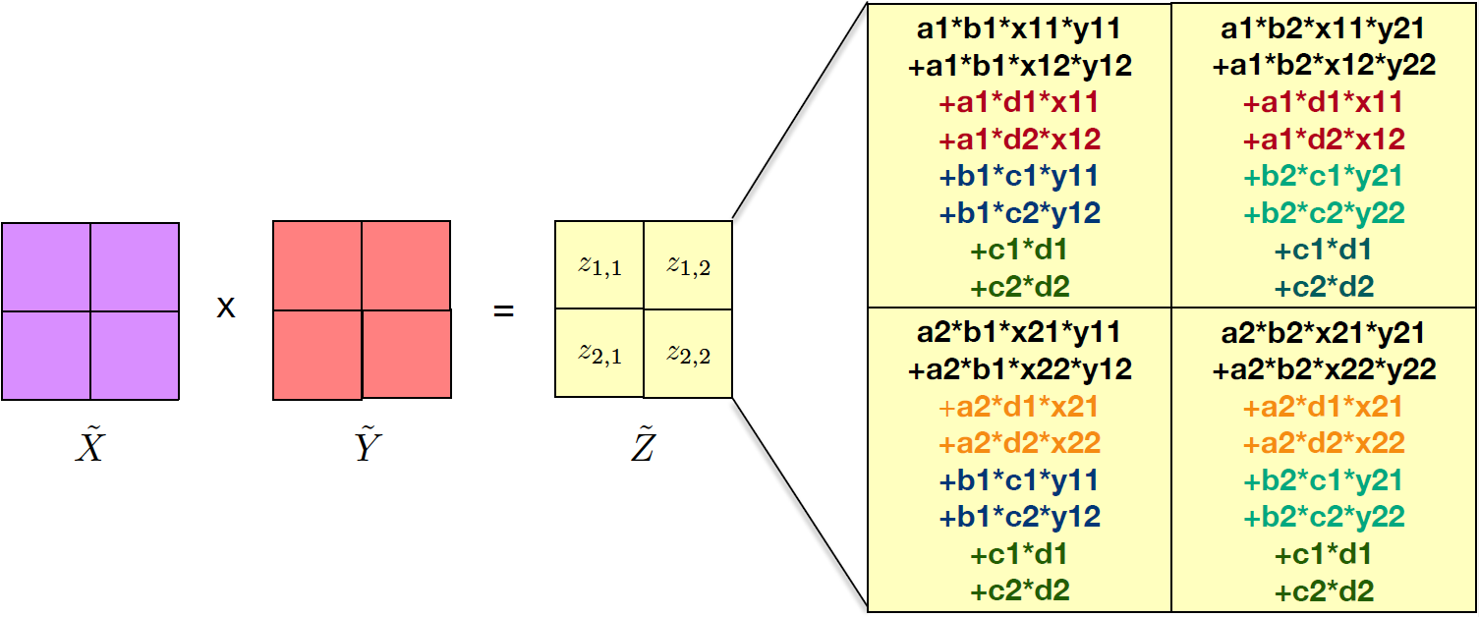


Decomposition of $\tilde{Z}$
Returned result $\tilde{Z}=\tilde{X}∗\tilde{Y}$ is sum of intended result and decryption key factors
32/51

Slide 33
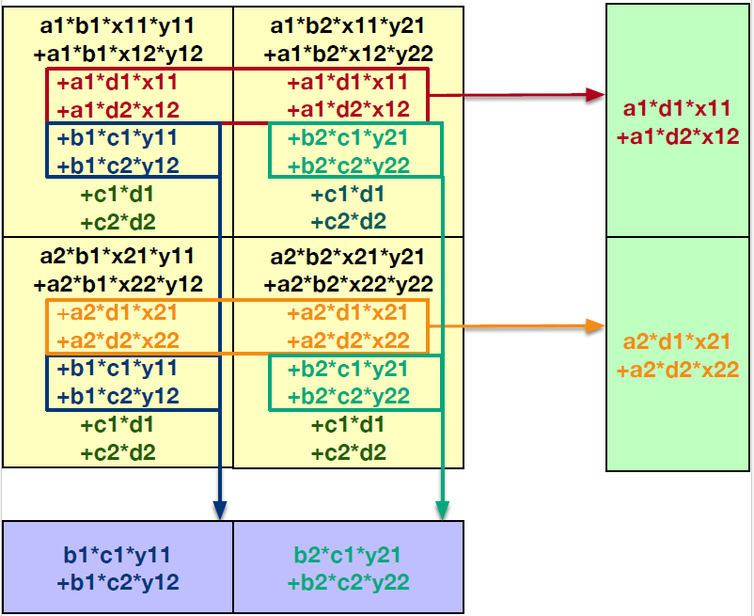

Reusable Decryption Factors
Decryption factors are shared row-wisely and column-wisely, $O\left(N^{2}\right)$
33/51
Notes:
원래 그림으로 원복

Slide 34
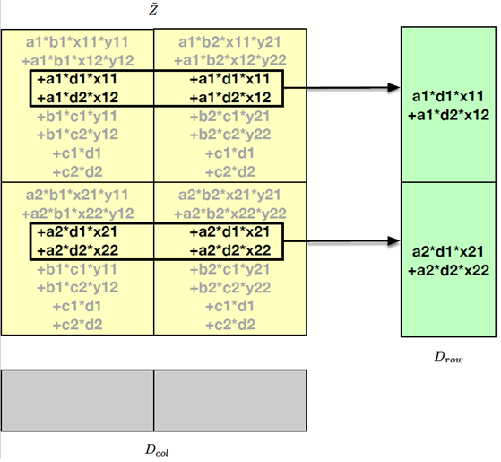
Row-wisely Shared Decryption Factors
34/51

Slide 35
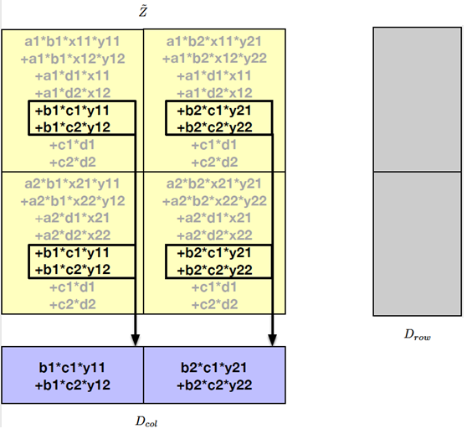
Column-wisely Shared Decryption Factors
35/51

Slide 36
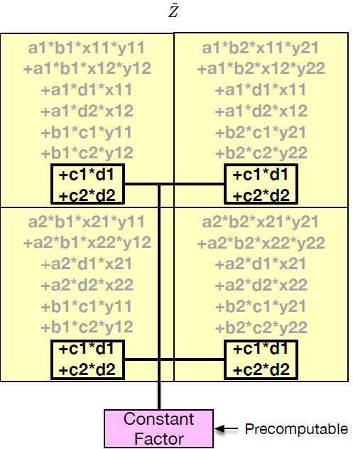
Globally Shared Decryption Factors
36/51

Slide 37






Generalized Process
Encryption, $O\left(N^{2}\right)$
Decryption Key Generation, $O\left(N^{2}\right)$
37/51
Notes:
백업

Slide 38

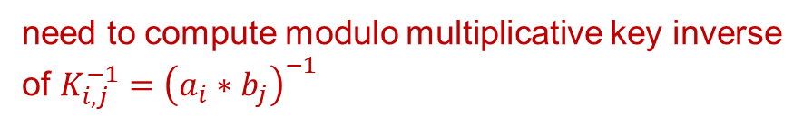
Decryption Process
Now we can subtract decryption keys from $\tilde{Z}$, $O\left(N^{2}\right)$
One more step to go
subtract decryption keys
need to compute modulo multiplicative key inverse of ${K_{i,j}^{−1}=\left(a_{i}∗b_{j}\right)}^{−1}$
38/51
Notes:
백업

Slide 39
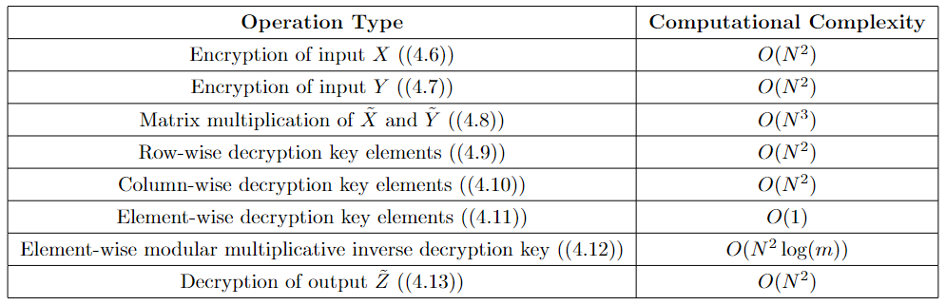
Summary of Our Proposed Algorithm
39/51

Slide 40
Security Analysis
Frequency Analysis Attack: secure against it as each element is encrypted with a unique key pair
Known-plaintext Attack-Proof: secure against it as we never reveal (Plaintext, Ciphertext) pairs
40/51

Slide 41
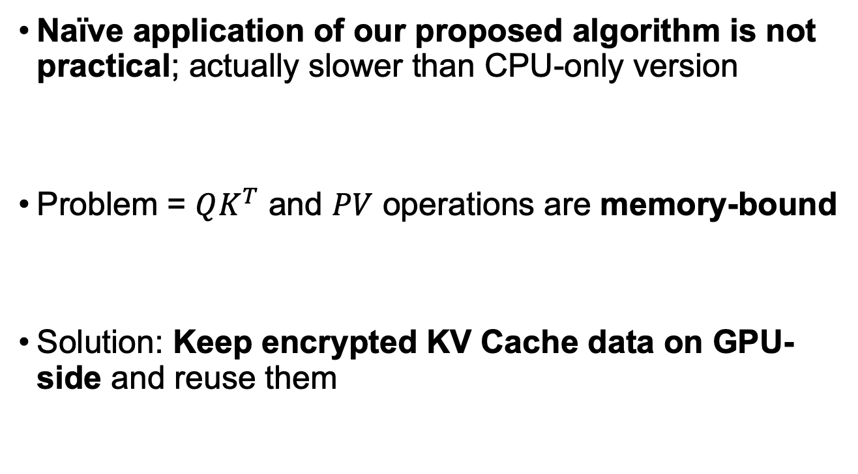
Encrypted KV Cache Migration
Naïve application of our proposed algorithm is not practical; actually slower than CPU-only version
Problem = $QK^{T}$ and $PV$ operations are memory-bound
Solution: Keep encrypted KV Cache data on GPU-side and reuse them
41/51
Notes:
실제로 impracticality하다는 얘기를 제목에

Slide 42
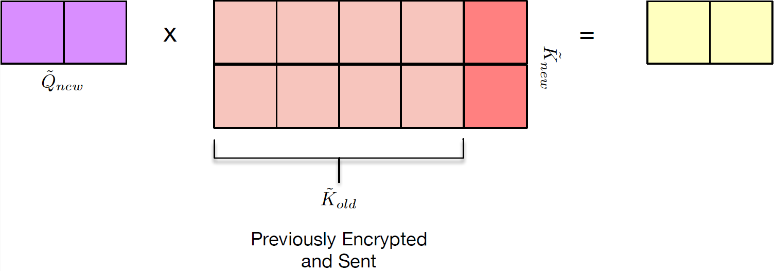

Encrypted KV Cache Migration Example
This is the case of $\tilde{Q}{\tilde{K}}^{T}$ operation
Previously encrypted ${\tilde{K}}_{cache}={\tilde{K}}_{old}$ stays in GPU-side when ${\tilde{K}}_{new}$ is newly arrived to GPU, they are concatenated before computation
42/51

Slide 43
Contents
Introduction
Background
Motivation
Thesis Statement
Design
Evaluation
Future Work
Conclusion
43/51

Slide 44
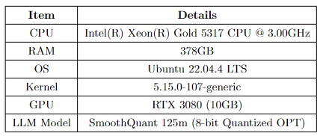
Evaluation
Experiment Setup Environment
44/51
Notes:
표 다시 그리기

Slide 45
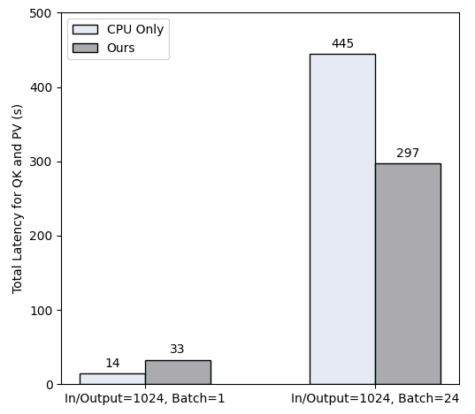

Experiment 1
We compare latencies of $QK^{T}$ and $PV$ for
CPU-only vs. Our proposed algorithm (+KV cache migration)
In/Output token lengths are each 1024, Batch size 1 and 24
45/51
Notes:
33%라는 말이 있어야됨, scalable

Slide 46




Experiment 2
Effect of encrypted KV cache migration
$$QK^{T}$$
$$PV$$
46/51

Slide 47
Contents
Introduction
Background
Motivation
Thesis Statement
Design
Evaluation
Future Work
Conclusion
47/51

Slide 48
Low CPU Utilization of Slalom Scheme
Low CPU utilizations during the Slalom scheme
CPU is idle
48/51
Notes:
tldr

Slide 49



Split Batch Pipelining for $QK^{T}$ and $PV$
$QK^{T}$ and $PV$ operations are not batchable
Pipelining of encryption, decryption key generation, GPU operation, and decryption might be possible
49/51

Slide 50

KV Cache Migration Strength Control
Keeping entire encrypted KV cache on GPU-side might
Take up GPU memory without reason
It is necessary to figure out how much of KV cache migration is appropriate
50/51

Slide 51
Conclusion
LLM inference faces unique challenges regarding user privacy preservation due to its computational characteristics, making traditional methods like Slalom unusable.
This study proposes a modified affine cipher technique with row- and column-wisely shared secret keys
Our new technique led to a 33% performance improvement compared to the CPU-only version.
51/51
Notes:
아이디어 + 리절트 + 챌린지

Slide 52
Reference
[1] https://www.techtarget.com/searchsecurity/definition/trusted-computing-base
[2] SmoothQuant, https://arxiv.org/pdf/2211.10438
[3] Flexgen, https://arxiv.org/pdf/2303.06865
[4] Slalom, https://openreview.net/pdf?id=rJVorjCcKQ

Slide 53
Thank you!

Slide 54
Backup: Trusted Computing Base (TCB)
A set of HW/SW in a computing system that are guaranteed to behave in accordance to the system’s security policy
In our case
HW-side: CPU hardware package boundary
SW-side: Trusted Execution Environment (TEE) by Intel Scalable SGX Enclave
In other words, any HW/SW in TCB provides a secure environment for operations

Slide 55





Backup: Affine Cipher (Permutation Effect)
Affine Cipher has an effect of permutation
Each plaintext with a given pair of secret keys generates a ciphertext as if permuted
Example) suppose $a=5$, $b=3$, $m=7$
$$P=\{0 1 2 3 4 5 6\}$$
$$Enc_{5,3}(1)$$
$$Enc_{5,3}(0)$$
$$C=\{0 1 2 3 4 5 6\}$$

Slide 56









Backup: Affine Cipher (Example)
Encryption
$$C=Enc_{a,b}\left(P\right)≡a∗P+b (mod m)$$
Decryption
$$P=Dec_{a,b}\left(C\right)≡a^{−1}∗(C−b) (mod m)$$
Example) suppose $P=2$, $a=5$, $b=3$, $m=7$
Encryption
Decryption
$$P=2$$
$$C=6$$
$$C=6$$
$$P=2$$
$$C=6≡2∗5+3=13 (mod 7)$$
$$P=2≡3∗\left(6−3\right)=9 (mod 7)$$

Slide 57

Backup: Integer quantized Large Language Model
For applying number theory-based cryptography, datatype of input activation needs to be integer
SmoothQuant (ICML 23)
First work to quantize input activation into 8-bit integer by migrating the effect of input outliers to model weights

Slide 58


Backup: Reusability of Decryption Key Factors
Returned result $\tilde{Z}=\tilde{X}∗\tilde{Y}$ is sum of intended result and decryption key factors
Row-wisely shared decryption key factors exist
Column-wisely shared decryption key factors exist
Globally shared and precomputable decryption key exist

Slide 59
Backup: Row-wisely Shared Decryption Factors

Slide 60
Backup: Column-wisely Shared Decryption Factors

Slide 61
Backup: Globally Shared Decryption Factors

Slide 62


Backup: Computing Multiplicative Key Inverse
${\tilde{z}}_{1,1}=a_{1}∗b_{1}∗\left(x_{1,1}∗y_{1,1}+x_{1,2}+y_{1,2}\right)+dec_factors$
desired output

Slide 63













Backup: One-time pad (OTP) for Perfect Secrecy
With OTP encryption, attackers cannot deduce original plaintext from exposed ciphertext
Example) $P=C=B=\left\{0,1,2\right\}$, $A=\left\{1,2\right\}$, $m=3$
$C=2$ is known
$$Enc_{1,2}(P=0)$$
$$C=2$$
$$Enc_{2,2}(P=0)$$
$$C=2$$
$$Enc_{1,1}(P=1)$$
$$C=2$$
$$Enc_{2,0}(P=1)$$
$$C=2$$
$$Enc_{1,0}(P=2)$$
$$C=2$$
$$Enc_{2,1}(P=2)$$
$$C=2$$
Notes:
백업으로 빼는 걸 로

Slide 64

CPU Memory for Large Language Model
Flexgen (ICML 23) enables LLM inference with a single GPU by utilizing CPU memory and disk space
Notes:
한줄 설명, 이전 연구

Slide 65

Computing Multiplicative Key Inverse - 2
$K=a_{1}∗b_{1}$
${\tilde{z}}_{1,1}=K∗\left(x_{1,1}∗y_{1,1}+x_{1,2}+y_{1,2}\right)+dec_factors$
$z_{1,1}=$ $K^{−1}∗K∗\left(x_{1,1}∗y_{1,1}+x_{1,2}+y_{1,2}\right)$
Multiplicative Key Inverse $K^{−1}$ can be efficiently computed by the following algorithms with $O(\log_{2}{N)}$
Extended Euclidean Algorithm
Modified Fermat’s Little Theorem
Modified Euler’s Theorem
desired output
already subtracted

