Slide 1
Swanson School of Engineering
Electric Vehicle Hosting Capacity Study
Jillian Zitcovich
Spring 2025

Slide 2
Methodology
IEEE 13 Node system simulated in OpenDSS
Integrated with Python via py_dss_interface
EV chargers modeled as ZIPV loads
Constant impedance, current, and power
Load model 8 in OpenDSS
Dynamically choose number of chargers placed within system
Random placement of level 2 chargers on candidate buses
Violated bus voltages tagged after circuit is solved with additional EV’s
Swanson School of Engineering

Slide 3
ZIP Load Model
Common level 2 charger demand range: 3.3 kW – 19.2 kW @ .95 PF lagging
ZIP coefficients
Pz = .1824 Qz = 8.917
Pi = .9949 Qi = -12.91
Pp = -.1773 Qp = 4.993
Represent the proportion of each load component within the overall power consumption
Swanson School of Engineering

Slide 4
Load Model Implementation
OpenDSS ZIPV load model (8)
First three inputs represent the real power contributions (Pz, Pi, Pp)
Second three inputs represent reactive power coefficients (Qz, Qi, Qp)
Both sets of three inputs should sum to 1
Final input represents voltage threshold
If load crosses below this threshold → transform into a constant impedance model which would not accurately reflect desired load behavior (set at a relatively low value (.85 p.u.) to avoid this misbehavior )
Swanson School of Engineering

Slide 5
Simulation Setup
Base system is initialized according to OpenDSS script
No EV’s present in base case
Python script will iteratively add chargers randomly to available buses
OpenDss will solve the circuit according to generated load file (DistLoads.dss) created with EV load model
Python script will read in the solved voltage values for further analysis
Swanson School of Engineering

Slide 6
Analysis Procedure
Python script loops through generated .txt file of solved voltage values
Bus voltages are logged and evaluated per ±5% standard
Violations will be tagged for plotting and visualized in output table accordingly
HTML output tables generated per simulation to view these results
Violating bus voltages plotted as a function of increasing EV added to the system
Swanson School of Engineering

Slide 7
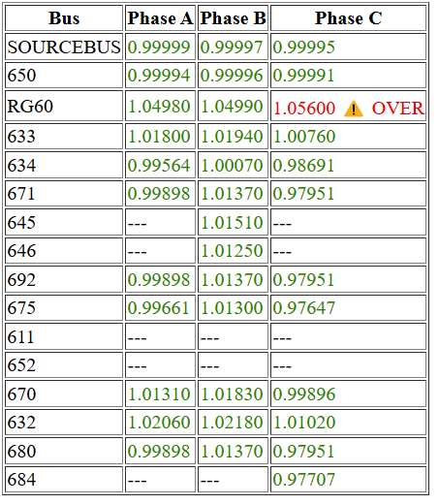
HTML Result File Per Iteration
Resulting output file after addition of 5 chargers added
Majority of bus voltages are printed in green indicating they are within an acceptable range
System is not overloaded/it has not reached capacity yet
Swanson School of Engineering

Slide 8
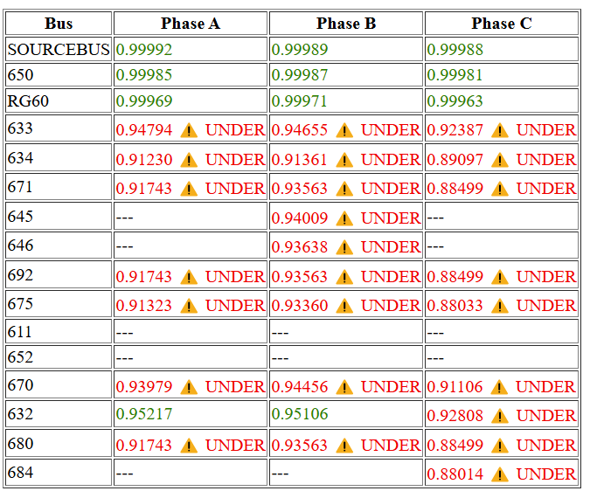
HTML Result File Per Iteration
Resulting output file after addition of 227 chargers added
Majority of bus voltages are under voltage violations indicating the system has reached its capacity and/or the system is overloaded
Swanson School of Engineering

Slide 9
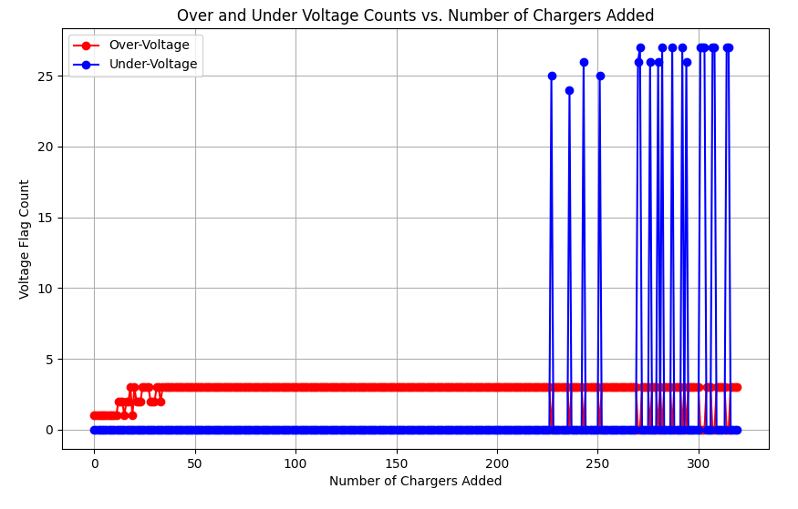
Results
Voltage deviations observed as charger count increases
Hosting capacity of IEEE 13 node system can be approximates to 227 EV’s
Beyond this point, voltage violations become more frequent
Swanson School of Engineering

Slide 10
Discussion/Mitigation
Multiple methods currently researched to mitigate the impacts of increased EV presence
Smart charging algorithms help shift charging demand to off-peak hours, easing stress on the grid.
Vehicle-to-grid (V2G) technologies to enable EVs to discharge energy back into the grid improving load balancing.
Upgraded infrastructure such as transformers, voltage regulators, and capacitor banks, improves the grid’s ability to handle increased demand.
IEEE P1729 provides guidance for hosting capacity analysis, supporting utilities in planning and managing distributed energy resources (DERs).
Swanson School of Engineering

Slide 11
References
A. Dubey and S. Santoso, "Electric Vehicle Charging on Residential Distribution Systems: Impacts and Mitigations," IEEE Access, vol. 3, pp. 1871–1893, 2015.
X. Yang et al., "V2G Potential Evaluation Method Considering Spatiotemporal Transfer Features of Electric Vehicles," Proc. 2022 IEEE ICPICS, Shenyang, China, pp. 306–311.
S. Sirisumrannukul et al., "Determining Hosting Capacity... Monte Carlo-Based Simulation," Proc. 2024 IEEE CPESE, Nara City, Japan, pp. 396–401.
P. Paudyal et al., "EV Hosting Capacity Analysis on Distribution Grids," 2021 IEEE PESGM.
W. H. Kersting and R. Kerestes, Distribution System Modeling and Analysis, 5th ed., CRC Press, 2022.
EEE Standards Association, "IEEE Draft Guide for Hosting Capacity Analyses for Distribution Systems," IEEE Std P1729/D1.4, 2023.
Swanson School of Engineering

Slide 12
Swanson School of Engineering

