Slide 1

WEBSITE DESIGN REVIEW
Picking ACE’s
public face
Five directions. Two to sit with. One decision — and the names that carry it.
Notes:
We’re not here to admire mockups forever. We’re here to pick a face and own what happens next.
Keep this short. The room knows the business. Say what the next stretch is: look at the work, choose, put names on it.

Slide 2
Pick a face. Leave with owners, not vibes
WHY WE’RE HERE
01
Choose the direction the website ships in
Five built. Two featured. All on the table.
02
Put one name on the build
One owner, not a committee.
03
Leave with Rocks and To-Dos
Written down before we stand up.
Notes:
Three outcomes. If we leave with a direction but no owner, we didn’t finish the meeting.
The site is the first thing a new fleet manager or farm buyer sees before they ever call Pleasanton. That’s why it’s worth a real decision, not a vibe check.

Slide 3
One name on every Rock
THE LENS FOR TODAY · EOS
Hold that while we look at the designs. Liking one is easy. Owning it to launch is the job.
Notes:
EOS is blunt on purpose: one name on the Rock. That’s how websites actually ship.
Plant the lens now. We’ll come back to it after the designs, when it’s time to assign.

Slide 4
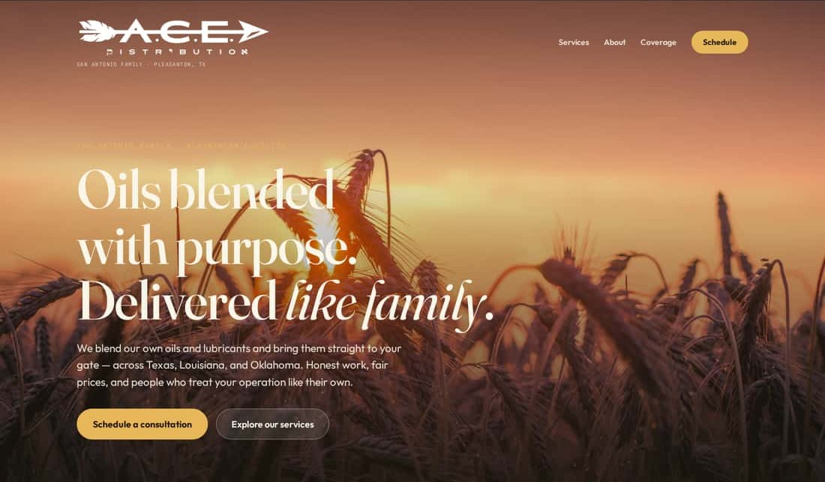
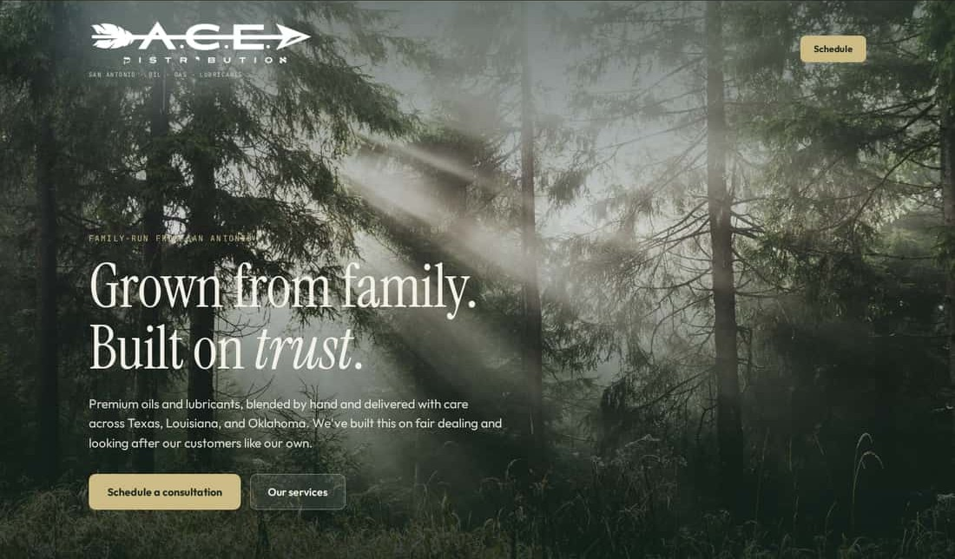
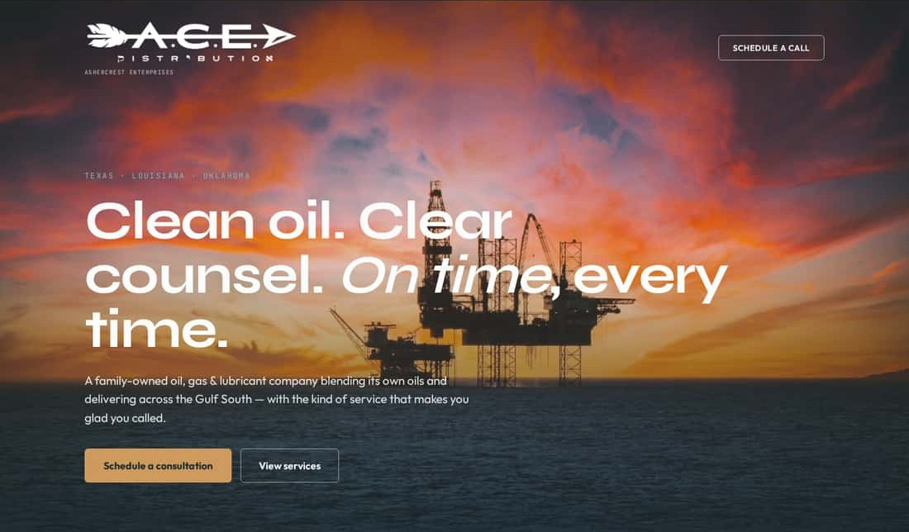
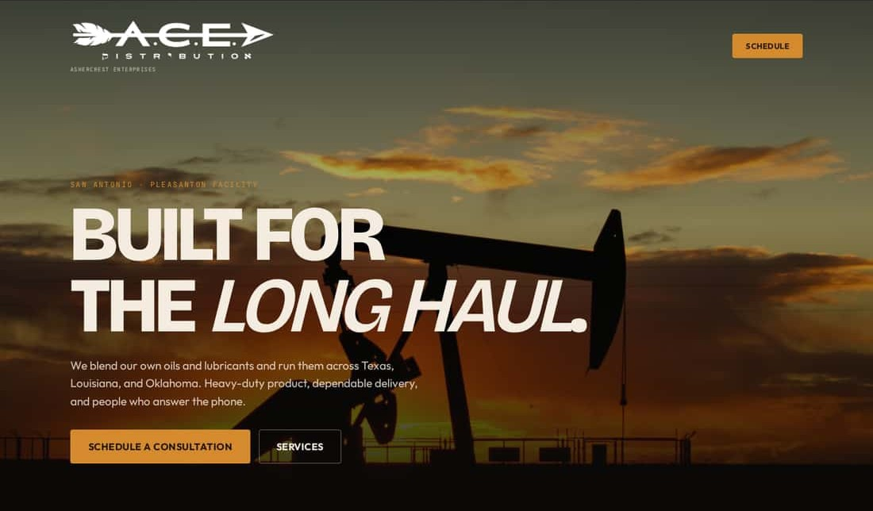
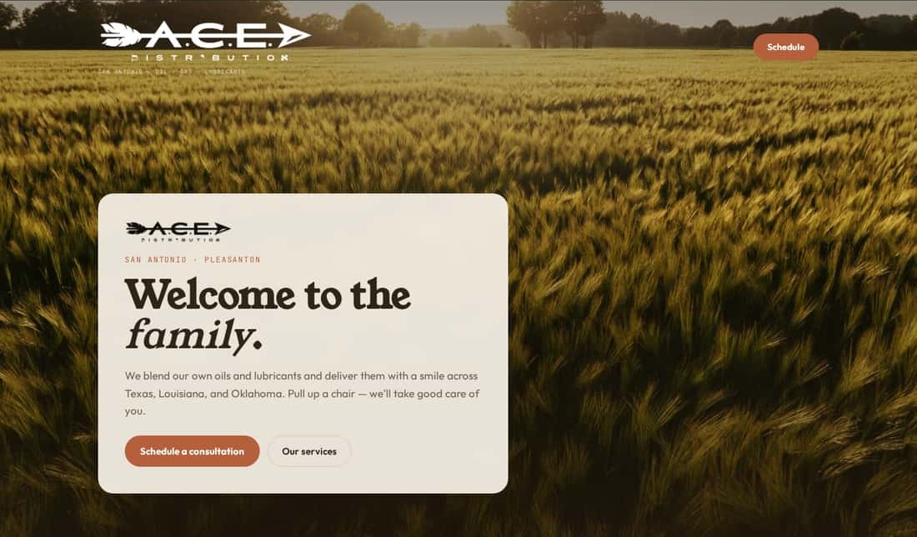
Five directions. Two to sit with
THE WORK
01 · FEATURED
02
03
04 · FEATURED
05
Big Sky
Piney Woods
Open Water
Heartland Steel
Hill Country
Warm, editorial, timeless.
Rooted, calm, organic.
Crisp, corporate, confident.
Bold, cinematic, industrial.
Warm, friendly, welcoming.
Notes:
Five directions were built end to end — homepage, services, booking flow — not just mood boards.
The two highlighted are the ones I want us to sit with. The other three are real alternates; we’ll see them side by side after.
Try this with each one: cover the logo for two seconds. Does it still feel like ACE?

Slide 5
01
Big Sky
Warm, editorial, timeless.
FEATURED A
OPEN LIVE ↗
Notes:
Name the feeling in one sentence: a family company that has been doing this right for a long time.
Point out how the gold in the site is the gold in our mark — nothing fights the logo.
Ask the room: cover the logo for two seconds. Still ACE?

Slide 6
FEATURED A · 01
Big Sky
“A family company that’s been doing this right for a long time.”
The gold is ours. Its palette is the ACE mark — the logo looks native, not placed.
Editorial serif = credibility. Reads established without reading corporate.
“Delivered like family” says the family-company promise without a history lesson.
Watch: Can read soft or lifestyle to hard-nosed fleet buyers.
OPEN THE LIVE SITE ↗
GOLD · PRAIRIE HERITAGE
Notes:
Three reasons it works for ACE, one honest risk.
The gold is ours. Its palette is the ACE mark — the logo looks native, not placed.
Editorial serif = credibility. Reads established without reading corporate.
“Delivered like family” says the family-company promise without a history lesson.
Watch: Can read soft or lifestyle to hard-nosed fleet buyers.

Slide 7
04
Heartland Steel
Bold, cinematic, industrial.
FEATURED B
OPEN LIVE ↗
Notes:
Heavy-duty product and people who answer the phone. Built for the long haul.
This is the same promise as Big Sky at a different volume.
Fair risk: it is loud, and the orange would move toward our gold in the build.

Slide 8
FEATURED B · 04
Heartland Steel
“Heavy-duty product and people who answer the phone.”
Built for the buyer who runs trucks. Speaks ops, not lifestyle.
Dark stage lets the mark pop. The gold logo has never looked stronger.
Most distinct in the market. Nobody in our space looks like this.
Watch: Loudest option. The orange accent needs tuning toward our gold.
OPEN THE LIVE SITE ↗
ORANGE ON DARK · OPS DRAMA
Notes:
Three reasons it works for ACE, one honest risk.
Built for the buyer who runs trucks. Speaks ops, not lifestyle.
Dark stage lets the mark pop. The gold logo has never looked stronger.
Most distinct in the market. Nobody in our space looks like this.
Watch: Loudest option. The orange accent needs tuning toward our gold.

Slide 9
The other three
ALSO ON THE TABLE
02 · FOREST GREEN · HANDSHAKE TRUST
03 · TEAL / SAND · B2B POLISH
05 · TERRACOTTA · TEXAS HOSPITALITY
Piney Woods
Open Water
Hill Country
Rooted, calm, organic. The handshake you can trust.
Crisp, corporate, confident. A supplier that runs like a serious business.
Warm, friendly, welcoming. Pull up a chair — we’ll take care of you.
Notes:
These are not throwaways. Each one is a complete direction and any of them could ship.
If someone in the room is pulling for one of these, now is the time to say so — we can swap it into the final two.

Slide 10
Feeling, audience, watch-outs
ALL FIVE, SIDE BY SIDE
DIRECTION | FEELING | SPEAKS TO | WATCH OUT FOR
Big Sky ★ | Warm, editorial, timeless. | Farm, ranch, and long-time accounts | Can read soft or lifestyle to hard-nosed fleet buyers.
Piney Woods | Rooted, calm, organic. | Relationship buyers who value calm and trust | Green pulls away from the gold mark; forest isn’t oilfield TX-LA-OK.
Open Water | Crisp, corporate, confident. | Procurement and larger B2B accounts | Offshore rig reads as drilling, not distribution. Coolest temperature.
Heartland Steel ★ | Bold, cinematic, industrial. | Fleet, oilfield, and operations buyers | Loudest option. The orange accent needs tuning toward our gold.
Hill Country | Warm, friendly, welcoming. | Smaller and first-time accounts | Most consumer-feeling; terracotta competes with the gold mark.
★ featured pair
Notes:
One line each so we’re comparing the same things: feeling, who it speaks to, what it costs us.
The watch-out column is where the real conversation is.

Slide 11
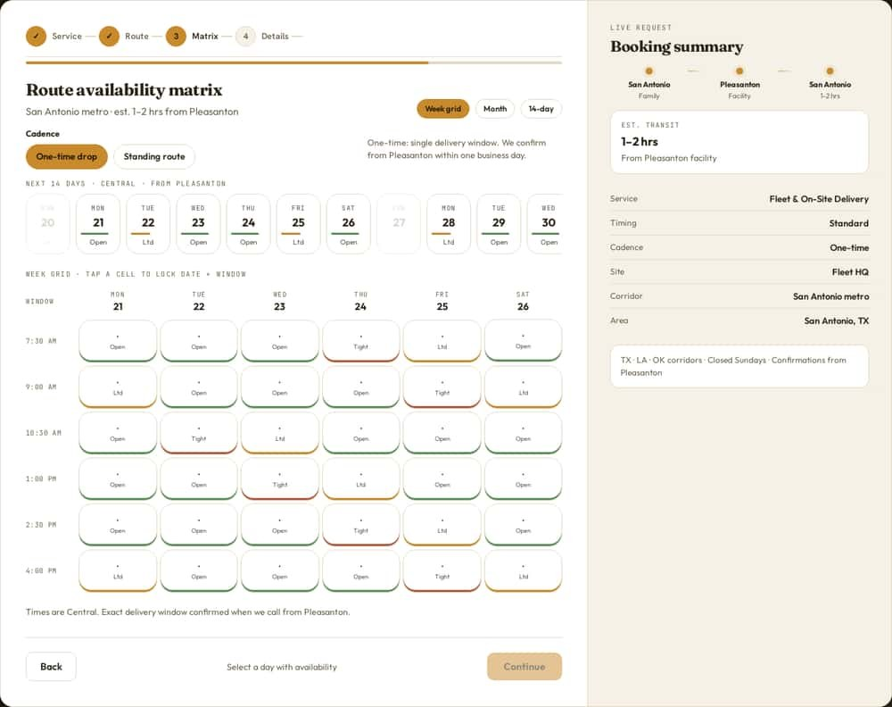
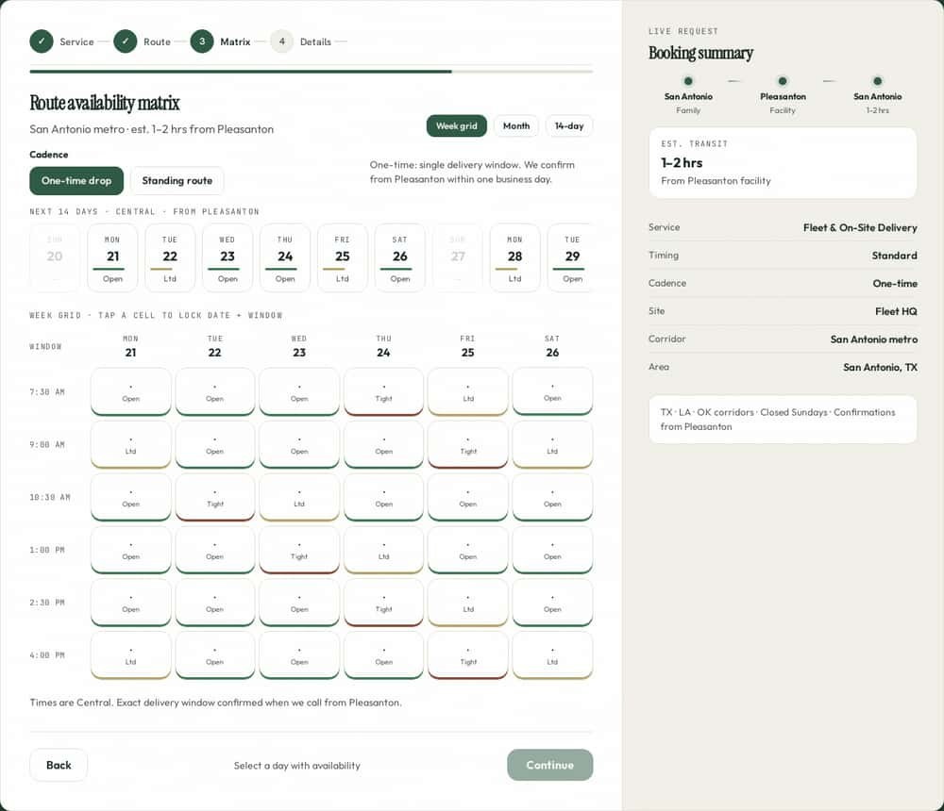
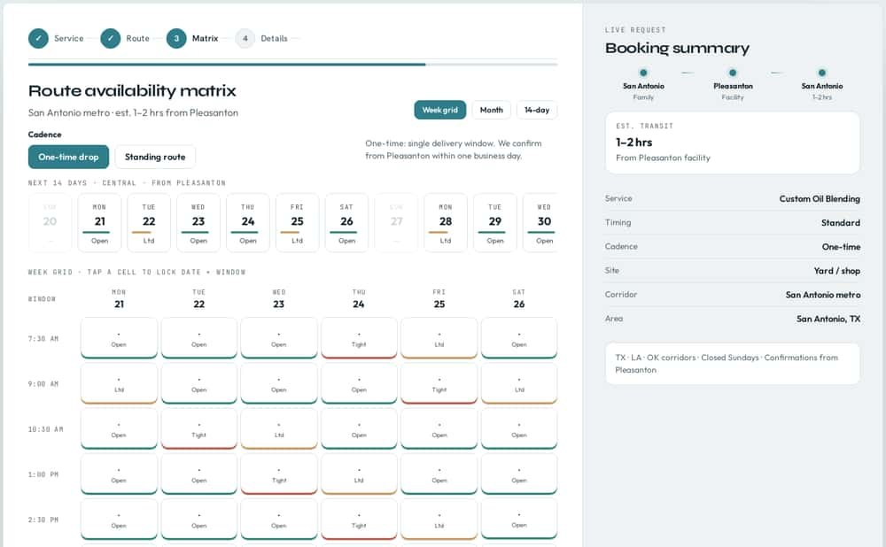
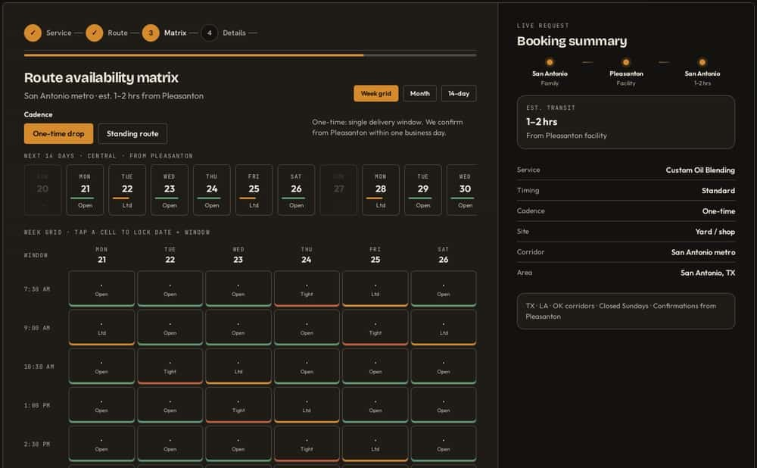
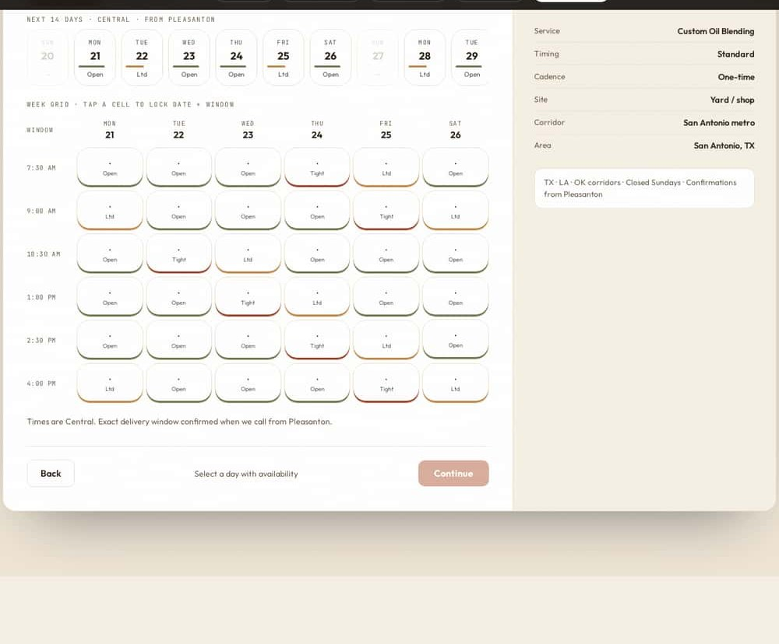
Booking is built in — and it wears whichever face we pick
HOW THE SITE CONVERTS
01 · BIG SKY
02 · PINEY WOODS
03 · OPEN WATER
04 · HEARTLAND STEEL
05 · HILL COUNTRY
Notes:
One slide on this — it’s supporting, not the story.
Whichever face we pick, the booking matrix already wears it. The site doesn’t just look good; it turns a visit into a scheduled delivery window.

Slide 12
Accountability
EOS · TRACTION
EOS
Picking a design isn’t the finish line. It’s the first thing someone has to own.
Notes:
Shift gears. The designs are the easy part. This is the part that decides whether the site exists in ninety days.

Slide 13
If everyone owns it, no one owns it
ONE SEAT · ONE NAME
Everyone
The team
Someone
→
One name
ACCOUNTABILITY CHART
NOT BLAME
Names who owns each outcome — not who reports to whom. The website gets a seat, and the seat gets one name.
Clarity + ownership + follow-through. Clarity kills drift. Nobody wonders who’s driving.
Notes:
In EOS every seat has one person accountable. Not two. Not “the team.”
The Accountability Chart isn’t the org chart. It’s who owns which outcome. The website needs a seat and a name in it.
Accountability isn’t blame. It’s clarity — so nobody has to guess who’s driving.

Slide 14
What you say, you do
COMMITMENTS
Rocks
To-Dos
90 DAYS · FEW · IMPORTANT
7 DAYS · SHORT · SPECIFIC
The handful of things that must be true by the end of the quarter.
You take a Rock → you drive it to done.
This week’s promises to the team.
Done — or flag it early. Never quietly late.
Notes:
Rocks are the few things that matter this quarter. You take one, you drive it to done.
To-Dos are the weekly promises. You do them — or you raise the flag early, not at the deadline.
Both are commitments to yourself and to the team. Same standard.

Slide 15
Finish what you gave yourself
DRIVE
Ambition without ownership is noise. Credit goes to the finish — not the intention.
Notes:
This is the personal one. You are accountable for the things you give yourself.
Ambition without ownership is noise. Everyone in this room has had a “we should redo the website” moment. You don’t get credit for the intention to rebuild the site. You get credit for the finish.

Slide 16
The website, as Rocks
THIS QUARTER · PROPOSED ROCKS
ROCK | OWNER
Launch the homepage in the chosen direction Live on the domain, mobile-checked, real photos.
Booking flow taking real requests Matrix live, requests landing with whoever confirms windows.
Content & photos ready to publish Services, coverage, contact — written and approved.
Type owner names into the Owner column during the meeting.
Notes:
What it means for ACE this quarter. These are proposed — adjust them in the room.
Type owner names straight into the Owner column.

Slide 17
Which face ships?
DECISION
01
02
03
04
05
Big Sky
Piney Woods
Open Water
Heartland Steel
Hill Country
Warm, editorial, timeless.
Rooted, calm, organic.
Crisp, corporate, confident.
Bold, cinematic, industrial.
Warm, friendly, welcoming.
TO-DO · THIS WEEK | OWNER | DUE
Confirm the direction (or final two + who decides)
Kick off the build with the chosen design
Gather photos & copy owners need
Notes:
Ask it plainly: which face ships? If the room can’t land on one, land on two and name who decides by when.
Fill the To-Do owners and dates before anyone stands up.

Slide 18
Own it.
Finish it.
We picked a face. Now we put the names on it and drive it to done.
Notes:
Close on the commitment, not the design. Read the names back.

Slide 19
The alternates, full size
APPENDIX
Swap any of these into the final two if the room is pulling for it.
Notes:
Backup slides: a full view of each alternate, in case the room wants to swap one into the final two.

Slide 20
02
Piney Woods
Rooted, calm, organic.
ALTERNATE
OPEN LIVE ↗
Notes:
The handshake you can trust. Calm, rooted.
Honest risk: the green pulls away from our gold, and the forest feels East Texas more than our corridors.

Slide 21
03
Open Water
Crisp, corporate, confident.
ALTERNATE
OPEN LIVE ↗
Notes:
A supplier that runs like a serious business. Built for procurement.
Risk: the offshore rig says drilling, not distribution. Imagery would need to change.

Slide 22
05
Hill Country
Warm, friendly, welcoming.
ALTERNATE
OPEN LIVE ↗
Notes:
Pull up a chair — Texas hospitality.
Risk: it is the most consumer-feeling of the five, and terracotta competes with our gold.

