Slide 1





Wave Energy Converters Dataset
Data Analyst and predictions models
Notes:
In this presentation, I’ll talk about how we can use machine learning to improve wave energy converters, or WECs

Slide 2
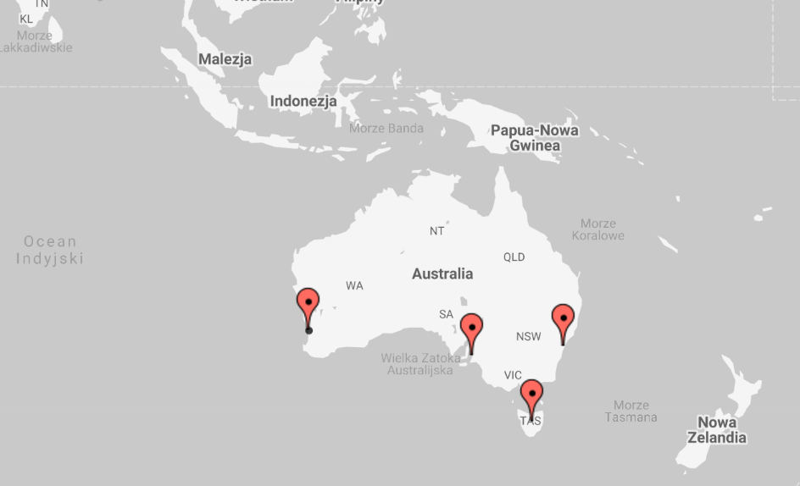
Dataset Overwiew
This data set consists of positions and absorbed power outputs of wave energy converters (WECs) in four real wave scenarios from the southern coast of Australia
Perch
Sydney
Adelaide
Tasmania
Notes:
This data set consists of positions and absorbed power outputs of wave energy converters (WECs) in four real wave scenarios from the southern coast of Australia

Slide 3
About data set
The dataset contains data from 4 cities
In every city we have 16 energy converters
Our X and Y converter position coordinates take values ​​from 0-566

Slide 4
Project Purpose
Notes:
The goal of this project was to study data collected from WECs, which generate renewable energy from ocean waves, and use advanced predictive models to optimize their placement for maximum energy output. This presentation integrates both technical insights and potential real-world applications.

Slide 5
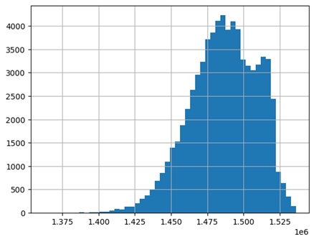
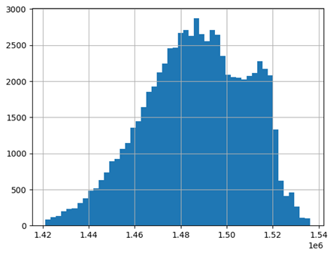
Data cleaning process
Removing Nulls
Removing outliers
Data from Sydney: Before removing outliers vs After removing outliers
Notes:
Removing null values ​​(missing data):
Preventing computational errors: Most machine learning algorithms cannot handle missing values, which can lead to errors during model training.
. Outliers can significantly distort the results of models sensitive to extreme values, such as linear regression. Removing them can improve the overall performance of the model.

Slide 6
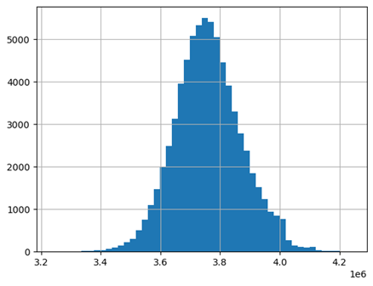
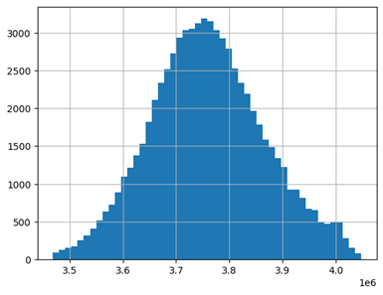
Data from Tasmania: Before removing outliers vs After removing outliers

Slide 7
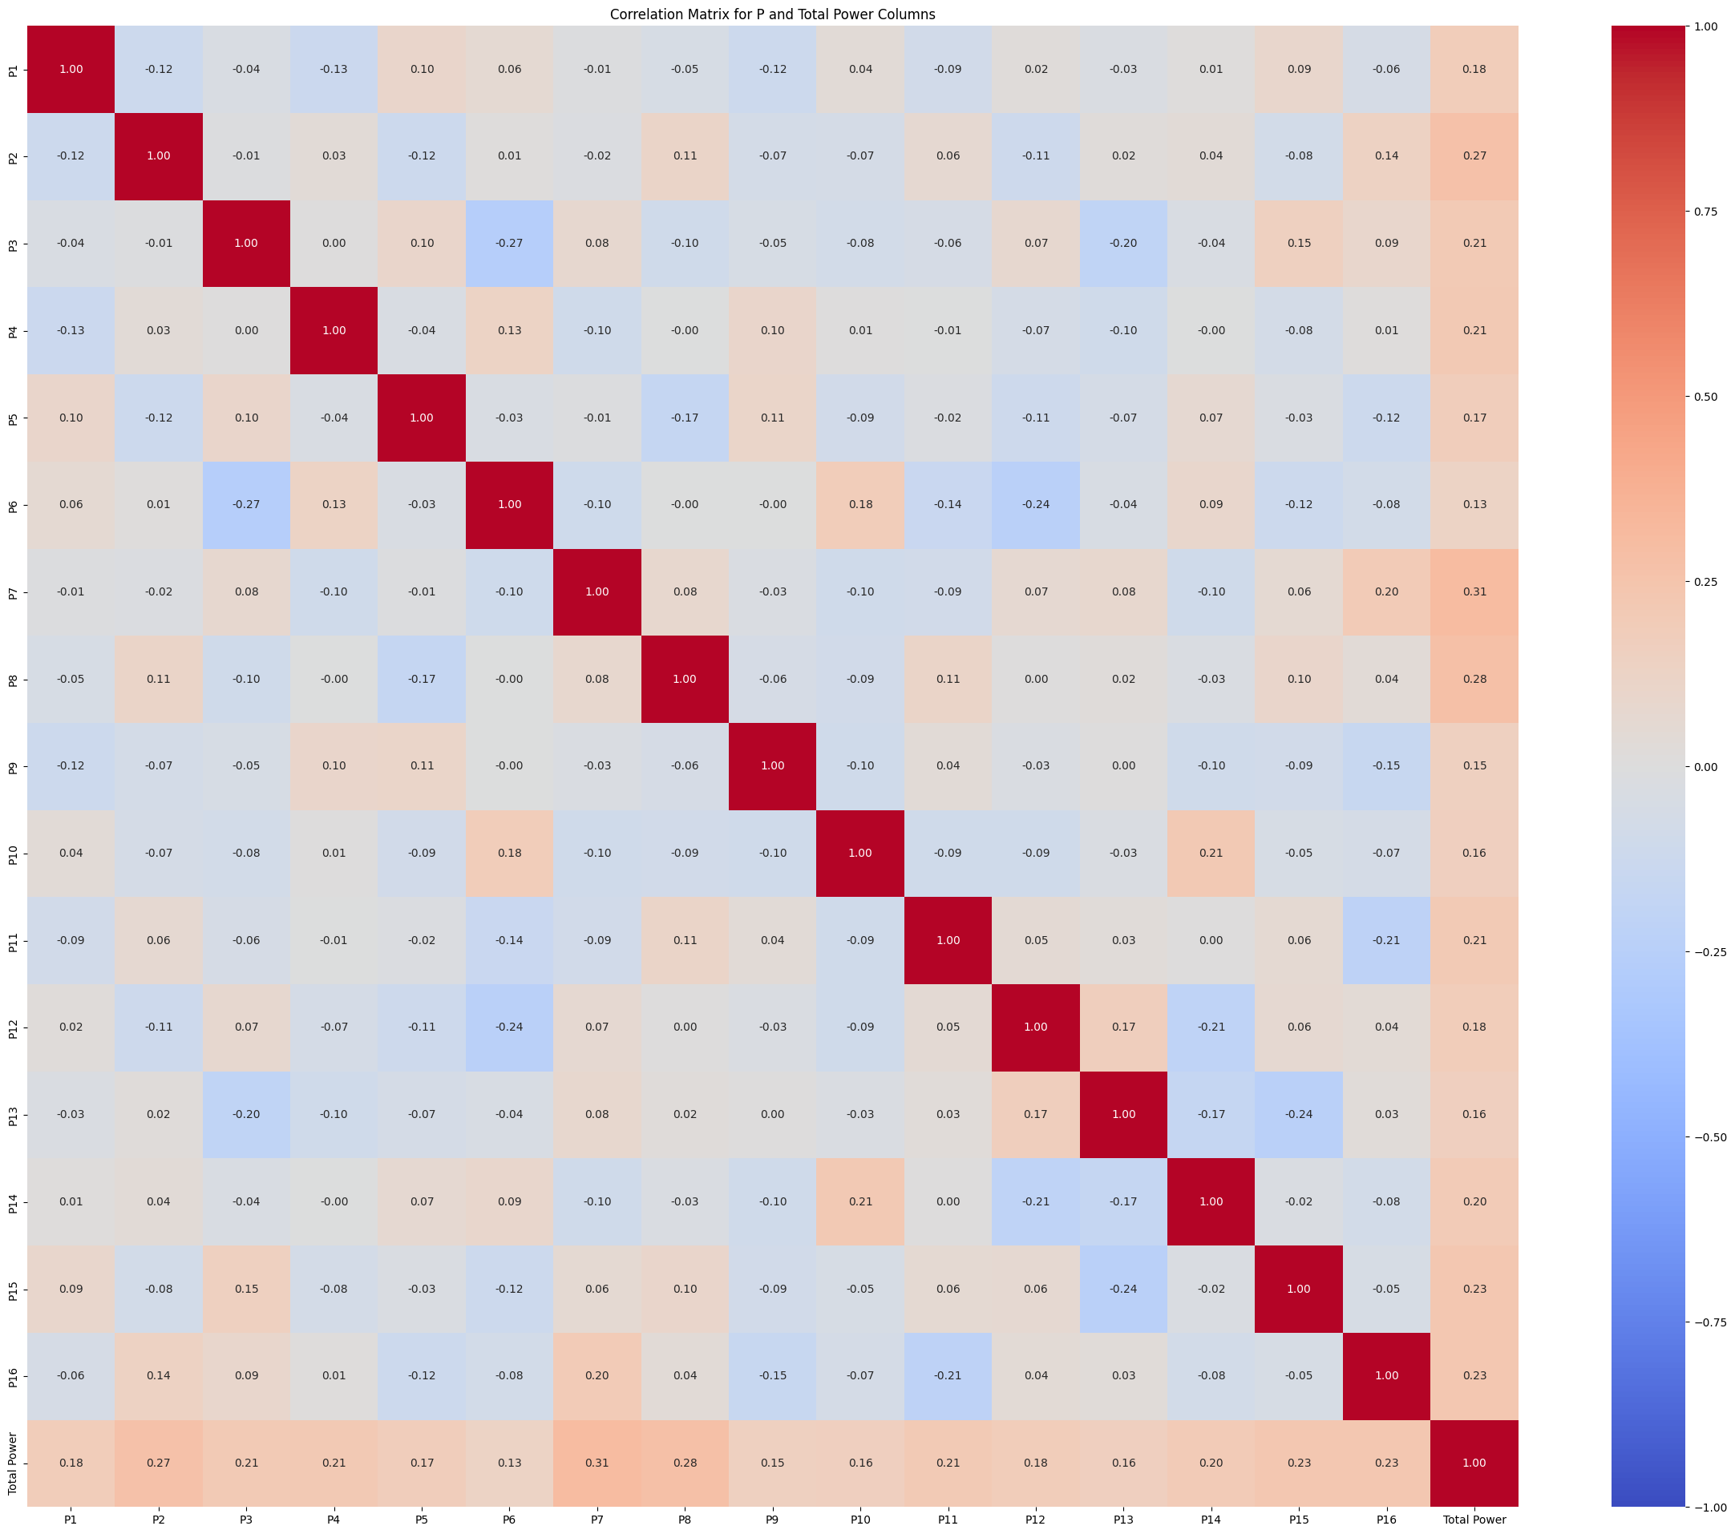
Correlation analysis
Correlation Matrix for Power 1 – Power 16 and Power total can show us how strongly the features (P1-P16) are connected to the target variable (Power total)
This proves that P1-Pn is the output data and since we are predicting P_total it is necessary to remove P1-Pn. In a module the output data cannot be treated as features
Correlation Matrix for Sydney
Notes:
This is equivalent to strong linear dependencies between P1-Pn and P_total

Slide 8
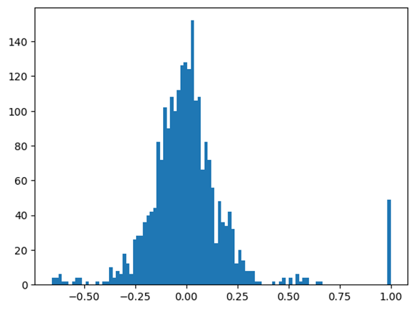
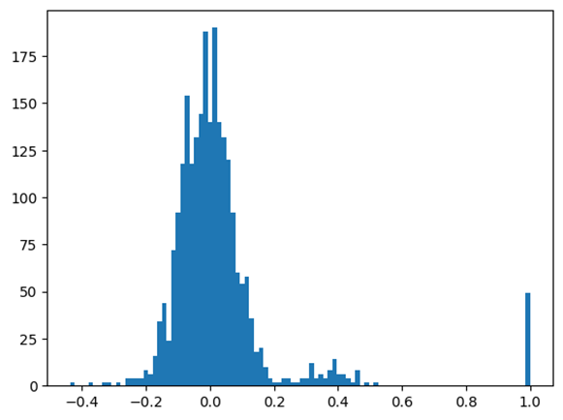
Correlation histograms
Correlation histogram showing which correlation is a lot for which data set
Sydney Adelaide
Notes:
we can therefore see that for Sydney the strong correlation starts at 0.25 and for Adelide already at 0.20. For Tasmania and Phern it works practically identically as for Adelide
values of 1.0 are not significant because they show the values of the diagonals

Slide 9
Model construction
We divided the data into training, validation, and test sets (e.g. 70/15/15).
We selected several models to evaluate their performance on this dataset including : Linear Regression, Random Forest, XGBoost, and Gradient Boosting
For each model, the appropriate hiperparameters were adjusted based on the MSE
Notes:
This outcome emphasizes the importance of matching the model to the type and complexity of the data. While simpler models work well for linear relationships, more advanced algorithms can capture intricate patterns and dependencies within the data.

Slide 10
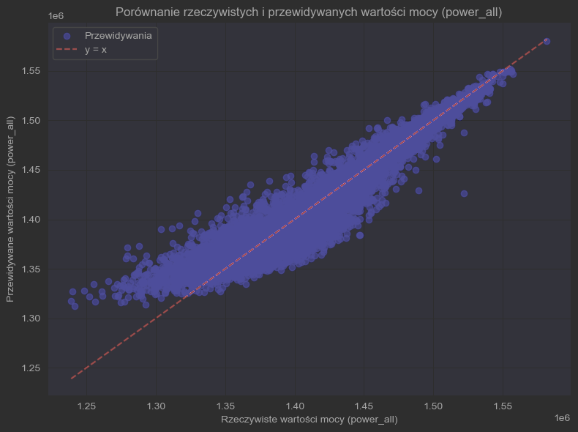
Comparison of expected and actual power all values in Adelide

Slide 11
Validation Results
We used RMSE as a metric to compare models and coefficient of determinations
The results highlighted variations in how well each model handled the data.
Scores from Perth: .
Linear Regression - Best RMSE on validation set: 47745.2761
Gradient Boosting - Best RMSE on validation set: 20125.2351
Random Forest – RMSE 24776.4345
kNN - Best RMSE on validation set: 23726.3113
XGBoost - Best RMSE on validation set: 20218.1594
Best Model: GradientBoostingRegressor
RMSE on test set: 200`53.6101
R² 0.8489107490603724
Scores from Adelaide:
LinearRegression - Best RMSE on validation set: 50408.5017
GradientBoosting - Best RMSE on validation set: 19710.0581
kNN - Best RMSE on validation set: 24033.2817
XGBoost - Best RMSE on validation set: 19400.5251
Best Model: XGBRegressor
RMSE on test set: 19538.3502
R²: 0.8760941824500015
Notes:
(coefficient of determination) measures how much of the variance in the dependent variable (y) is explained by the independent variables (X) in the model , 0.8: Means that the model explains 80% of the variance in the data, suggesting that the model has a good fit, although it may require further optimization.

Slide 12
Results of best models for each region
Notes:
the highest rmse in Tasmania is due to the fact that it had greater total power, which resulted in greater errors

Slide 13
Conclusion
Samples which includes nulls data should be removed
The outliners of targets should be always removed if we have enought data
It's crucial to recognaize the type of data and don't tread targets like a features
Important to choose good models for our datas
The most complex model is worthless without the appropriate parameters
Notes:
Better generalization: Removing outliers allows the model to focus on patterns that are representative of the majority of the data, which translates into better predictions on new data
Linear regression, as expected, performed the worst. Its R^2 value is around 13%, which means it explains only a small part of the variance in the data. This is a clear indication that the problem involves non-linear relationships, which linear regression cannot effectively capture.

