Slide 1
Algorithmic Stock Market Prediction
By Mark Mercado, Thuan Ho, Shlok Gharia, Siddharth Patel
Su Jin Cho, Justin Chang, and Fiona Cheung

Slide 2

The Problem
We want to predict which companies’ stock will outperform the S&P500 within a given year

Slide 3
Why use AI?
The amount of data that is usually created by stock markets is overwhelming
To make sense of all these numbers, we can use machine learning to simplify these statistics into a more consumable piece of data
Machine Learning also enables us to come up with predictions at a blistering speed, meaning we can use this tool in actual practice for predicting successful business ventures

Slide 4
References
Based on a paper by the University of Manchester, UK (see reference), and also based on data available from Kaggle by user Dominik Gawlik (see reference) we selected the following features to predict whether or not a company outperformed the S&P500 that year
(We are not Financial Experts, so many of these features were chosen based on preference by the University of Manchester, UK)

Slide 5
Data & Methodology
Training Set:
Stock data from 2013-2015
Treat each company's fiscal year as separate entry
(Example: 2013 AAPL is one entry, 2015 AAPL is another)
After removing incomplete data entries, we have 1017 entries
Classifiers used:
Linear classifier
PCA Histogram classifier
PCA Bayesian classifier
Checked classifier accuracy by reclassifying training set
Testing Set:
Stock data from 2016
108 complete entries
Used 2013-2015 data to attempt to predict outperform/underperform based on 2016 company financial statistics

Slide 6
Features
(We are not Financial Experts, so many of these features were chosen based on preference by a paper from the University of Manchester, UK)
Revenue Growth: Average Price to Earning Ration over a 5-year period
Market Capitalization: # of shares times the share price
Current Ratio: Current Assets/Current Liability
Book Value: Total Assets – (Intangible Assets and Liabilities)
Price to Book Ratio: Stock Price/(Book Value per Share)
Quick Ratio: (Current Assets – Inventories)/Current Liabilities
Total Debt to Equity: Total Liabilities/Shareholders Equity
Earnings per share: Net Income – ((Dividends on Preferred Stocks)/# of shares outstanding)
Price to earnings Ratio: Stock Price/Earnings per share
Operating Margin: Operating Income/Net Sales
Net Income: Individual Income – (Taxes and Deductibles)

Slide 7
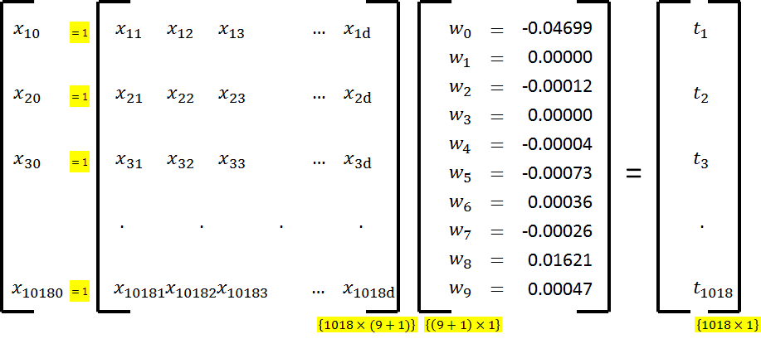
Linear Classifier – Mean-square error minimizer
2013-2015 data

Slide 8
Linear Classifier – Mean-square error minimizer
Reclassifying 2013-2015 data
 | Result Class Label
 | Outperform | Underperform
Outperform | 408 | 119
Underperform | 300 | 190
Accuracy | 59%
Sensitivity | 77%
Specificity | 39%
PPV | 58%
Ground Truth

Slide 9
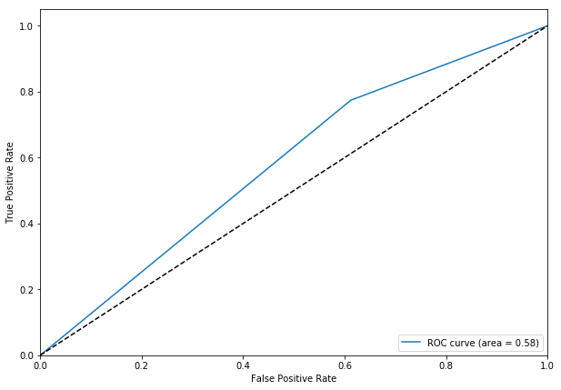
Linear Classifier – Receiver Operating Curve (ROC)
2013-2015 data
Area under the curve of 0.58 suggest the linear classifier is barely better than random

Slide 10
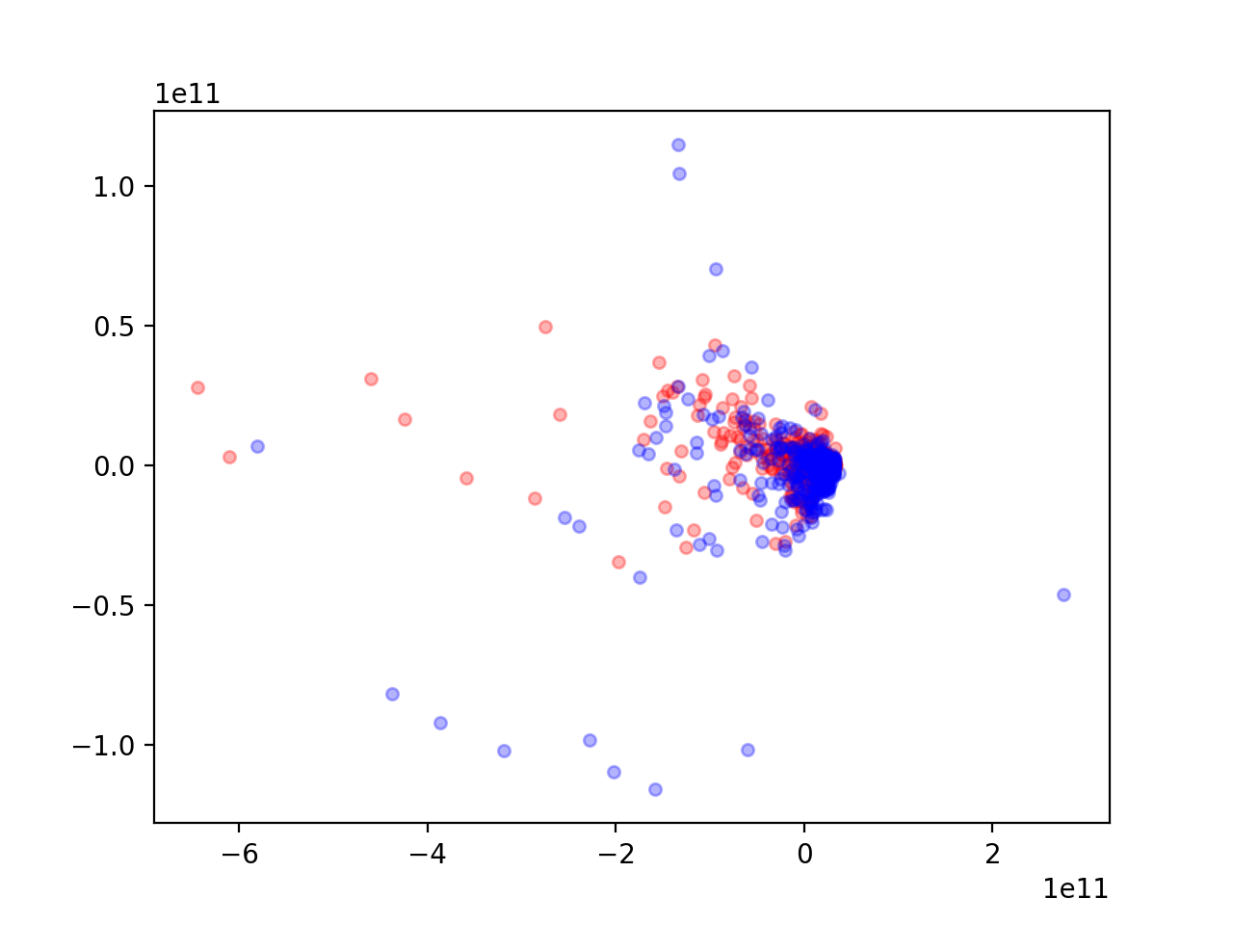
PCA Scatterplot
Training set: Stock data from 2013-15
Testing set: Evaluated if classifier could properly re-classify each stock in the training set
Visually, feature space is not well separated.

Slide 11
PCA Histogram Classifier
Reclassifying 2013-2015 data
 | Result Class Label
 | Outperform | Underperform
Outperform | 446 | 467
Underperform | 0 | 104
Accuracy | 54%
Sensitivity | 48%
Specificity | 100%
PPV | 100%
Ground Truth

Slide 12
PCA Bayesian Classifier
Reclassifying 2013-2015 data
 | Result Class Label
 | Outperform | Underperform
Outperform | 466 | 61
Underperform | 364 | 126
Accuracy | 58%
Sensitivity | 88%
Specificity | 26%
PPV | 56%
Ground Truth

Slide 13
Classifier Metrics (Reclassifying 2013-15 Data)
 | Accuracy | Specificity | Sensitivity | PPV
Linear Classifier | 59% | 77% | 39% | 58%
PCA Histogram (*10 unclassified) | 54% | 48% | 100% | 100%
PCA Bayesian | 58% | 88% | 26% | 56%

Slide 14
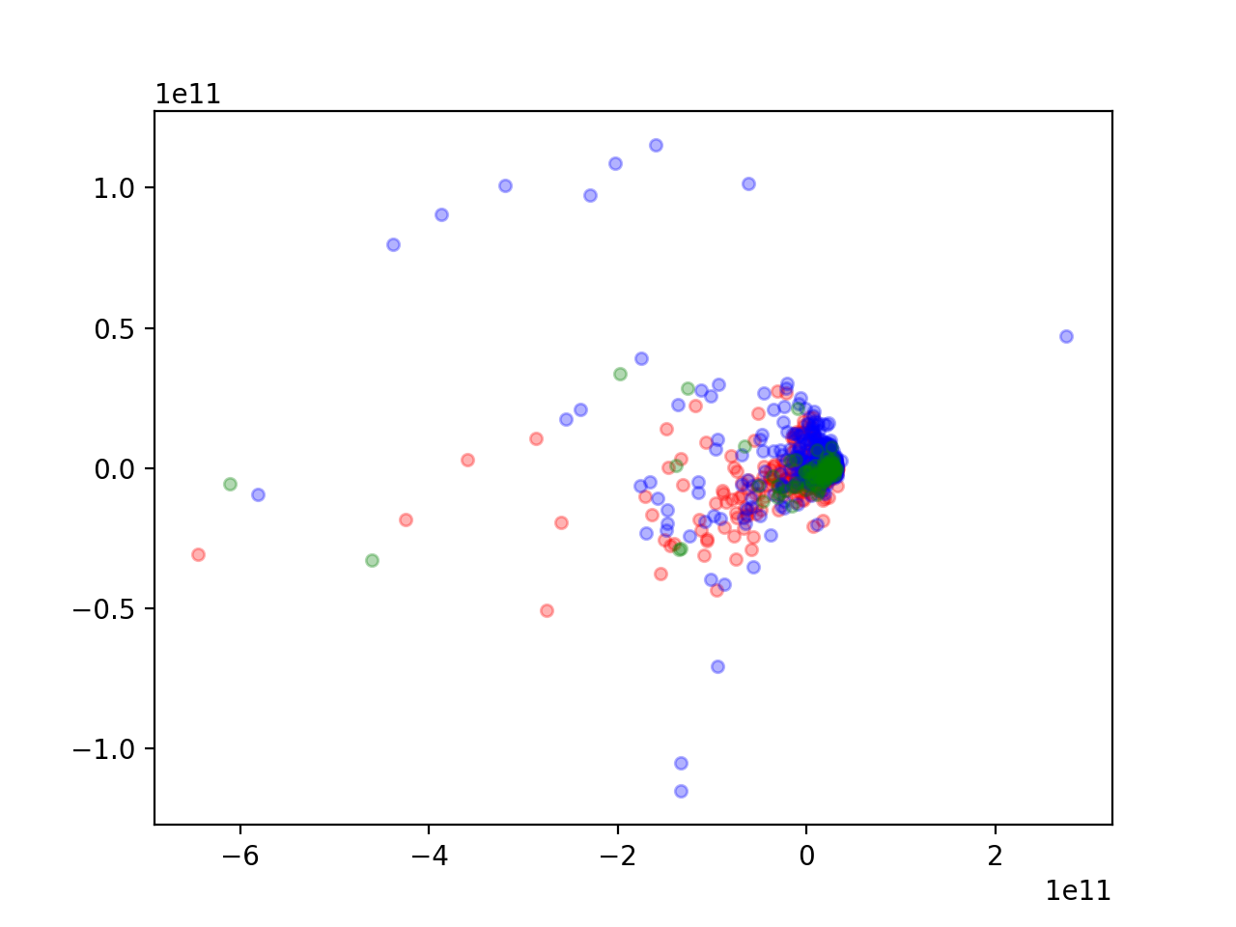
Predicting the future?
Testing set: Stock data from 2016 from 108 companies (shown in green)
Can we use data from past years to find patterns that predict if a stock will outperform?

Slide 15
Linear Classifier
Applying classifier to 2016 data
 | Result Class Label
 | Outperform | Underperform
Outperform | 37 | 12
Underperform | 49 | 10
Accuracy | 44%
Sensitivity | 76%
Specificity | 17%
PPV | 43%
Ground Truth

Slide 16
PCA Histogram Classifier
Applying classifier to 2016 data
 | Result Class Label
 | Outperform | Underperform
Outperform | 25 | 20
Underperform | 31 | 22
Accuracy | 48%
Sensitivity | 56%
Specificity | 42%
PPV | 47%
Ground Truth
* 10 companies could not be classified – no data for those bins

Slide 17
PCA Bayesian Classifier
Applying classifier to 2016 data
 | Result Class Label
 | Outperform | Underperform
Outperform | 1 | 48
Underperform | 0 | 59
Accuracy | 55%
Sensitivity | 2%
Specificity | 100%
PPV | 43%
Ground Truth

Slide 18
Classifier Metrics (Classifying 2016 Data)
 | Accuracy | Specificity | Sensitivity | PPV
Linear Classifier | 44% | 76% | 17% | 43%
PCA Histogram (*10 unclassified) | 48% | 56% | 42% | 47%
PCA Bayesian | 55% | 2% | 100% | 43%

Slide 19
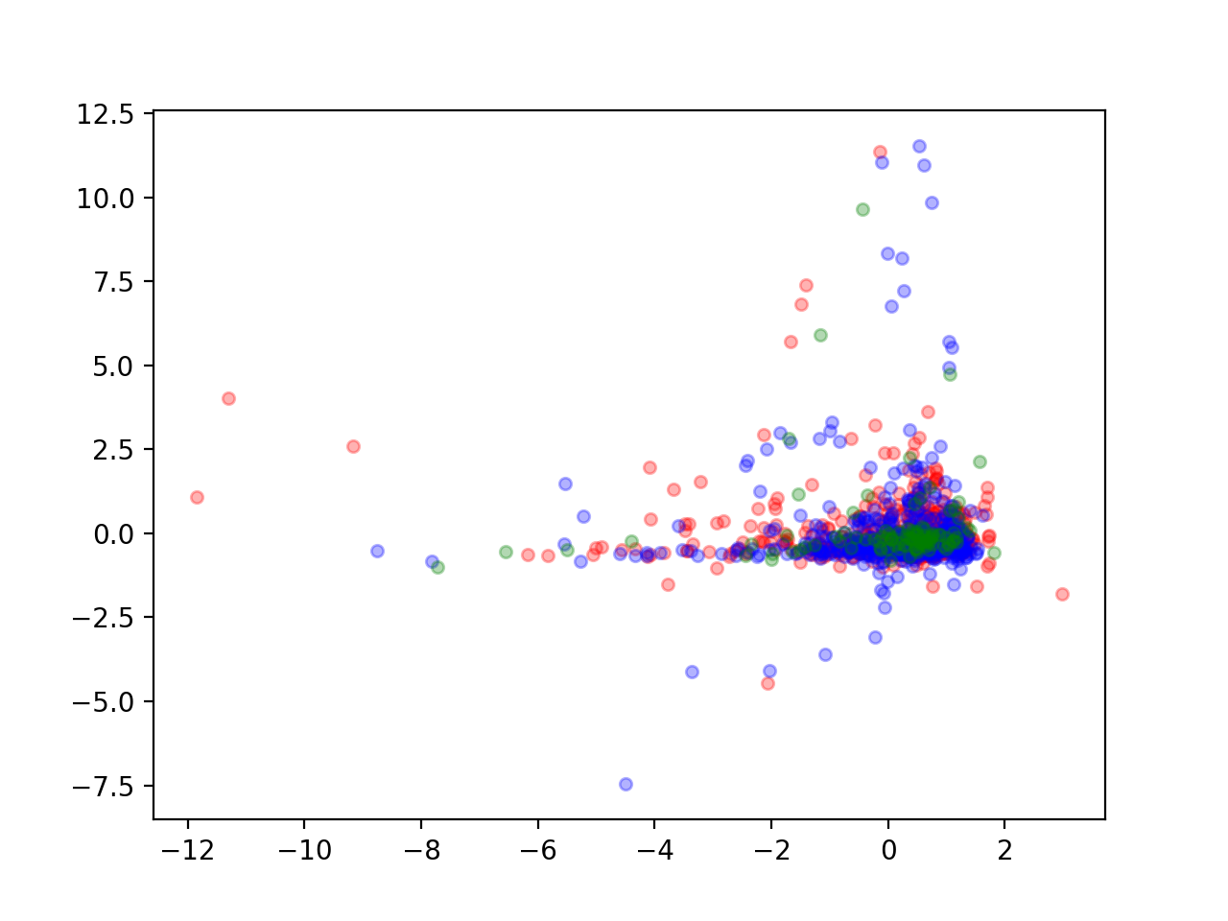
Normalized Data
A few of our features were much bigger numbers than the other features (representing billion $s)
Large numbers = large variation
Affecting eigenvectors
Normalized data by dividing by standard deviation before reducing dimensions

Slide 20
Normalized PCA Histogram Classifier
Applying classifier to 2016 data
 | Result Class Label
 | Outperform | Underperform
Outperform | 17 | 29
Underperform | 27 | 27
Accuracy | 44%
Sensitivity | 37%
Specificity | 50%
PPV | 37%
Ground Truth
* 8 companies could not be classified – no data for those bins

Slide 21
Normalized PCA Bayesian Classifier
Applying classifier to 2016 data
 | Result Class Label
 | Outperform | Underperform
Outperform | 3 | 46
Underperform | 1 | 58
Accuracy | 56%
Sensitivity | 6%
Specificity | 98%
PPV | 75%
Ground Truth

