Slide 1
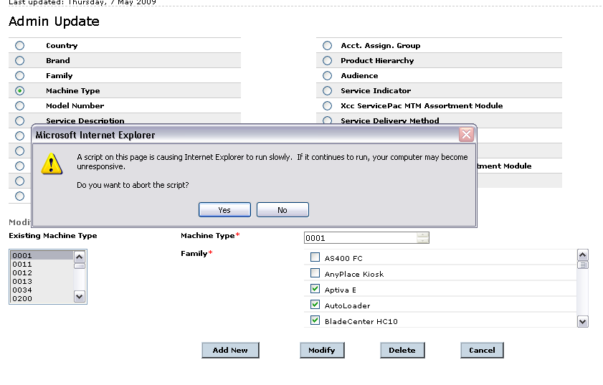
What ever value I selected here corresponding values should populate on Right side, that time I am getting this alert.
Right side means these 2 arrows

Slide 2
Code:
function machineTypeDetails()
{
var mTypeName=$("select[@name='mtypeNames'] option:selected").text();
var mTypeId=$("select[@name='mtypeNames'] option:selected").val();
var chkBoxesLength = $("input[@name='mtypefamilychkbox']").length;
$("input[@name='mtypeId']").val(mTypeId);
$("input[@name='mtypeName']").val(mTypeName);
var family = machineFamilyIds[mTypeName].split(',');
for(var i=0; i<chkBoxesLength; i++)
{
for(var j=0; j<family.length; j++){
if( $("input[@name='mtypefamilychkbox']:nth("+i+")").val() ==family[j])
{
$("input[@name='mtypefamilychkbox']:nth("+i+")").attr("checked",true);
break;
}else if($("input[@name='mtypefamilychkbox']:nth("+i+")").attr("checked")==true ){
$("input[@name='mtypefamilychkbox']:nth("+i+")").attr("checked",false);
}
}
}
}

