Slide 1
Building an Artifact-Grounded
Auto-Research Agent
A meta deck on the research pipeline behind the Lie-group integrator work
Jingquan Wang
Simulation-Based Engineering Laboratory
University of Wisconsin - Madison
06/09/2026

Slide 2
The problem is not just coding
Long-horizon research fails when the agent loses
state, evidence, and claim boundaries.
The hard part is remembering what was proved, what merely ran, and what must not be claimed.
The agent must carry months of negative results without turning them into noise.
It must know when a cheap validator is enough and when a full campaign needs human opt-in.
06/09/2026
University of Wisconsin - Madison
2

Slide 3
Why naive research agents drift
Common failure mode
What we need instead
Runs one experiment and overstates the result.
Forgets old counterexamples.
Treats a plot, validator pass, or paper draft as proof.
Reruns expensive scripts to answer read-only questions.
Versioned memory.
Executable claim gates.
Negative evidence ledgers.
Strict command boundaries.
06/09/2026
University of Wisconsin - Madison
3

Slide 4
Central thesis
An auto-research agent becomes useful when
research state is an artifact graph
and claims are executable contracts.
The agent does not rely on chat memory as the source of truth.
It reads the current files, chooses the next missing gate, and verifies before updating status.
The workflow is autonomous inside bounded tasks and conservative at claim boundaries.
06/09/2026
University of Wisconsin - Madison
4

Slide 5
Defending the central thesis
Question 1 - How do we encode research memory so the agent can resume correctly?
Question 2 - How do we make evidence and non-evidence machine-checkable?
Question 3 - How do we keep the agent from promoting diagnostics into claims?
Question 4 - What did this architecture enable in the v047/v048 case study?
06/09/2026
University of Wisconsin - Madison
5

Slide 6
Roadmap
1
2
3
4
5
Research state
Agent loop
Guardrails
Case study
Lessons
artifact tree, version ledger, current contract
inspect, choose gap, implement, verify, record
claim boundary, validators, opt-in gates
v047/v048 Lie-group integrator pipeline
what generalizes to other auto-research systems
06/09/2026
University of Wisconsin - Madison
6

Slide 7
1 / Research State
Make context durable
The agent can only be persistent if the research state lives outside the conversation.
06/09/2026
University of Wisconsin - Madison
7

Slide 8
The agent is built around artifacts, not memory
Human objective
broad research intent, stop conditions, opt-in gates
Agent loop
inspect -> choose gap -> edit/run -> verify -> update ledgers
Artifact tree
vNNN folders, CSV/JSON/PNG/MD reports, paper package
Validators
read-only checks that decide whether claims remain admissible
06/09/2026
University of Wisconsin - Madison
8

Slide 9
The workspace is a research artifact tree
48
527
220
198
versioned vNNN research directories
generated result files checked by the top-level validator
CSV tables in the validation inventory
PNG plots checked by header
The tree is treated as evidence, not disposable build output.
06/09/2026
University of Wisconsin - Madison
9

Slide 10
Context is encoded as a contract
CURRENT_PIPELINE_CONTRACT.md
current claim boundary and command boundary
CURRENT_STATUS_CN.md
human-readable state, including recent negative probes
ORDER_PROOF_LEDGER.md
what is proved, conditional, or diagnostic
VERSION_LEDGER.md / version_ledger.csv
cross-version memory
VALIDATION_QUICKSTART.md
which command is safe for which question
06/09/2026
University of Wisconsin - Madison
10

Slide 11
Versions are kept, not overwritten
v001-v048 preserve the full path from SO(3) kinematics to external same-test scaffolds.
Each version has a role: method candidate, diagnostic, baseline, proof audit, or paper gate.
The version ledger lets the agent ask: what changed, what passed, what remains blocked?
This is how the next action is selected from evidence rather than memory.
06/09/2026
University of Wisconsin - Madison
11

Slide 12
2 / Agent Loop
Make progress auditable
The loop is designed so every autonomous step leaves a checkable trace.
06/09/2026
University of Wisconsin - Madison
12

Slide 13
The per-round research loop
1
2
3
4
5
Inspect
Select
Act
Verify
Record
read current contract, summary JSON, ledgers, audit files
choose the next real missing gate, not a convenient subtask
edit code or run the bounded target audit
run validators and inspect generated artifacts
update ledgers only when evidence changes the boundary
06/09/2026
University of Wisconsin - Madison
13

Slide 14
Validators are executable memory
They prevent stale README prose from becoming the source of truth.
They distinguish accepted rows from diagnostic rows.
They check figures, CSV, JSON, proof gates, and paper claim text together.
They make the agent safe to resume after context compaction.
06/09/2026
University of Wisconsin - Madison
14

Slide 15
Two command classes
Read-only checks
Artifact generators
validate_paper_package.py.
validate_four_asme_minimal.py.
validate_v047_outputs.py.
validate_v048_outputs.py.
Fast enough for routine state checks.
run_v047.py.
v048 campaign runners.
B4 source-policy execution commands.
Used only after code changes or explicit opt-in.
06/09/2026
University of Wisconsin - Madison
15

Slide 16
Negative evidence is first-class
A failed candidate is recorded with residual, rank, span, runtime, and missing direction.
The agent uses those records to avoid re-testing ruled-out ideas.
Recent full-TFE probes localize the gap instead of pretending it is closed.
This turns failed experiments into search-space pruning.
06/09/2026
University of Wisconsin - Madison
16

Slide 17
3 / Guardrails
Prevent claim inflation
The pipeline is built to say exactly what is and is not known.
06/09/2026
University of Wisconsin - Madison
17

Slide 18
Claim gates are explicit
Gate
What it prevents
Evidence
Status
Order gate
observed slopes becoming theorem claims
ORDER_ACCEPTANCE_GATE.json
closed in scope
Proof gate
diagnostics becoming proof
CMAME_PROOF_CONTRACT_GATE.json
conditional
External gate
common-reference rows becoming superiority
CMAME_EXTERNAL_BASELINE_GATE.json
open
TFE gate
paper-style formula maps becoming full replacement
FULL_TFE_REPLACEMENT_GAP_LEDGER.md
open
Submission gate
validator pass becoming submission-ready
CMAME_BLOCKER_CLOSURE_GATE.json
global open
06/09/2026
University of Wisconsin - Madison
18

Slide 19
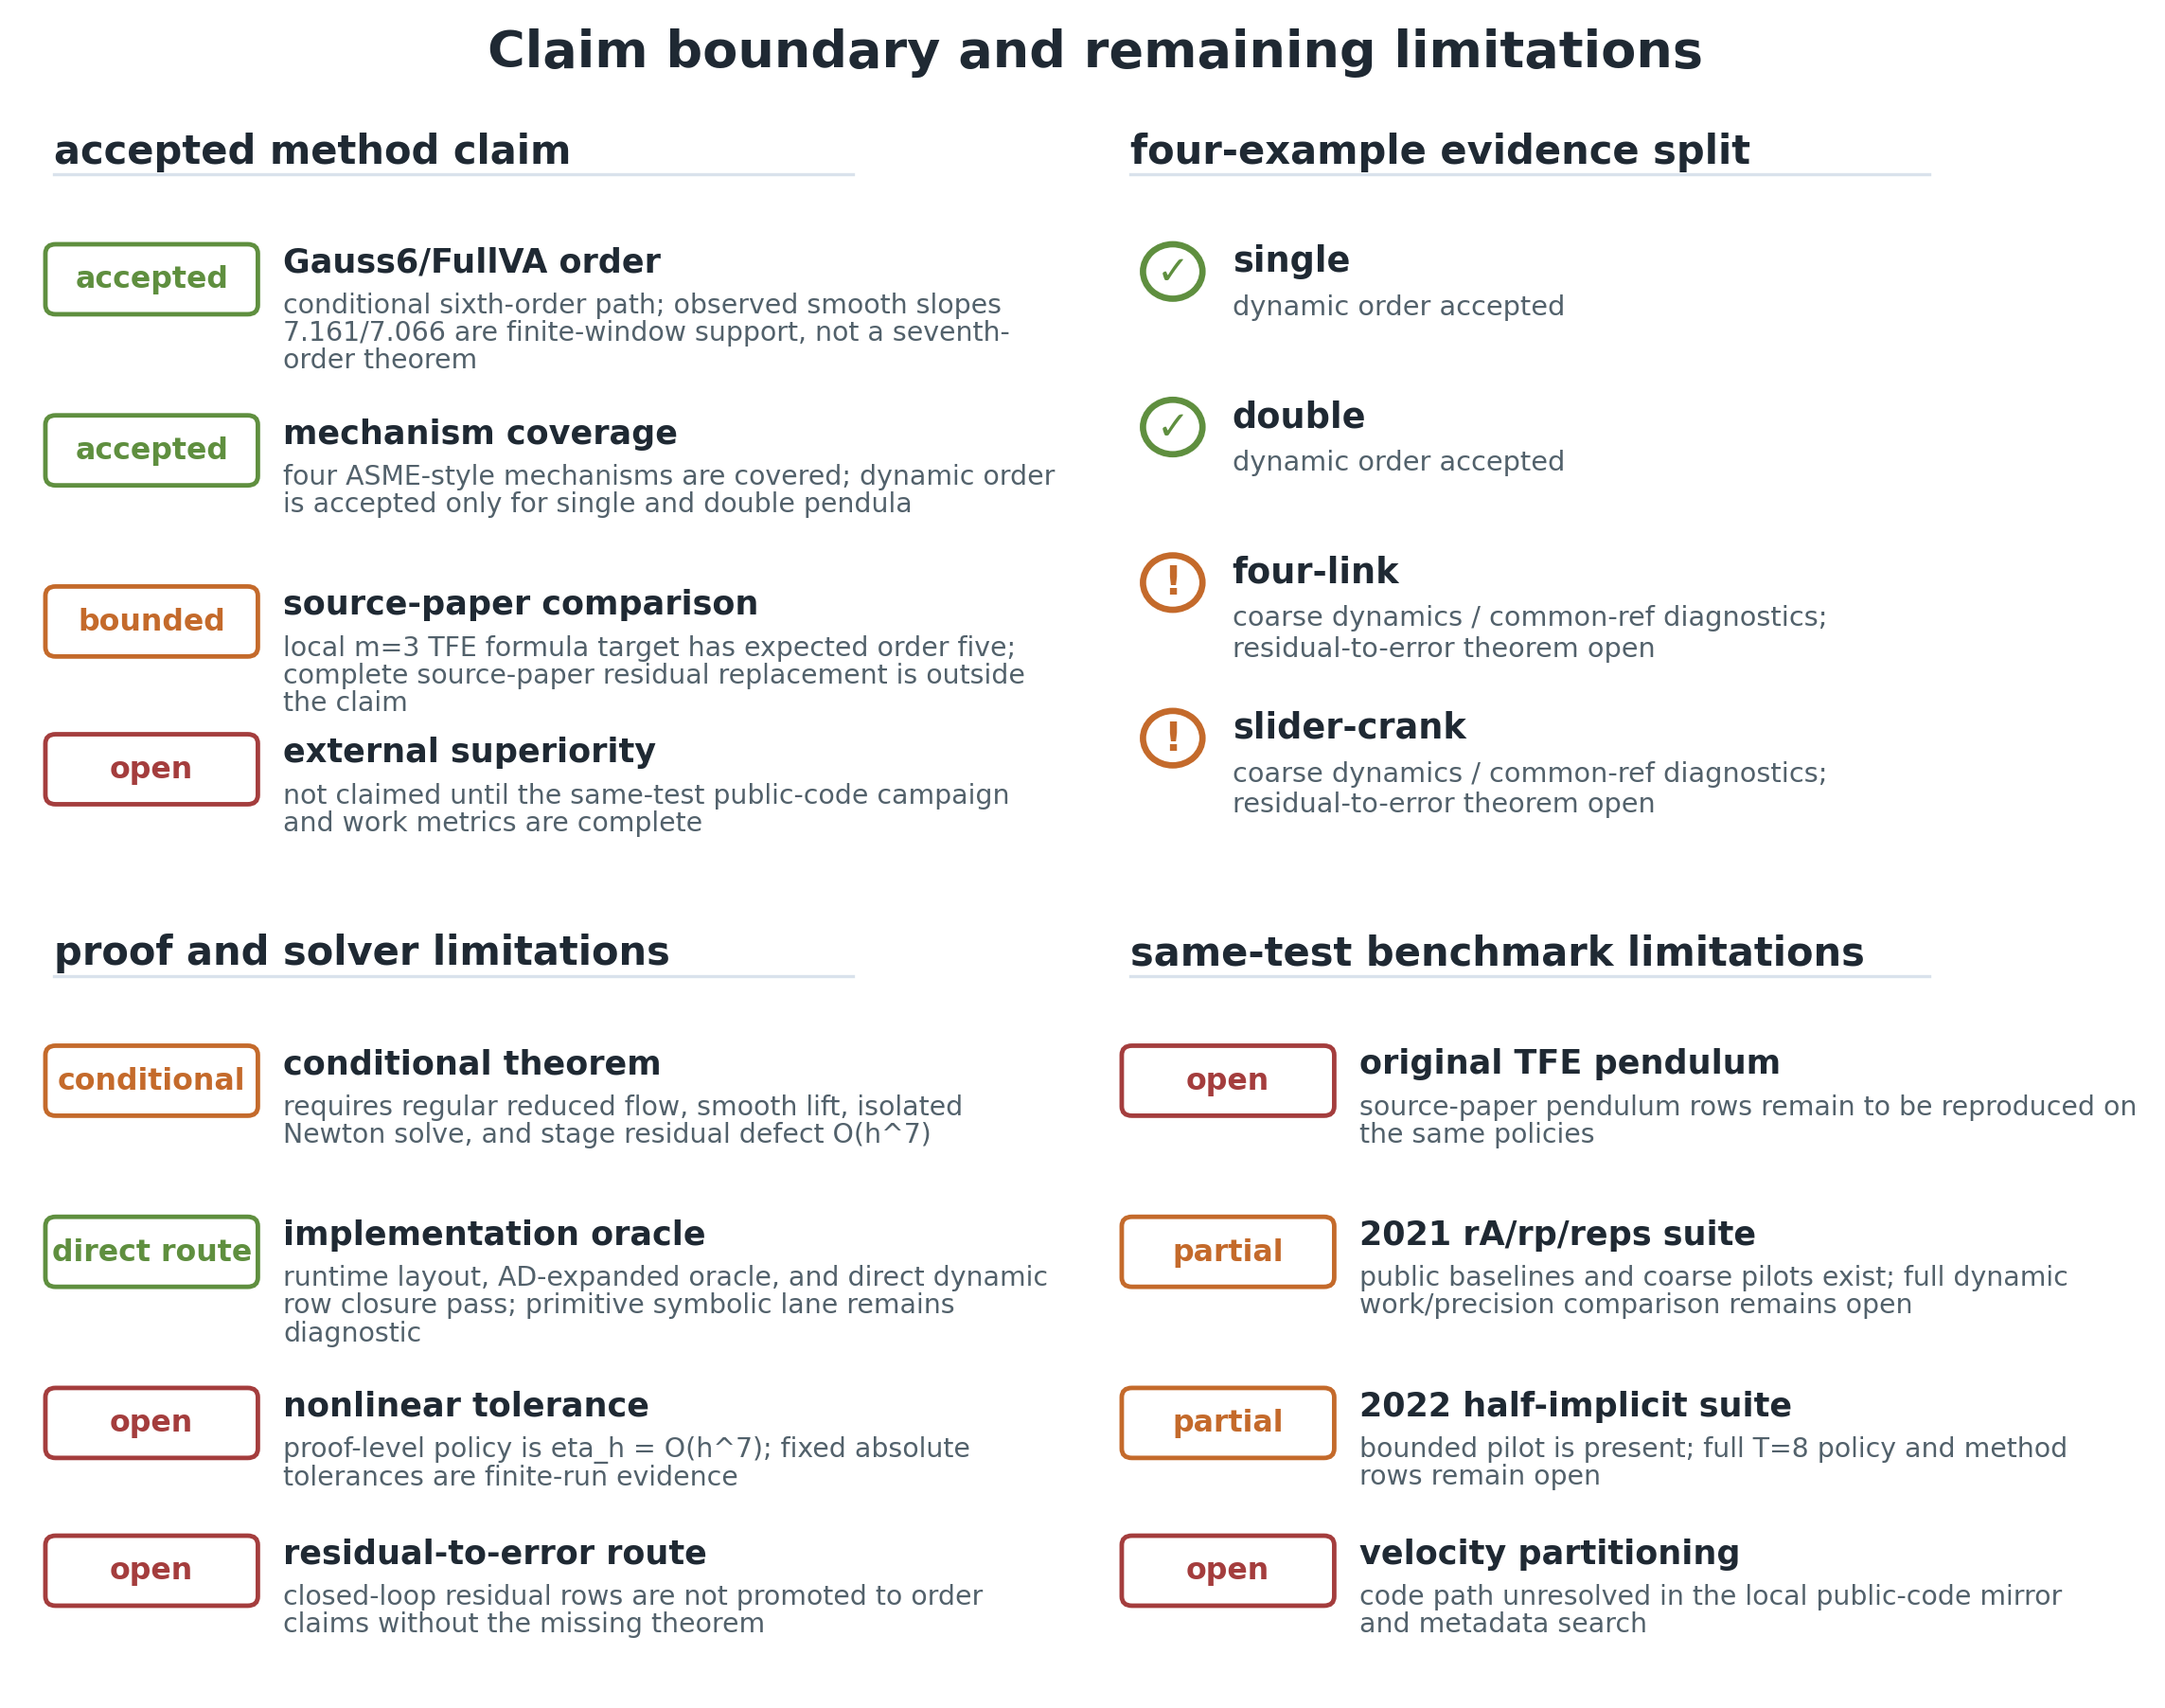
Claim boundary as a visual artifact
The agent can show the boundary instead of burying it in prose.
This is valuable for humans reviewing a long autonomous run.
It makes non-claims part of the presentation.
The paper package uses a figure to separate accepted evidence, bounded diagnostics, and open gates.
06/09/2026
University of Wisconsin - Madison
19

Slide 20
Proof route versus proof residue
Accepted direct route
Still diagnostic
Direct residual-bridge/Kantorovich route.
96 non-dynamic certificate rows.
36 Newton-Euler direct-substitution zero rows.
Active PC2 closed in this route.
Primitive 162-subterm Taylor lane.
Residual-to-error promotion for closed-loop rows.
Fixed-tolerance logs as theorem evidence.
Source-policy superiority.
06/09/2026
University of Wisconsin - Madison
20

Slide 21
The agent has hard non-claims
false
false
false
opt-in
submission_ready
external_superiority_claim
full_tfe_stage_replacement
strict 1e-4 public-policy runs
These fields are allowed to remain false while the narrower research claim is still useful.
06/09/2026
University of Wisconsin - Madison
21

Slide 22
4 / Case Study
v047/v048 as an agent-built research product
The method is technical; here the point is how the agent managed the research.
06/09/2026
University of Wisconsin - Madison
22

Slide 23
What the agent helped assemble
v047
v048
B1-B8
OC4/6/12
cylindrical-chain method pipeline
cross-paper same-test scaffold
narrowed claim blockers closed
global submission blockers still open
The architecture supports a useful narrowed result without hiding the global gaps.
06/09/2026
University of Wisconsin - Madison
23

Slide 24
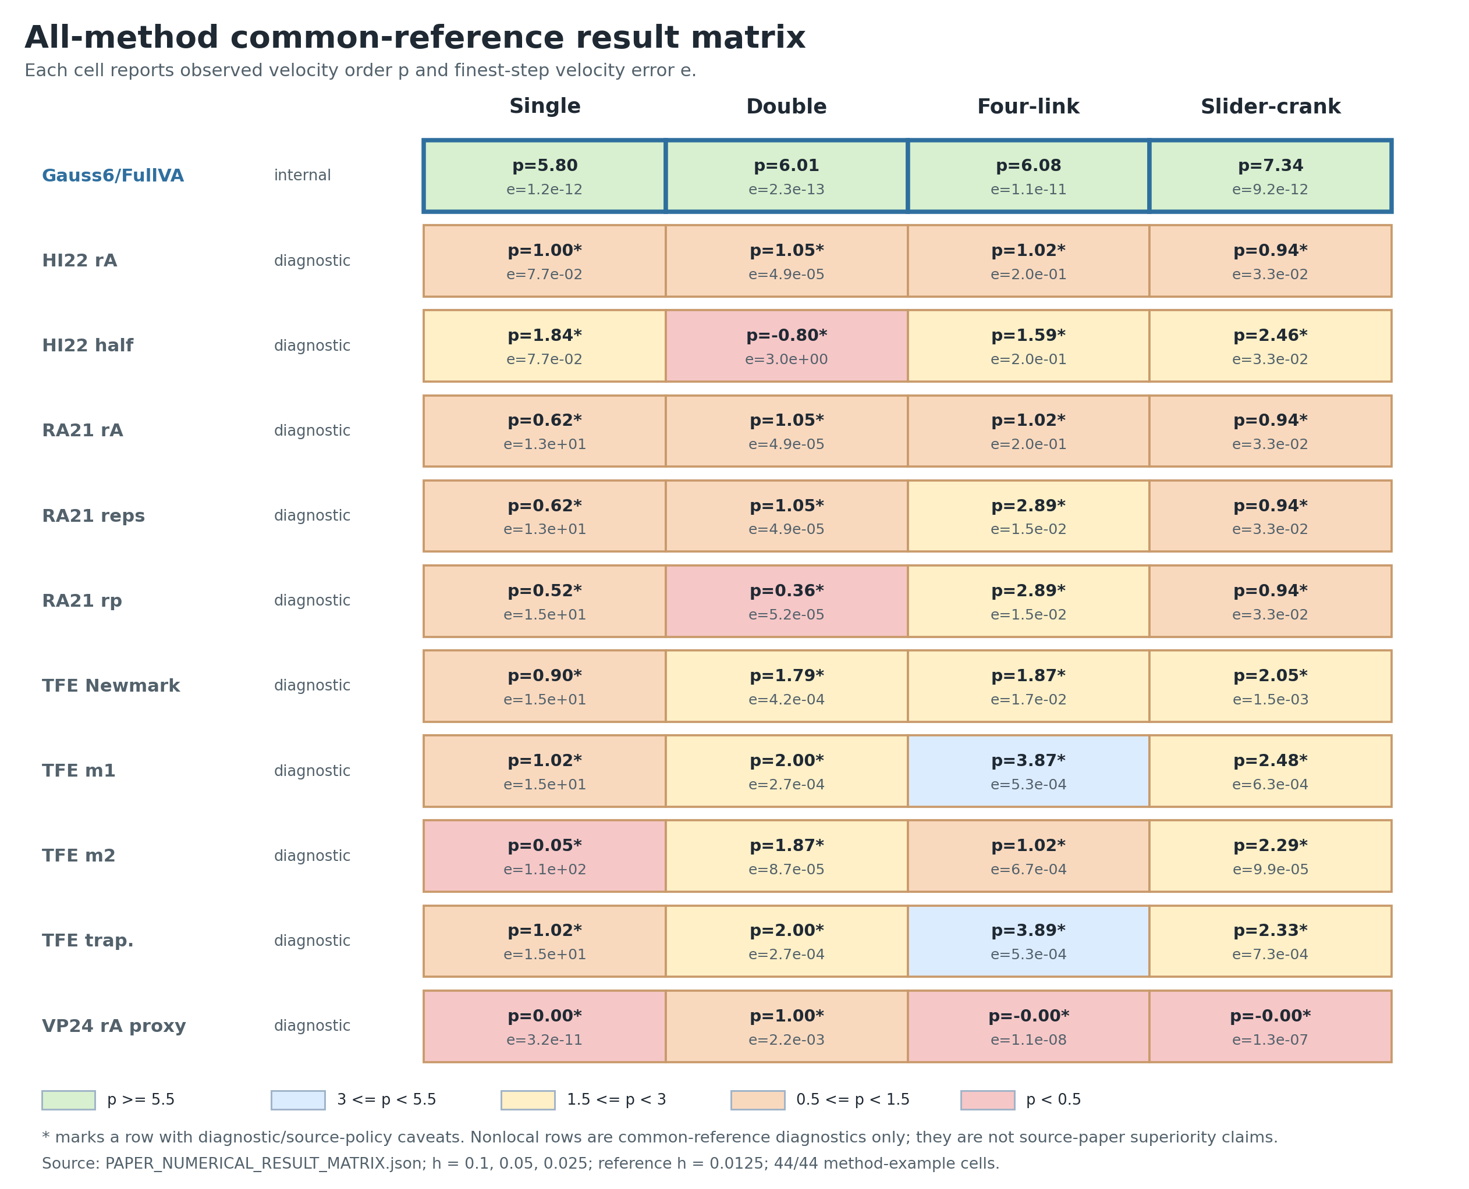
The paper result matrix is an agent-facing dashboard
This is not just a paper figure.
It is a compressed state representation for the agent and the human.
The matrix prevents isolated rows from being over-promoted.
The result matrix makes examples, methods, orders, and boundaries reviewable in one place.
06/09/2026
University of Wisconsin - Madison
24

Slide 25
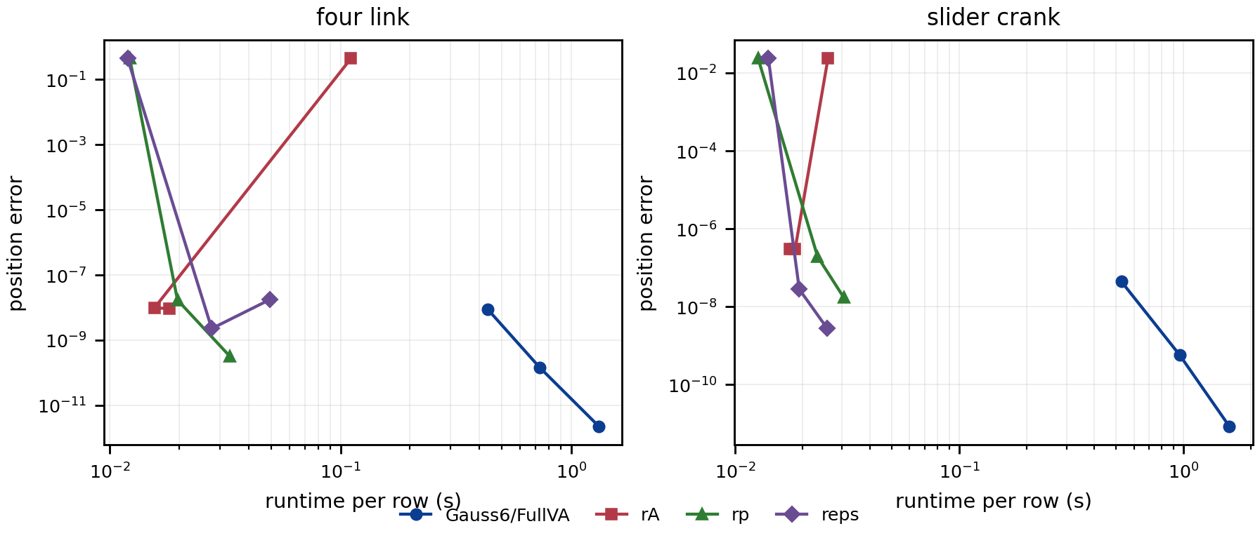
Common-reference evidence is useful but bounded
The agent can run and summarize fairer rows.
It still keeps source-policy rows at 0/40 promoted.
The difference between useful and claim-ready evidence is explicit.
v048 records common-reference work/precision evidence without converting it into source-policy superiority.
06/09/2026
University of Wisconsin - Madison
25

Slide 26
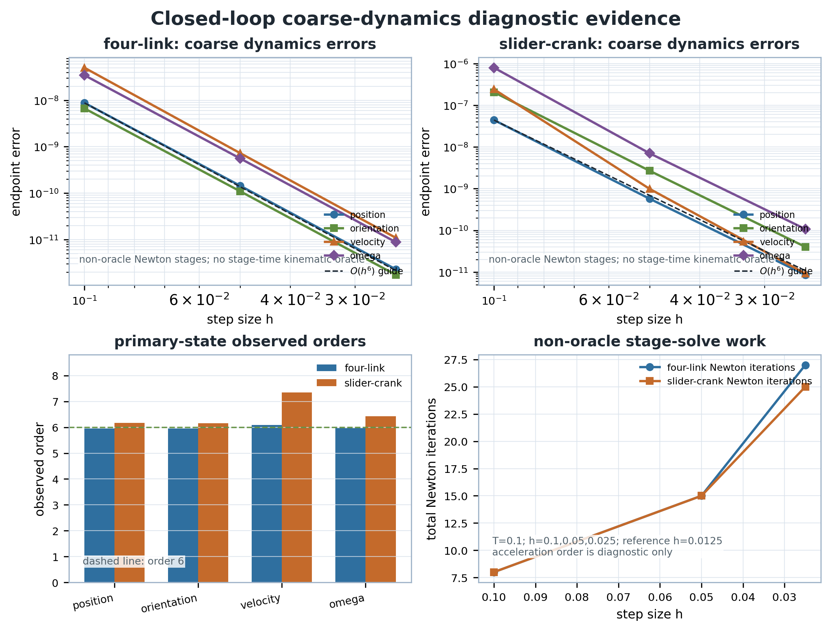
Closed-loop dynamics moved from plan to candidate evidence
First a feasibility audit.
Then residual scaffold.
Then one-step smoke.
Then coarse order candidates and work/precision rows.
The v048 closed-loop true-dynamic rows are a good example of incremental autonomous progress.
06/09/2026
University of Wisconsin - Madison
26

Slide 27
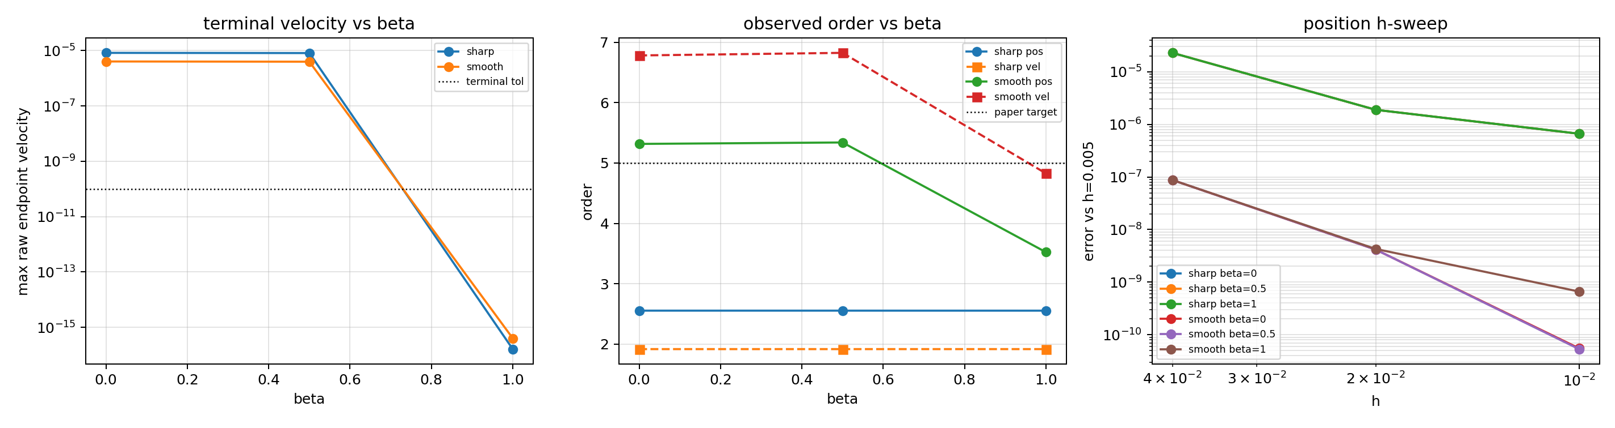
The hard open problem stays visible
The agent ruled out many nearby families.
It localized the gap to lower-pair closure directions.
It did not rewrite the conclusion to make the gap disappear.
Full-TFE replacement remains open because terminal closure and smooth order do not intersect.
06/09/2026
University of Wisconsin - Madison
27

Slide 28
The case study shows the agent doing research work
It keeps a broad objective active across many small turns.
It separates method evidence, proof evidence, paper evidence, and external evidence.
It turns failed probes into structured exclusions.
It creates reviewer-facing artifacts while preserving non-claims.
06/09/2026
University of Wisconsin - Madison
28

Slide 29
5 / Lessons
What generalizes
The pipeline is a pattern for agentic research, not only this integrator project.
06/09/2026
University of Wisconsin - Madison
29

Slide 30
Design pattern: artifact-grounded autonomy
Use a current contract file as the first read on every turn.
Represent claims as JSON/Markdown gates with validators.
Store evidence in small, typed artifacts: CSV, JSON, PNG, reports.
Make expensive or policy-sensitive commands opt-in.
Treat negative evidence as part of the result.
06/09/2026
University of Wisconsin - Madison
30

Slide 31
What the agent should do
Autonomous
Human-controlled
Read current state.
Select the next missing gate.
Run bounded checks.
Generate artifacts.
Summarize evidence and non-evidence.
Change the research objective.
Approve strict source-policy campaigns.
Decide when a narrowed claim is worth submitting.
Accept broader claim promotion.
06/09/2026
University of Wisconsin - Madison
31

Slide 32
What we would improve next
A smaller domain-specific language for claim gates.
Better automatic figure and table generation from JSON ledgers.
Subagent review roles for proof, numerical policy, and paper package audits.
Cost-aware scheduling for external same-test campaigns.
A compact dashboard that shows accepted, diagnostic, open, and forbidden claims.
06/09/2026
University of Wisconsin - Madison
32

Slide 33
Conclusion
The agent is not a magic scientist.
It is a disciplined research operating system.
Its leverage comes from durable artifacts, validators, and conservative claim boundaries.
The v047/v048 project shows that this can sustain months of technical search.
The same pattern can be reused wherever research progress depends on evidence hygiene.
06/09/2026
University of Wisconsin - Madison
33

Slide 34
Thank You
Questions?
Meta claim: autonomous research becomes reliable when claims are executable artifacts

