Slide 1
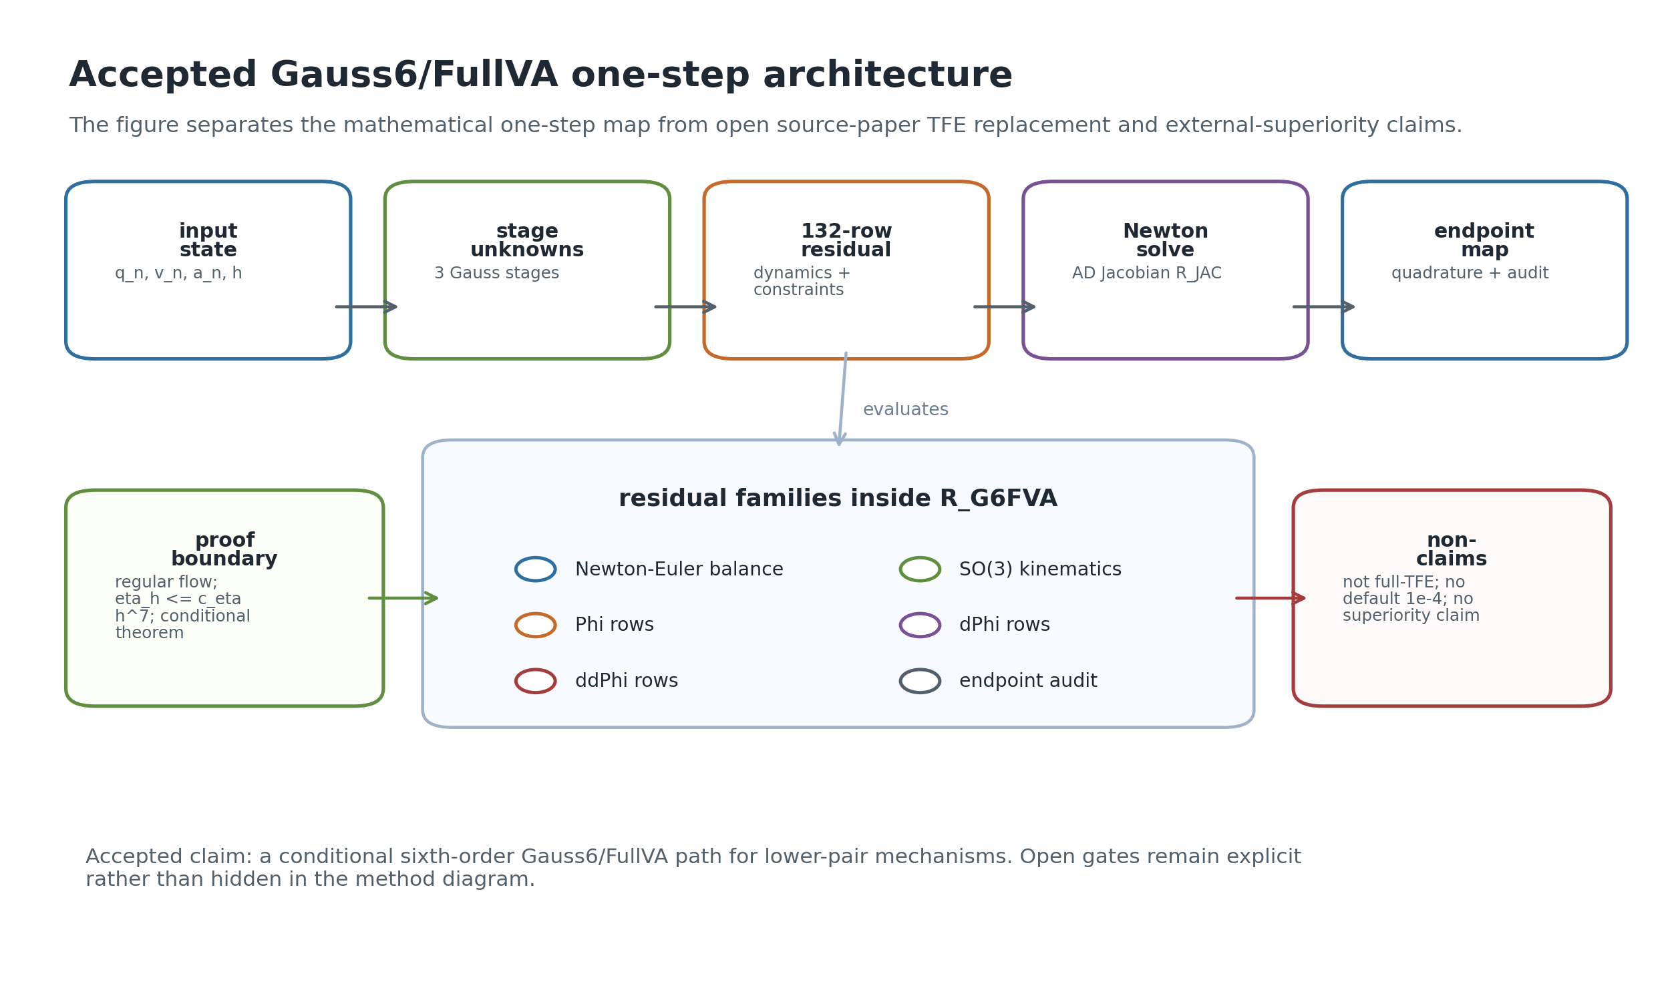
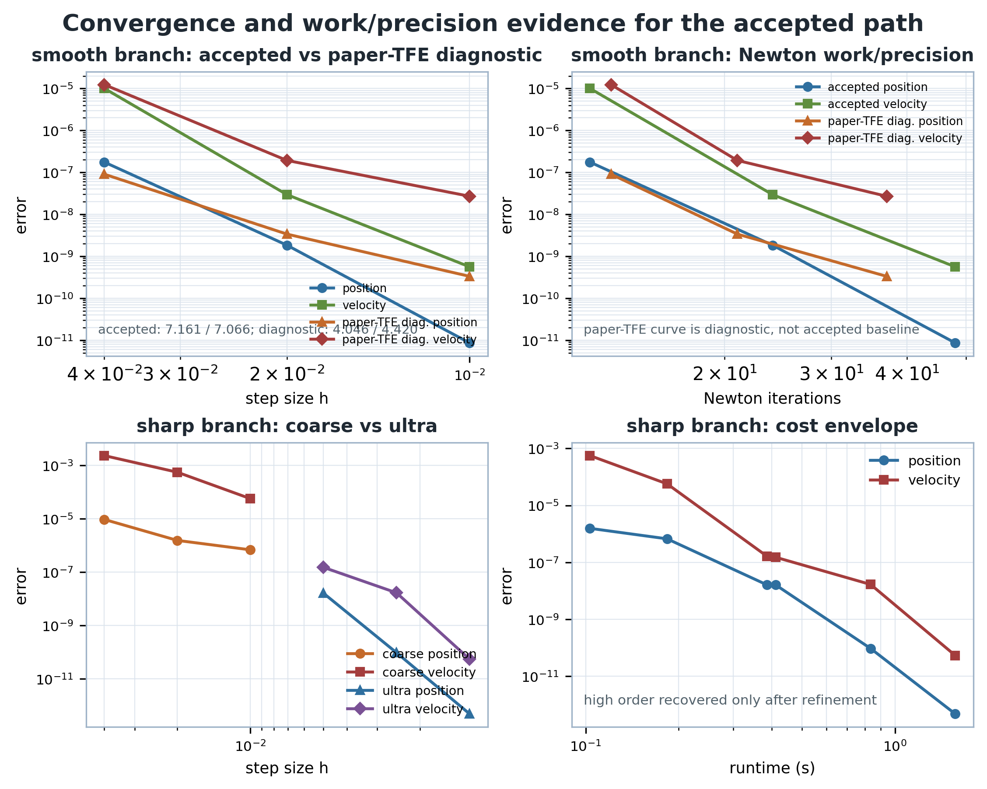
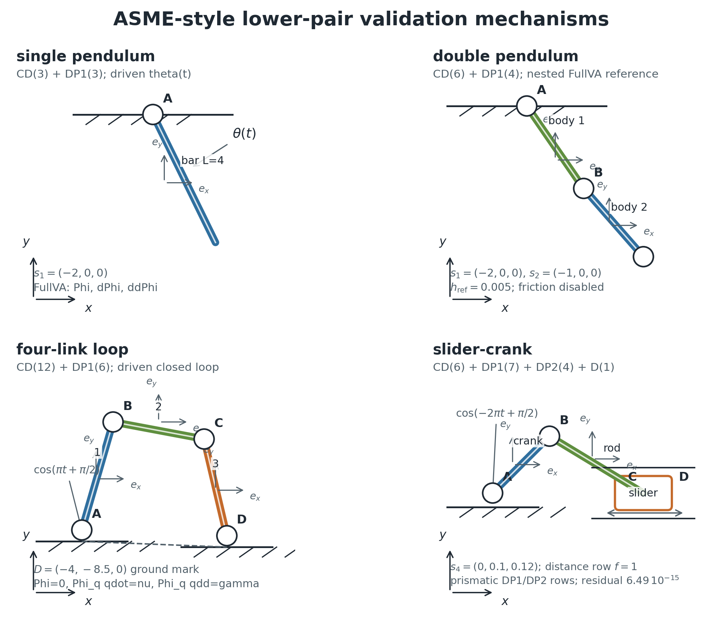
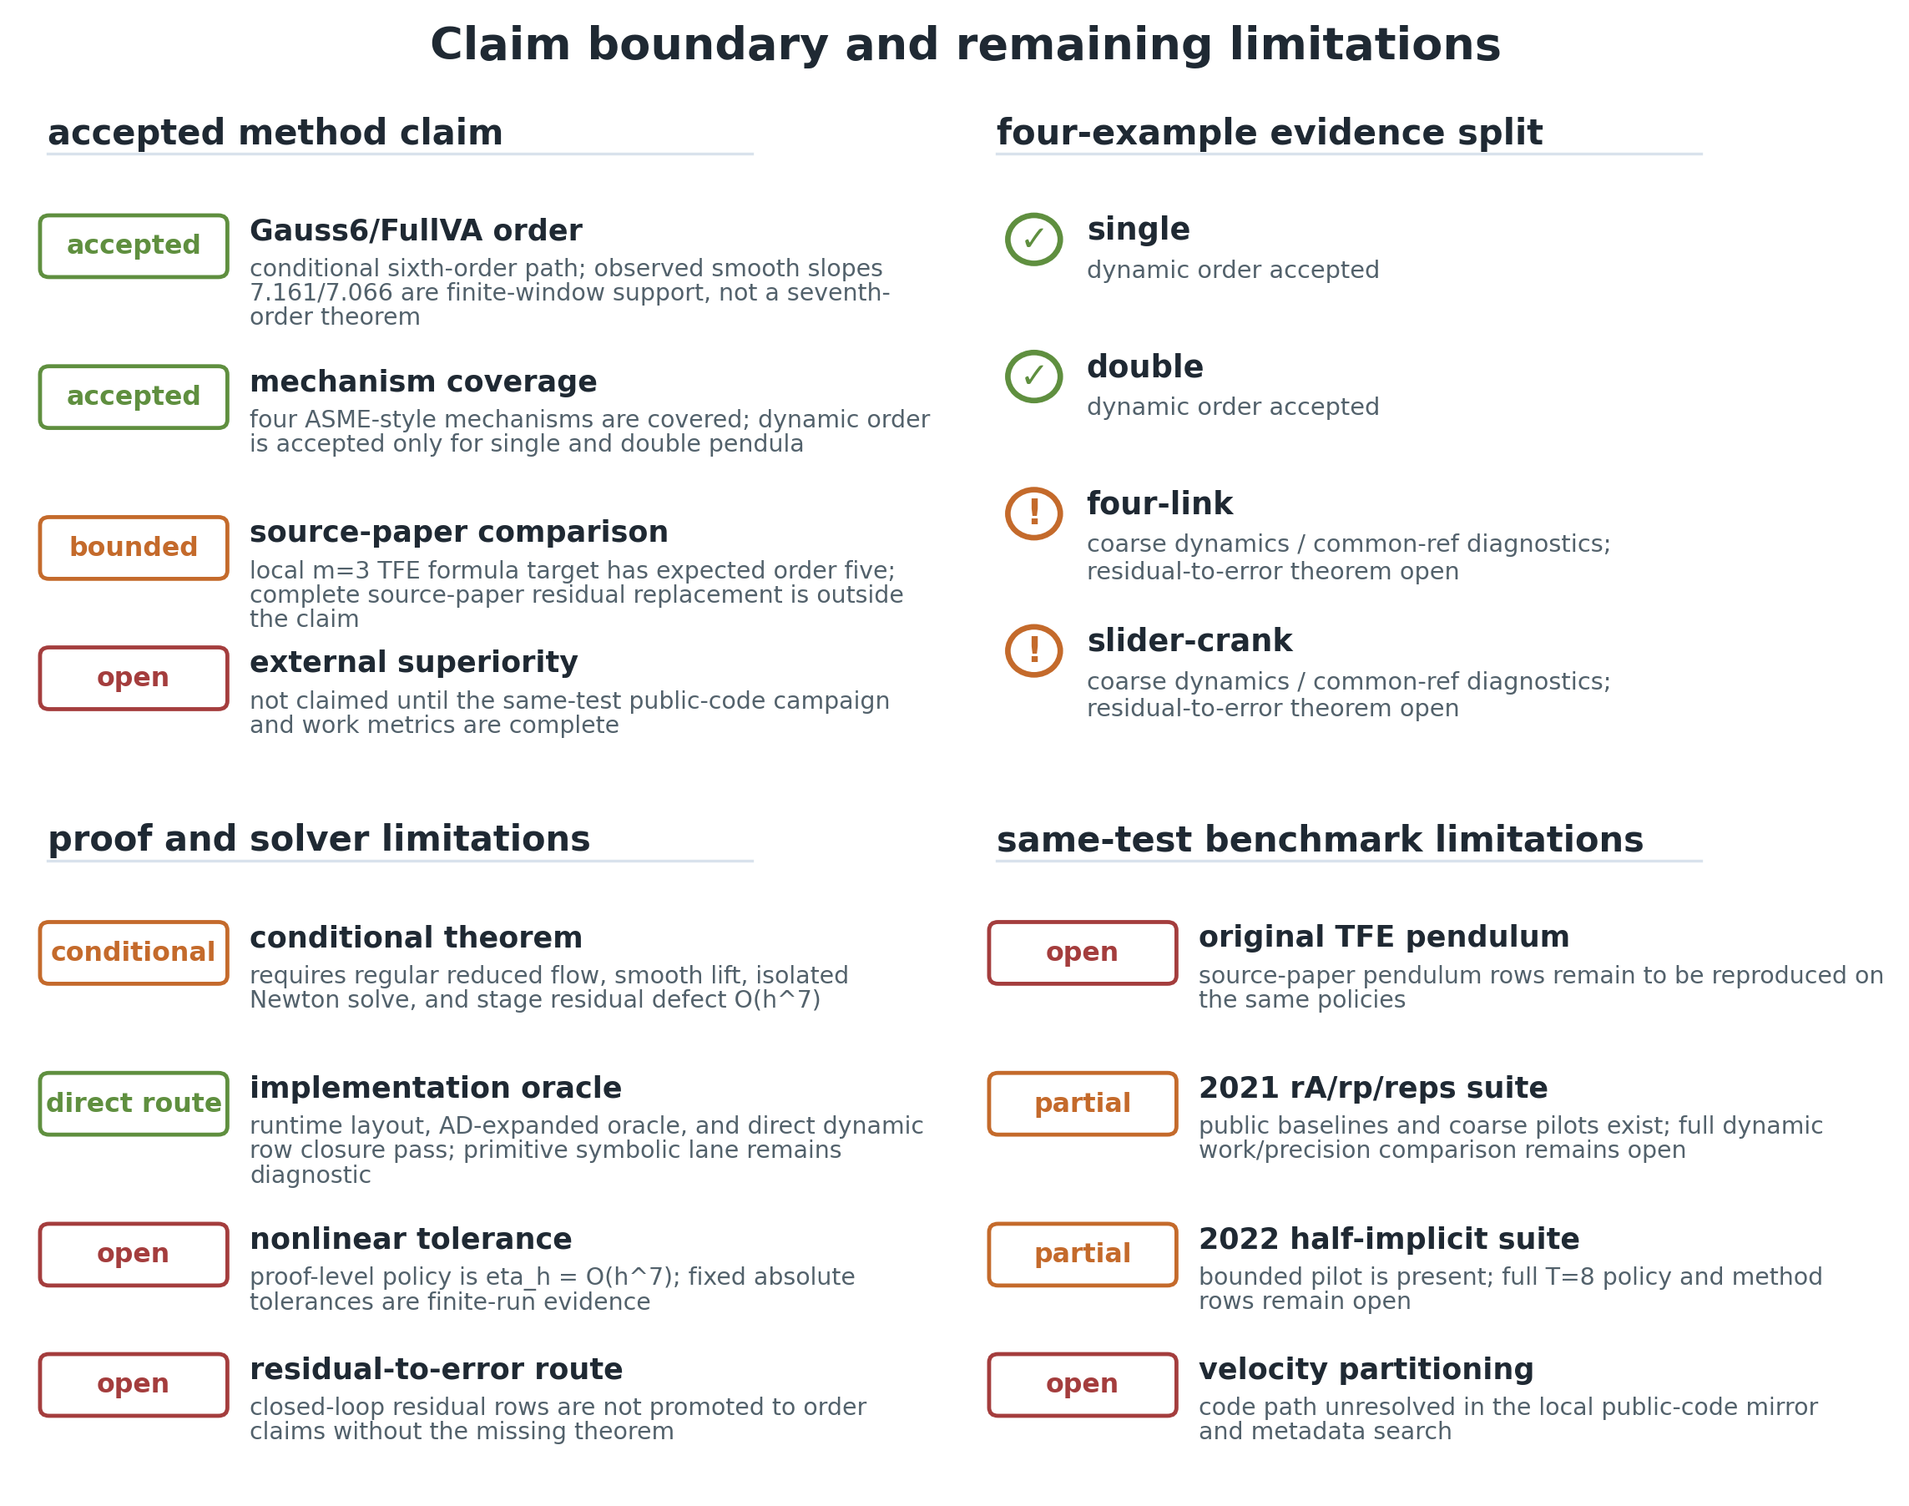
Building an Auto-Research Agent
for Integrator Research
method object
Verifier sandboxes, proof gates, and numerical test ladders for Lie-group multibody DAE methods
Jingquan Wang
Simulation-Based Engineering Laboratory
University of Wisconsin - Madison
order verifier
mechanism gate
06/09/2026
claim boundary

Slide 2
Why this matters in our lab
Many people are attacking the same hard object:
Lie groups
DAE mechanisms
SO(3), SE(3), charts
joints, drivers, reactions
defensible multibody
time integration
friction/contact
papers
smooth vs nonsmooth tests
sparse solvers
benchmarks, claims, refs
AD, coloring, Newton
Agent purpose: keep method identity, examples, proof status, and paper claims synchronized across this shared evidence space.
06/09/2026
University of Wisconsin - Madison
2

Slide 3
Reference landscape drives the verifier design
stream
references
agent obligation
index-3 DAE
Hairer-Wanner; Gear-Leimkuhler-Gupta
check Phi, Phi_q v, Phi_q a, multipliers
Lie-group time integration
Munthe-Kaas; Bruls-Cardona-Arnold; Wieloch-Arnold
preserve rotation geometry and method identity
time finite elements
Borri-Atluri; Hughes-Hulbert; Chaturvedi-Sandu-Sandu
separate source residual reproduction from local method claims
SBEL baselines
Taves-Kissel-Negrut; Kissel-Negrut-Taves; Fang et al.
make external rows comparable under explicit policy
friction/contact
Brown-McPhee; Stewart-Trinkle; Anitescu-Potra
separate smooth order from nonsmooth diagnostics
06/09/2026
University of Wisconsin - Madison
3

Slide 4
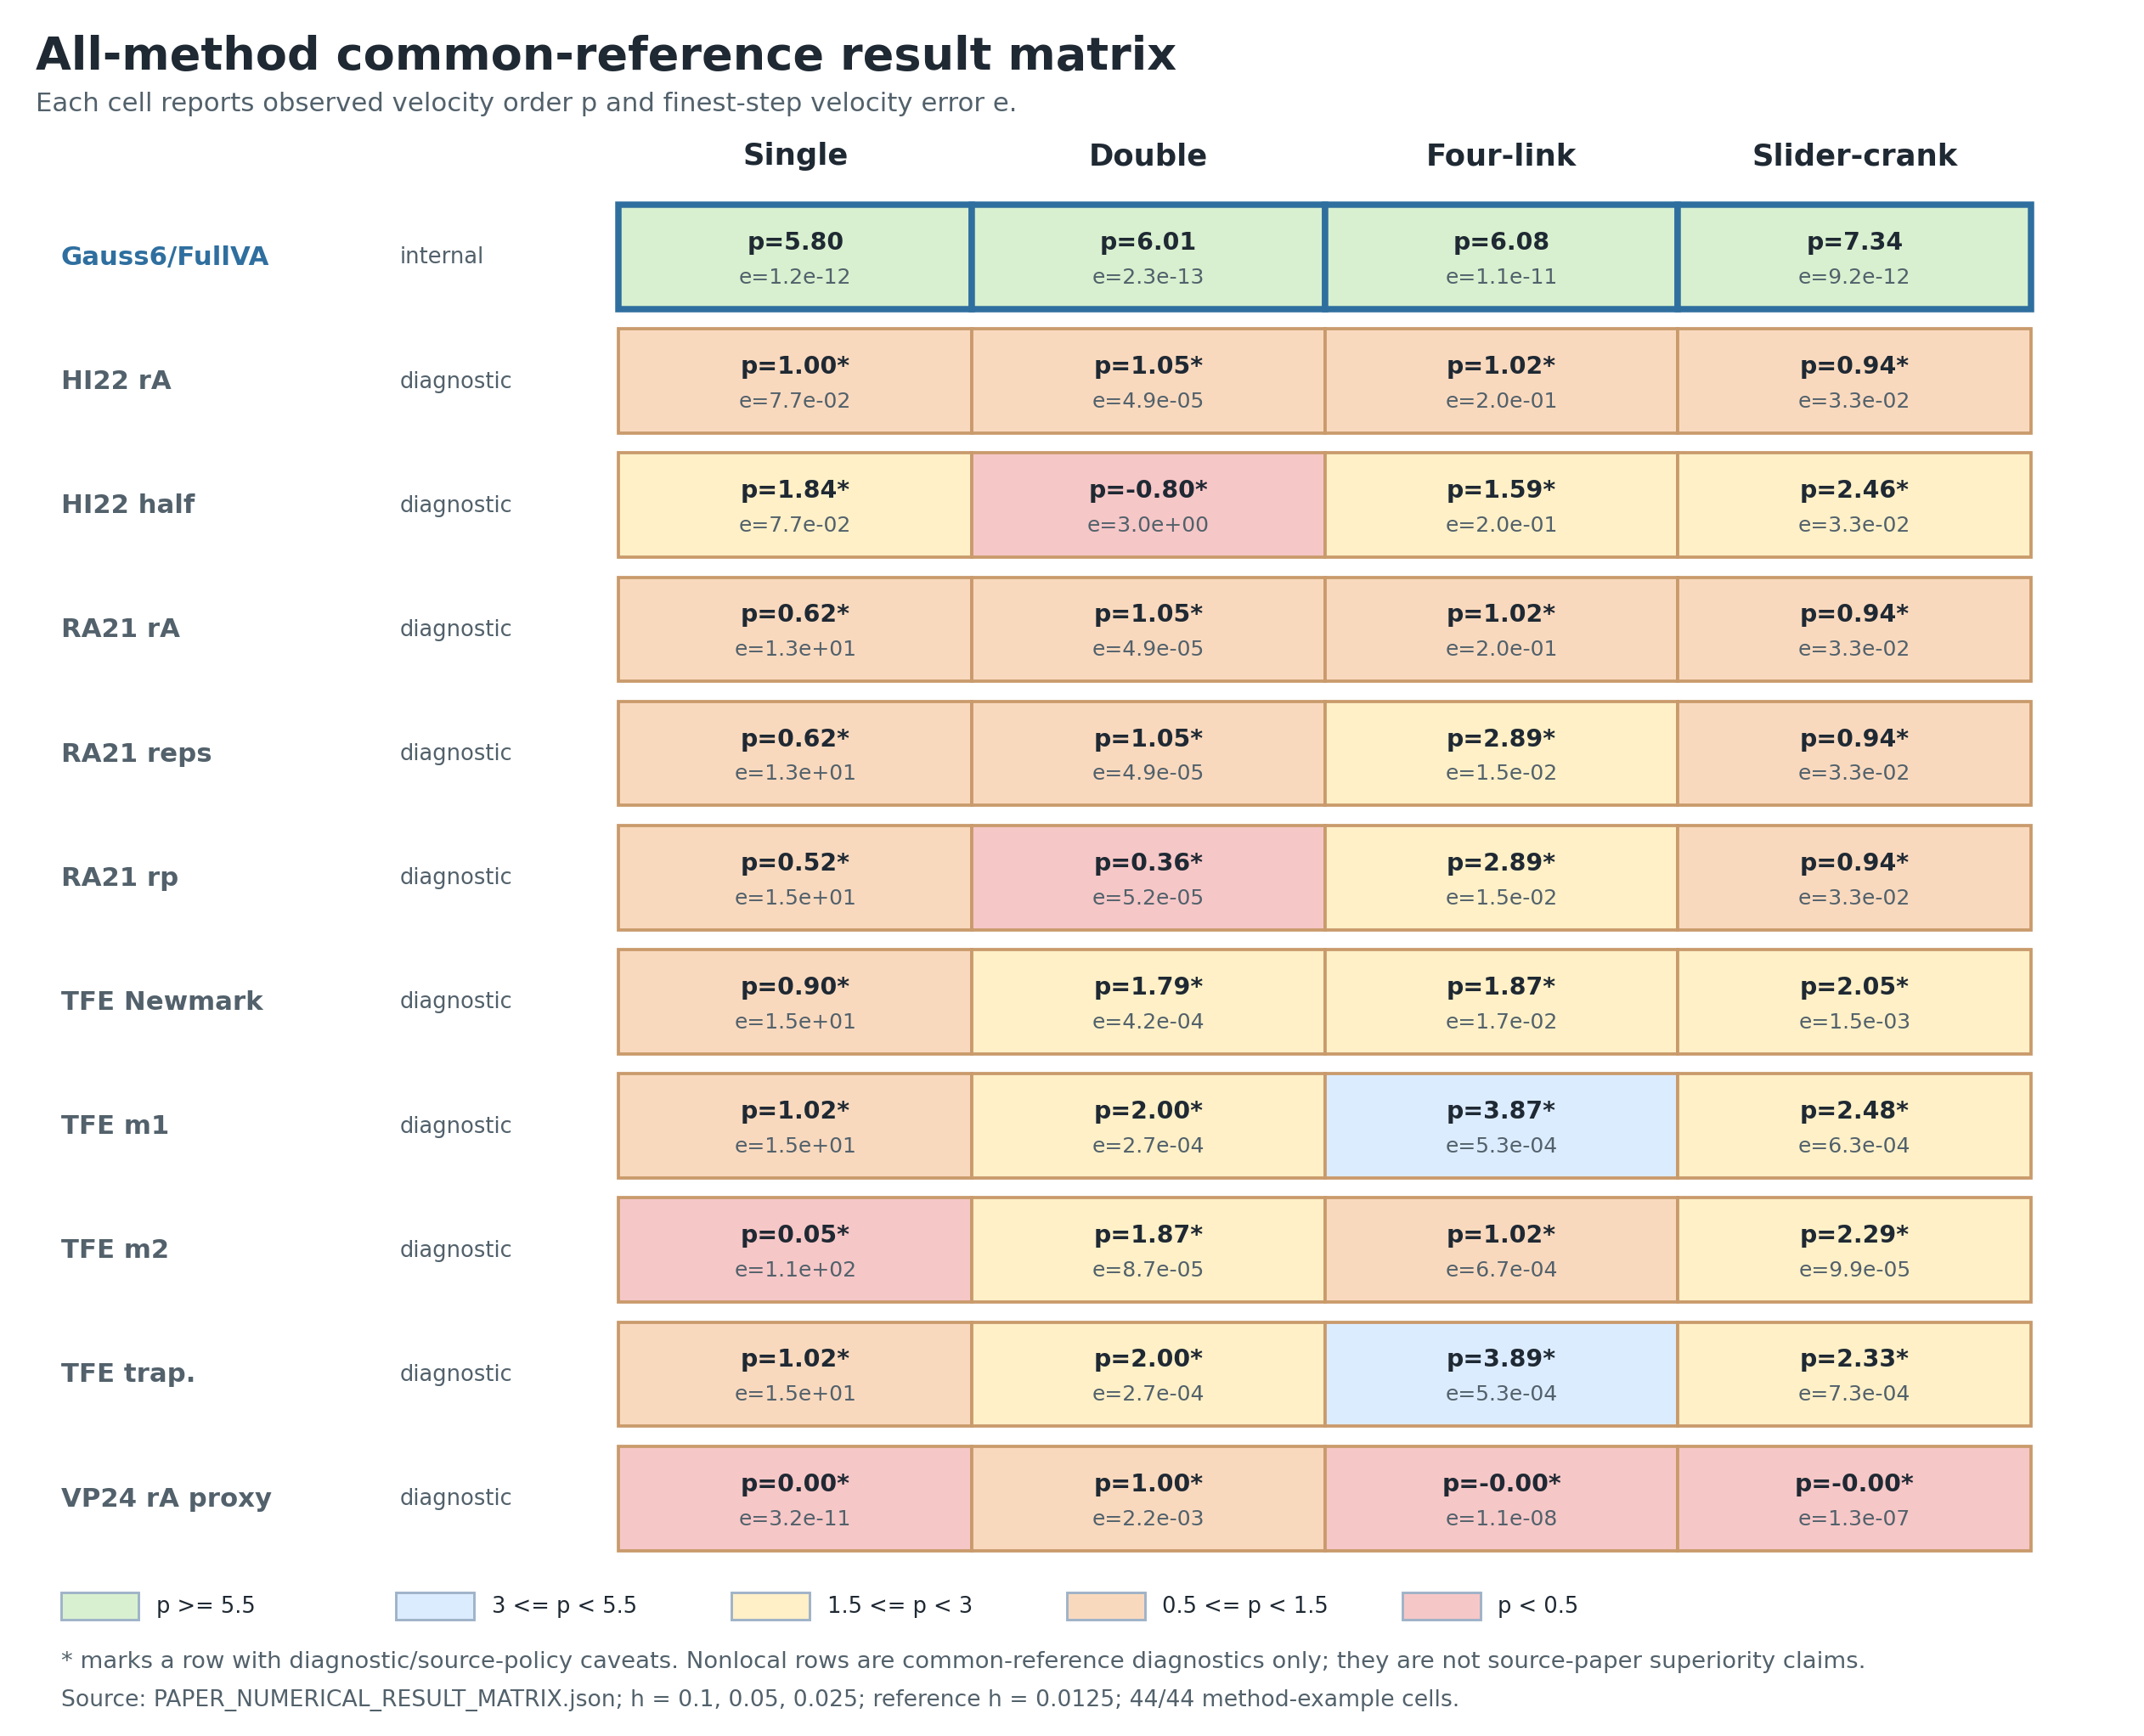
Why v001 had to become v048
v001-005
v006-013
v014-022
v023-029
v030-045
v046-048
>
>
>
>
>
SO(3) order
DAE closure
friction
FullVA
sparse scaling
claim gates
Evolution rule
Each version exists because the previous verifier found a missing gate.
The agent is not a generic code loop; it is a blocker-driven research controller.
v048 is the point where external same-test policy becomes a first-class object.
evidence matrix
06/09/2026
University of Wisconsin - Madison
4

Slide 5
The agent we need
MethodSpec
ProblemSpec
EvidenceSpec
ClaimSpec
what one-step map is being claimed
which mechanisms and parameters are pinned
CSV, JSON, plots, validators
accepted, diagnostic, open, forbidden
closed loop
generate
>
sandbox
>
prove
>
test
>
write
Human role: choose the research direction; agent role: enforce the gates before claims move.
06/09/2026
University of Wisconsin - Madison
5

Slide 6
Method object: the agent cannot verify a moving target
For v047
3 Gauss stages
132 FullVA rows
position, velocity, acceleration constraints
endpoint closure audited separately
solver tolerance is a theorem gate
Non-claim: full source-paper TFE replacement unless its own residual gate closes.
method architecture as verifier target
06/09/2026
University of Wisconsin - Madison
6

Slide 7
Verifier sandbox: constrain what the agent can run
L0
read-only validators
paper/package/proof checks
L1
target audit
one bounded hypothesis
L2
full generator
version-wide artifacts
L3
external source-policy
same-test public campaigns, opt-in
Promotion rule: outputs move upward only when the lower sandbox cannot answer the claim question.
06/09/2026
University of Wisconsin - Madison
7

Slide 8
Proof sandbox: only gated facts enter the theorem
P1
P2
P3
P4
P5
P6
P7
smooth chart
regular branch
residual defect O(h^7)
endpoint perturbation O(h^7)
dynamic rows
solver scale
residual-to-error
Accepted lane
Diagnostic lane
direct residual bridge
AD row identity
Newton-Euler substitution
conditional sixth-order claim
fixed tolerance logs
primitive Taylor fragments
external source-policy rows
residual-only mechanism rows
The ledger tells the agent what not to say.
06/09/2026
University of Wisconsin - Madison
8

Slide 9
Numerical ladder: examples expose different failure modes
6
external same-test
5
ASME mechanisms
4
friction regimes
3
constrained DAE
2
smooth mechanics
1
SO(3) kinematics
Acceptance evidence: at least three h values, pinned reference policy, CSV/JSON/plot trail, and claim role.
06/09/2026
University of Wisconsin - Madison
9

Slide 10
Case evidence: smooth order verifier
Accepted local method claim
Gauss6 / FullVA
conditional sixth-order path
observed slopes about 7.16 / 7.07
not an external superiority claim
The agent must preserve this boundary exactly.
v047 smooth cylindrical-chain convergence
06/09/2026
University of Wisconsin - Madison
10

Slide 11
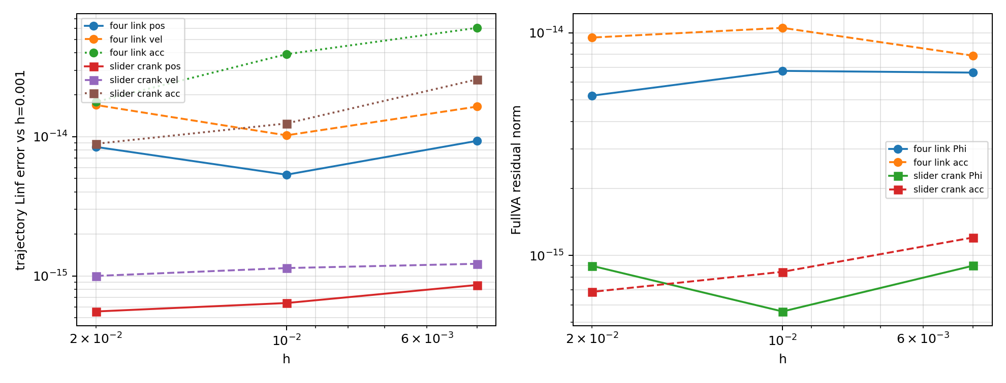
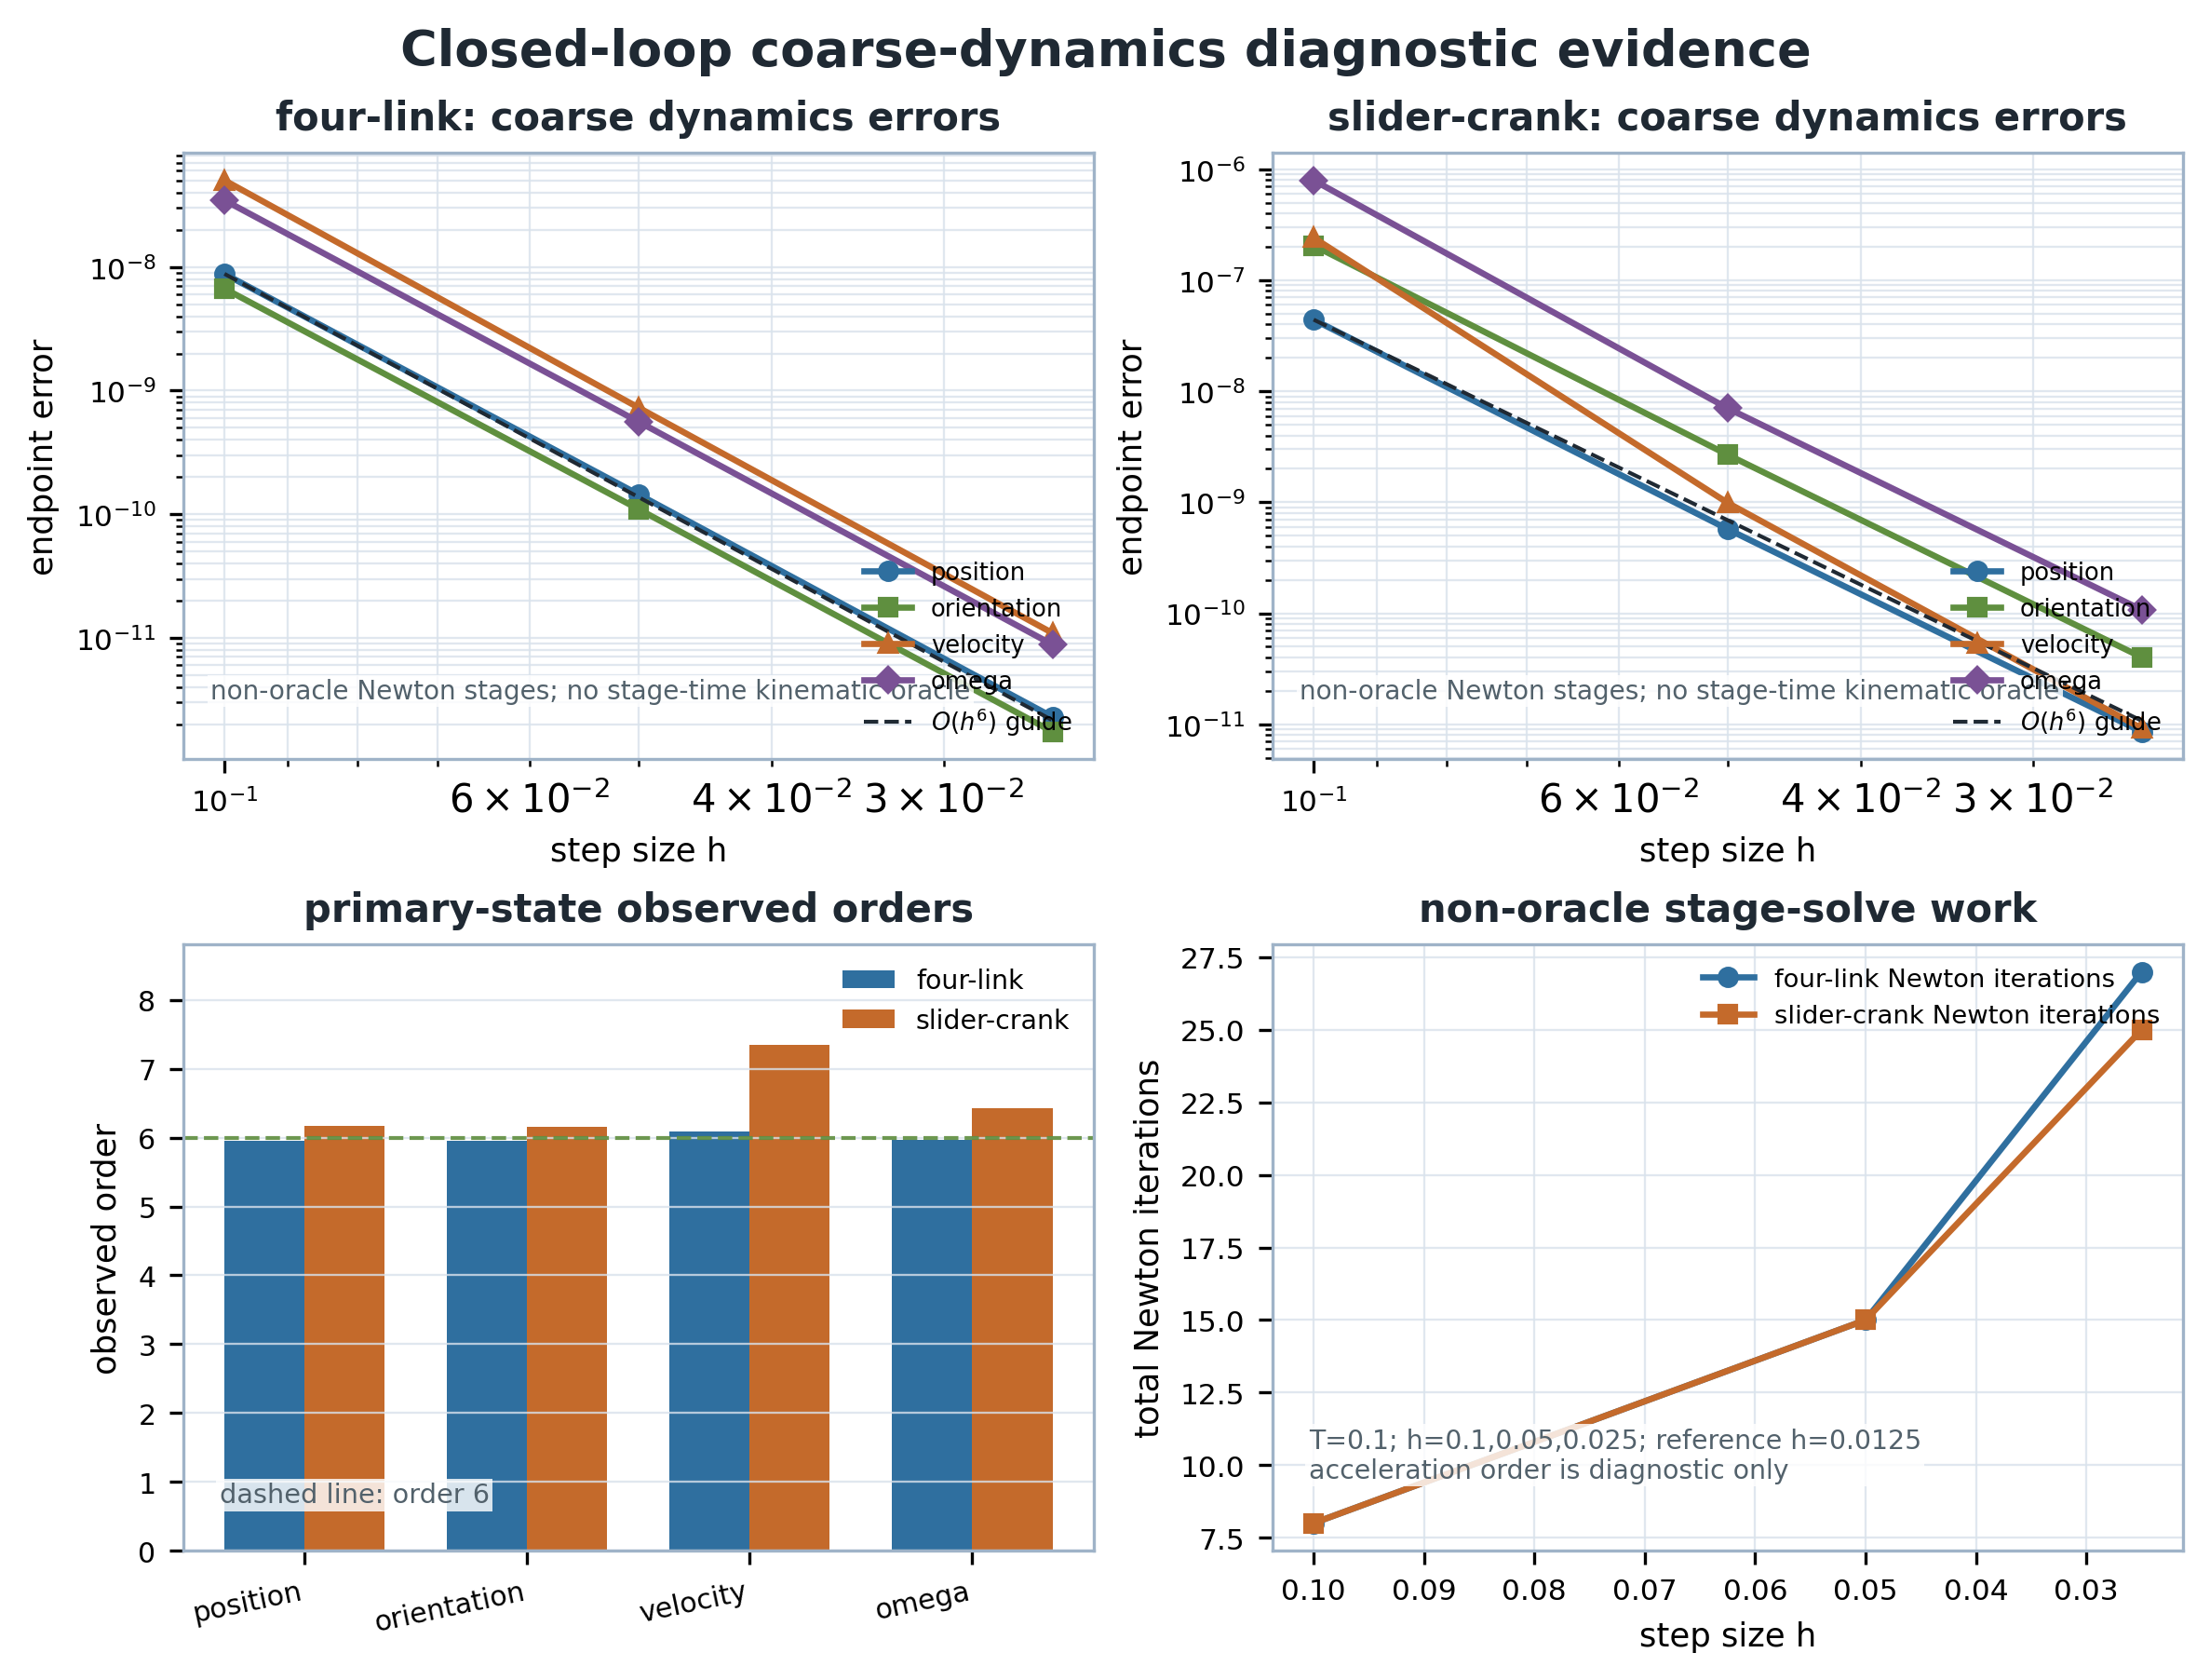
Mechanism verifier: ASME lower-pair examples
closed-loop kinematic FullVA
lower-pair graph bridge
dynamic-order staging
06/09/2026
University of Wisconsin - Madison
11

Slide 12
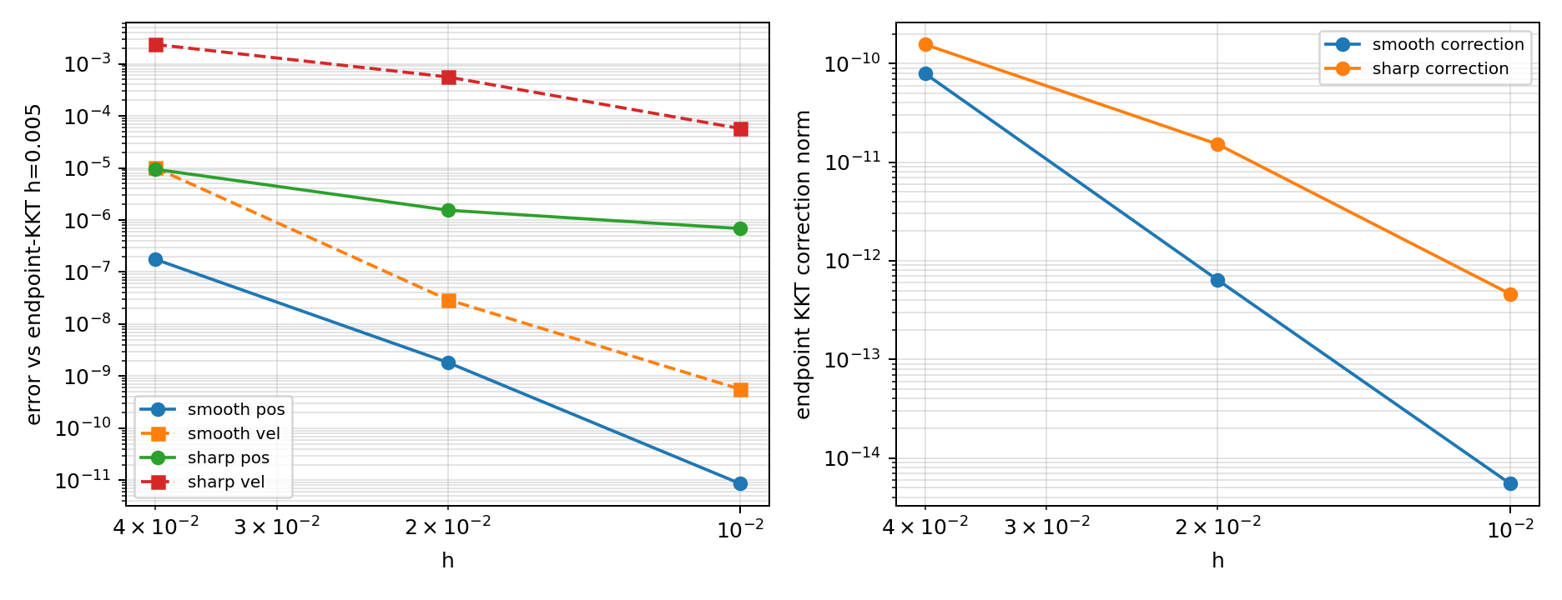
Endpoint closure is its own sandbox
raw residual, projection baseline, and KKT closure must stay separated
Why it matters
A projection can make constraints look clean while changing the one-step map. The agent cannot hide that inside an order claim.
06/09/2026
University of Wisconsin - Madison
12

Slide 13
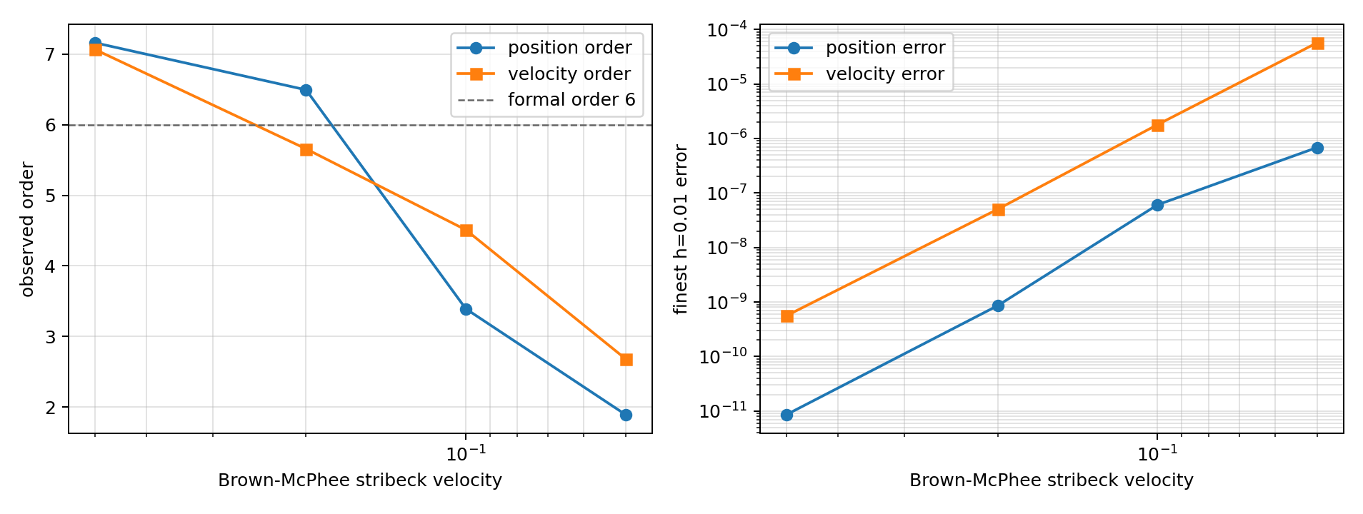
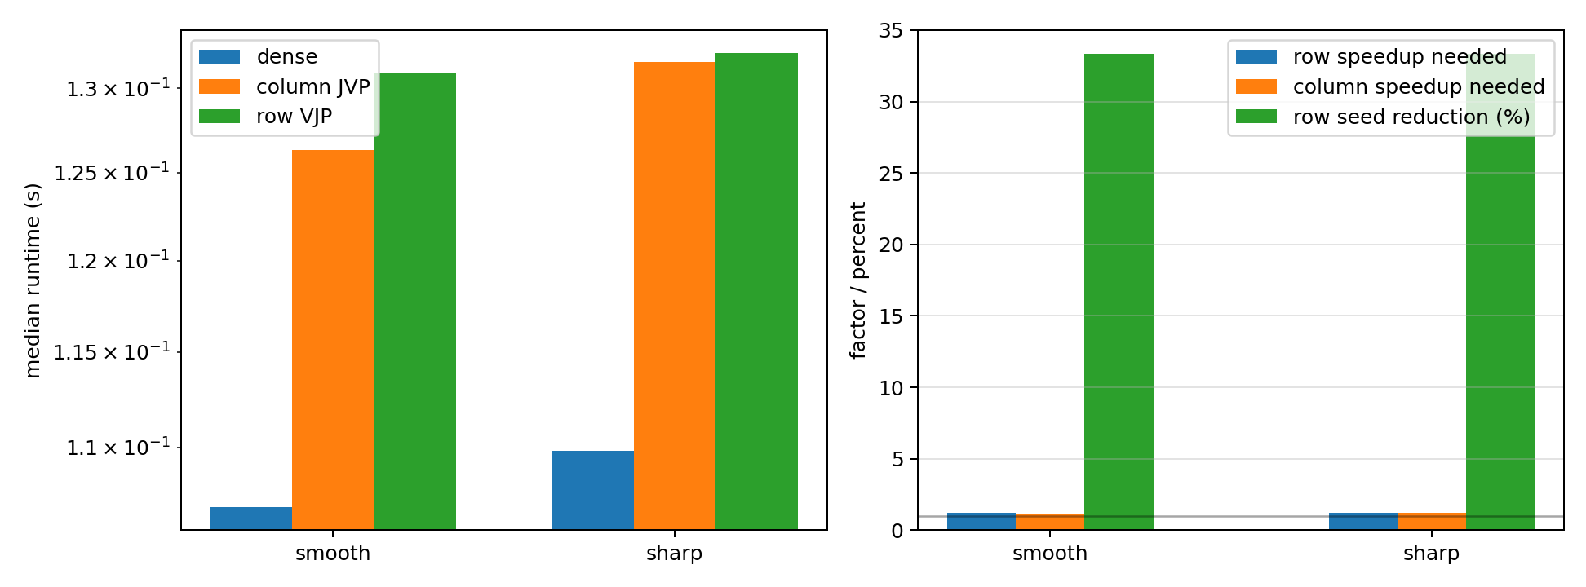
Caveats are first-class evidence
friction smoothness boundary
sparse correctness vs sparse speed
Agent behavior
Do not delete caveats. Promote smooth-order evidence, demote sharp-friction and runtime caveats to their correct claim lanes.
06/09/2026
University of Wisconsin - Madison
13

Slide 14
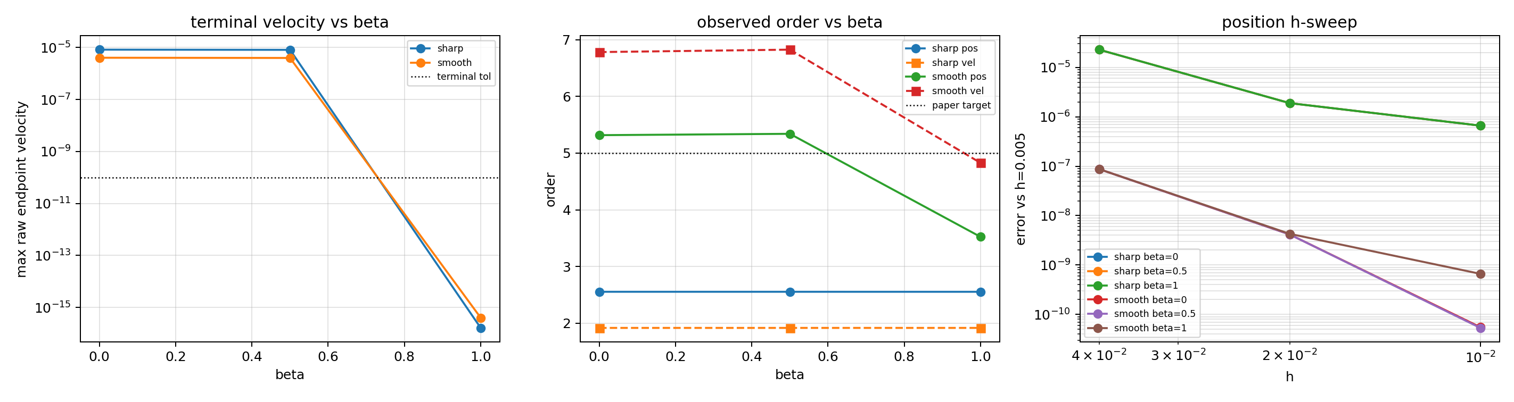
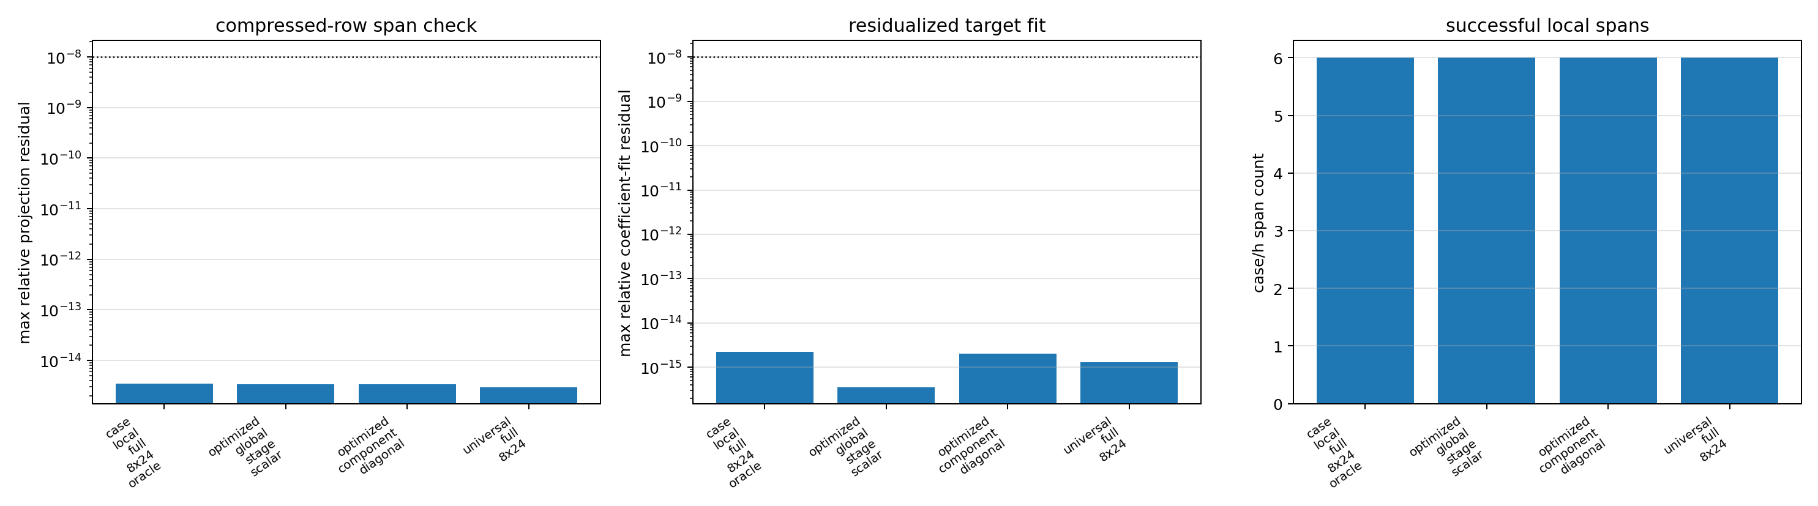
Search strategy: negative results guide the next verifier
order and terminal closure do not automatically intersect
velocity-compression probes prune rows that miss the required span
06/09/2026
University of Wisconsin - Madison
14

Slide 15
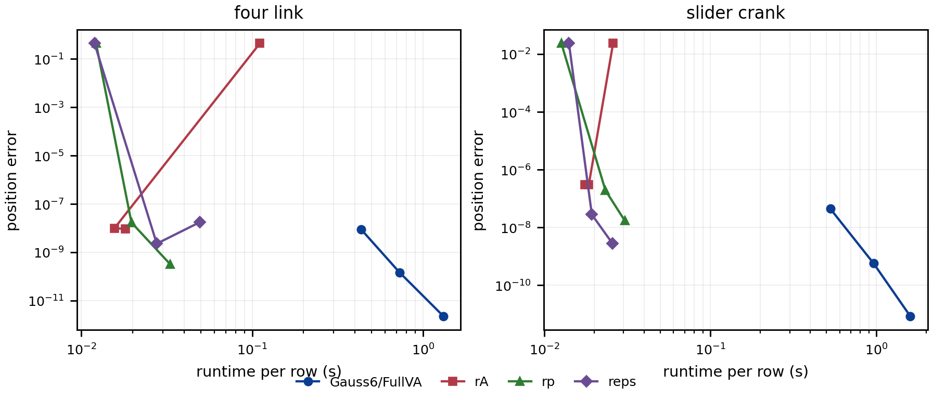
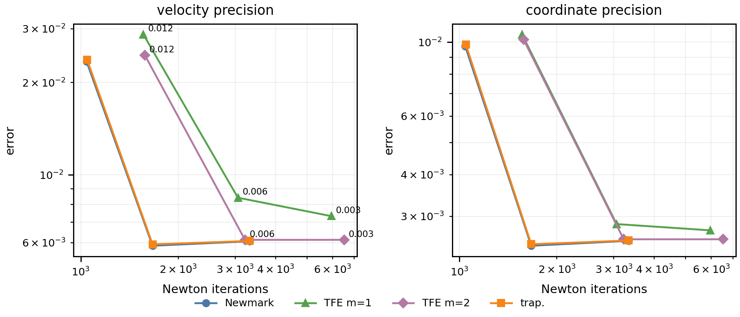
External comparison remains bounded
common-reference work/precision
literal TFE algorithm diagnostics
Boundary
v048 provides same-test scaffolds, but source-policy external superiority remains false until the strict public campaigns close.
06/09/2026
University of Wisconsin - Madison
15

Slide 16
Claim state machine
hypothesis
diagnostic
accepted
open
forbidden
A claim can move backward when a validator exposes stale prose or unfair policy.
accepted, diagnostic, and open boundaries in one frame
06/09/2026
University of Wisconsin - Madison
16

Slide 17
How to build this agent for our integrator work
1
encode MethodSpec
2
pin ProblemSpec
3
choose sandbox level
4
run numerical ladder
5
update proof ledger
6
gate paper claims
Good autonomy here means fewer unverified claims, not fewer human research decisions.
06/09/2026
University of Wisconsin - Madison
17

Slide 18
References used by the agent design
DAE / Lie groups
Hairer & Wanner 1996; Gear, Leimkuhler & Gupta 1985; Munthe-Kaas 1998/1999; Bruls, Cardona & Arnold 2012; Wieloch & Arnold 2021.
TFE / higher order
Chaturvedi, Sandu & Sandu 2026, doi:10.1007/s11044-026-10153-w; Kim & Reddy 2017; Borri & Atluri 1988; Hughes & Hulbert 1988; Bauchau 2024.
SBEL baselines
Taves, Kissel & Negrut 2020; Kissel, Negrut & Taves 2021/2022; Fang et al. 2023; Kissel, Bakke & Negrut 2024.
Friction/contact
Brown & McPhee 2016; Stewart & Trinkle 1996; Anitescu & Potra 1997; Tasora & Anitescu 2011.
Local artifacts
main_cmame.tex bibliography; REFERENCE_METADATA_AUDIT.md/json; CURRENT_PIPELINE_CONTRACT.md; ORDER_PROOF_LEDGER.md; summary_v047.json; v048 same-test scaffolds.
Reference metadata audit status: 28 references; 16/16 DOI rows verified; 12/12 local non-DOI rows verified.
06/09/2026
University of Wisconsin - Madison
18

