Slide 1
A Conditional Sixth-Order
Lie-Group FullVA Integrator
for Lower-Pair Mechanisms
Jingquan Wang
Simulation-Based Engineering Laboratory
Department of Mechanical Engineering, UW-Madison
06/09/2026

Slide 2
Lower-pair integration is hard
A position-accurate step can still carry
velocity and reaction inconsistency.
Finite rotations live on SO(3).
Lower-pair mechanisms are index-3 DAEs.
The useful method must synchronize position, velocity, acceleration, and multipliers in one solve.
06/09/2026
University of Wisconsin - Madison
2

Slide 3
The method tradeoff so far
What existing tools do well
What remains exposed
Lie-group integrators keep rotations on the manifold.
DAE methods enforce holonomic constraints.
TFE methods provide a high-order direct-integration route.
Endpoint velocity and acceleration rows can drift.
Source-paper residual reproduction is not the same as a method claim.
External same-test superiority needs stricter evidence than local runs.
06/09/2026
University of Wisconsin - Madison
3

Slide 4
Central thesis
A monolithic Gauss6/FullVA residual can deliver
a conditional sixth-order smooth path
while keeping lower-pair P/V/A constraints synchronized.
Accepted claim: Gauss6/FullVA order-six path.
Comparator: local paper-style m=3 TFE formula target, expected order five.
Non-claims stay explicit: full TFE replacement and external superiority remain open.
06/09/2026
University of Wisconsin - Madison
4

Slide 5
Defending the central thesis
Question 1 - Can we build a square Lie-group FullVA residual?
Question 2 - Does the accepted branch retain sixth-order behavior?
Question 3 - Does the same residual vocabulary cover the four ASME examples?
Question 4 - What does the evidence not claim?
06/09/2026
University of Wisconsin - Madison
5

Slide 6
Roadmap
1
2
3
4
Method
Claim boundary
Evidence
Diagnostics
Gauss6/FullVA residual
conditional sixth order
cylindrical chain and ASME examples
external comparison and open gates
06/09/2026
University of Wisconsin - Madison
6

Slide 7
1 / Method
Gauss6/FullVA
Build the lower-pair constraints into the Newton stage system.
06/09/2026
University of Wisconsin - Madison
7

Slide 8
FullVA means three constraint levels
P
V
A
position: Phi(q) = 0
velocity: Phi_q(q) v = nu
acceleration: Phi_q a + dot(Phi_q) v = gamma
The point is not to repair these rows after the step; they live inside the same nonlinear solve.
06/09/2026
University of Wisconsin - Madison
8

Slide 9
The cylindrical-chain stage solve is square
3
2
2
132
Gauss stages
bodies
lower-pair joints
unknowns and residual rows
For v047, 3 x {2 x 18 body variables + 2 x 4 multipliers} = 132.
06/09/2026
University of Wisconsin - Madison
9

Slide 10
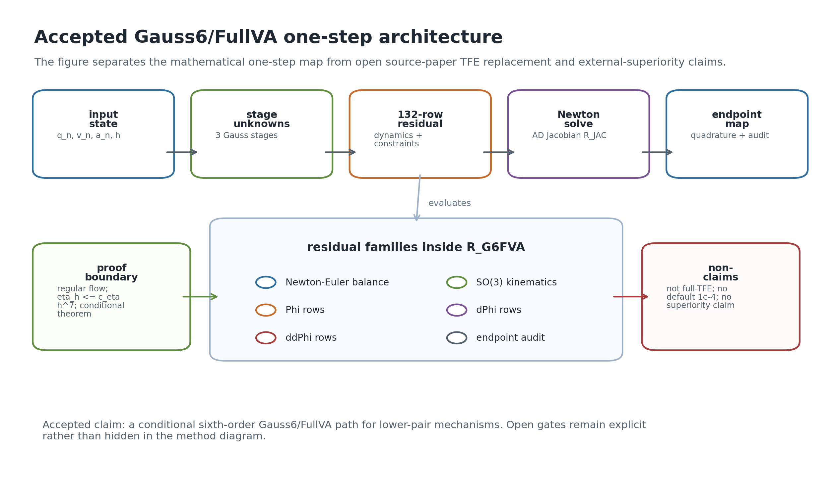
Method architecture
The method path is Gauss6/FullVA.
Paper TFE rows remain a comparator/diagnostic boundary.
Artifacts bind figures, JSON, CSV, and validators.
Figure from the CMAME package: the accepted residual, proof boundary, and validators are kept separate.
06/09/2026
University of Wisconsin - Madison
10

Slide 11
What Newton solves
Compact form: R_G6FVA(q_n, v_n, a_n, Z; h) = 0.
Stage kinematics for r, Q, v, omega, a, alpha.
Newton-Euler translational and rotational balance.
Lower-pair position, velocity, and acceleration rows.
Lagrange multipliers in the same 132-row stage vector.
06/09/2026
University of Wisconsin - Madison
11

Slide 12
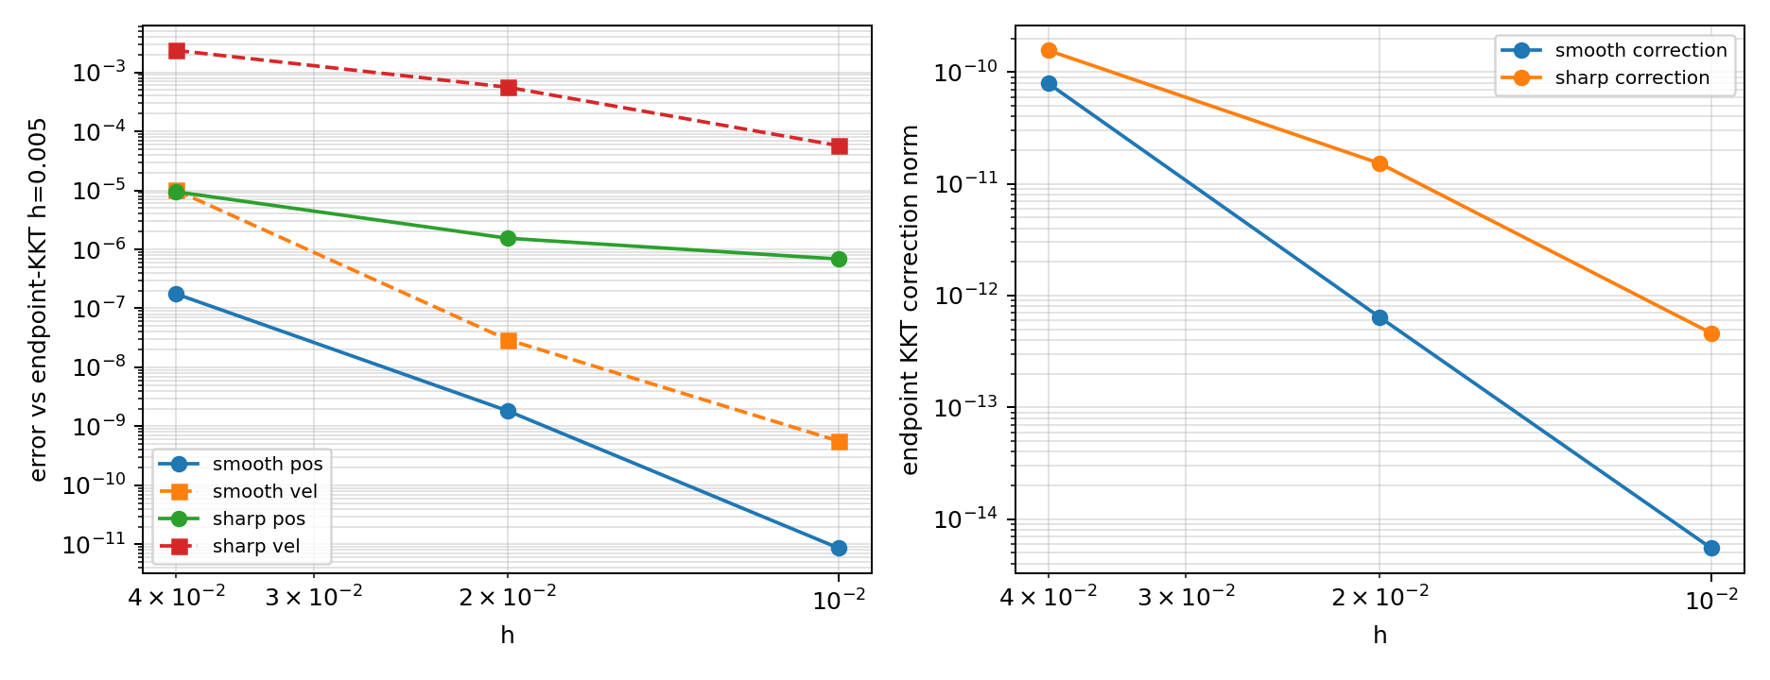
Endpoint closure is audited, not hidden
Endpoint position and velocity closure are checked.
Projection and KKT paths are separated.
The accepted order claim is tied to the branch and solver contract.
KKT endpoint closure is part of the accepted v047 audit trail; projection baselines are retained only for comparison.
06/09/2026
University of Wisconsin - Madison
12

Slide 13
2 / Claim Boundary
Conditional order, not claim inflation
The proof route and the paper-facing comparator have different jobs.
06/09/2026
University of Wisconsin - Madison
13

Slide 14
The theorem is conditional by design
Observed slopes are downstream consistency evidence, not theorem premises.
Assume a smooth FullVA lift on the accepted compact branch.
Use the implemented 132-row residual and fixed row scaling.
Require local residual defect O(h^7).
Require branch-selected Newton scale eta_h^tube <= c_eta h^7.
06/09/2026
University of Wisconsin - Madison
14

Slide 15
Formal-order comparison
Accepted method
Comparator boundary
Gauss6/FullVA.
Method-order claim: 6.
Smooth observed orders: 7.161 position, 7.066 velocity.
Four ASME examples covered under the method gate.
Local paper-style m=3 Gauss-Lobatto TFE target.
Expected formula order: 2m - 1 = 5.
Not a claim that the source-paper residual has been reimplemented.
Not an external same-test superiority claim.
06/09/2026
University of Wisconsin - Madison
15

Slide 16
Allowed and forbidden statements
Allowed
Forbidden for this deck
Gauss6/FullVA is the accepted production path.
The local formal-order comparator is order five.
The current four-example mechanism coverage gate is accepted.
Common-reference diagnostics can be shown as diagnostics.
External superiority is accepted.
Complete source-paper TFE residual reproduction is accepted.
Full TFE stage replacement is solved.
Default 1e-4 public-policy runs are required.
06/09/2026
University of Wisconsin - Madison
16

Slide 17
3 / Evidence
What the artifacts show
The talk follows the same evidence boundaries as the paper package.
06/09/2026
University of Wisconsin - Madison
17

Slide 18
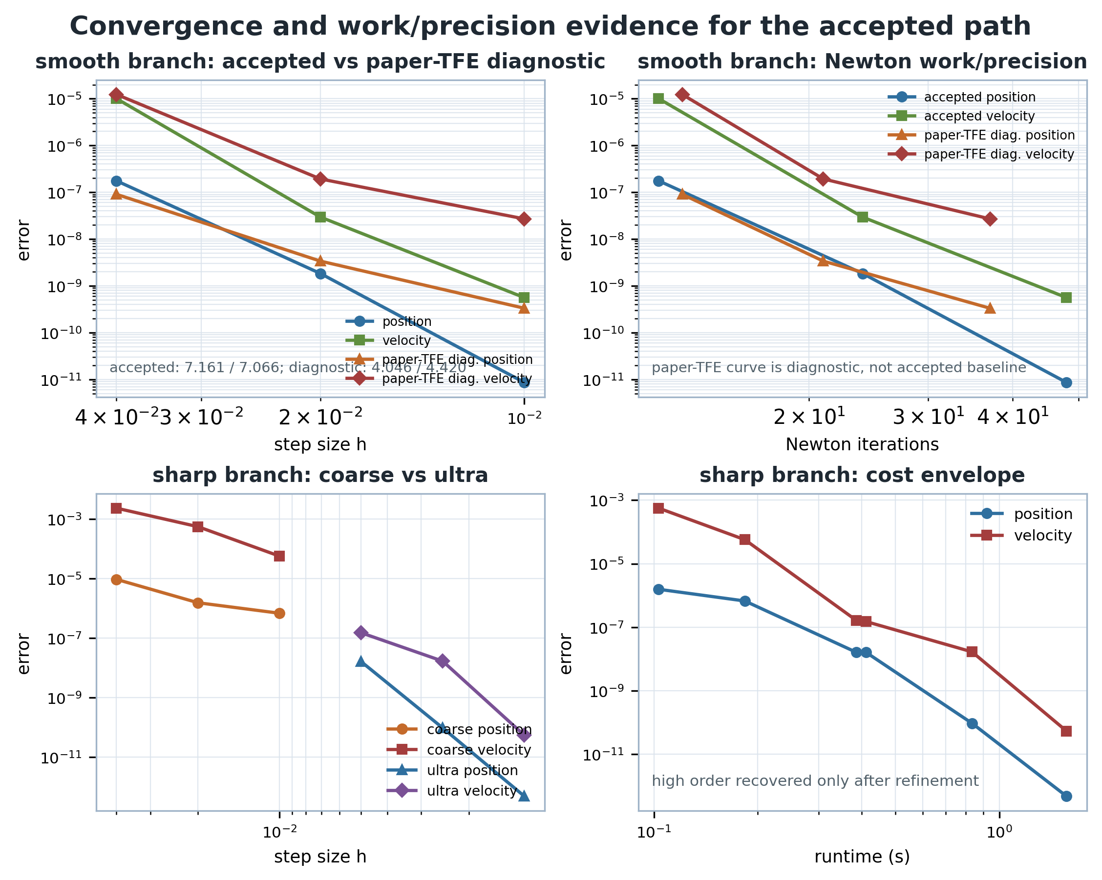
Smooth cylindrical chain: high-order consistency
Step sizes: h = 0.04, 0.02, 0.01.
This supports the conditional order-six path.
It is not a seventh-order theorem.
Headline v047 smooth h-sweep: position order 7.161, velocity order 7.066 against reference h=0.005.
06/09/2026
University of Wisconsin - Madison
18

Slide 19
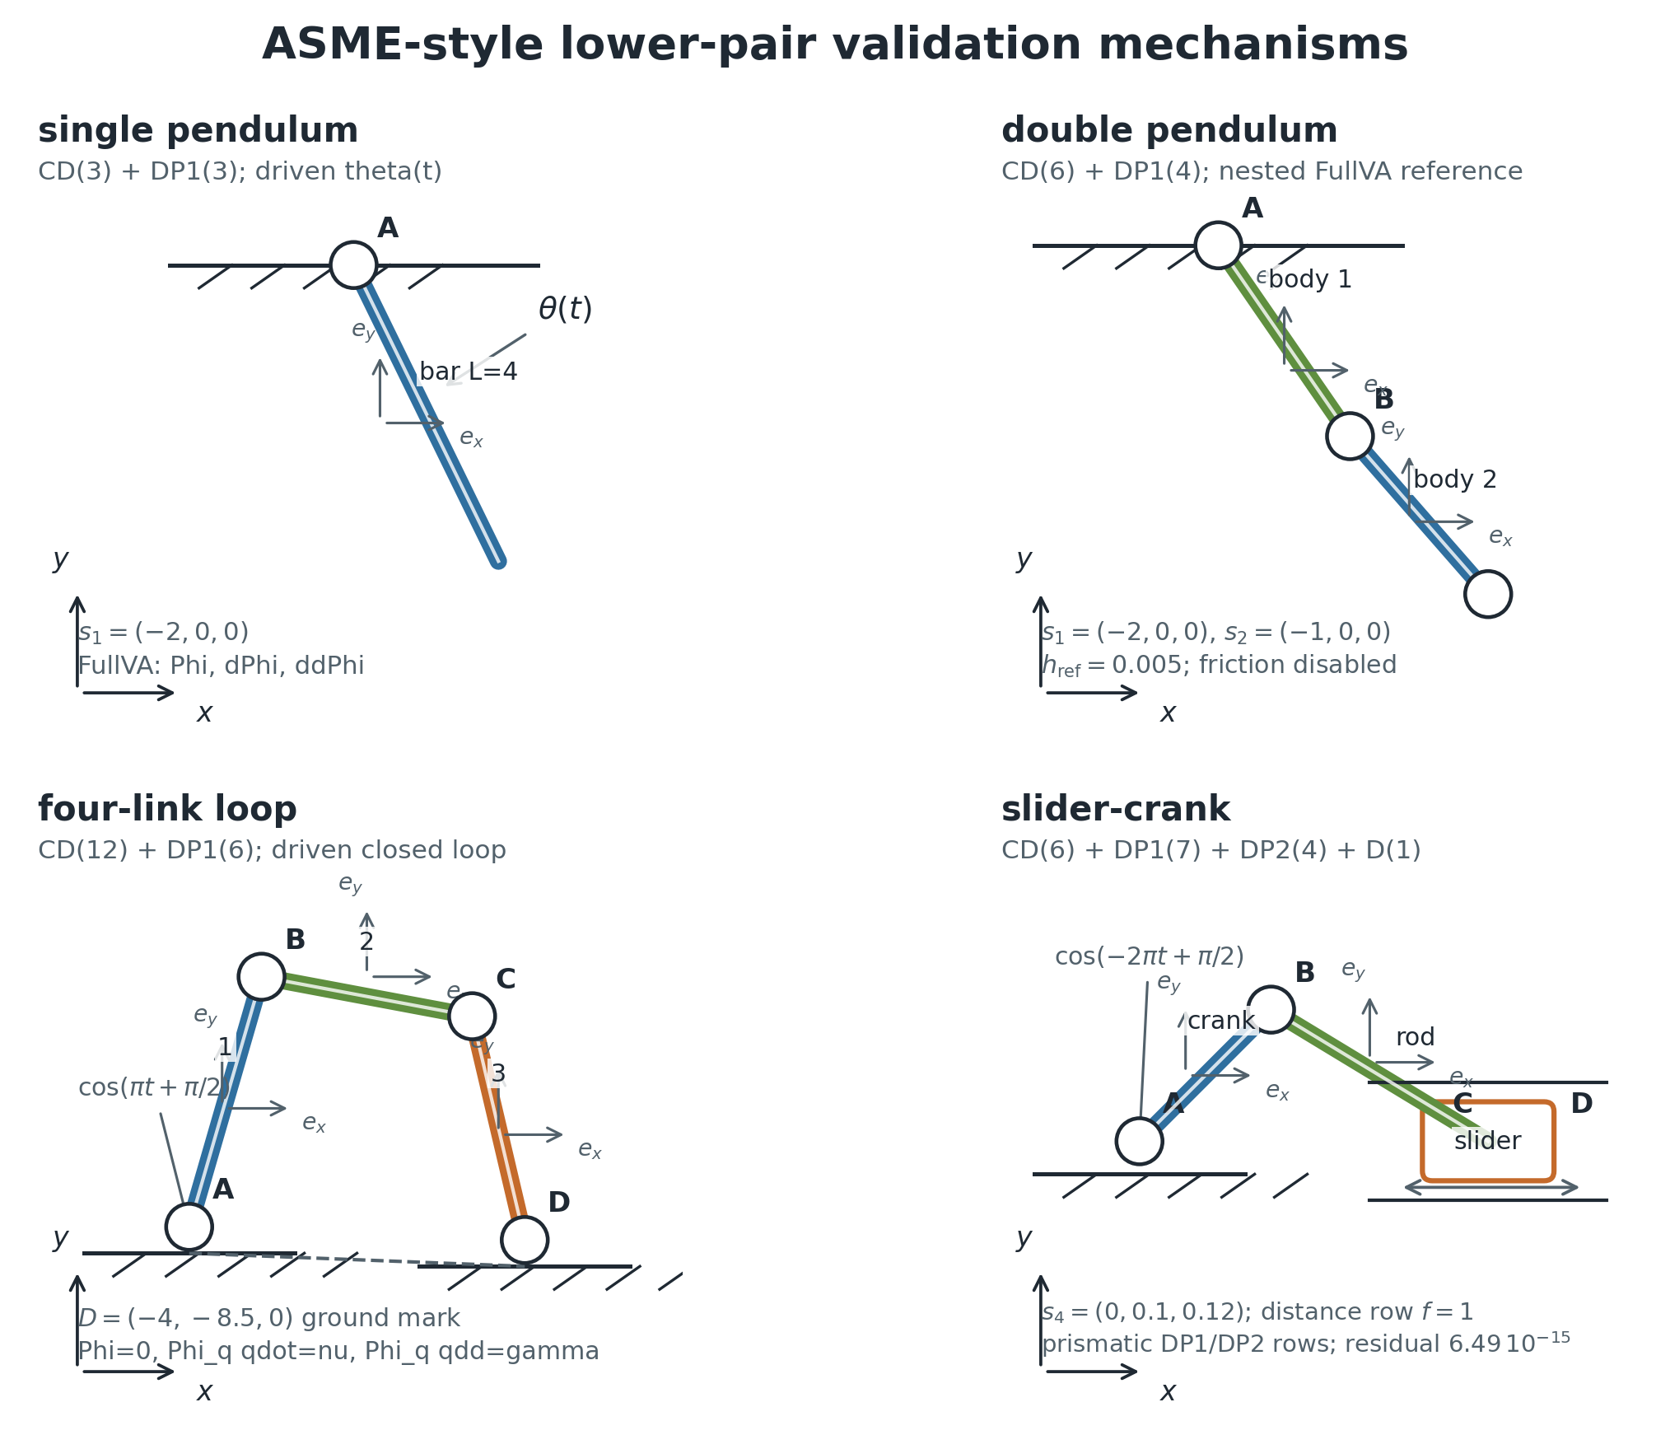
The four ASME mechanisms use the same constraint vocabulary
The gate is about mechanism coverage.
Rows are checked at position, velocity, and acceleration levels.
The same FullVA vocabulary is used across the examples.
The bridge maps CD, DP1, DP2, and D lower-pair rows across single pendulum, double pendulum, four-link, and slider-crank.
06/09/2026
University of Wisconsin - Madison
19

Slide 20
Example-level order boundary
6.024
6.089
1.34e-13
6.49e-15
single pendulum min accepted dynamic order
double pendulum min accepted dynamic order
four-link max reaction dynamics residual
slider-crank max reaction dynamics residual
Single and double pendulum carry accepted dynamic-order evidence; four-link and slider-crank are coverage/reaction evidence.
06/09/2026
University of Wisconsin - Madison
20

Slide 21
Single and double pendulum carry dynamic-order rows
Single pendulum: absolute-coordinate driven FullVA residual, minimum observed order 6.024.
Double pendulum: method-side FullVA mapping, nested local reference policy, minimum observed order 6.089.
Both rows support the method-side dynamic order claim.
They stay separate from external source-policy claims.
06/09/2026
University of Wisconsin - Madison
21

Slide 22
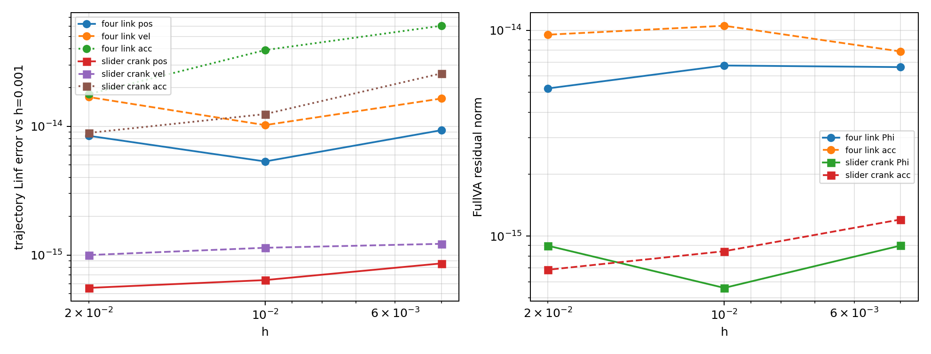
Four-link and slider-crank close the kinematic loop
These rows are accepted mechanism coverage.
They are not promoted to external dynamic-order rows.
Reaction reconstruction is checked separately.
Closed-loop FullVA solves enforce Phi=0, Phi_q qdot=nu, and Phi_q qdd=gamma for the two mechanisms.
06/09/2026
University of Wisconsin - Madison
22

Slide 23
Reaction dynamics closes after kinematics
Four-link max full dynamics residual: 1.338e-13.
Slider-crank max full dynamics residual: 6.492e-15.
The multipliers are reconstructed from accepted kinematic states.
This supports mechanism coverage, not source-policy superiority.
06/09/2026
University of Wisconsin - Madison
23

Slide 24
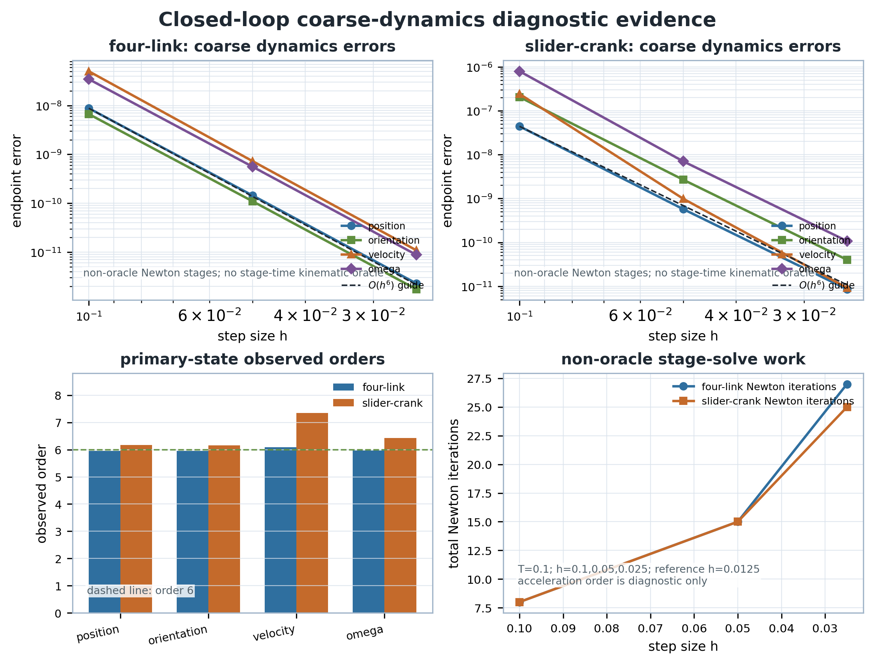
Closed-loop true-dynamic candidates are now visible
Four-link primary orders near 5.96 to 6.09.
Slider-crank primary orders near 6.16 to 7.34.
Same-test external promotion is still open.
v048 adds coarse true-dynamic local candidates for four-link and slider-crank, but keeps them out of external-superiority claims.
06/09/2026
University of Wisconsin - Madison
24

Slide 25
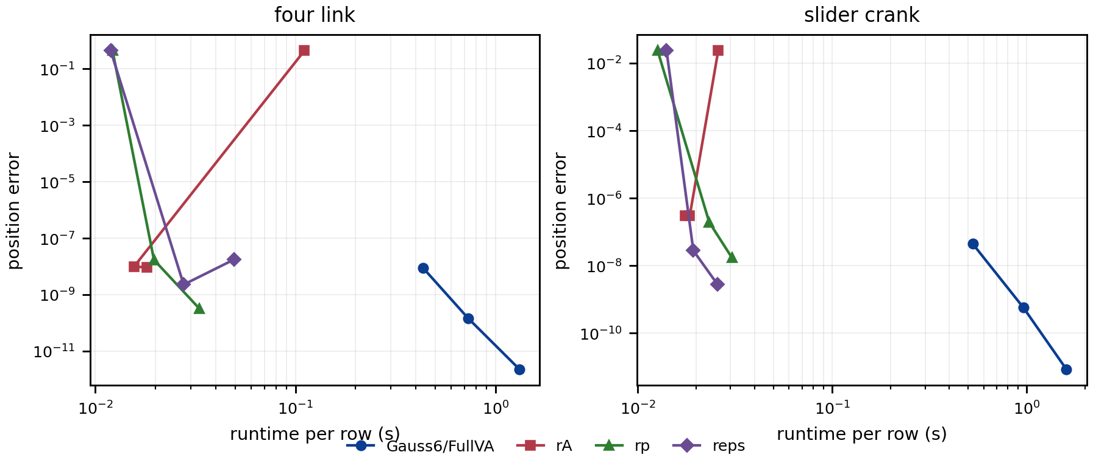
Common-reference work/precision is diagnostic
Common-reference cells are useful for comparison.
Source-policy rows remain open.
The deck should call this diagnostic evidence.
The same-window common-reference rows make error/work visible without closing source-policy superiority.
06/09/2026
University of Wisconsin - Madison
25

Slide 26
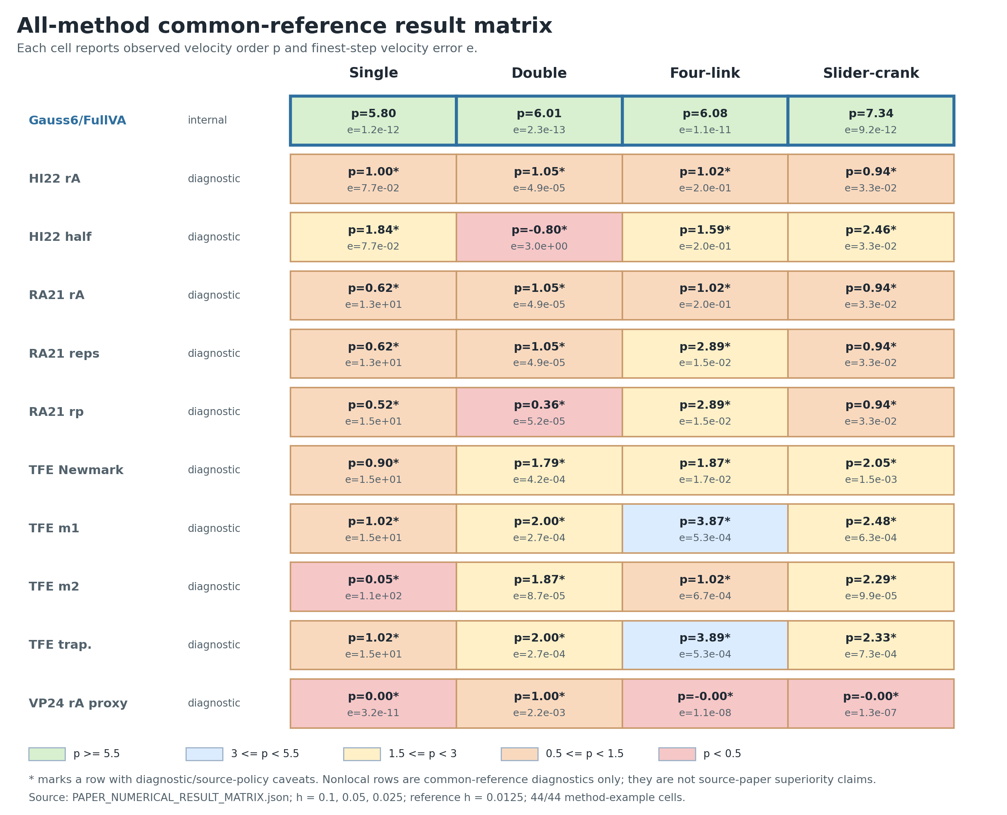
All-method result matrix
44 method/example cells are checked in the current common-reference matrix.
40/40 nonlocal velocity-order comparisons are positive.
Those counts do not become source-paper superiority.
The paper package records all method/example cells while preserving the non-claim boundary for external rows.
06/09/2026
University of Wisconsin - Madison
26

Slide 27
4 / Boundaries
What remains open
The negative space is part of the scientific result.
06/09/2026
University of Wisconsin - Madison
27

Slide 28
External comparison is not submission-ready
32/48
0/40
not run
false
performance matrix rows completed
source-policy rows promoted
full same-test campaign status
external superiority claim
The current package supports a narrowed Gauss6/FullVA claim, not a global source-policy claim.
06/09/2026
University of Wisconsin - Madison
28

Slide 29
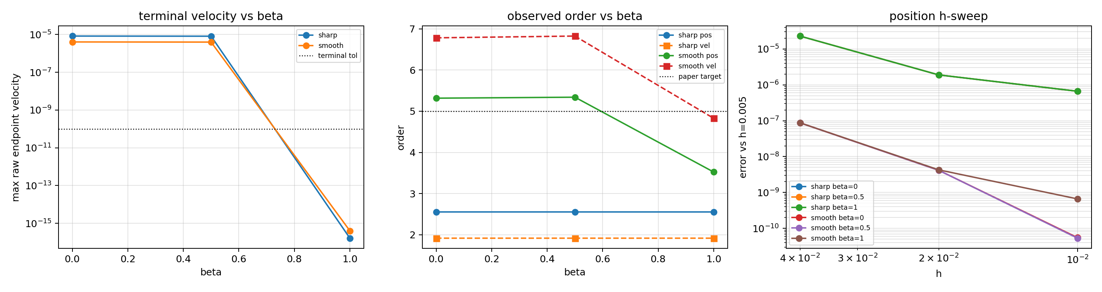
Full TFE replacement remains open
Full TFE replacement is a stronger source-paper reproduction gate.
It is not required for the accepted formal-order comparison.
Current candidates do not satisfy both terminal closure and order.
The strongest source-free closures split terminal velocity closure from smooth order recovery.
06/09/2026
University of Wisconsin - Madison
29

Slide 30
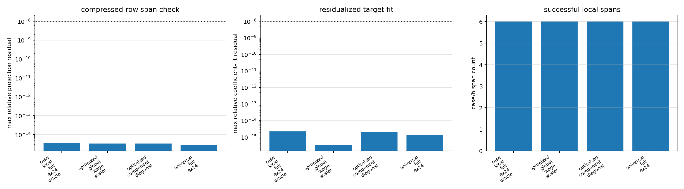
The lower-pair closure gap is localized
The missing complement has eight lower-pair directions.
Many terminal-limit and source-transport variants are ruled out.
Next progress needs a revised analytical weak-row formula.
Velocity-compression audits show that target-free non-final rows do not span the missing closure directions.
06/09/2026
University of Wisconsin - Madison
30

Slide 31
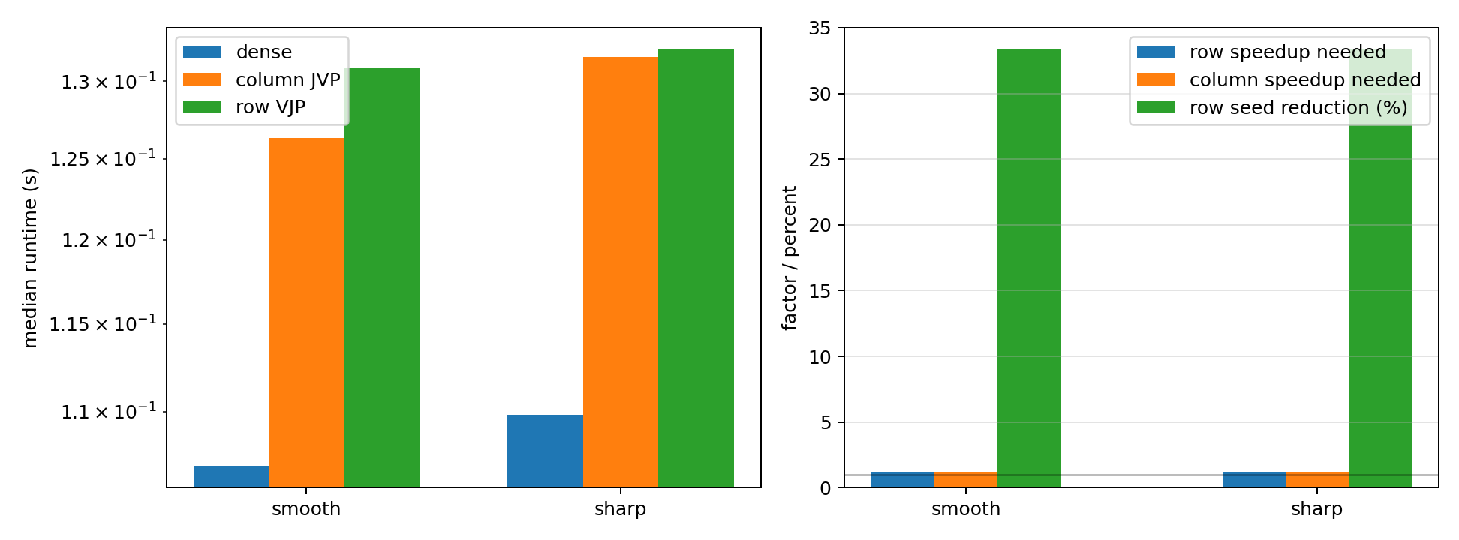
Sparse backend: correct, not yet faster
Exact pattern: 2637 entries.
Row colors: 60 versus 90 column colors.
Needed row-runtime reduction: about 18% to match dense.
The sparse pattern is exact and row-VJP reduces colors, but dense jacfwd is still faster in the recorded wall-clock runs.
06/09/2026
University of Wisconsin - Madison
31

Slide 32
Sharp friction is a practical cost caveat
The method claim rests on the smooth conditional path; sharp-friction coarse behavior is reported as a limitation.
Smooth case: position/velocity orders 7.161/7.066.
Sharp coarse h-sweep at vs=0.05: orders 1.894/2.683.
Ultra refinement recovers high order: 7.521/5.725.
Recovery costs about 7.25x runtime versus the h=0.01 baseline.
06/09/2026
University of Wisconsin - Madison
32

Slide 33
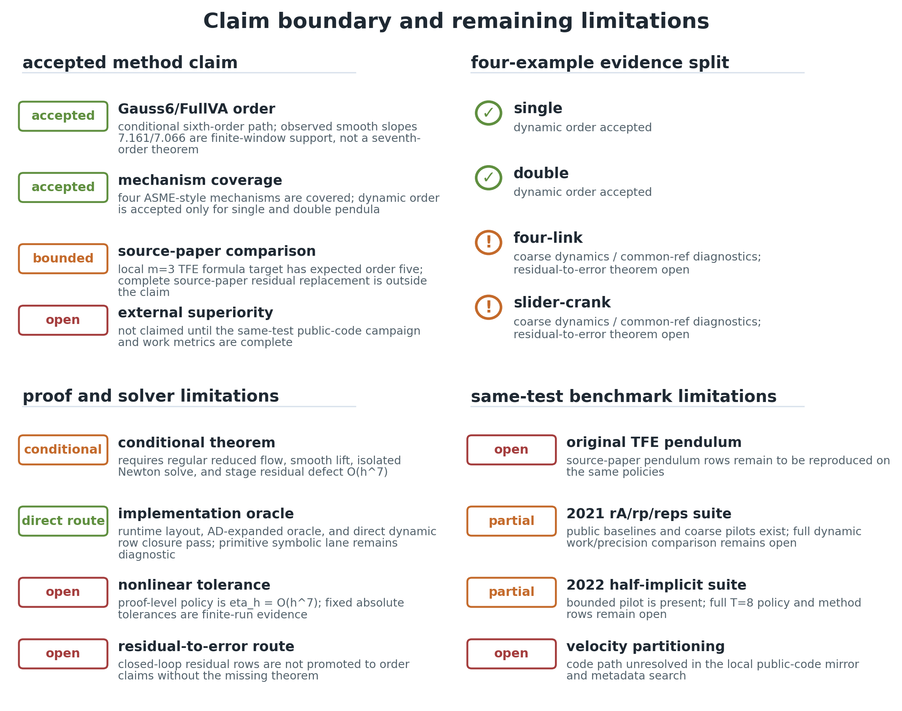
Claim boundary map
Green: accepted method/evidence.
Orange: bounded diagnostic evidence.
Open: source-policy rows, full TFE replacement, external superiority.
The accepted claim, diagnostic evidence, and open gates are intentionally separated.
06/09/2026
University of Wisconsin - Madison
33

Slide 34
Conclusion
Gauss6/FullVA is a usable sixth-order lower-pair path
when the smooth branch and solver-scale contracts hold.
It solves a monolithic 132-row stage residual for the cylindrical chain.
It passes the four ASME mechanism gate under the stated evidence roles.
It exceeds the local order-five m=3 TFE formula target at the formal-order level.
It does not claim full source-paper residual replacement or external superiority.
06/09/2026
University of Wisconsin - Madison
34

Slide 35
Open problems
Close or explicitly demote the remaining external source-policy suites.
Derive an independent full-TFE weak-row replacement that closes terminal velocity and preserves smooth order.
Turn exact sparse structure into a stable wall-clock win.
Reduce sharp-friction cost while keeping high-order behavior in practical step ranges.
06/09/2026
University of Wisconsin - Madison
35

Slide 36
Thank You
Questions?
Accepted claim: conditional sixth-order Gauss6/FullVA path
Open boundary: source-policy/full-TFE/external superiority

