Slide 1
Project kasparov Game theory applications of chess openings
Weiyu Tong
Metis SF Fall 2019

Slide 2
Questions:
Should smaller businesses compete against bigger businesses in the same location or use different strategies?
How should a bidder with less money than other bidders strategize in an auction?

Slide 3
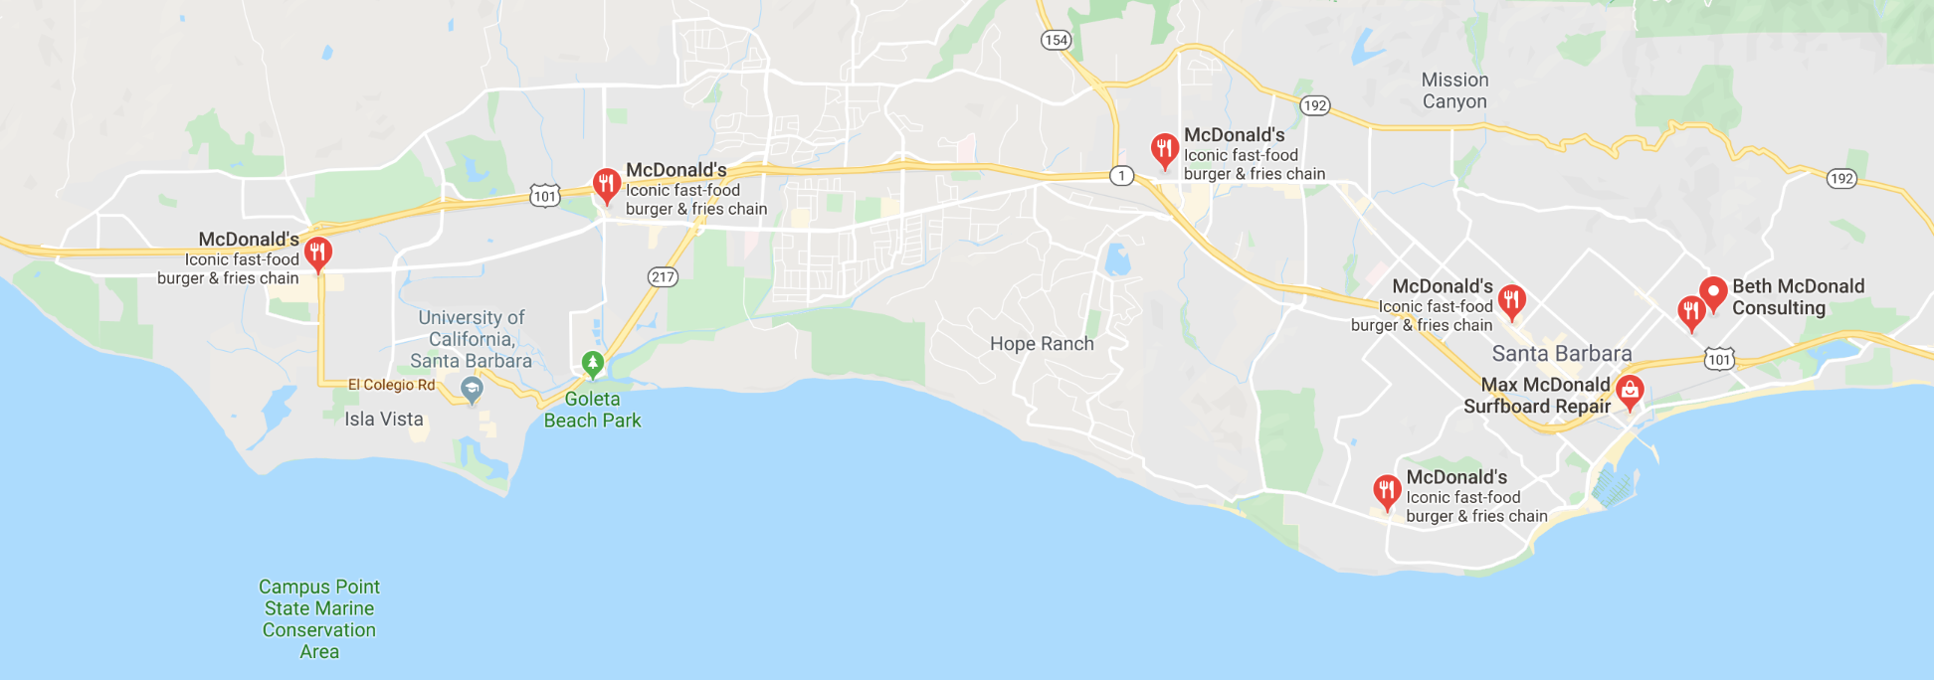
McDonald’s in Santa Barbara

Slide 4

The Habit in Santa Barbara

Slide 5
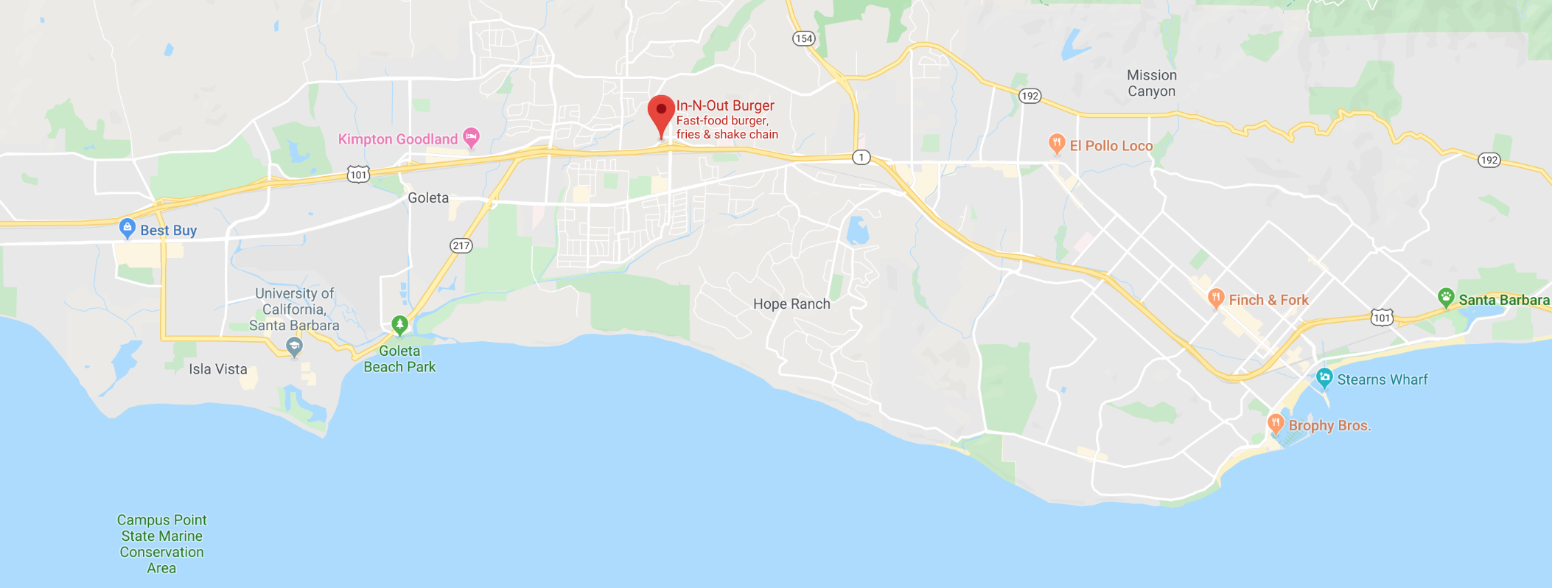
In-n-Out in Santa Barbara

Slide 6
Difficulties Analyzing
Auction information is ephemeral and not recorded.
Internal business decisions are usually proprietary and difficult to procure

Slide 7

Why Study Chess?
Abundant data
Nearly every game at tournaments is recorded
Very popular game
Accessible data
Millions of chess games in archives
Consistent game notation formatting
.pgn file format (Portable Game Notation)
Hundreds of years of deeply-fleshed opening theory

Slide 8
Common Features
Perfect-Information Games
Non-Cooperative Players
Sequential “Turns”

Slide 9
Chess
Business Applications
Game Theory

Slide 10
Definitions and Concepts
White always moves first
Opening
the first few moves of a chess game
Elo Rating
a measure of the skill of a player
Elo Difference
White Elo Rating – Black Elo Rating
Win Ratio
Probability of winning based on Elo, Elo difference, and opening.

Slide 11
Data Acquisition
theweekinchess.com
Website for chess news and games
Has archive of global chess tournaments going back to 2012
Web-scraping: mass-downloaded
Total size of data downloaded: 1.01 GB

Slide 12
Initial Dataset
1.3 million games read
Mostly tournaments
Strong bias towards high Elo Players
Relevant features:
White Elo
Black Elo
Opening
Result (i.e. win, loss, or draw)
After cleaning, reduced to 1.1 million games
Added Elo Difference
Rounded Elo Ratings and Elo Difference to nearest 50

Slide 13
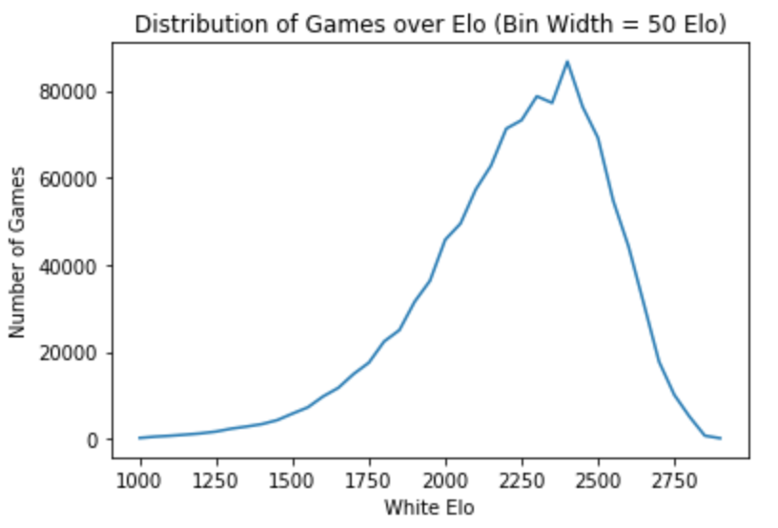

Slide 14
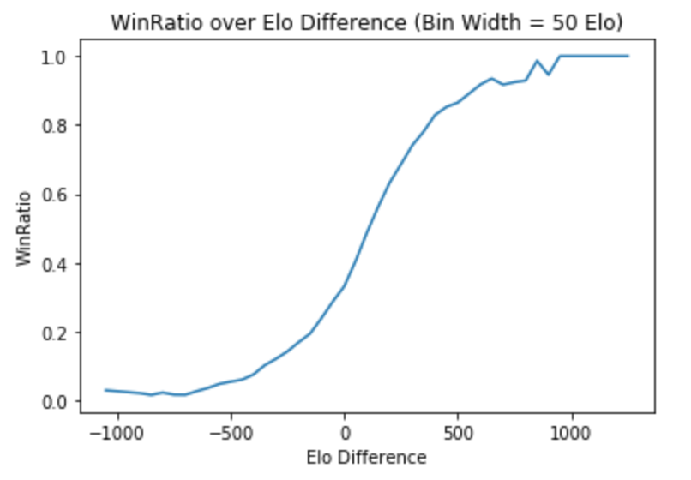

Slide 15
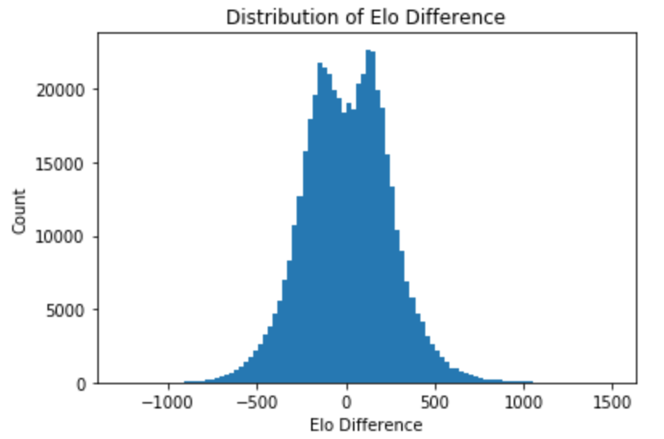

Slide 16
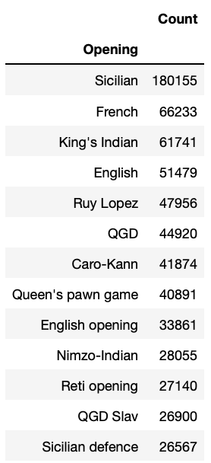
Choosing most popular openings
Top 7 most frequent openings accounts for about half of all games (~490k rows).
Take these 7 openings as categorical features.

Slide 17
Feature Engineering
Only used rows which employed those six openings.
Features:
White Elo
Elo Difference
The six openings as categoricals
Target:
Win probability as a function of Elo Difference
“Elo Difference” collinear with “White Elo”
”White Elo” deleted
”Caro-Kann” and “English” immediately had large p-values > 0.5
Both deleted from features

Slide 18
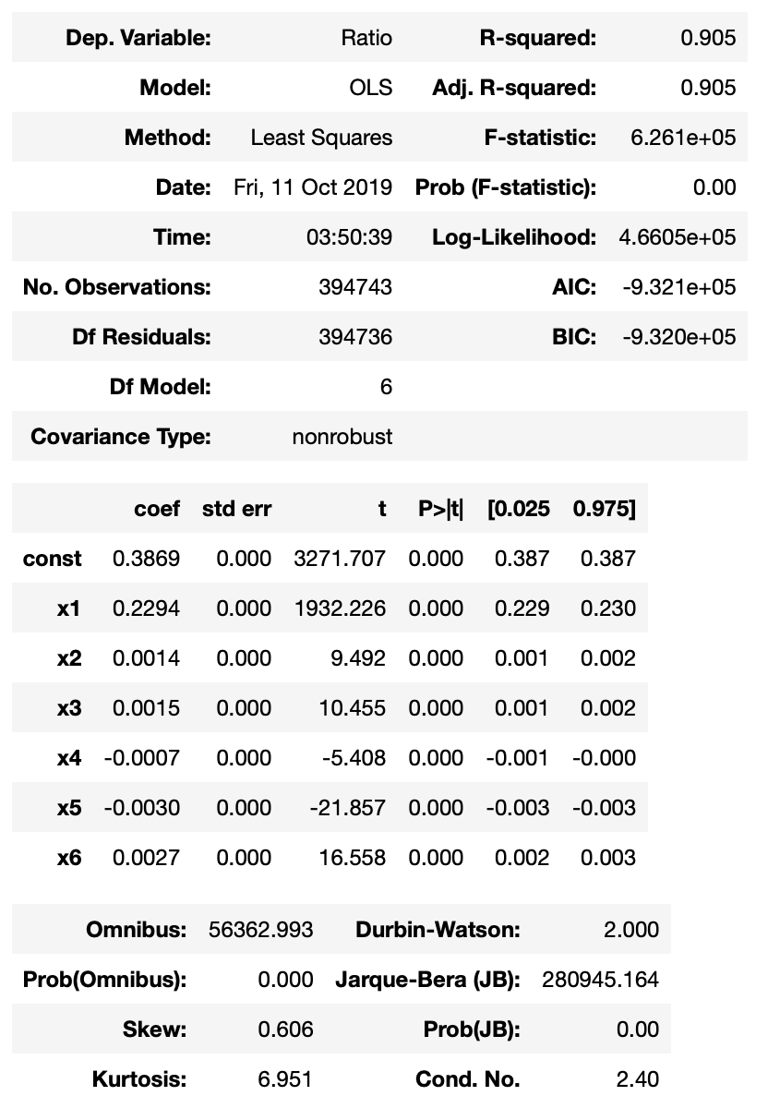
Model Evaluation
First with statsmodel
Trained with 80% of data
Tested with remaining 20%
High R-squared > 0.9
All features have p-values < 0.05
Coefficients are small
MSE = 0.01

Slide 19
Sci-kit Learn Prediction
Feature | Coefficient
Intercept | 0.387
Elo Difference | 9.48e-4
“French” | 4.01e-3
“King’s Indian” | 4.51e-3
“Queen’s Gambit Declined” | -2.58e-3
”Ruy Lopez” | -1.02e-2
“Sicilian | 5.56e-3
The only opening which doesn’t start with 1. e4 is “King’s Indian”

Slide 20
Ruy lopez opening
Beta = -0.01, most advantageous for negative Elo Difference
AGGRESSIVE!
THREATS AND COUNTER-ATTACKS AT EVERY MOVE!
FORCEFUL PUSH

Slide 21
Sicilian opening
Beta = 0.005, most advantageous for positive Elo Difference
Passive
Black does not threaten any pieces or directly control the center

Slide 22
Conclusions
If Black is the decision-maker, openings with positive coefficients are advantageous if their Elo is less than the opponent’s
Sicilian > Ruy Lopez
Passive > Aggressive

