Slide 1
Image Processing Based Detection & Classification of Blood Group Using Color Images
Submitted by,
Esther Baby
Roll No : 27
S6 MCA
CET Trivandrum
Guided by,
Asst. Prof. Vinya Vijayan

Slide 2
CONTENTS
Problem Statement
System Architecture
System Design
Operating Environment
Software Requirements .
Hardware Requirements
Conclusion and future scope
References

Slide 3
Problem Statement
Domain of image processing is progressing a lot and has achieved tremendous milestones.
Various diseases have been identified using image processing techniques and thus have provided early phase detection
Image Processing techniques can be used for blood group identification
The system can help a lab technician or a novice user with no prior knowledge to detect blood group

Slide 4
Problem Statement
It will reduce human effort and time
Automation of the blood group detection system
No microscopic image is needed.
The system could detect blood group by a clear image of blood mixed with anti serums using a digital camera

Slide 5
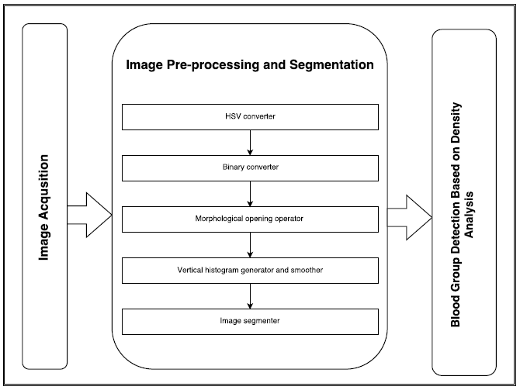
SYSTEM ARCHITECTURE
Hsv Converter
BINARY Converter
Morphological opening operator
Vertical histogram generator
Histogram smoother and derivative generator
IMAGE SEGMENTATION
Notes:
5

Slide 6
SYSTEM ARCHITECTURE
Main Modules
Image Acqusition and pre-processing
Histogramic processing and Segmentation
Detection
Notes:
6

Slide 7
Image Acqusition and pre-processing
Notes:
7

Slide 8
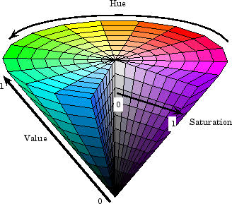
HSV conversion and Binary conversion
RGB Hue Saturation Binary
Value image image
Hue value ID : 0 – 360
Saturation : 0 – 1
Brightness : 0 – 1

Slide 9
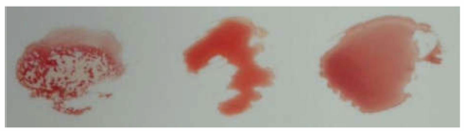
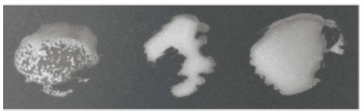
Image acquired using digital camera during blood test at laboratory
Conversion of RGB image into HSV

Slide 10

Morphological opening operation
Erosion followed by a dilation, using the same structuring element for both operations and is defines by equation

Slide 11
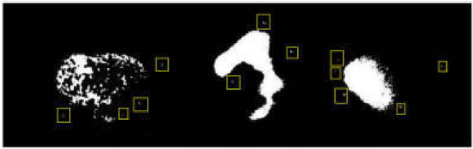
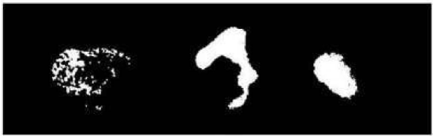
Morphological opening operation
Applying morpholoigal opeations to remove small components

Slide 12
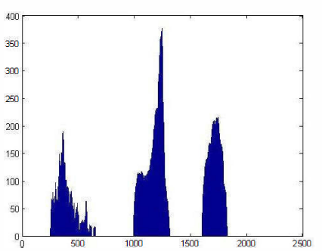

Vertical Histogram

Slide 13
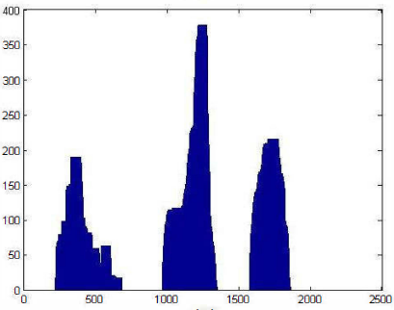

Histogram Smoothing
Done using dialation equation

Slide 14

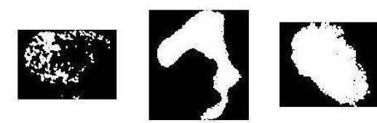
Histogram Derivation & Segmentation
First derivative of histogram is taken using equation
Based on information of edges segmentation is done

Slide 15
Detection
Density of white pixel of each segmented region
Total number of elements in each segmented image
Threshold for Density to accept a region
< 13000
Threshold for number of elements to accept a region
> 5

Slide 16
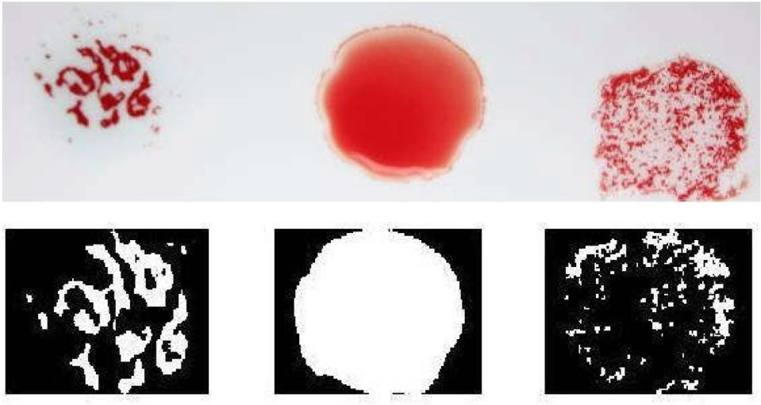
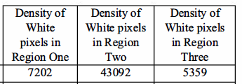

Detection
X
1
0
1
X

Slide 17
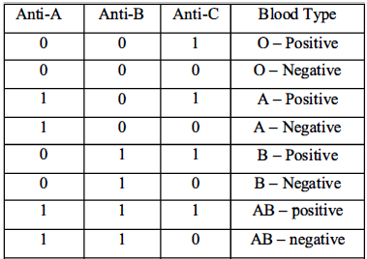
Detection

Slide 18

SYSTEM DESIGN
Image Acqusition
HSV Convertion
Morphological Operation
Binary Conversion
Vertical Histogram
User
Derivative Histogram
Histogram Smoothing
Density based Detection
Image Segmentation

Slide 19
DFD

Slide 20
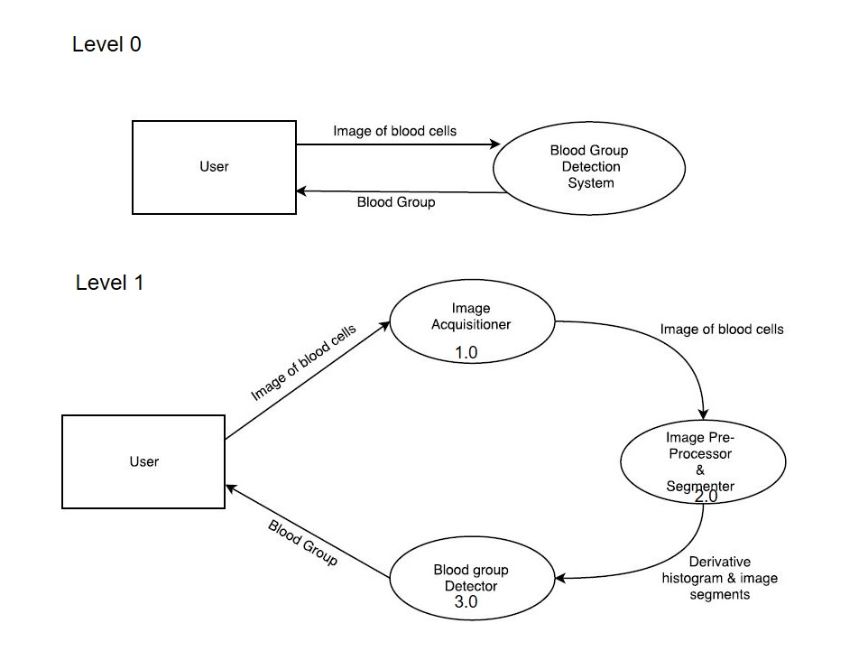

Slide 21
System Design
..\Documents\dfd3.docx

Slide 22
Operating Environment
Software Requirement
➢ Operating system : Ubuntu 10.04
➢ Coding Language : Python
➢ Tool Kit : PythonToolKit(PTK)
➢ IDE : Pychram
Hardware Requirement
The minimum hardware requirement of computer is
➢ Processor : intel core i5 processor
➢ Hard Disk : 200 GB
➢ RAM : 4 GB

Slide 23
CONCLUSION AND FUTURE SCOPE
The colored image taken will uploaded into application and will be converted to HSV format.
Then image will be rendered for the development of histogram then taking the derivative and focusing the area of blood image.
Using the image blood group will be classified.
In future a small hardware device can be made like diabetes checking machine that we see in our daily life and that small machine could be used by novice users in disaster or other remote areas where expert staff is not available.

Slide 24
REFERENCES
Abubakar Yamin, FaisalIrnran, UsmanAkbar, Syed Hassan Tanvir. “Image Processing Based Detection & Classification of Blood Group Using Color Images” 2017 International Conference on Communication, Computing and Digital Systems (C-CODE), IEEE
Ferraz, Ana. "Automatic system for determination of blood types using image processing techniques." Bioengineering (ENBENG), 2013 IEEE 3rd Portuguese Meeting in. IEEE,2013.
WWW.wikipedia.org/wiki/Blood_cell
WWW.wikipedia.org/wiki/RBC

Slide 25
Thank You ☺

