Slide 1
Data Center Control Plane
Servers

Slide 2
Current State
Broken
Business logic exist in code
  simplified contract (/kick_server/<server_id>)
  orchestration in code
Databases are indexed by external business id
Translation of asset data occurs within the application, rather than being a requirement of the contract

Slide 3
Well defined contract
Removal of business logic from the core provisioning services, agents, and libraries
High-level abstractions and orchestration is pushed further up the stack
Resulting in
  Isolated and traceable operations
  Simpler code
    less error
    easier to secure and maintain

Slide 4
Well defined contract
Example Remote Procedure
  create_raid_configuration
    kwargs:
      adapter: 0
      level: 10
      cache_policy: write_back
      ssd_over_provisioning: True
      pdisks: [0:5]
      span_depth: 2
      size: 0
      hotspares: [6, 7]
      stripe: 64KiB

Slide 5
Mercury RPC service
Inventory Query
* Parallel execution on devices that match the inventory query
{
switch_name: j6-23-1s.ord1,
hardware.raid.adapter.0.disks:
{
$gte: 4
}
}
Agent RPC
create_raid_configuration
(
level: 10,
adapter: 0,
pdisks: [0:3]
)

Slide 6
mercury-rpc micro service
Front End
Back End
RPC endpoint service
ROUTER / REQ
Registration Service
ROUTER / REQ
Active Queue
Results Queue
Queue Runners
Command bus
Ping threads
Results bus
clients

Slide 7
MercuryRPC
Register IP / PORT
ping
pong
Agent
RPC Queue
Workers
Capabilities:
configure_obm
set_obm_user
set_obm_password
enable_ipmi
configure_raid
reboot
poweroff
launch_press
RPC REP Socket
Clients

Slide 8
Two states
Inventory (provider controlled) | Allocated (customer/support controlled)
Static TOR configuration per zone Always available via long running agent Supplemented with out of band access No need for CORE holding account No need for inventory services data backend | Custom TOR configuration per customer Variable asset data Only available through inband (invasive) and out of band (limited capabilities) ADC

Slide 9
Plugable asset backends
CORE data is incomplete and inaccurate
IP addresses information does not describe bonding or identify what networks are associated with a physical interface
Pre-rendered asset information supplemented with explicit customer requirements
  custom images
  ssh keys
  ip information
  complex networking
  complex storage
  everything else

Slide 10
DCX Data Problems
Environment and location data ends at the switch port

Slide 11
Single Document
Describes physical state
Scope
  Routers
    asset info
    vlans
    bridge info
    SVI
    interfaces
      links to TOR
    access capabilities
  TOR
    asset info
    aggregated vlans (allowed vlans)
    ports
      links to unique identifier of network devices, storage devices, and servers
  Network devices
    firewalls
    load balancers
  Servers
    mercury_id
    mercury_inventory
  Storage
Notes:
Logical state document that can be generated using existing datasets (hopefully)

Slide 12
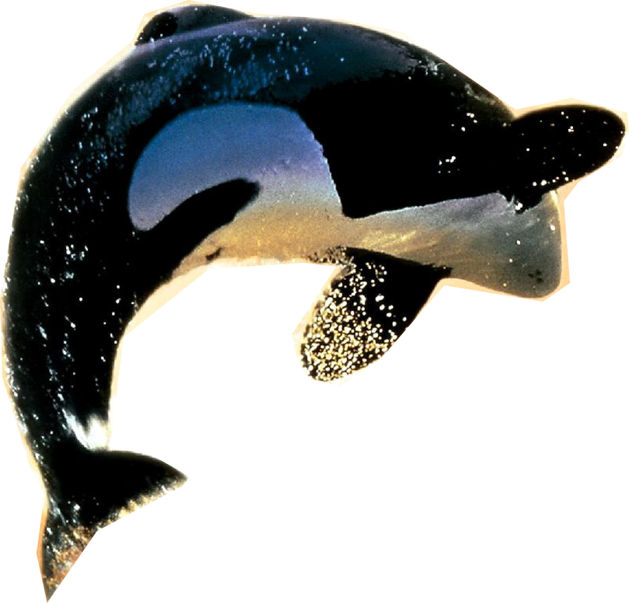

ORCA

Slide 13
ORCA
Hypothetical orchestration framework
Operates on state change events for documents it is configured to monitor
For instance, if assets.image_target, or inventory.interfaces.0.lldp.switch_port is updated, orca executes the predefined software handlers intended to perform

