Slide 1
INF501 - Research Methods in Informatics and Computing
Lecture #01
Dr. Igor Steinmacher
e-mail: Igor.Steinmacher@nau.edu
Twitter: @igorsteinmacher

Slide 2


Slide 3
Introductions
Igor Steinmacher, PhD
Assistant Professor
Interested in behavior in Software Development
Mainly Open Source
This course
Overview of informatics and computing research areas (in SICCS)
Professors’ talks
Critical thinking
Research proposal writing

Slide 4
Introductions
Join your closes colleague and present yourself (5 minutes)
Your name
A little about you (where from, previous educational/industrial background, etc.)
Motivation to be here
Research topic (advisor, if applicable)
What do you expect from this course

Slide 5
This Course: Assignments
Response essays
7 talks → each students choose 4 to write about
Talk + 2 or 3 papers
Inform your decision 24 hours after the talk
Attendance is mandatory even if not writing an essay for the talk
Essays are due on Thursday before next talk (in 2 weeks)
Essays need to be written and peer reviewed** before final submission
Peer-review
I will pair the students (submitter – reviewer)
1st version by Friday after the talk
Reviewer must return the review before Tuesday
Final submission addressing concerns by Thursday before next talk

Slide 6
Essay Schedule
Week 1
Fri | Sat | Sun | Mon | Tue | Wed | Thu
TALK + discussion
Week 2
Fri | Sat | Sun | Mon | Tue | Wed | Thu
V1 deadline |  |  |  | Review deadline |  | Submission deadline

Slide 7
Talk Schedule (Tentative)
Sept 7 | Talk 1: Professor Joseph Mihaljevic
Sept 21 | Talk 2: Professor Marc Tollis
Oct 5 | Talk 3: Professor Tolga Yalcin
Oct 19 | Talk 4: Professor Marco Gerosa
Nov 2 | Talk 5: Professor Truong Nghiem
Nov 16 | Talk 6: Professor Benjamin Rudell
Nov 30 | Talk 7: Professor Toby Hocking

Slide 8
This Course: Assignments
Mediating discussions
Talks will be followed by a discussion
Each talk will require 1 or 2 students to mediate the discussion
Everybody need to mediate one talk
Collaboratively building knowledge about the research
Research proposal
introduction;
literature review;
research questions/hypotheses and needs/objectives;
research plan and methods.

Slide 9
Assignment Schedule
Assignment | Due Date | Weight
Attendance and Class Participation |  | 10%
Discussion Mediation |  | 5%
Response Essays | Every 2 weeks | 40%
Peer Reviews | Every 2 weeks | 10%
Research proposal 1 – Introduction | Oct 26 | 5%
Research proposal 2 – Literature Review | Nov 13 | 10%
Research proposal 3 – Research Questions/Hypotheses, Needs/Objectives | Nov 30 | 5%
Elevator Pitch | Dec 7 | 5%
Research proposal 4 – Final (Research Plan/Methods) | Dec 10, 2:30PM | 10%

Slide 10
Important Information
Where to find me:
Over there → Room 090-115
Igor.Steinmacher@nau.edu
Office Hours:
TuTh 09:30AM – 11:20AM
And you can schedule appointments

Slide 11
Writing response essays

Slide 12
Critical Thinking/Reading
Try to engage with the researcher in a discussion, asking questions and defending a thesis
Note taking, discussing with peers during round tables
Take notes on how you react to the main points of the research
Recognizing the main points is key
Summarize(paraphrase) author’s main ideas
Support or defend your point of view relate to author’s ideas

Slide 13
Organize Yourself
Write the thesis you are defending/reverberating
Decide the key points that will back your ideas (topics)
Develop your ideas by adding references, quotes, evidences and details to your paragraphs (just bullets so far)
Make sure the last paragraphs connect to each other
Check your thesis and make sure the points and ideas support it

Slide 14
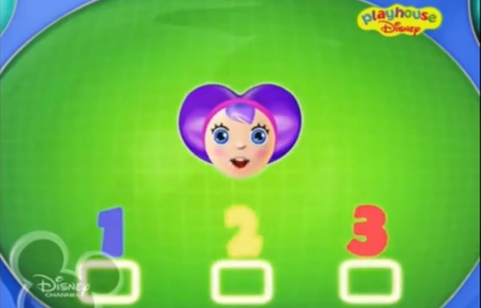
THREE SPECIAL STEPS
THAT’S ALL YOU NEED

Slide 15
Three Special Steps
Introduction
Body
Conclusion

Slide 16
Introduction
Bring context, motivation and problem
Engage the reader by making the topic interesting
State author’s main goals and ideas
Main points
Reader needs to have a general sense of all key aspects of the original work
Do not engage in discussion (Informative)
No personal/response to the work
Statement and brief description on your point about the research

Slide 17
Body
Reaffirm your main idea, bringing some more context to introduce the section and the upcoming support topics
For each topic, discuss based on your thoughts and, more importantly, facts, evidences, and results (from the paper, other known source, personal experience)
Think about how is the work related to problems in our research
Discuss how the research increase your understanding of a particular issue/changed your perspective
Evaluate the importance of the research
Try to avoid over using “I agree” and “I disagree”
You can bring points agreeing/disagreeing (try to back this decisions)
You can structure in one or many sections (organization is key!)

Slide 18
Conclusion
Give a final point and close it getting back to the topics presented in the introduction
Bring important highlights from your discussion
Most interesting things
Points that attracted you
Ideas that came up
How your research is tied to it

Slide 19
For Next Week
Joe Mihaljevic
https://jrmihalj.github.io/
Read the papers

