Slide 1
AES---MATLAB Advanced Encryption System
Jun Rao
Northern Arizona University
INF638

Slide 2


step-1: Byte substitution; the s-boxes

Slide 3

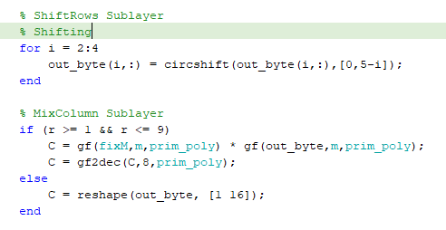
step-2: shift rows

Slide 4



step-3: Mix Column

Slide 5
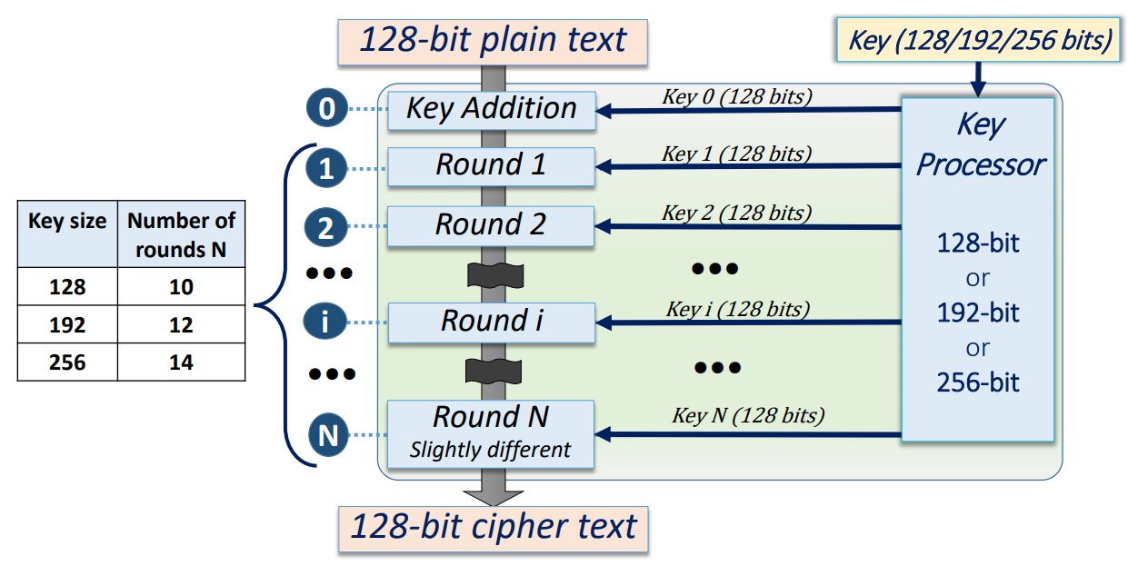
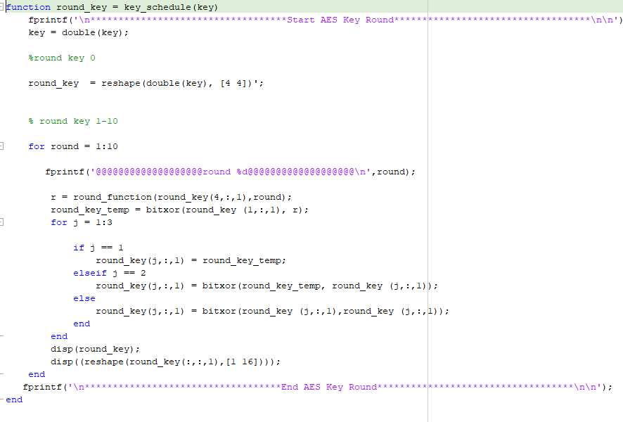
AES step-4: Key addition (XOR)

