Slide 1
Error detection and correction
Jun Rao
Northern Arizona Universty

Slide 2
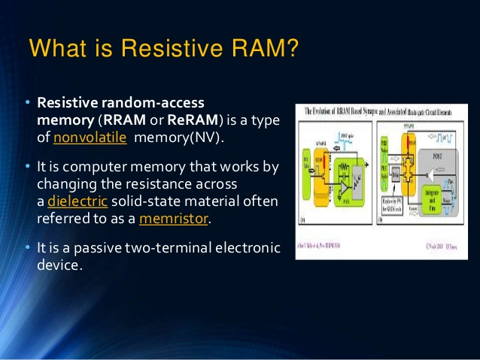
Resistive Random Access Memory
1.1
 | 2.2
 |  | 3.3
 |  |  | 4.4
 |  |  |  |  |  |  |  |  | n.n

Slide 3
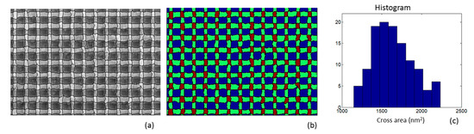
Error detection

Slide 4
Research Processing
1.In our research, we total check 75 cells
2.For each cell, we have 8 different injection
3.We check the same ReRAM, in different temperature, one is natural temperature which is 60F, and the other one is 23F

Slide 5
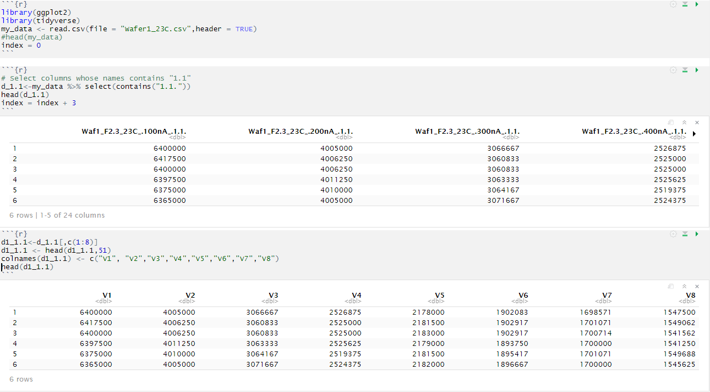
Example Code

Slide 6
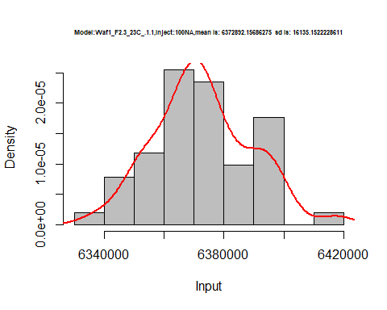
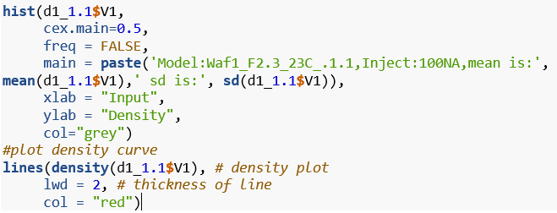
Research Processing

Slide 7
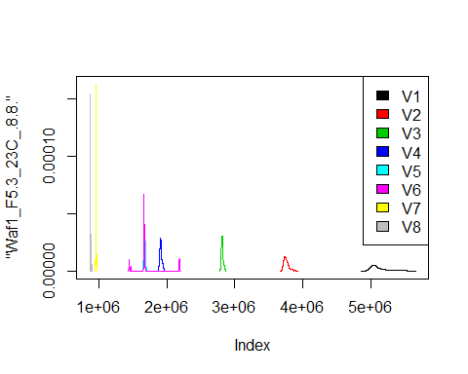
Research Processing

Slide 8
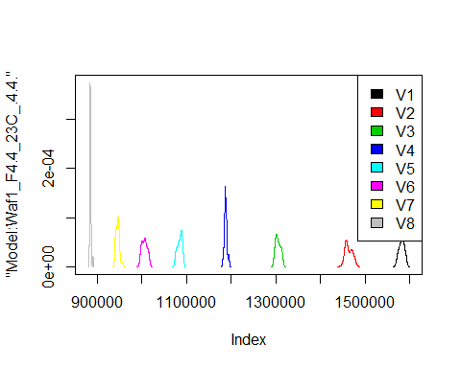
Research Processing

Slide 9
Result Compare

Slide 10
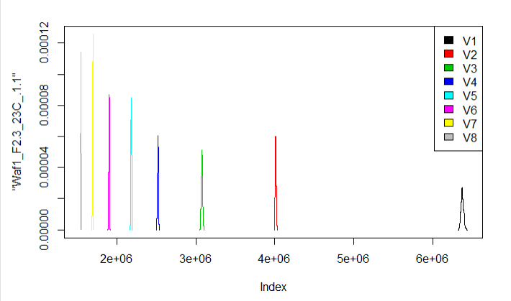
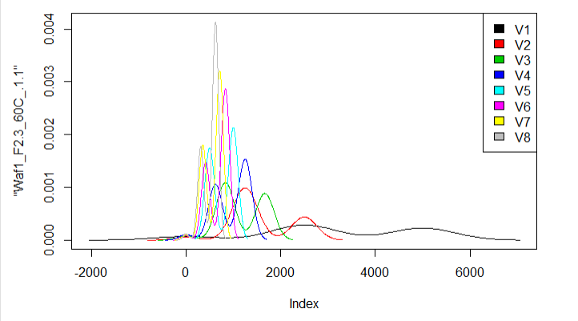
Result Compare

Slide 11


Conclusion
Even for the same SRAM in the same cell, if the temperature is different, the result is far away from each other.
We can assume temperature is a very important measurement in our research

Slide 12

Future Work
By collect the data in different temperature, we can find the association (positive or negative ) between the temperature and the useful number of cells in the ReRAM.

