Slide 1
Advanced Structural Analysis using ANSYS
Project 6: Buckling Analysis
Devang Keshavlal Kachhadiya (3127394)
Sasank Maduku Naga (3129054)
Nikunj Ashokbhai Panchal(3105056)
Ahmed Yassin (3076314)

Slide 2
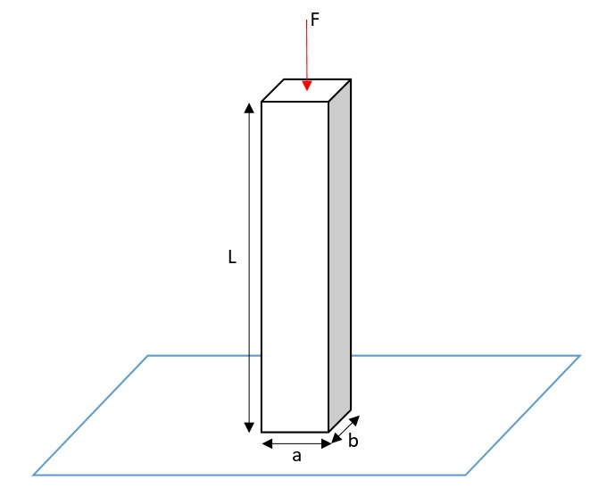
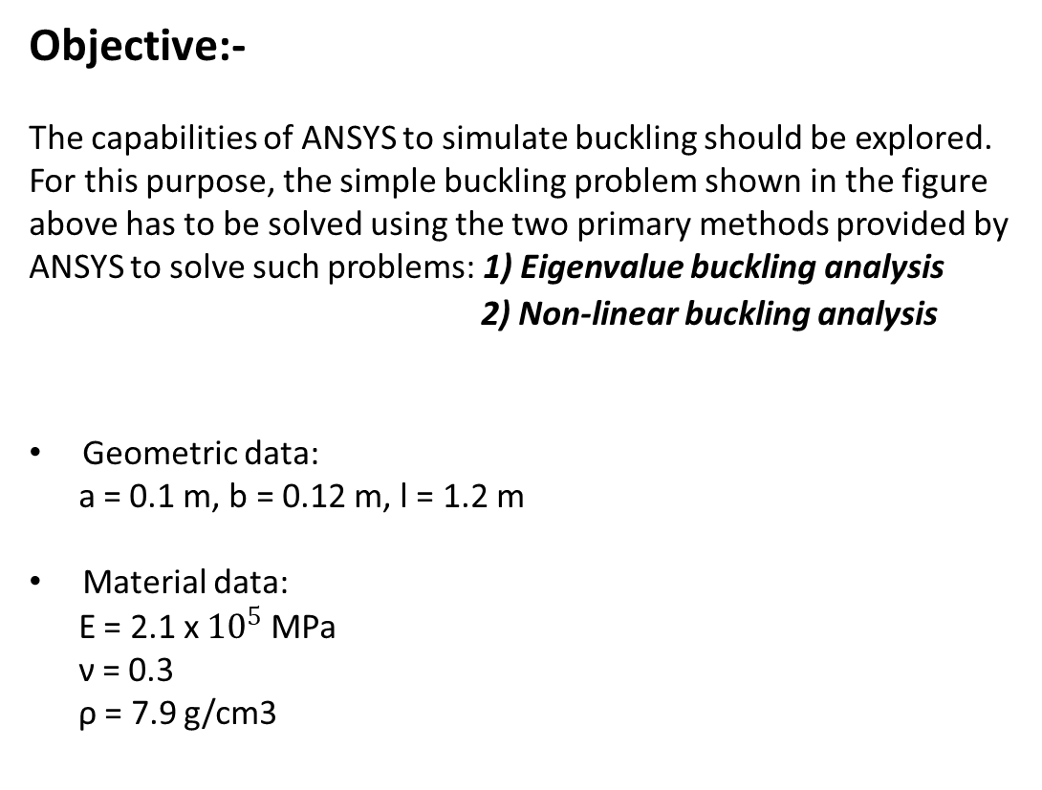
Buckling Analysis : Problem overview
Objective:-
The capabilities of ANSYS to simulate buckling should be explored. For this purpose, the simple buckling problem shown in the figure above has to be solved using the two primary methods provided by ANSYS to solve such problems: 1) Eigenvalue buckling analysis
2) Non-linear buckling analysis
Geometric data:
a = 0.1 m, b = 0.12 m, l = 1.2 m
Material data:
E = 2.1 x ${10}^{5}$ MPa
ν = 0.3
ρ = 7.9 g/cm3
Figure 1: Column under load F

Slide 3
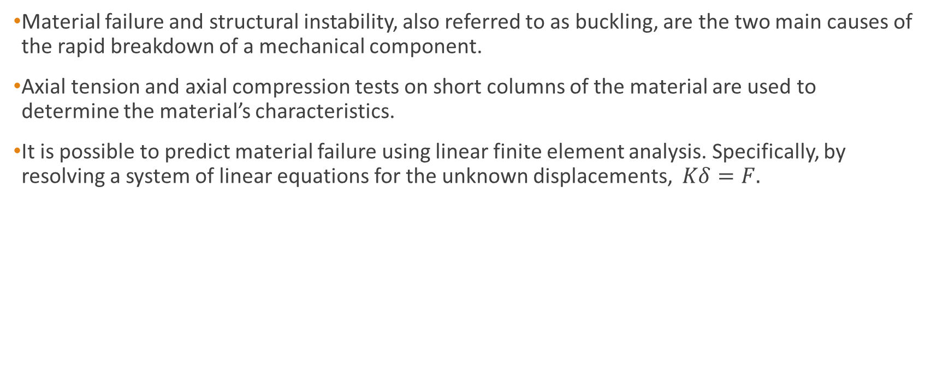
Buckling Analysis
Material failure and structural instability, also referred to as buckling, are the two main causes of the rapid breakdown of a mechanical component.
Axial tension and axial compression tests on short columns of the material are used to determine the material’s characteristics.
It is possible to predict material failure using linear finite element analysis. Specifically, by resolving a system of linear equations for the unknown displacements, $Kδ=F.$

Slide 4
Eigenvalue Buckling analysis
Eigenvalue analysis predicts the theoretical buckling strength of a structure which is idealized as elastic.
For a basic structural configuration, structural eigenvalues are computed from constraints and loading conditions.
Buckling loads are then derived, each associated with a buckled mode shape which represents the shape a structure assumes under buckling.
In a real structure, imperfections and nonlinear behaviour keep the system from achieving this theoretical buckling strength, leading Eigenvalue analysis to over predict buckling load. Therefore, we recommend Nonlinear buckling analysis

Slide 5
Non-linear buckling analysis
Greater accuracy is offered by nonlinear buckling analysis than by elastic formulation.
The amount of applied force is gradually increased until a little change in the load level results in a considerable change in displacement.
A structure has become unstable if it is in this state. Nonlinear buckling analysis is a static approach that takes into consideration gaps, load disturbances, geometrical flaws, and material and geometric non-linearities.
The initiation of a desirable buckling mode requires either a minor destabilizing force or an initial defect.

Slide 6
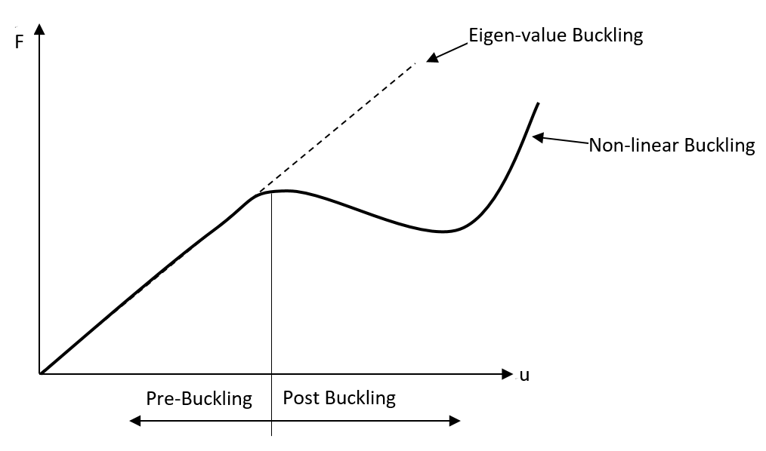
Comparison
Results from Nonlinear Buckling Analysis are frequently more accurate than those from eigenvalue Buckling Analysis because it takes material nonlinearity into account while generating buckling response.
A graph of the deformed configuration against the application of load shows the outcomes of the nonlinear-static analysis.
This plot exhibits the characteristic that signals the beginning of buckling: Softening.
Figure:2 Force vs Deflection plot

Slide 7
Eigenvalue buckling analysis
Non- linear buckling analysis
Positives:-
Computing time is less.
Easy to define.
No convergence problems.
Negatives:-
In few cases the outcome is not suitable or wrong.
Cannot take material nor geometrical nonlinearity into account.
Positives:-
Instability failure process can be animated easily.
Result is more robust and accurate.
Can account for non linearity of the material.
Negatives:-
Computation time is longer.
Convergence problems.
Far more difficult to set up.

Slide 8
Boundary Value Problem
F
In our boundary value problem we have contrained our beam at the bottom in all 6 DOF.
The vertical load is applied at the center of the surface the top of the load.
The beam will be deflected due to applied load and the load required for the deflection has to be calculated.

Slide 9

Analytical Calculations
Given Data:
$$a=100mm, b=120mm, L=1200mm, E=2.1×{10}^{5}MPa$$
$$θ=0.3$$
$$I_{min}=\frac{b×a^{3}}{12}=\frac{\left(120×{100}^{3}\right)}{12}=10×{10}^{6}mm^{4}$$

Slide 10

$$effective length L_{e}=2L=2×1200=2400mm$$
$$Slenderness ratio: S=\frac{L_{e}}{k_{min}}=\frac{L_{e}}{\sqrt{\frac{I_{min}}{A}}}=\frac{2400}{\sqrt{\frac{10×{10}^{6}}{120×100}}}=83.138$$
$$Buckling load F=P_{critical}=\frac{π^{2}EI_{min}}{L_{e}^{2}}=3598.3kN$$

Slide 11
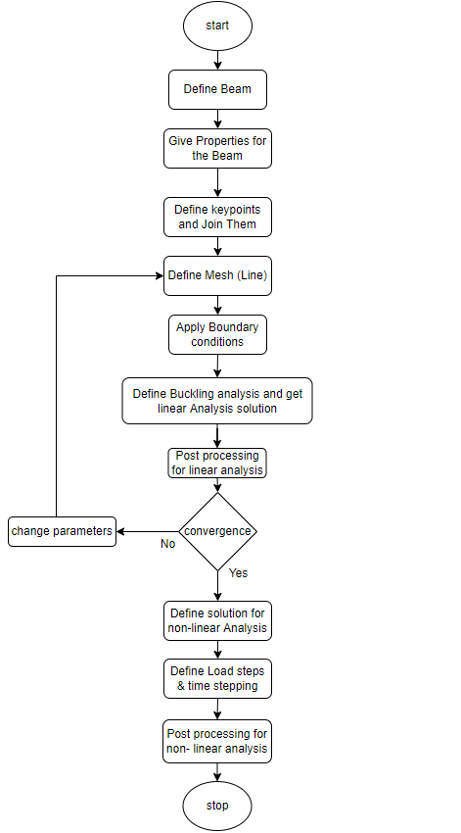
Process flow in APDL

Slide 12
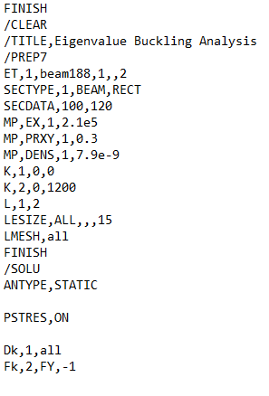
Description of APDL script (Linear)
Creating and meshing the Geometry
Static Analysis before doing the buckling analysis

Slide 13
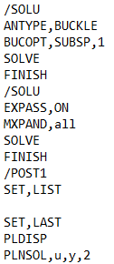
Defining the parameters for Buckling analysis
Post Processing

Slide 14
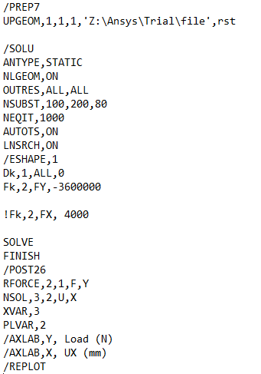
Description of APDL script (Non-linear)
Importing the result of
Eigen value buckling
Defining the parameters for Non-linear buckling
Post Processing

Slide 15
Results
It can be seen in the convergence study that the convergence occurs at 6 mesh elements. After that critical buckling load doesn’t vary.
Figure 3: Convergence Study

Slide 16
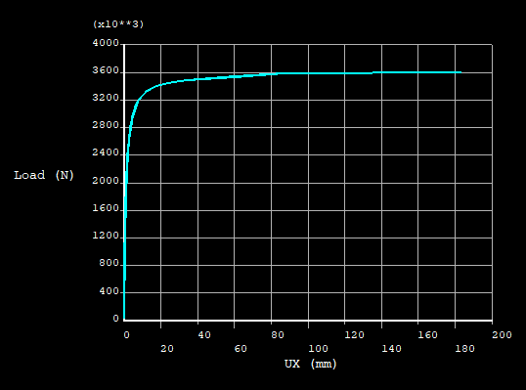
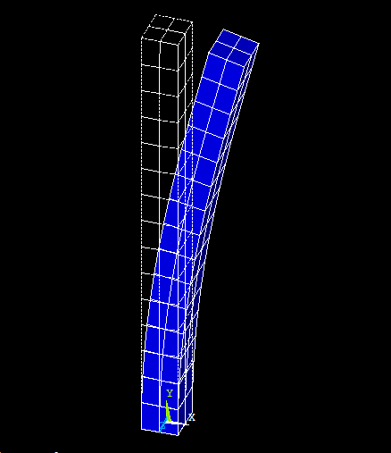
Results
Figure 4: Load vs Deflection
Figure 5: Deformed shape

Slide 17
Results
The Load-Deflection plot displays the softening behavior which indicates the onset of buckling.
It can be seen from the graph that the column starts to buckle around 3000 kN of load and then it carries the load for a large amount of deflection.
The graph also tells us about how much the beam deflects with the progression of load.

Slide 18
Conclusion and Outlook
If loads and boundary conditions are carefully considered, linear solutions may be suitable for simple structures. However, a complete nonlinear analysis is is necessary for the majority of unstable structures.
Because linear buckling overestimates the model’s capacity, the results of eigen value buckling and non-linear buckling may differ.
A linear buckling analysis might be suitable in some circumstances to fulfill checks against buckling, but in others, it might only serve as a decent beginning point for a comprehensive nonlinear buckling analysis.
An in-depth evaluation of buckling is provided by nonlinear analysis, which can take boundary, material, and geometric influences into account.

Slide 19
References
ANSYS Mechanical APDL Technology Demonstration Guide, ANSYS Mechanical APDL 2 - ANSYS, Inc; Release 14.0, November 2011

