Slide 1

404 error
Bugs not found

Slide 2



Team members
Tilak Thapa (jrTilak)
Anurag Dahal (blaze)
Utsab Pandey (kaleUtsab)
[Coder/Designer]
[Quality Tester/Assistant]
[Data Miner /Designer]

Slide 3
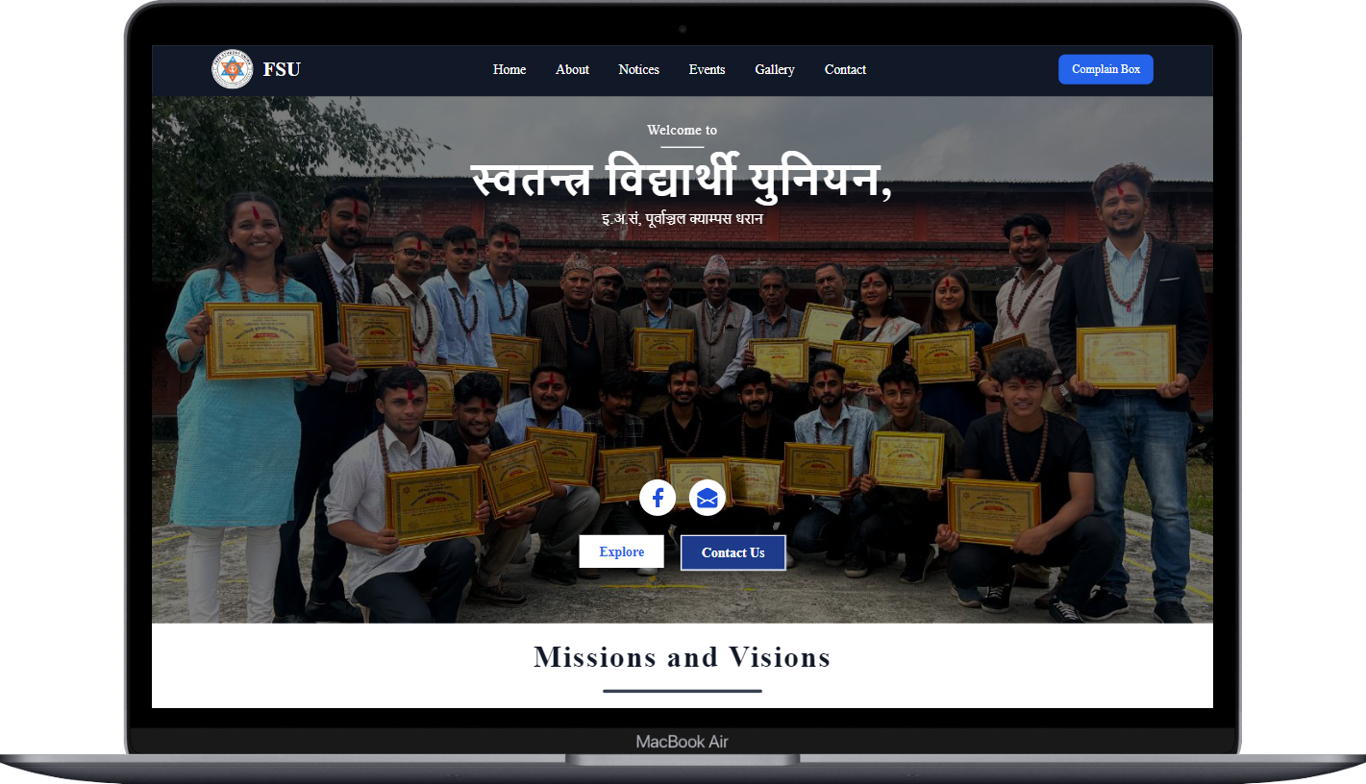
WEL-COME TO WEBSITE DEMONSTRATION OF FREE STUDENT UNION

Slide 4
Modern Websites (must have):
Functionality
Performance
Search Engine Optimization (SEO)
Simple and Straight forward UI (Responsive Design)

Slide 5
Functionality of our website
Interact with FSU community.
Provide details About FSU members and its works.
Shows recent news.
Information about upcoming events.

Slide 6
Performance of site
Loading speed
Performance Testing
User Experience Considerations

Slide 7
Search Engine Optimization
Keyword optimization

Slide 8
Responsive design

Slide 9



TECHNOLOGY USED
NEXT JS/REACT JS IS USED FOR WRITING THE JAVASCRIPT
TAILWIND CSS FOR THE STYLE
SHARP FOR IMAGE OPTIMIZATION
EMAIL JS FOR SENDING THE EMAIL

Slide 10
conclusion
We explored the principles of modern website design, the technologies used in its development, and the importance of responsive design for optimal user experience across devices. We discussed the website's functionality, interactivity, and its commitment to search engine optimization (SEO) for improved visibility and organic traffic. The presentation emphasized the website's performance, showcasing its loading speed, optimization techniques, and the positive impact on user engagement. Additionally, we covered the user experience and navigation, emphasizing the user-centered design approach, intuitive navigation, and responsive design. Overall, our website aims to serve the needs of students, enhancing their experience on campus through informative content, user-friendly navigation, and engaging features. We are committed to ongoing improvements and look forward to delivering a valuable online platform for the student community.

Slide 11
THANK YOU

