Slide 1
R for Biologists

Slide 2
R for Biologists
kindeRgarten

Slide 3
Goals for this section of the module
Set up your computational tools
Learn basics of R
Get your own data into R
Explore your data (exploratory data analysis/ EDA)
Do a simple RNA-seq analysis
Know where to find help
Batch effects - multiple levels - multiple comparisons
Downstream analysis (GSEA/GO/enrichr)
Bioconductor

Slide 4
Goals for this section of the module
Set up your computational tools
Learn basics of R
Get your own data into R
Explore your data (exploratory data analysis/ EDA)
Do a simple RNA-seq analysis
Know where to find help
Batch effects - multiple levels - multiple comparisons
Downstream analysis (GSEA/GO/enrichr)
Bioconductor

Slide 5
April 11 | Installing R/Rstudio Git/Github Basics Basic R Getting data into R
April 14 | How to plot data (and make it look good) Exploring data
April 16 | Functions Some best practices
April 18 | No class - Holiday
April 21 | No Class
April 23 | RNA-seq analysis
April 25 | Contrasts Batch Effects
April 28 | Visualizations GO Analysis Extra help

Slide 6
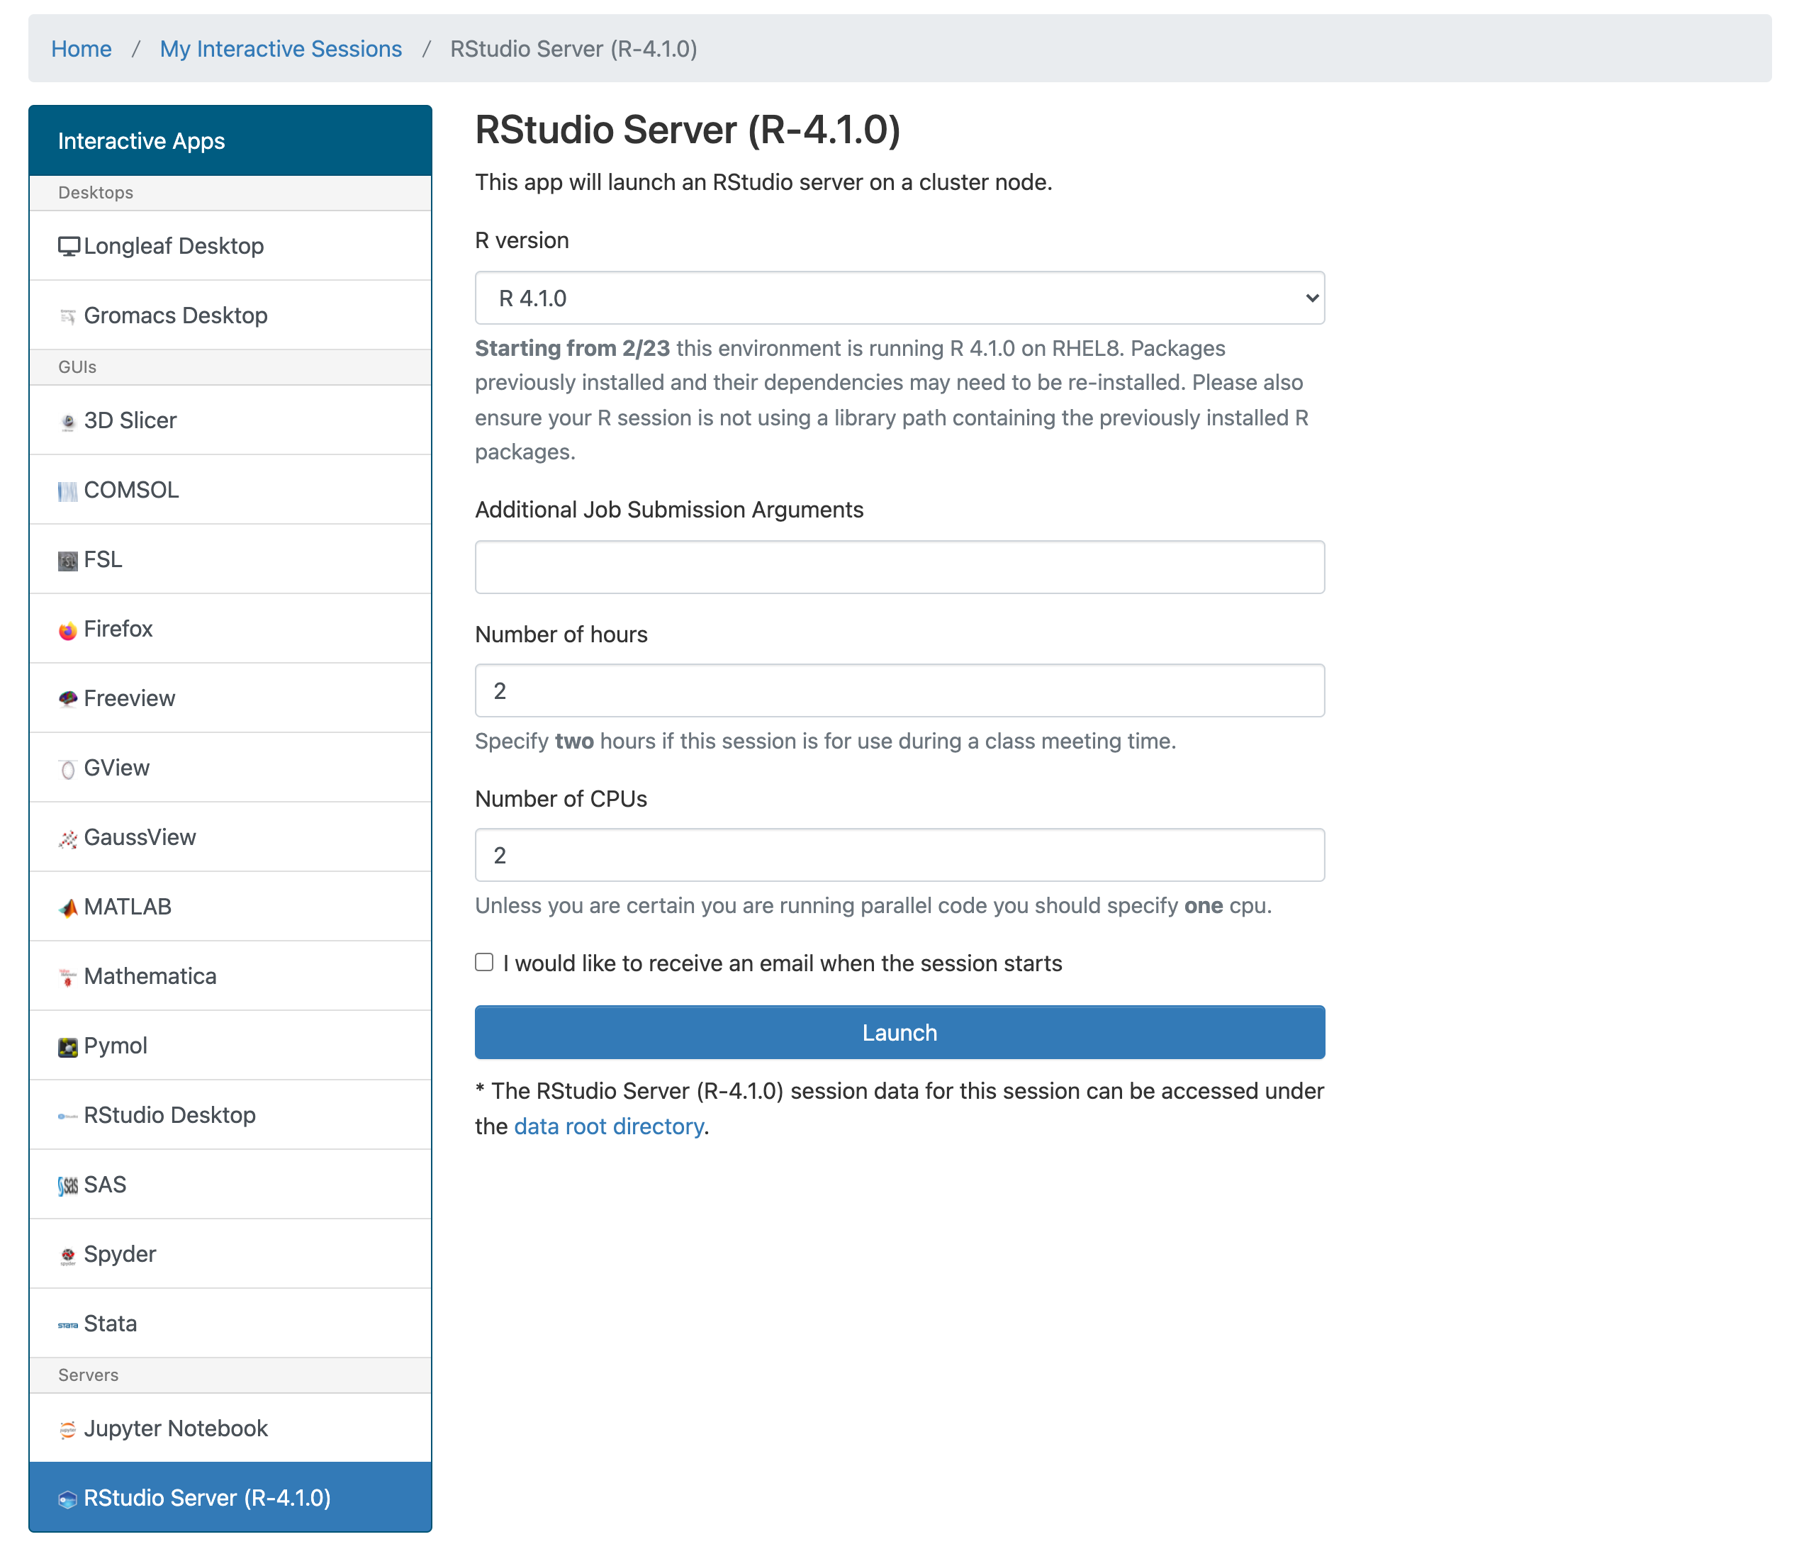
Step 1: Get R/Rstudio
Install R http://www.r-project.org/
Download Rstudio https://www.rstudio.com/products/rstudio/
Alternate route
login at ondemand.rc.unc.edu
Use R 4.3.1
No additional arguments
Number of hour 2
Number of CPUS 1

Slide 7
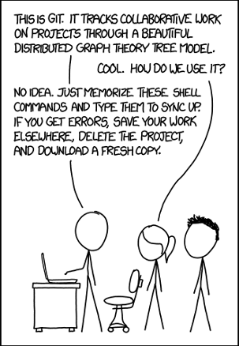
Step 2: Git/Github
What are Git and Github
Git - version control - like Microsoft Track changes but with lots of extras and lasts forever
Github - way to share code - like dropbox but with some extra features
We’ll use Github to share code from this course

Slide 8
Why use Git/Github
Revert to older versions of code
Make a new copy of code to try out an approach without breaking it
More people can work on something at once and manage conflicts
Share with others
Let people see your skills
https://think-like-a-git.net/sections/about-this-site.html
https://marklodato.github.io/visual-git-guide/index-en.html
https://happygitwithr.com/big-picture.html

Slide 9
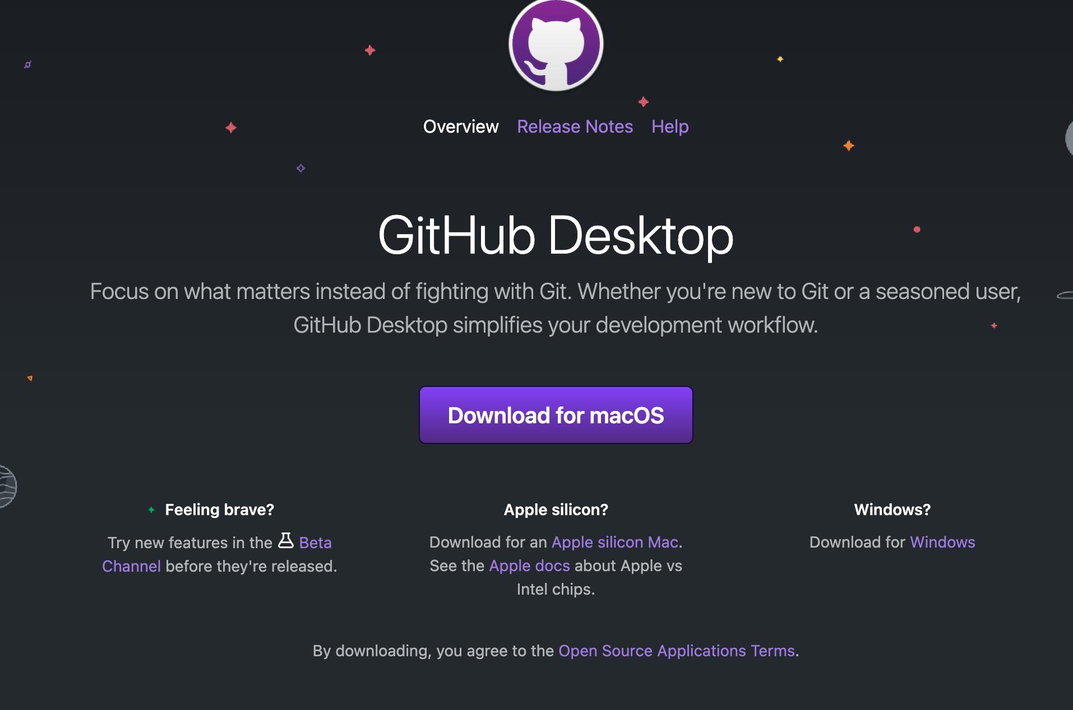
Getting code from this class
If working on your own computer
On your computer
desktop.github.com

Slide 10
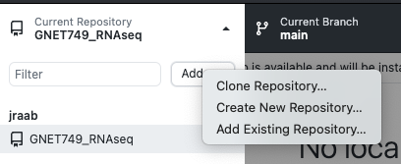
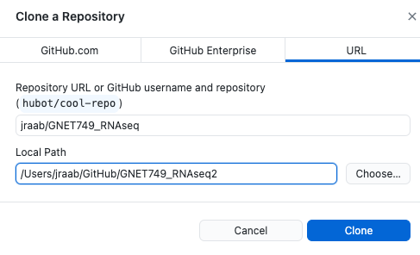
https://github.com/jraab/GNET749_RNAseq

Slide 11
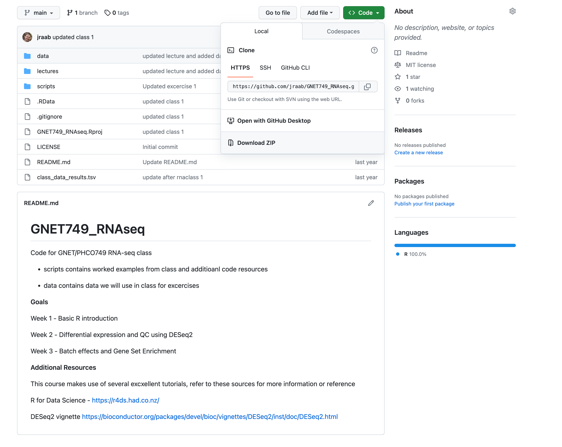
https://github.com/jraab/GNET749_RNAseq
Getting code from this class

Slide 12
Getting code from this class
Ondemand in a terminal
Here's how to clone a repository in RStudio:
Open RStudio
Go to File → New Project
Select "Version Control" in the New Project dialog
Select "Git" from the options
Enter the repository URL (the HTTPS URL from GitHub)
Choose the local directory where you want to save the project
Click "Create Project"

Slide 13
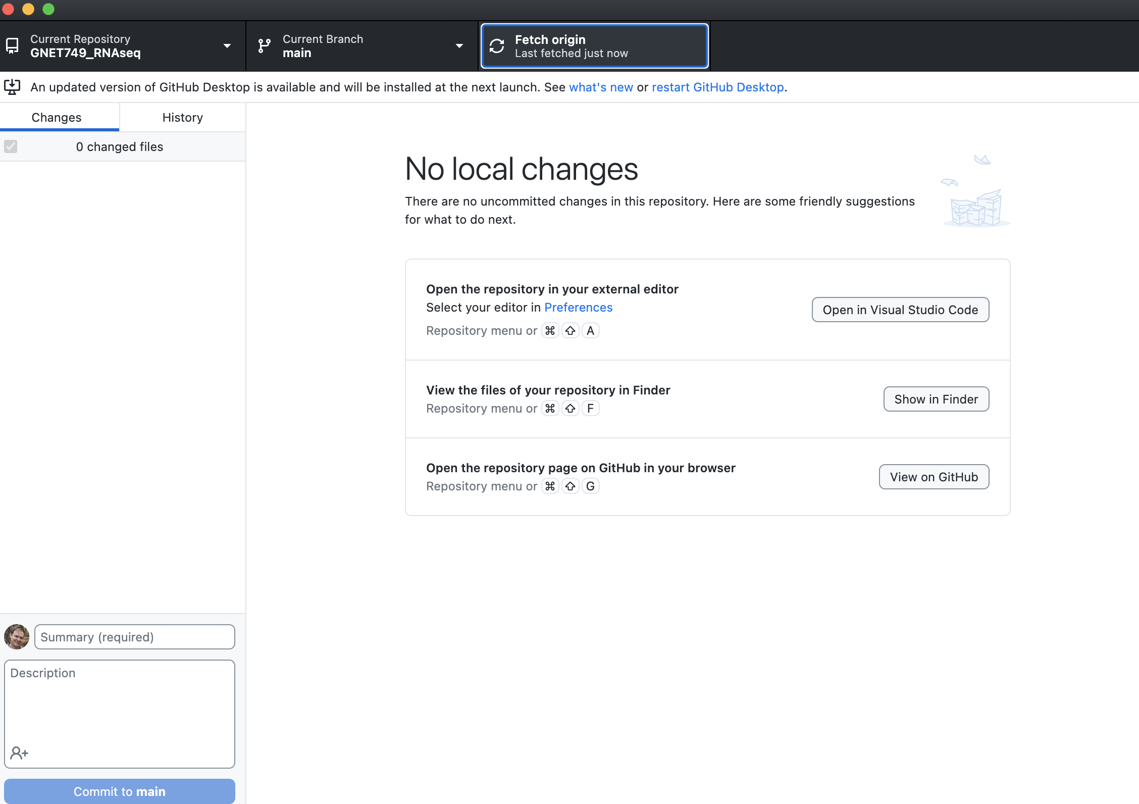
Changes to code will be on github and git pull can be used to grab them

Slide 14
Questions on….
Setting up R or getting ondemand running
Git/Github or getting code from class

Slide 15
Why Learn R?
Extremely powerful statistical tools
Reproducibility
High quality visualizations
Multiple ways to do things
R is free, has a huge Great packages for biologists (RNAseq, ChIPseq, TF Motifs)
community (CRAN and Bioconductor)
Works on most operating systems (Linux, Mac, Windows)

Slide 16
Downsides of R
Steep learning curve
Multiple ways to do things (base vs tidyverse)
Syntax is unlike other programming languages
Not a general programming language

Slide 17
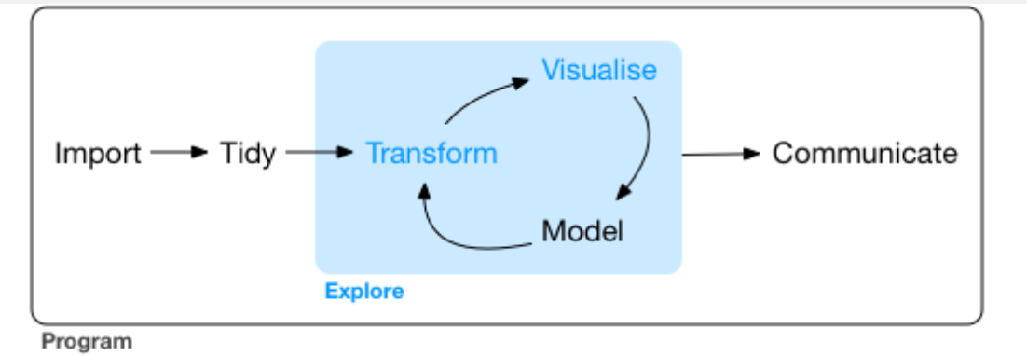
Where to get more information?
R for data science https://r4ds.hadley.nz/
http://r-statistics.co/Complete-Ggplot2-Tutorial-Part1-With-R-Code.html
https://melbournebioinformatics.github.io/r-intro-biologists/intro_r_biologists.html#R_for_Biologists_course
Sticking to a style
https://style.tidyverse.org/syntax.html

Slide 18
Basic Syntax
a <- “some string”
variable
assignment
string

Slide 19
Basic Syntax
character
a <- “some string”
vector
b <- c( “a”, “vector”, “of”, “words”)
list
d <- list( “also” “a”, “list”)
data.frame
df <- data.frame( c(column1 = c(‘a’, ‘b’, ‘c’),
c(column2 = c(‘d’, ‘e’, ‘f’) )

Slide 20
Commenting your code
# create vector of primes
primes <- c(2, 3, 5, 7, 11, 13)
# multiply primes by 2
primes * 2
#> [1] 4 6 10 14 22 26
Example from
https://r4ds.hadley.nz/

Slide 21
Getting data into R
df <- read_csv(‘somefile.csv’)
df <- read_tsv(‘somefile.tsv’)
df <- read_table(‘somefile.tsv’, sep = “\t”)
df <- read.csv(‘somefile.csv’)
Tidyverse
base
For this class these are similar enough that you can read them either way.
https://r4ds.had.co.nz/tibbles.html#tibbles-vs.-data.frame

Slide 22
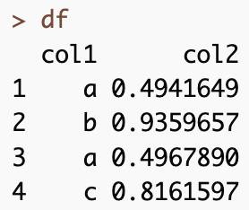


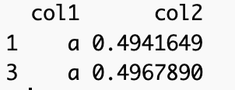
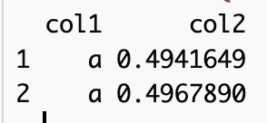
Base R vs Tidyverse
Base
Tidyverse ( library(tidyverse)
https://dplyr.tidyverse.org/articles/base.html

Slide 23
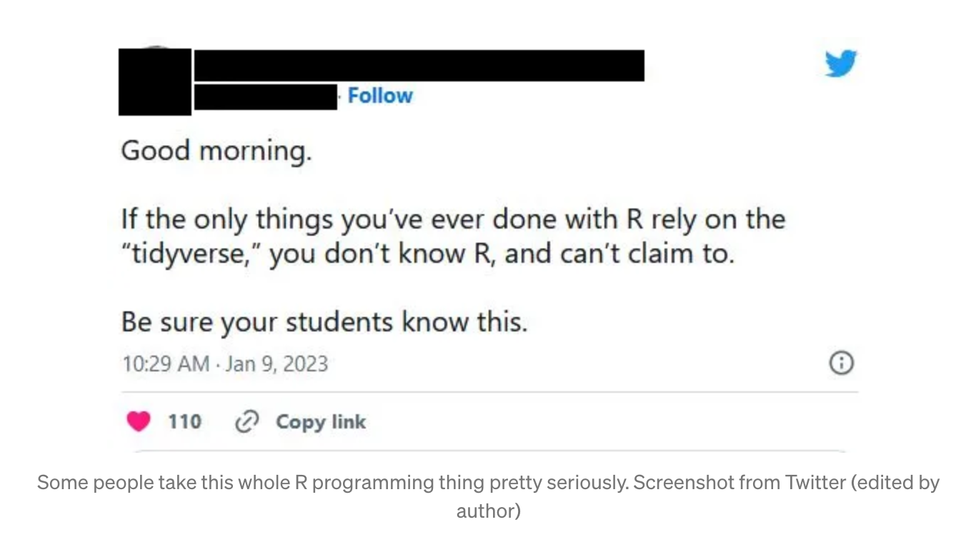
Why use one or the other?
Base R
Can be faster
Older/Can be more stable
Easier for some specific cases
Don’t need to install anything extra
https://towardsdatascience.com/tidyverse-vs-base-r-how-to-choose-the-best-framework-for-you-29b702bdb384

Slide 24
Why use one or the other?
Tidyverse
More readable (left to right like english)
Standardized
Different parts work well together (dplyr, pipes, ggplot)
Many useful functions (verbs)
https://towardsdatascience.com/tidyverse-vs-base-r-how-to-choose-the-best-framework-for-you-29b702bdb384

Slide 25
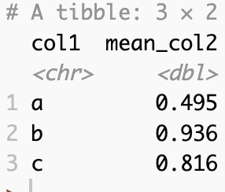
Why use one or the other?
https://towardsdatascience.com/tidyverse-vs-base-r-how-to-choose-the-best-framework-for-you-29b702bdb384

Slide 26
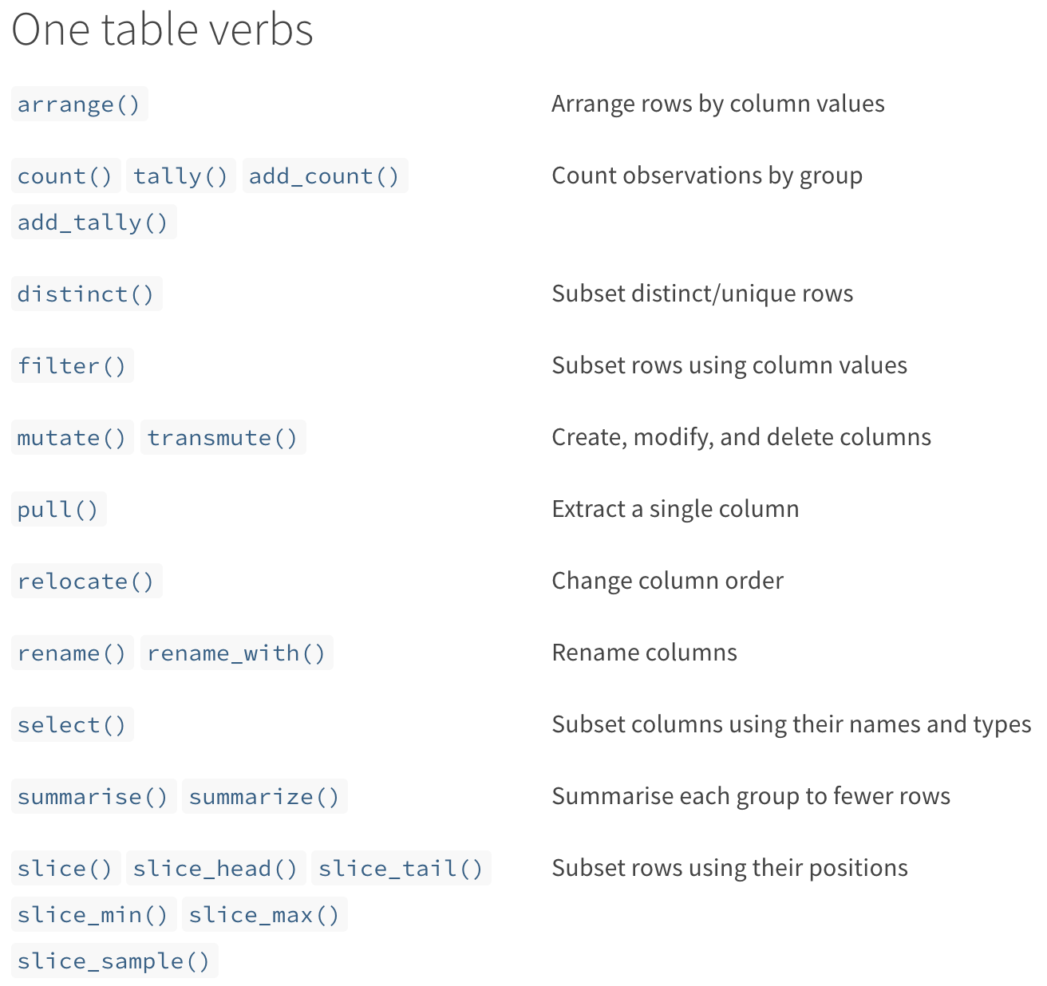
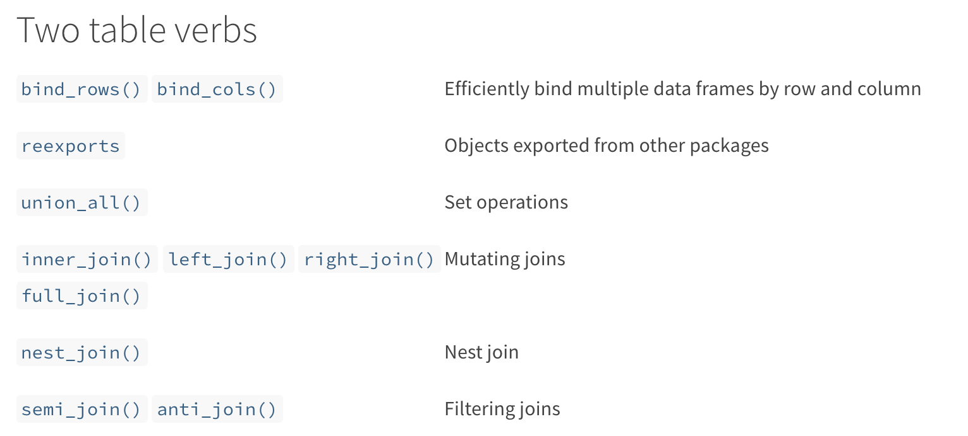
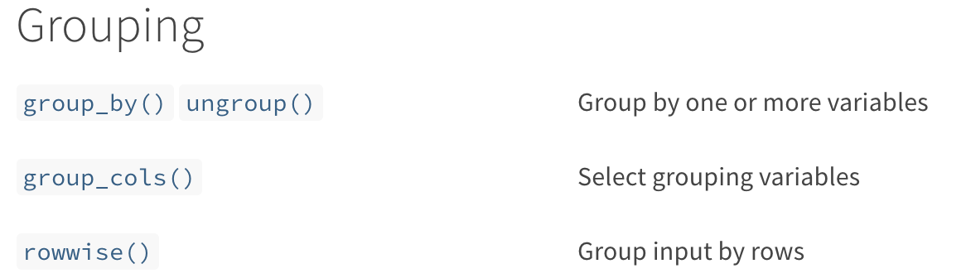
Tidyverse ‘verb’s
https://dplyr.tidyverse.org/reference/index.html
Notes:
The tidyverse syntax makes more sense to me (as a non computational biologist). In pulling this slide off the tidyverse site I learned several new verbs,s o they are actively adding

Slide 27
Pipes
In Unix Pipes let you chain commands together with the pipe ( | )
cat file.txt | grep ‘sometext’
Tidyverse uses %>% or |> to link commands
df |> filter() |> group_by() |> summarise()
Pipes make reading a series of steps easier
https://r4ds.had.co.nz/pipes.html

Slide 28
Fun data sets to play with
iris
built-in
ToothGrowth
built-in
Cereal
https://www.kaggle.com/crawford/80-cereals
flightdata
install.packages('nycflights13')
nih
NIH Reporter (on github as data/Worldwide2020.csv)

Slide 29
Recap - Class 1
Installing R and Github and getting code
R syntax
Getting data into R
working with data in R

Slide 30
switch to live mode

