Slide 1
R for Biologists

Slide 2
Why Learn R?
Extremely powerful statistical tools
Reproducibility
High quality visualizations
Great packages for biologists (RNAseq, ChIPseq, TF Motifs)
R is free, has a huge community (CRAN and Bioconductor)
Works on most operating systems (Linux, Mac, Windows)

Slide 3
Downsides of R
Steep learning curve
Multiple ways to do things (base vs tidyverse)
Syntax is unlike other programming languages
Not a general programming language

Slide 4
Goals
How to get data into R
How to plot data (and make it look good)
Functions
Some best practices
Week 1
April 11, 13 (15 holiday)
Week 2
RNA-seq analysis - the basics
Visualization
Contrasts
Batch Effects
April 18, 20, 22
Week 3
GO analysis
GSEA
April 25,27

Slide 5
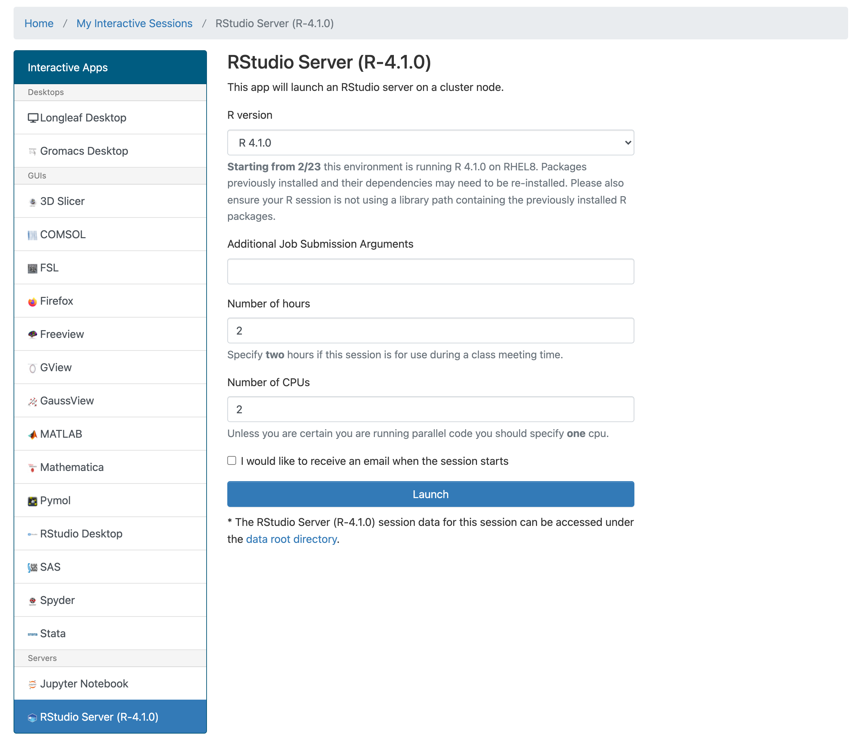
Getting Started
Install R http://www.r-project.org/
Download Rstudio https://www.rstudio.com/products/rstudio/
Alternate route
login at ondemand.rc.unc.edu

Slide 6
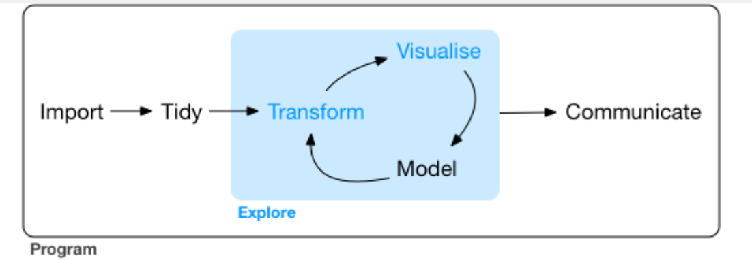
Where to get more information?
R for data science https://r4ds.had.co.nz/index.html
http://r-statistics.co/Complete-Ggplot2-Tutorial-Part1-With-R-Code.html
https://melbournebioinformatics.github.io/r-intro-biologists/intro_r_biologists.html#R_for_Biologists_course
Sticking to a style
https://style.tidyverse.org/syntax.html

Slide 7
switch to live mode

Slide 8
Fun data sets to play with
iris
built-in
ToothGrowth
built-in
Cereal
https://www.kaggle.com/crawford/80-cereals
flightdata
install.packages('nycflights13')
nih
NIH Reporter

