Slide 1
Class 3 – Creating your own functions and new data structures and best practices

Slide 2
Recap from last time
Access to class github
Tidy Data (wide vs long format of data)
Plotting
Merging and joining (relational data)

Slide 3
Today’s Goals
Additional Plotting
Factors
Functions
Loops
Summarized experiment
Best practices
Practice

Slide 4
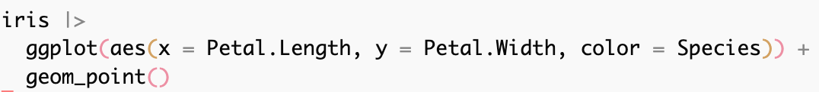
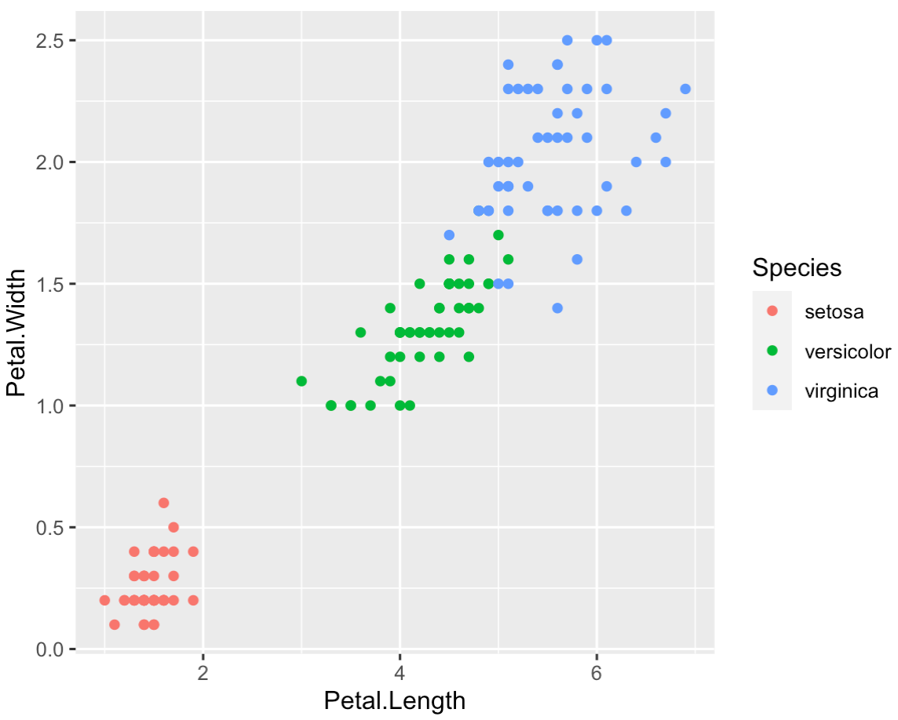
Faceting

Slide 5
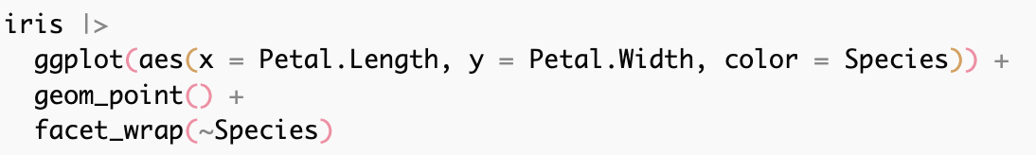
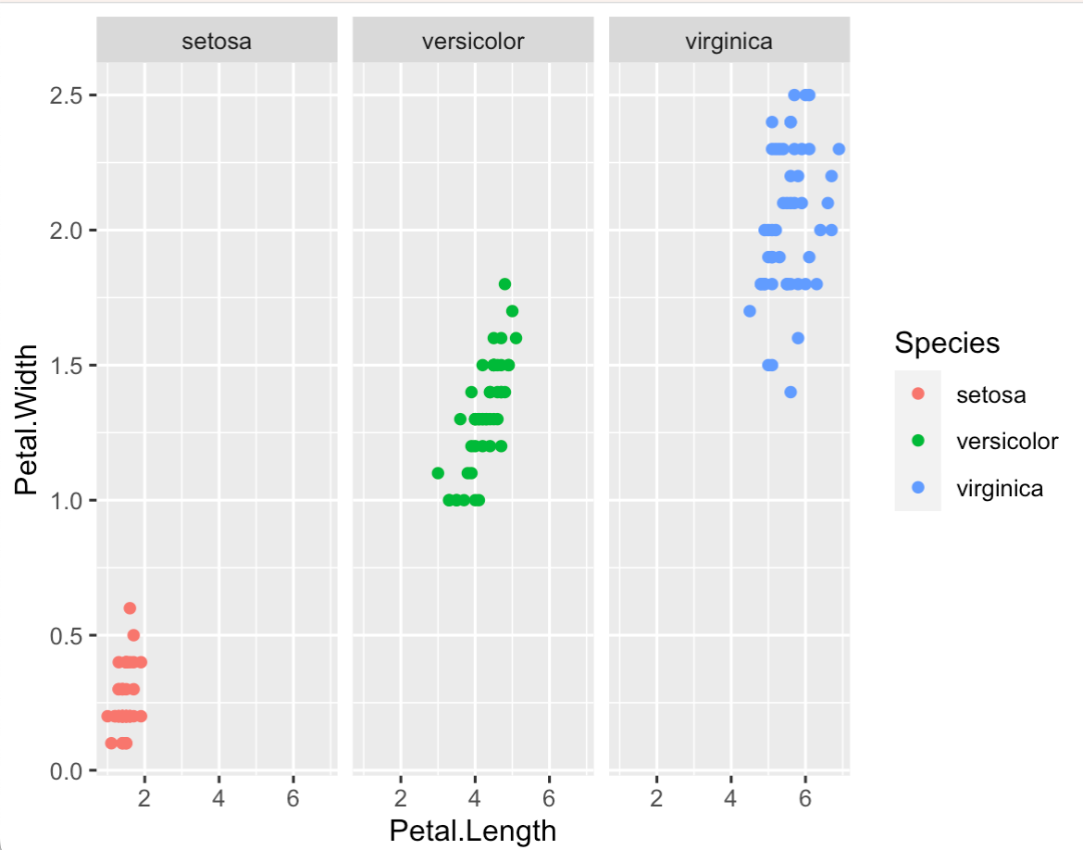
Faceting

Slide 6
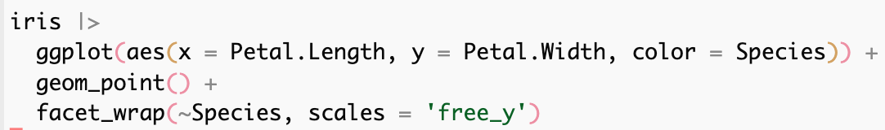
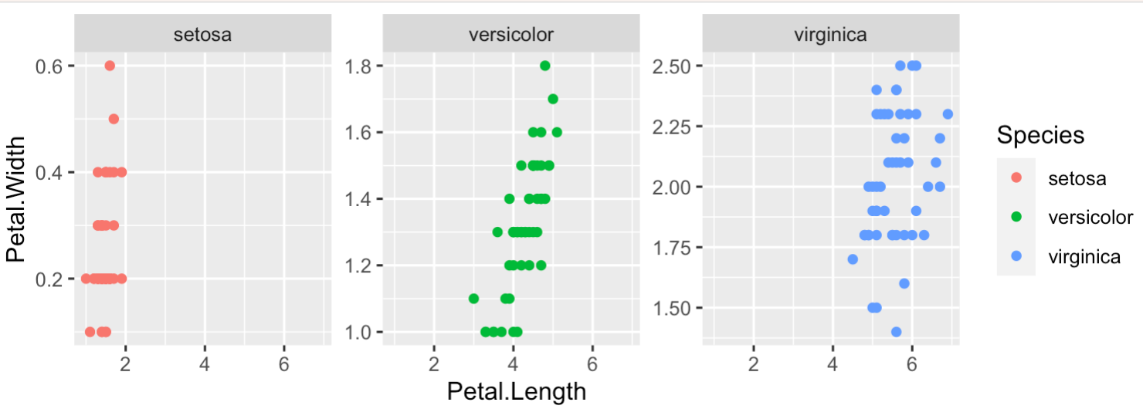
Faceting

Slide 7


Characters vs Factors
Character

Slide 8

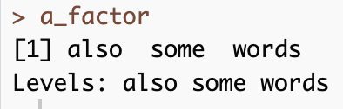
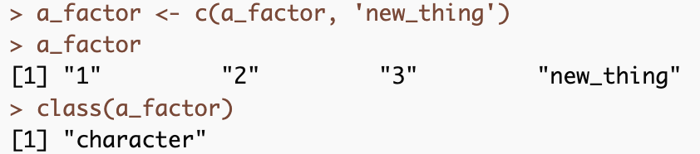
Characters vs Factors
Character
Factor

Slide 9
Characters vs Factors
Character
Factor
Key Points
Characters are less picky and behave as you’d expect
Factors have predetermined levels
Factors have an order with a base
Base R will read in all strings as factors (read.csv) – but this can be turned off globally

Slide 10
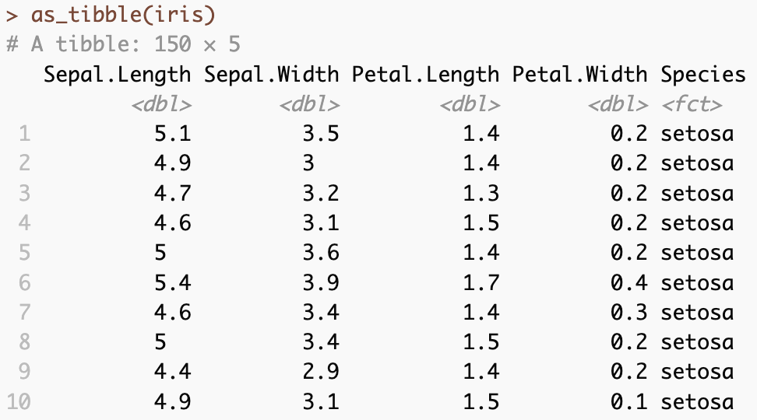
Tibbles helpfully tell you what data type is in a column

Slide 11
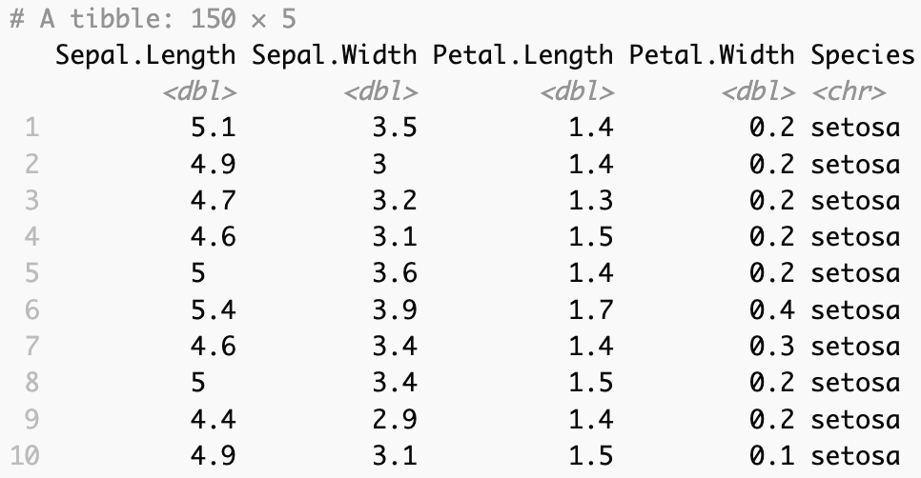
You can coerce one data type into another

Slide 12
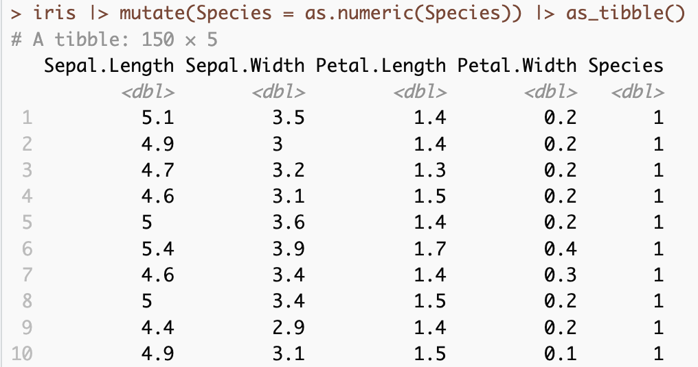
As long as that make sense
Now species has been replaced by an integer representing the group (1,2,3)

Slide 13
Functions
What are functions
Any chunk of code you are going to reuse - can be built in or come with a package or user made
Can take 0 or more arguments
Can return some value(s) or objects
-https://r4ds.had.co.nz/functions.html

Slide 14
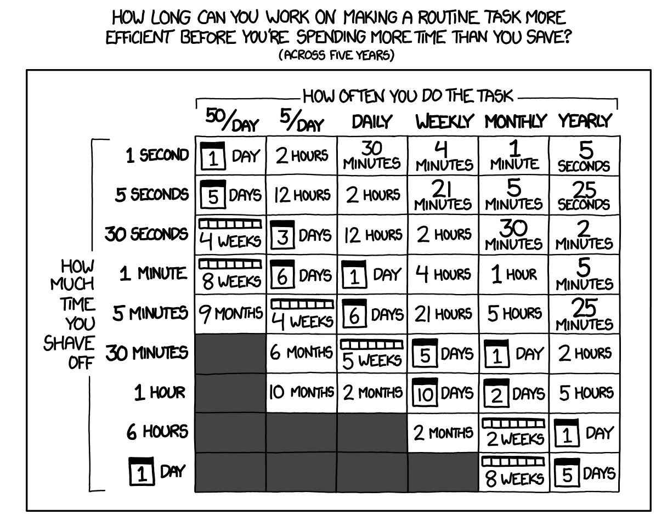
Functions
What are functions
Any chunk of code you are going to reuse - can be built in or come with a package or user made
Can take 0 or more arguments
Can return some value(s) or objects
Reasons to make a new function
Time savings
You can give a function a descriptive name that makes your code easier to understand.
As requirements change, you only need to update code in one place, instead of many.
You eliminate the chance of making incidental mistakes when you copy and paste
(i.e. updating a variable name in one place, but not in another).
https://xkcd.com/1205/
-https://r4ds.had.co.nz/functions.html

Slide 15
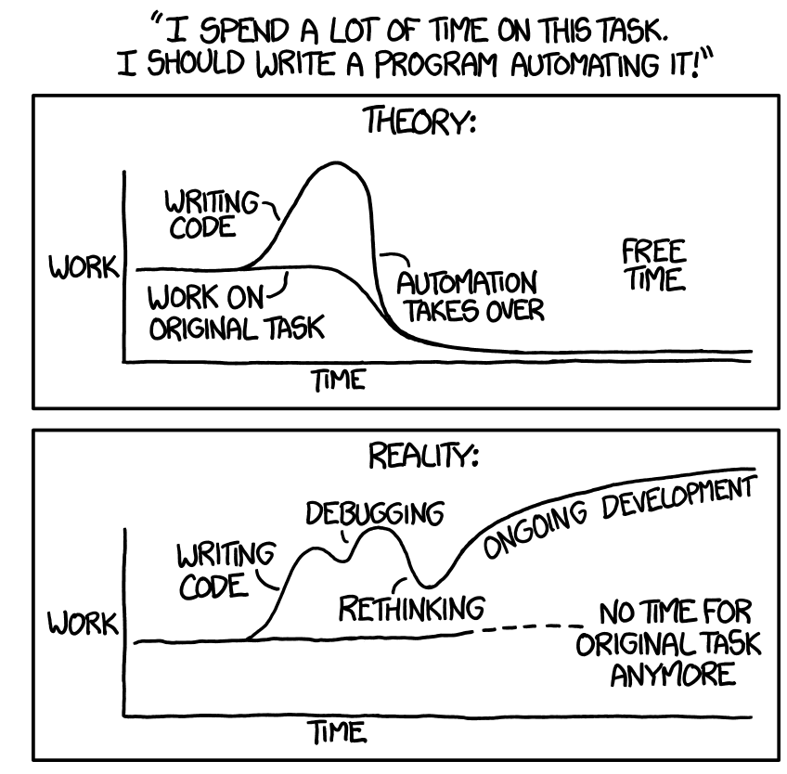
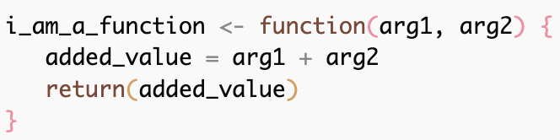

Basic Function
arguments
Function name
Function
body
Return value
https://xkcd.com/1319/

Slide 16

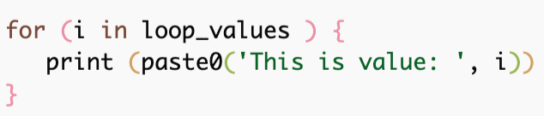

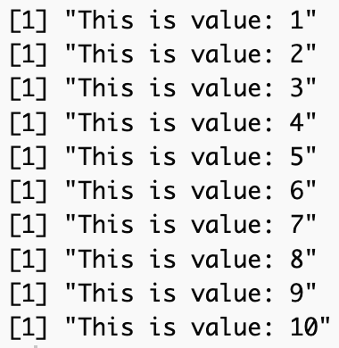
Loops (or performing the same operation on many things)

Slide 17
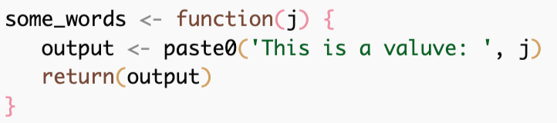

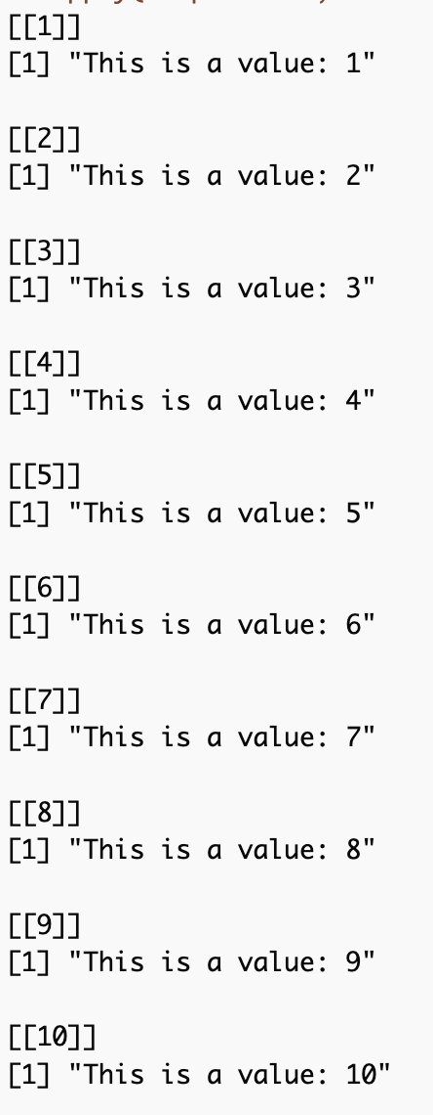
Loops (or performing the same operation on many things)
Function that takes a number and prints it out
Just like the loop on the last slide
lapply is a function that takes a list
and applies a function to each element
of the list
list
function

Slide 18
Loops (or performing the same operation on many things)
Function doesn’t have to be have already been made
list
Anonymous function

Slide 19
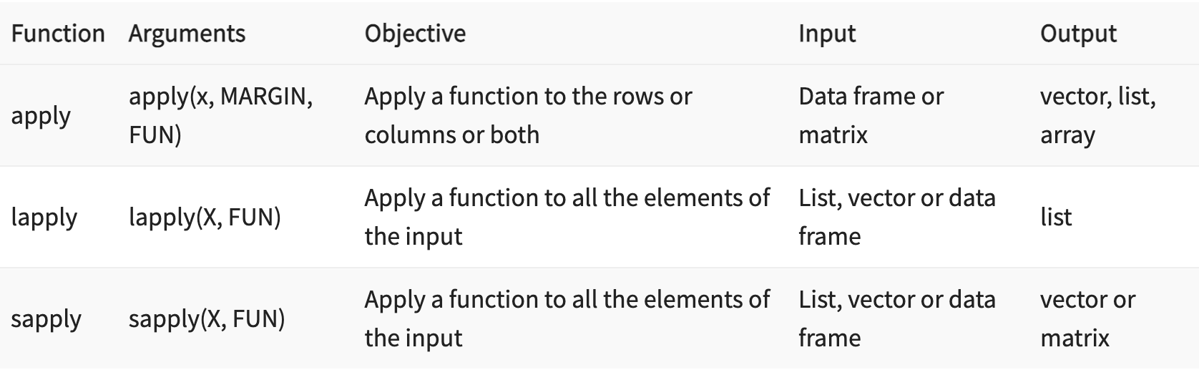
Apply functions
https://www.guru99.com/r-apply-sapply-tapply.html

Slide 20
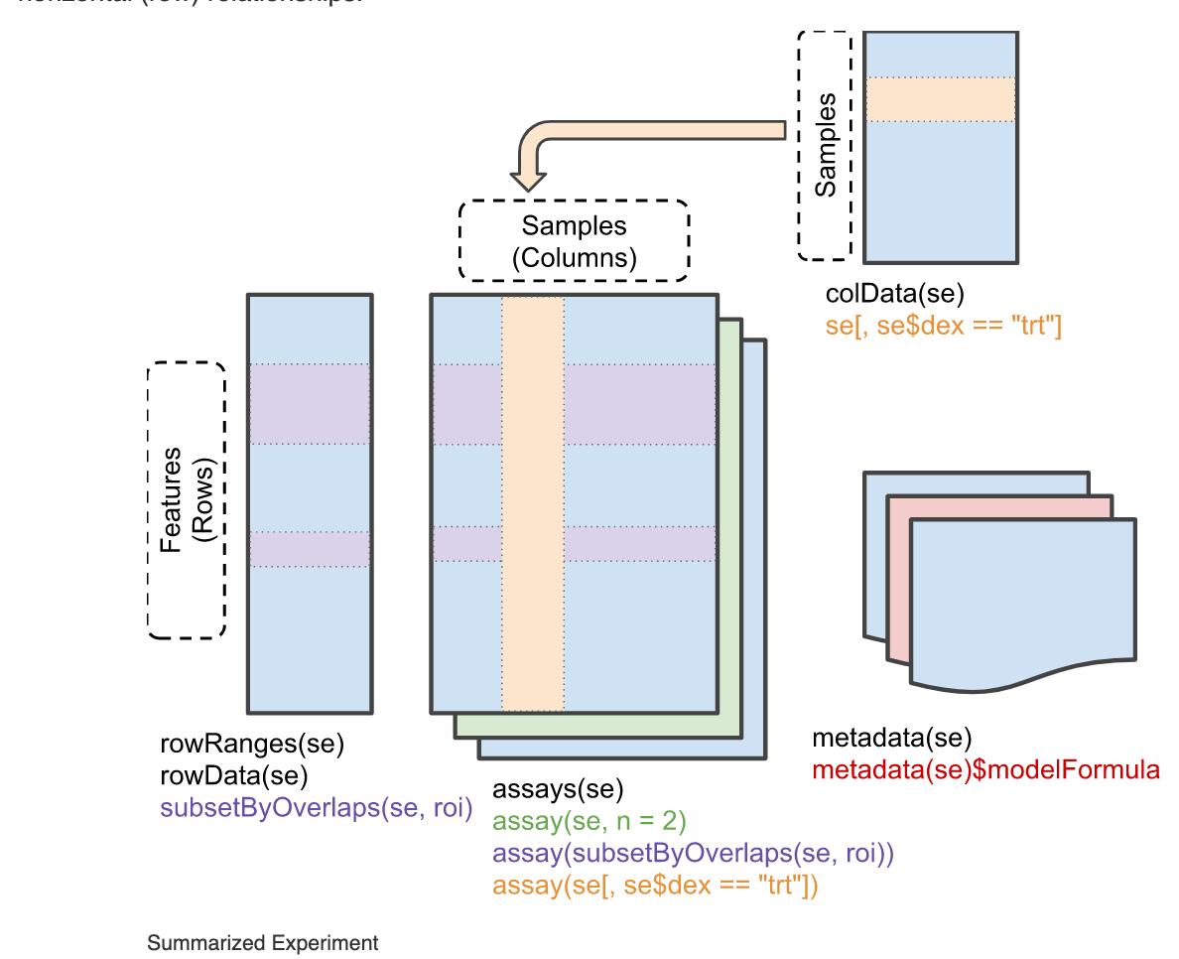
What is a summarized experiment object
RangedSummarizedExperiment - these represent genomic ranges
DESeqDataSet
Non-negative integer counts
Must have a formula describing experiment design
SummarizedExperiment -
https://bioconductor.org/packages/release/bioc/vignettes/SummarizedExperiment/inst/doc/SummarizedExperiment.html
Notes:
I have mentioned that dds is a ‘SummarizedExperiment’ object , what is this. DDS is actually a DEseqDataset - which itself is an extension of RangedSummarizedExperiments which is an extension of SummarizedExperiment.
These are something a little more fancy than a list or a dataframe or a string. These are called objects and the bioconductor project has tried to formalize the usage of a specific style of these objects for genomics data.

Slide 21
Suggestions for Best Practices
Keep a code notebook
Work in a script and not the console
Name variables, functions, scripts something descriptive
Comment your code heavily
Have a project structure in mind

Slide 22
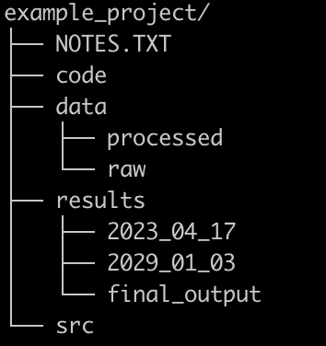
Suggestions for Best Practices
Keep a code notebook
Work in a script and not the console
Name variables, functions, scripts something descriptive
Comment your code heavily
Have a project structure in mind

Slide 23
Suggestions for Best Practices
Keep a code notebook
Work in a script and not the console
Name variables, functions, scripts something descriptive
Comment your code heavily
Have a project structure in mind
Use R projects – keep data and script files together
Put libraries first
Put hardcoded paths second
Don’t repeat yourself – write a function
Use a consistent style
https://google.github.io/styleguide/Rguide.html
https://style.tidyverse.org/index.html
https://r4ds.had.co.nz/workflow-projects.html
https://towardsdatascience.com/best-practices-for-r-programming-ec0754010b5a

Slide 24
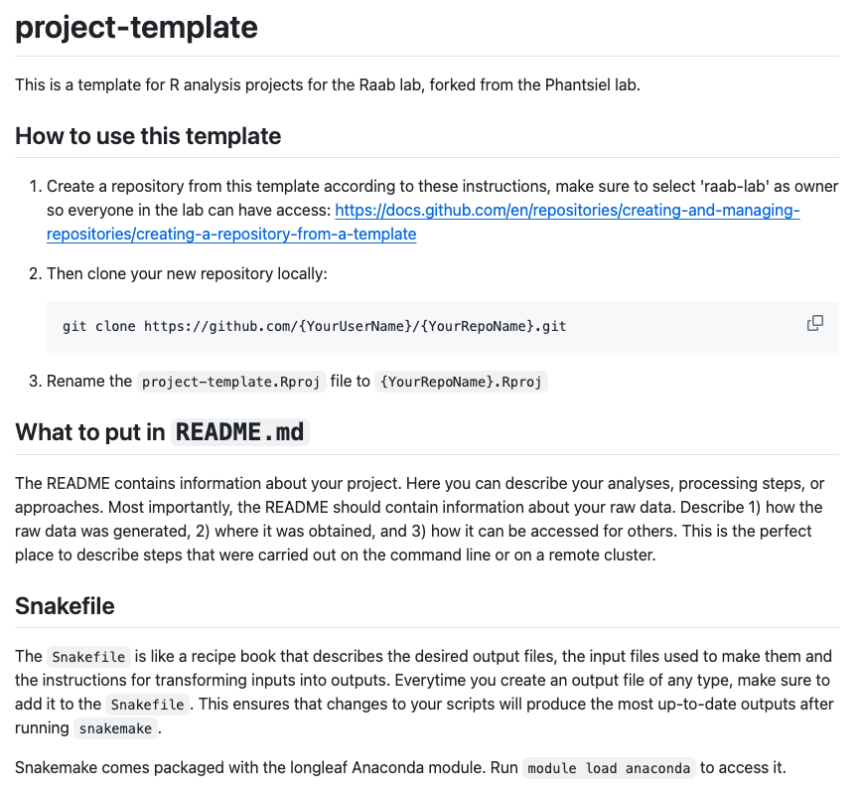
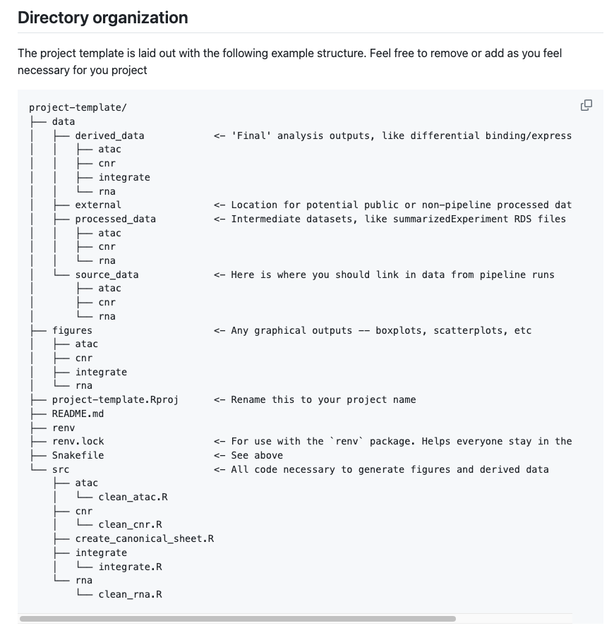
R Project templates can help set this up

Slide 25
R Crash Course – what you need to (should) know
Basic data structures – vector, data.frame, matrix, summarizedExperiment
How to get data into R (read_csv)
How to use tidyverse to manipulate and explore data
filter() group_by() mutate() summarise()
How to plot data
ggplot(data, aes(x = , y =, color = , fill = , shape = ) ) +
geom_point() + geom_boxplot() + geom_col()
What is a function – why might you make your own

Slide 26
Practice
Work through intro_R_skeleton_3.R

Slide 27
Practice
Work through intro_R_skeleton_3.R
Additional fun data set in honor of Taylor Swift album release day
https://www.kaggle.com/datasets/jarredpriester/taylor-swift-spotify-dataset

