Slide 1
R for Biologists

Slide 2
R for Biologists
kindeRgarten

Slide 3
Goals for this section of the module
Get your own data into R
Explore your data (exploratory data analysis/ EDA)
Do a simple RNA-seq analysis
Know where to find help

Slide 4
Goals for this section of the module
Get your own data into R
Explore your data (exploratory data analysis/ EDA)
Do a simple RNA-seq analysis
Know where to find help
Batch effects - multiple levels - multiple comparisons
Downstream analysis (GSEA/GO/enrichr)
Bioconductor
Bonus

Slide 5
April 14 | Installing R/Rstudio Git/Github Basics Basic R Getting data into R
April 17 | How to plot data (and make it look good) exploring data
April 19 | Functions Some best practices
April 21 | RNA-seq analysis
April 24 | Visualization
April 26 | Contrasts Batch Effects
April 28 | GO analysis GSEA

Slide 6
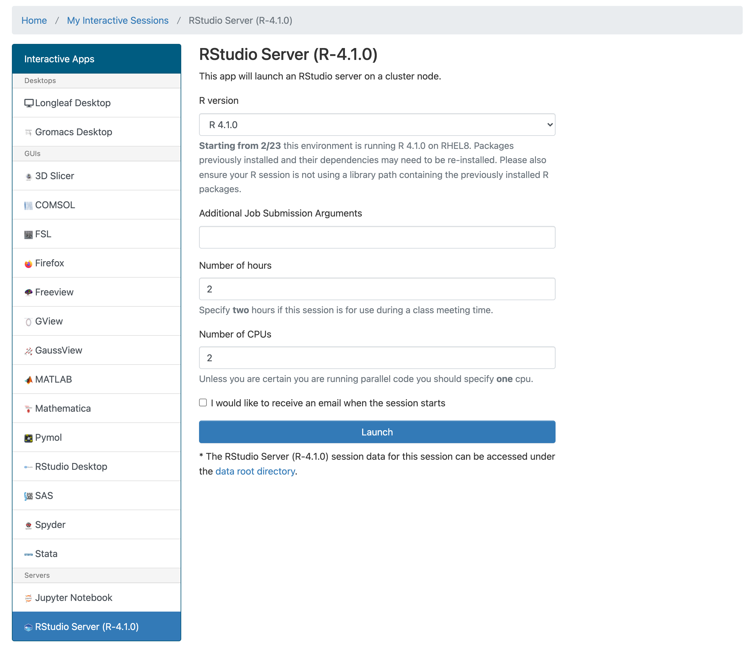
Getting Started with R
Install R http://www.r-project.org/
Download Rstudio https://www.rstudio.com/products/rstudio/
Alternate route
login at ondemand.rc.unc.edu

Slide 7
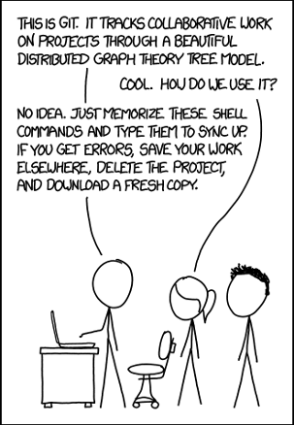
What are Git and Github
Git - version control - like Microsoft Track changes but with lots of extras and lasts forever
Github - way to share code - like dropbox but with some extra features

Slide 8
Why use Git/Github
Revert to older versions of code
Make a new copy of code to try out an approach without breaking it
More people can work on something at once and manage conflicts
Share with others
Let people see your skills
https://vallandingham.me/git-workflow.html
https://happygitwithr.com/big-picture.html

Slide 9
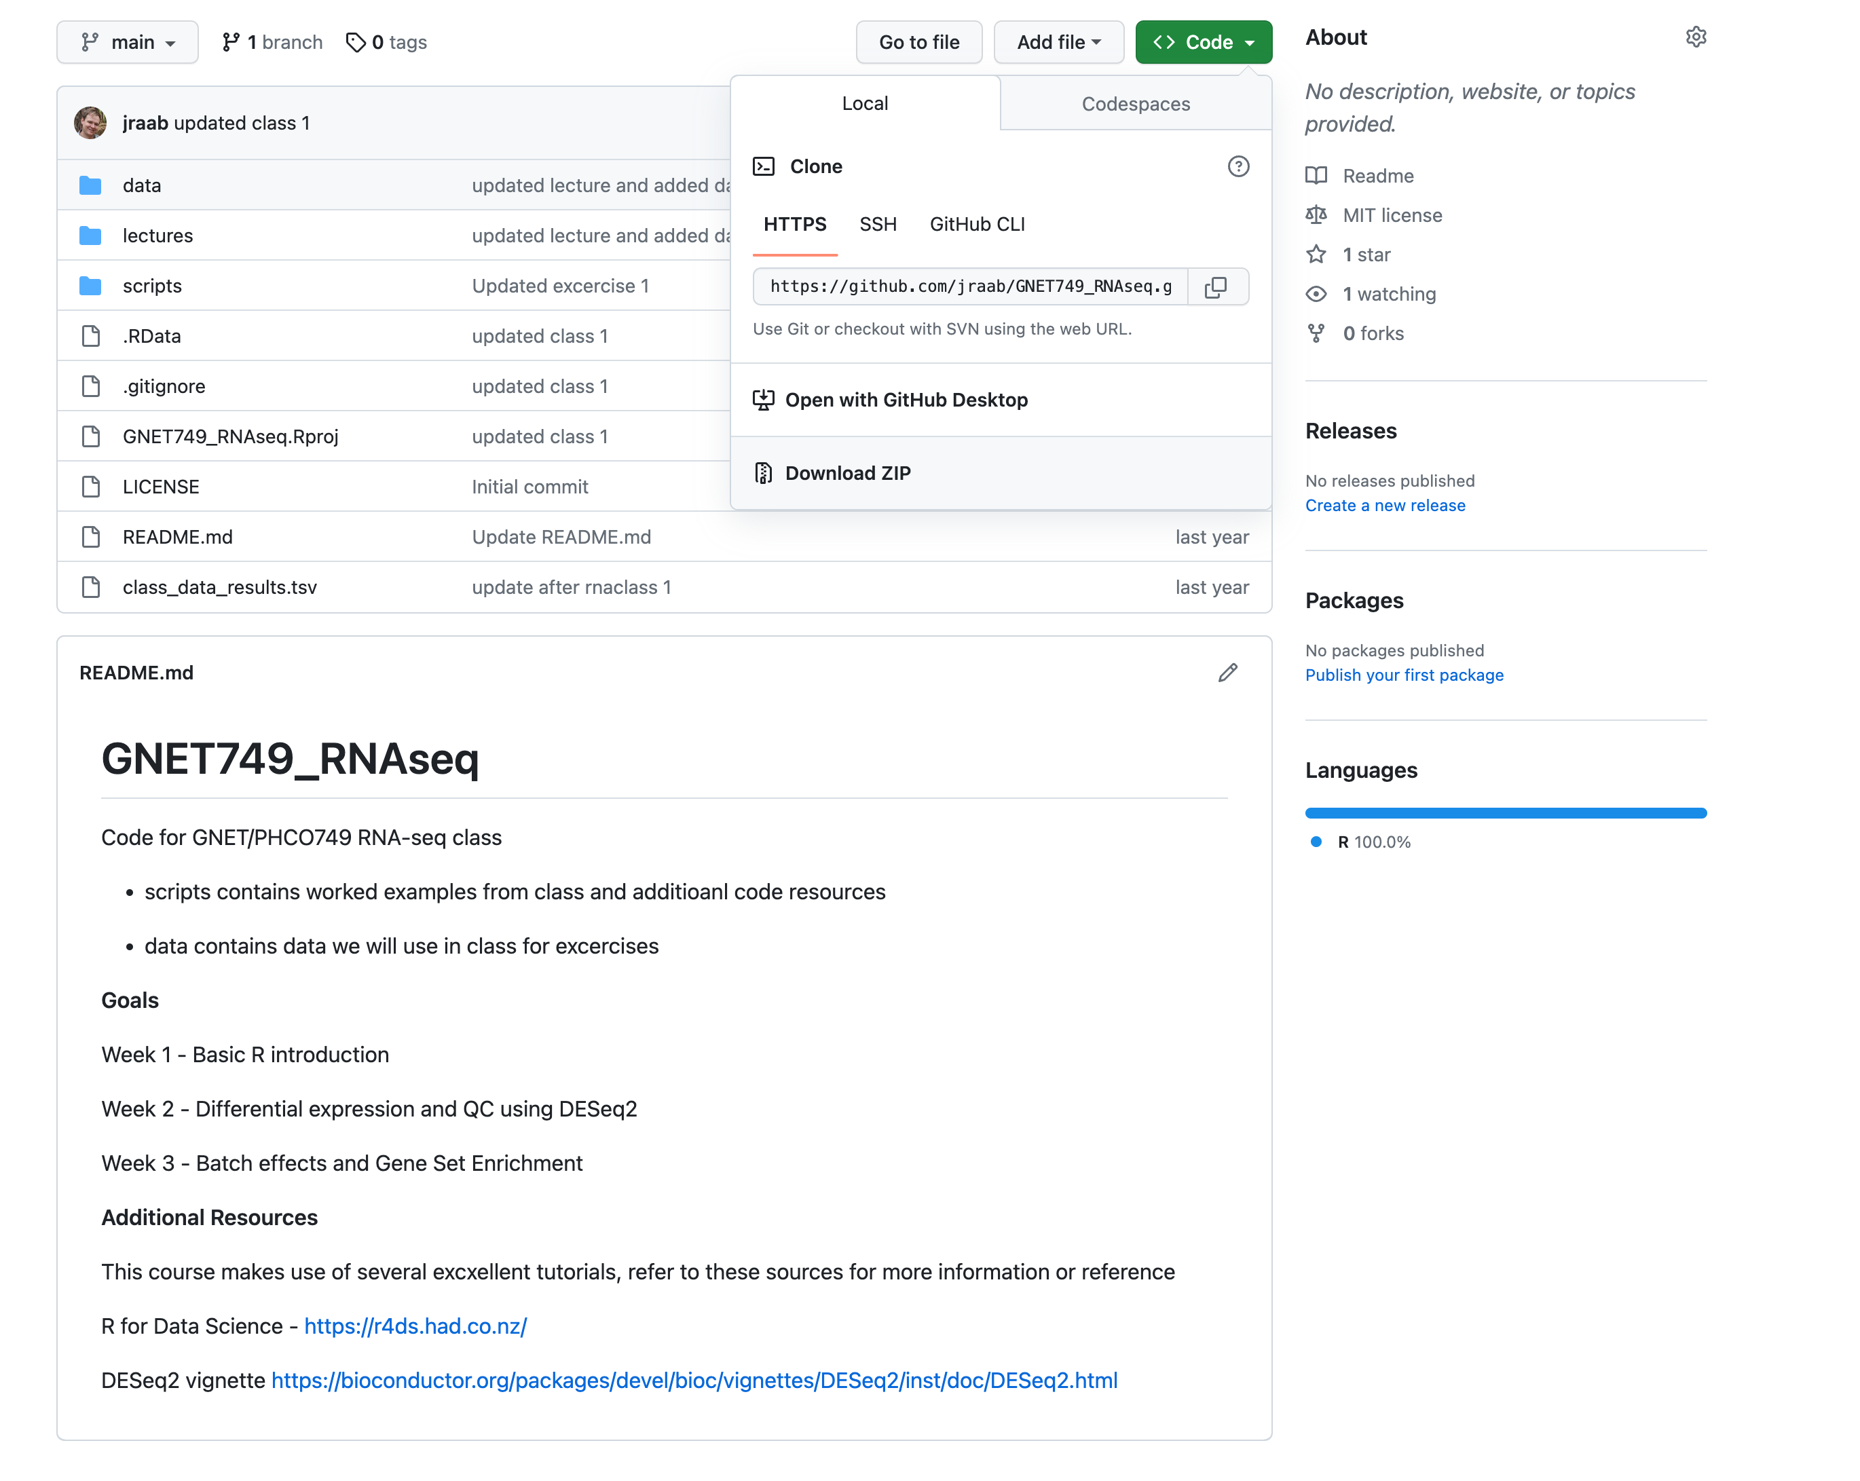
Getting code from this class
https://github.com/jraab/GNET749_RNAseq

Slide 10
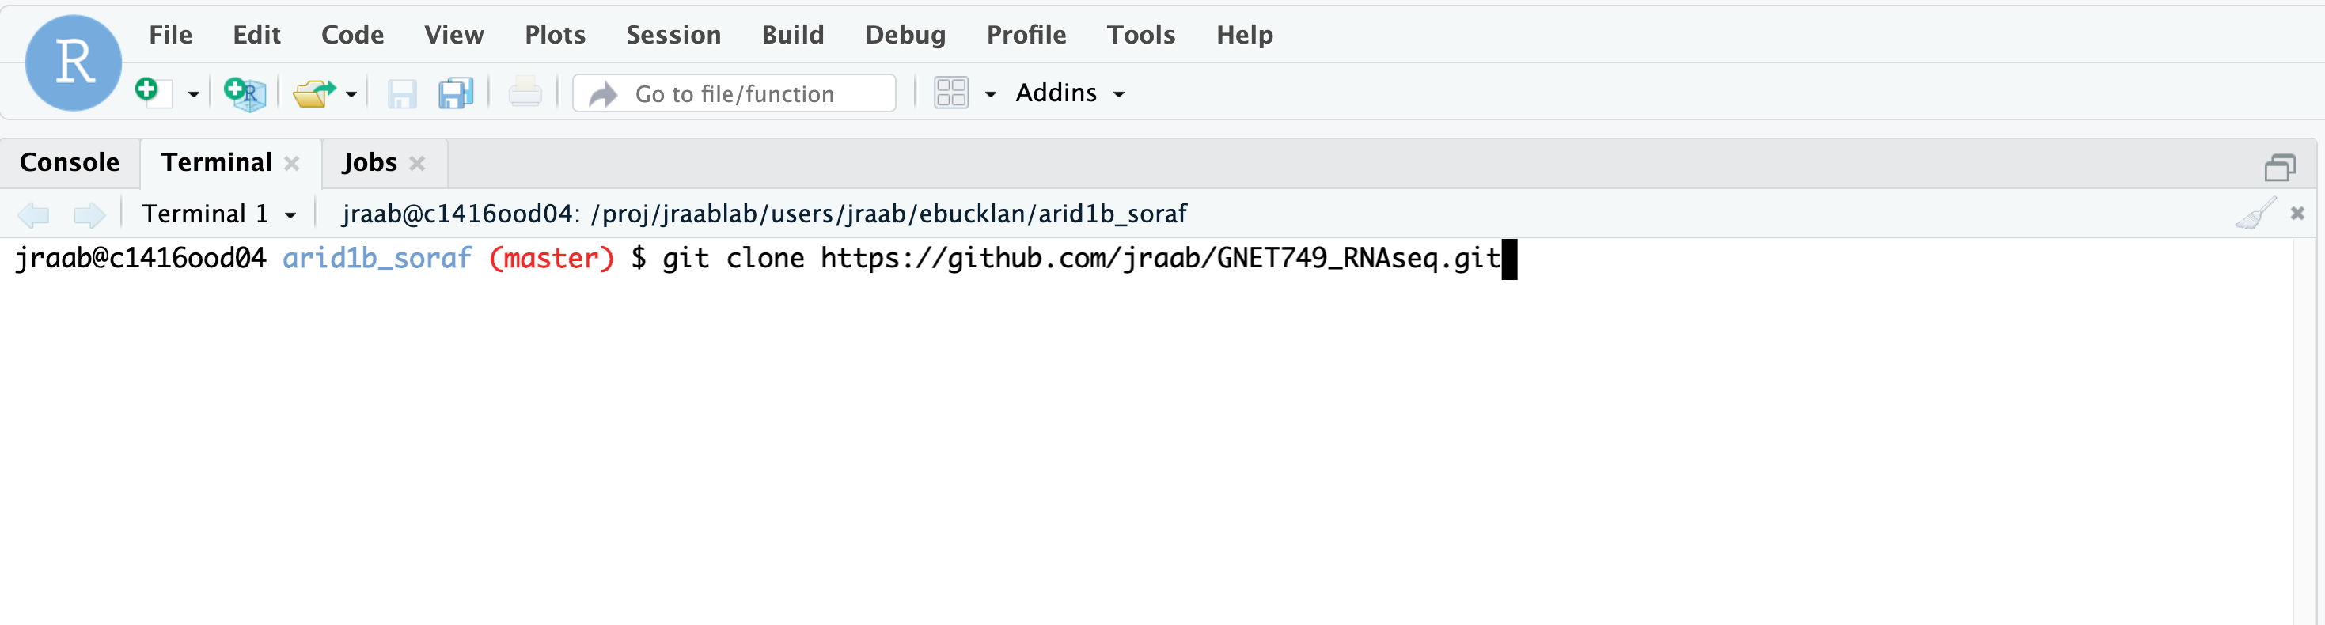
Getting code from this class
Ondemand in a terminal
module load git
git clone https://github.com/jraab/GNET749_RNAseq.git
git fetch

Slide 11

Getting code from this class
On your computer
desktop.github.com

Slide 12
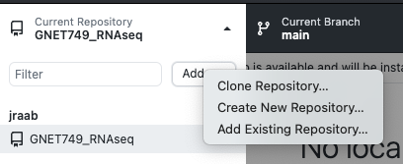
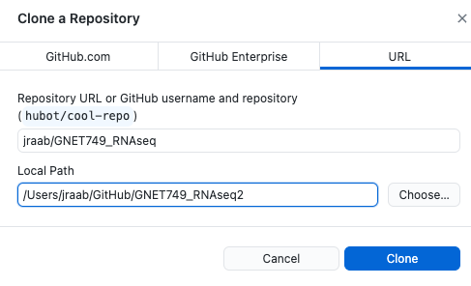

Slide 13
Why Learn R?
Extremely powerful statistical tools
Reproducibility
High quality visualizations
Multiple ways to do things
Great packages for biologists (RNAseq, ChIPseq, TF Motifs)
R is free, has a huge community (CRAN and Bioconductor)
Works on most operating systems (Linux, Mac, Windows)

Slide 14
Downsides of R
Steep learning curve
Multiple ways to do things (base vs tidyverse)
Syntax is unlike other programming languages
Not a general programming language

Slide 15
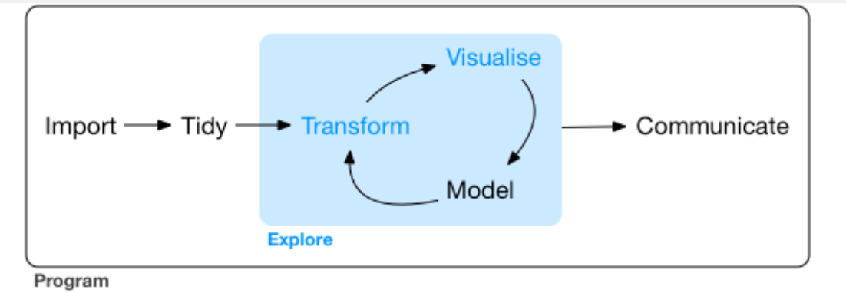
Where to get more information?
R for data science https://r4ds.hadley.nz/
http://r-statistics.co/Complete-Ggplot2-Tutorial-Part1-With-R-Code.html
https://melbournebioinformatics.github.io/r-intro-biologists/intro_r_biologists.html#R_for_Biologists_course
Sticking to a style
https://style.tidyverse.org/syntax.html

Slide 16
Basic Syntax
a <- “some string”
variable
assignment
string

Slide 17
Basic Syntax
character
a <- “some string”
vector
b <- c( “a”, “vector”, “of”, “words”)
list
d <- list( “also” “a”, “list”)
data.frame
df <- data.frame( c(column1 = c(‘a’, ‘b’, ‘c’),
c(column2 = c(‘d’, ‘e’, ‘f’) )

Slide 18
Getting data into R
df <- read_csv(‘somefile.csv’)
df <- read_tsv(‘somefile.tsv’)
df <- read_table(‘somefile.tsv’, sep = “\t”)
df <- read.csv(‘somefile.csv’)
Tidyverse
base

Slide 19
Getting data into R
Tidyverse
df <- read_csv(‘somefile.csv’)
df <- read.csv(‘somefile.csv’)
df is a tibble, strings are characters
Base R
df is a data frame, strings are factors
For this class these are similar enough that you can read them either way.
https://r4ds.had.co.nz/tibbles.html#tibbles-vs.-data.frame

Slide 20
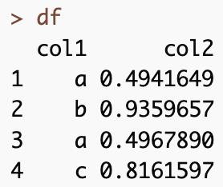


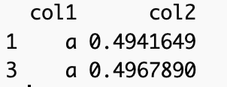
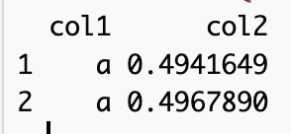
Base R vs Tidyverse
Base
Tidyverse ( library(tidyverse)
https://dplyr.tidyverse.org/articles/base.html

Slide 21
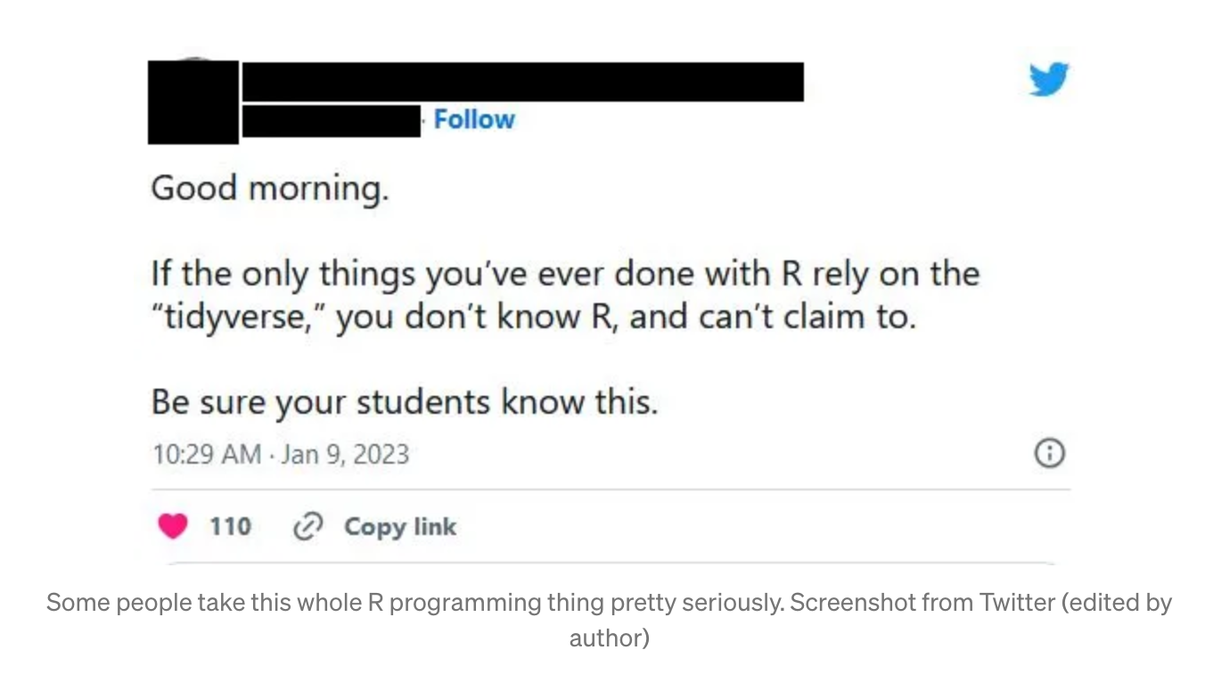
Why use one or the other?
Base R
Can be faster
Older/Can be more stable
Easier for some specific cases
Don’t need to install anything extra
https://towardsdatascience.com/tidyverse-vs-base-r-how-to-choose-the-best-framework-for-you-29b702bdb384

Slide 22
Why use one or the other?
Tidyverse
More readable (left to right like english)
Standardized
Different parts work well together (dplyr, pipes, ggplot)
Many useful functions (verbs)
https://towardsdatascience.com/tidyverse-vs-base-r-how-to-choose-the-best-framework-for-you-29b702bdb384

Slide 23
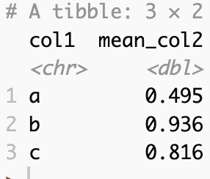
Why use one or the other?
https://towardsdatascience.com/tidyverse-vs-base-r-how-to-choose-the-best-framework-for-you-29b702bdb384

Slide 24
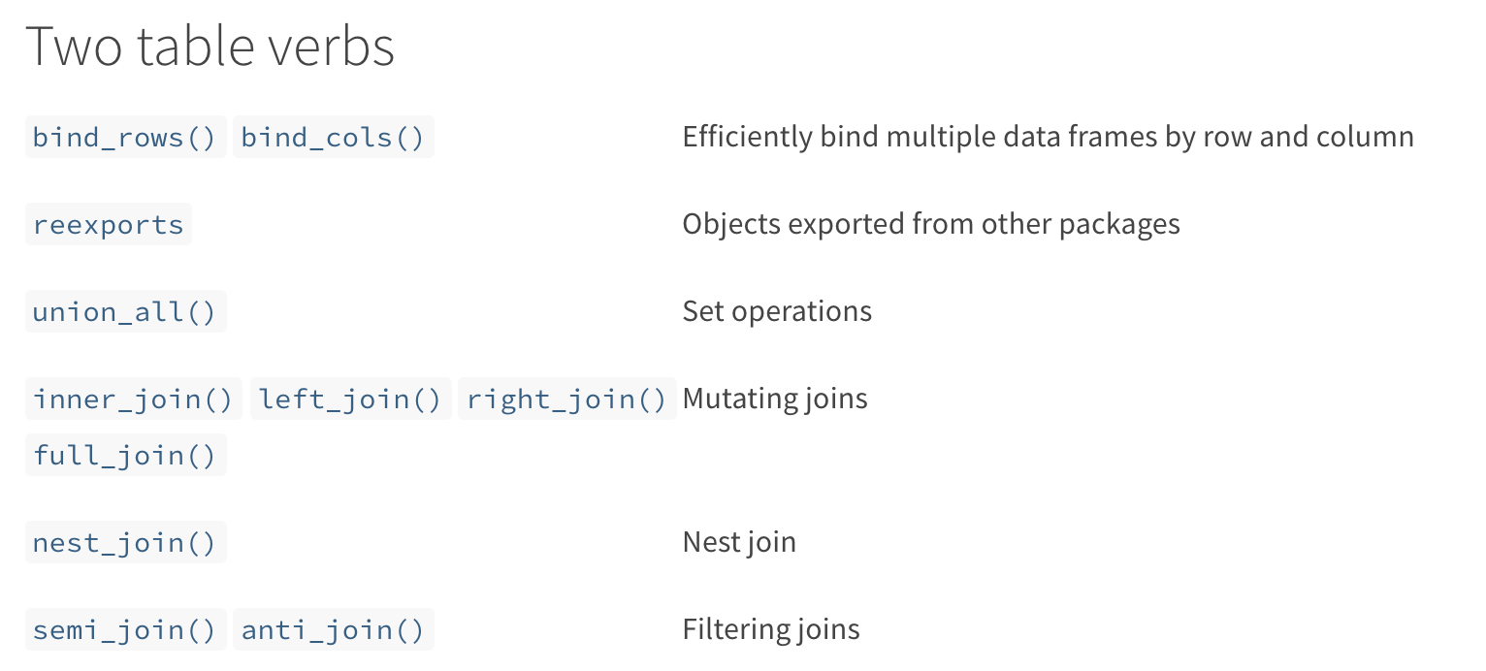
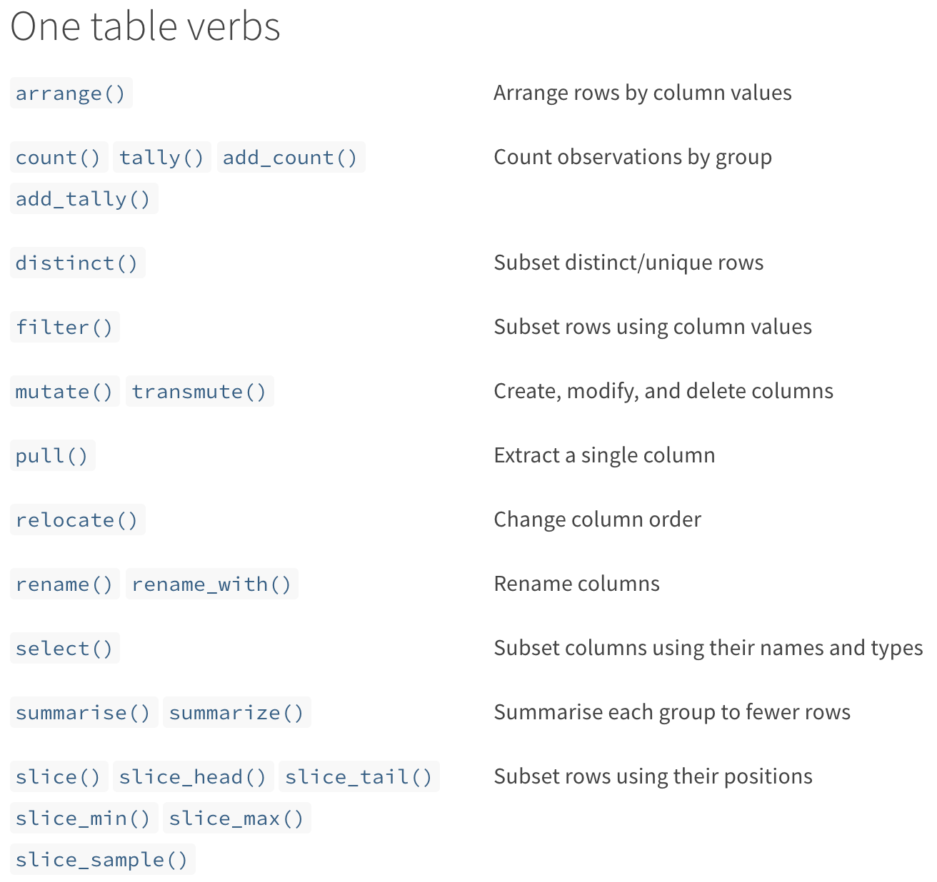
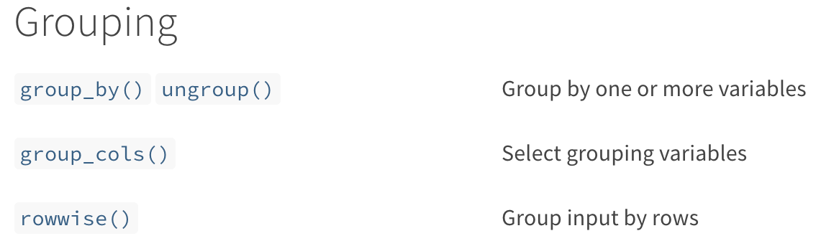
Tidyverse ‘verb’s
https://dplyr.tidyverse.org/reference/index.html
Notes:
The tidyverse syntax makes more sense to me (as a non computational biologist). In pulling this slide off the tidyverse site I learned several new verbs,s o they are actively adding

Slide 25
Pipes
Tidyverse uses %>% or |> to link commands
In Unix Pipes let you chain commands together with the pipe ( | )
cat file.txt | grep ‘sometext’
df |> filter() |> group_by() |> summarise()
Pipes make reading a series of steps easier
https://r4ds.had.co.nz/pipes.html

Slide 26
Fun data sets to play with
iris
built-in
ToothGrowth
built-in
Cereal
https://www.kaggle.com/crawford/80-cereals
flightdata
install.packages('nycflights13')
nih
NIH Reporter (on github as worldwide2020.csv)

Slide 27
Recap - Class 1
Installing R and Github and getting code
R syntax
Getting data into R
working with data in R

Slide 28
switch to live mode

Slide 29
Recap
Installing/loading libraries - library()
Plotting - ggplot()
Filter/Grouping/Summarizing - filter(), group_by(), summarise(), mutate()
Importing Data - read_csv(), read_tsv()

Slide 30
install.packages(‘nycflights13’)
data(ToothGrowth)
How many observations for each treatment?
How many for each dose?
How many for each treatment/dose combination?
What is the average length for each dose, treatment, and combination
Does treatment affect growth? (plotting practice)

Slide 31
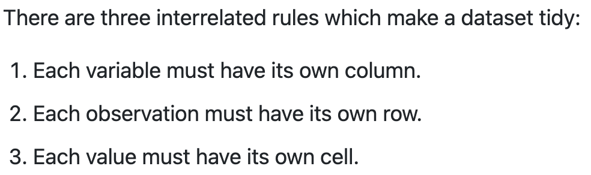
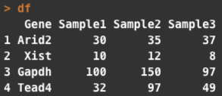
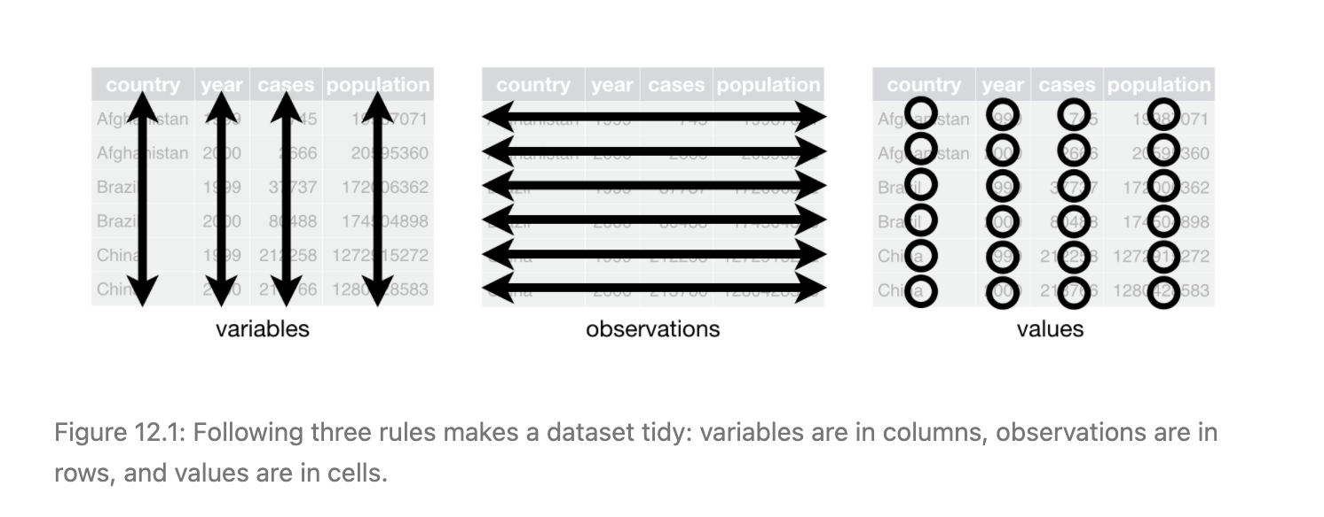
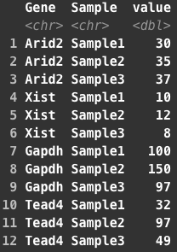
Tidy Data
Not Tidy - wide
Tidy - long
https://r4ds.had.co.nz/tidy-data.html

Slide 32
Why should data be Tidy
Consistency - easier if you always know how the data should be represented
Ease - Works seamlessly with tools in the tidyverse (like ggplot)
Speed - Having variables in columns lets R work more quickly (using vectorization)
Not all data need to be in this format
Speed - Some specialized data formats can be faster for specific problems/computations (gene expression matrices are an example of this)
Field norms - some fields are used to storing data in a specfic way (summarizedExperiment in R )
Some tools work more easily on matrices - Heatmaps
From JT Leek https://simplystatistics.org/2016/02/17/non-tidy-data/

Slide 33
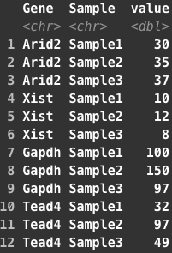
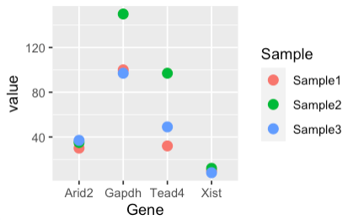
What if we want to look at expression levels of these 4 genes?

Slide 34
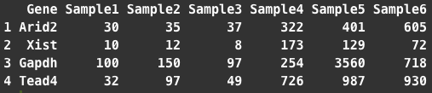
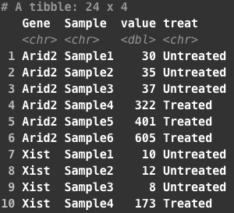
A little more complicated example - samples from different conditions
Untreated
Treated
Wide
Long
Notes:
Now lets try somethign a little more involved. On the left is the wide data. You can see I’ve added 3 more samples, lets assume from some drug treatment or somethign. On the right I’ve made this into a tidy/long dataset and added a new column to describe the treatment (treated vs untreated). We might want to know what effect treatment has

Slide 35

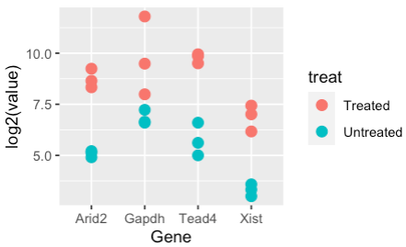
A little more complicated example - samples from different conditions
Notes:
Thats very simple using ggplot when we have data in this orientation. You just change the aes parameters to reflect what you’re now asking. We can still put Gene on the x axis, and value on the y (here I’m log2 transforming just so the plot looks a little better since the values are pretty different in the two groups). Instead of of color by sample, we can color by treatment and the difference is really clear.

Slide 36

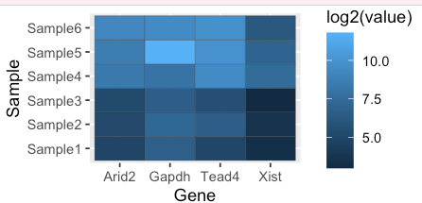
A little more complicated example - samples from different conditions
Notes:
You can make very different plots using this same basic structure, I find this really lets you dig into the data and explore quickly. Here all we did was again change what we are mapping to the x and y axis, we kept Gene on the X, but now put the samples on the y and made the color fill equal to the counts.
These plots are much harder (for me at least) to make from base R graphics and without using tidyverse syntax. Its definitely worth taking some toy data or some of your own data and getting comfortable plotting things. I spend a lot of time doing exploratory data analysis in R, and the tidyverse packages and ggplot make it very interactive and fun.
I’ll put a script covering some of this onto sakai if you want to play around more. I included some prompts for other things to look at

Slide 37
Back to code

Slide 38
Merging and Joining (relational data)
Gene | Count | Sample
Arid2 | 33 | A
Xist | 22 | B
Arid2 | 100 | C
Xist | 30 | D
Sample | Disease
A | Tumor
B | Normal
C | Tumor
D | Normal

Slide 39
Merging and Joining (relational data)
Gene | Count | Sample
Arid2 | 33 | A
Arid2 | 22 | B
Xist | 100 | A
Xist | 30 | B
Sample | Disease
A | Tumor
B | Normal

Slide 40
left_join()
Gene | Count | Sample | Disease
Arid2 | 33 | A | Tumor
Arid2 | 22 | B | Normal
Xist | 100 | C | Tumor
Xist | 30 | D | Normal

Slide 41
inner_join()
Gene | Count | Sample
Arid2 | 33 | A
Xist | 22 | B
Arid2 | 100 | C
Xist | 30 | C
Sample | Disease
A | Tumor
B | Normal
C | Stroma
D | Brain

Slide 42
inner_join()
Gene | Count | Sample
Arid2 | 33 | A
Xist | 22 | B
Arid2 | 100 | A
Xist | 30 | B
Sample | Disease
A | Tumor
B | Normal
C | Stroma
Gene | Count | Sample | Disease
Arid2 | 33 | A | Tumor
Arid2 | 22 | B | Normal
Xist | 100 | A | Tumor
Xist | 30 | B | Normal

Slide 43
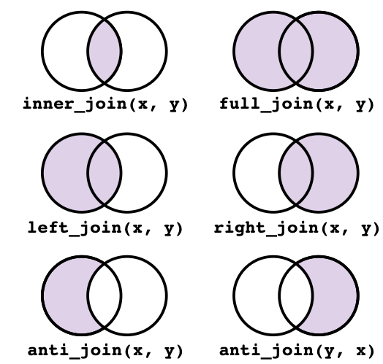
https://tavareshugo.github.io/r-intro-tidyverse-gapminder/08-joins/index.html
link to the license

Slide 44
back to code

Slide 45
Functions
What are functions
Any chunk of code you are going to reuse - can be built in or come with a package or user made
Can take 0 or more arguments
Can return some value(s) or objects
Reasons to make a new function
-https://r4ds.had.co.nz/functions.html
You can give a function an evocative name that makes your code easier to understand.
As requirements change, you only need to update code in one place, instead of many.
You eliminate the chance of making incidental mistakes when you copy and paste (i.e. updating a variable name in one place, but not in another).

