Slide 1
RNAseq Quality Control and Visualization
Class 5

Slide 2
Quality Control and Data Visualization
Do experimental groups look right
Does number of reads make sense
Do replicates cluster together
Are there potential batch effects/biases
How to visualize DE
Full scripts in :
scripts/deseq_qc.R
scripts/visualize_deseq_results.R

Slide 3
Goals in RNA-seq Analysis
Samples
Genes
Raw Counts
Visualization/Quality Control
Differential Expression
DESeq2::vst()
DESeq2::rlog()
DESeq2::plotPCA()
DESeq2::plotCounts()
ComplexHeatmap::Heatmap()
DESeq2::DESeq()
DESeq2::results()
R code for Differential Expression
Full annotated methods in salmon_DE.R
Notes:
So now that we have our data into a DESeq object we can do either of these two paths, and we need to do both. I’m going use the time we have left to show some visualization/quality control things about our data.
Next time we’ll do the differenetial expression side, work through that code and talk about what DESeq is actually doing

Slide 4
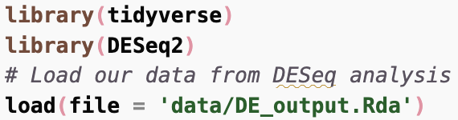


Quality Control and Data Visualization
Loads 2 objects (des and res) from previous script salmon_DE.R

Slide 5
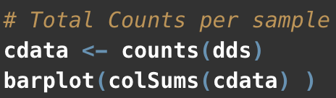
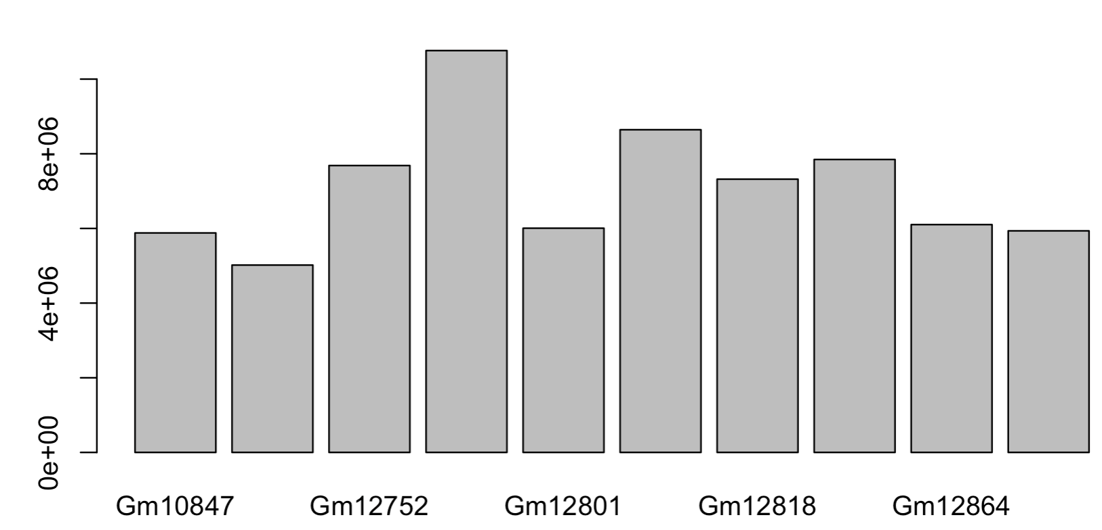
Total counts per sample
Do any samples have an unexpectedly high or low number of reads?

Slide 6
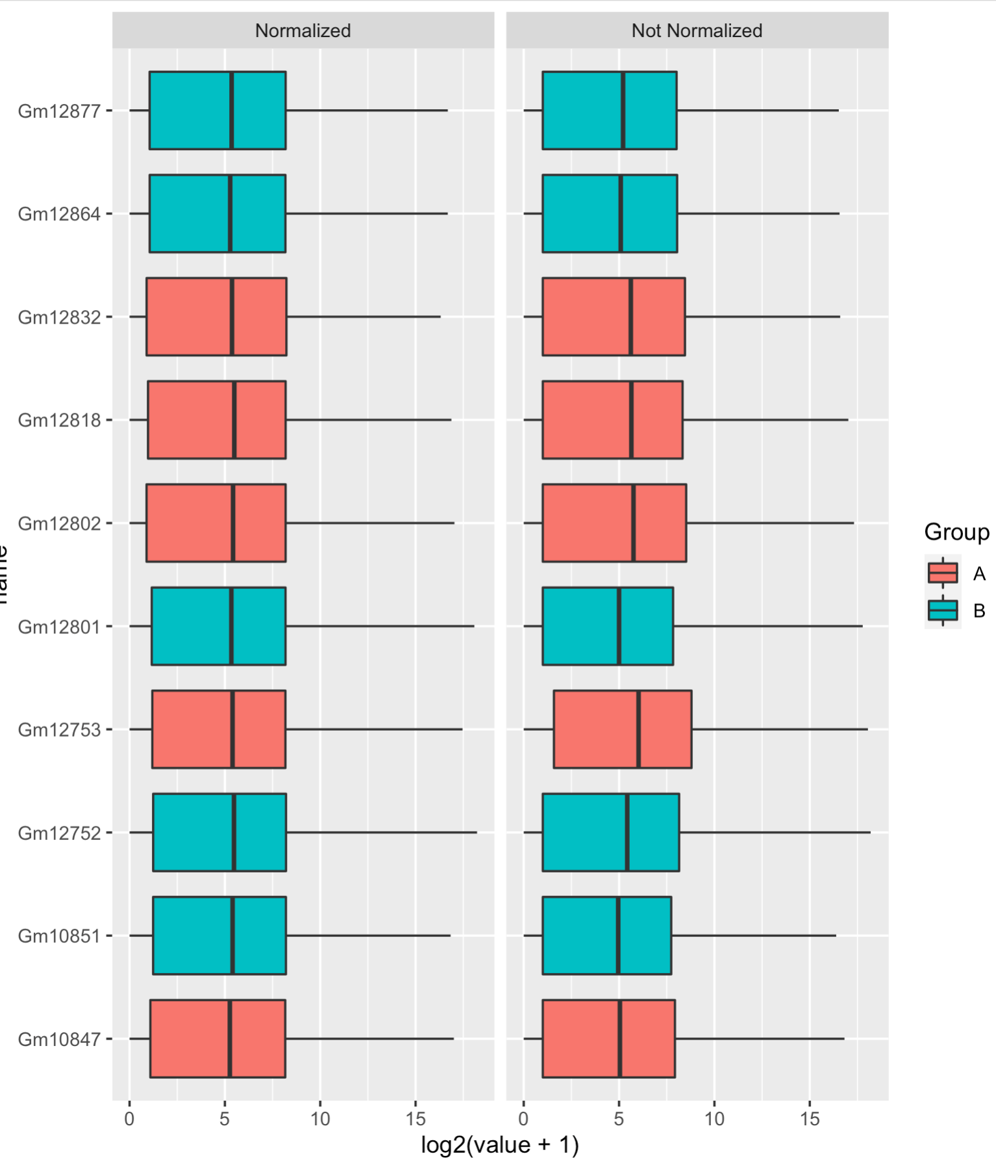
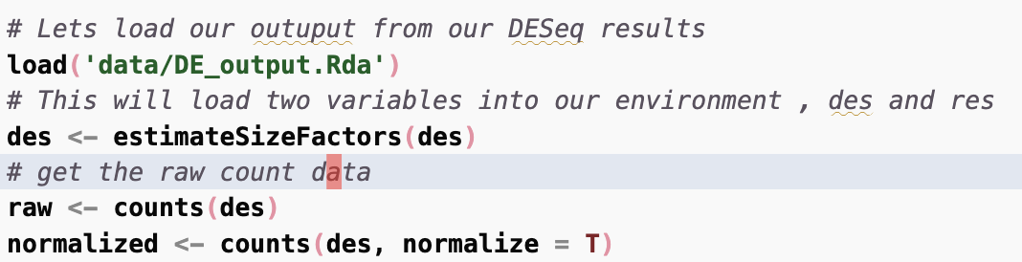
Normalized using DESeq
Notes:
Trrying to evaluate if there are any imbalances in the data or groups we should take note of.
On the right side is the non-normalized raw count data (this will be the input do DESEq analysis next time). The left side is normalized data where we’ve taking the count matrix back out of the DESeq object and normalized it using the sizefactors DESeq estmiates.
This is probably not the best way to do this, and DESeq includes two better approaches rlog and vst which are useful when you want to do clustering or anything related to distances between samples.

Slide 7
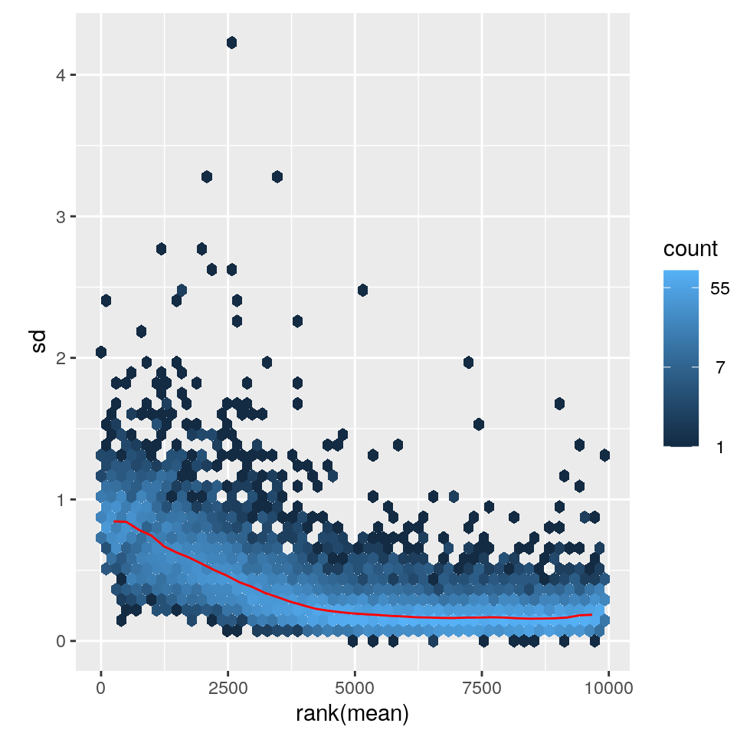
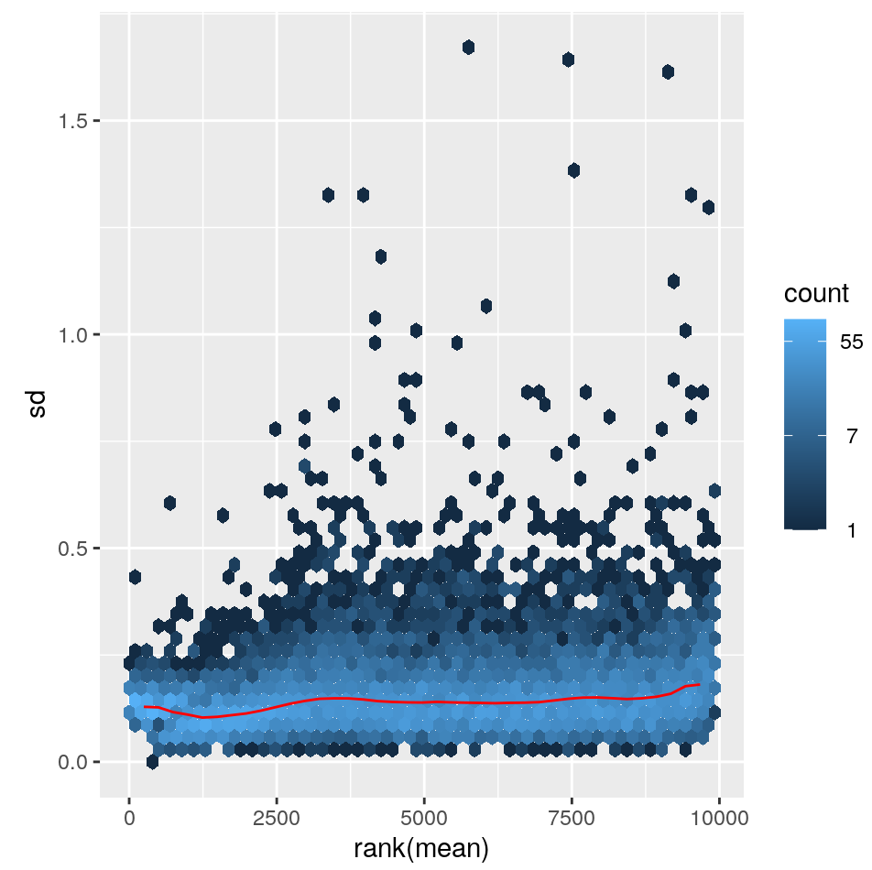
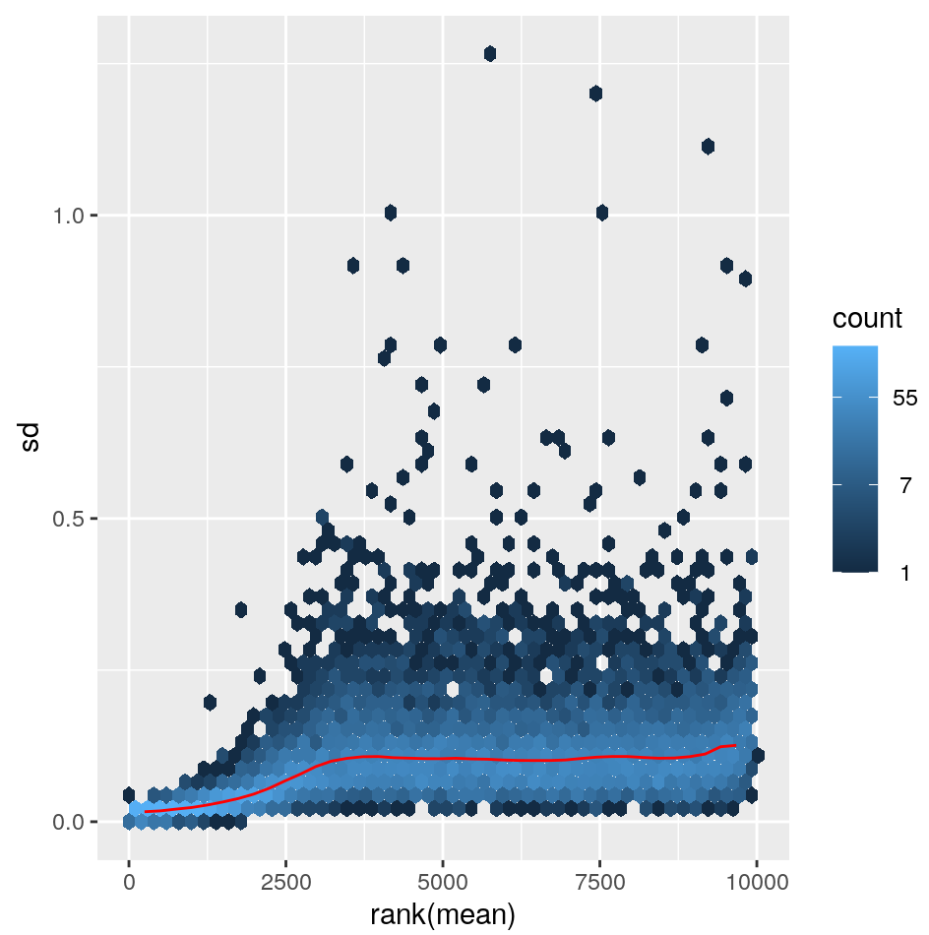
Data transformations – how to transform data for visualization purposes
Log2(n+1)
vst
rlog
https://bioconductor.org/packages/release/bioc/vignettes/DESeq2/inst/doc/DESeq2.html#data-transformations-and-visualization
Notes:
One problem we are trying to solve with normalization approaches is correting for library size - the other major problem is that the variance of a gene depends on its mean. I took these plots from the DESEq2 manual at the bottom.
bThis means that low expressed genes have high standard deviations of expresion. Ideally you’d want to have constant variation across expression range. The first plot is just the log2 value of the counts. You can see low expressed genes have higher standard deviations.
VST fixes this and you get relatively constant sd across the expression range
Rlog also flattens this in the low end, but possibly a bit too much. I think both vst and rlog are likely appropriate for most analyes, but vst is a little faster.

Slide 8
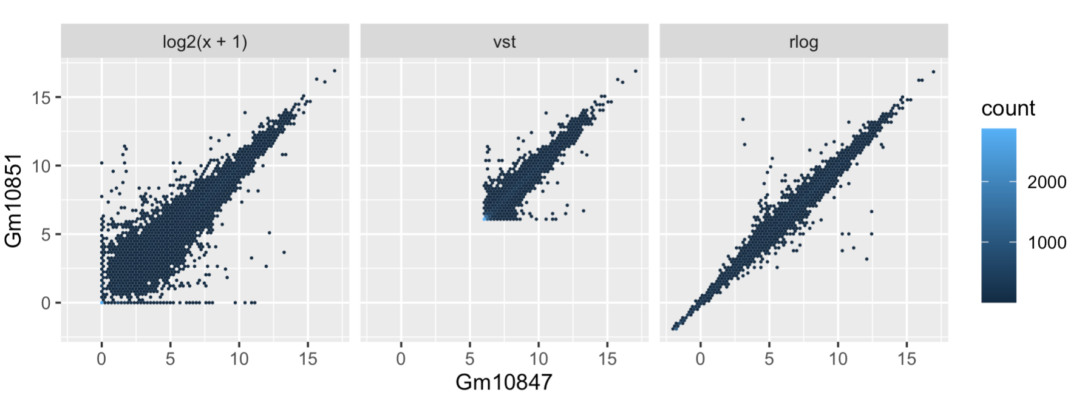
A better way - rlog and VST
Sample2
Sample1
Sample1
At low expression
Noise is dominating
Better,
shifts expression of lower expressed genes
Shrinks low counts
Notes:
We can compare two samples using these plots as well. This also comes form the DESEq2 manual. Here we are comparing two samples that we’ve transformed using one of the three prevouis methods
I think you can really appreciate how noisy the shifted log version is - the low values are just all over the place due to noise of counting those weakly expressed genes.
vst is faster and maybe is then better for bigger data sets,but might be a bit more sensitive to outliers. - while rlog might work a bit better on small datasets, but isn’t as good if you have a huge range of sequencing depth (like more than an order of magnitude)
You can try both but they should give relatively similar results
These are important as the variance of your data will increase as the mean does. These variances will dominate princple components and other visualization methods.

Slide 9
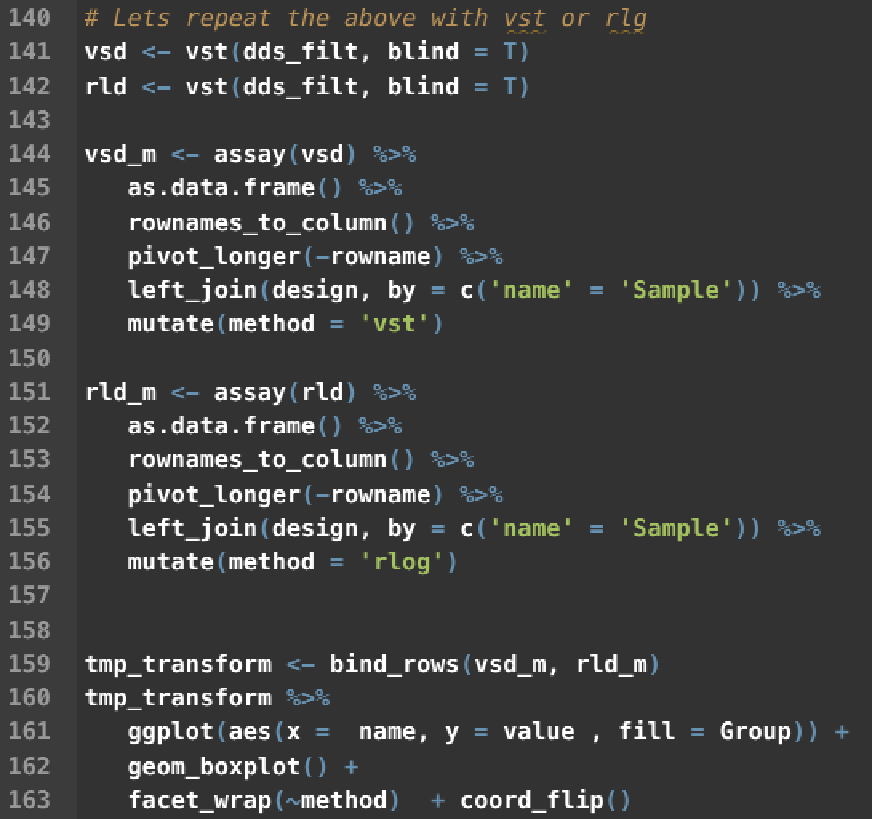
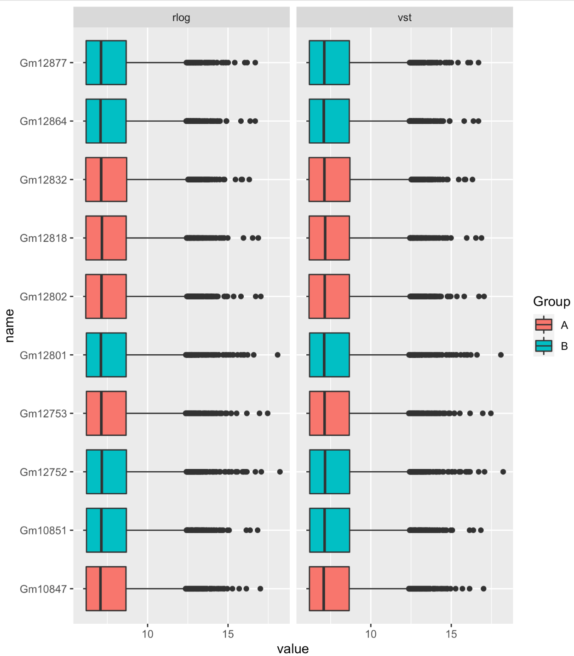
vst and rlog transformations
Notes:
These functions are described well int he DESeq documentation, both do roughly equivalent things, vst is faster and is the one I usually use.
Walk through code -
SO you can see for both vst and rlog the normalzied data look relatively simialr and there are not obvious gorup differences remaining after this transformation. That doesn’t mean there are no biases or batch effects, but nothing very obvious jumps out to me here.

Slide 10
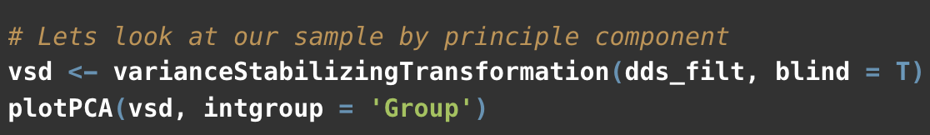
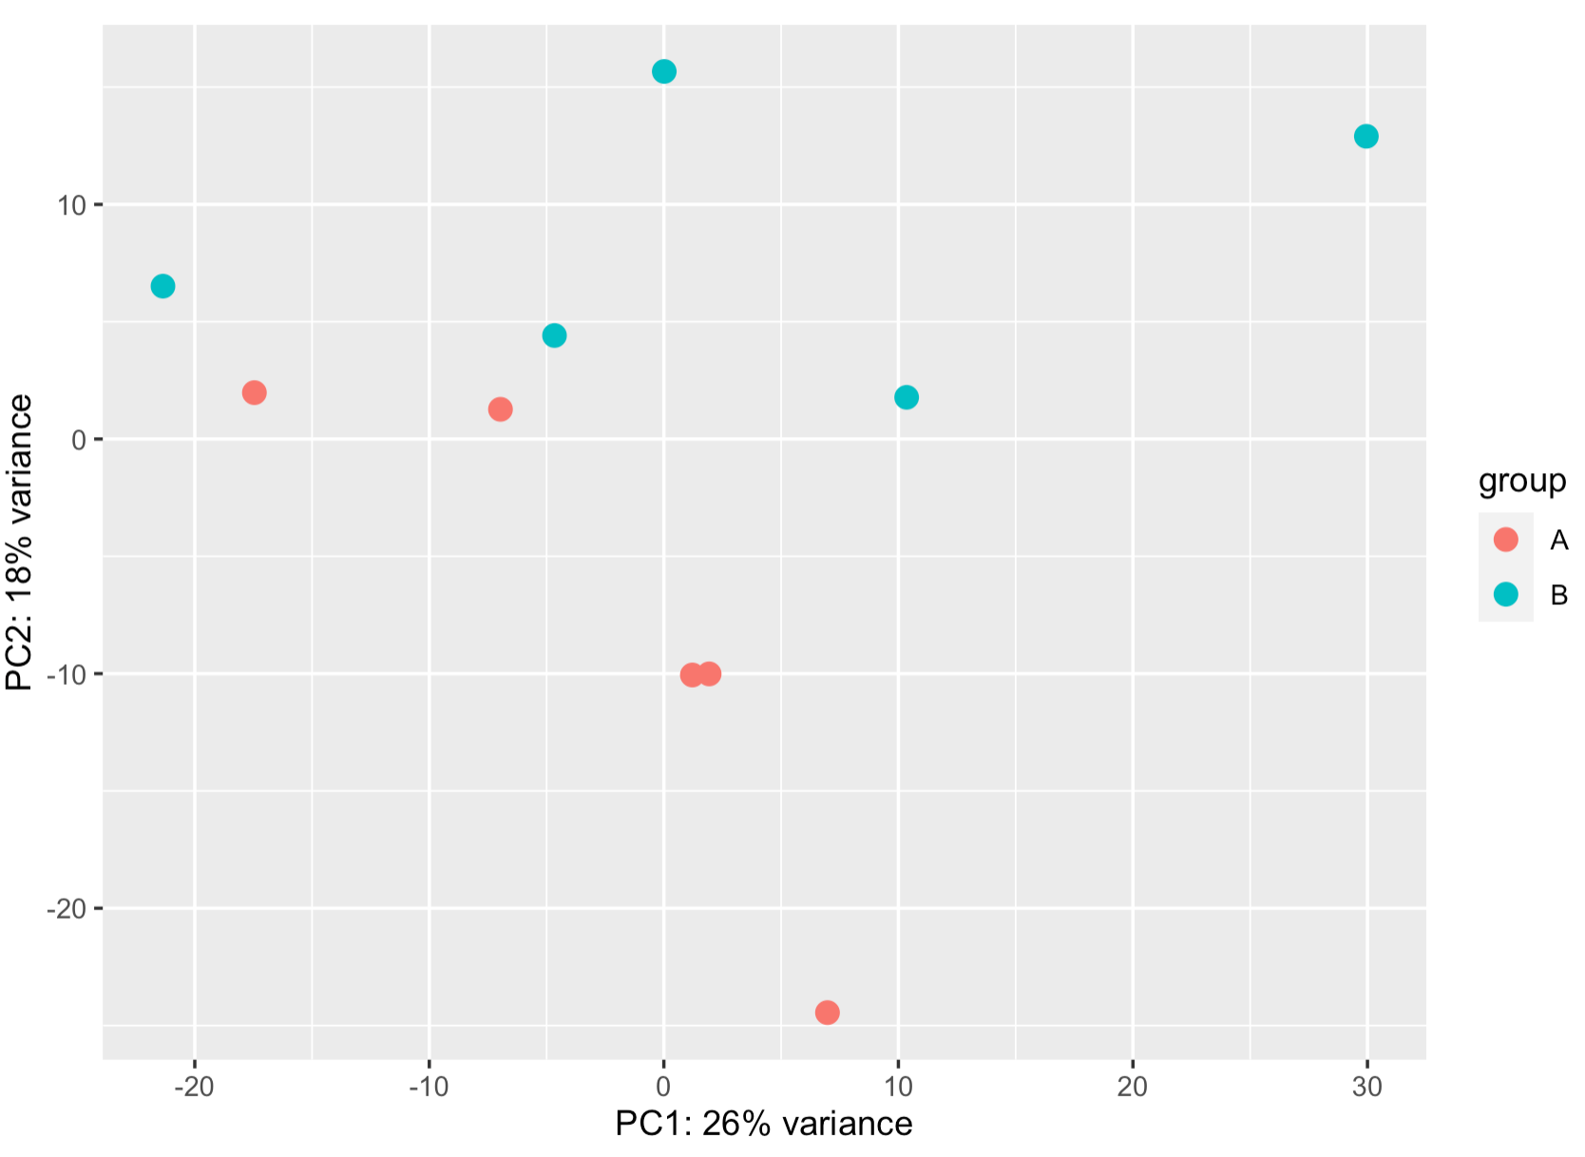
blind = T

Slide 11
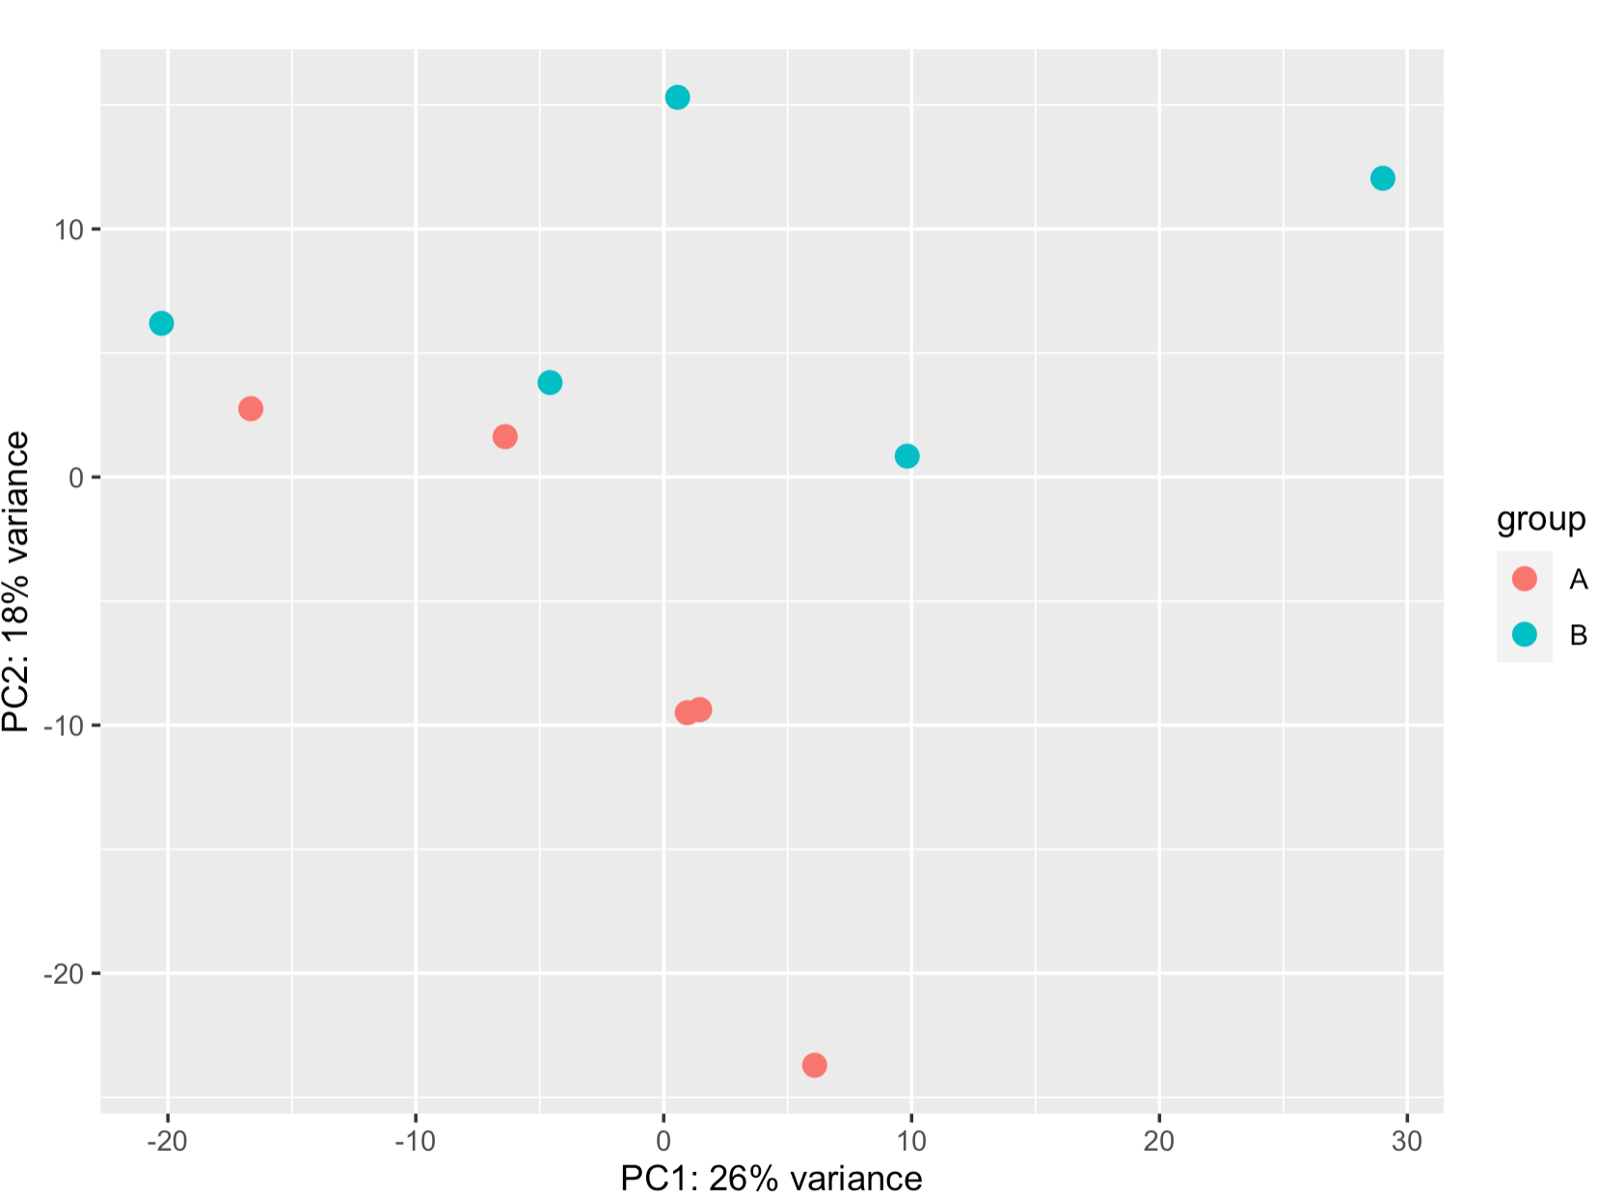
blind = T
blind = F

Slide 12
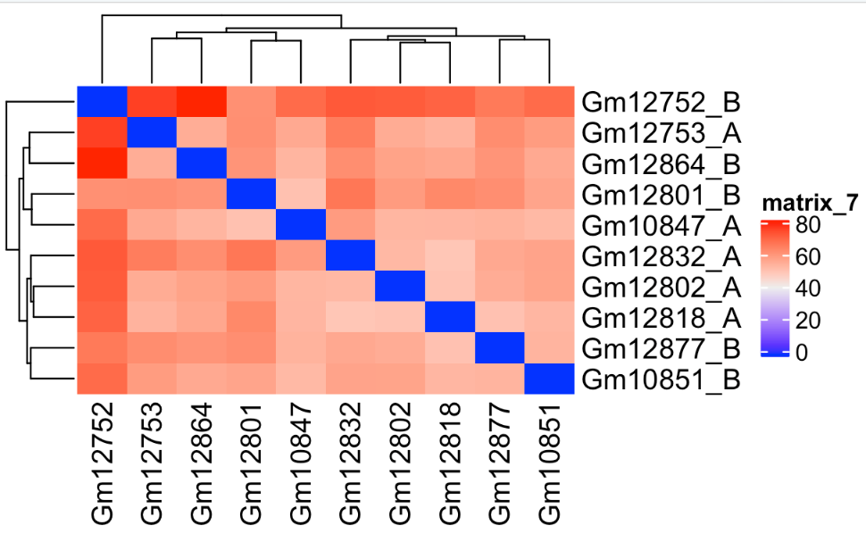
Sample Clustering
Notes:
What you’re looking for hear is that samples cluster based on replciates. Pretty clearly we aren’t getting very good cluster separeation. Next time we’ll look for hidden batch effects to see if that can improve clustering - and then move on to DE analysis.

Slide 13
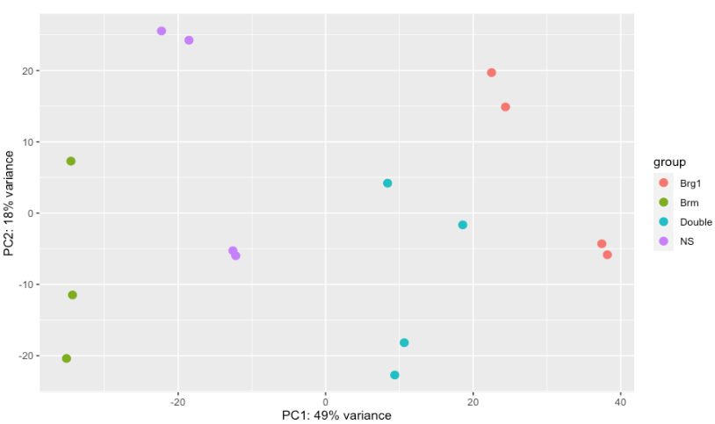

QC examples

Slide 14
QC examples
Clustering is OK, but not perfect

Slide 15
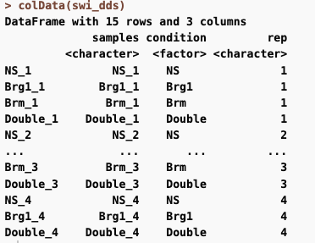
QC examples
Clustering is OK, but not perfect

Slide 16
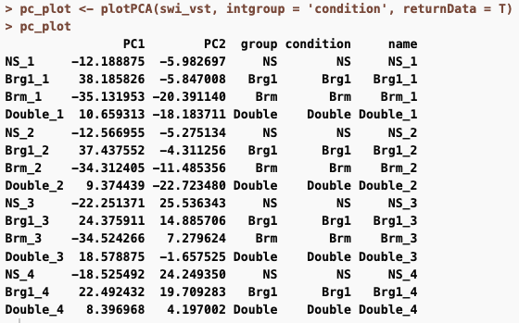
Data from the PCA plot can be returned

Slide 17
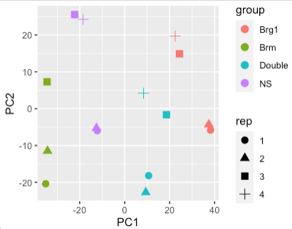
Some replicates always cluster together
Evidence of a batch effect

Slide 18
R code for QC

Slide 19
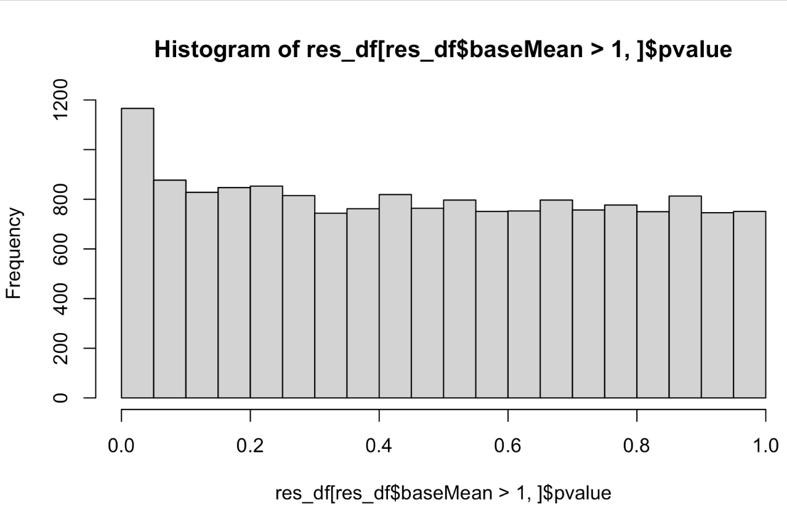
P-values
Notes:
some of these are just by chance - you can sort of look at th edistrubtion and assume at least ~800 of them are, but there could be a few hundred p-values that really are - we use an correction for multiple testing to find these.
Default here is false discovery rate (benjami hochberg) -or the proportion of false discoveries - so with an FDR of 0.1, we expect ~10% of the rejected null hypothesis to be an error, and to actually be just due to chance.

Slide 20
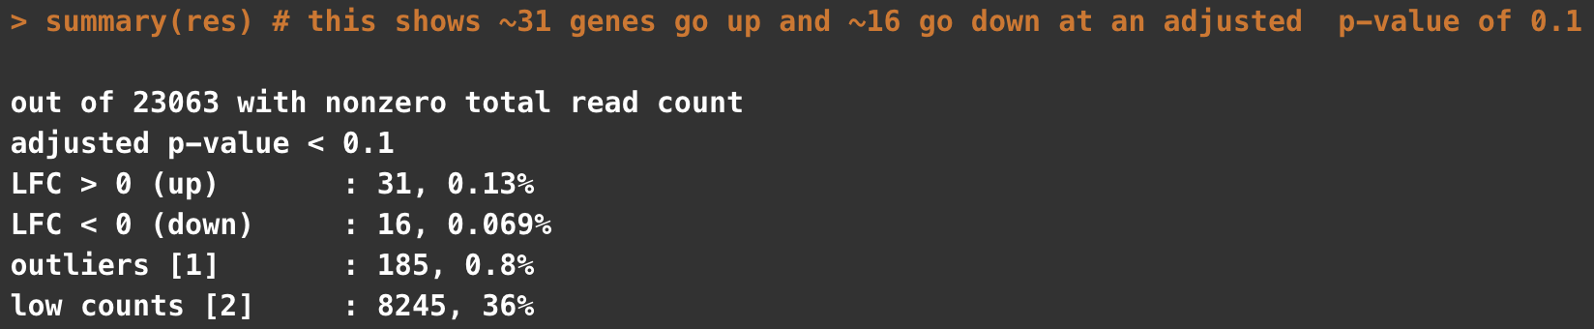
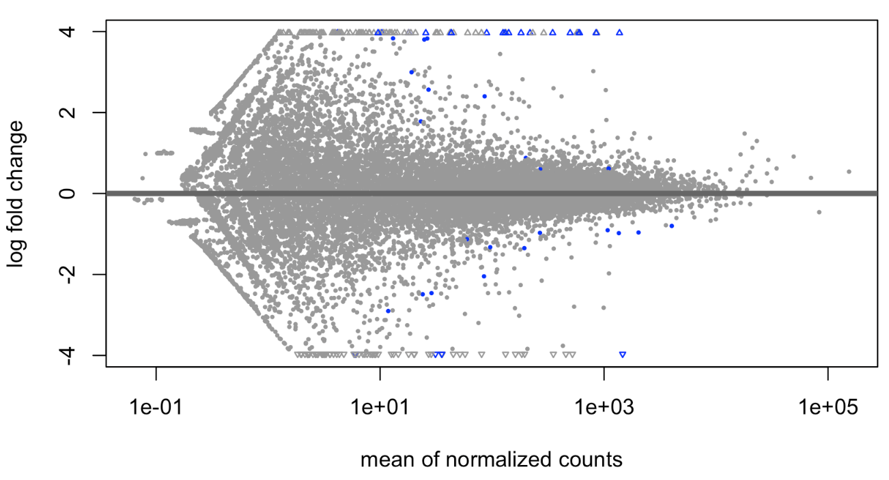
Basic plotting and visualizing of results
Notes:
basic plot shows few genes with pretty strong log fold changes are significant . BUt you can see some odd banding and stuff in the data. This is inpart becuase the genes with low counts can have very high (but pretty unreliabile ) fold changes

Slide 21
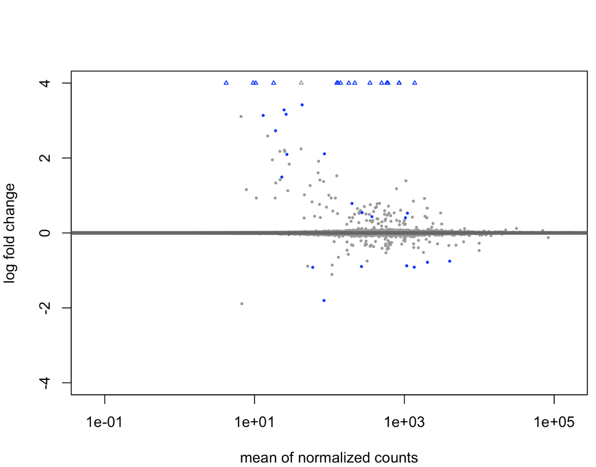
Basic plotting and visualizing of results
Initial
Shrunk

Slide 22
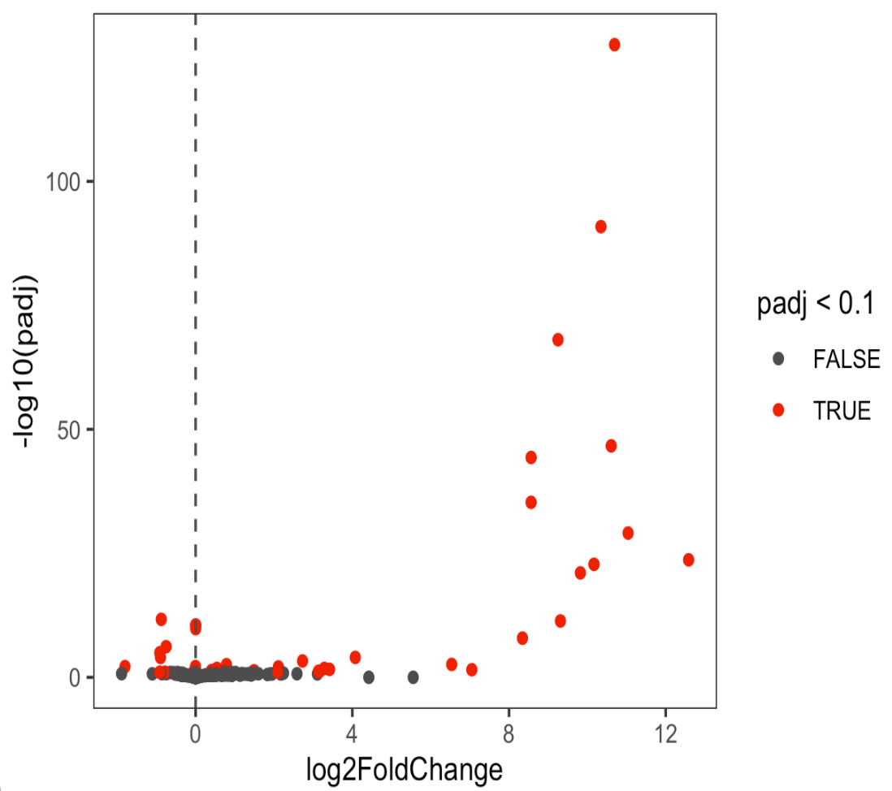
Basic plotting and visualizing of results
VolcanoPlot
Shrunk

Slide 23
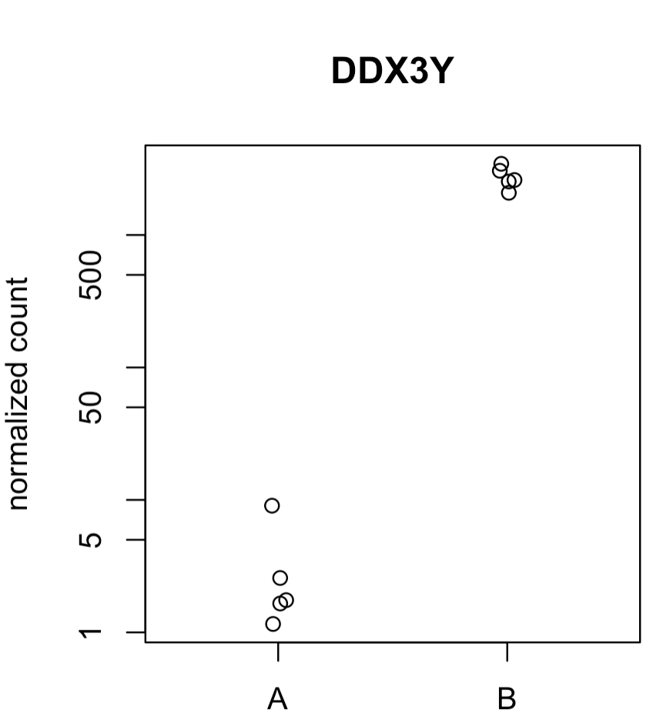
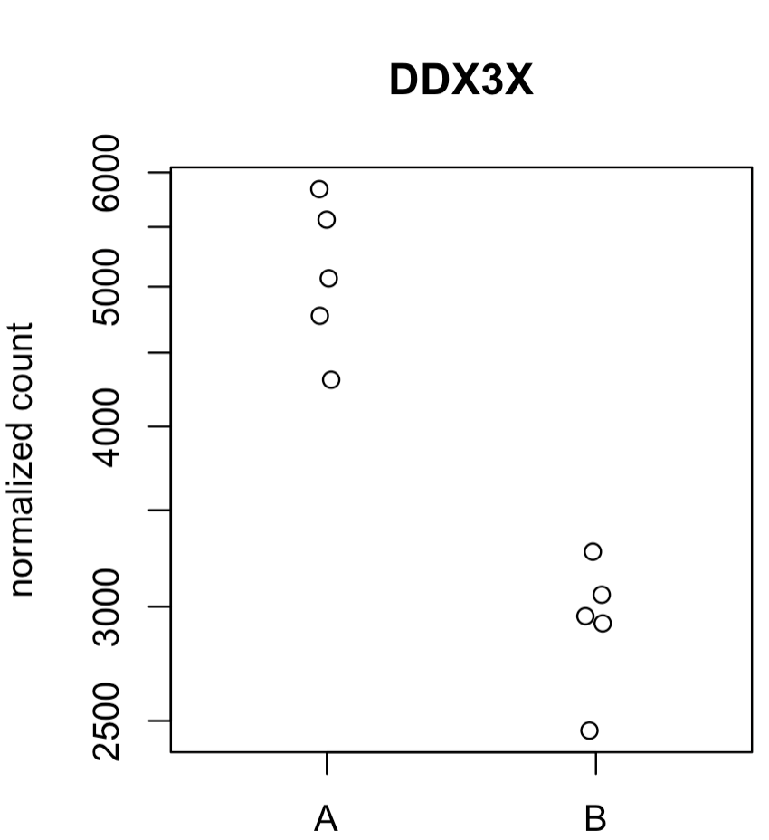
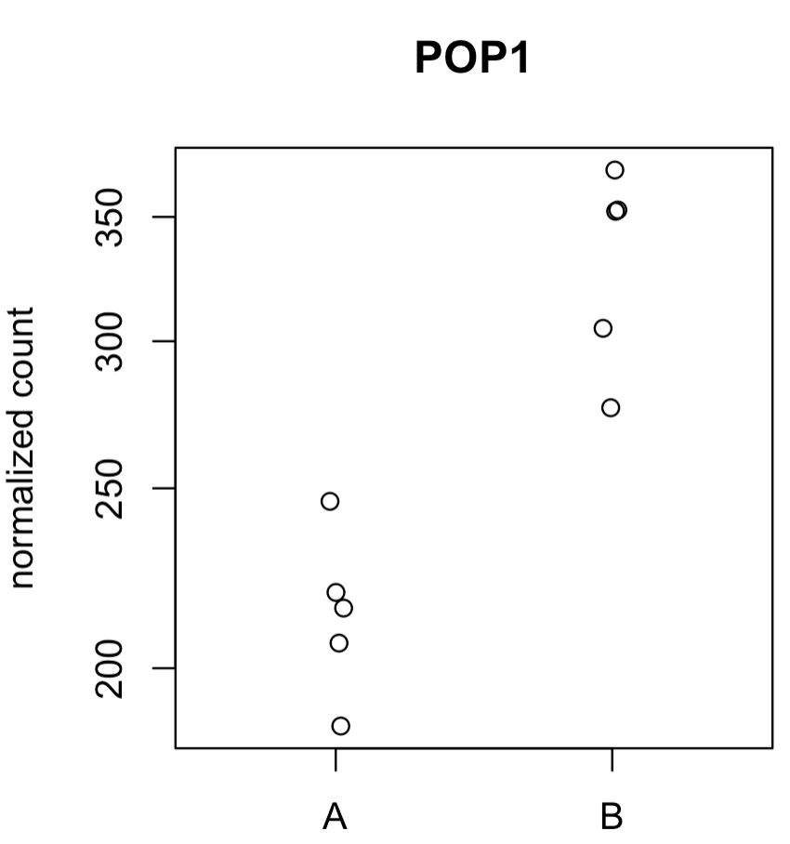
Basic plotting and visualizing of results

Slide 24
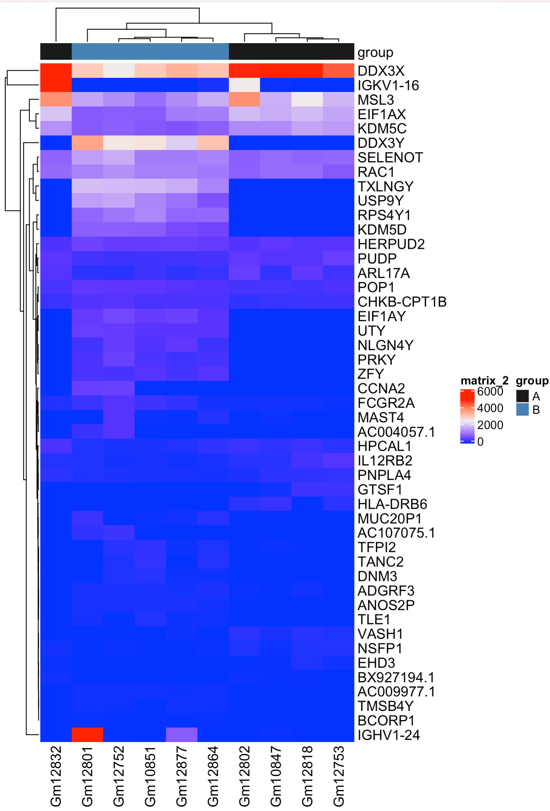
Basic plotting and visualizing of results
Notes:
Important to go back to your original count data transformed somehow to do these plots
Like last time, we can see that the count data varies a lot so this is really just dominated by the total counts. Usually we want to scale this by row, so that we can see difference between groups. Also notice that one sample GM12832 is sort of off doing its own thing, which is in line with what we saw the other day.

Slide 25
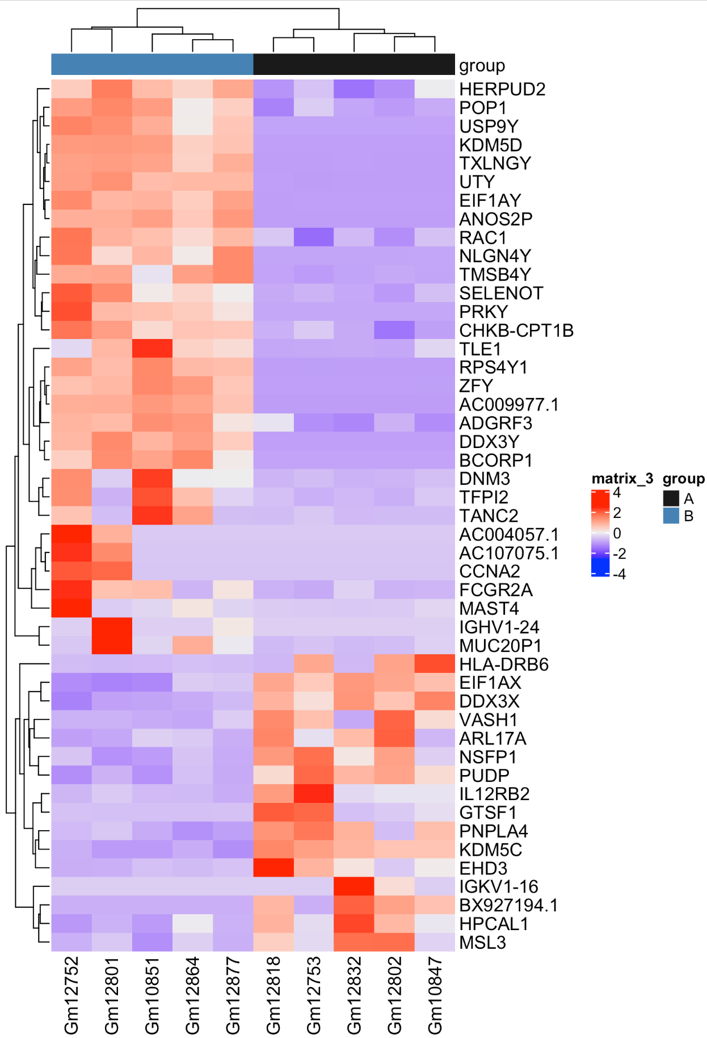
Basic plotting and visualizing of results
Notes:
center = T subtracts the column mean from each value
scale = T divides these values by the standard deviation of the column
This gives you a z-score of the expression in that row.
We transpose the original matrix since scale operates on columns, then transpose again to return to the original dimensions
NOw this behaves much better and our samples cluster. Even the problem child 12832, which because we put all these values on the same scales (z-scores) a few genes with very high counts in that sample don’t drag it away.

Slide 26
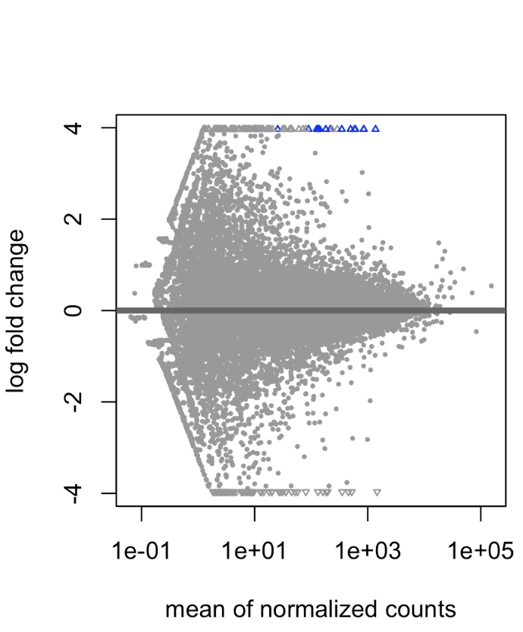
Filter by Fold Change
Notes:
We tested the null hypothesis that there was not a difference in experssion between two conditions (condition A == condition B). It’s possible that we’lll have small fold changes that relate to large enough p-values to pass our threshold for significance. This coudl be becuase we have lots of replicates and very high power or because we have some very h igh expression levels that we’re pretty sure of and can mroe easily ‘see’ the difference (i.e. we’re more sure of our estimate of that genes expression in each condition).
While these might statistically be different, we might not care biologically - in practice, some will enforce a threshold of 2-fold or 1.5 fold or something like that. This experient has few genes, so I woulnd’t bother even though a couple have pretty small fold changes

Slide 27
Visualization Code Demo

