Slide 1

RNAseq analysis in R

Slide 2
Goals/Agenda
Why do RNA-seq
Practical advice (read depth, replicates)
Differential testing
Basic RNAseq analysis - template script using class data
QC
Experimental designs
Batch effects
Visualizing data
Normalization
Deriving biological meaning / enrichment analysis
Notes:
Here are the goals and agenda for the next couple of classes. I’m guessing this will be 3-4 lectures, we’ll see how the pace goes.
Plan is to start today with a lecture about RNA-seq techniques, approaches, and the steps involved. The overall goal is to explain and then walk through the practical steps of analyzing RNAseq data using R.
we’ll go through how to explore and QC your data. There will be some material about how to QC your data and make sure everything looks right. This is where being a biologist and computational biologist is important since you’ll understand you're samples you’ll know what to look for (sample swaps, genes that should show up in your data, etc)
The next class we’ll work through some examples for how to go from counts to differential genes.
Class 3 to talk about visualizing data and getting biological meaning from them. We’ll talk about how to make things like heatmaps and annotate functions and do enrichment profiling and stuff like that.
Class 4 will be going through the code for those methods.
We may not take the full class each time, so please interrupt and slow me down if something isn’t clear. Class 1 and 3 will be more of a lecture, with class 2 and 4 being putting some of those methods into practice. We’ll have time for a fifth class if we need to cover more hands-on computational work, or I can be available to answer questions you have about getting your code running the way you want.
I’ll make all these slide avaiable on Sakai and where I’m showing you code snippets I’ll have full Rscripts up on Sakai as well. Definitely try to go through and understand the steps on your own.

Slide 3
Why Do RNA-seq
Measure differences in gene expression between conditions
Better dynamic range and isoform/transcript information than microarrays
Detect structural variation, fusions, or single nucleotide variants
Identify new transcripts/genes
Measure ‘weird’ transcripts
Applicable to single cells
Less technical bias than microarray
Notes:
RNA-seq has largely replaced microarrays, with a few exceptions like some copy number analysis and maybe some really common gene panels or something people like. But I’ve only ever run like 1 or 2 microarrays (as a rotation student) . It can still be useful to learn how to analyze that data since so much is in GEO (gene expression omnibus). Analyzing other peoples data, a so-called data parasite, is one of my favorite things to do since at least reagent-wise its free
The big thing you want to do is “Measure differences in gene expression” and this can be expanded to look not just at a a gene as one thing, but isoforms or alternative starts or polyA sites
A lot of folks, especially in cancer are looking for “fusions, structural variants, or single nucleotide variation” that might indicate a mutation of some sort.
Possible to identify new genes - with RNA-seq you don’t necessarily need a transcriptome before you start, so this can work on non-model organisms or poorly annotated genomes. This will require more reads and thought in how you analyze the data.
You “can analyze weird transcripts” - some transcripts are poorly represented on commercial microarrays like lncRNAs or various small RNAs or transposable elements. You can map really any transcribed region of the genome. You can also assay RNAs associated with the ribosome or different subcellular locations (cytoplasmic vs nuclear RNA) or enhancers. This may all reveal important biology
More recently, single cell RNAseq, has started to become really common. My personal view is analysis has a long way to go here. I read there are more papers with new analysis methods than there are RNAseq data sets and people handle variation/replicates poorly right now. BUt its pretty clear more and more single cell data are going to be coming during the time you’re all here (at least in UNC, but maybe in this module)
There are fewer technical artifacts in RNA-seq

Slide 4
Why Do RNA-seq
Measure differences in gene expression between conditions
Notes:
RNA-seq has largely replaced microarrays, with a few exceptions like some copy number analysis and maybe some really common gene panels or something people like. But I’ve only ever run like 1 or 2 microarrays (as a rotation student) . It can still be useful to learn how to analyze that data since so much is in GEO (gene expression omnibus). Analyzing other peoples data, a so-called data parasite, is one of my favorite things to do since at least reagent-wise its free
The big thing you want to do is “Measure differences in gene expression” and this can be expanded to look not just at a a gene as one thing, but isoforms or alternative starts or polyA sites
A lot of folks, especially in cancer are looking for “fusions, structural variants, or single nucleotide variation” that might indicate a mutation of some sort.
Possible to identify new genes - with RNA-seq you don’t necessarily need a transcriptome before you start, so this can work on non-model organisms or poorly annotated genomes. This will require more reads and thought in how you analyze the data.
You “can analyze weird transcripts” - some transcripts are poorly represented on commercial microarrays like lncRNAs or various small RNAs or transposable elements. You can map really any transcribed region of the genome. You can also assay RNAs associated with the ribosome or different subcellular locations (cytoplasmic vs nuclear RNA) or enhancers. This may all reveal important biology
More recently, single cell RNAseq, has started to become really common. My personal view is analysis has a long way to go here. I read there are more papers with new analysis methods than there are RNAseq data sets and people handle variation/replicates poorly right now. BUt its pretty clear more and more single cell data are going to be coming during the time you’re all here (at least in UNC, but maybe in this module)
There are fewer technical artifacts in RNA-seq

Slide 5
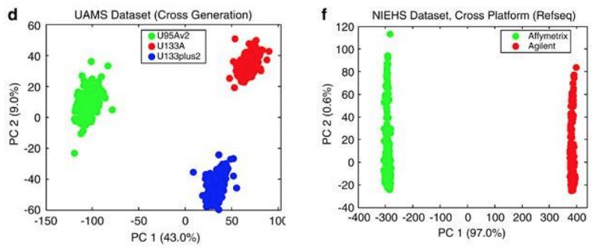
Technical Bias in expression analysis
Microarray
Luo et al., MAQC-II 2010
Notes:
One major advantage vs arrays is lower technical variance . This is array data processed on 3 different versions of the array chips on the let or two different manufactureres and you can see by principle components huge differences driven just by the array itself.

Slide 6
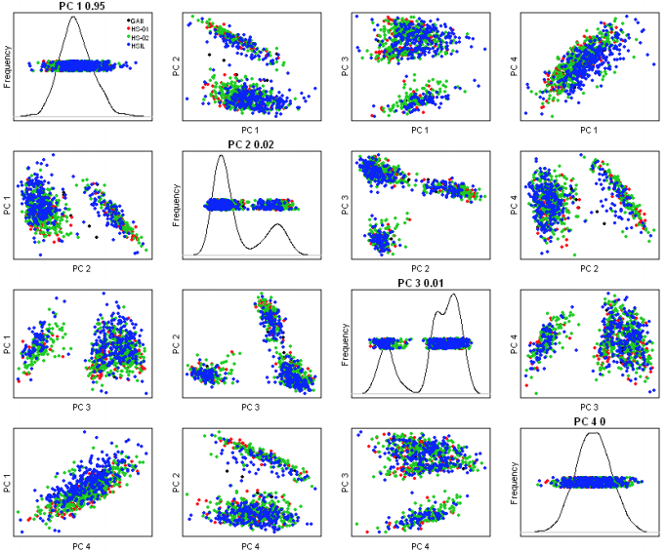

Technical Bias in expression analysis
Microarray
RNA-seq
Luo et al., MAQC-II 2010
Joel Parker
Notes:
On the right are some data I borrowed from Joel Parker’s slide on technical variation where they did RNA-seq using several different sequencing sites and this scatter plot of the principle componenets shows neraly complete overlap of the clusters - so the technical effects due to the actual machines used is pretty low.
There are still pretty serious technical or batch effects that can cause challenges, but for RNA-seq this seems to be more driven by the library prep steps rather than the sequencing step.s

Slide 7
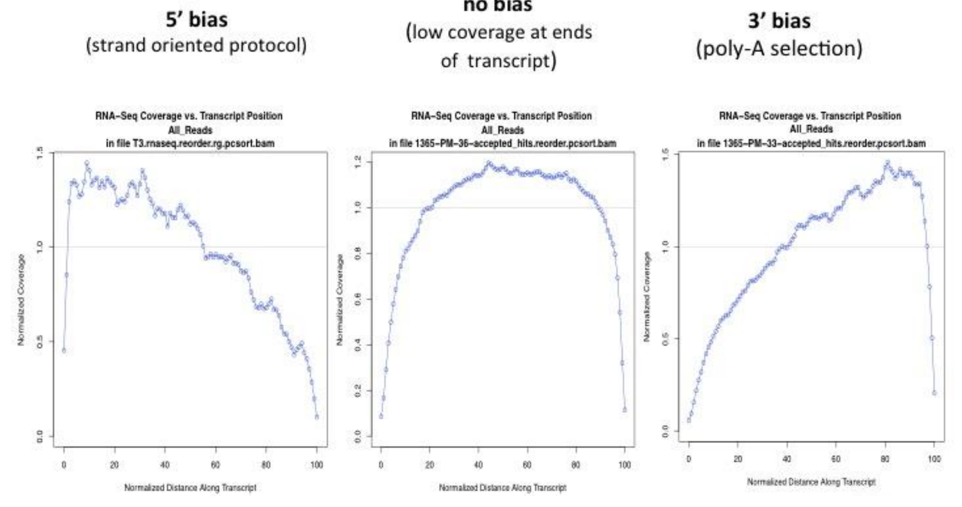
RNA-seq biases
Joel Parker

Slide 8
Practical considerations in RNA-seq processing and experimental design

Slide 9
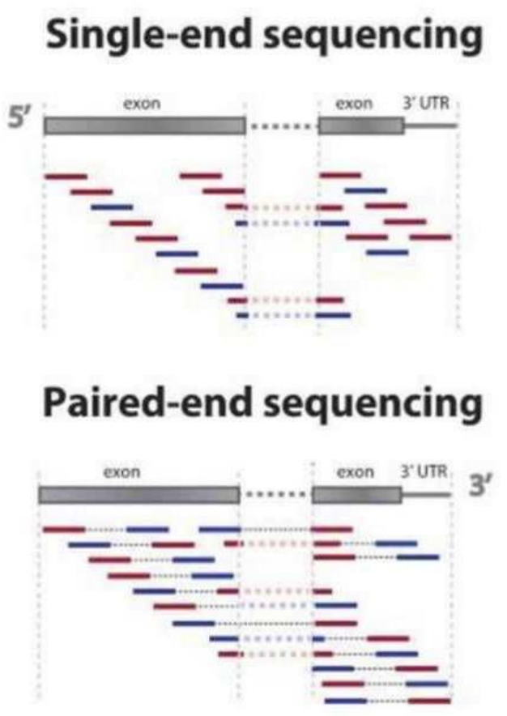
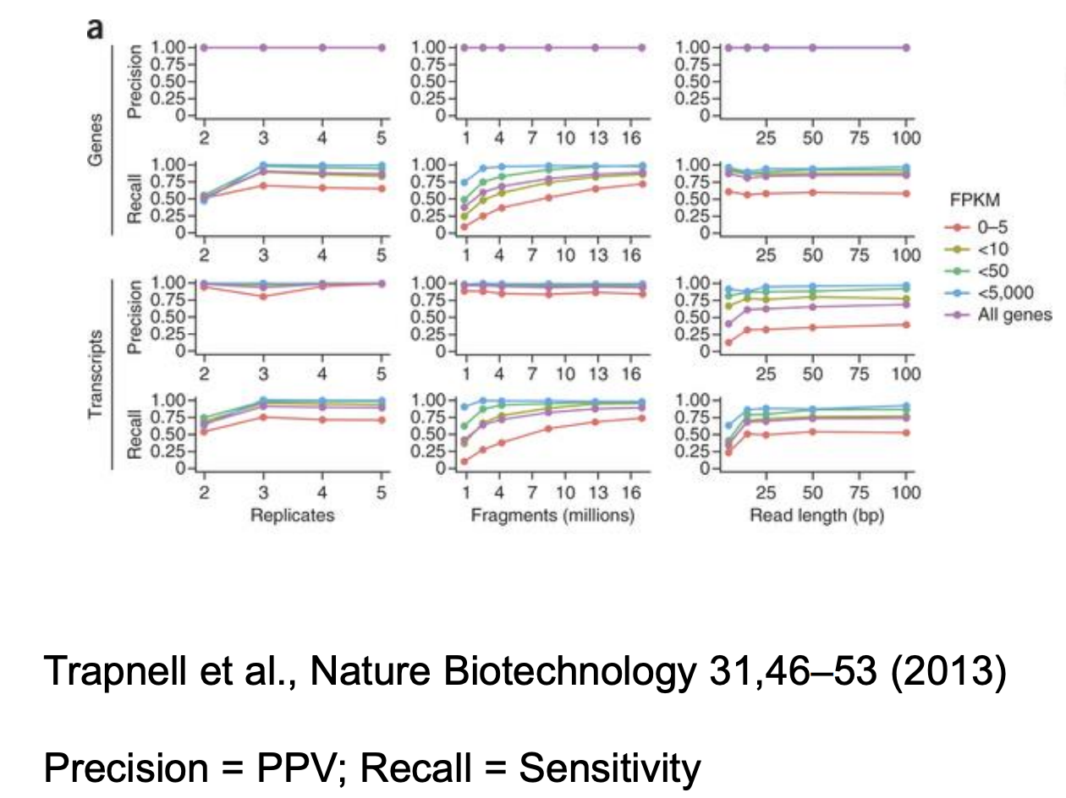
Sequencing Parameters
Key Points
> 25bp
Single end fine for DE - paired end might help mapping/splicing
Joel Parker

Slide 10
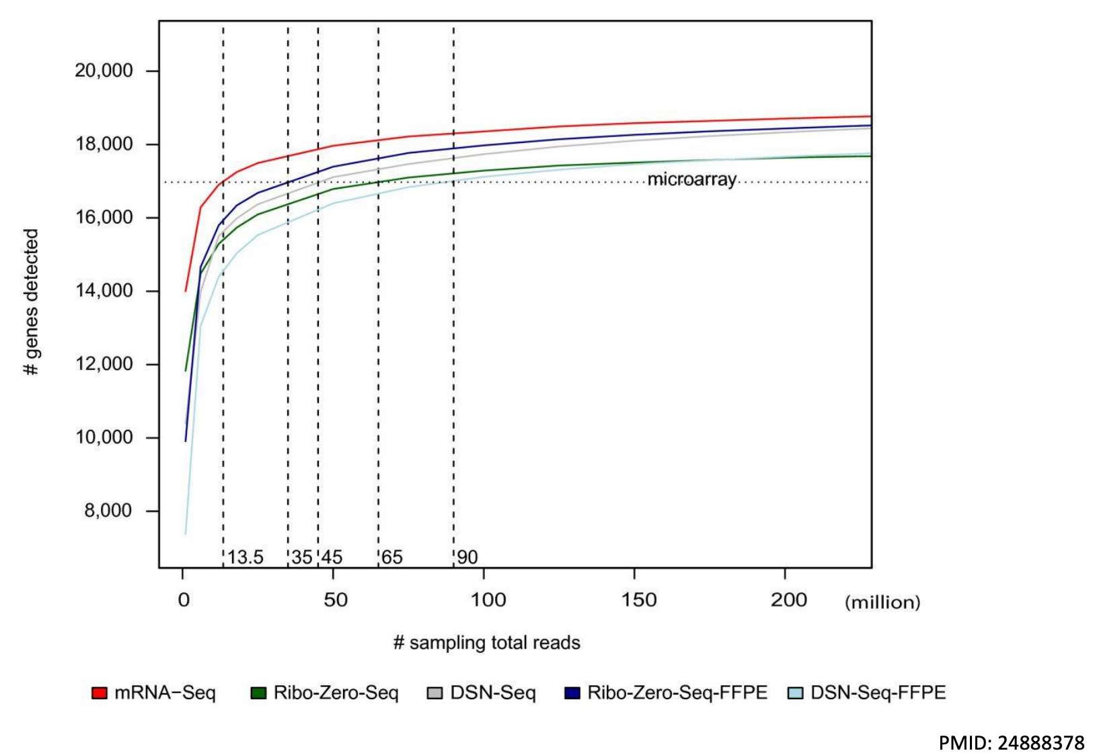
Read Depth / Sensitivity
For DE of mRNA 20-30 million, deeper if you are looking for rare transcripts/events
Library type affects needed depth
Joel Parker

Slide 11
More Depth or More Replicates
Replicates >>>>> Depth
More replicates
Liu et. al. (2014) Bioinformatics

Slide 12
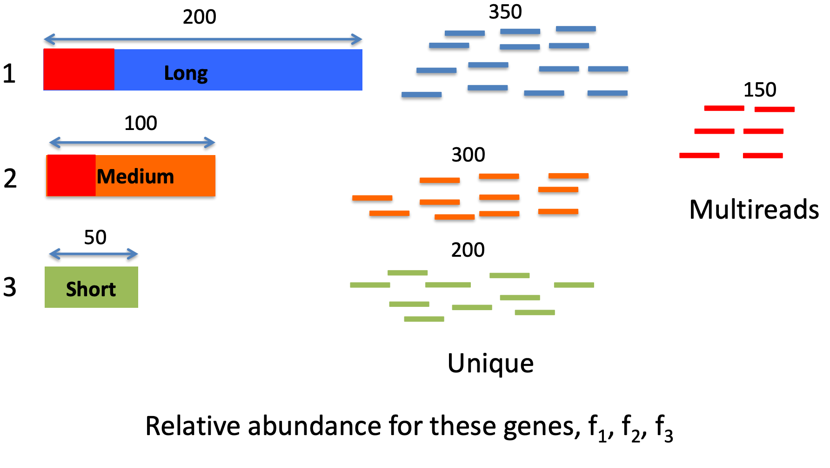
How to handle multimapping
Joel Parker

Slide 13
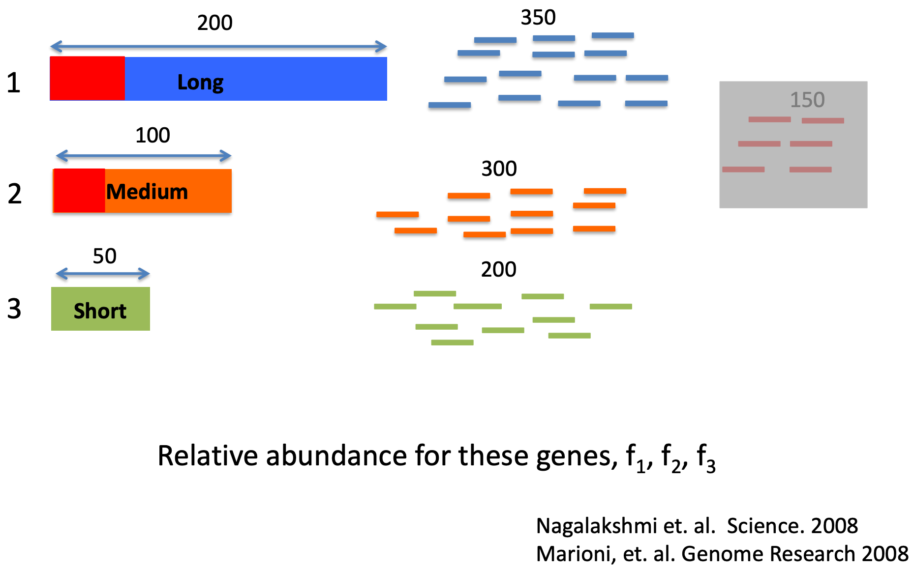
Approach 1: Ignore them
Joel Parker
Notes:
Ignoring them was the first approach but leads to a potentially seroius error (
This over-estimates the abundance of reads that are from highly unique genes - so transcript 3 here w
It understimates genes with some amount of repetitiveness.

Slide 14
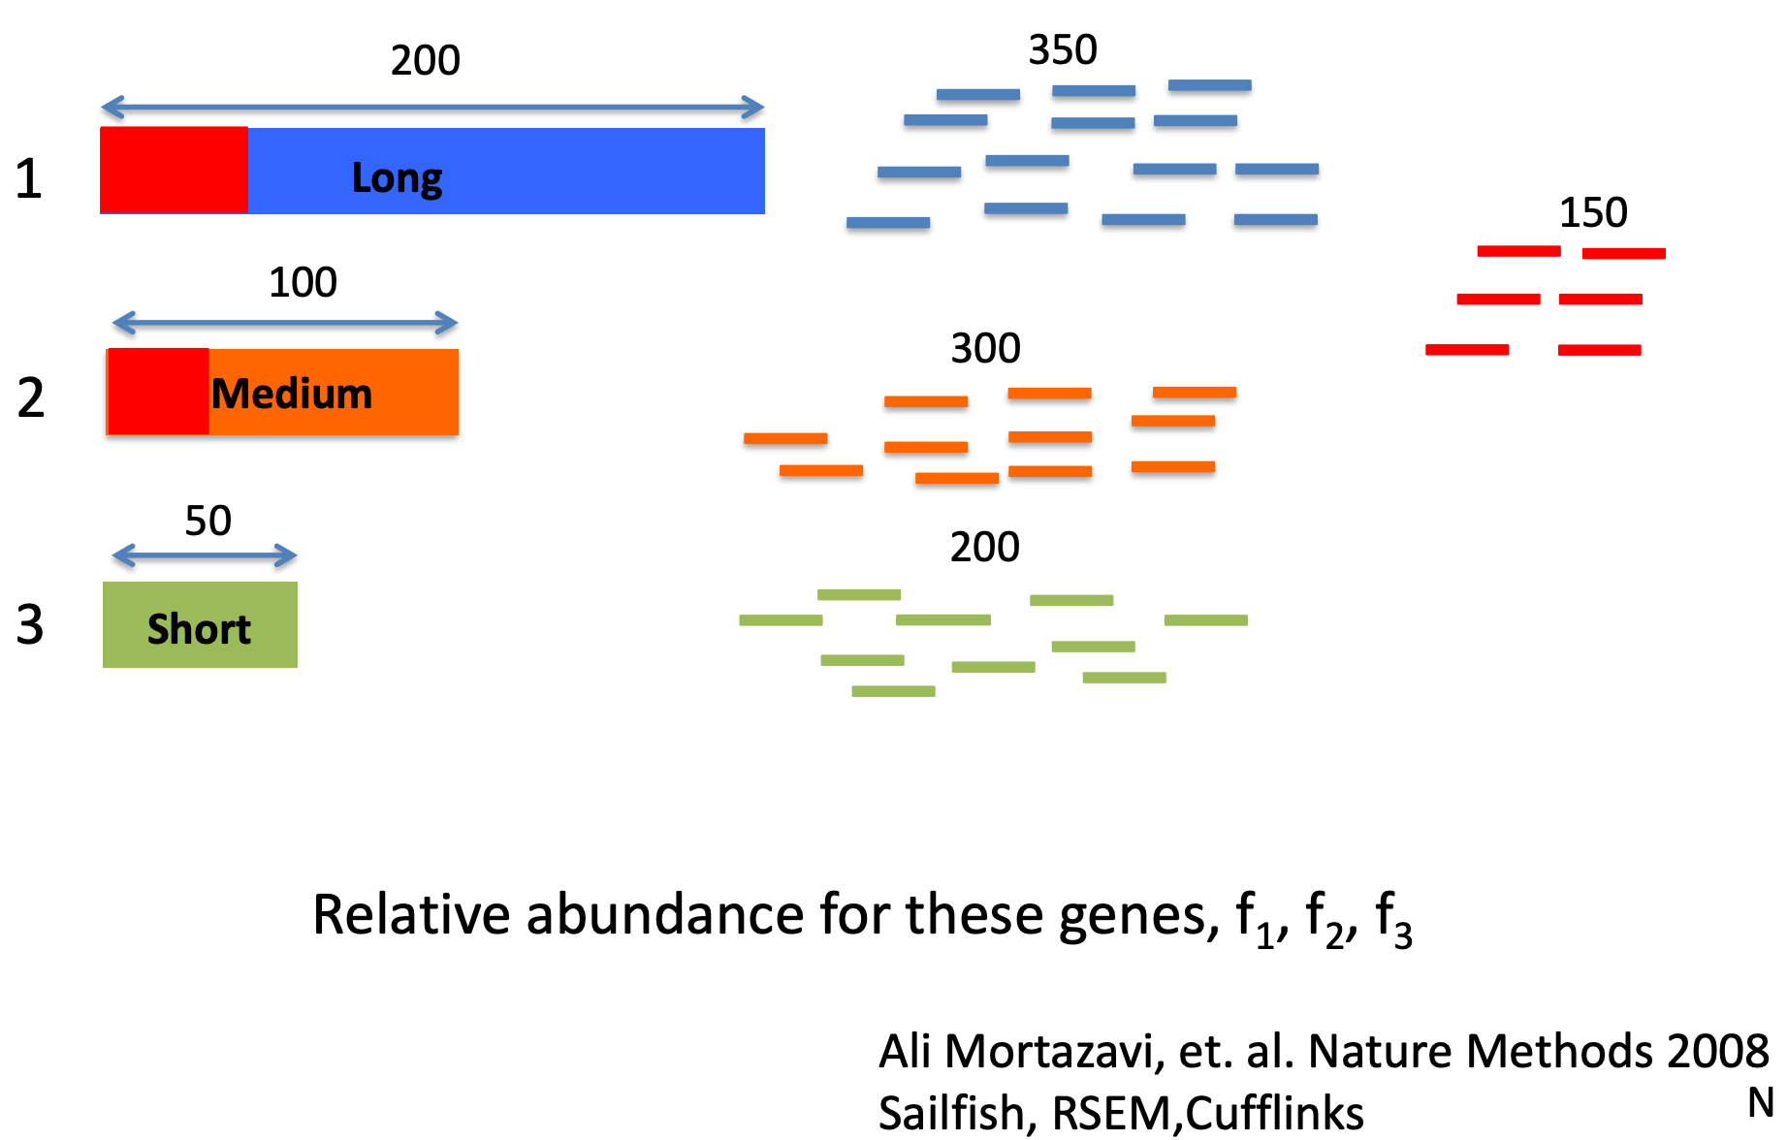
Approach 2: Fractional Allocation
Assign based on previous abundances
Joel Parker
Notes:
This is the approach that more or less has stuck and people have iterated on.
Cufflinks started by trying to figure out which transcript a multimapped read was more likely to come from by first alining unique reads and then doing a single pass step where reads were assigned based on a these prior abundancces
RSEM took this idea further by using expectation maximization steps where multiple rounds of fractional assignment were used to update the abundance estimates until you reached a convergence point. This can be pretty computationally intensive (slow and high memory usage)
Salmon/Kallisto use a streaming approach where they look at each read one at a time and assign it based no the reads already counted. THis requires that reads be randomly streamed in and not sorted somehow before. Both methods can also work without ever doing the alignment step where reads are shredded into kmers and the smaller kmers are used to exactly match transcripts which can be very fast

Slide 15

Memory Usage
Kallisto: 282 +/- 22.5, 399M
Salmon: 287.6 +/- 27.4, 339M
RSEM: 8.7, 16GB
Runtime
Kallisto: 11 + /- 3.5, 23 minutes
Salmon: 9.55 +/- 2.2, 15 minutes
RSEM: 9.1 +/- 3.5 15 hours
Joel Parker

Slide 16
Computational Processing Overview
Technical variation from sequencing is pretty small - but can be present based on library preparation strategies and batches
Raw results require significant computation processing - many approaches
Alignment : How to deal with ambiguous alignments, mapping across splice junctions, identifying new transcripts: Bowtie, Tophat, STAR, HiSat
Abundance Estimation: Gene or transcript; alignment based or alignment free, what to do with multimapping. RSEM, Cufflinks, Salmon, Kallisto, featureCounts
Normalization strategies: Total reads, upper quartile, effects of length, median ratios

Slide 17
RNA-seq Workflow
Samples
Genes
Visualization/Quality Control
Raw Counts
Differential Expression
DESeq2::vst()
DESeq2::rlog()
DESeq2::plotPCA()
DESeq2::plotCounts()
ComplexHeatmap::Heatmap()
DESeq2::DESeq()
DESeq2::results()
Package::function()
https://www.bioconductor.org/packages/release/bioc/vignettes/DESeq2/inst/doc/DESeq2.html

Slide 18
RNA-seq Workflow
Samples
Genes
Visualization/Quality Control
Raw Counts
Differential Expression
DESeq2::vst()
DESeq2::rlog()
DESeq2::plotPCA()
DESeq2::plotCounts()
ComplexHeatmap::Heatmap()
DESeq2::DESeq()
DESeq2::results()
edgeR::glmFit()
edgeR::glmLRT()
edgeR::topTags()
Biological Inference
Gene set enrichment
ComplexHeatmap::Heatmap
DESeq2::plotMA

Slide 19
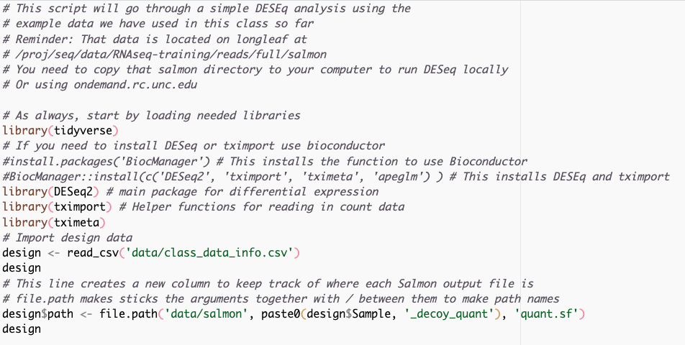
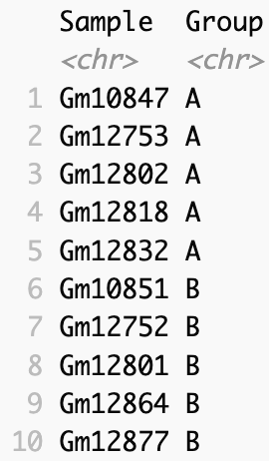
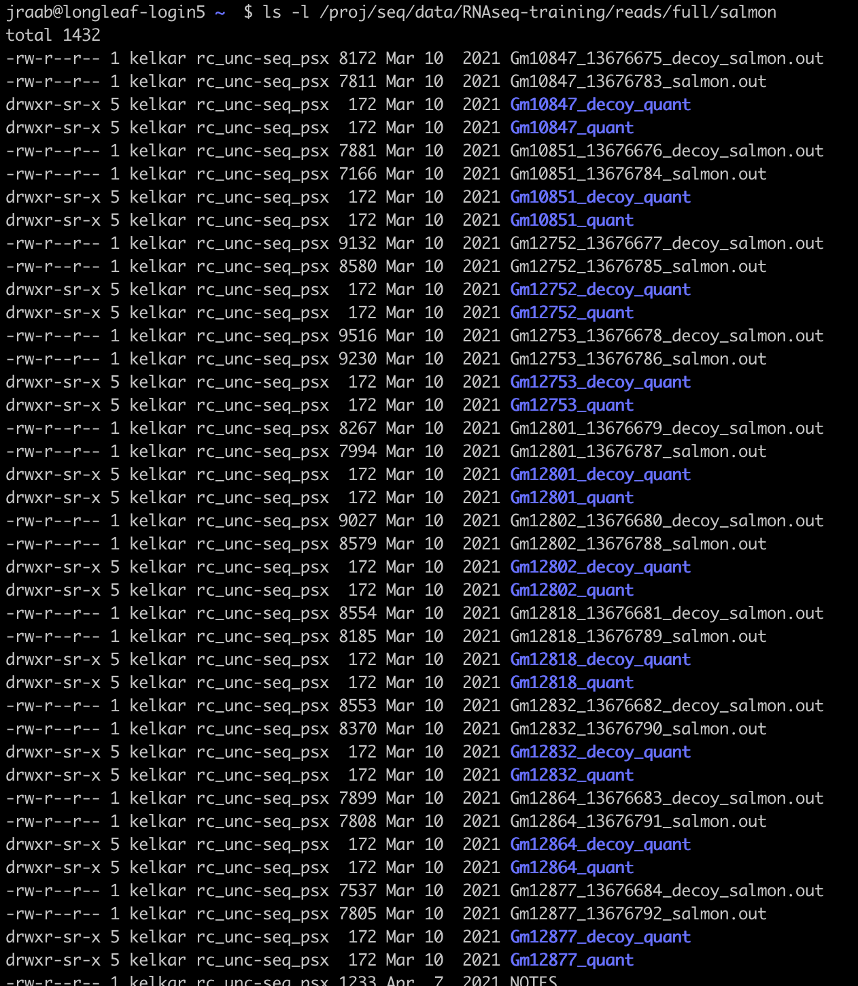
Getting your quantification data into R
These files need to be accessible on the machine you are running DESeq on
scripts/salmon_DE.R
Notes:
We use biomart to look up the annotatin mappings between ensembl’s transcript IDS and gene names (here external_gene_name) to give something I recognize when I look at the DE table.
Then we do the improt using tximport. It reads from the path we specificed, we tell it salmon did the quantification, and use tx2gene to map transcripts to genes. IgnoreTx version drops the little suffix number in the ensembl transcript id.
This gives us a list that contains a table of counts. One very important parameter is countsFromAbundance, which I Have as false. This allows scaling the counts by the transcript lengths which may change betwen conditions. If you make this True you can use the count table in txi directly - either way is fine, but I’d encourage you to be explicit in how you’ve coded this
Finally, We feed that whole thing into DESeq2 using the datasetfrommatrix call and specificy our groups using the designn = ~ Group) this is how you specificy the formula. We’ll come to more advanced formula designs in a bit, or maybe nexttime).

Slide 20
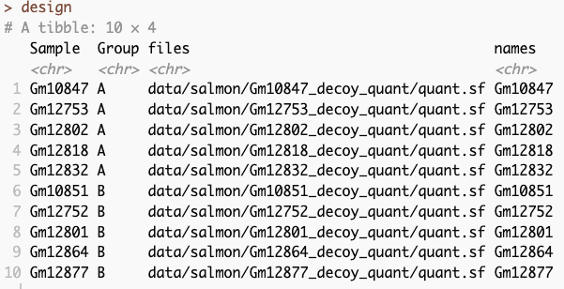

Slide 21

Getting your quantification data into R
Quant type
Function that helps info about your samples and reads in your data
Needs a column with ‘names’ and a column with ‘files’
Summarize transcripts to genes (this is usually what I care about, but you could do transcript level DE)
Transcripts oftn have a trailing digit. ENST00000.1 This gets rid of that
This is the first major step
Notes:
Now we need to read those files in. I’m using a few packages from R for this, DEseq2 for its ability to make a nice summarizedExperiment object (I’ll come back to this in a few slides) , tximport is handy for reading in data from salmon and other quantification strategies. It can summarize to genes from transcripts (recall you may have more than one transcript fromt he same gene in your data set) I usually want to work at gene level and it is the simplest to do, but let your biological question the analyssi you want to do. You may care about transcript or isoform differences. Maybe you are interested in specific exon usage or that sort =of things.
We use biomart to look up the annotatin mappings between ensembl’s transcript IDS and gene names (here external_gene_name) to give something I recognize when I look at the DE table.
Then we do the improt using tximport. It reads from the path we specificed, we tell it salmon did the quantification, and use tx2gene to map transcripts to genes. IgnoreTx version drops the little suffix number in the ensembl transcript id.
This gives us a list that contains a table of counts. One very important parameter is countsFromAbundance, which I Have as false. This allows scaling the counts by the transcript lengths which may change betwen conditions. If you make this True you can use the count table in txi directly - either way is fine, but I’d encourage you to be explicit in how you’ve coded this
Finally, We feed that whole thing into DESeq2 using the datasetfrommatrix call and specificy our groups using the designn = ~ Group) this is how you specificy the formula. We’ll come to more advanced formula designs in a bit, or maybe nexttime).

Slide 22
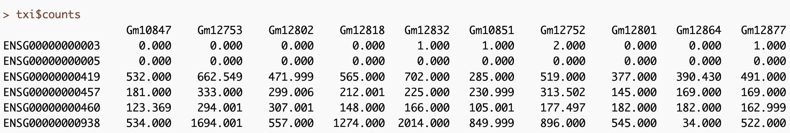

Slide 23

Major Step 2 – Make the DESeq Data set (dds)
Function to create dataset
Experimental design
SE object

Slide 24
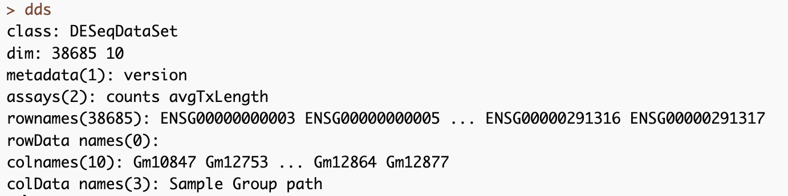
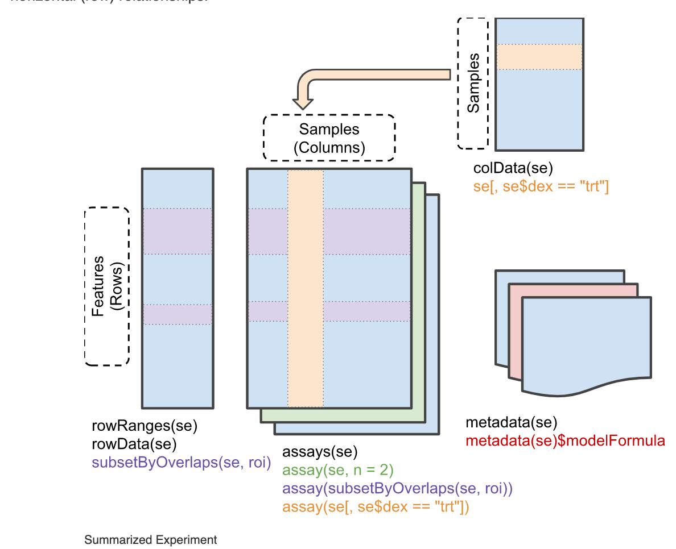
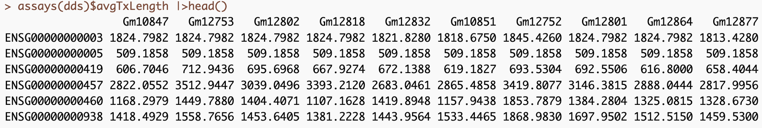
Major Step 2 – Make the DESeq Data set (dds)

Slide 25
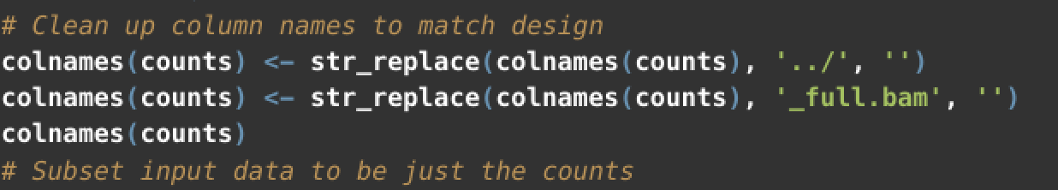
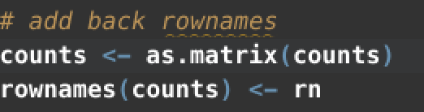
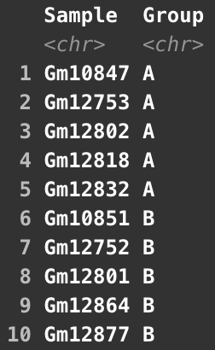
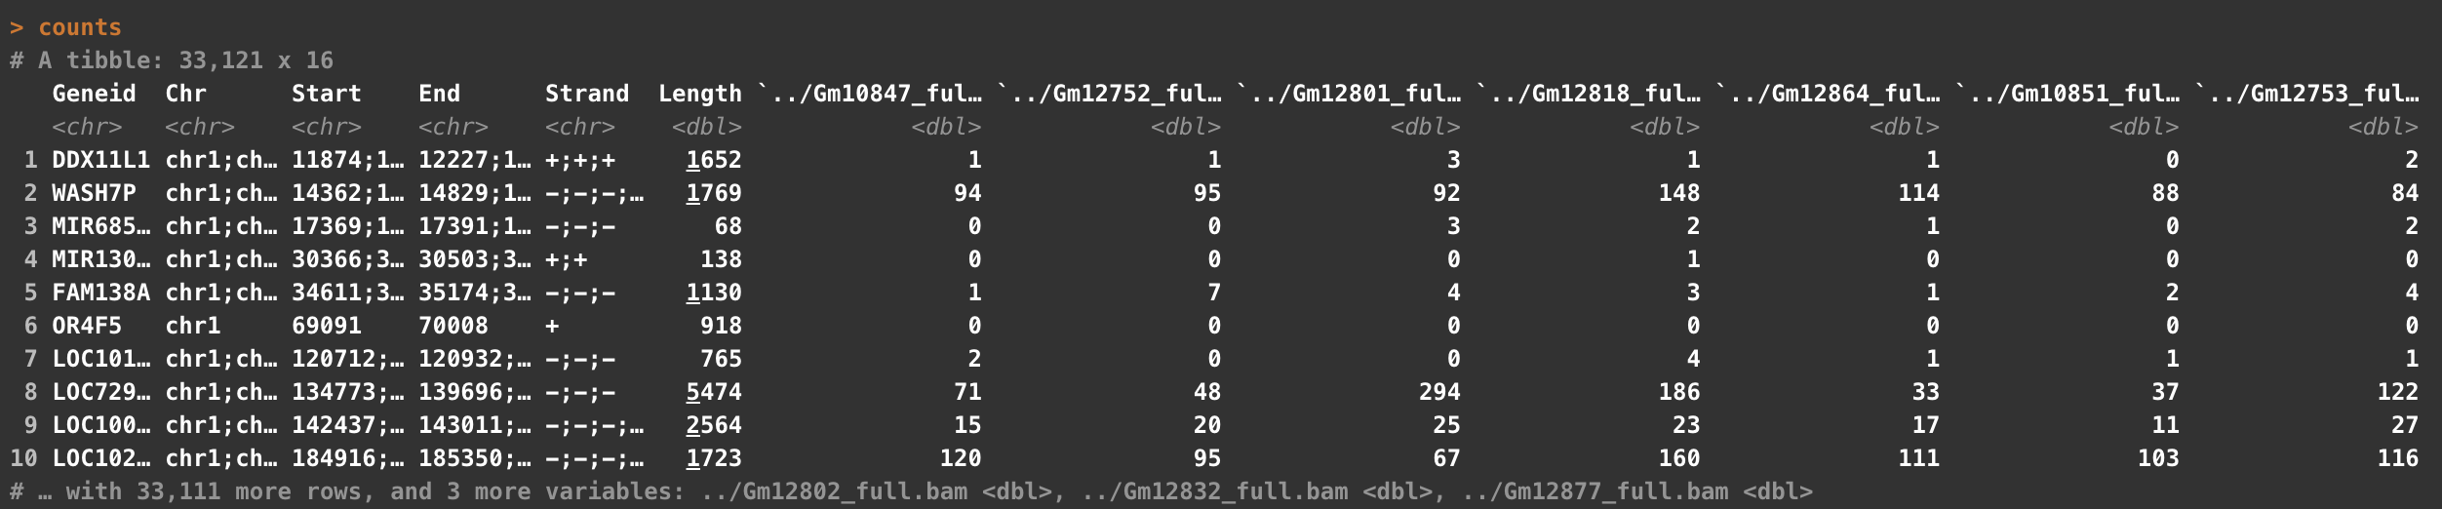
Alternatively - if you use a tool like featureCounts or already have a count matrix
Can also use janitor::clean_names()
Samples
Count Matrix
Notes:
You could do similarly iwth any matrix of count data you have. This is an example of how I’d do it for quantitation data from featureCounts. You can read that table in directly, but the first 6 columns describe some information about the annotations we used to quantify. I really only want the geneid here, so I keep that as an additional variable, and make the rest a matrix. I do a little bit int he middle to clean up the column names so that my column names and the Sample names in my design table match (AND ARE IN THE SAME ORDER)

Slide 26
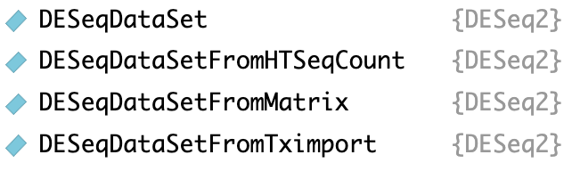
Additional functions for reading in data to a DESeqDataSet

Slide 27
Goals in RNA-seq Analysis
Samples
Genes
Raw Counts
Visualization/Quality Control
Differential Expression
DESeq2::vst()
DESeq2::rlog()
DESeq2::plotPCA()
DESeq2::plotCounts()
ComplexHeatmap::Heatmap()
DESeq2::DESeq()
DESeq2::results()
R code for Differential Expression
Full annotated methods in salmon_DE.R
Notes:
So now that we have our data into a DESeq object we can do either of these two paths, and we need to do both. I’m going use the time we have left to show some visualization/quality control things about our data.
Next time we’ll do the differenetial expression side, work through that code and talk about what DESeq is actually doing

Slide 28
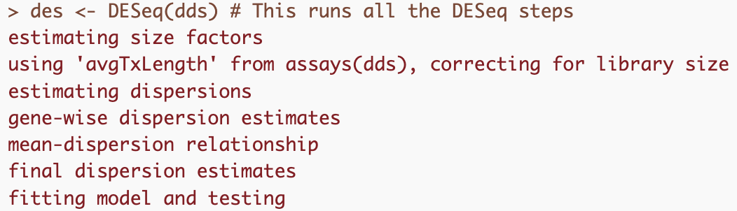
Goals in RNA-seq Analysis
Samples
Genes
Differential Expression
Raw Counts
DESeq2::DESeq()
DESeq2::results()
estimateSizeFactors
estimateDispersions
GLM fit for each gene
edgeR::glmFit()
edgeR::glmLRT()
edgeR::topTags()

Slide 29
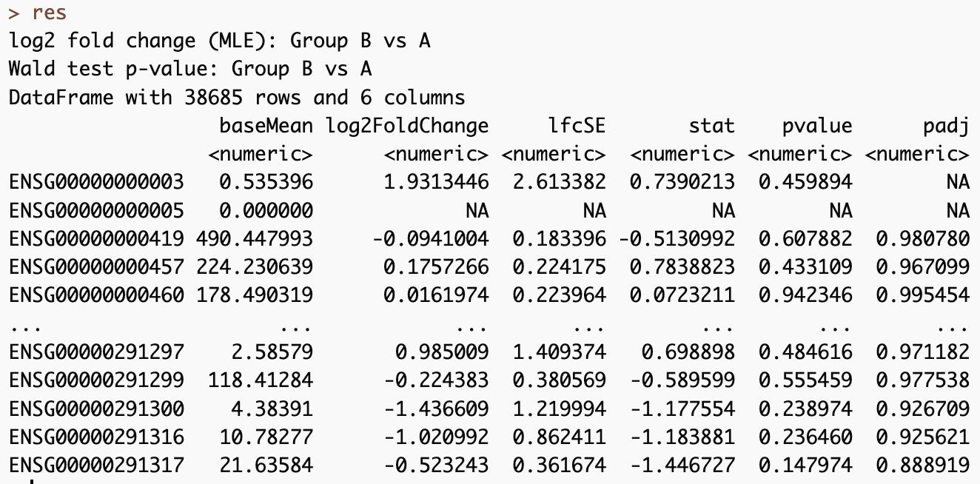
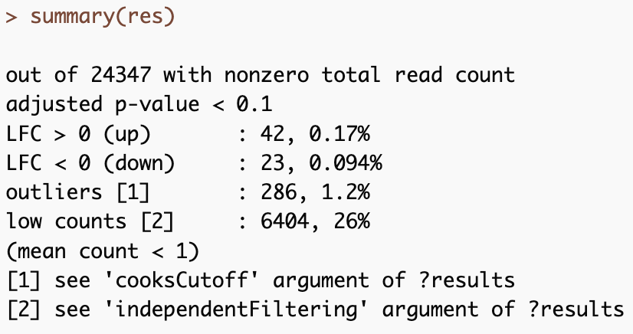
Goals in RNA-seq Analysis
Samples
Genes
Differential Expression
Raw Counts
DESeq2::DESeq()
DESeq2::results()
Wald Test (Default)
Likelihood Ratio Test
edgeR::glmFit()
edgeR::glmLRT()
edgeR::topTags()
Notes:
Choosing between these tests is a little confusing ( I generally have to look this up when I’m doing something more complicated thanusual).
Wald test works well when you are doing pairwise comparisons - so what chagnes change between drug and vehicle treatmentes. pvalues here are telling you whch fold changes are significantly different.
LRT tests are appropriate for timecourse of if you want to analyze all levels of a factor at once. Say for example you have drug a drug b drug c and vehicle and you want to see which genes change - here the pvalue tells you that including your treatment condition in the model provides value to the model, it doesn’t relate to a specific lfc comparison.

Slide 30
You could run these steps independently
DESeq()
Estimate size factors
estimateSizeFactors()
Estimate dispersion
estimateDispersion()
Fit negative binomial GLM
nbinomWaldTest()
nbinomLRT()

Slide 31
DESeq Results
des <- DESeq(dds)
Estimate Size Factors
What are size factors?
Generate a reference sample from the geometric mean of all samples
Estimate gene-wise dispersions
Get ratio of each sample to that ‘reference’
Fit curve to dispersion estimates
Shrink gene-wise dispersion estimates
GLM for each gene

Slide 32
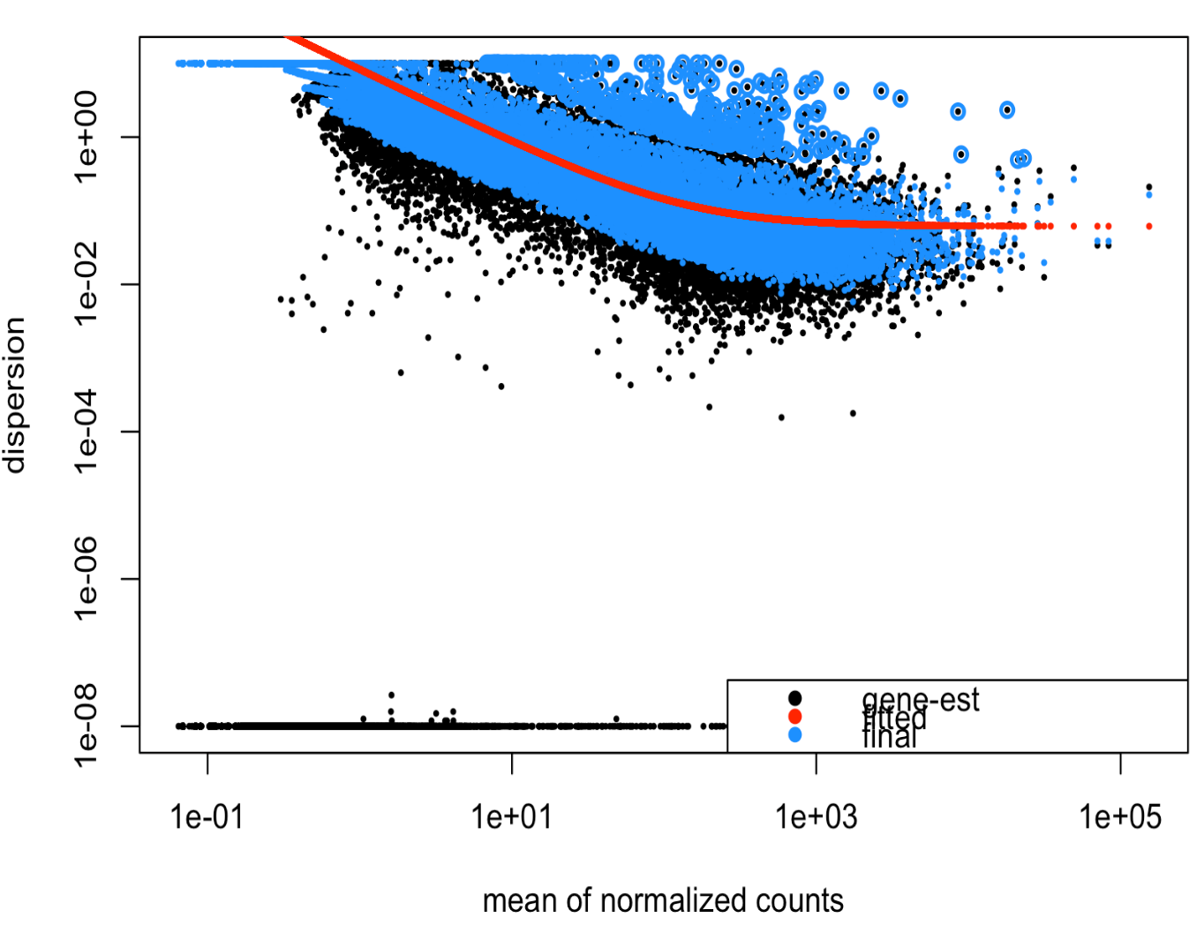
DESeq Results
des <- DESeq(dds)
Estimate Size Factors
Estimate gene-wise dispersions
Fit curve to dispersion estimates
Shrink gene-wise dispersion estimates
GLM for each gene

Slide 33
DESeq Results
des <- DESeq(dds)
Estimate Size Factors
Estimate gene-wise dispersions
Fit curve to dispersion estimates
Shrink gene-wise dispersion estimates
GLM for each gene
What is this fit doing?

Slide 34
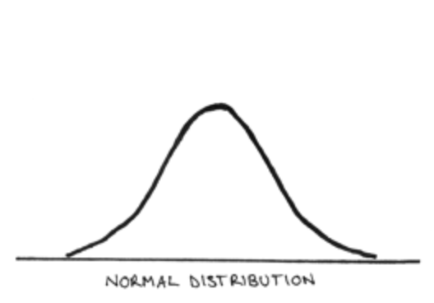
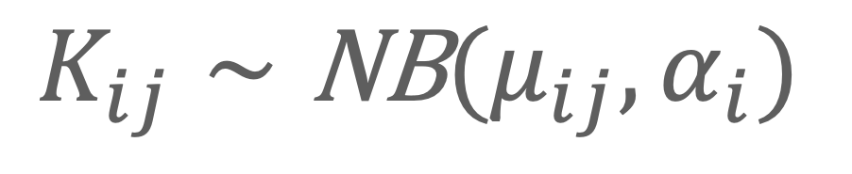
DESEq Theory
$$K_{ij}∼\text{NB}(μ_{ij},α_{i})$$
Observed Counts
Mean
Dispersion
Notes:
A really deep understanding of the model here I don’t think is necessary, but its good to have a little understanding of why we use this model and approach for RNA seq. This formula essentially is saying we are modeling the count data (K) for the ith gene in the jth sample from a binomial distribution. This binomial distribution has two parameters, the mean and the dispersion. We use negative binomal instead of say, the normal distribution becaues as what we are measuring is count data, it can’t be normally distributed,we cant have -3 reads for example. Count data can be measured with a Poisson distributiojn,b ut this assumes that variance does not change with the mean. As we talkea bout last time, genes with low counts have high dispersion so we see dependece on expression level.

Slide 35
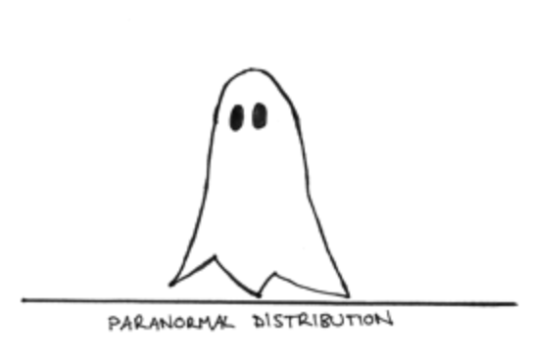
DESEq Theory
$$K_{ij}∼\text{NB}(μ_{ij},α_{i})$$
Observed Counts
Mean
Dispersion
https://www.statisticshowto.com/negative-binomial-experiment/
Notes:
A really deep understanding of the model here I don’t think is necessary, but its good to have a little understanding of why we use this model and approach for RNA seq. This formula essentially is saying we are modeling the count data (K) for the ith gene in the jth sample from a binomial distribution. This binomial distribution has two parameters, the mean and the dispersion. We use negative binomal instead of say, the normal distribution becaues as what we are measuring is count data, it can’t be normally distributed,we cant have -3 reads for example. Count data can be measured with a Poisson distributiojn,b ut this assumes that variance does not change with the mean. As we talkea bout last time, genes with low counts have high dispersion so we see dependece on expression level.

Slide 36
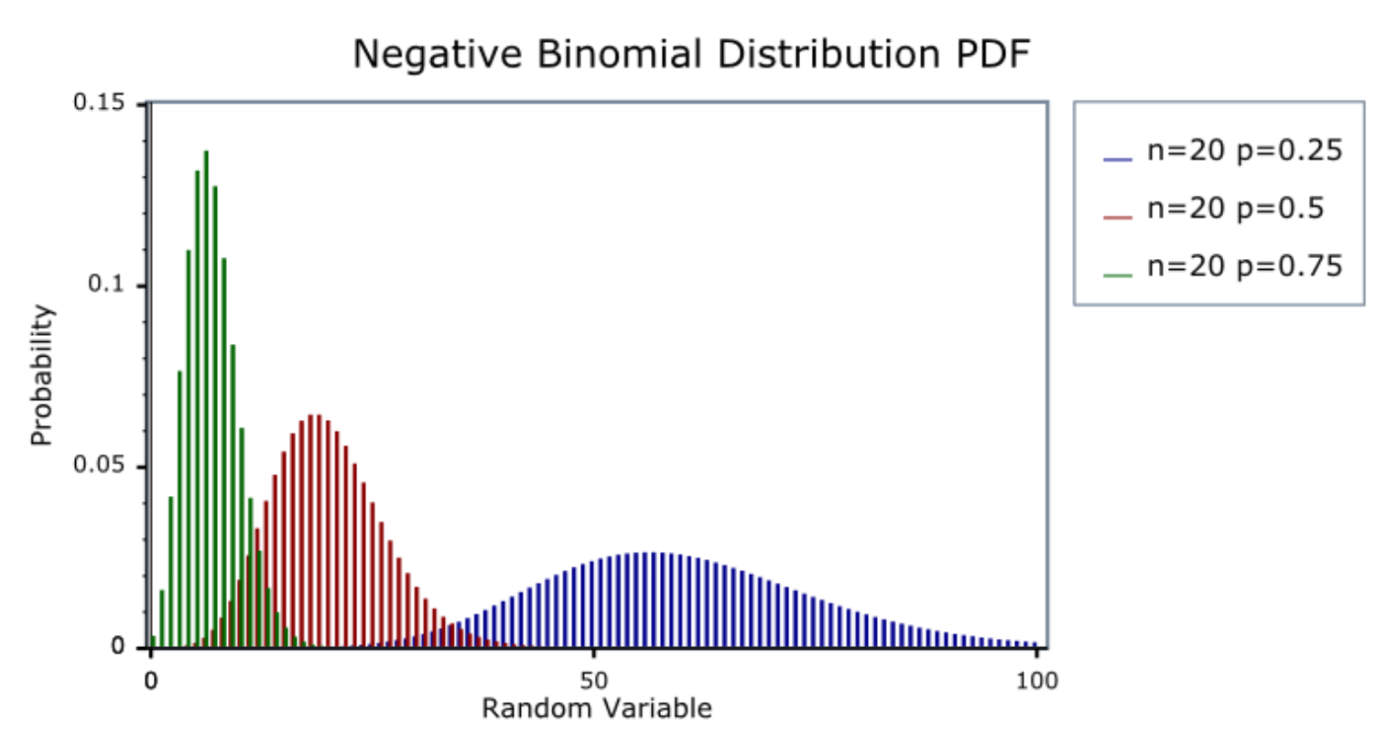
DESEq Theory
$$K_{ij}∼\text{NB}(μ_{ij},α_{i})$$
Observed Counts
Mean
Dispersion
https://www.statisticshowto.com/negative-binomial-experiment/
Notes:
A really deep understanding of the model here I don’t think is necessary, but its good to have a little understanding of why we use this model and approach for RNA seq. This formula essentially is saying we are modeling the count data (K) for the ith gene in the jth sample from a binomial distribution. This binomial distribution has two parameters, the mean and the dispersion. We use negative binomal instead of say, the normal distribution becaues as what we are measuring is count data, it can’t be normally distributed,we cant have -3 reads for example. Count data can be measured with a Poisson distributiojn,b ut this assumes that variance does not change with the mean. As we talkea bout last time, genes with low counts have high dispersion so we see dependece on expression level.

Slide 37

DESEq Theory
$$K_{ij}∼\text{NB}(μ_{ij},α_{i})$$
Observed Counts
Mean
gene-specific dispersion
$$μ_{ij}=s_{j}q_{ij}$$
Size Factor
Concentration of fragments
in sample
https://www.bioconductor.org/help/course-materials/2015/CSAMA2015/lect/L05-deseq2-anders.pdf
Notes:
A really deep understanding of the model here I don’t think is necessary, but its good to have a little understanding of why we use this model and approach for RNA seq. This formula essentially is saying we are modeling the count data (K) for the ith gene in the jth sample from a binomial distribution. This binomial distribution has two parameters, the mean and the dispersion. We use negative binomal instead of say, the normal distribution becaues as what we are measuring is count data, it can’t be normally distributed,we cant have -3 reads for example. Count data can be measured with a Poisson distributiojn,b ut this assumes that variance does not change with the mean. As we talkea bout last time, genes with low counts have high dispersion so we see dependece on expression level.

Slide 38
Hypothesis Testing
Wald: (default) - Is the LFC == 0 (null)
LRT (two or more classes) : Does the full model add anything to the fit
e.g full model ~ Group
reduced model ~ 1 (intercept)
Notes:
Wald does this by taking LFC and dividing by SE to get a z-statistic which is compared to the normal distribution to get a p-value ( the liklihood of observing this or a more extreme statistic if the null were tru)
LRT tells you if there is any difference between the condition of interst, the LFC values are not informative though. You can extract individual comparisons using Wald tests -we will go into more depth about different formula and extracting meaning from these tests next time.

Slide 39
Lecture 4
Recap
More replicates more important than more reads/sample
20-30 million/sample
How to import Salmon data in R (tximport)
Make a DESeqDataset (DESeqDataSetFromTximport)
Calculate differentially expressed genes (DESeq)
Full annotated methods in salmon_DE.R

Slide 40
Goals in RNA-seq Analysis
Samples
Genes
Raw Counts
Visualization/Quality Control
Differential Expression
DESeq2::vst()
DESeq2::rlog()
DESeq2::plotPCA()
DESeq2::plotCounts()
ComplexHeatmap::Heatmap()
DESeq2::DESeq()
DESeq2::results()
edgeR::glmFit()
edgeR::glmLRT()
edgeR::topTags()
Biological Inference
Gene set enrichment
ComplexHeatmap::Heatmap
DESeq2::plotMA

Slide 41
DESeq Code

