Slide 1
Recap
How to import Salmon data in R (tximport)
Make a DESeqDataset (DESeqDataSetFromTximport)
Calculate differentially expressed genes (DESeq)
QC of RNAseq data (clustering of samples, heatmap, pca, numbers of reads)

Slide 2
Visualization of RNAseq results
MA plots - expression vs log fold change(LFC)
Shrinking LFC (why ?)
Heatmaps

Slide 3
Batch Effects and Advanced Experimental Designs

Slide 4
Batch effects
Sample | Condition | Batch
1 | A | X
2 | A | X
3 | B | Y
4 | B | Y
Notes:
These can occur when yoiu process different samples at different times. You can control for this, and remove them from the data if you carefully plan and designyour epxeriment.
This would be bad, our batches and conditions are confounded. We’ll never be able to remove the batch effect.

Slide 5
X
Batch effects
Sample | Condition | Batch
1 | A | X
2 | A | X
3 | B | Y
4 | B | Y
Sample | Condition | Batch
1 | A | X
2 | B | X
3 | A | Y
4 | B | Y
Notes:
This is much better - now each of your batches has both of your conditions. If there was an issue between batches that affected what you were measure, you likely can control for it. (Of course a real experimetn should have more than two replicatse.

Slide 6
Data sets to illustrate
GSE102560 - shRNA KD of SWI/SNF subunits
-GSE10260_count_matrix.csv.gz
4 Groups - NS, Brg1, Brm, Double
arid2_es.Rda
mouse - ARID2 KO vs WT
4 treatment conditions (ES, EB, FGF24, FGF48)
load(arid2_es.Rda)
dds is a then a DESeqDataSet
Notes:
The count table for this will be on Sakai - which I downloaded directly from GEO

Slide 7
How to handle Batch Effects
The easy way - we know which samples came from which batches
For Differential expression analysis - account for them in the DESeq design formula - Does not change underlying data
DESeqDataSet(counts, colData, design = ~ batch + condition)
For visualizing - correct the matrix to remove the effect
assay(vsd) <- limma::removeBatchEffect(assay(vsd), batch = vsd$batch)
This alters the data in the variance stabilized matrix based on the batch information in the replicate column of our design matrix
Notes:
The easy way is to model them directly into DESeq2 or however you are doing your experiment.
This essentially includes batch as a term in your design matrix. Its important to ahve batch listed first here as the last term is the effect you are interested in.
If you want to go back to count data and remove it you can use the limma package’s function removeBatchEffect

Slide 8
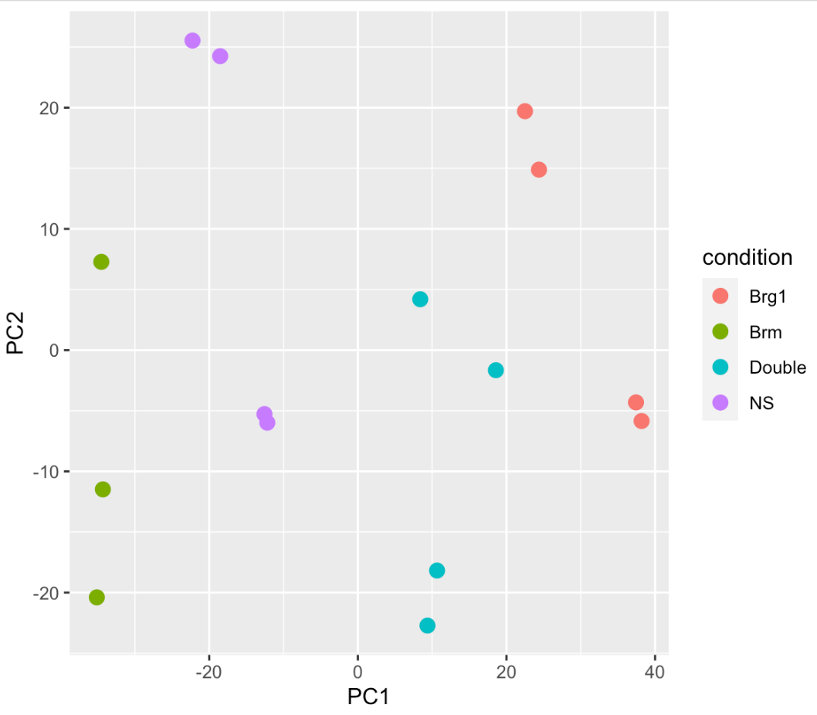
Finding Batch Effects
What if you don’t know the batches, but suspect there is a batch effect?
Notes:
lets look at our uncorrected PCA plot again - now our clusters aren’t as good and its not obvious there is a batch effect - different groups aren’t right on top of each other, but for example, these 2 NS are closer in PC2 to some none NS samples - so maybe we should look for these effects. There are (as you may have begun to see a pattern), multiple ways to do this. Two common are RUVseq and SVA for remove unwanted variation and surrogate variable analysis. RUVSeq works especially well if you have some known set of genes to use as controls, although all genes works. I’m going to demonstrate SVA - but both of these attempt to find a new variable that would explain some of the differences.

Slide 9
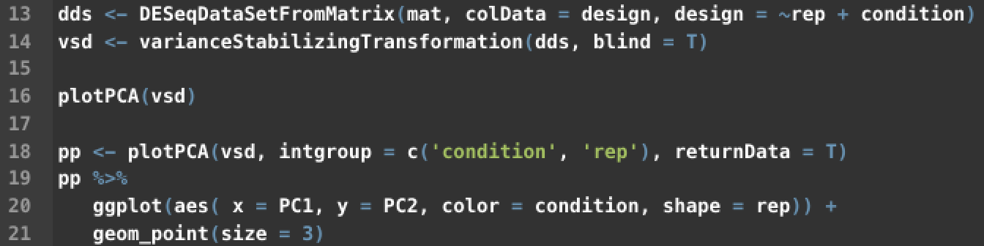
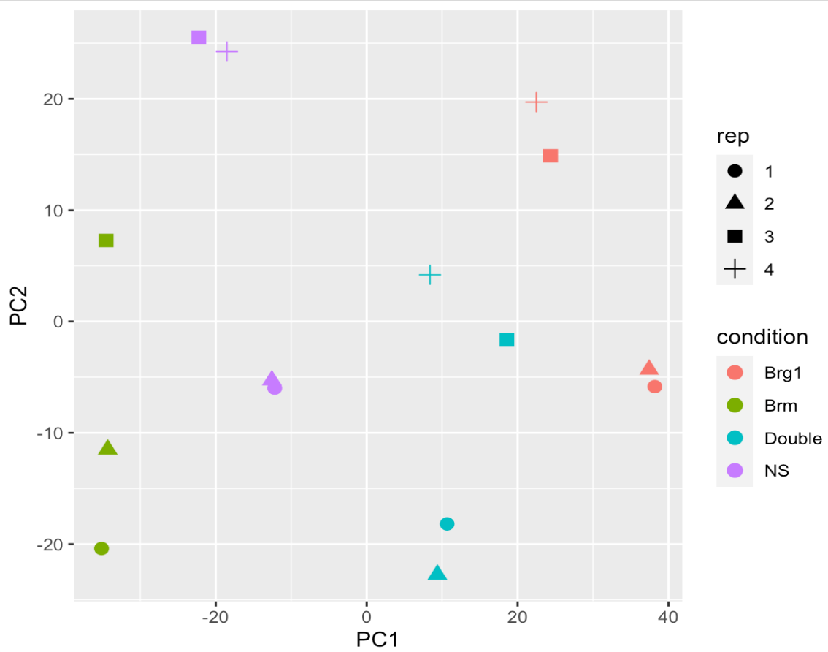
PC Plot including batch and condition
Notes:
so we can see evidence of different batches here - the plus and squar (reps 3 and4 ) seem to be closer than the circle and triangle (1,2) possible we prepped those libraries in two batches of two biological replicates each.
Including batch as a covariate in the design formula lets us account for this in our differential exprsesion results.

Slide 10
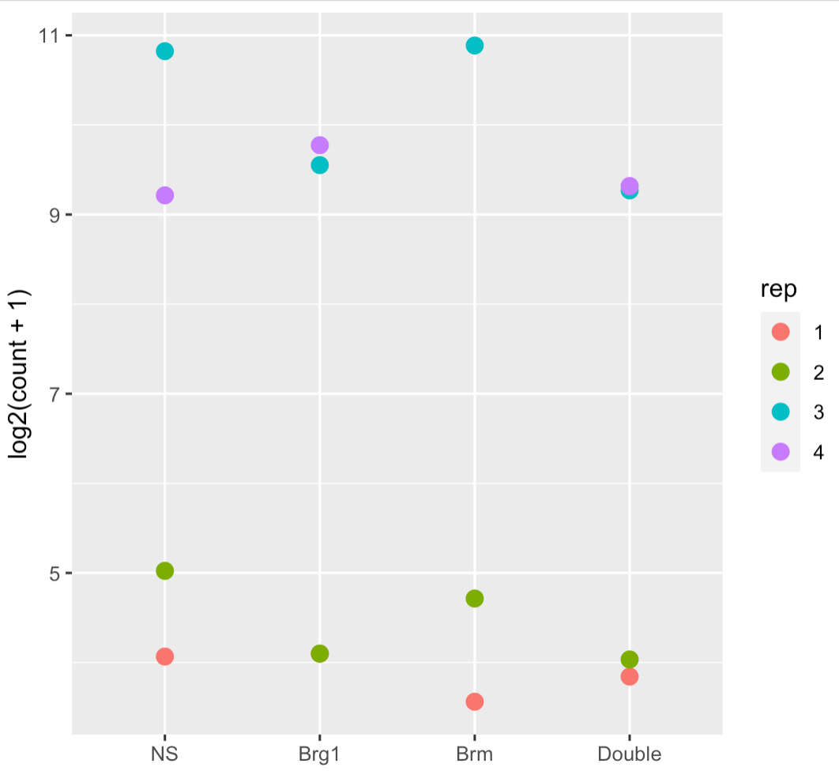
Strong difference between replicates
But no difference between conditions
MT1G

Slide 11
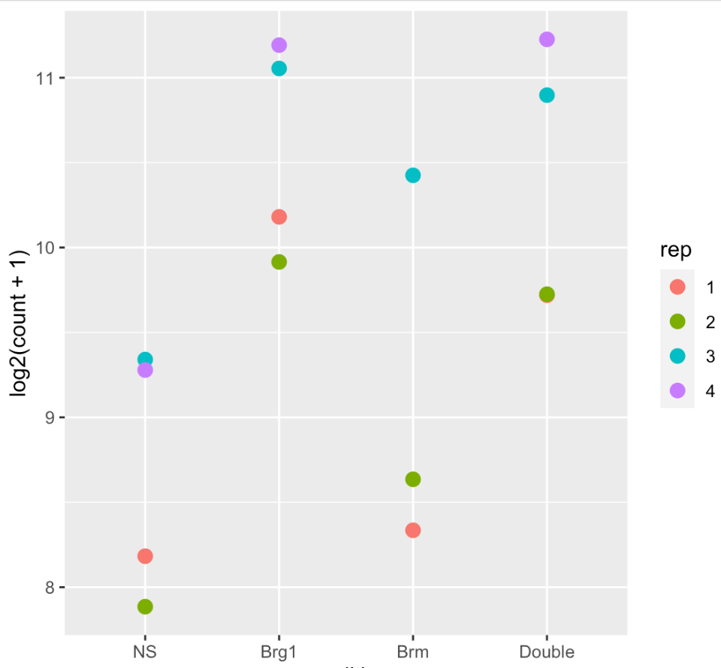
Strong difference between replicates
But no difference between conditions
Strong difference between replicates
Still difference between groups
MT1G
CDC42EP2

Slide 12
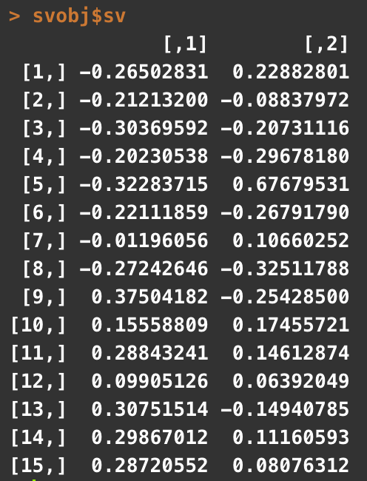
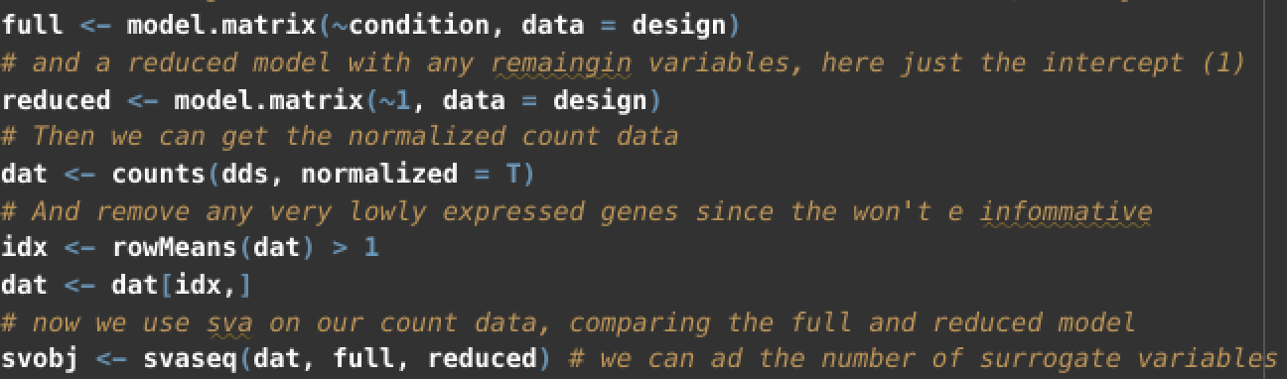
Finding unknown variation/batch effects
package - sva
* could also use RUVseq or comBat
Specific two models
full = ~condition {the effect(s) we care about }
reduced = ~1 { everything else , here just the intercept }
Surrogate Variables
They can be incorporated in to our design just like any other variable
Notes:
we need to have two models one that contains all our variables and one that just contains our variable of interst - so in our case we only have our condition variable (remember we’re blind about the batch variable here) - our reduce model is then just the intercept (removing that condition variable)

Slide 13
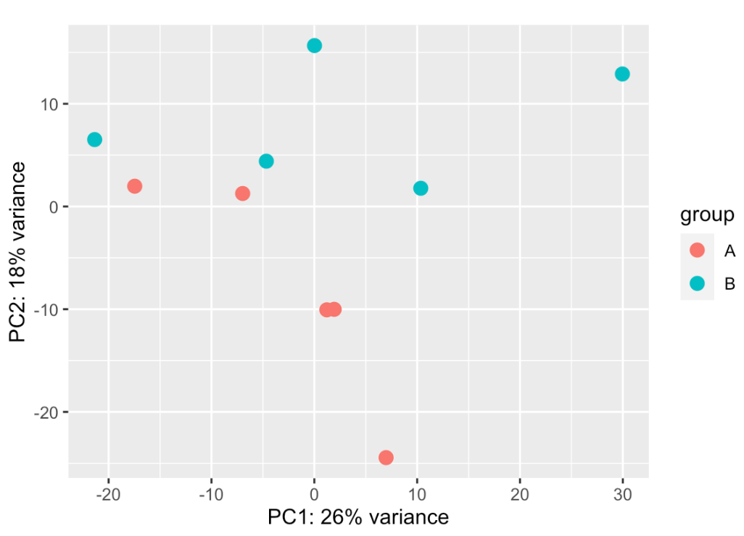
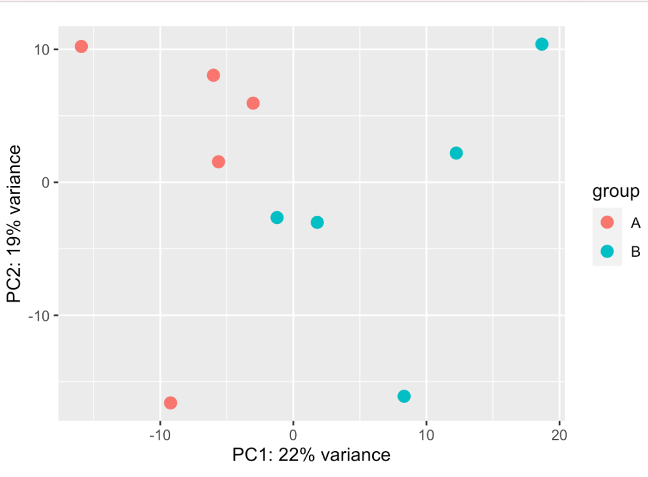
Did our class data have a batch effect?
Original
SVA corrected

Slide 14
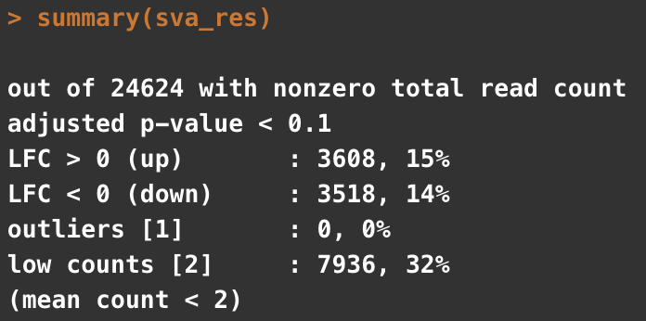
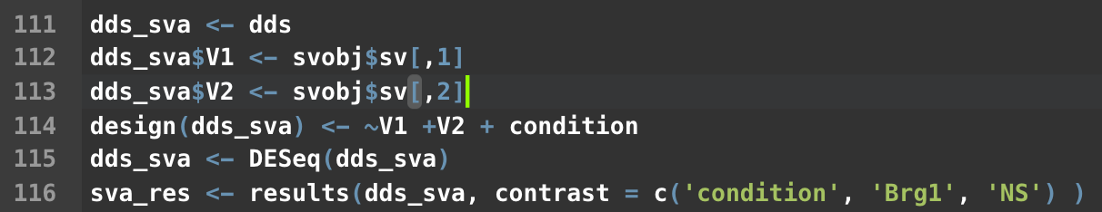
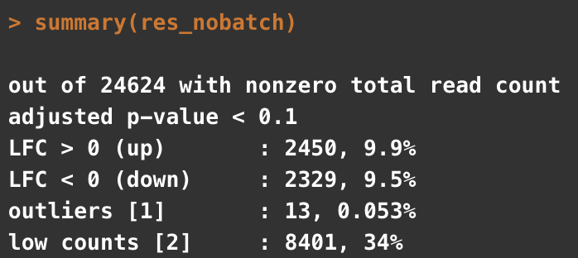
Finding unknown variation/batch effects
Notes:
Now we can use these new surrogate variables in our differnetial expresssion analysis

Slide 15
We can use the surrogate variables to correct the actual counts, just like we did with known batches before

Slide 16
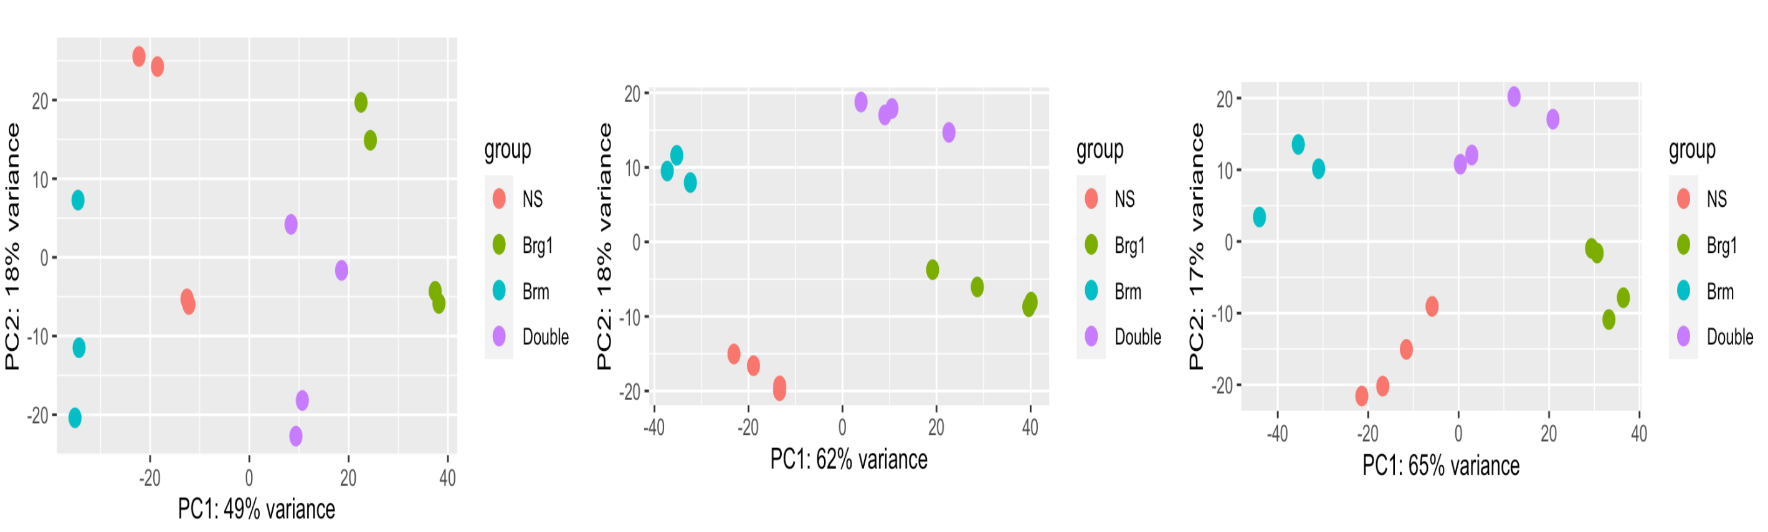
uncorrected
known batches
surrogate variables

Slide 17
How do we know these methods are actually working?
Controls!

Slide 18
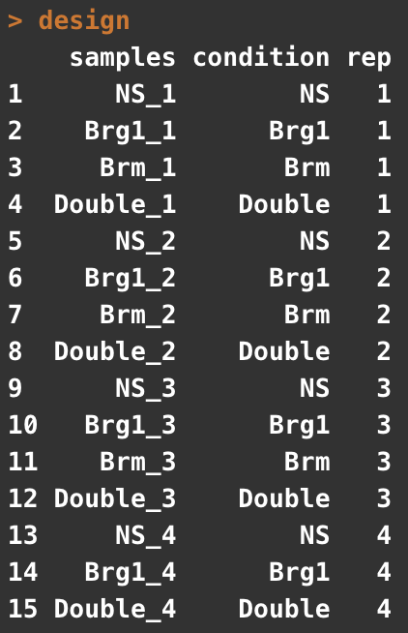
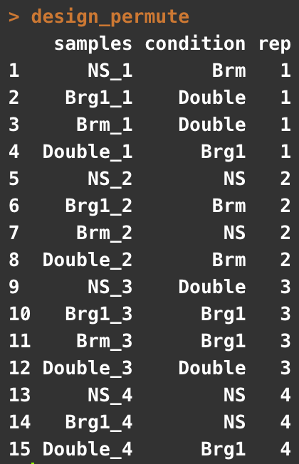
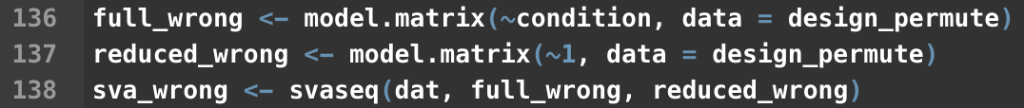
Permute your sample labels and test
Correct
Shuffled
redo svaseq using
the incorrect design matrix

Slide 19
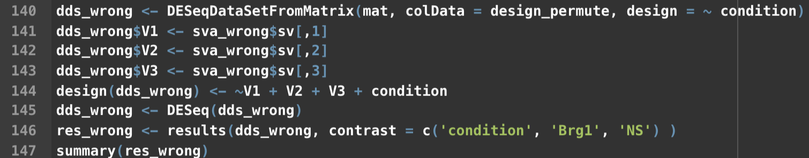
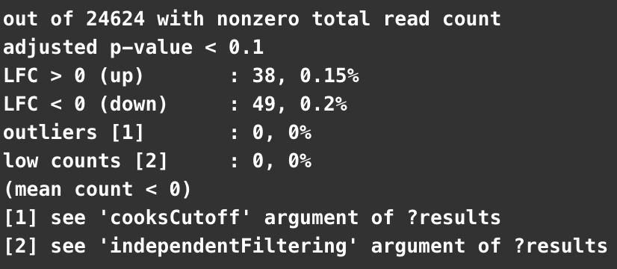
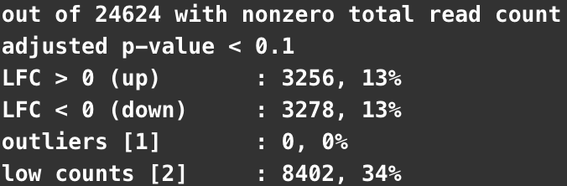
Add the surrogate variables to our DESeqDataSeq
Run the DESeq analysis
Extract Results
Shuffled
Correct

Slide 20
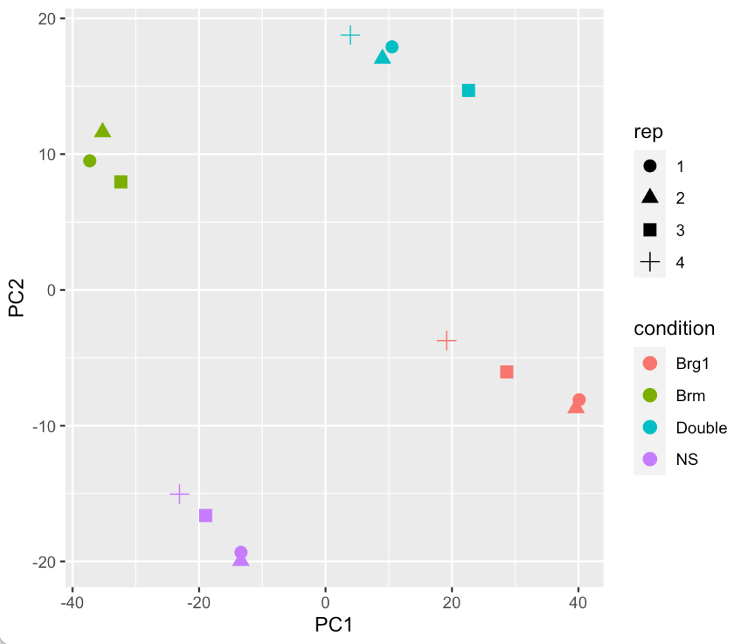
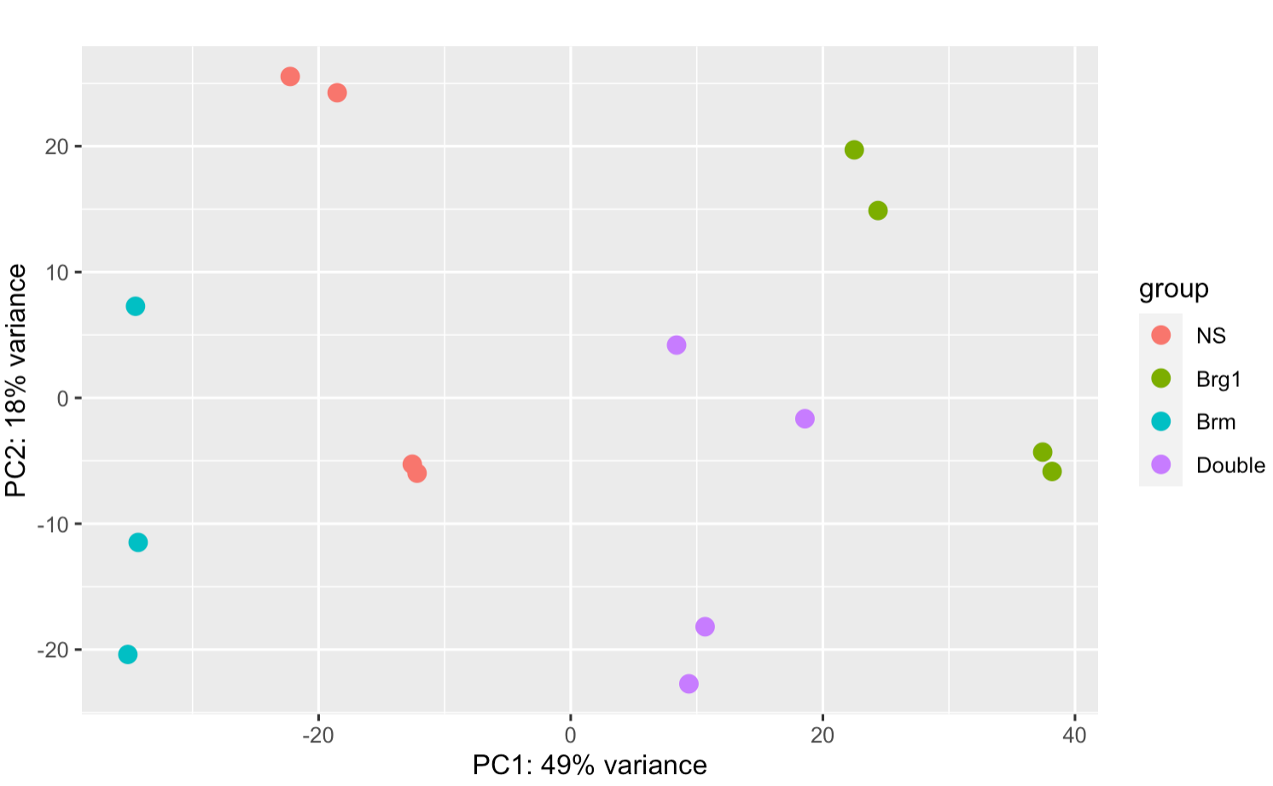
We can use the same approach to look at PCA plots
corrected
Corrected - using permuted condition labels
Original Data

Slide 21
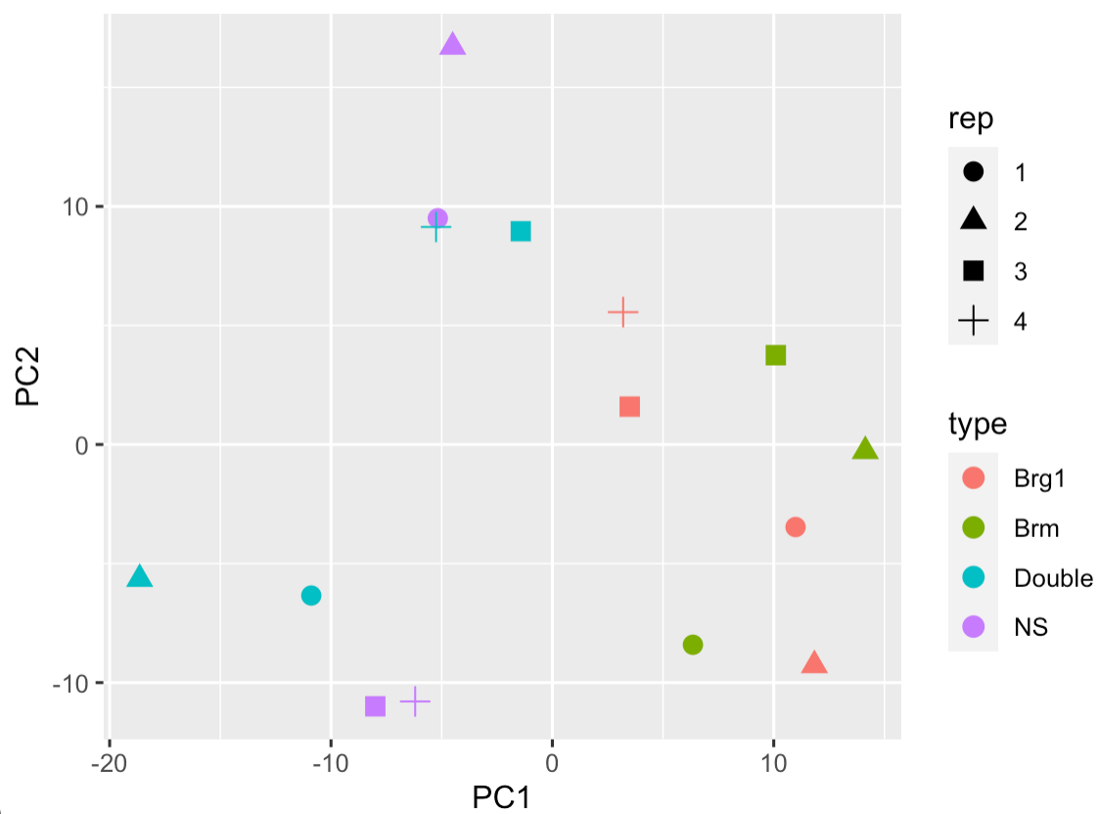
We can use the same approach to look at PCA plots
corrected
Permuted Data
Corrected - using permuted condition labels

Slide 22
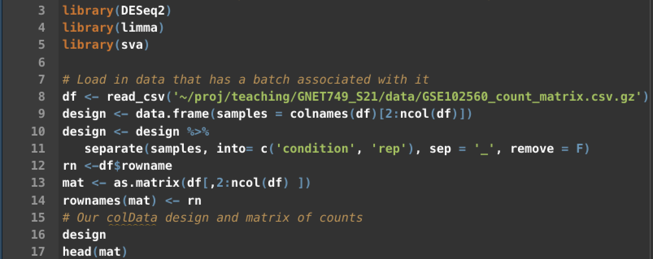

Slide 23
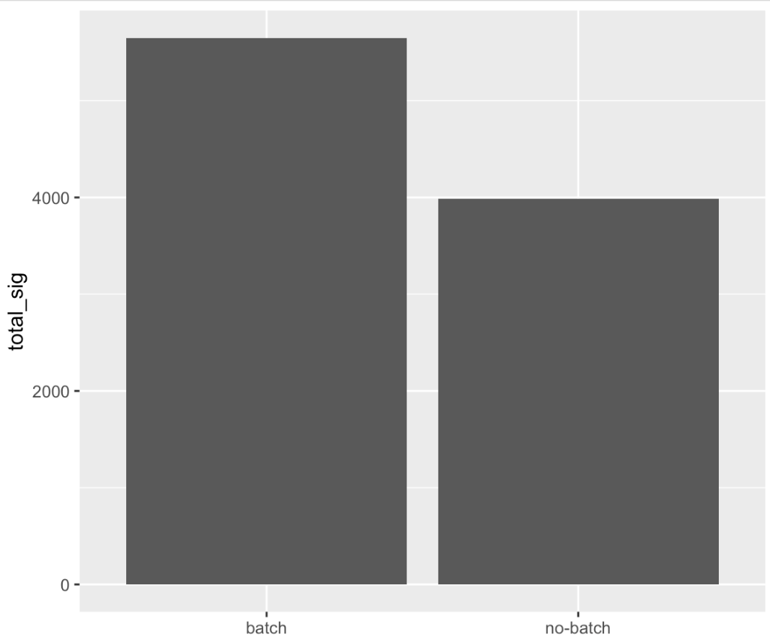
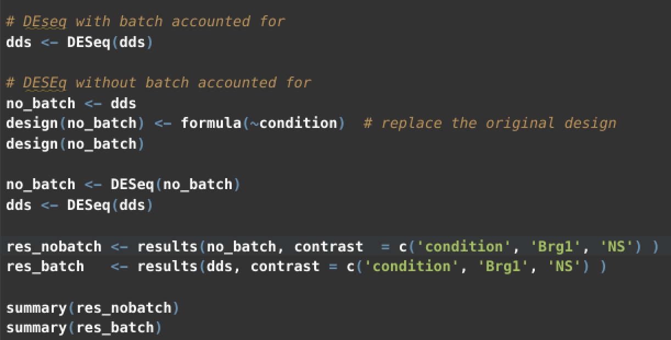
~ batch + condition
Notes:
you can see an incrase in power here when we account for the batch effects we observed. Since we know the replicates this is more straightforward.

Slide 24
limma::removeBatchEffect()
no correction
correction
Notes:
Lets go back and see if we can fix the pca plot by removing the batch effect - note accounting for the batch affect in DESEq does not change the underlying data at alll - here , we are actually altering our counts to remove that effect, don’t use what we do here for DE, this is just for visualizing.
After removing batch effect you can now see much better clustering of our samples - consistent with the increase in power we observed.

Slide 25
Advanced Experimental Designs
More than 1 group in your explanatory variable (genotype, e.g. wt vs heterozygous vs homozygous)
More than 1 explanatory variable ( genotype + treatment)
What question are you trying to understand
all groups relative to control, differences between all groups?
effect of treatment accounting for genotype or treatment effects that differ by genotype?

Slide 26
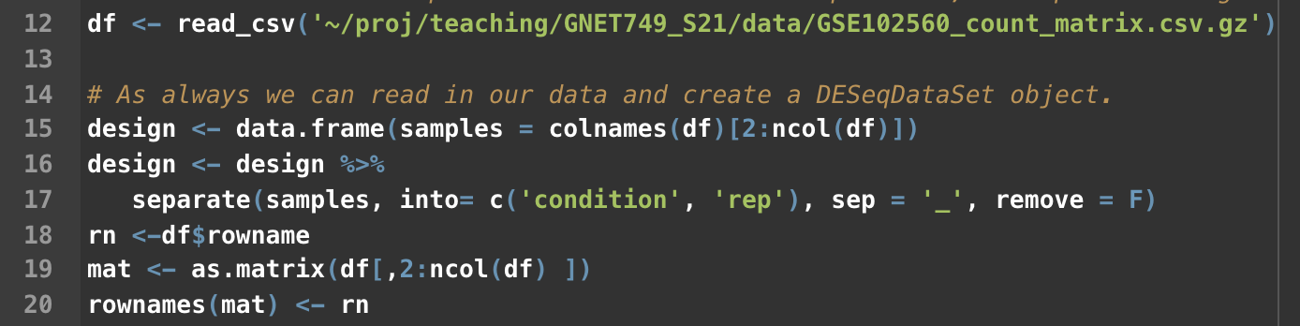
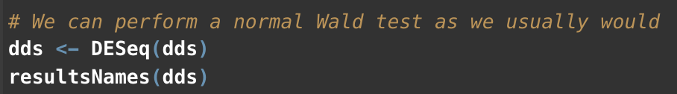
What if you have more than 2 groups?
Use contrasts to compare them

Slide 27
What if you have more than 2 groups?
Use contrasts to compare them
Since we are using the Wald test the logfoldchanges here are interpretable as the logfoldchanges between groups.

Slide 28
Comparison of 1 condition vs a group of conditions

Slide 29
Comparison of 1 condition vs a group of conditions
This could be useful if you don’t have a true reference population
e.g. comparing a group of different cell types for example

Slide 30
Another way of comparing multiple groups: Likelihood Ratio Test (LRT)
Is there a difference between the full and reduced model
Full: ~ condition
Reduced: ~ 1
A significant p-value is telling you that the full model has more information than the reduced.
It is not telling you what that difference is
You can extract the logFoldChanges using the same approach as before for specific comparisons, but the p-values always will come from the above comparison
Notes:
This is most useful if you want to test multiple interactions or conditions at one time to see if there is any effect

Slide 31
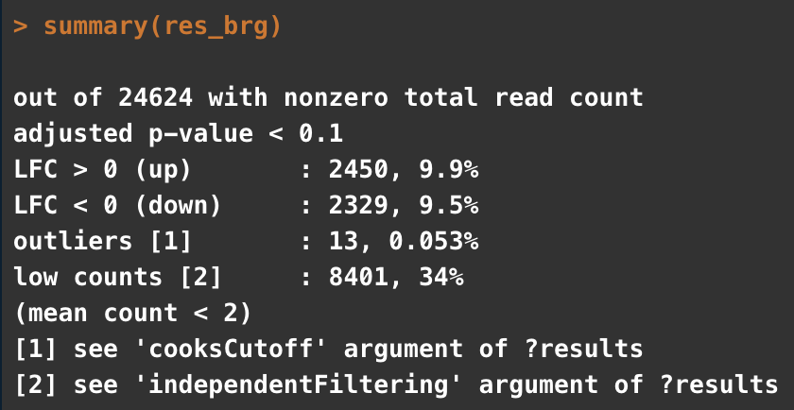
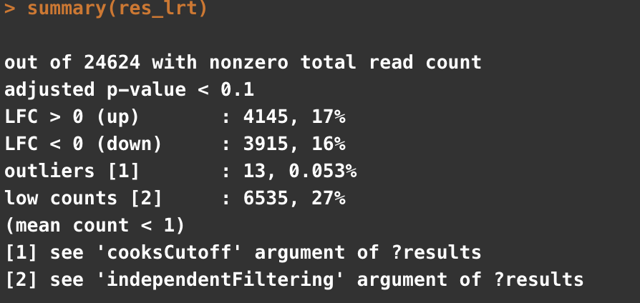
Using the LRT to identify genes where there is a difference among your groups
The pvalues reported by LRT are for the comparison of the models (and are the same for any contrast you specify)
Fold changes will be specific to one comparison (here NS vs Brg1)

Slide 32
Multiple effects
What if you have genotype and treatment information ?
For example, you have WT and KO animals and they were treated with DrugA or Vehicle control
Depends on your questions?
What genes are affected by drug treatment
= ~ genotype + treatment
Specify which contrast you want in results (e.g. results(dds, contrast = c(‘treatment’, ‘drug’, ‘vehicle’)
What genes are affected by genotype
Specify which contrast you want in results (e.g. results(dds, contrast = c(‘genotype’, ‘KO’, ‘WT’)

Slide 33
Multiple effects
What if you have genotype and treatment information ?
For example, you have WT and KO animals and they were treated with DrugA or Vehicle control
Depends on your questions?
What genes are differentially affect by treatment in the genotypes?
~ genotype + treatment + genotype:treatment
This is where it becomes more complicated. Good specific examples in the Rnaseq workflow vignette on bioconductor
https://master.bioconductor.org/packages/release/workflows/vignettes/rnaseqGene/inst/doc/rnaseqGene.html#time-course-experiments
Often, you want to use the LRT test here, because you are interested in finding the genes with a different response to treatment by genotype
Notes:
Often better to use the LRT in this sort of design because you want to identify genes for which teh full model above, is better than one without the interaction therm

Slide 34
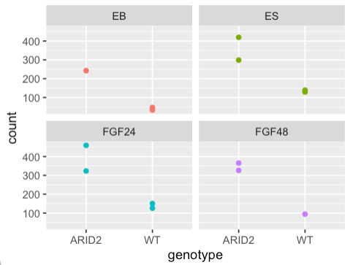

A concrete example
WT vs ARID2 KO
ES
EB
FGF24
FGF48
What genes does loss of ARID2 affect?
~4x increase regardless of treatment
Genotype comparison

Slide 35

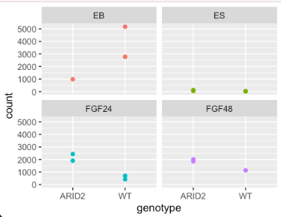

A concrete example
WT vs ARID2 KO
ES
EB
FGF24
FGF48
What genes have a different outcome to treatment based on genotype?
LRT
full = ~ genotype + treatment + genotype:treatment
reduced = ~ genotype + treatment
Small p values mean that there is a genotype specific effect of one (or more) treatments
Notes:
So here you can see nothing happens in ES cells and the gene seems to be off, in the FGF treatments loss of ARID2 increase this gene, but inEB it decreases, but in EB WT cells turn this gene way up, ARID2 do not.

