Slide 1
Class 3 – Creating your own functions and new data structures and best practices

Slide 2
Recap from last time
Tidy Data (wide vs long format of data)
Plotting
Merging and joining (relational data)

Slide 3
Practice

Slide 4
Today’s Goals
Factors (and R data types)
Functions
Objects
Best practices
More practice with pivoting and merging
More advanced plotting (faceting/multiple layers)

Slide 5
Data types in R

Slide 6
Functions
What are functions
Any chunk of code you are going to reuse - can be built in or come with a package or user made
Can take 0 or more arguments
Can return some value(s) or objects
-https://r4ds.had.co.nz/functions.html

Slide 7
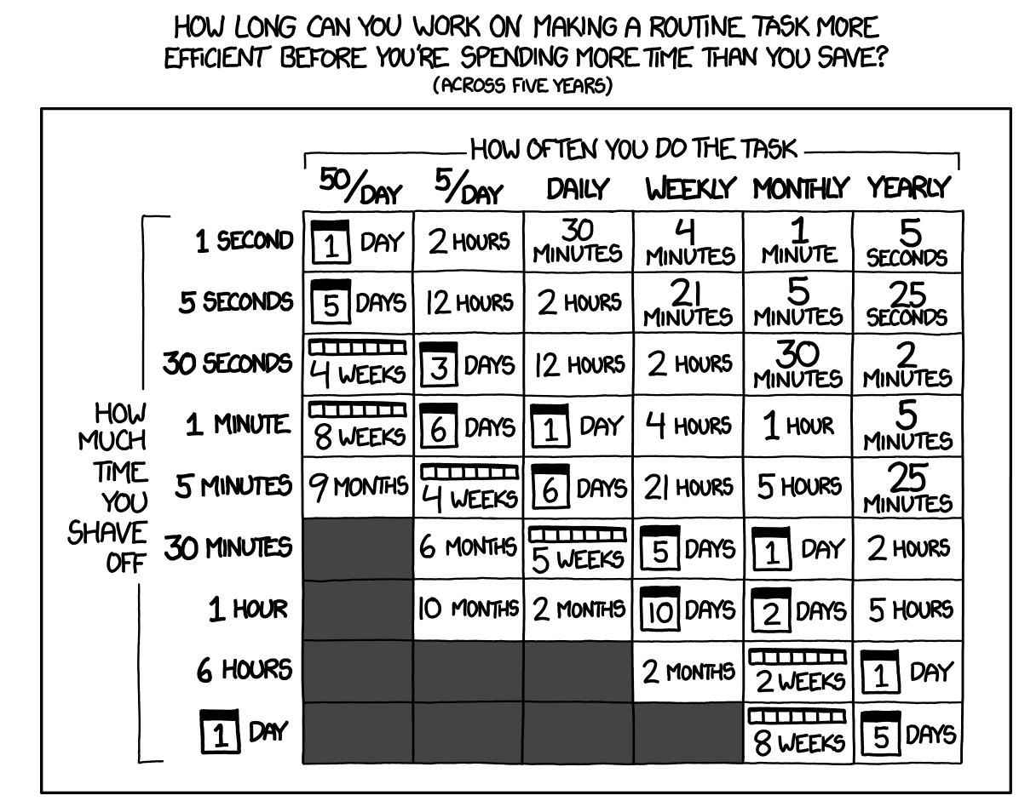
Functions
What are functions
Any chunk of code you are going to reuse - can be built in or come with a package or user made
Can take 0 or more arguments
Can return some value(s) or objects
Reasons to make a new function
You can give a function an evocative name that makes your code easier to understand.
As requirements change, you only need to update code in one place, instead of many.
You eliminate the chance of making incidental mistakes when you copy and paste
(i.e. updating a variable name in one place, but not in another).
https://xkcd.com/1205/
-https://r4ds.had.co.nz/functions.html

Slide 8
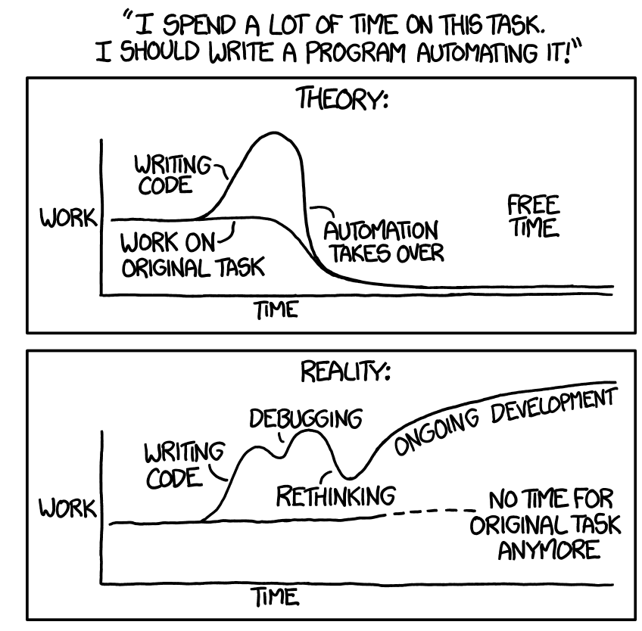
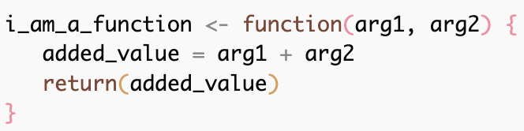

Basic Function
arguments
Function name
Function
body
Return value
https://xkcd.com/1319/

Slide 9
Objects

Slide 10
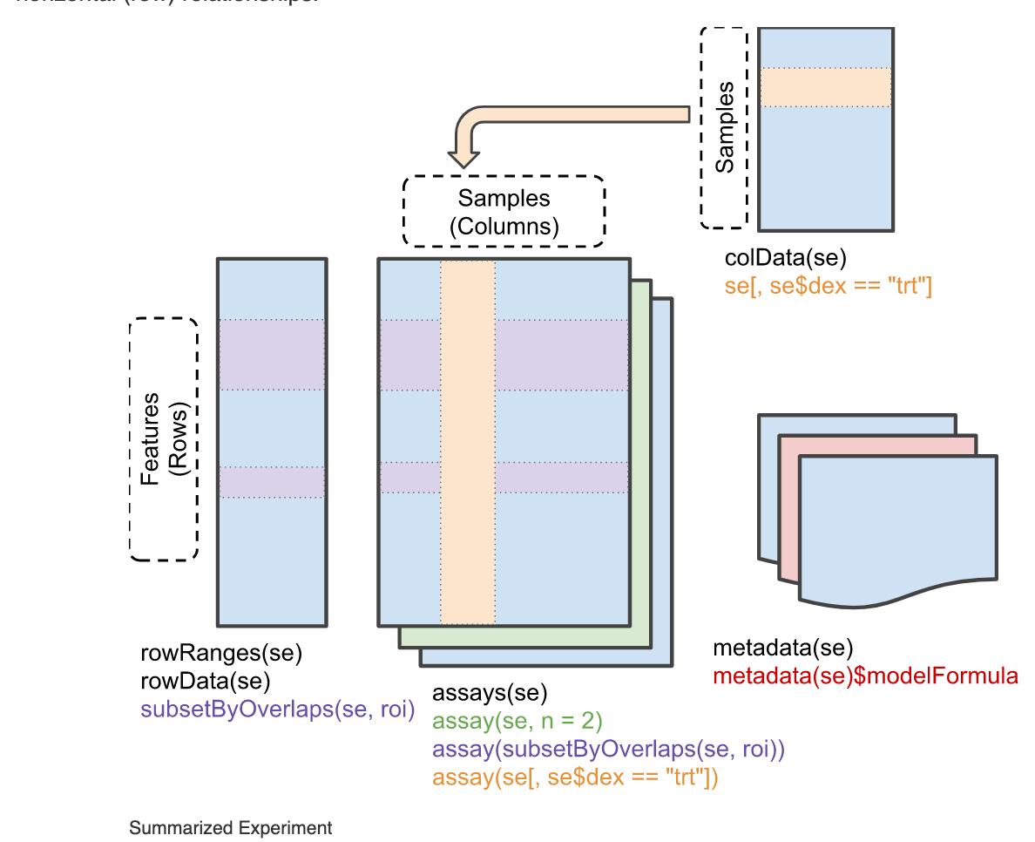
What is a summarized experiment object
RangedSummarizedExperiment - these represent genomic ranges
DESeqDataSet
Non-negative integer counts
Must have a formula describing experiment design
SummarizedExperiment -
https://bioconductor.org/packages/release/bioc/vignettes/SummarizedExperiment/inst/doc/SummarizedExperiment.html
Notes:
I have mentioned that dds is a ‘SummarizedExperiment’ object , what is this. DDS is actually a DEseqDataset - which itself is an extension of RangedSummarizedExperiments which is an extension of SummarizedExperiment.
These are something a little more fancy than a list or a dataframe or a string. These are called objects and the bioconductor project has tried to formalize the usage of a specific style of these objects for genomics data.

Slide 11
10 best practices

Slide 12
More pivoting/merging - examples

Slide 13
More plotting/faceting examples

