Slide 1
Lecture 6 – experimental designs, visualization, enrichment/downstream analysis

Slide 2
What if you have more than 2 groups?
GSE102560 - shRNA KD of SWI/SNF subunits in human
data/GSE102560.Rda
4 Groups - NS, Brg1, Brm, Double KO

Slide 3
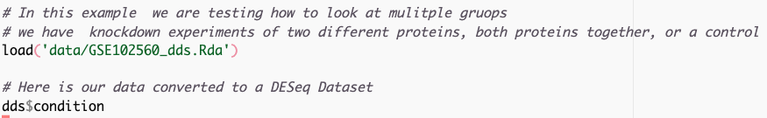

What if you have more than 2 groups?
Use contrasts to compare them
All our results are relative to Brg1 – is that what we want

Slide 4
What if you have more than 2 groups?
Use contrasts to compare them
results() can be used to extract any comparison
lfcShrink() must have levels set correctly before running the test.
Since we are using the Wald test the logfoldchanges here are interpretable as the logfoldchanges between groups.

Slide 5



What if you have more than 2 groups?
Use contrasts to compare them
results() can be used to extract any comparison
lfcShrink() must have levels set correctly before running the test.
Since we are using the Wald test the logfoldchanges here are interpretable as the logfoldchanges between groups and p-values are for that comparison.

Slide 6
comparing multiple groups: Likelihood Ratio Test (LRT)
Is there a difference between the full and reduced model
Full: ~ condition
Reduced: ~ 1
A significant p-value is telling you that the full model has more information than the reduced.
It is not telling you what that difference is
You can extract the logFoldChanges using the same approach as before for specific comparisons, but the p-values always will come from the above comparison
Notes:
This is most useful if you want to test multiple interactions or conditions at one time to see if there is any effect

Slide 7
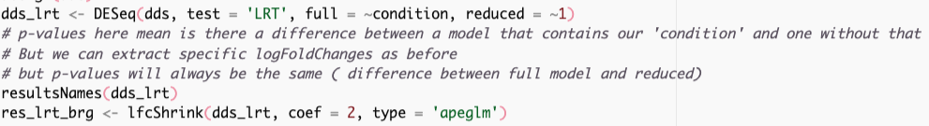
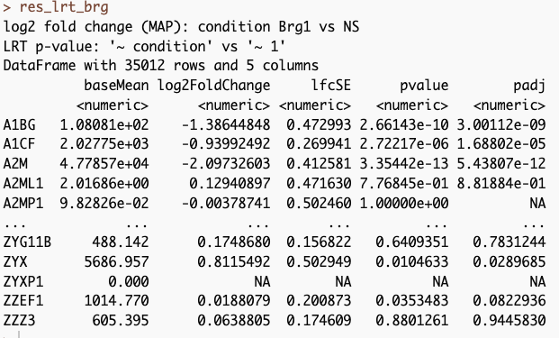
Testing multiple variable levels at once

Slide 8
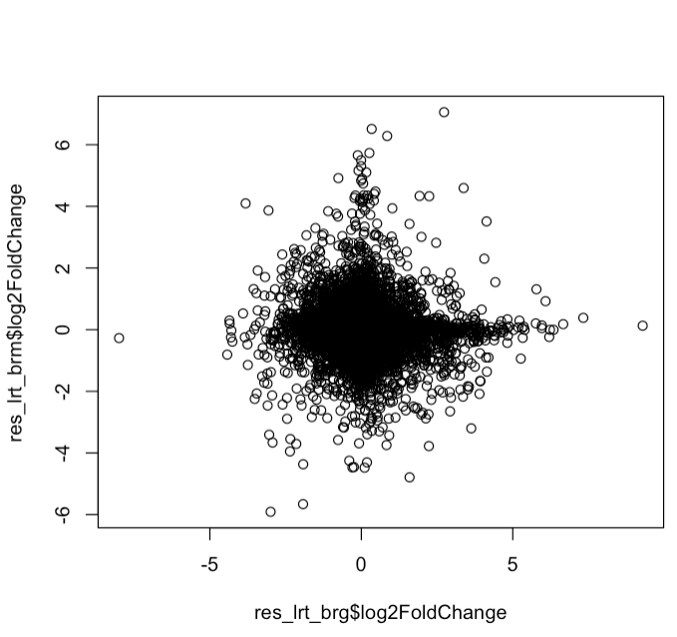

Testing multiple variable levels at once
Fold changes differ
But p-values are the same
(you only get 1 p-value per gene)

Slide 9
Multiple effects
What if you have genotype and treatment information ?
For example, you have WT and KO animals and they were treated with Drug or Vehicle control
Depends on your questions?
What genes are affected by drug treatment
= ~ genotype + treatment
Specify which contrast you want in results
(e.g. results(dds, contrast = c(‘treatment’, ‘drug’, ‘vehicle’) )
What genes are affected by genotype
= ~ treatment + genotype
Specify which contrast you want in results
(e.g. results(dds, contrast = c(‘genotype’, ‘KO’, ‘WT’) )

Slide 10

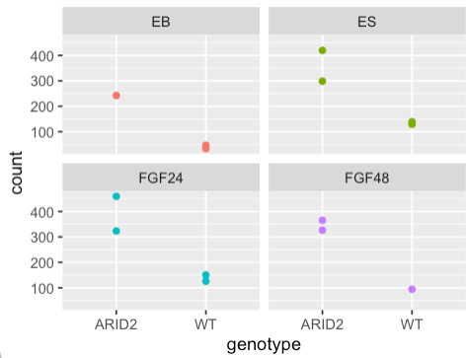
A concrete example
WT vs ARID2 KO
ES
EB
FGF24
FGF48
What genes does loss of ARID2 affect?
~4x increase regardless of treatment

Slide 11
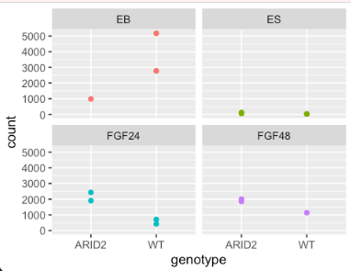
Interaction between treatment and genotype
WT vs ARID2 KO
ES
EB
FGF24
FGF48
What genes have a different outcome to treatment based on genotype?
LRT
full = ~ genotype + treatment + genotype:treatment
reduced = ~ genotype + treatment
Small p values mean that there is an interaction between genotype and treatment
Notes:
So here you can see nothing happens in ES cells and the gene seems to be off, in the FGF treatments loss of ARID2 increase this gene, but inEB it decreases, but in EB WT cells turn this gene way up, ARID2 do not.

Slide 12

Interaction between treatment and genotype
WT vs ARID2 KO
ES
EB
FGF24
FGF48
What genes have a different outcome to treatment based on genotype?
LRT
full = ~ genotype + treatment + genotype:treatment
reduced = ~ genotype + treatment
You can extract fold changes between comparisons – but pvalues are for the interaction term
Notes:
So here you can see nothing happens in ES cells and the gene seems to be off, in the FGF treatments loss of ARID2 increase this gene, but inEB it decreases, but in EB WT cells turn this gene way up, ARID2 do not.

Slide 13
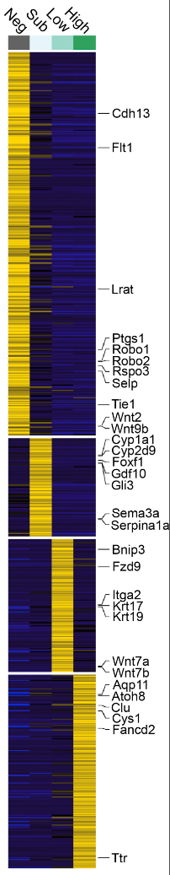
You may want the LRT style analysis to find genes chaning in complicated experimental designs

Slide 14
Advanced experimental designs – Data sets you can try out
data/arid2_es.Rda
mouse - ARID2 KO vs WT ES cells
4 treatment conditions (ES, EB, FGF24, FGF48)
data/Gracz_2020.Rda
Mouse facs purified cell populations (High, Low, Sublow, Negative)

Slide 15
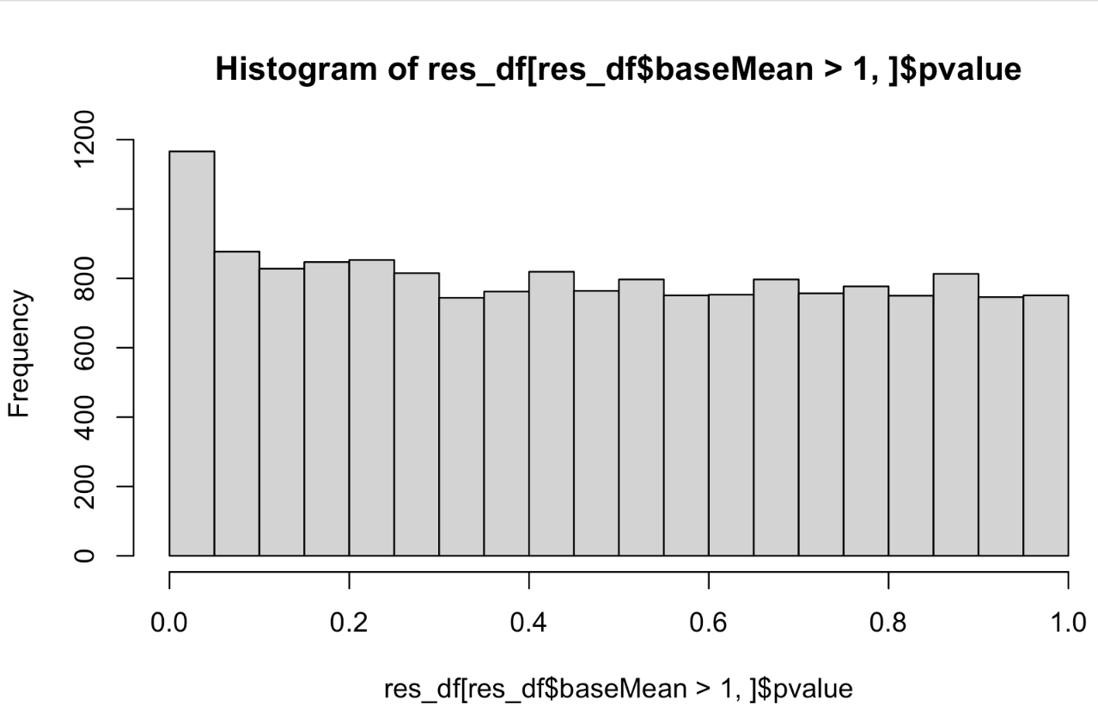
P-values
Notes:
some of these are just by chance - you can sort of look at th edistrubtion and assume at least ~800 of them are, but there could be a few hundred p-values that really are - we use an correction for multiple testing to find these.
Default here is false discovery rate (benjami hochberg) -or the proportion of false discoveries - so with an FDR of 0.1, we expect ~10% of the rejected null hypothesis to be an error, and to actually be just due to chance.

Slide 16
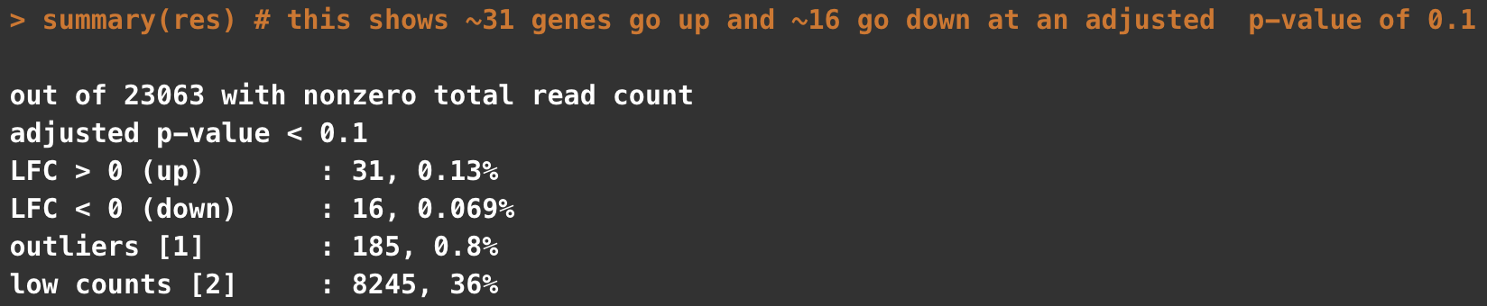
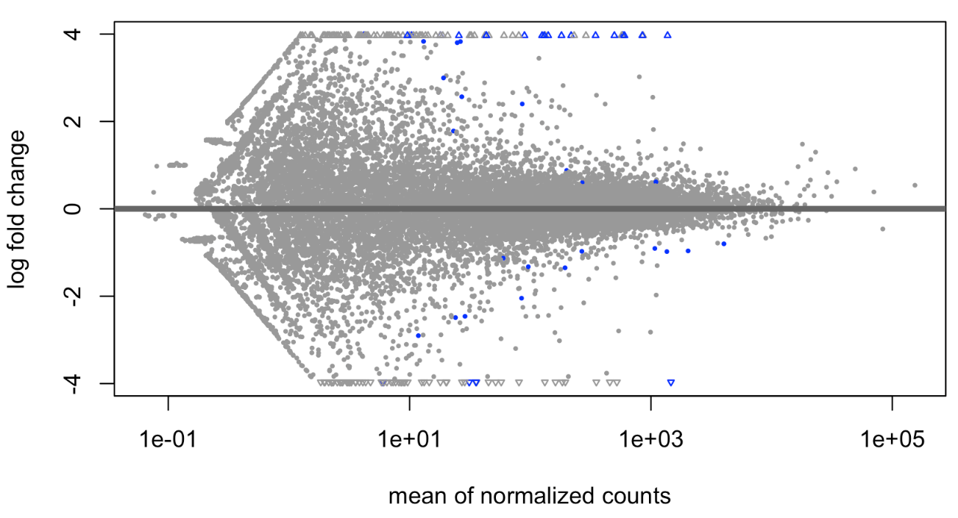
Basic plotting and visualizing of results
Notes:
basic plot shows few genes with pretty strong log fold changes are significant . BUt you can see some odd banding and stuff in the data. This is inpart becuase the genes with low counts can have very high (but pretty unreliabile ) fold changes

Slide 17
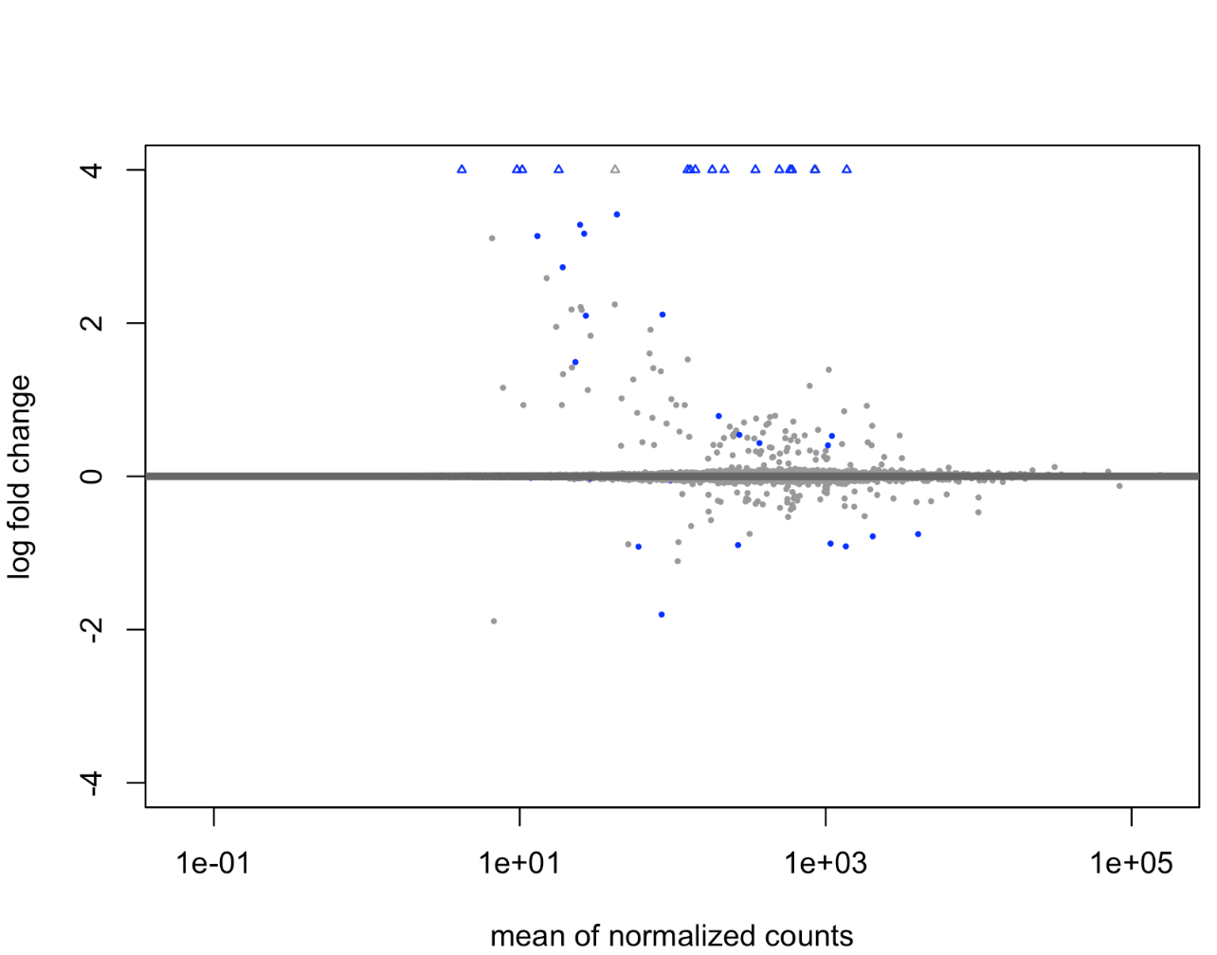
Basic plotting and visualizing of results
Initial
Shrunk

Slide 18
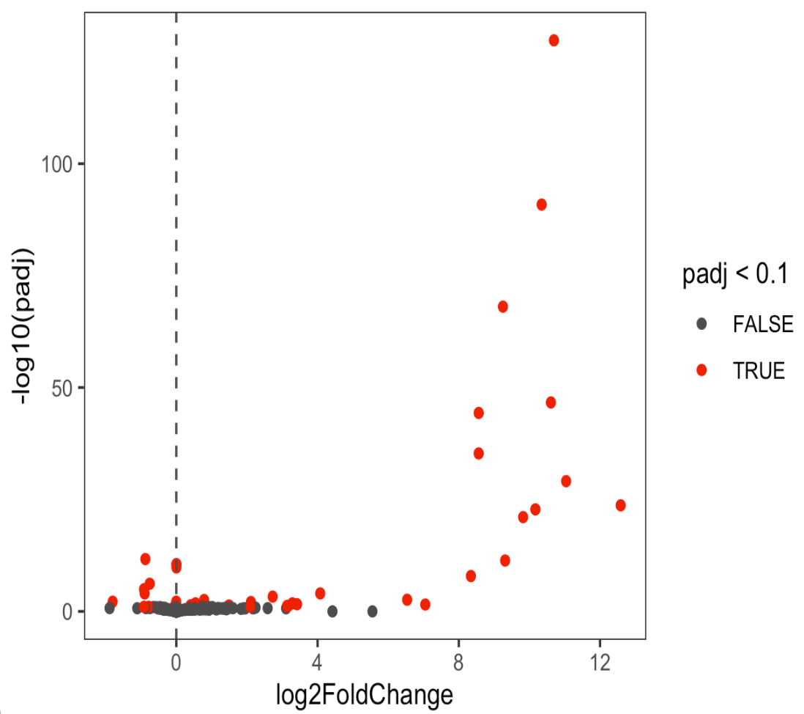
Basic plotting and visualizing of results
VolcanoPlot
Shrunk

Slide 19
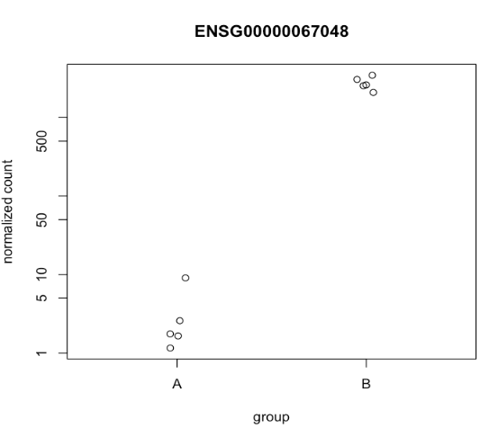
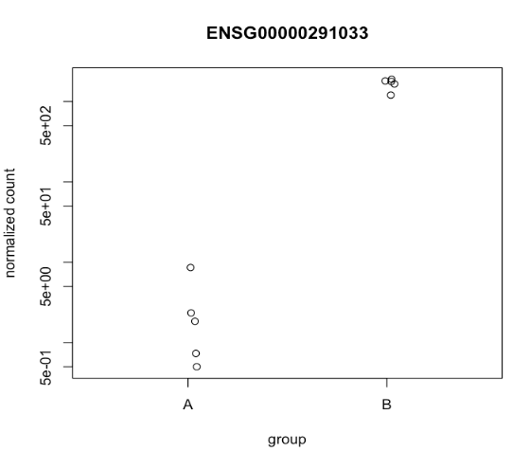
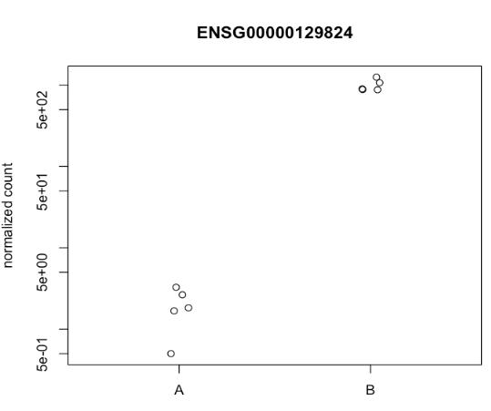
Basic plotting and visualizing of results

Slide 20
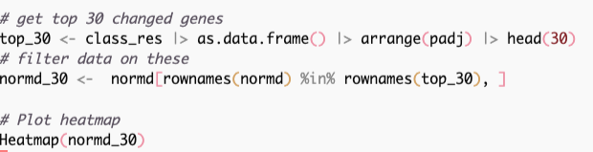
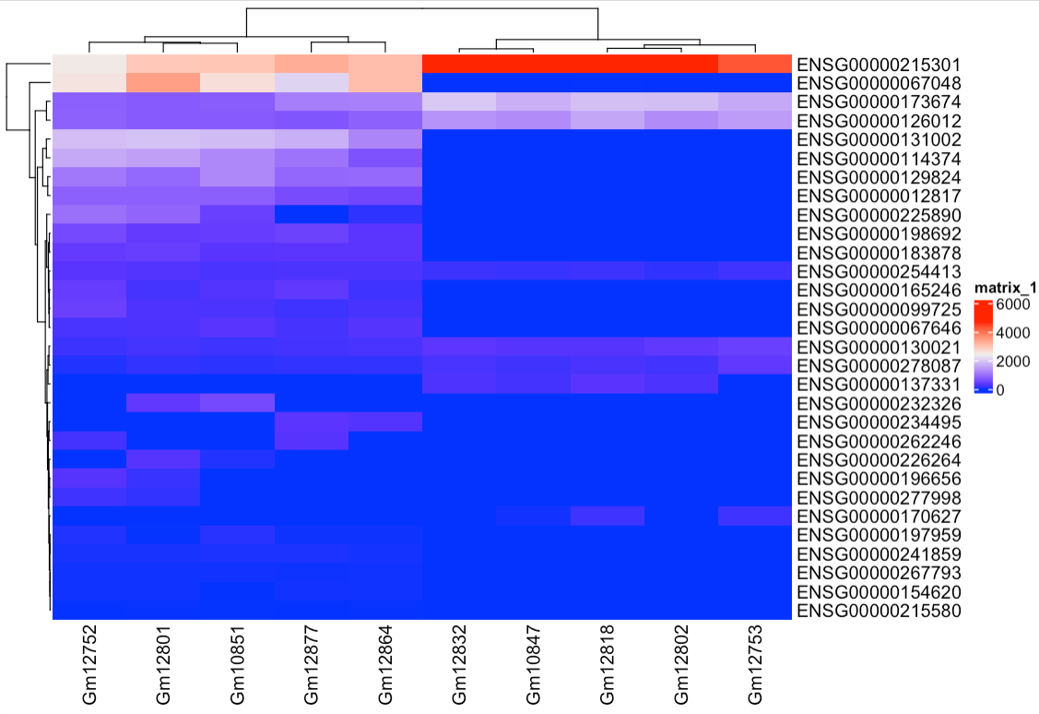
Basic plotting and visualizing of results
Notes:
Important to go back to your original count data transformed somehow to do these plots
Like last time, we can see that the count data varies a lot so this is really just dominated by the total counts. Usually we want to scale this by row, so that we can see difference between groups. Also notice that one sample GM12832 is sort of off doing its own thing, which is in line with what we saw the other day.

Slide 21
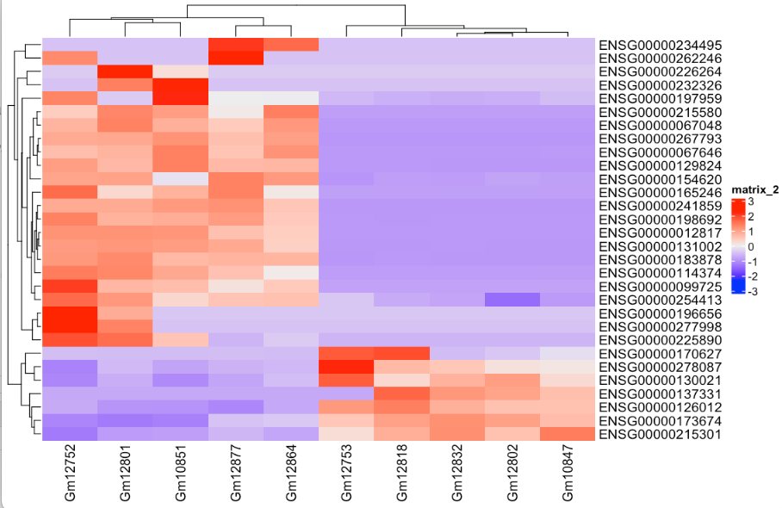
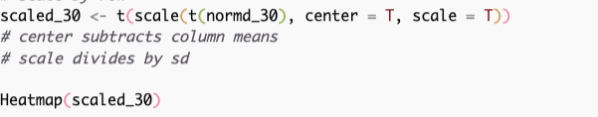
Basic plotting and visualizing of results
Notes:
center = T subtracts the column mean from each value
scale = T divides these values by the standard deviation of the column
This gives you a z-score of the expression in that row.
We transpose the original matrix since scale operates on columns, then transpose again to return to the original dimensions
NOw this behaves much better and our samples cluster. Even the problem child 12832, which because we put all these values on the same scales (z-scores) a few genes with very high counts in that sample don’t drag it away.

Slide 22
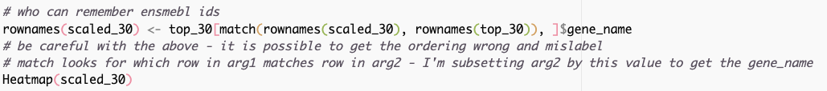
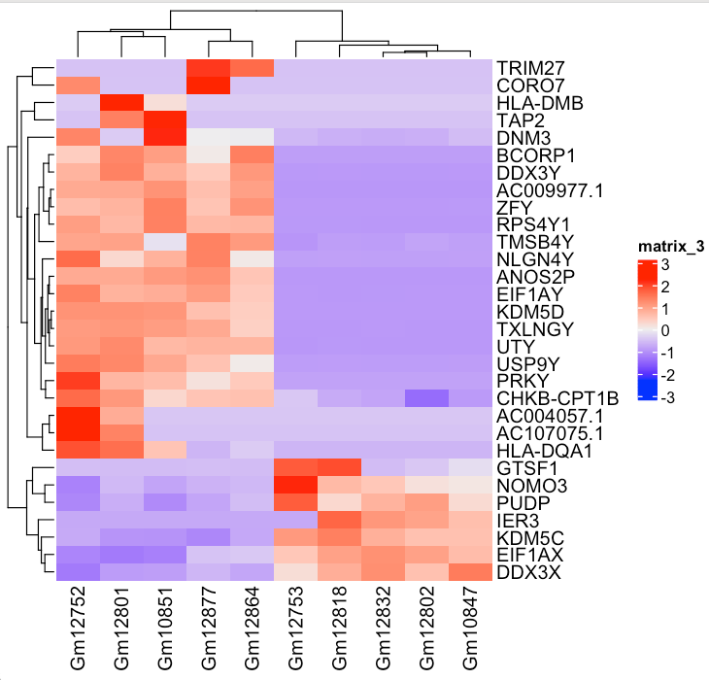

Slide 23
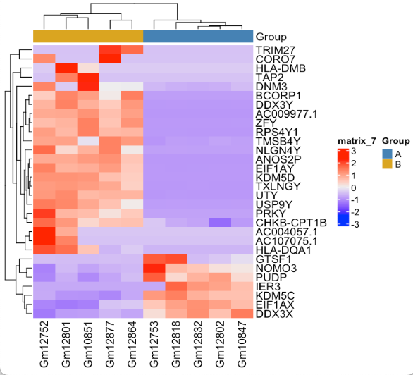

Slide 24

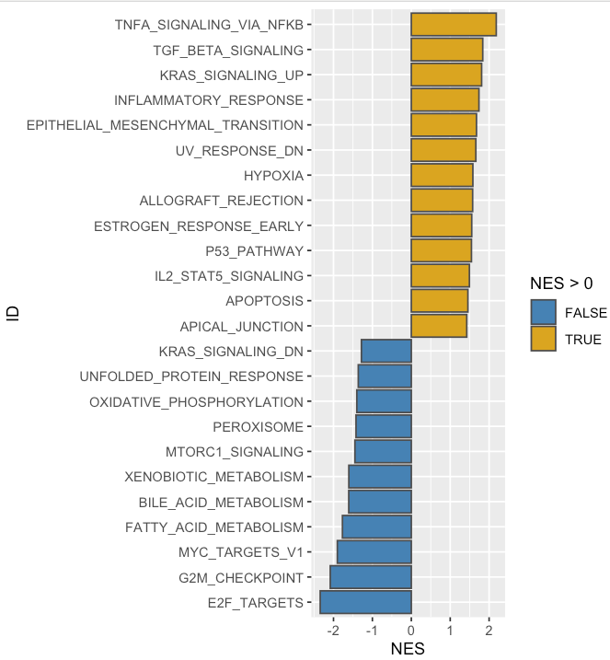

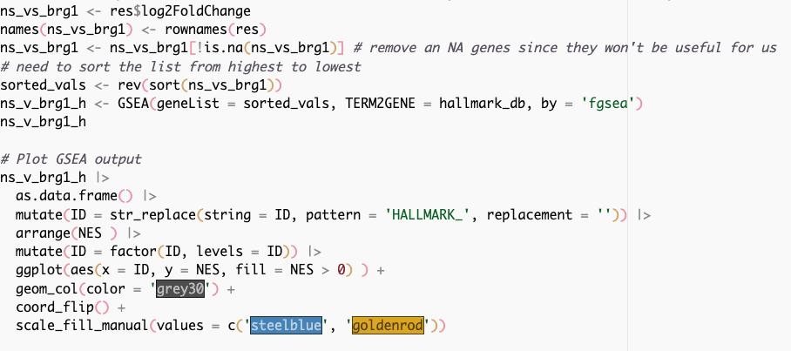
Enrichment - GSEA

Slide 25
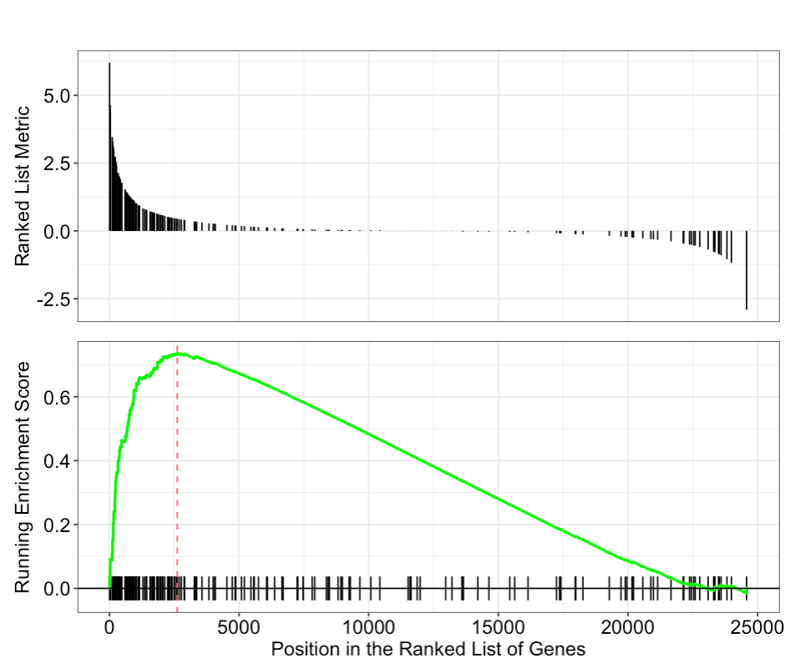
GSEA plot
TNFA Signaling via NFKB

Slide 26
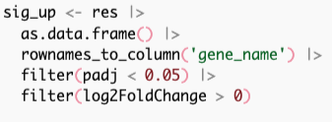
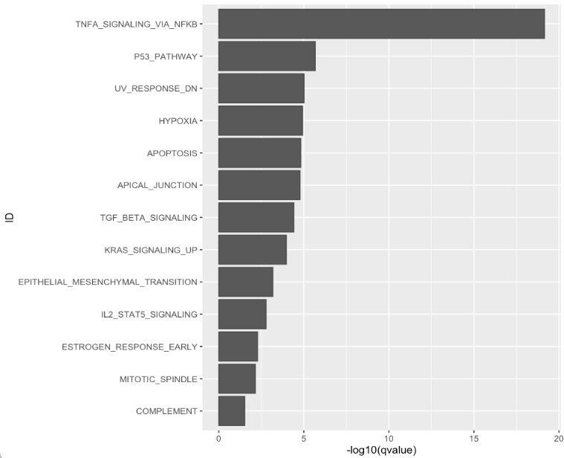
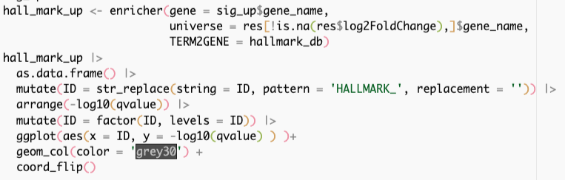
Enrichment - enricher

Slide 27
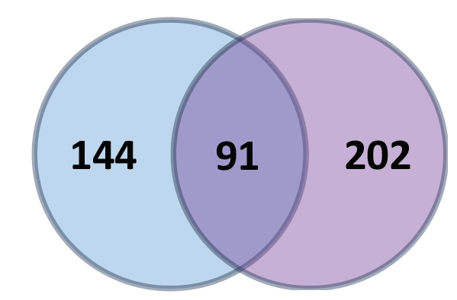
GSEA vs enricher
GSEA
Takes whole gene list (no cutoff)
Compares ranks of your genes to some predefined set
enricher
Subset of your total genes (lfc, pvalue, etc cutoff)
Compares if your set overlaps another set significantly

Slide 28
Relating expression to the genome - motif analysis
HOMER
MEMES
Show in the code

