Slide 1
Class 2 – Plotting and Data Exploration

Slide 2
Last time
Installing/loading libraries - library()
Filter/Grouping/Summarizing - filter(), group_by(), summarise(), mutate()
Importing Data - read_csv(), read_tsv()

Slide 3
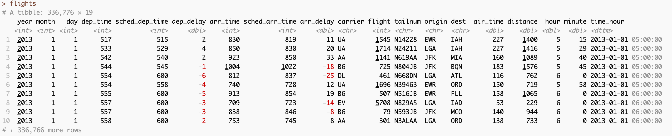
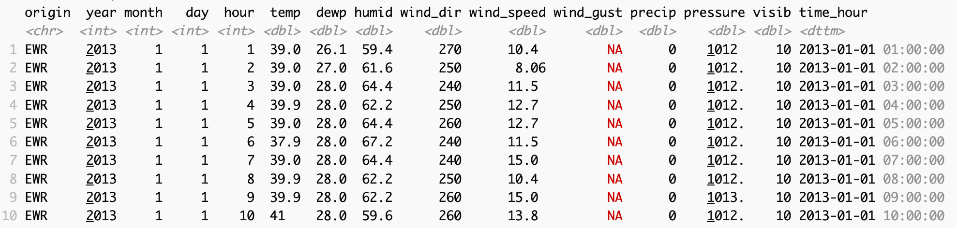
install.packages(‘nycflights13’)
Practice
How many flights originated at each airport
How long was the average flight that left EWR (Newark)
What airport had the longest average arrival delay
Which carrier had the most departure delays (> 0)
How many flights per month

Slide 4
Today’s Goals
Tidy Data (wide vs long format of data)
Plotting
Merging and joining (relational data)

Slide 5
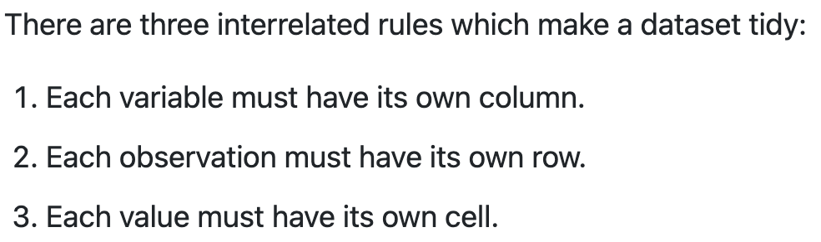
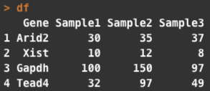
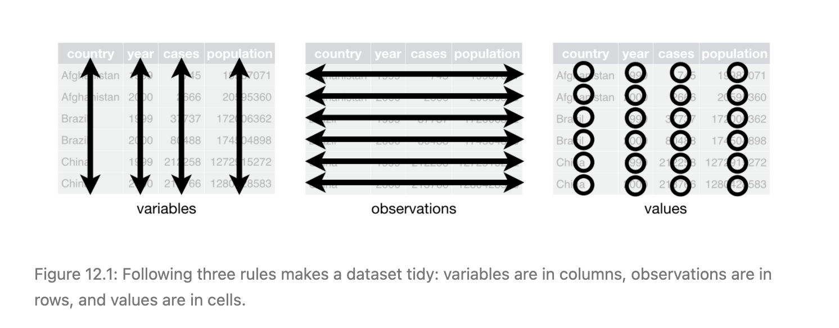
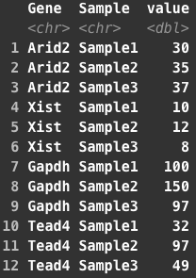
Tidy Data
Not Tidy - wide
Tidy - long
https://r4ds.had.co.nz/tidy-data.html

Slide 6
Why should data be Tidy
Consistency - easier if you always know how the data should be represented
Ease - Works seamlessly with tools in the tidyverse (like ggplot)
Speed - Having variables in columns lets R work more quickly (using vectorization)
Not all data need to be in this format
From JT Leek https://simplystatistics.org/2016/02/17/non-tidy-data/

Slide 7
Why might data NOT need to be tidy
Speed - Some specialized data formats can be faster for specific problems/computations (gene expression matrices are an example of this)
Field norms - some fields are used to storing data in a specfic way (summarizedExperiment in R )
Some tools work more easily on matrices - Heatmaps

Slide 8
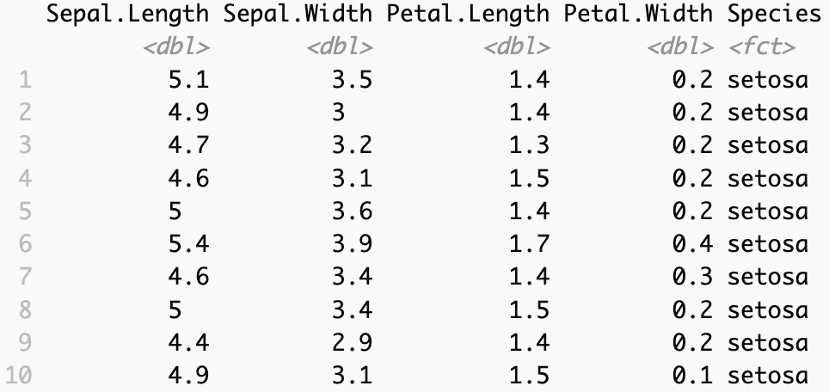
Converting between wide and long formats
pivot_longer()
https://tidyr.tidyverse.org/articles/pivot.html

Slide 9
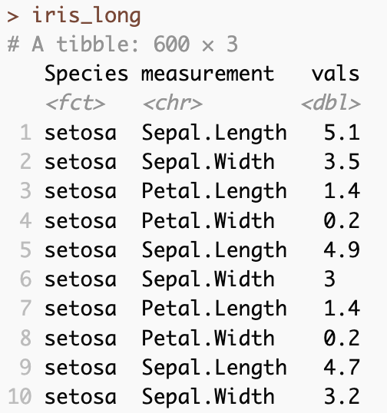
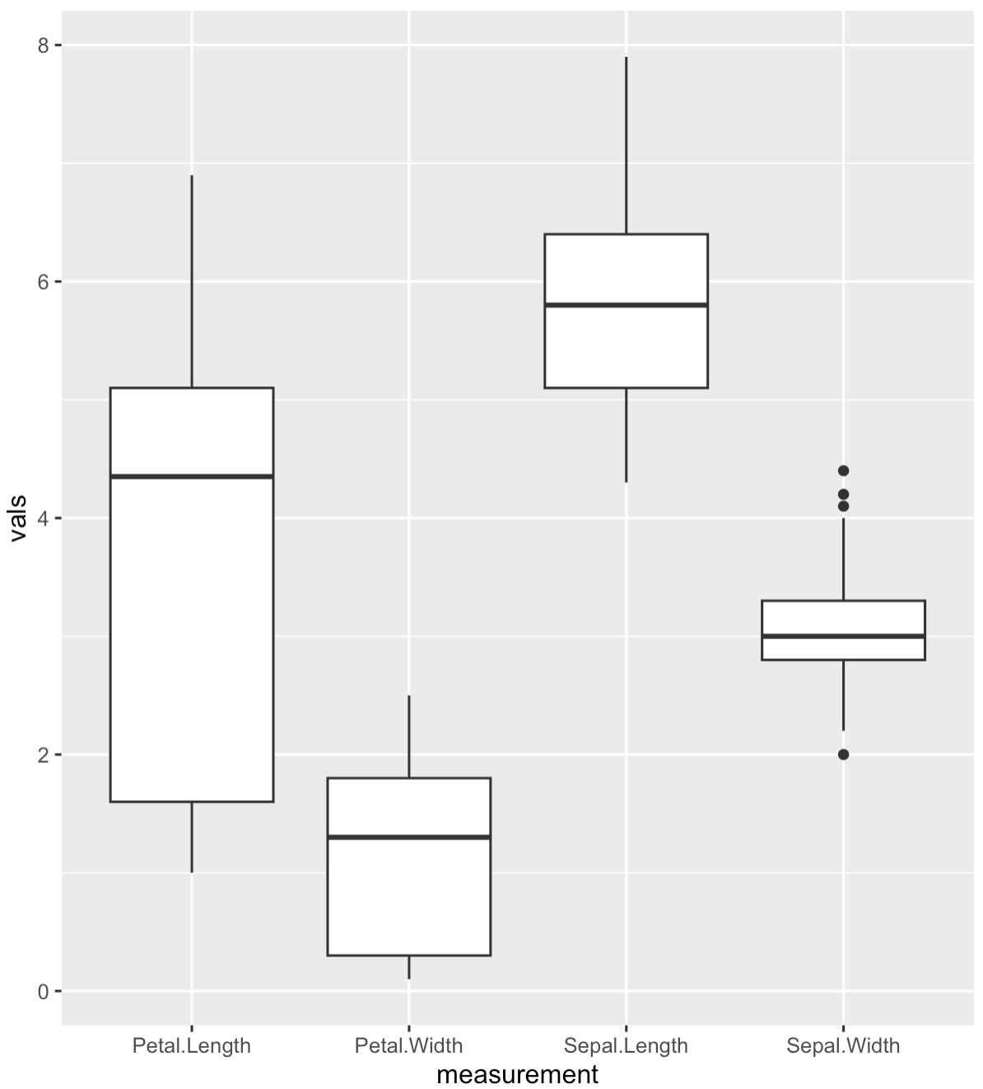
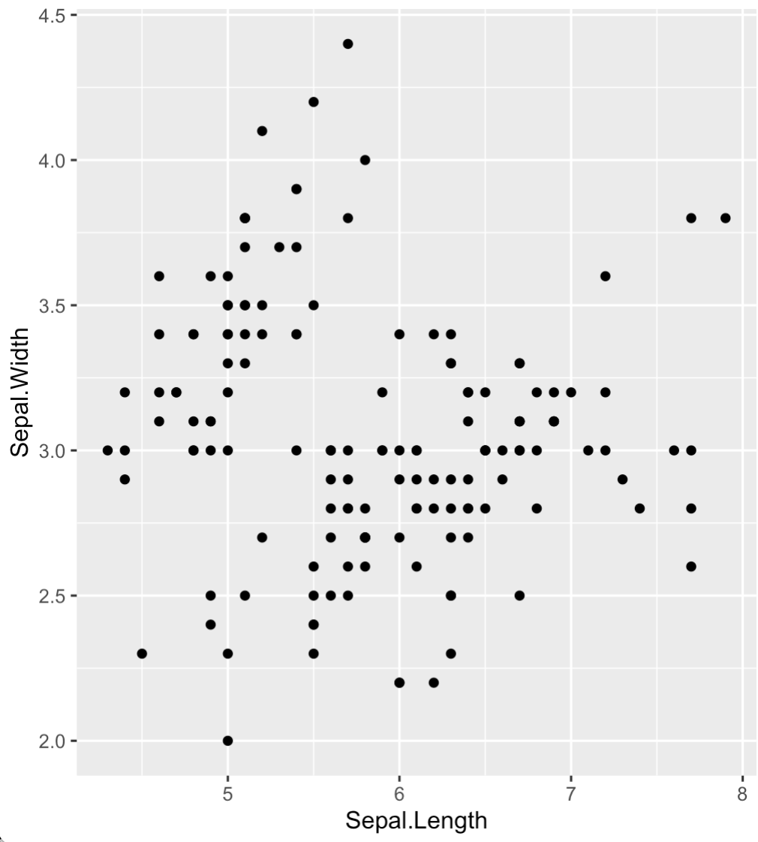
Converting between wide and long formats
pivot_longer()
More useful if you want to plot all attributes together
More useful if you want to plot length vs width
https://tidyr.tidyverse.org/articles/pivot.html

Slide 10
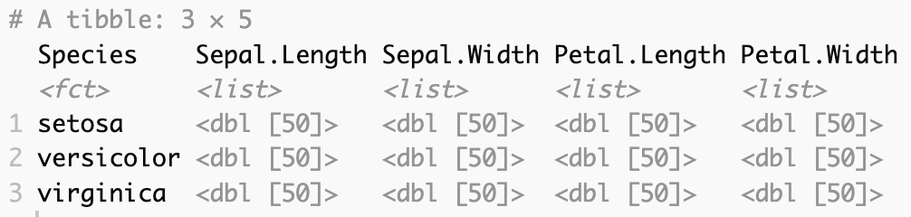
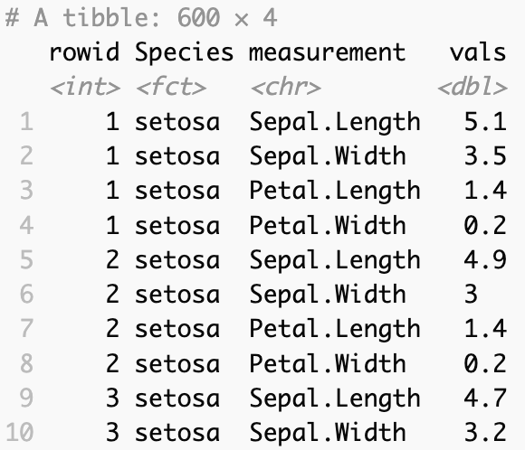
Converting between wide and long formats
pivot_longer()
pivot_wider()
Each set of 4 measurements – (originally 1 row) has a unique rowid
https://tidyr.tidyverse.org/articles/pivot.html

Slide 11
Plotting using ggplot
library(ggplot2)
data
aesthetics
Type of plot
https://ggplot2.tidyverse.org/

Slide 12
Plotting using ggplot
library(ggplot2)
data
aesthetics
Type of plot
https://r4ds.had.co.nz/data-visualisation.html
https://ggplot2.tidyverse.org/

Slide 13
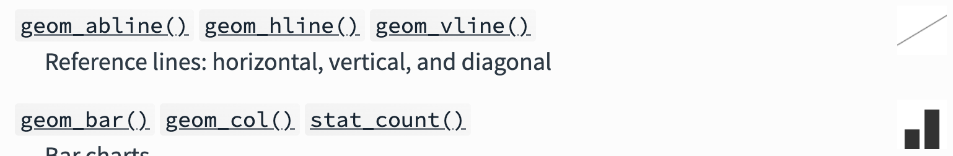
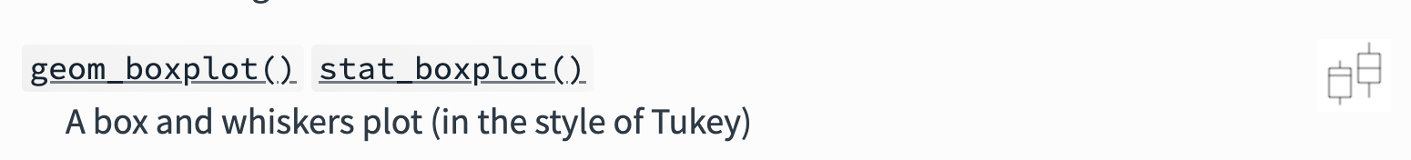
ggplot lets you make many different kinds of plots by using different ‘geoms’
https://ggplot2.tidyverse.org/reference/

Slide 14
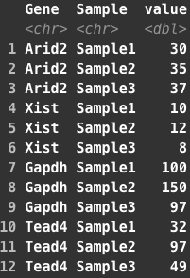
What if we want to look at expression levels of 4 genes?

Slide 15
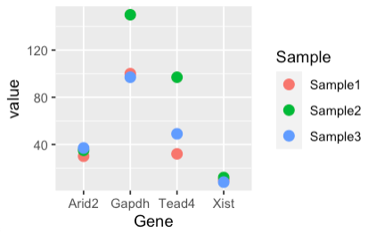
What if we want to look at expression levels of 4 genes?

Slide 16
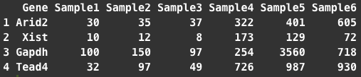
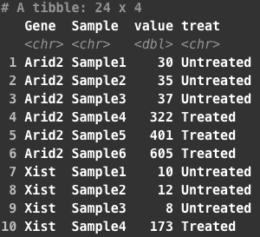
A little more complicated example - samples from different conditions
Untreated
Treated
Wide
Long
Notes:
Now lets try somethign a little more involved. On the left is the wide data. You can see I’ve added 3 more samples, lets assume from some drug treatment or somethign. On the right I’ve made this into a tidy/long dataset and added a new column to describe the treatment (treated vs untreated). We might want to know what effect treatment has

Slide 17

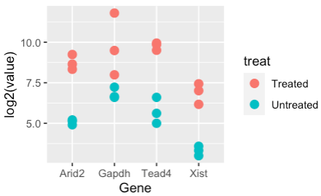
A little more complicated example - samples from different conditions
Notes:
Thats very simple using ggplot when we have data in this orientation. You just change the aes parameters to reflect what you’re now asking. We can still put Gene on the x axis, and value on the y (here I’m log2 transforming just so the plot looks a little better since the values are pretty different in the two groups). Instead of of color by sample, we can color by treatment and the difference is really clear.

Slide 18

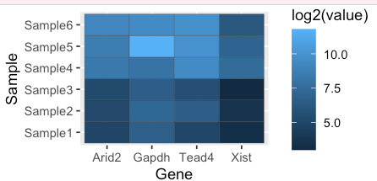
A little more complicated example - samples from different conditions
Notes:
You can make very different plots using this same basic structure, I find this really lets you dig into the data and explore quickly. Here all we did was again change what we are mapping to the x and y axis, we kept Gene on the X, but now put the samples on the y and made the color fill equal to the counts.
These plots are much harder (for me at least) to make from base R graphics and without using tidyverse syntax. Its definitely worth taking some toy data or some of your own data and getting comfortable plotting things. I spend a lot of time doing exploratory data analysis in R, and the tidyverse packages and ggplot make it very interactive and fun.
I’ll put a script covering some of this onto sakai if you want to play around more. I included some prompts for other things to look at

Slide 19
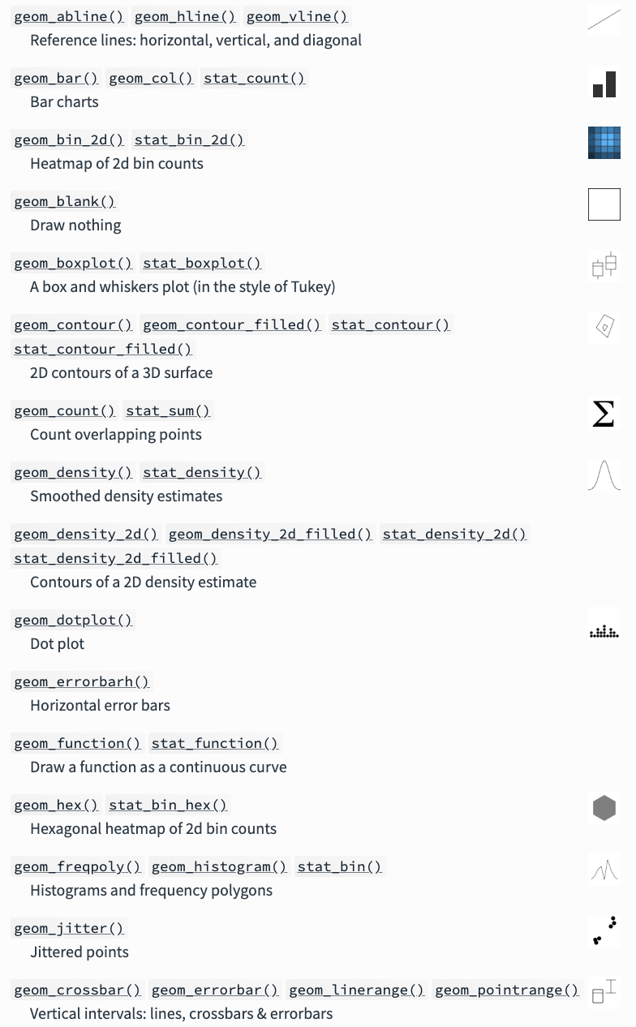
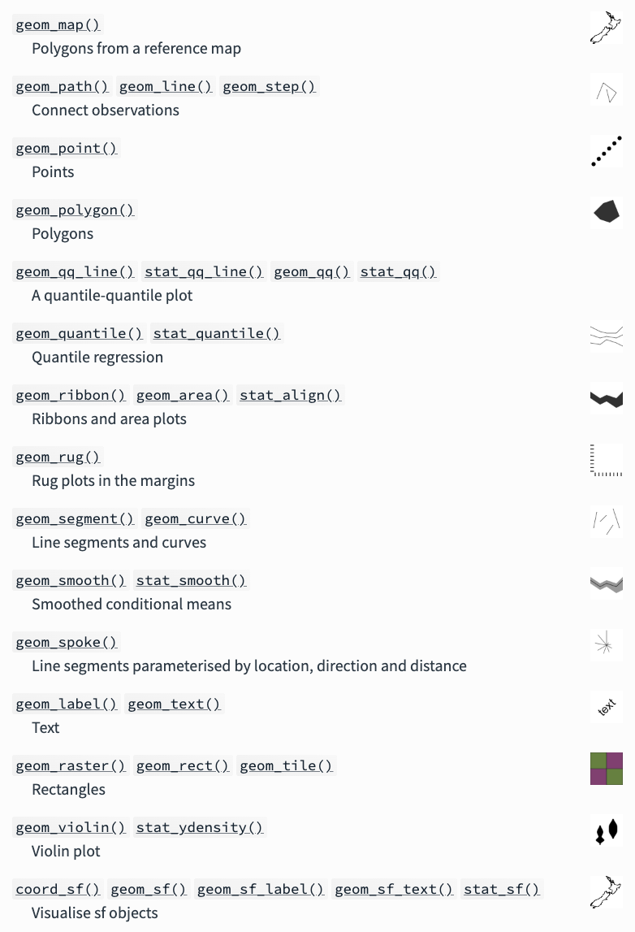
https://ggplot2.tidyverse.org/reference/
There are many geom types

Slide 20
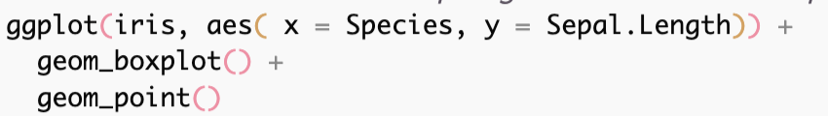
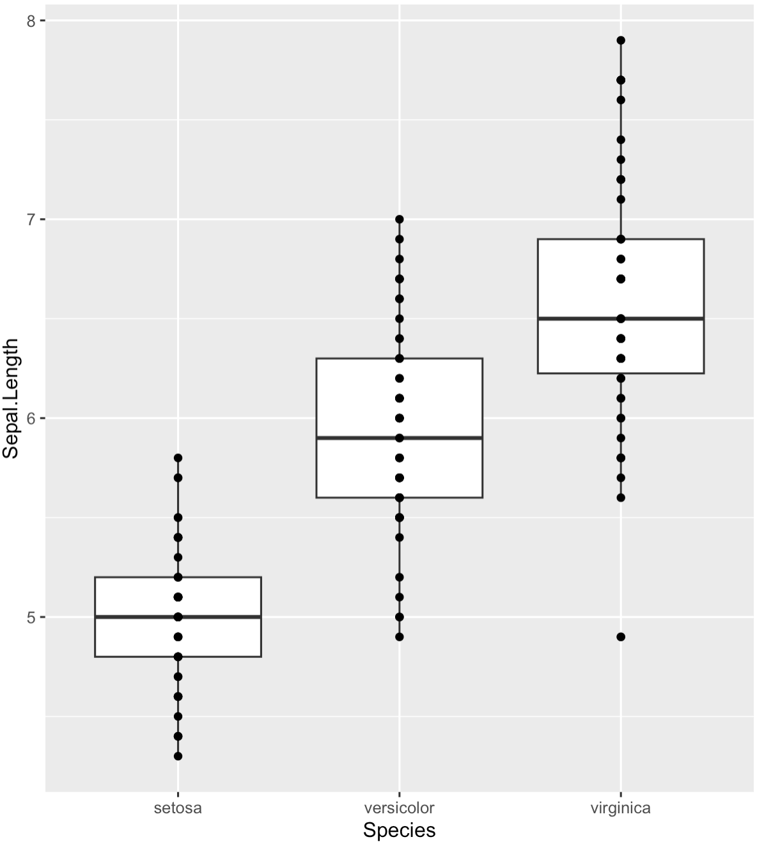
Adding to plots

Slide 21
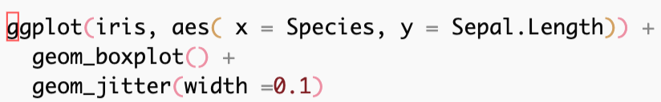
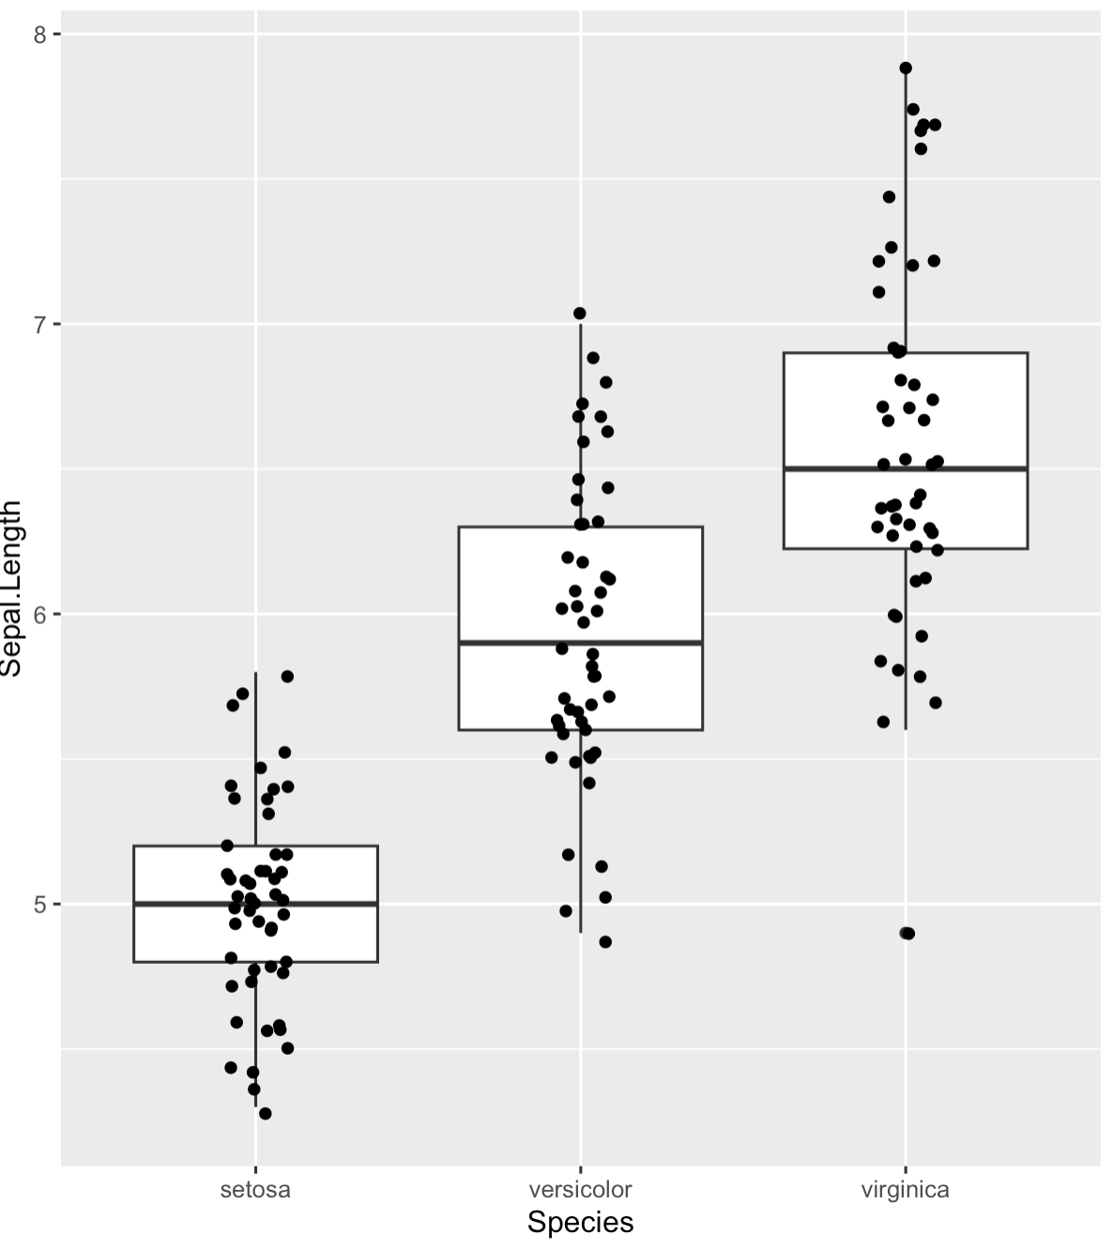
Adding to plots

Slide 22
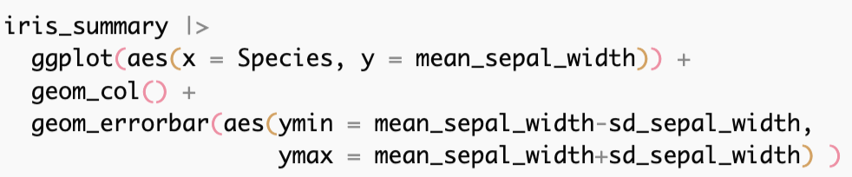
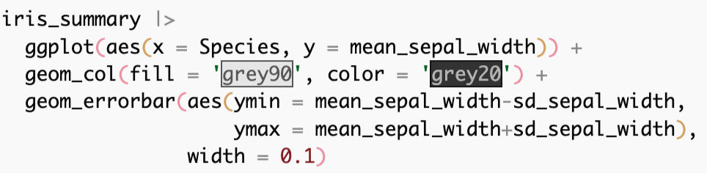
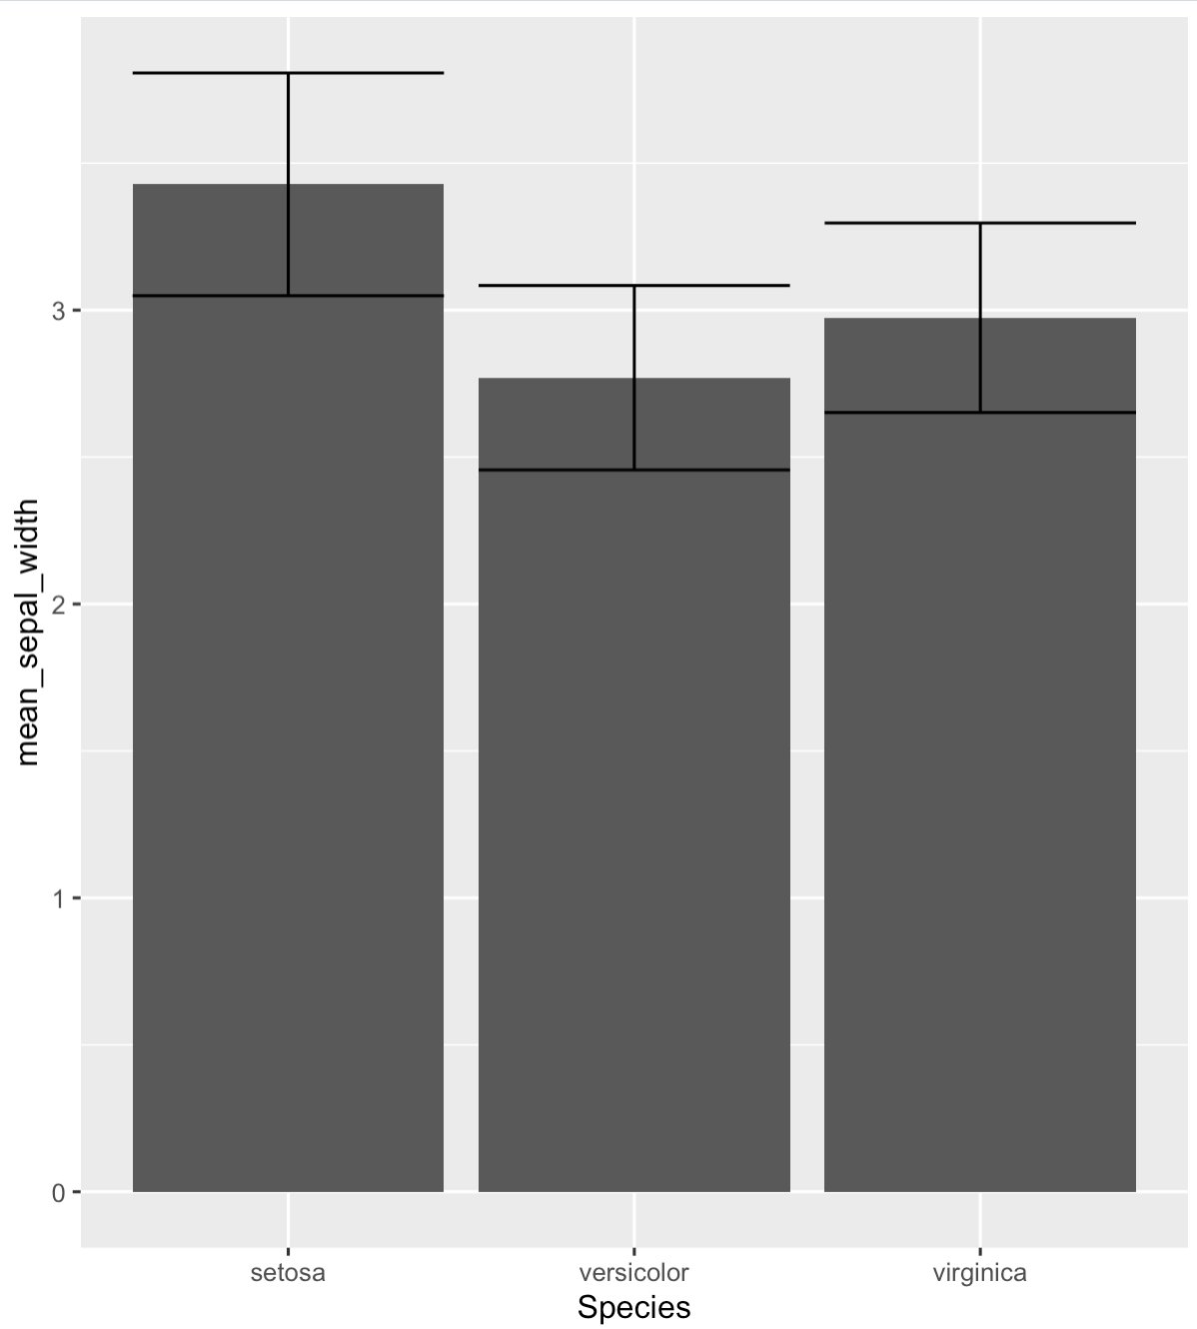
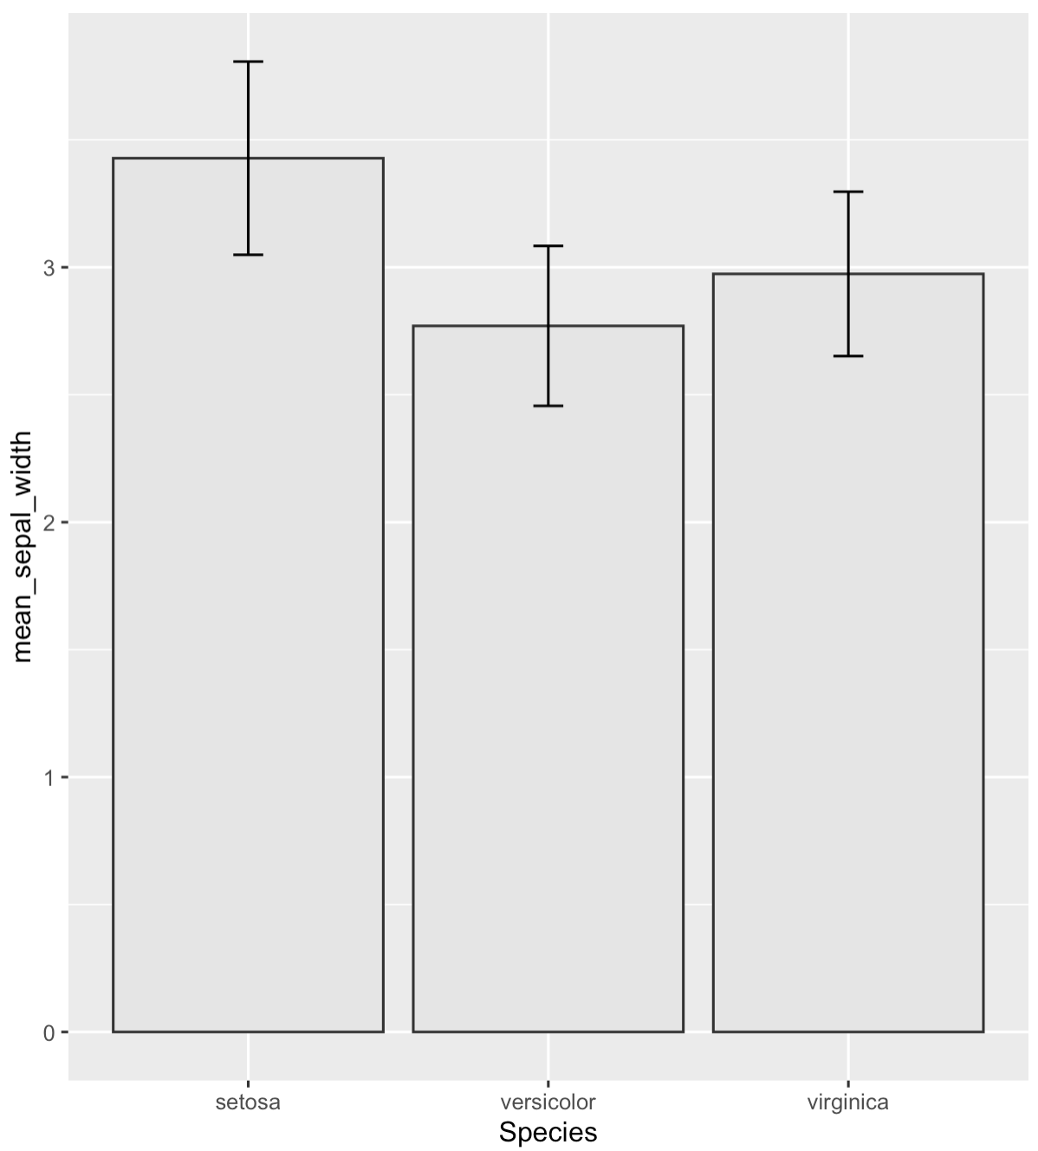
Adding to plots

Slide 23
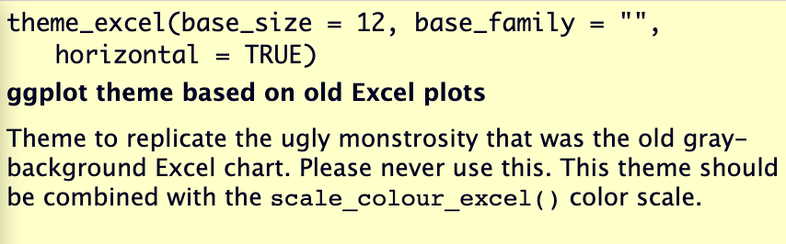



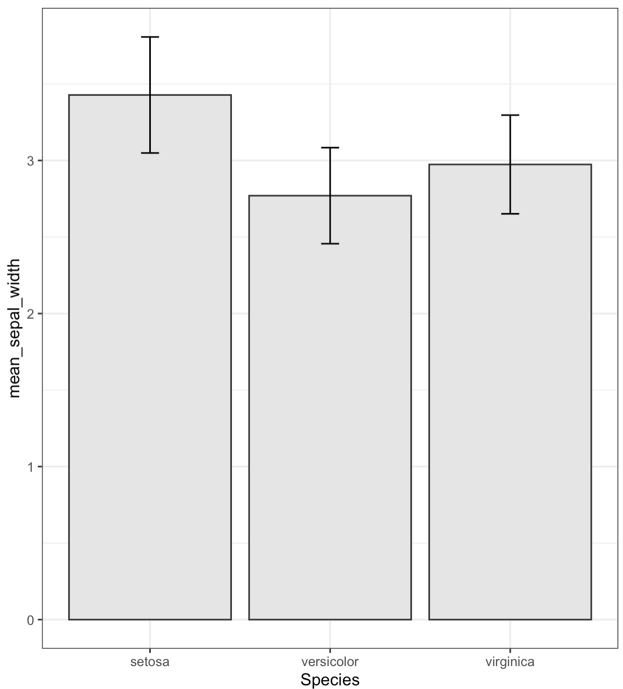
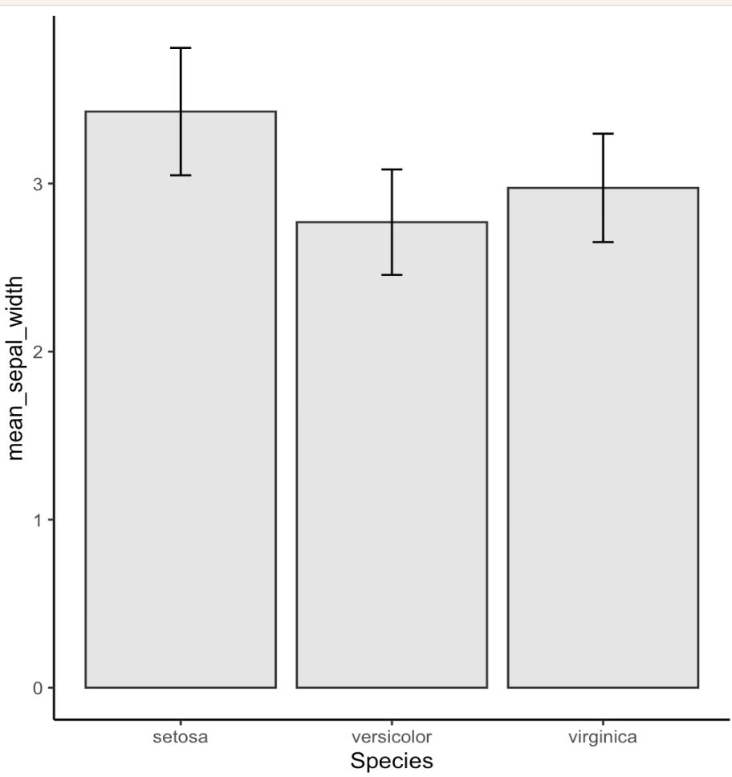
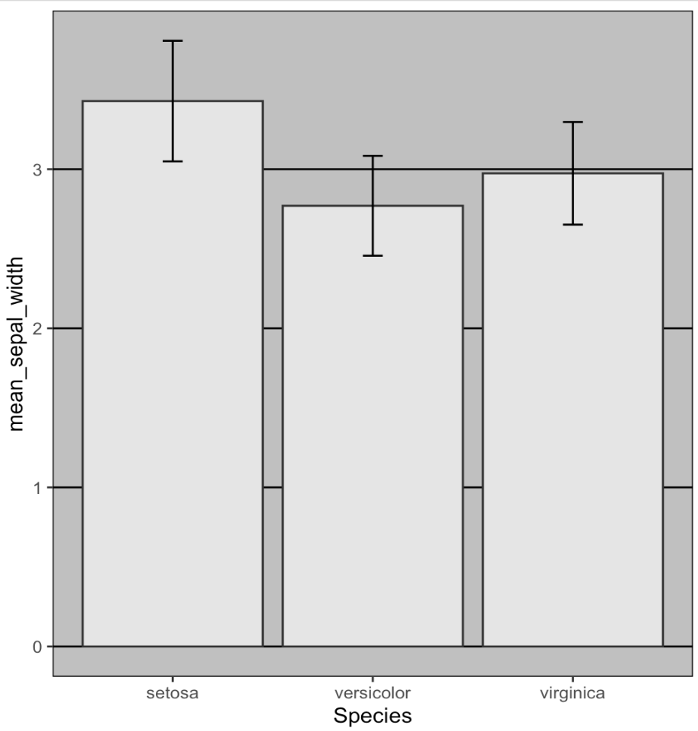
Making plots look better – Themes!

Slide 24
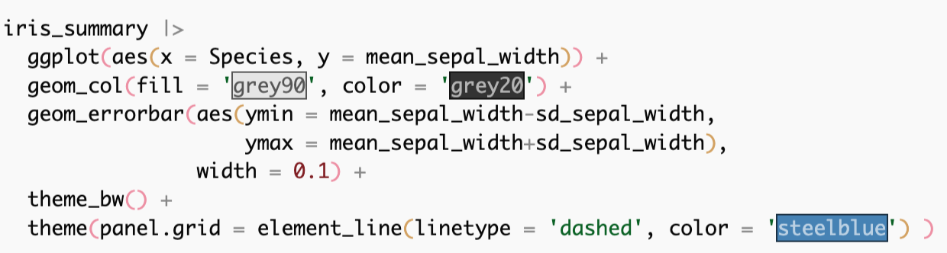
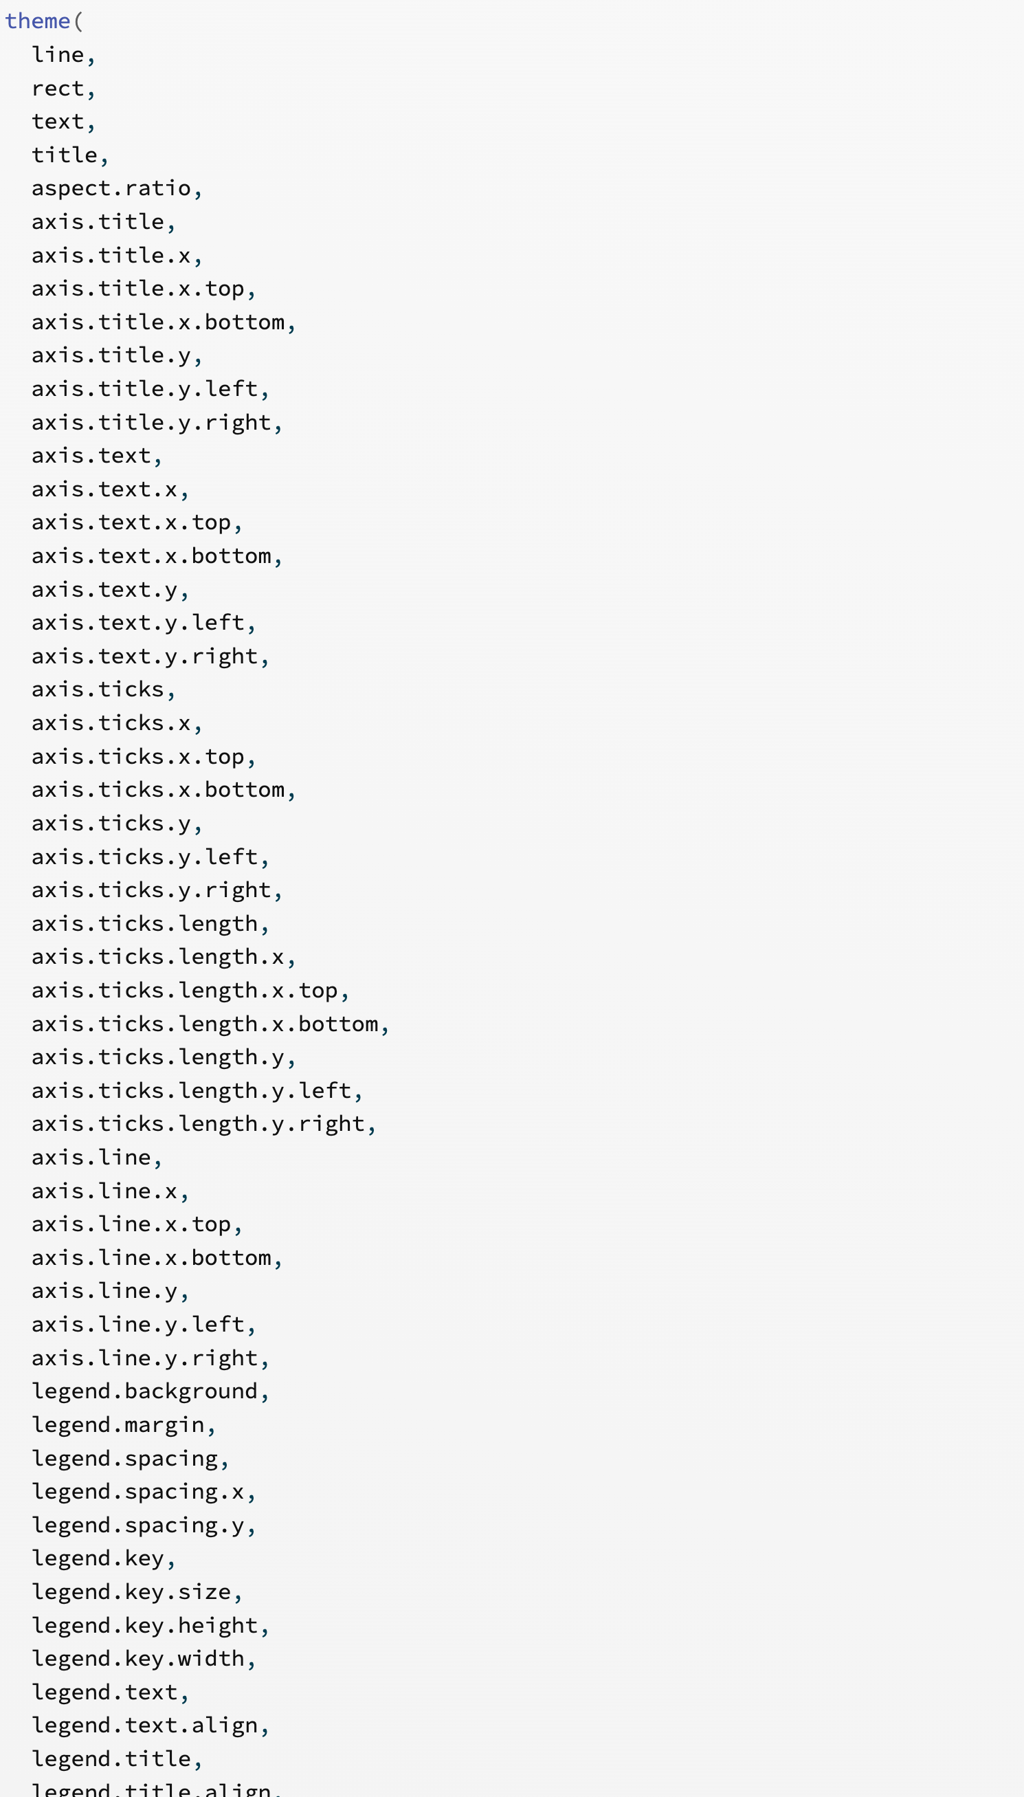
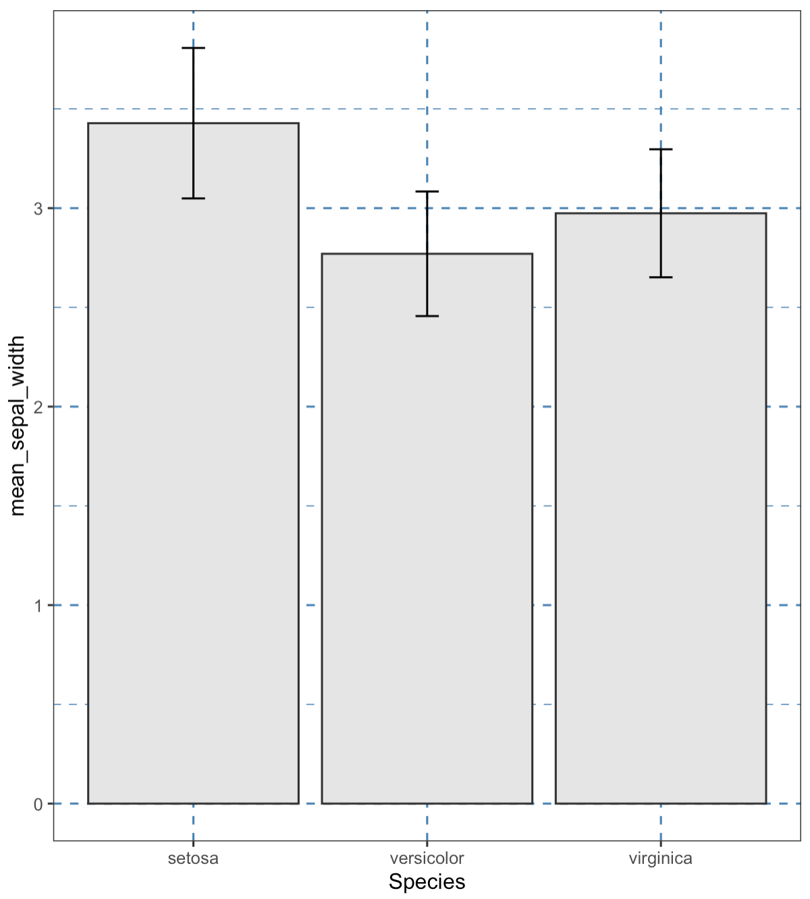
Themes can be added to like any other plot element
https://ggplot2.tidyverse.org/reference/theme.html

Slide 25
Merging and Joining (relational data)
Gene | Count | Sample
Arid2 | 33 | A
Xist | 22 | B
Arid2 | 100 | C
Xist | 30 | D
Sample | Disease
A | Tumor
B | Normal
C | Tumor
D | Normal

Slide 26
Merging and Joining (relational data)
Gene | Count | Sample
Arid2 | 33 | A
Arid2 | 22 | B
Xist | 100 | A
Xist | 30 | B
Sample | Disease
A | Tumor
B | Normal

Slide 27
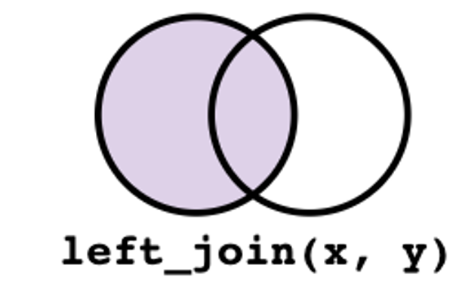
left_join()
Gene | Count | Sample | Disease
Arid2 | 33 | A | Tumor
Arid2 | 22 | B | Normal
Xist | 100 | C | Tumor
Xist | 30 | D | Normal

Slide 28
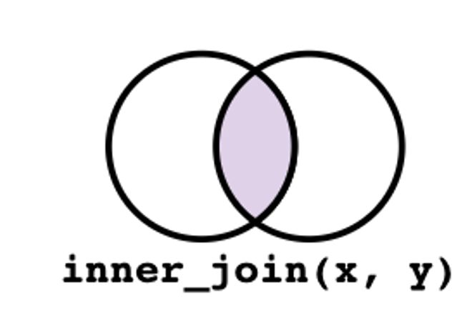
inner_join()
Gene | Count | Sample
Arid2 | 33 | A
Xist | 22 | B
Arid2 | 100 | A
Xist | 30 | C
Sample | Disease
A | Tumor
B | Normal
Gene | Count | Sample | Disease
Arid2 | 33 | A | Tumor
Xist | 22 | B | Normal
Arid2 | 100 | A | Tumor

Slide 29
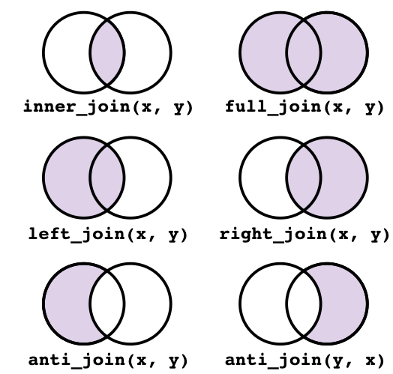
https://tavareshugo.github.io/r-intro-tidyverse-gapminder/08-joins/index.html
link to the license

Slide 30
Code examples

Slide 31
Class Practice
Load Duke vs UNC basketball data - data/duke_unc_hoops.csv
Make some plots to show which team is better
Use glimpse() to see an overview of the data frame (and data types)
Compare pre and post season ranking
Is there missing data? Why?

