Slide 1
RNA-seq in R
Enrichment Analysis
Jesse Raab - GNET/PHCO 749

Slide 2
Now that we have differentially expressed genes - what do we do with them?
Enrichment of biological process/pathways/function
There are far more methods and approaches to do these things than we can cover

Slide 3
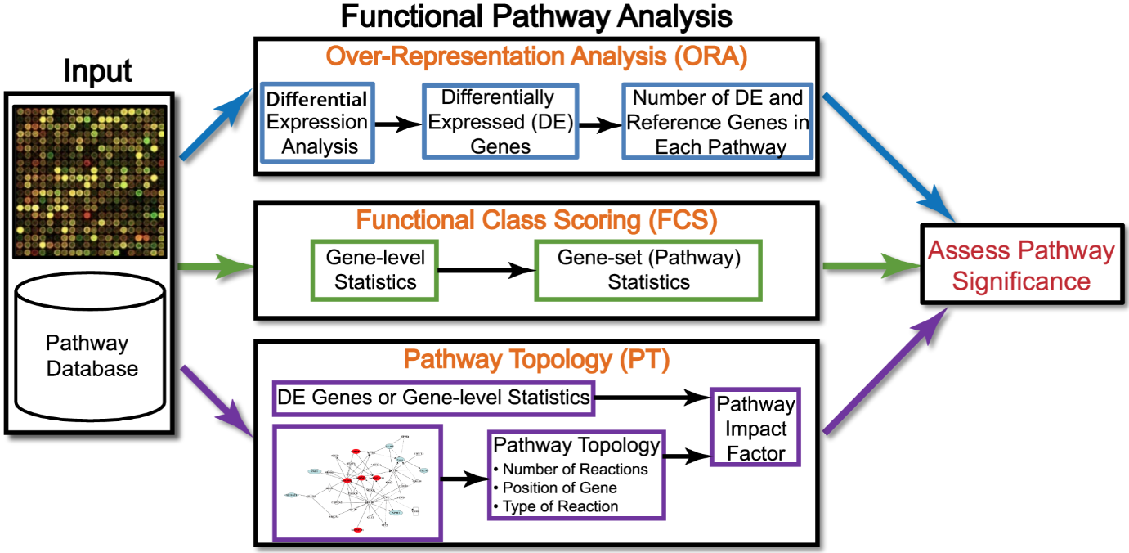
Ten years of pathway analysis: current approaches and outstanding challenges
Khatri, Sirota, and Butte 2012

Slide 4
Enrichment analysis
Many R packages and web servers available for these styles of analysis
msigdb - https://www.gsea-msigdb.org/gsea/msigdb/ or library(msigdbr)
clusterProfiler
GSEA (Gene Set Enrichment Analysis)
fgsea
singscore

Slide 5
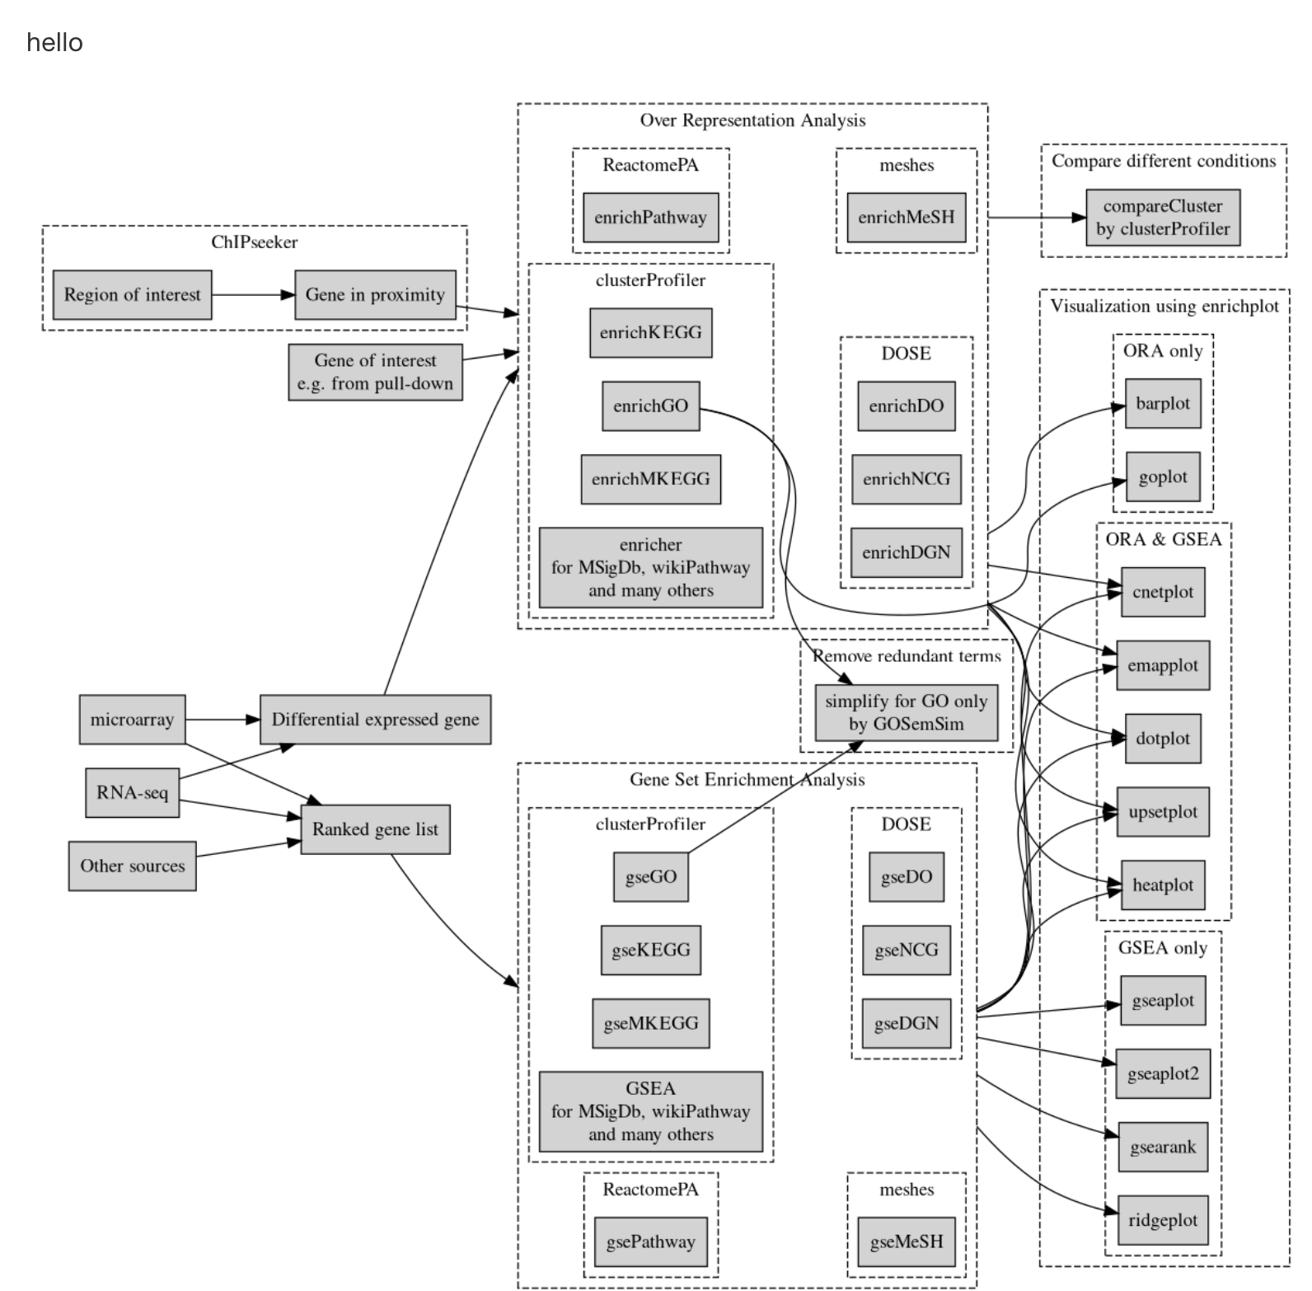
clusterProfiler
http://yulab-smu.top/clusterProfiler-book/

Slide 6
clusterProfiler
http://yulab-smu.top/clusterProfiler-book/
Over representation analysis
Takes a list of genes that pass some filter ( e.g. upregulated genes)
Pro: Computationally simple/fast
Con: Requires arbitrary thresholds

Slide 7
clusterProfiler
http://yulab-smu.top/clusterProfiler-book/
Gene set enrichment analysis
Takes ordered list of genes and expression values
Pros: Uses all genes, no arbitrary cutoff
Cons: Can be slower if using permutation testing
https://alexslemonade.github.io/refinebio-examples/03-rnaseq/pathway-analysis_rnaseq_03_gsva.html

Slide 8
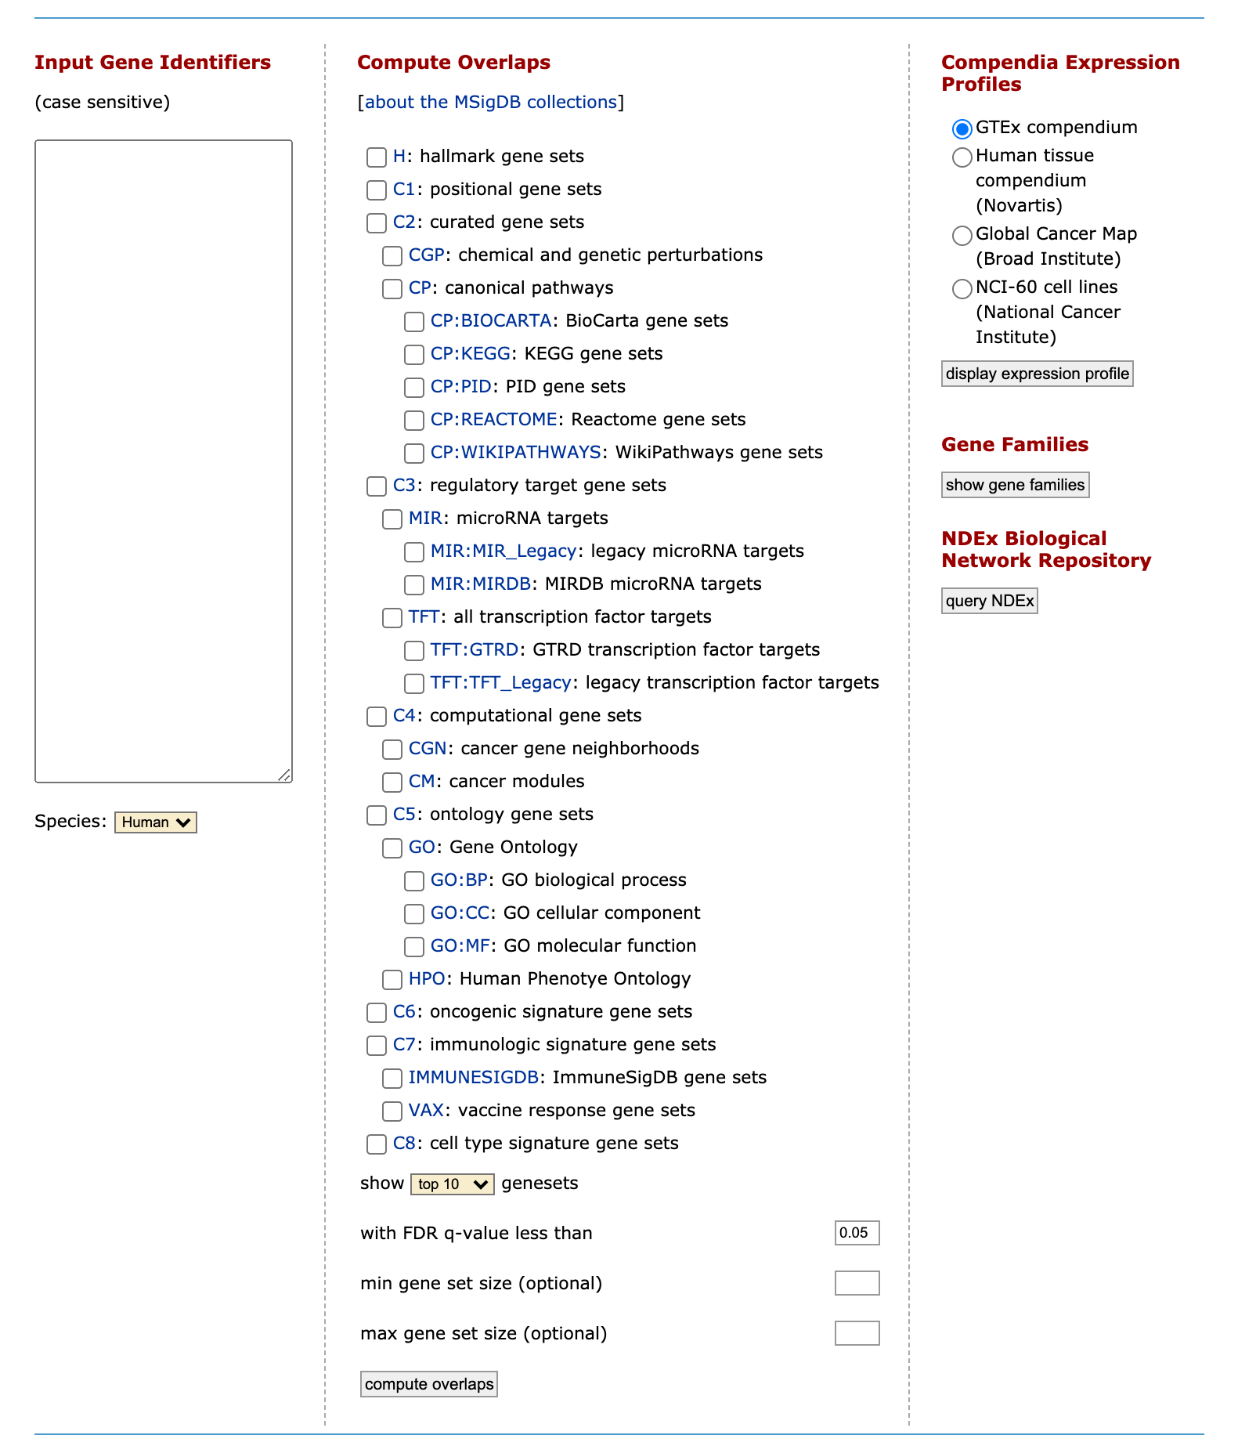
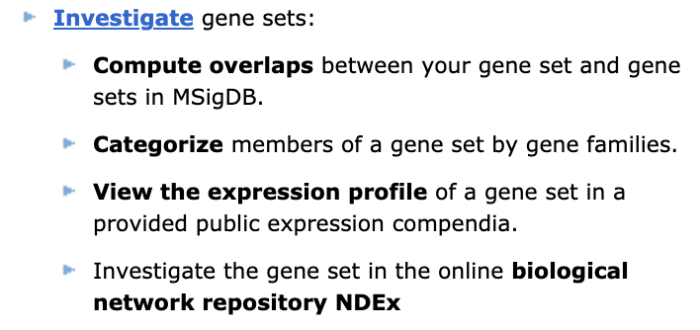
MSIGDB - http://www.gsea-msigdb.org/gsea/msigdb/index.jsp

Slide 9
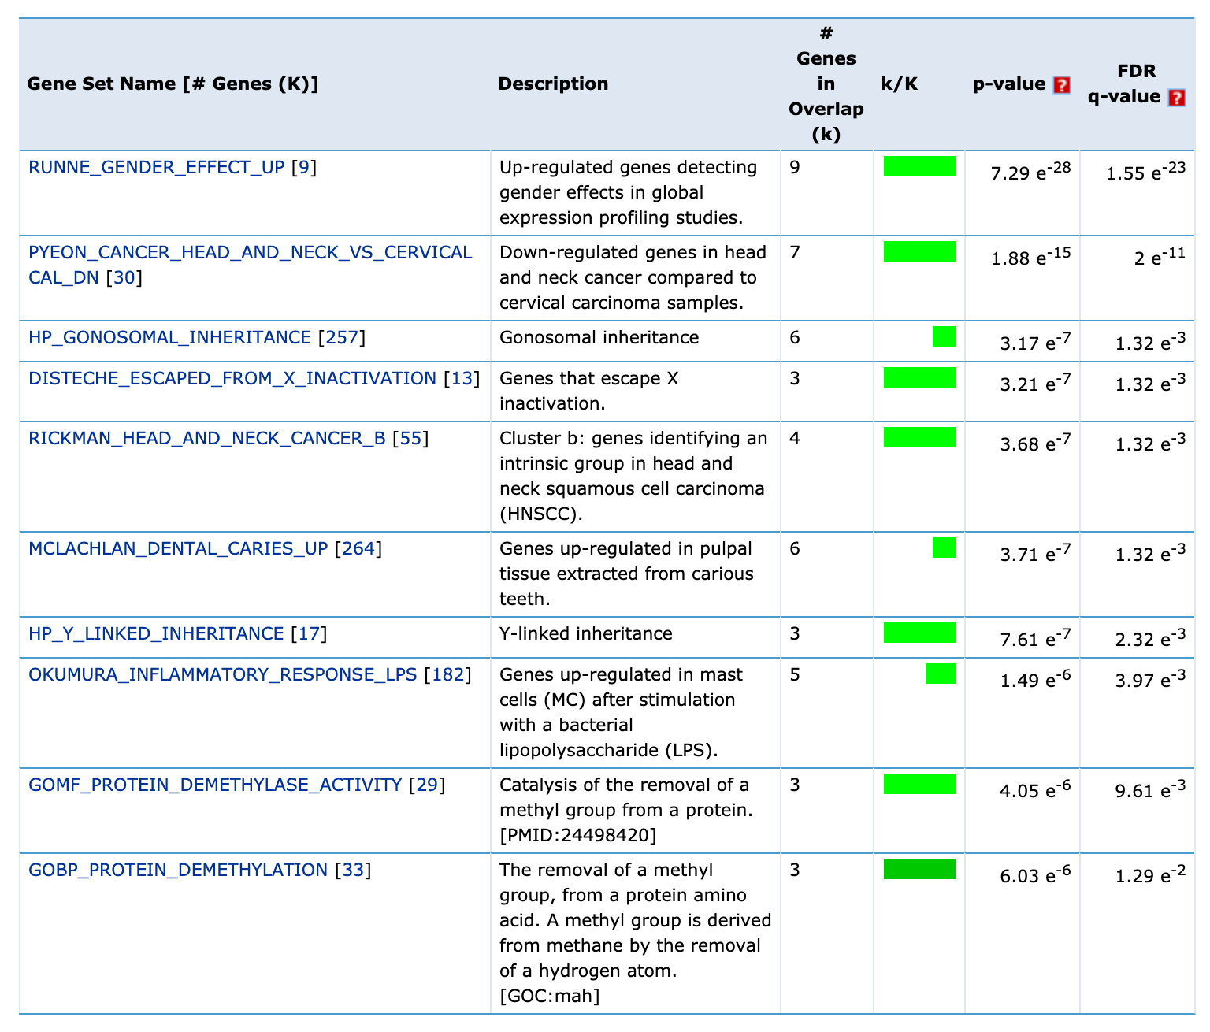
MSIGDB - http://www.gsea-msigdb.org/gsea/msigdb/index.jsp

Slide 10
Show code in R

