Slide 1
Project Setup and RStudio

Slide 2
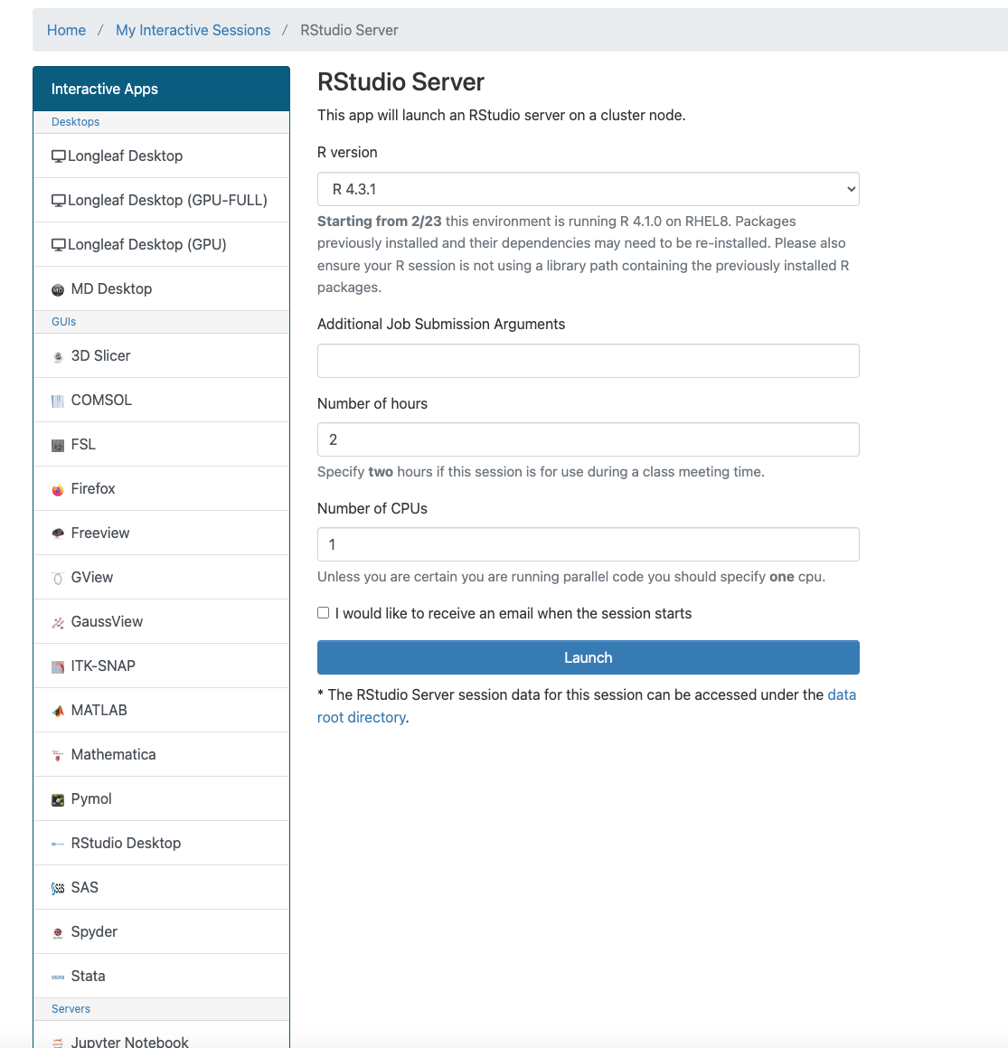
Start rstudio with these options on
ondemand.rc.unc.edu
Alternatively, just use rstudio on your laptop

Slide 3
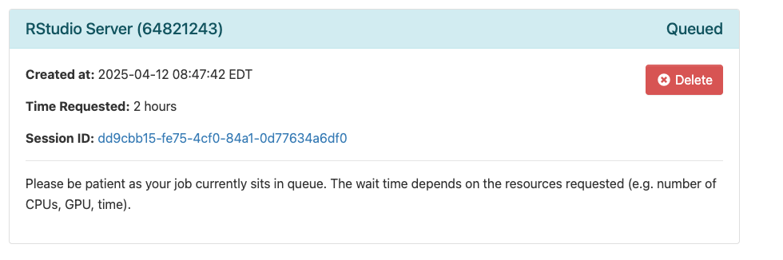
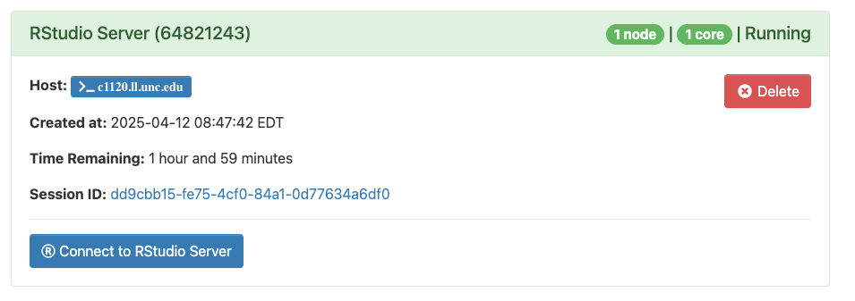
Wait for job to start
Click button to start

Slide 4
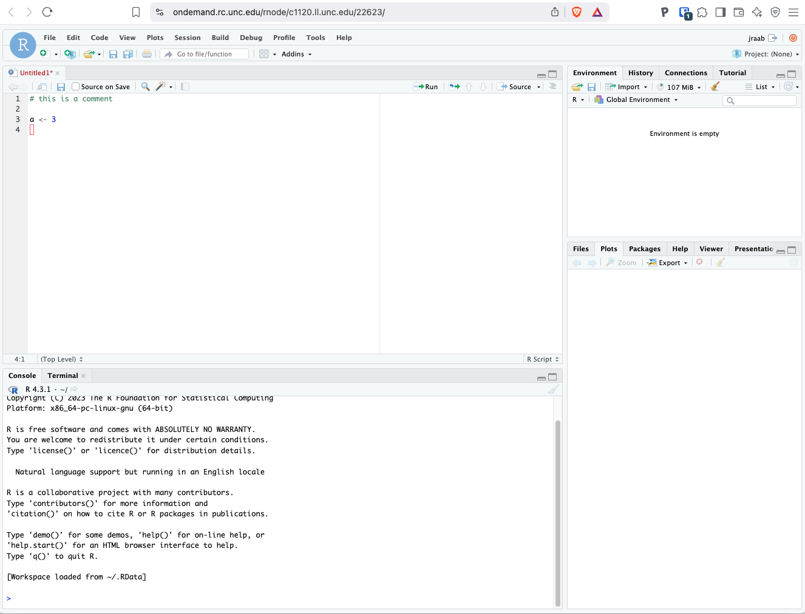
Click on Project
If you are working on your laptop and not on demand start here

Slide 5
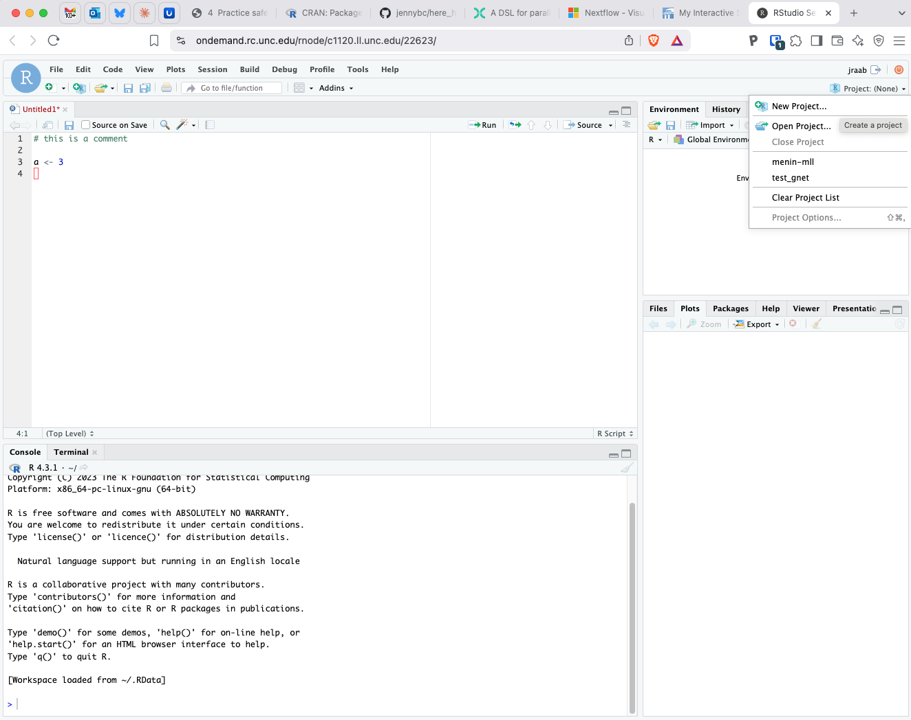
Select New Project

Slide 6
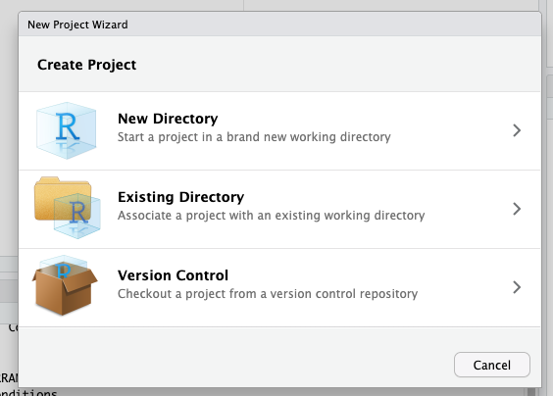
Select New Project

Slide 7
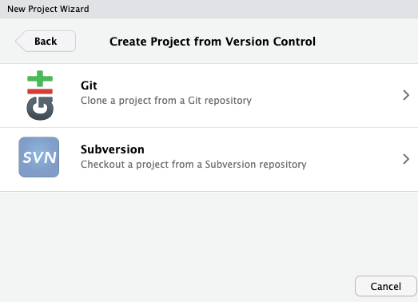
Select Git
If you don’t have git - this page has details
https://git-scm.com/book/en/v2/Getting-Started-Installing-Git
On Mac: open a terminal and type git —version
This will start the download and installation. It may take a while if you don’t already have Xcode
On Windows:
https://git-scm.com/download/win The installer is here
If you are working on ondemand you do not need to do this

Slide 8
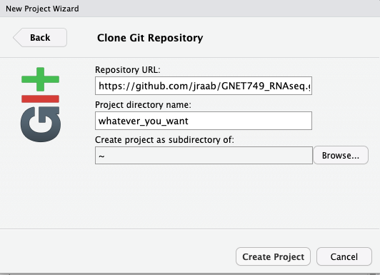
https://github.com/jraab/GNET749_RNAseq.git
Enter this url in the ‘Repository URL:’ Field
Name the project directory anything you’d like
Then click create project

Slide 9
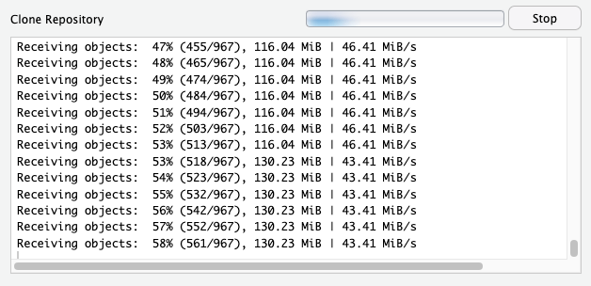
You will see lots of files being downloaded
This is all the code from the class

Slide 10
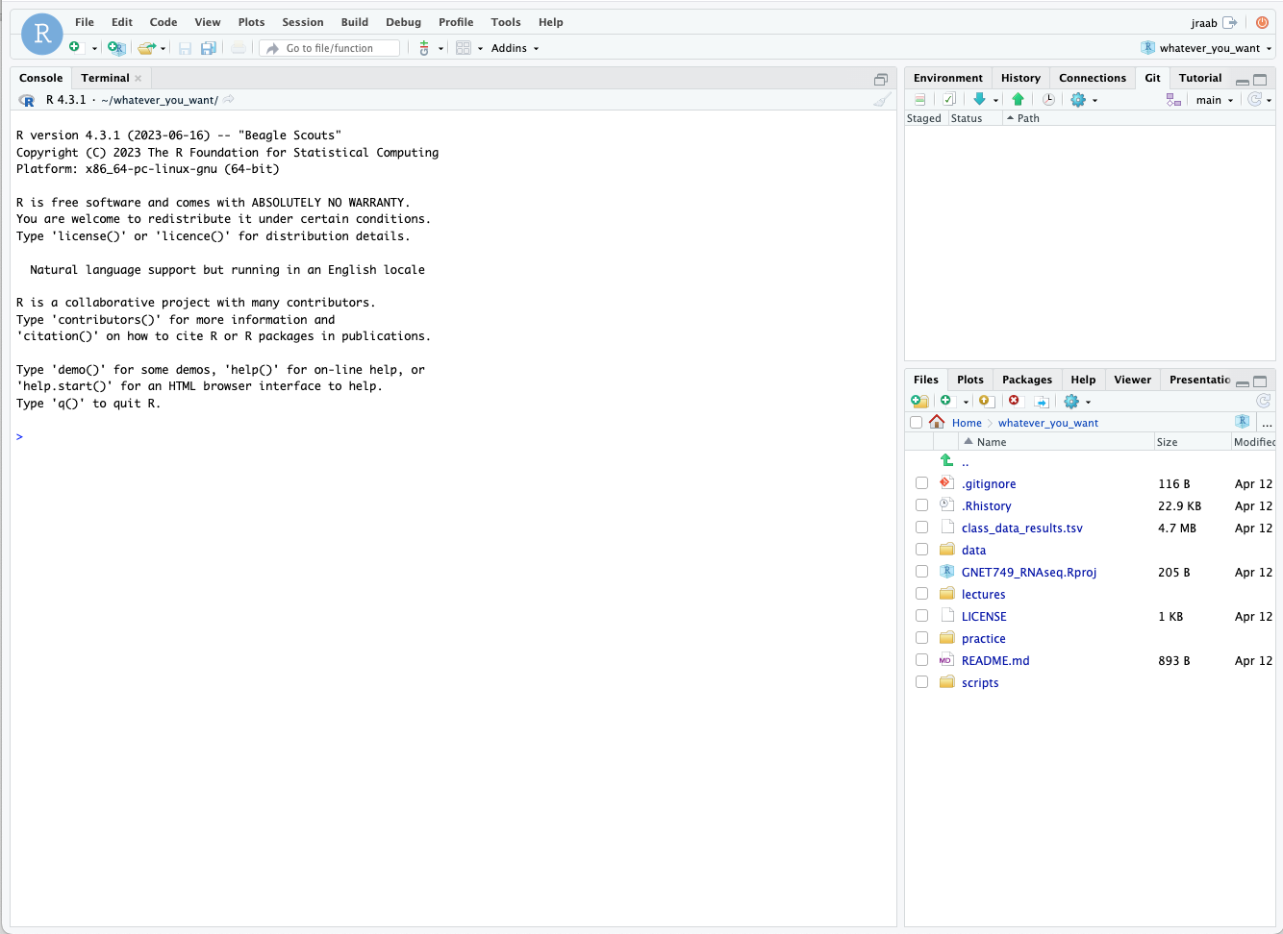
Project name

Slide 11
Files in
the project

Slide 12
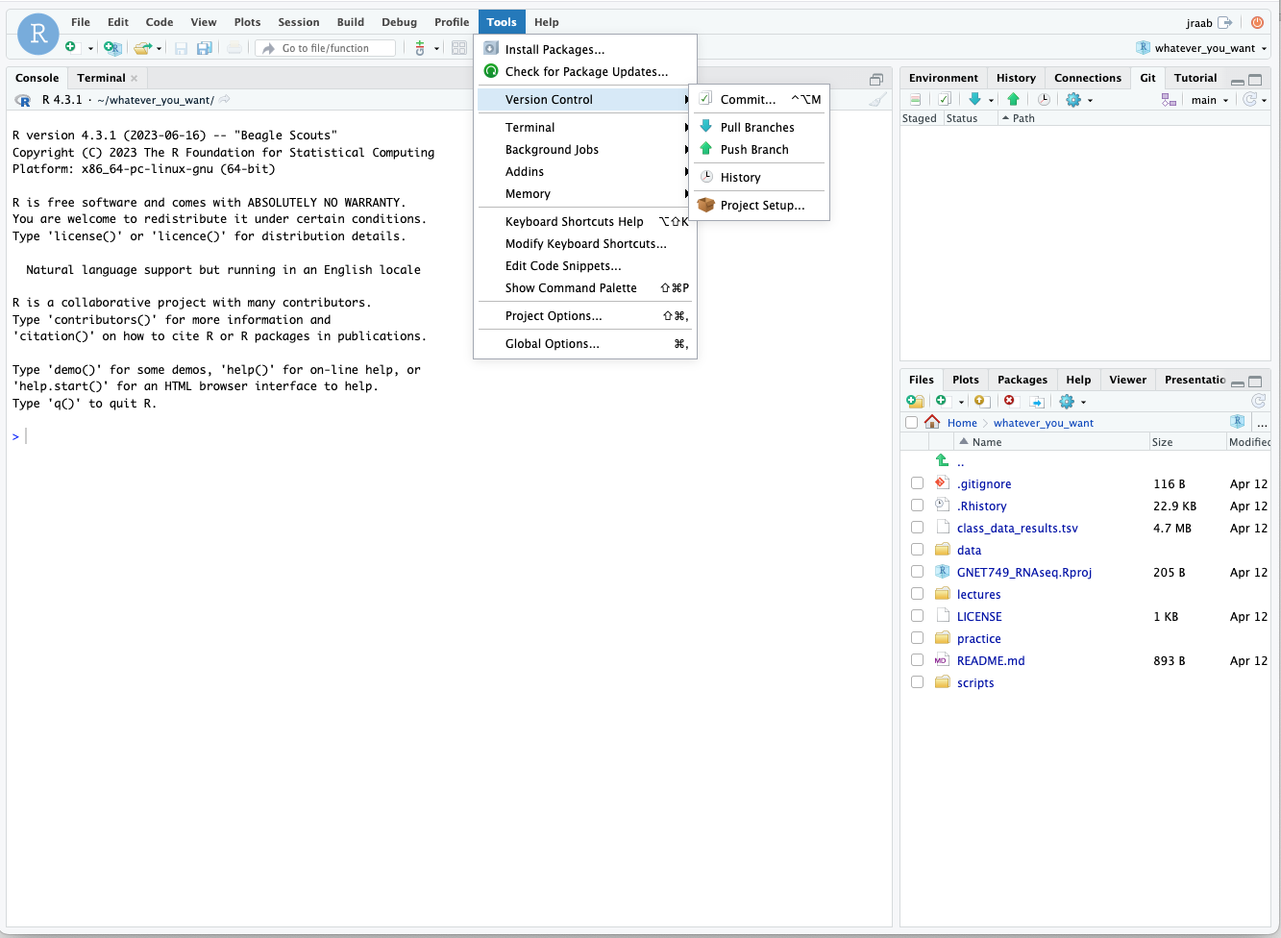
To get updates go to
Tools -> Version Control -> Pull Branches

Slide 13
To get updates go to
Tools -> Version Control -> Pull Branches
If you don’t see ‘Pull Branches’
You do not have `git` installed.
Go back to slide 7

Slide 14
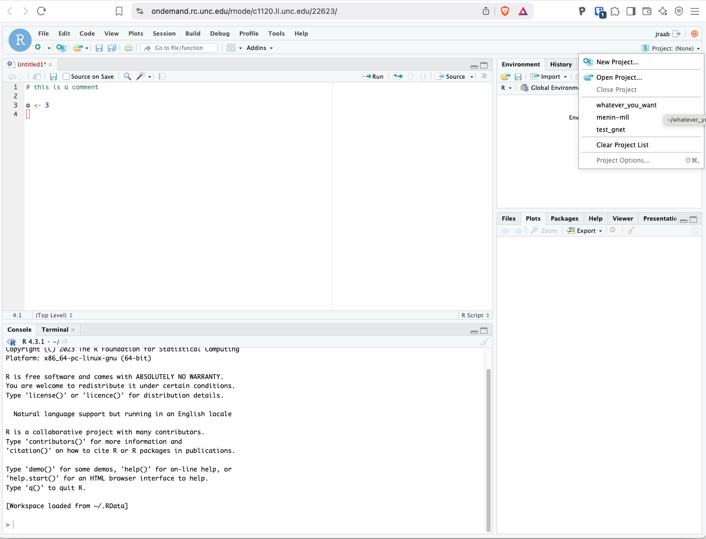
After restarting R or logging back into ondemand
You can find and open you project by clicking on the
Project tab

Slide 15
What is that .Rproj file
Rprojects
Why use projects
Consistent working directory
Simplifies file paths - using `here` package (here::here)
Integrates version control - use Tools->version control - pull branches
Reproducibility
Environment management -use `renv` package

