Slide 1
Quality Control and Data Visualization
Do experimental groups look right
Does number of reads make sense
Do replicates cluster together
Are there potential batch effects/biases
Full scripts in :
scripts/deseq_qc.R

Slide 2
Goals in RNA-seq Analysis
Samples
Genes
Raw Counts
Visualization/Quality Control
Differential Expression
DESeq2::vst()
DESeq2::rlog()
DESeq2::plotPCA()
DESeq2::plotCounts()
ComplexHeatmap::Heatmap()
DESeq2::DESeq()
DESeq2::results()
R code for Differential Expression
Full annotated methods in salmon_DE.R
Notes:
So now that we have our data into a DESeq object we can do either of these two paths, and we need to do both. I’m going use the time we have left to show some visualization/quality control things about our data.
Next time we’ll do the differenetial expression side, work through that code and talk about what DESeq is actually doing

Slide 3
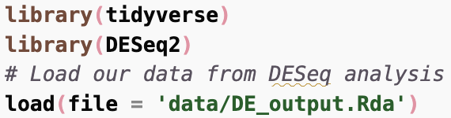


Quality Control and Data Visualization
Loads 2 objects (des and res) from previous script salmon_DE.R

Slide 4
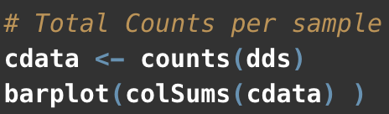
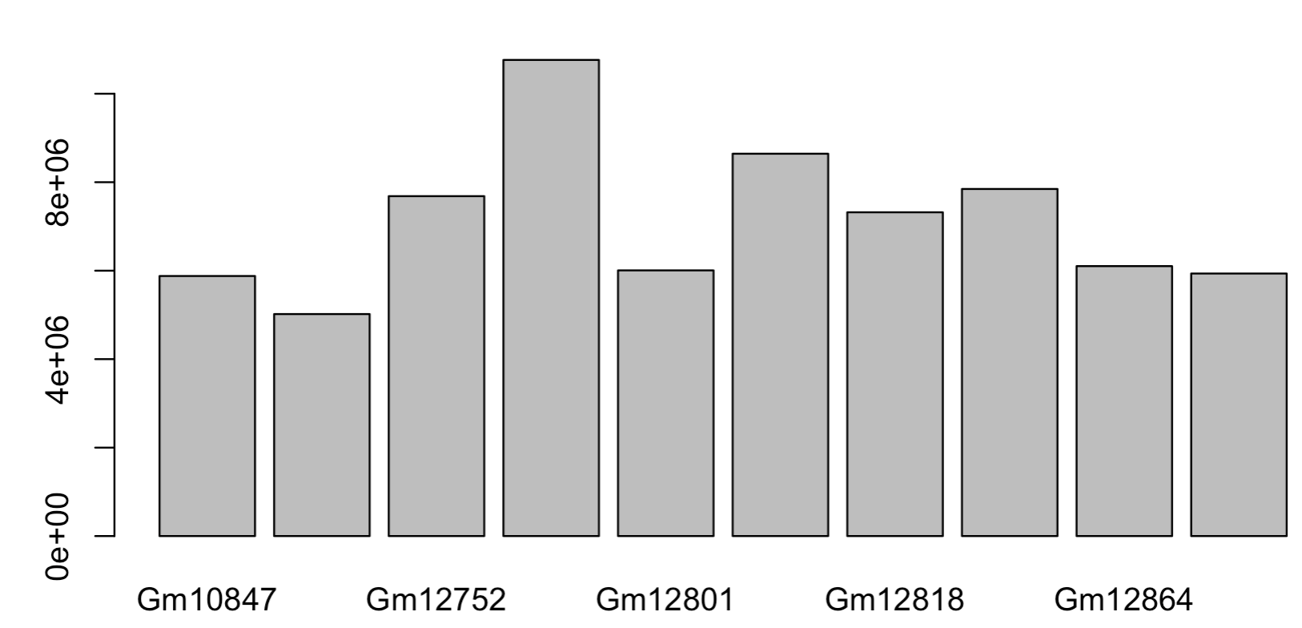
Total counts per sample
Do any samples have an unexpectedly high or low number of reads?

Slide 5
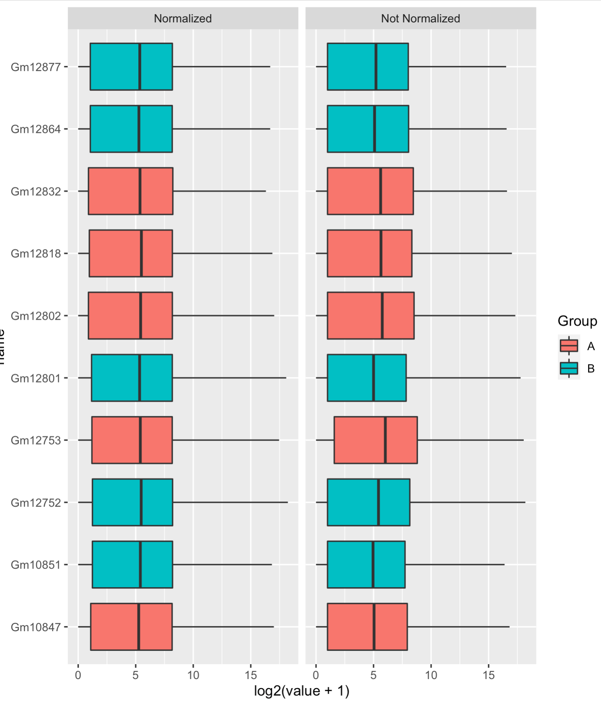
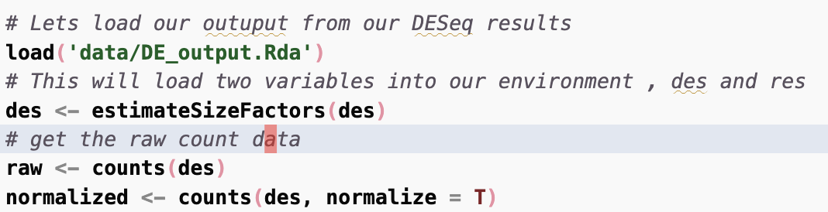
Normalized using DESeq
Notes:
Trrying to evaluate if there are any imbalances in the data or groups we should take note of.
On the right side is the non-normalized raw count data (this will be the input do DESEq analysis next time). The left side is normalized data where we’ve taking the count matrix back out of the DESeq object and normalized it using the sizefactors DESeq estmiates.
This is probably not the best way to do this, and DESeq includes two better approaches rlog and vst which are useful when you want to do clustering or anything related to distances between samples.

Slide 6
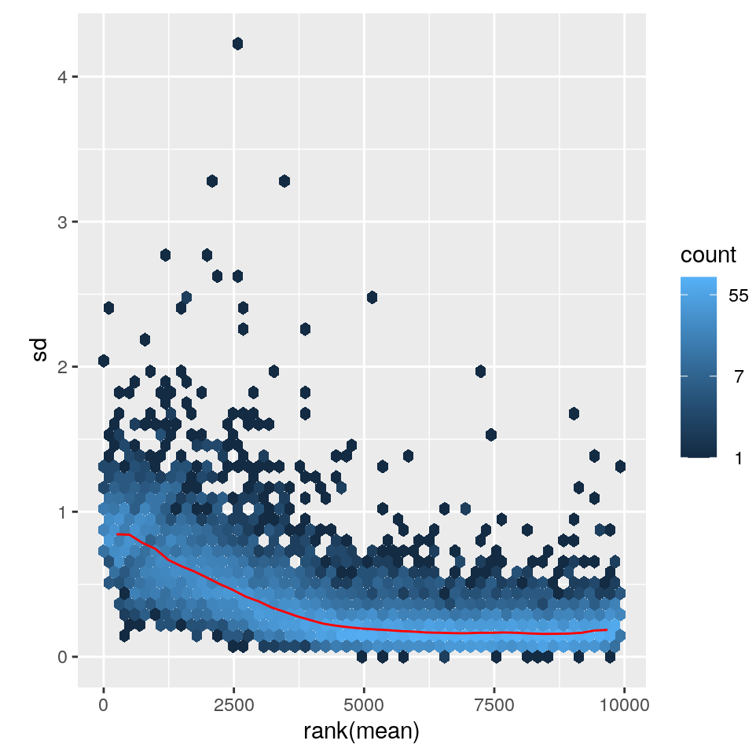
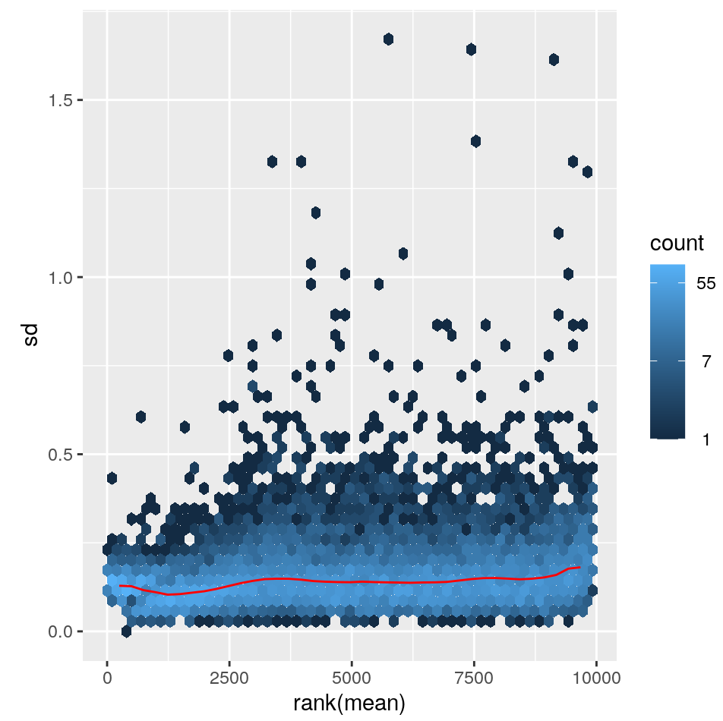
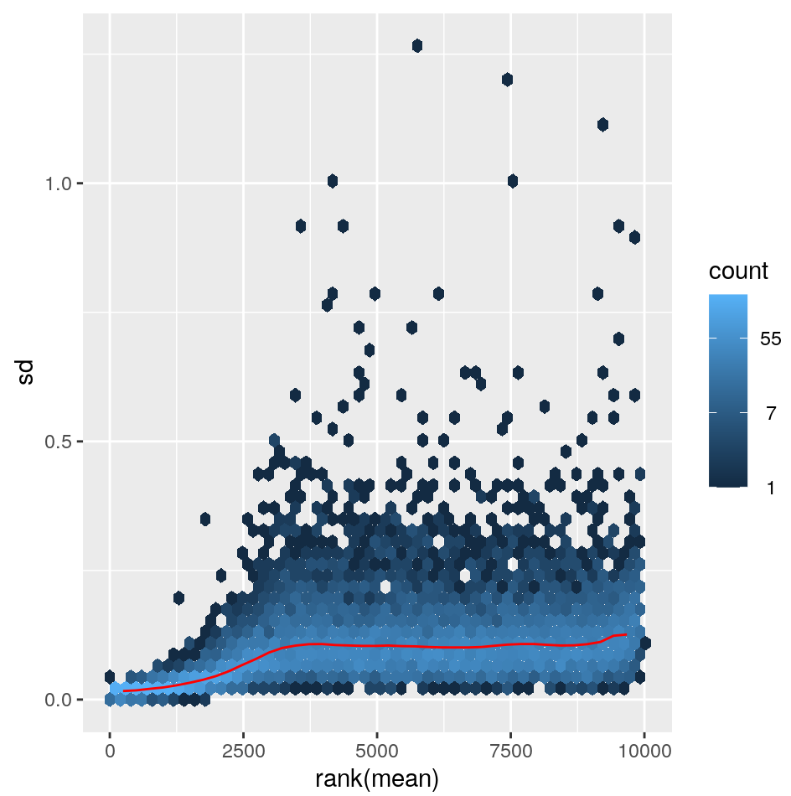
Data transformations – how to transform data for visualization purposes
Log2(n+1)
vst
rlog
https://bioconductor.org/packages/release/bioc/vignettes/DESeq2/inst/doc/DESeq2.html#data-transformations-and-visualization
Notes:
One problem we are trying to solve with normalization approaches is correting for library size - the other major problem is that the variance of a gene depends on its mean. I took these plots from the DESEq2 manual at the bottom.
bThis means that low expressed genes have high standard deviations of expresion. Ideally you’d want to have constant variation across expression range. The first plot is just the log2 value of the counts. You can see low expressed genes have higher standard deviations.
VST fixes this and you get relatively constant sd across the expression range
Rlog also flattens this in the low end, but possibly a bit too much. I think both vst and rlog are likely appropriate for most analyes, but vst is a little faster.

Slide 7
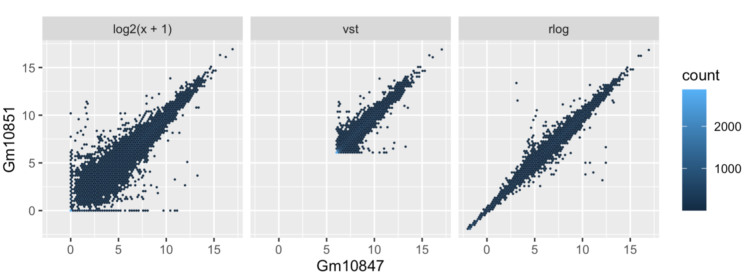
A better way - rlog and VST
Sample2
Sample1
Sample1
At low expression
Noise is dominating
Better,
shifts expression of lower expressed genes
Shrinks low counts
Notes:
We can compare two samples using these plots as well. This also comes form the DESEq2 manual. Here we are comparing two samples that we’ve transformed using one of the three prevouis methods
I think you can really appreciate how noisy the shifted log version is - the low values are just all over the place due to noise of counting those weakly expressed genes.
vst is faster and maybe is then better for bigger data sets,but might be a bit more sensitive to outliers. - while rlog might work a bit better on small datasets, but isn’t as good if you have a huge range of sequencing depth (like more than an order of magnitude)
You can try both but they should give relatively similar results
These are important as the variance of your data will increase as the mean does. These variances will dominate princple components and other visualization methods.

Slide 8
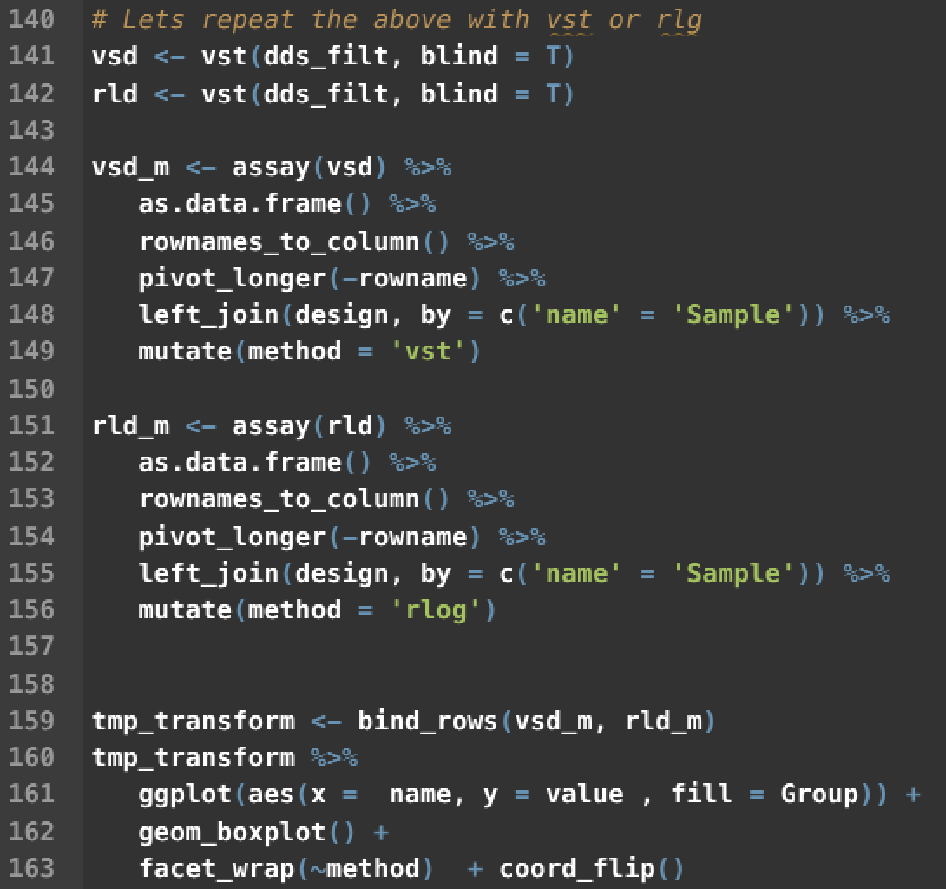
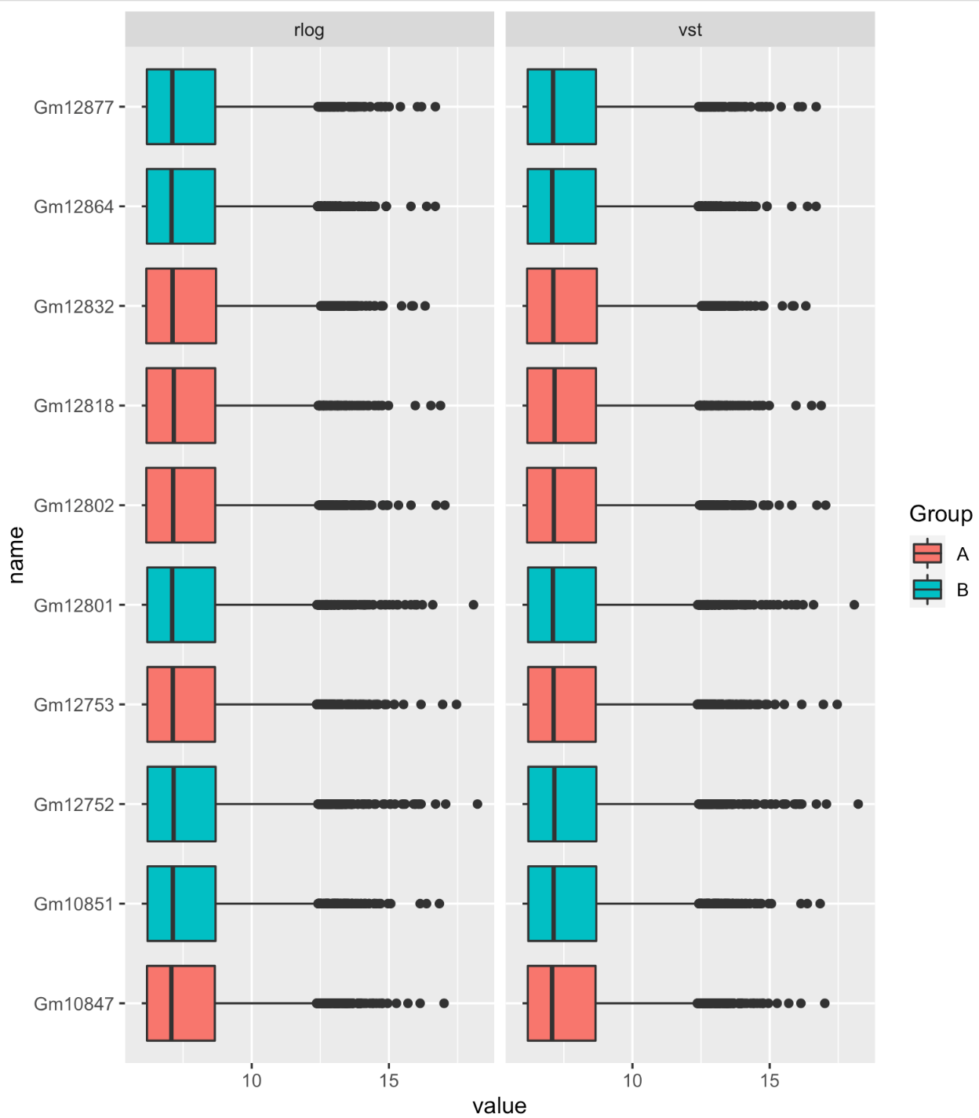
vst and rlog transformations
Notes:
These functions are described well int he DESeq documentation, both do roughly equivalent things, vst is faster and is the one I usually use.
Walk through code -
SO you can see for both vst and rlog the normalzied data look relatively simialr and there are not obvious gorup differences remaining after this transformation. That doesn’t mean there are no biases or batch effects, but nothing very obvious jumps out to me here.

Slide 9

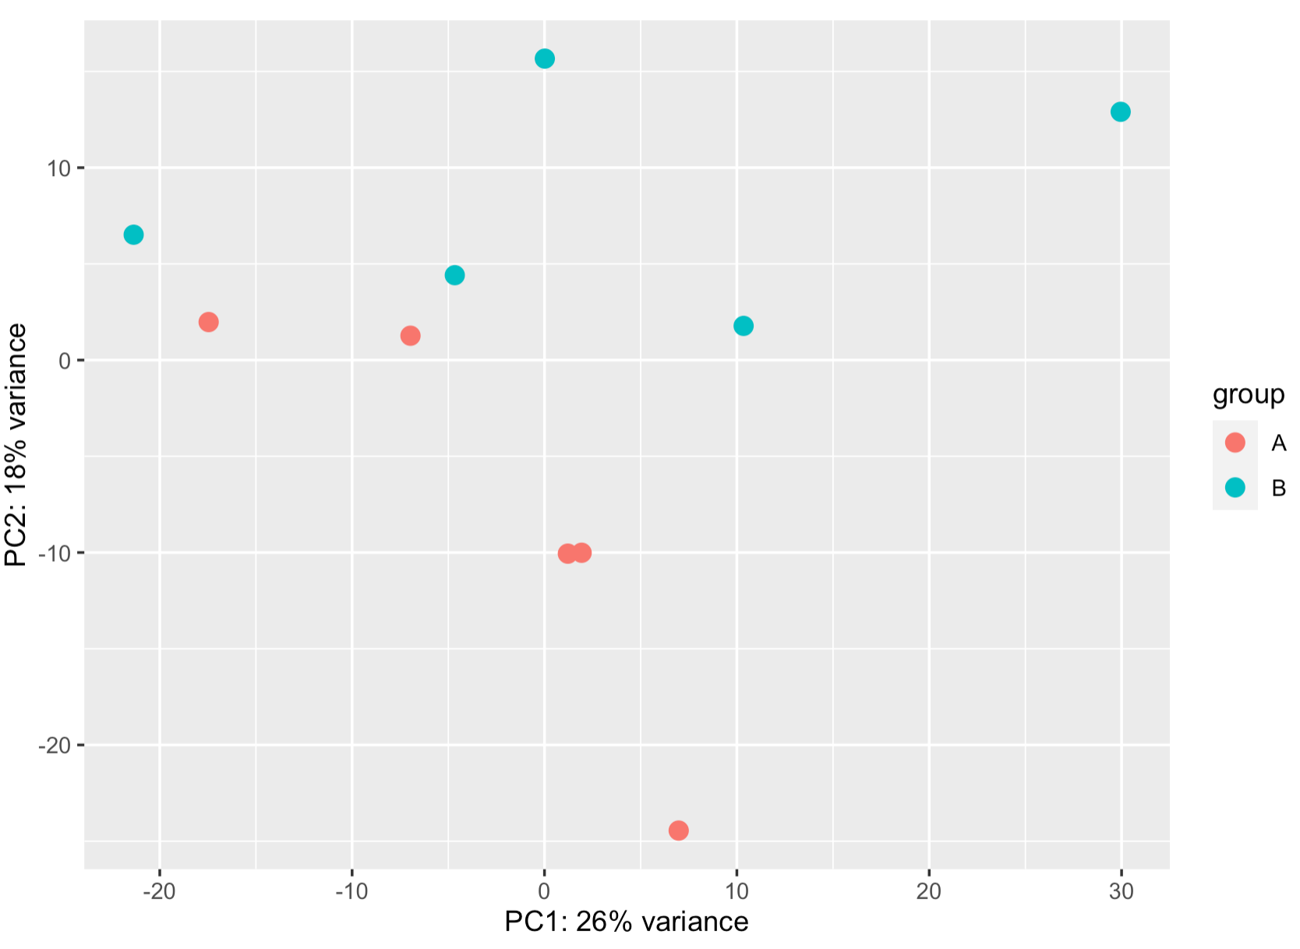
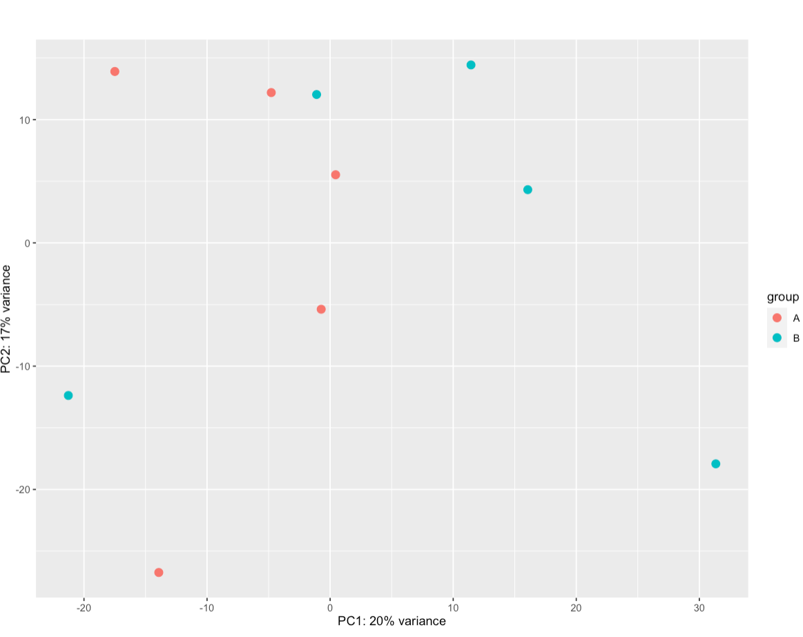
VST

Slide 10
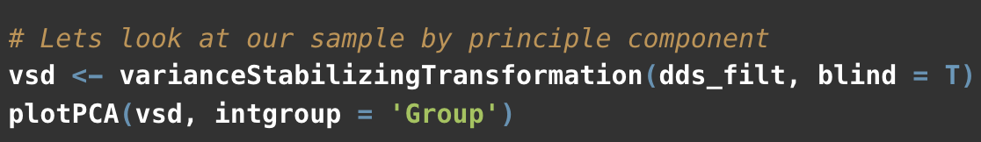
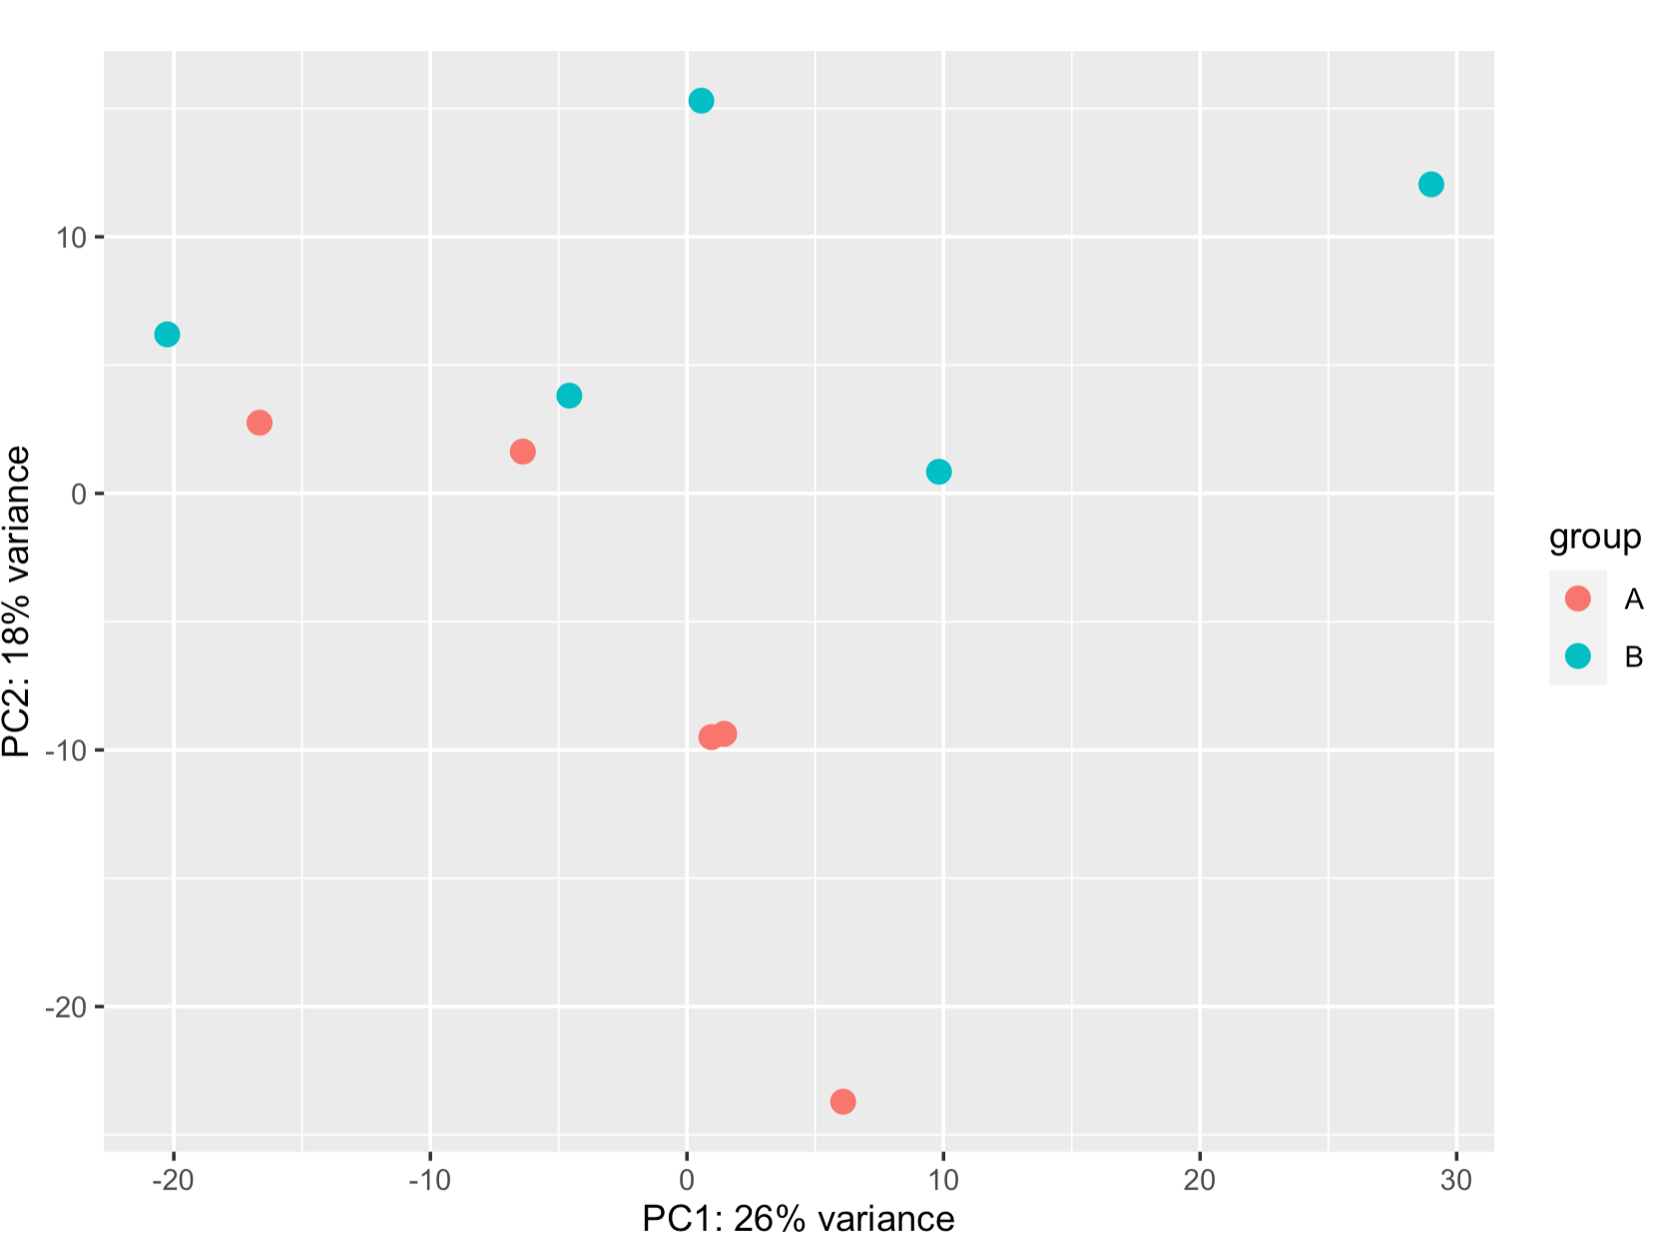
blind = T
blind = F

Slide 11

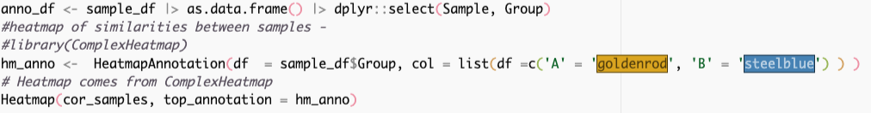
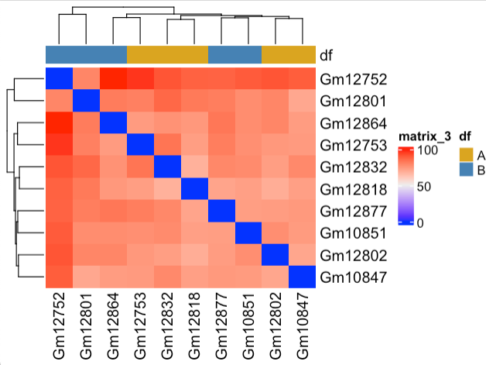
Sample Clustering
Notes:
What you’re looking for hear is that samples cluster based on replciates. Pretty clearly we aren’t getting very good cluster separeation. Next time we’ll look for hidden batch effects to see if that can improve clustering - and then move on to DE analysis.

Slide 12
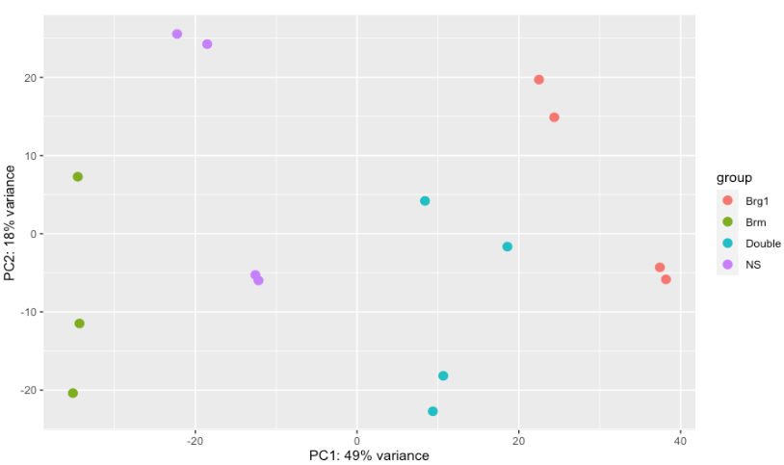

QC examples

Slide 13
QC examples
Clustering is OK, but not perfect

Slide 14
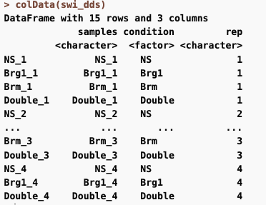
QC examples
Clustering is OK, but not perfect

Slide 15
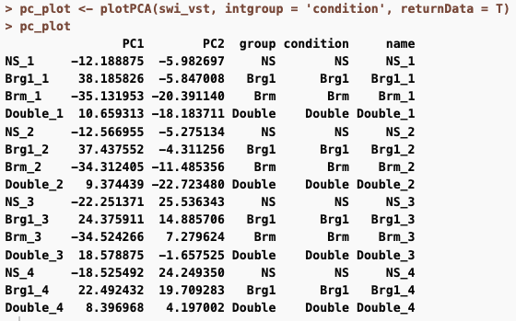
Data from the PCA plot can be returned

Slide 16
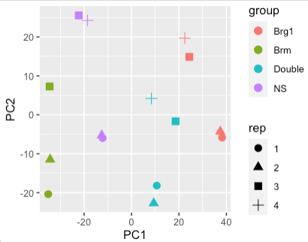
Some replicates always cluster together
Evidence of a batch effect

Slide 17
Code for deseq_qc.R

Slide 18
How to deal with batch effects

Slide 19
Data sets to illustrate
GSE102560 - shRNA KD of SWI/SNF subunits in human
data/GSE102560.Rda
4 Groups - NS, Brg1, Brm, Double KO
Notes:
The count table for this will be on Sakai - which I downloaded directly from GEO

Slide 20
Batch effects
Sample | Condition | Batch
1 | A | X
2 | A | X
3 | B | Y
4 | B | Y
Notes:
These can occur when yoiu process different samples at different times. You can control for this, and remove them from the data if you carefully plan and designyour epxeriment.
This would be bad, our batches and conditions are confounded. We’ll never be able to remove the batch effect.

Slide 21
X
Batch effects
Sample | Condition | Batch
1 | A | X
2 | A | X
3 | B | Y
4 | B | Y
Sample | Condition | Batch
1 | A | X
2 | B | X
3 | A | Y
4 | B | Y
Notes:
This is much better - now each of your batches has both of your conditions. If there was an issue between batches that affected what you were measure, you likely can control for it. (Of course a real experimetn should have more than two replicatse.

Slide 22
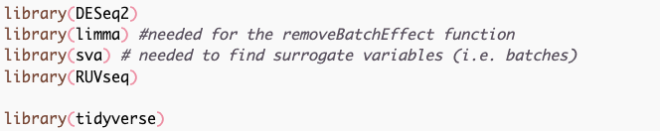
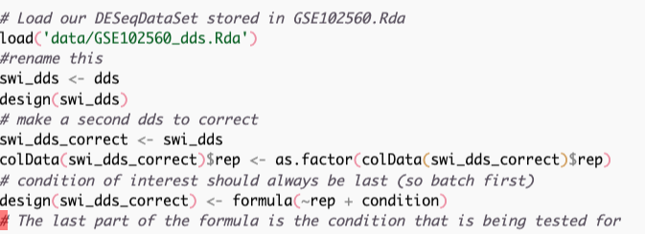

Slide 23
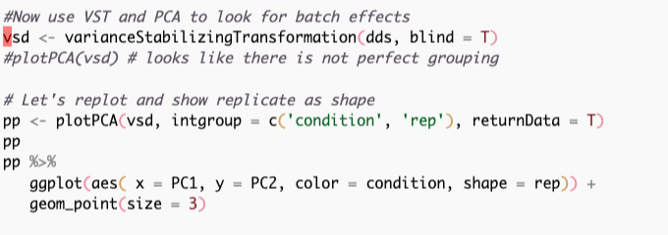
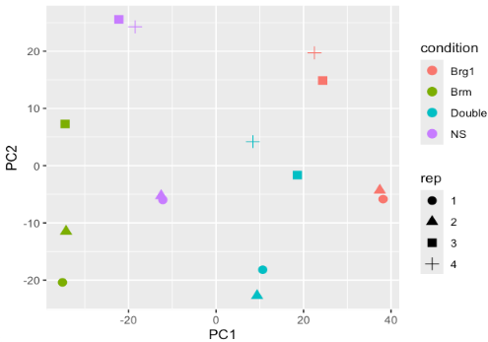
PC Plot including batch and condition
Notes:
so we can see evidence of different batches here - the plus and squar (reps 3 and4 ) seem to be closer than the circle and triangle (1,2) possible we prepped those libraries in two batches of two biological replicates each.
Including batch as a covariate in the design formula lets us account for this in our differential exprsesion results.

Slide 24
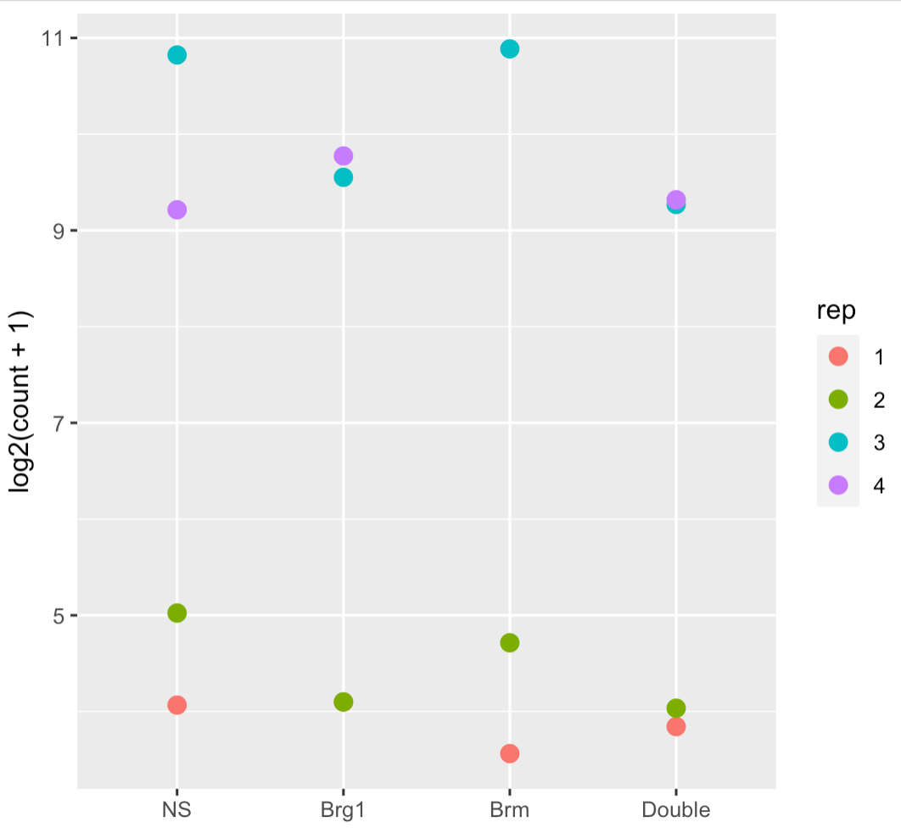
Strong difference between replicates
But no difference between conditions
MT1G

Slide 25
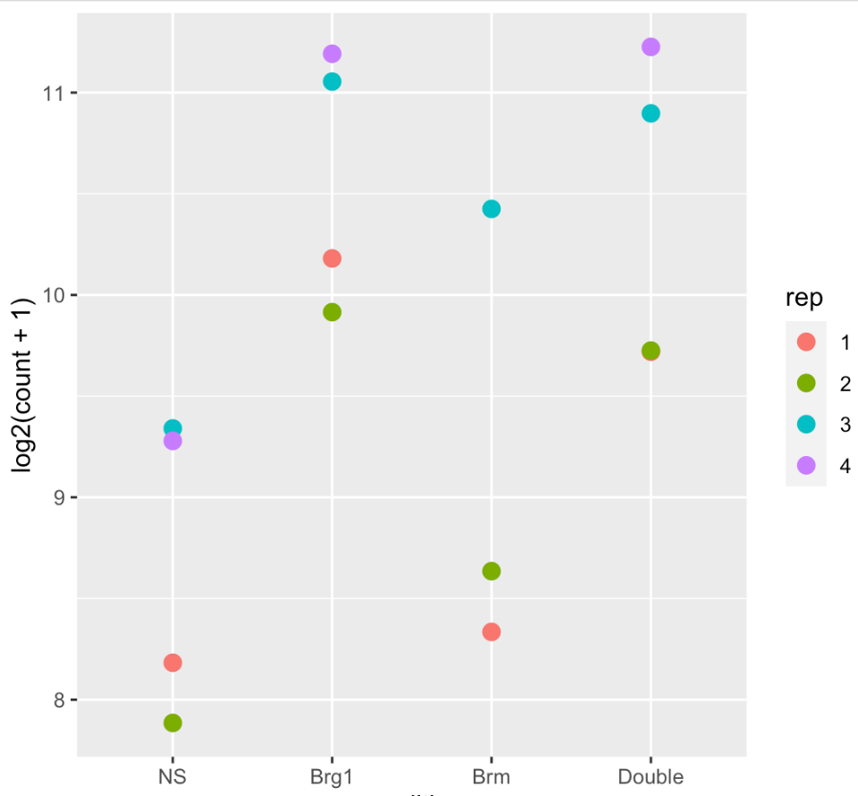
Strong difference between replicates
But no difference between conditions
Strong difference between replicates
Still difference between groups
MT1G
CDC42EP2

Slide 26
How to handle Batch Effects
The easy way - we know which samples came from which batches
Differential expression - account for them in the DESeq design formula - Does not change underlying data
DESeqDataSet(counts, colData, design = ~ batch + condition)
Visualizing- correct the matrix to remove the effect
assay(vsd) <- limma::removeBatchEffect(assay(vsd), batch = vsd$rep)
This alters the data in the variance stabilized matrix based on the batch information in the replicate column of our design matrix
Notes:
The easy way is to model them directly into DESeq2 or however you are doing your experiment.
This essentially includes batch as a term in your design matrix. Its important to ahve batch listed first here as the last term is the effect you are interested in.
If you want to go back to count data and remove it you can use the limma package’s function removeBatchEffect

Slide 27

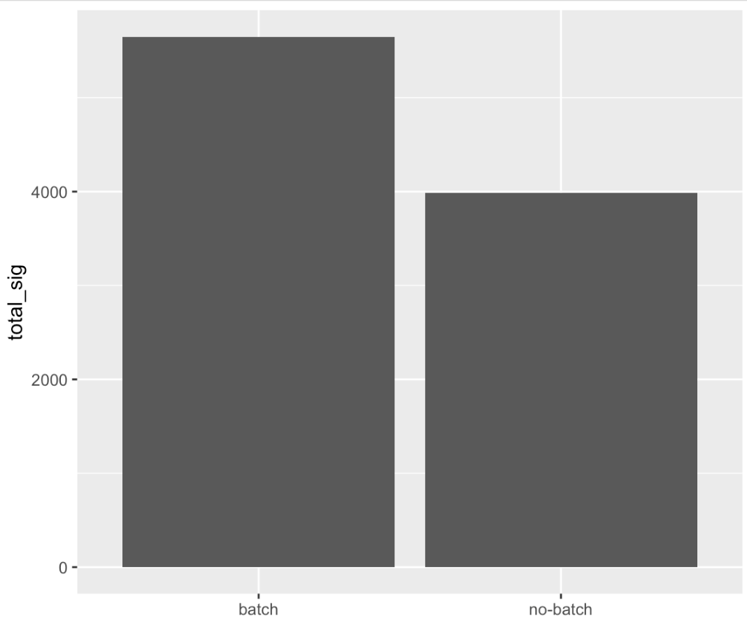
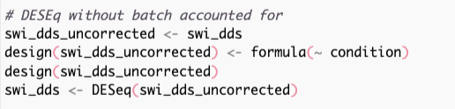
How does accounting for replicate impact results?
With batch
Without batch
Notes:
you can see an incrase in power here when we account for the batch effects we observed. Since we know the replicates this is more straightforward.

Slide 28
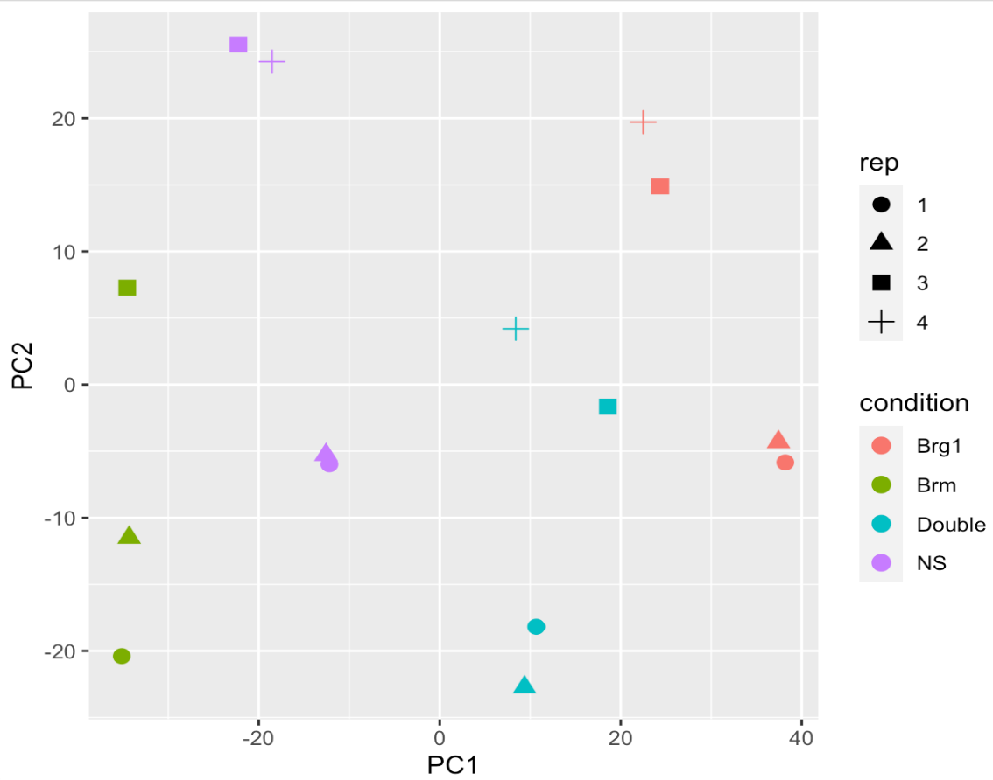
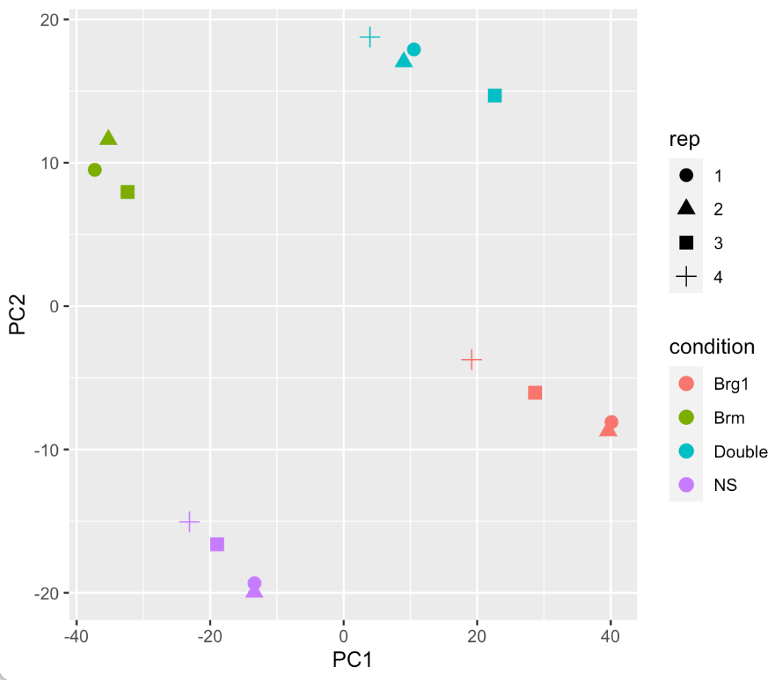
limma::removeBatchEffect()
no correction
correction
Notes:
Lets go back and see if we can fix the pca plot by removing the batch effect - note accounting for the batch affect in DESEq does not change the underlying data at alll - here , we are actually altering our counts to remove that effect, don’t use what we do here for DE, this is just for visualizing.
After removing batch effect you can now see much better clustering of our samples - consistent with the increase in power we observed.

Slide 29
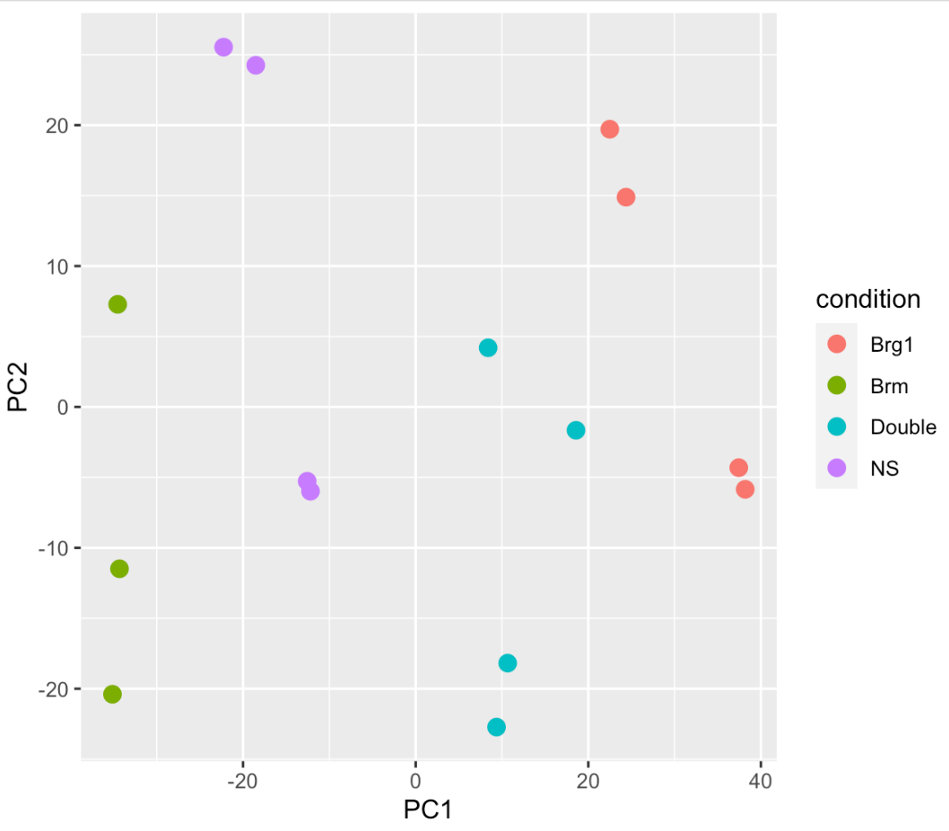
Finding Batch Effects
What if you don’t know the batches, but suspect there is a batch effect?
Notes:
lets look at our uncorrected PCA plot again - now our clusters aren’t as good and its not obvious there is a batch effect - different groups aren’t right on top of each other, but for example, these 2 NS are closer in PC2 to some none NS samples - so maybe we should look for these effects. There are (as you may have begun to see a pattern), multiple ways to do this. Two common are RUVseq and SVA for remove unwanted variation and surrogate variable analysis. RUVSeq works especially well if you have some known set of genes to use as controls, although all genes works. I’m going to demonstrate SVA - but both of these attempt to find a new variable that would explain some of the differences.

Slide 30
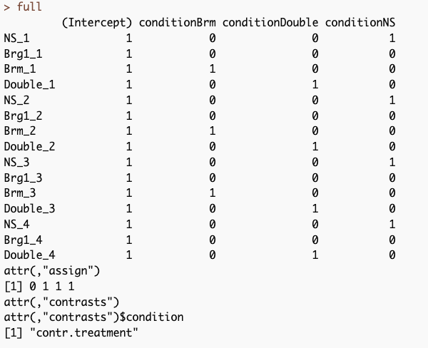
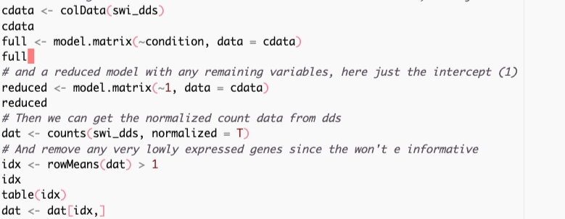
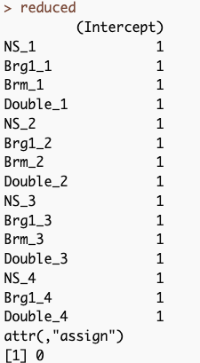
Finding unknown variation/batch effects
package - sva
* could also use RUVseq or comBat
Specify two models
full = ~condition {the effect(s) we care about }
reduced = ~1 { everything else , here just the intercept }
Notes:
we need to have two models one that contains all our variables and one that just contains our variable of interst - so in our case we only have our condition variable (remember we’re blind about the batch variable here) - our reduce model is then just the intercept (removing that condition variable)

Slide 31
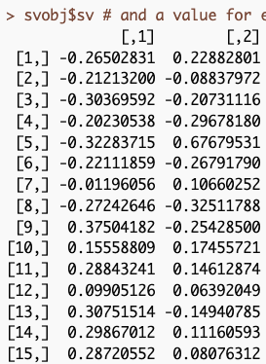

Finding unknown variation/batch effects
package - sva
* could also use RUVseq or comBat
Specify two models
full = ~condition {the effect(s) we care about }
reduced = ~1 { everything else , here just the intercept }
Surrogate Variables
They can be incorporated in to our design just like any other variable
Notes:
we need to have two models one that contains all our variables and one that just contains our variable of interst - so in our case we only have our condition variable (remember we’re blind about the batch variable here) - our reduce model is then just the intercept (removing that condition variable)

Slide 32

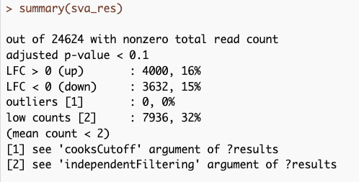
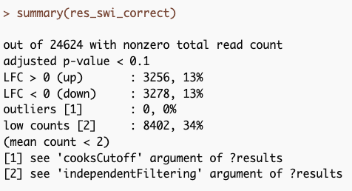
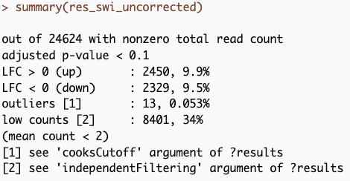
Finding unknown variation/batch effects
Notes:
Now we can use these new surrogate variables in our differnetial expresssion analysis

Slide 33
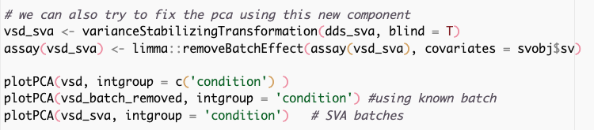
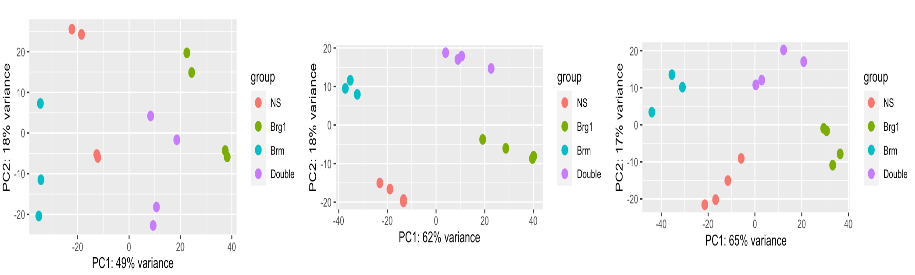
We can use the surrogate variables to correct the actual counts, just like we did with known batches before
uncorrected
known batches
surrogate variables

Slide 34
How do we know these methods are actually working?
Controls!

Slide 35
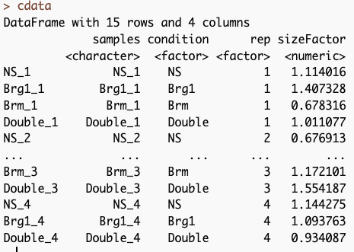
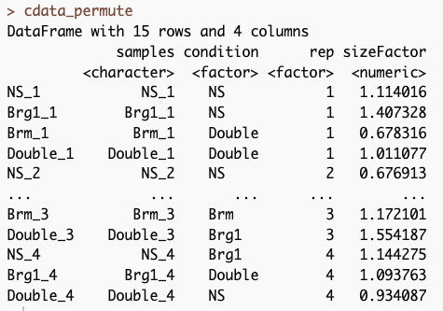
Permute your sample labels and test
Correct
Shuffled
redo svaseq using
the incorrect design matrix

Slide 36
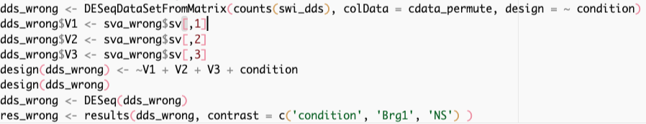
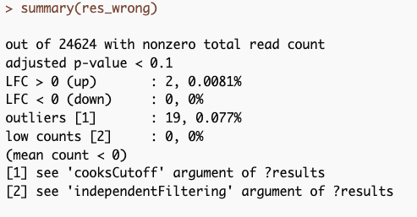
Add the surrogate variables to our DESeqDataSeq
Run the DESeq analysis
Extract Results
Correct
Shuffled

Slide 37
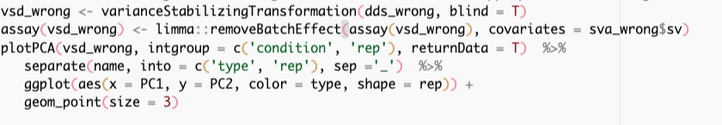
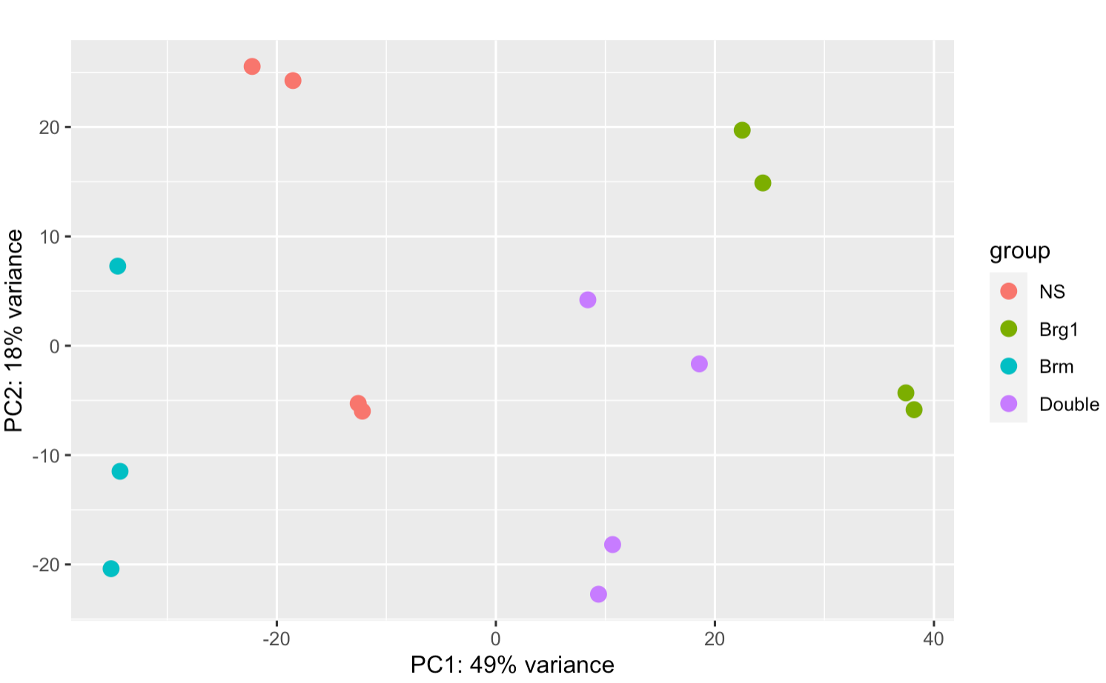
We can use the same approach to look at PCA plots
corrected
Original Data

Slide 38
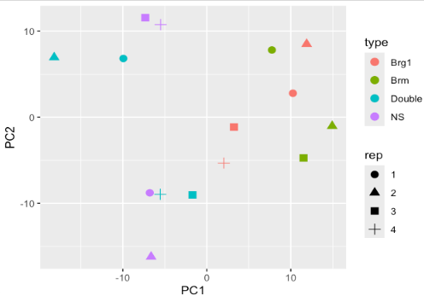
We can use the same approach to look at PCA plots
corrected
Permuted Data
Corrected - using permuted condition labels

Slide 39
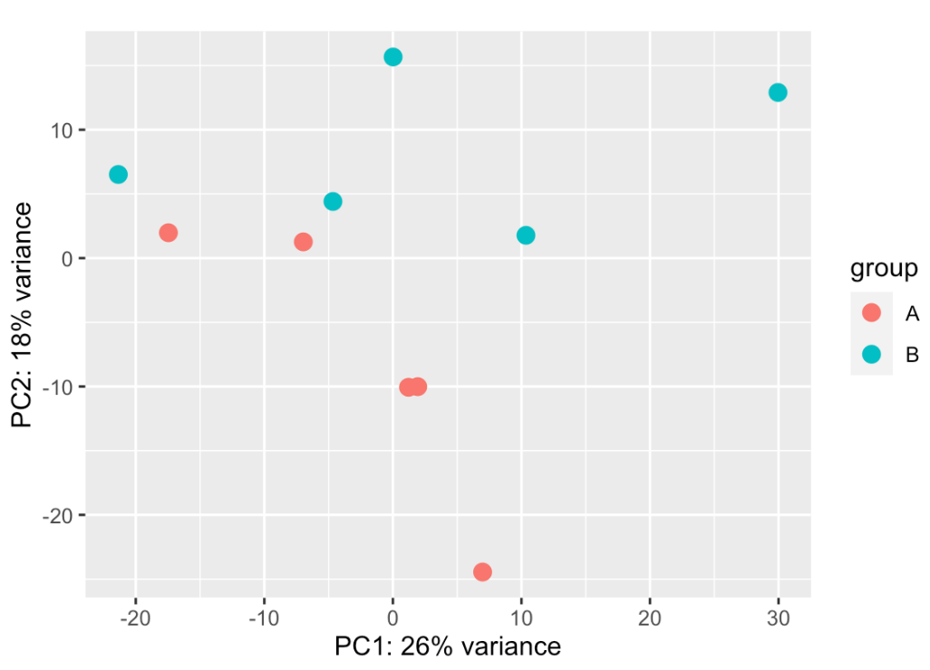
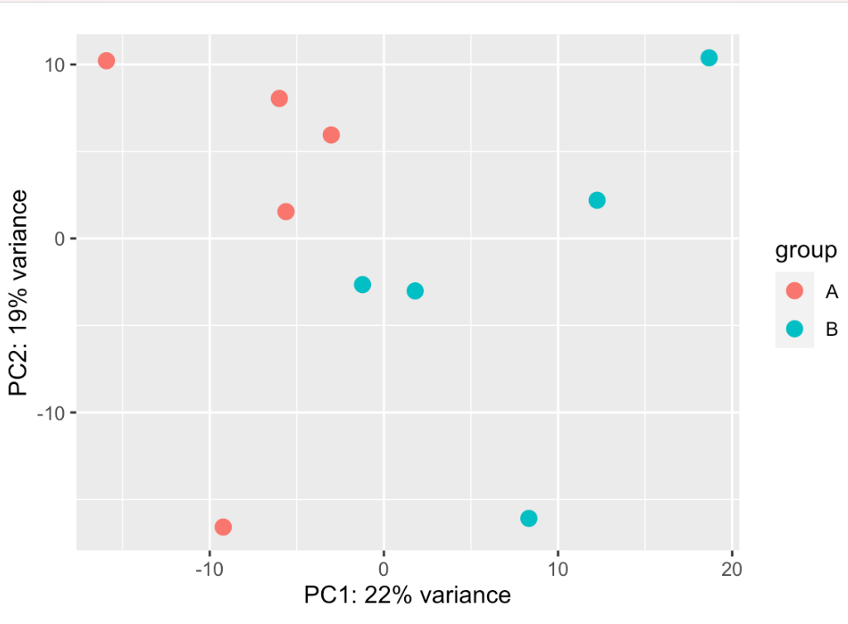
Did our class data have a batch effect?
Original
SVA corrected

Slide 40
BATCH EFFECT SCRIPT IS DE_BatchEffects.R

