Slide 1
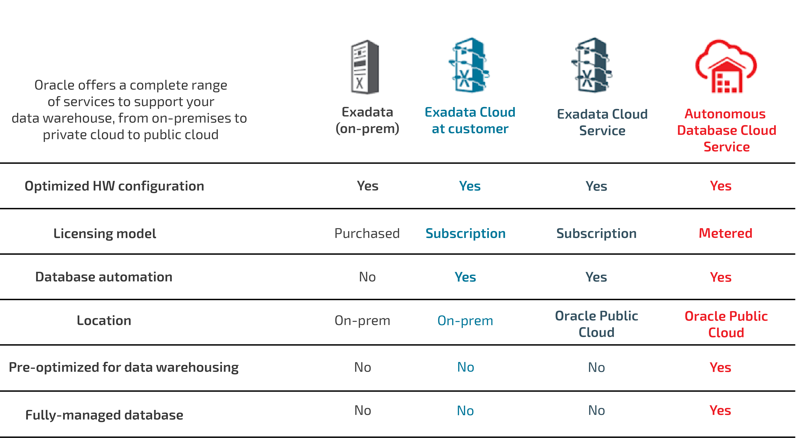
Oracle Data Warehouse Deployment Choice

Slide 2
Oracle 19c
Oracle E-Business Suite Certification
19C
20C
SNAP
19C Database
Container Database (CDB) Architecture
1. CDB with one PDB (single tenant) is currently the only certified deployment for Oracle E-Business Suite with Database 19c.
2. CDB with multiple PDBs (multitenant) is not currently certified for Oracle E-Business Suite.
3. Non-CDB architecture is not planned to be certified or supported for EBS with Database 19c.
20C Onwards : Standalone Database Architecture deprecated
Adopt EBS Single Tenant Architecture Prior to 20C upgrade
Enhanced Exadata Snapshots
SNAPSHOT DATABASES in EXADATA - Quick Clone & Storage Optimization
* recommended to be used with Exadata Storage Rack

Slide 3
Oracle Center of Excellence(OCE) Engineered Systems - Exadata X8M,ExaCC(On Prem), ExaCS(Oracle Cloud) Database - 19c and 20c brief E-Business Suite - 12.2.9 with 19c Oracle Data Integrator- ODI 12.x compatible with 19c Database Enterprise Manager - Oracle EM13c with Site Guard

Slide 4
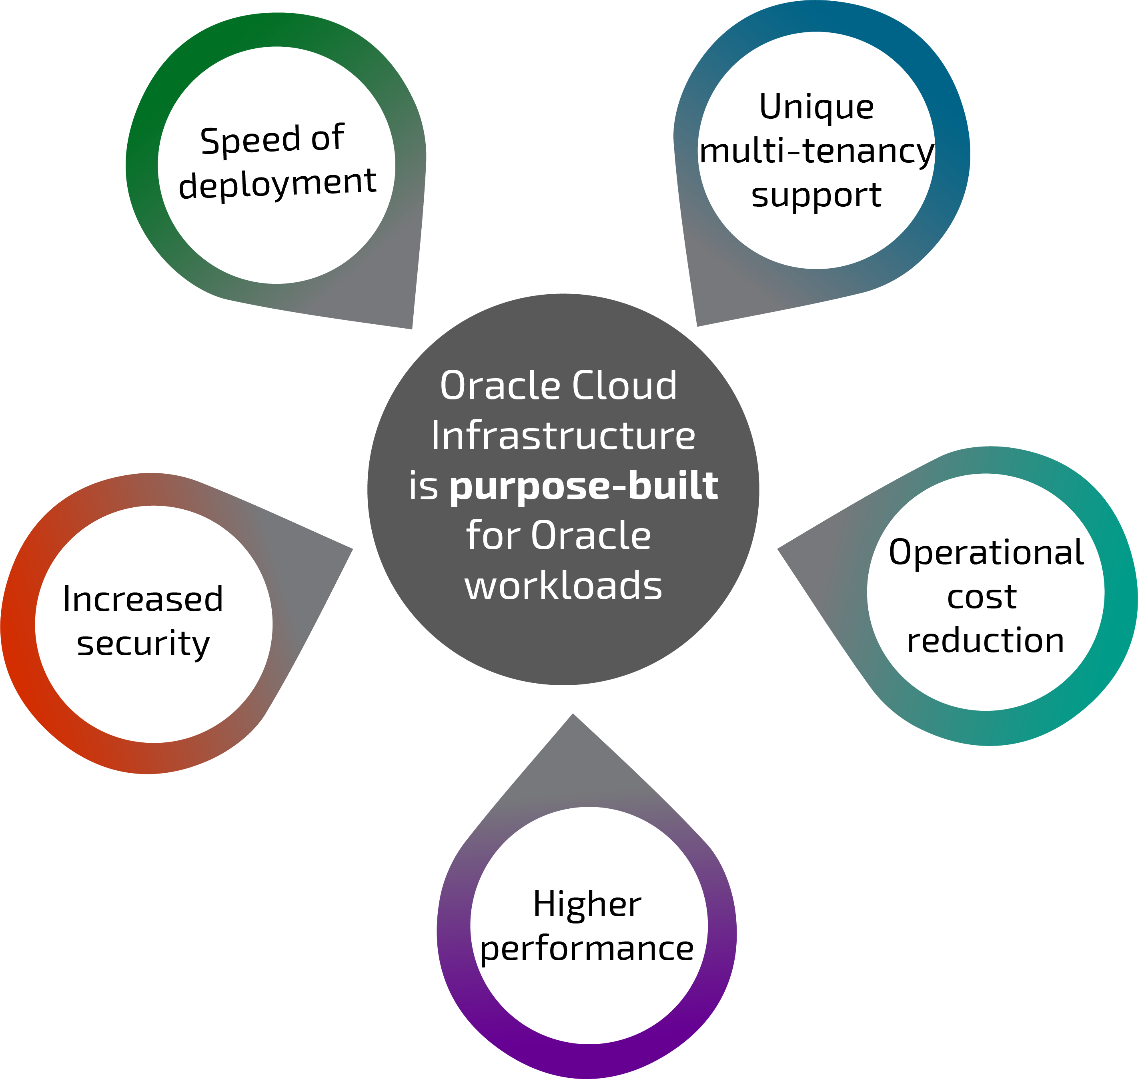
Advantages of running Oracle products on OCI
One-click provisioning of the entire Oracle stack
No more manual installations,automated Lift and Shift to OCI, Use Terraform to automate complete infrastructure build with advanced topology of mix and match of ExaData DBaaS,VM,Load Balancers
Oracle Multi Tenancy Support on OCI
Unique Advantage of Oracle Multi Tenancy Support on Oracle Cloud Only Feature.
No upfront investment in hardware
Pay ONLY for what you consume, dynamically start and stop instances.
4
Bare Metal and Dense I/O for higher performance
Improve Payroll, batch and online performance
Transparent Data Encryption (TDE), HIPAA, ISO, SOC, PCI DSS and more

Slide 5
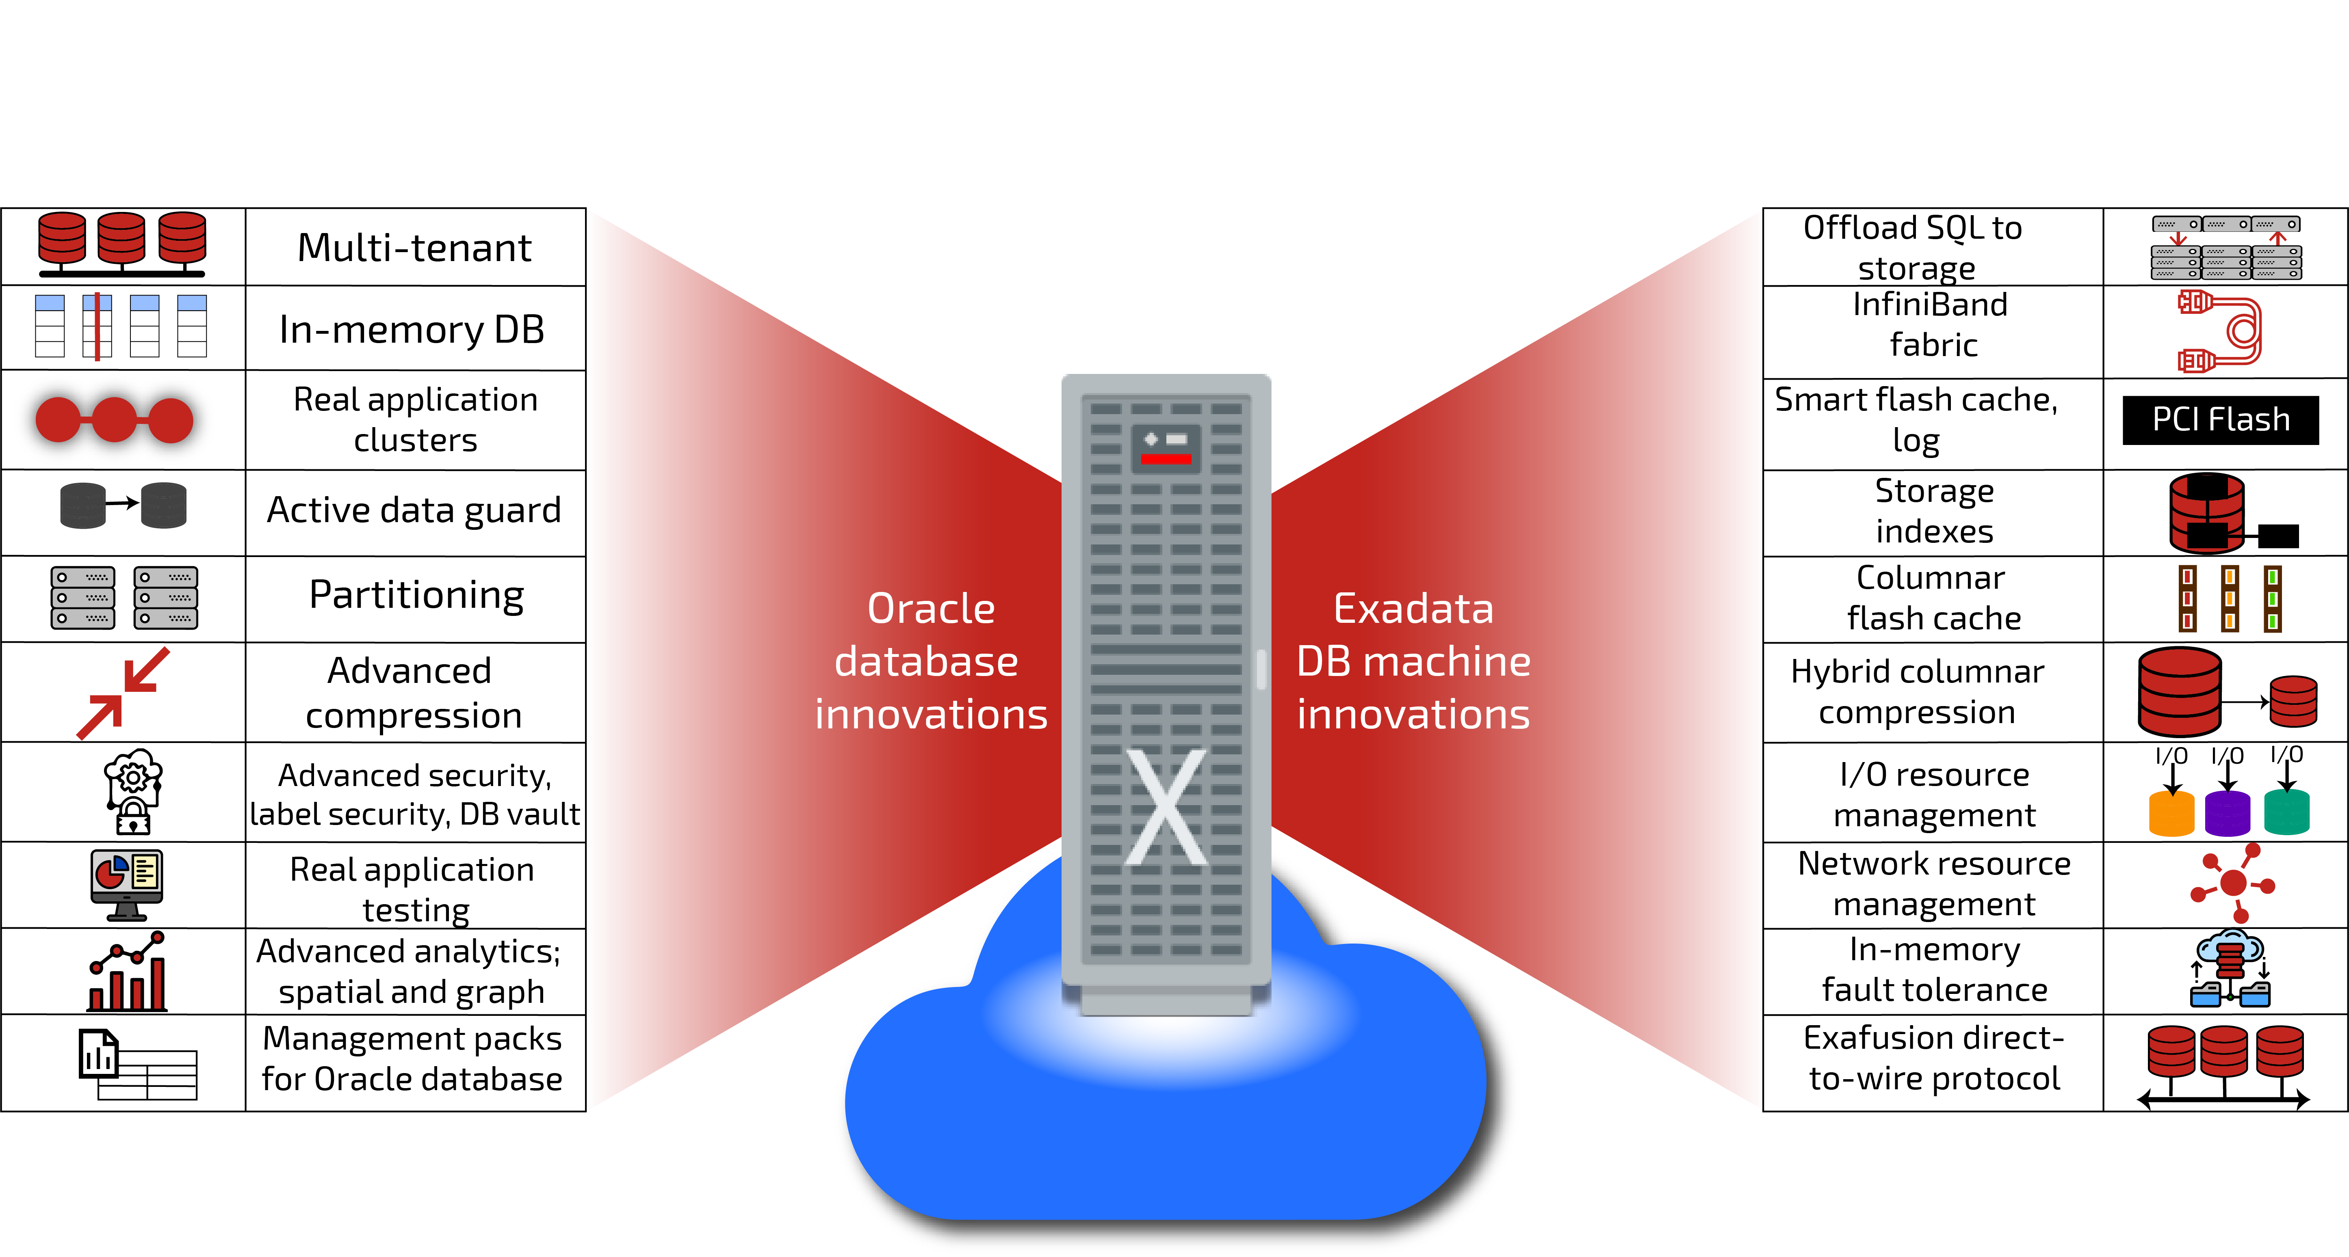
ExaData Cloud Services – Best of both worlds

Slide 6
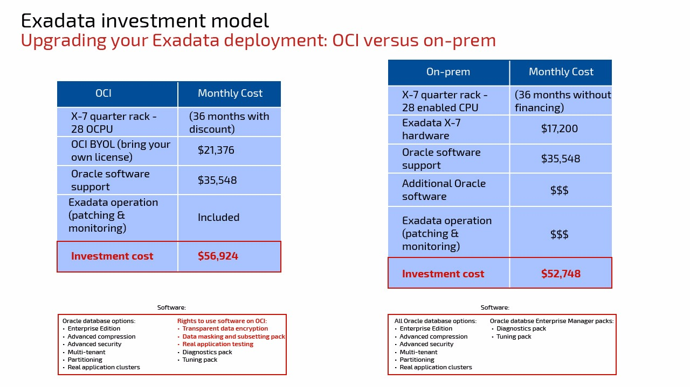
Source: viscosity product price assessment

Slide 7
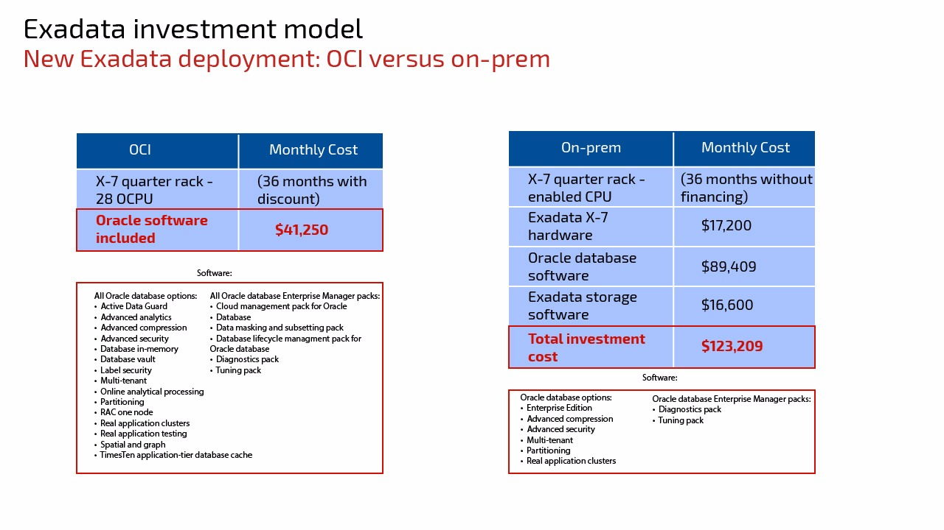
Source: viscosity product price assessment

