Slide 1


Music City Marathon 2.0
Julia Romano, NSSDA Cohort 1
Notes:
Hello, my name is Julia Romano and I am presenting on a data story I found within the Finisher’s data from the Nashville Marathon. I call it “2.0” because this is my second walk through the dataset.

Slide 2

Notes:
As a starting point, I chose to pick up where my previous project with this data set left off: this slide showing the runners who participated in more than one race. As a person who doesn’t find running a compelling activity, I found myself wondering why they might come back for more, as I saw it, punishment. So I thought maybe I would look for the indomitable human spirit amongst these brave individuals. I thought maybe they came back because they performed well in the previous race… after all: It’s a *race*, right? Competition is where its at! I targeted the 3 time runners and the 4 time runners: if one has already run 3 marathons, why not run a 4th?

Slide 3
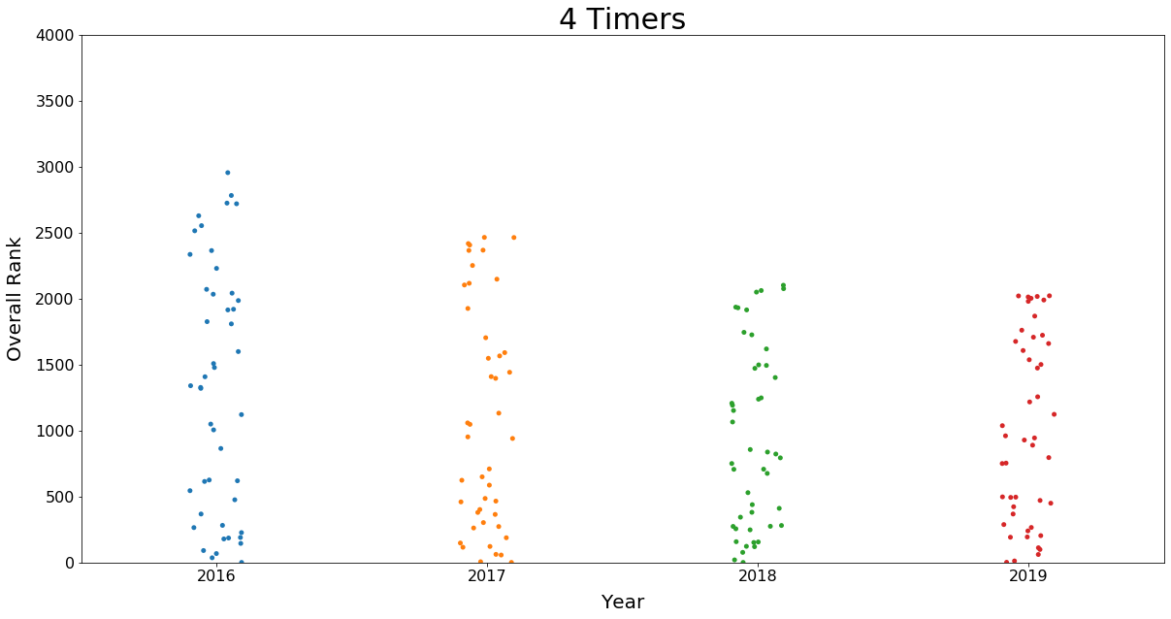
Notes:
SO I got my first chart, I was like… SWEET! Consistent drop in the ranks over time. By the way, a lower rank is a higher placement, meaning that as rank drops, performance is, relative to other racers, better. SO then I looked at the 3-fers, expecting t see poorer performance. BUT>>>>

Slide 4
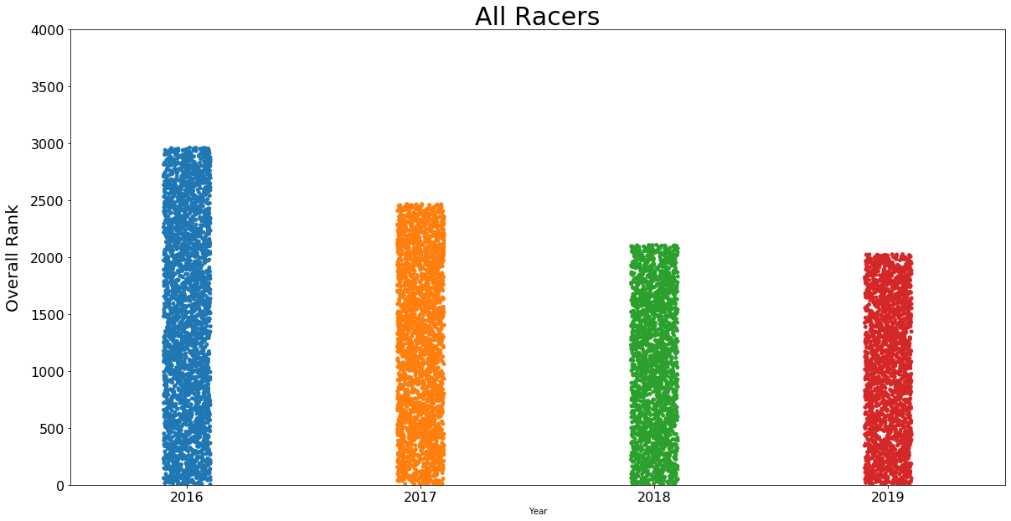
Notes:
Alas. Pretty much the exact same chart, actually. Distressingly similar. In fact…
The entire overall trend is precisely the same. In this case, the over all numbers trended down just because the total overall number of runners (and therefore the max rank) also went down. I did this over and over, with histograms and barcharts and scatterplots and violinplots and even a couple excel charts. Speaking of which:

Slide 5
Notes:
This is a chart I created in excel to get a more granular look at individual runner performance. As you can see, there were some runners, Chad and Naomi, who show consistent improvement over time until their last race. Others (Jasser, Kelsey, Terry) initially improved, then suffered a setback, but then persevered to the final race, with mixed results. Then there good ol’ Larry Epps there, who is just a hot mess.
It is blindingly apparent to me: Runner don’t participate in the Music City Marathon to compete with each other or themselves.

Slide 6
BUT IT’S A *RACE*
If it’s not competitive, why do people do it?
Notes:
BUT WHY. At first I was really discouraged. And then I realized that this might be a blessing in disguise. Sometimes the data isn’t everything. Sometimes your boss asks “Is there a correlation” and the answer is “no”.
But maybe I can try to answer “why” using other data.

Slide 7


Well,
What
do
they
Get Out of It, Exactly?
Scenic Course
Live, Local Bands along the Course
Spirited Cheer Squads on Course
Plentiful Course Support
Admission to the Finish Line Festival
Admission to Post-Race Concert
Admission to Two-Day Health & Fitness Expo
A Beer at the Finish Line Festival
Technical Participant T-Shirt
Exclusive Finisher Medal
Gear Bag
Notes:
Back to basics: This is what is advertised on the race site under “participant perks”
Maybe the reason that it really isn’t a competition-driven race is because they are not attracting competitors.

Slide 8

TOURISM
Notes:
They are attracting tourists. Really it’s ALL about *Nashville*
The Marathon is and excuse (albeit a painful one) to spend a weekend in Nashville, enjoy a great concert and local fun, and rarely COME BACK
At least… not for the race.
All of this is to say: perhaps the Marathon can reinject a little life back in, and recover from it’s failing numbers, by adding a little more touristy fun into the race weekend.

