Slide 1
tcaCALC: MATLAB Software for Quantitative Analysis of ¹³C Metabolic Isotopic Tracer Experiments
2993-Alger-1
J.R. Alger^{1,2,3}, G. Sharma¹, A.D. Sherry^{1,4}, C.R. Malloy^{1,5}
¹Advanced Imaging Research Center, University of Texas, Southwestern Medical Center, Dallas, TX
²Department of Neurology, University of California, Los Angeles, Los Angeles, CA
³NeuroSpectroScopics LLC, Sherman Oaks, CA
⁴Department of Chemistry, University of Texas at Dallas, Richardson, TX
⁵Department of Internal Medicine, University of Texas, Southwestern Medical Center, Dallas, TX
Support from NIH/NIBIB P41 EB015908

Slide 2

Declaration of Financial Interests or Relationships
Speaker Name: Jeffry R. Alger
I have no financial interests or relationships to disclose with regard to the subject matter of this presentation.
2993-Alger

Slide 3
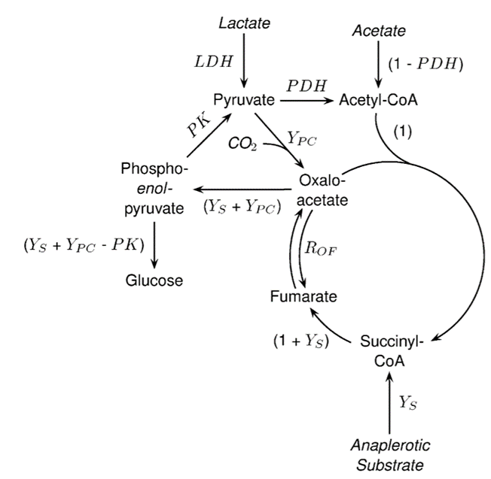
Introduction
2993-Alger-3
tcaCALC Purpose
Quantitative analysis of tricarboxylic acid (TCA) cycle ¹³C metabolic tracing
Determine relative steady state fluxes of
Pyruvate dehydrogenase (PDH)
Pyruvate Carboxylase (Ypc)
Pyruvate Kinase (PK)
Four-carbon anaplerosis (Ys)
tcaCALC New Features
Rewritten in MATLAB
Spectral analysis module
Reads Bruker and Agilent spectra
Guides user in identification of complex ¹³C NMR multiplets created by ¹³C homonuclear J-coupling
Non-linear least squares fitting to determine ¹³C multiplet intensities
Evaluates multiple metabolic models
Helps the user understand which of multiple candidate metabolic models best represents the biological system
Glu C5
Glu C4
Glu C3
Glu C1
Glu C2
200
150
100
50
0

Slide 4
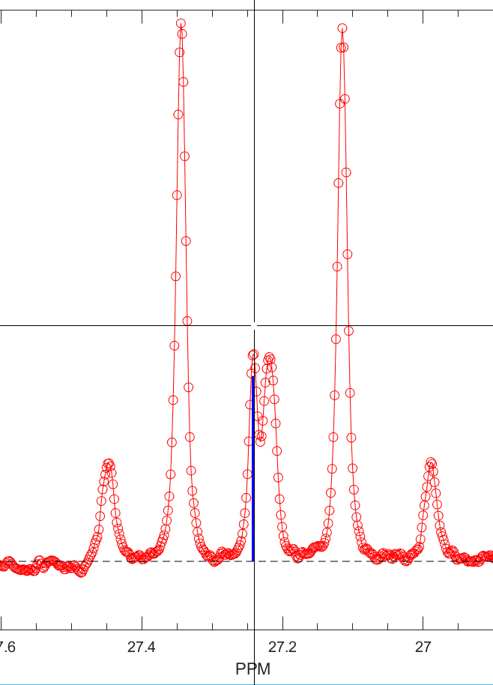
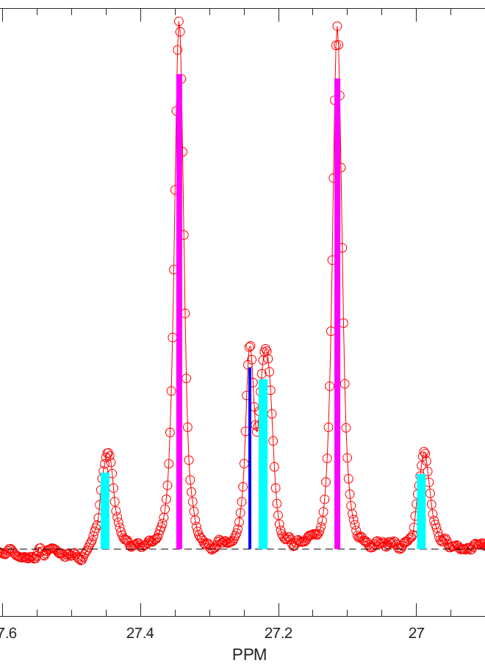
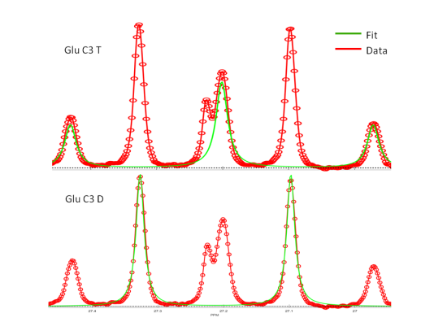
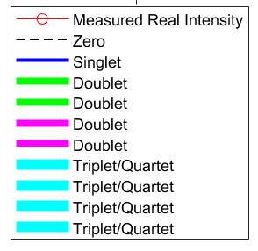
tcaCALC Spectral Analysis Example Glutamate C3 Multiplets
2993-Alger-4
User identifies location of Glutamate C3 singlet
tcaCALC identifies all relevant multiplets from
User defined singlet frequency
known J-coupling constants
Known isotope shifts
non-linear least squares spectral fitting to determine multiplet intensities

Slide 5
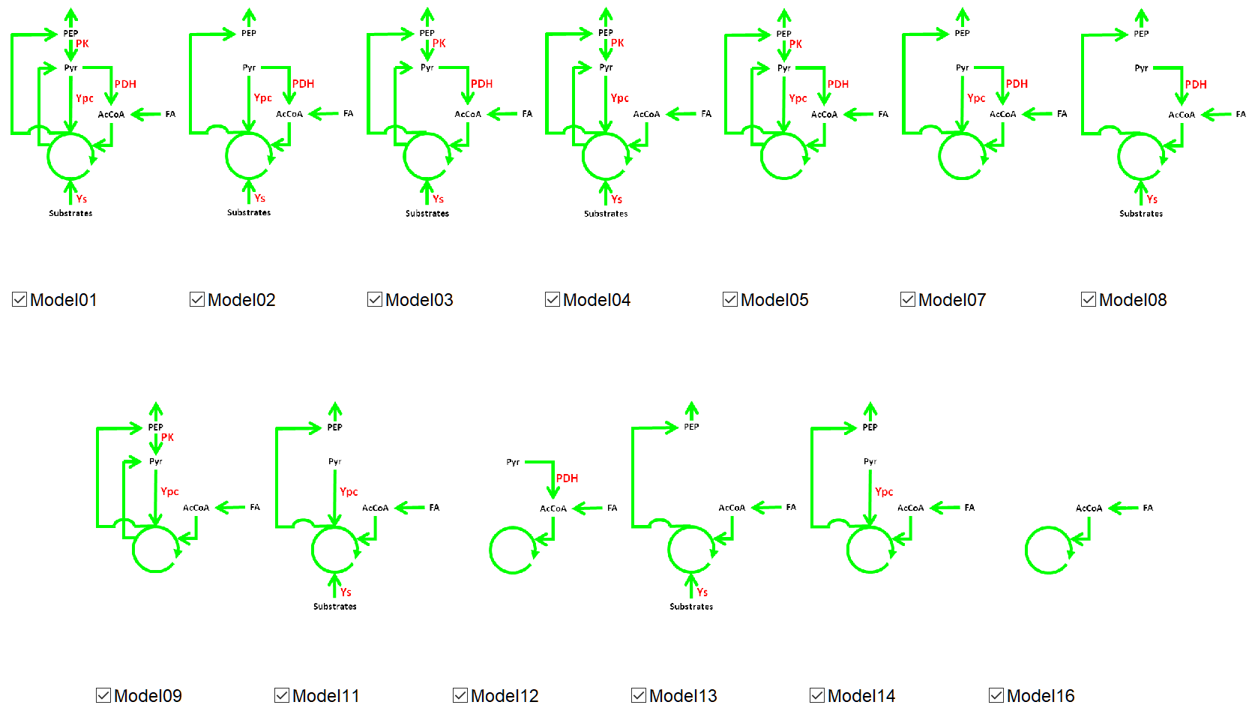
tcaCALC Metabolic Models
2993-Alger-5
Model01: generalized metabolic model
nonzero PDH, PK, Ypc, Ys
12 additional candidate metabolic models
combinations of PDH, Ypc, PK, Ys set to zero (not fit)
Model06, Model10 and Model15 (not shown) violate the steady state assumption

Slide 6
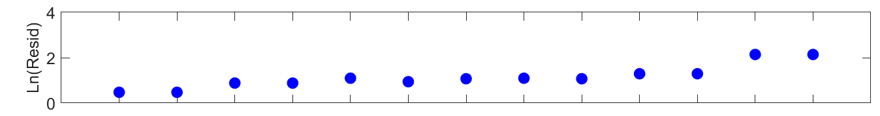
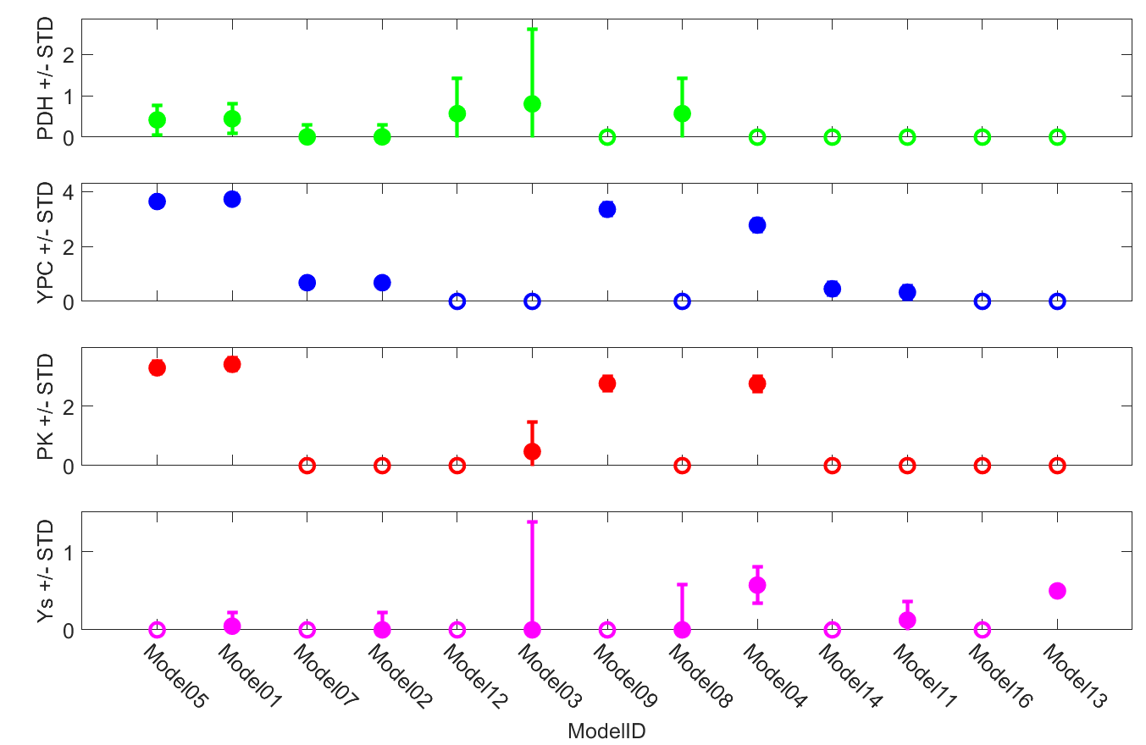
tcaCALC Metabolic Model Fitting
2993-Alger-6
tcaCALC uses tcaSIM¹ to simulate product ¹³C-NMR multiplet intensities for given substrate(s) enrichment and metabolic rates
tcaCALC optimizes least squares agreement between simulated and measured ¹³C-NMR multiplet intensities to determine best fit values of
PDH, Ypc, Ys, PK
substrate(s) enrichment (if necessary)
tcaCALC repeats optimization for each candidate metabolic model
or user may restrict fitting to specific models
In the example shown to the right
fasted perfused mouse liver
90% uniformly ¹³C enriched lactate and pyruvate
Models 05 and 01 give the best fits to the measured data according to the sum of squares residual
¹Alger JR, Sherry AD, Malloy CR. tcaSIM: A simulation program for optimal design of 13C tracer experiments for analysis of metabolic flux by NMR and mass spectroscopy. Current Metabolomics 2018;6:176-187.

Slide 7
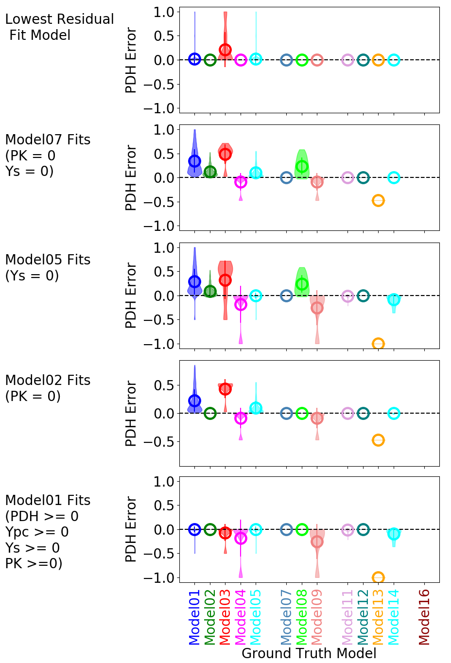
Example of tcaCALC Metabolic Model Fitting
This example illustrates the common practice of assuming that PK and/or Ys are insignificant when
lactate is used as a substrate
the primary study goal is to estimate PDH
tcaSIM simulated 8745 Glutamate ¹³C-NMR spectra
15 multiplets per spectrum
Substrate: 90% uniformly ¹³C-enriched lactate
0.0 < PDH < 1.0
0.0 < Ypc, Ys, PK < 5.0
Violin plots (right) illustrate PDH Error performance
PDH_{Error} = PDH_{GroundTruth} - PDH_{BestFit}
Mean Errors are circled
The plots illustrate results for fitting with different models
Fitting models that have Ys and PK turned off can lead to error/bias in PDH estimation in metabolic situations in which Ys and PK are actually active
Fitting with Model01 can result in PDH error if Model01 does not characterize the actual metabolism
Fitting all candidate models and selecting the best least squares metabolic model has optimal performance
2993-Alger-7

Slide 8
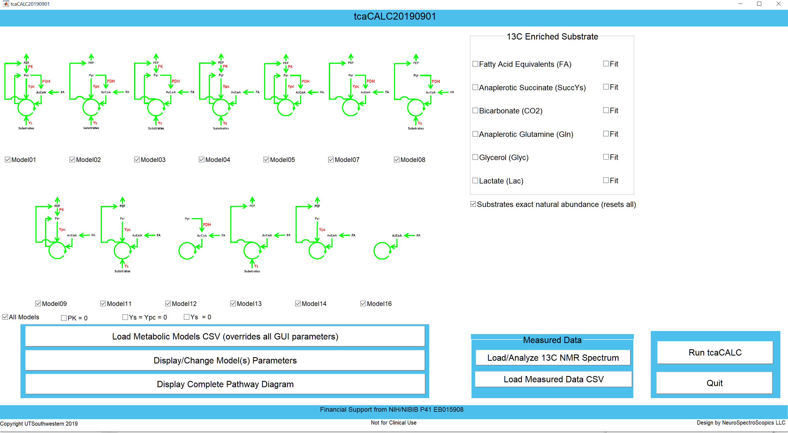
Conclusions
2993-Alger-8
tcaCALC facilitates the quantitative analysis of metabolic ¹³C tracing studies in MATLAB
Windows, linux, MacOS
New tcaCALC features
User-friendly assignment of complex J-coupled ¹³C-NMR multiplets
Spectral fitting of J-coupled ¹³C-NMR multiplets
Automatic testing of multiple metabolic models
In general, fitting to all candidate metabolic models and selecting the best fit model shows smaller and less frequent error compared to fitting with any particular metabolic model.
Request MATLAB tcaCALC source code from Jeffry.Alger@UTSouthwestern.edu

