Slide 1
Getting Started with tcaCALC
J.R. Alger
jeff@neurospectroscopics.com
jeffry.alger@utsouthwestern.edu
November 29, 2024

Slide 2
tcaCALC
The tcaCALC software tool is designed to determine best fit metabolic fluxes in studies that use ¹³C- or ¹⁴C-enriched tracers to probe TCA cycle metabolism.
The newest version of tcaCALC was written in MATLAB.
MATLAB assures compatibility across multiple operating system platforms.
tcaCALC is based on previous versions that were written in the C programming language and ran only under the now obsolete Microsoft Disk Operating System.
The user submits measured values of specific atom fractional enrichments, ¹³C NMR multiplet relative integrated intensities, or relative mass isotopologue intensities of common products of TCA cycle metabolism together with the substrate isotopic enrichment that was used in a particular experiment.
tcaCALC iteratively determines the PDH, YPC, YS and PK rates (relative to citrate synthase) that best fit the measured data.

Slide 3
User-input: Two methods
tcaCALC can be run with user-input
from GUI (General User Interface) or
from two user-generated comma-separated-value (CSV) spreadsheets.
The GUI method is useful for learning and understanding software but is cumbersome when complex studies need to be analyzed
This presentation is focussed on user-input via the csv spreadsheet

Slide 4
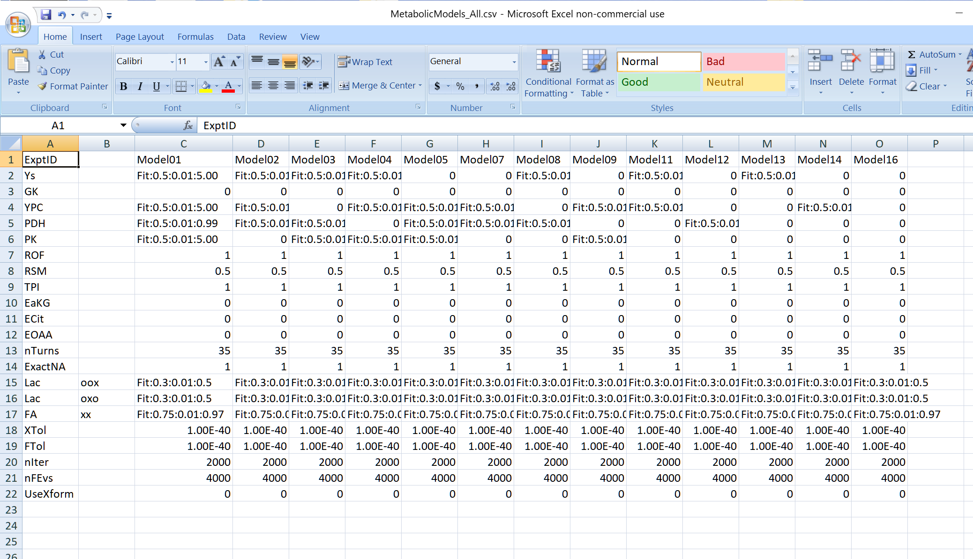
Create a CSV spreadsheet that describes the hypothetical metabolic models
An example csv is provided at .\InputTemplates\MetabolicModelInput\MetabolicModels_All.csv

Slide 5
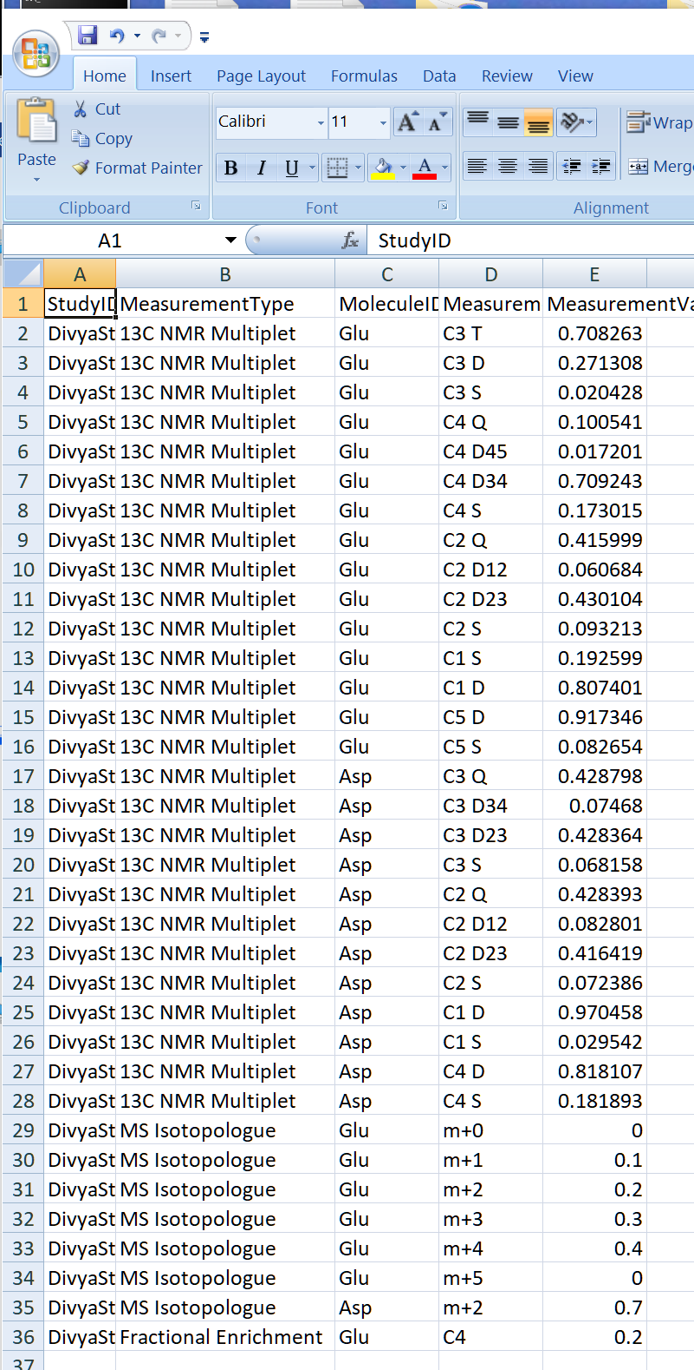
Create a CSV spreadsheet that describes the measured data
An example csv is provided at .\InputTemplates\GDAInput\GeneralDataArrayInput.csv
Legal entries for MoleculeID and Measures columns in this spreadsheet are given in .\InputTemplates\GDAInput\ LegalGDAEntries.txt

Slide 6
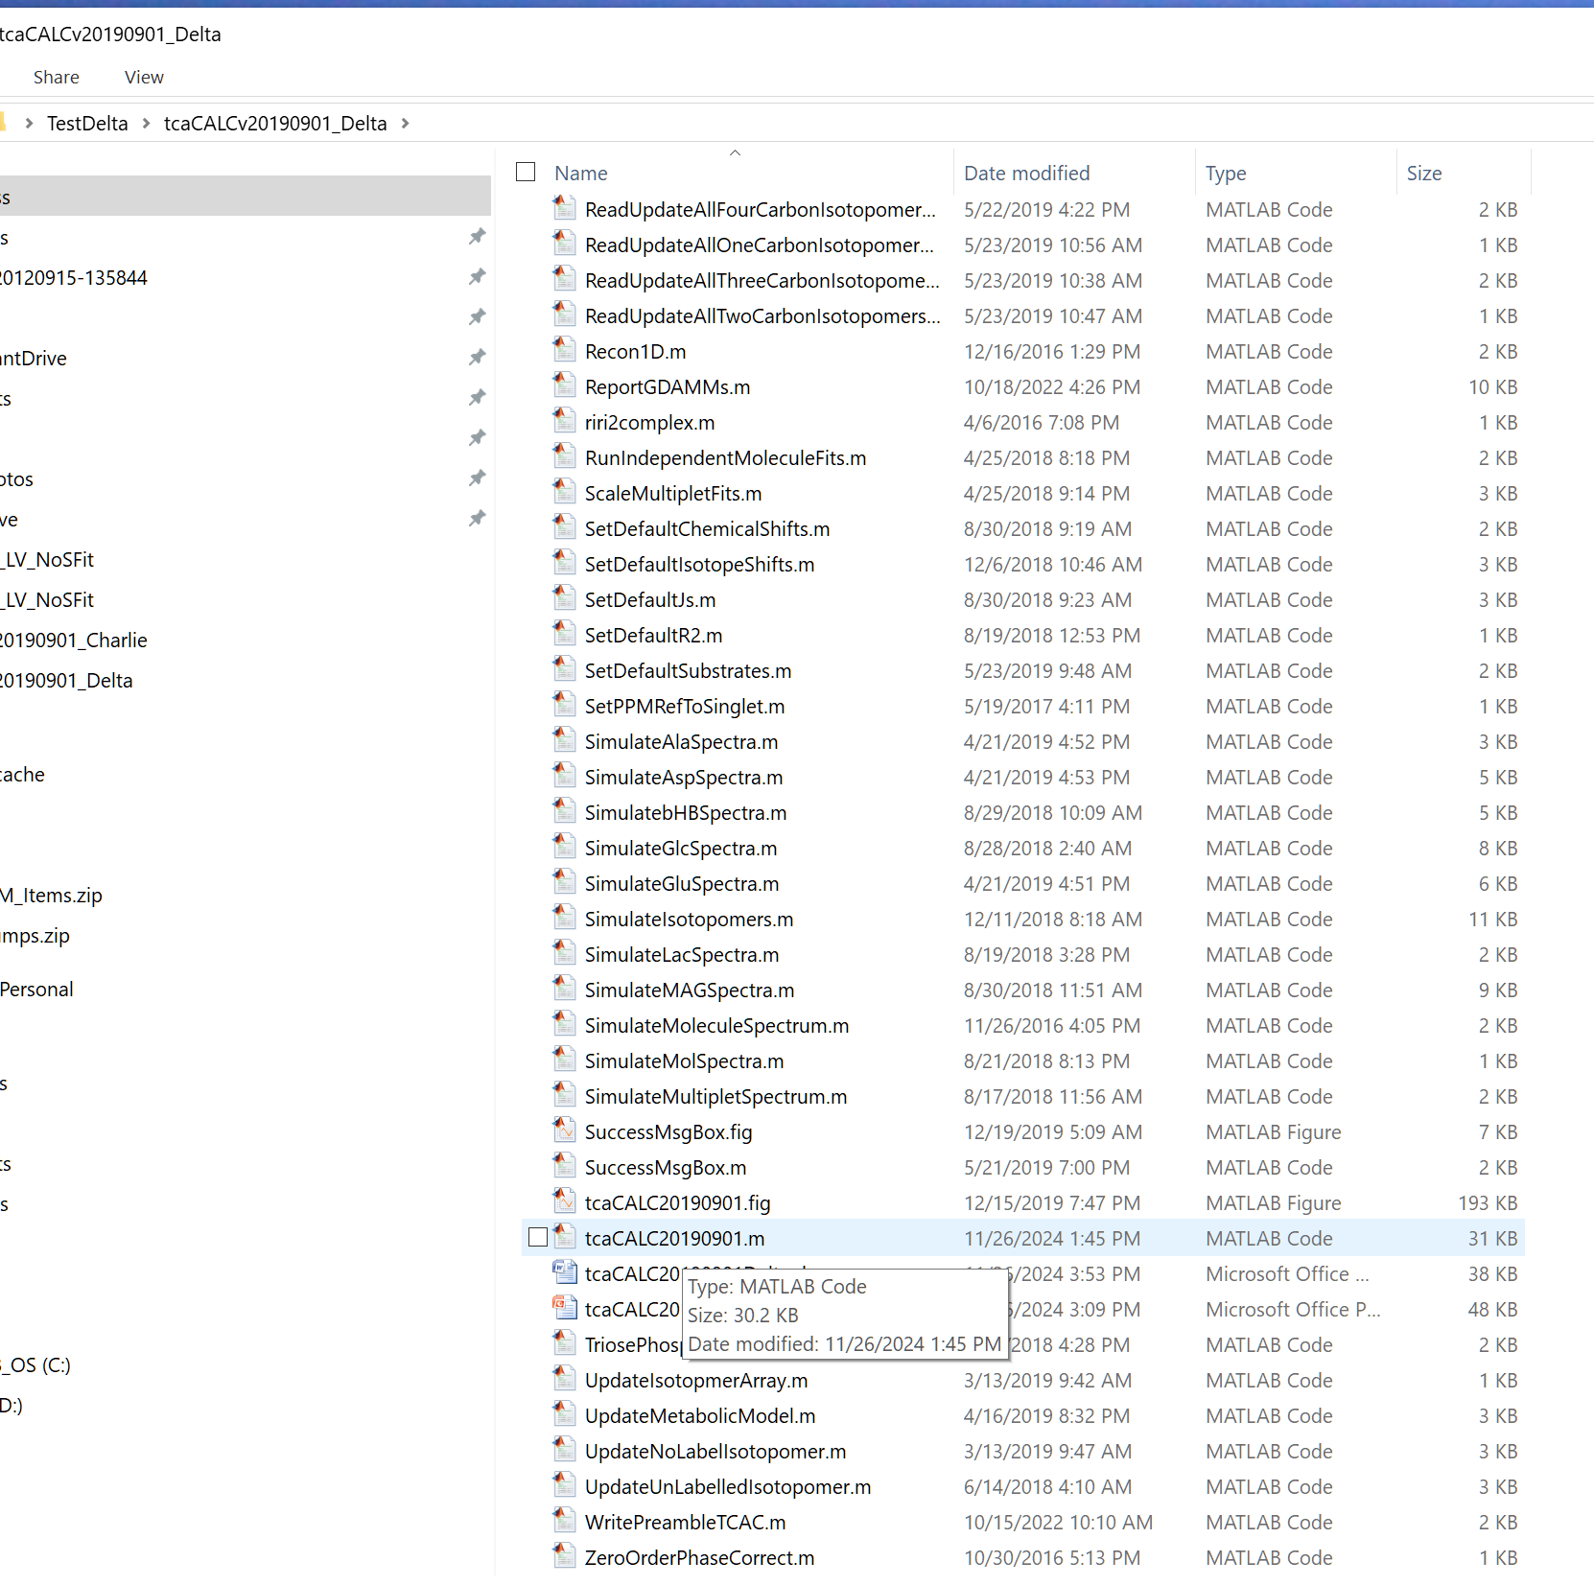
Start tcaCALC software
Open the tcaCALC distribution folder
Select tcaCALC20190901.m
MATLAB will open

Slide 7
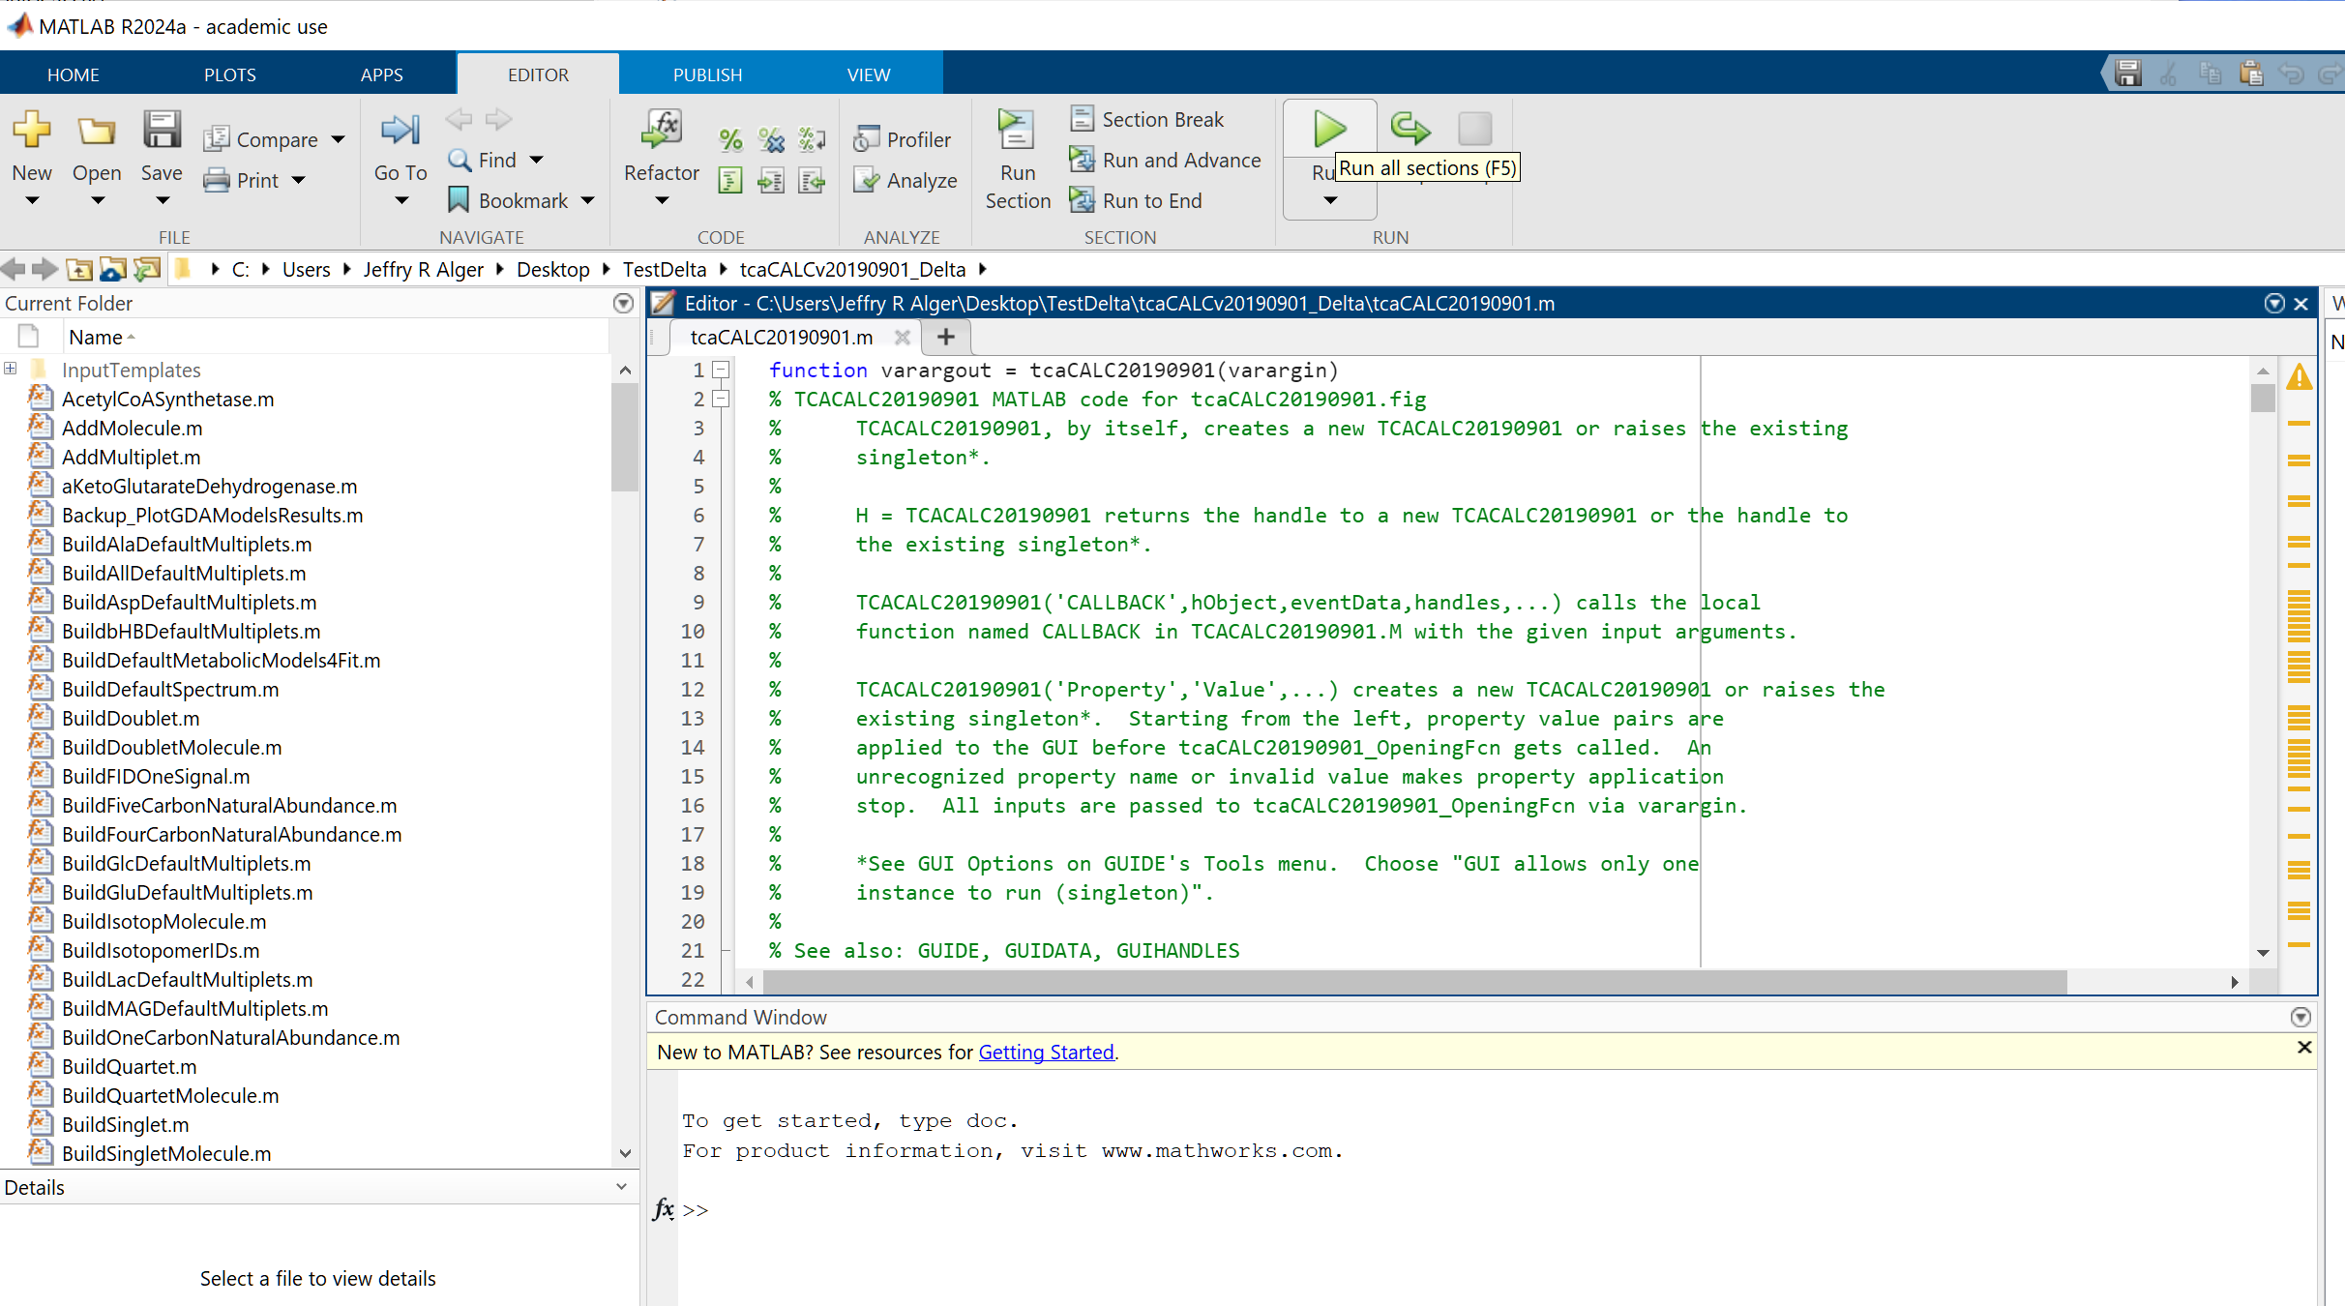
Run tcaCALC with MATLAB
Select the green arrow in the MATLAB editor to run the tcaCLAC software
The tcaCALC GUI will open

Slide 8
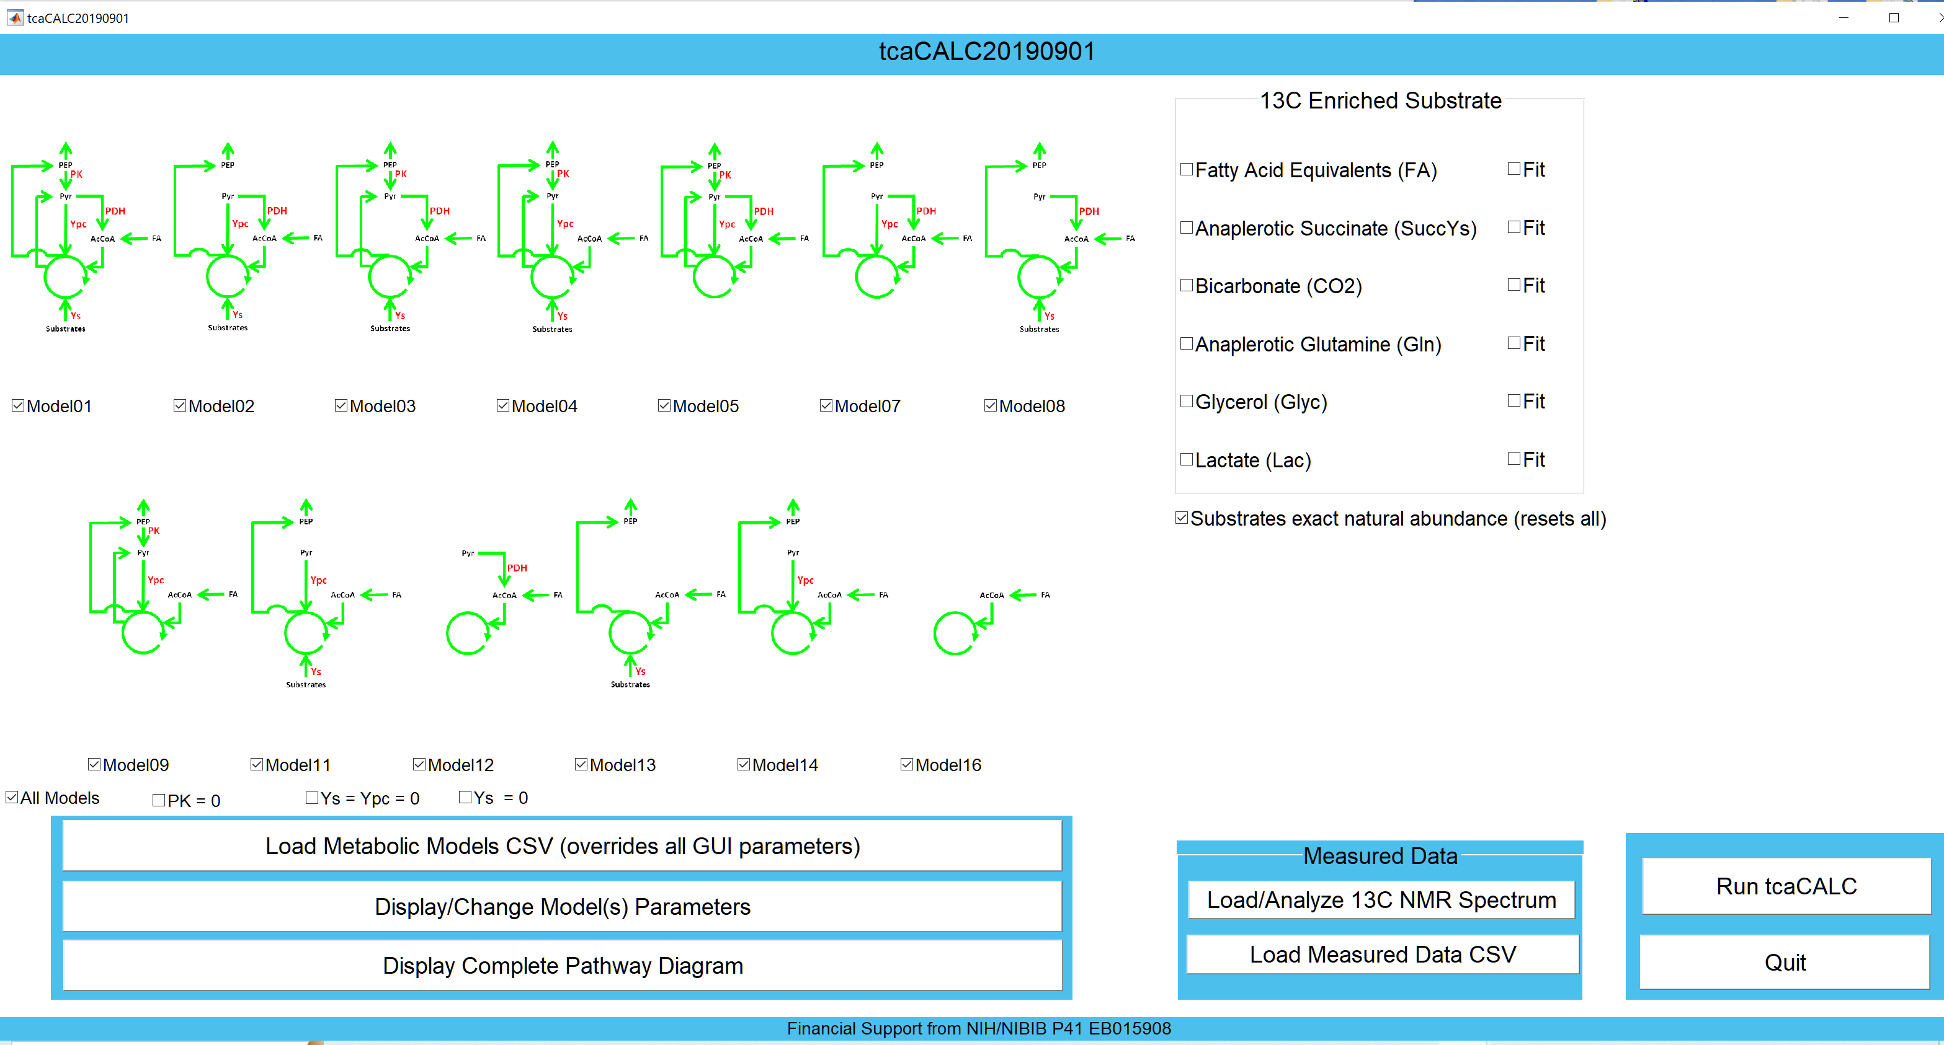
Input the Metabolic Models
Select Load Metabolic Models …

Slide 9
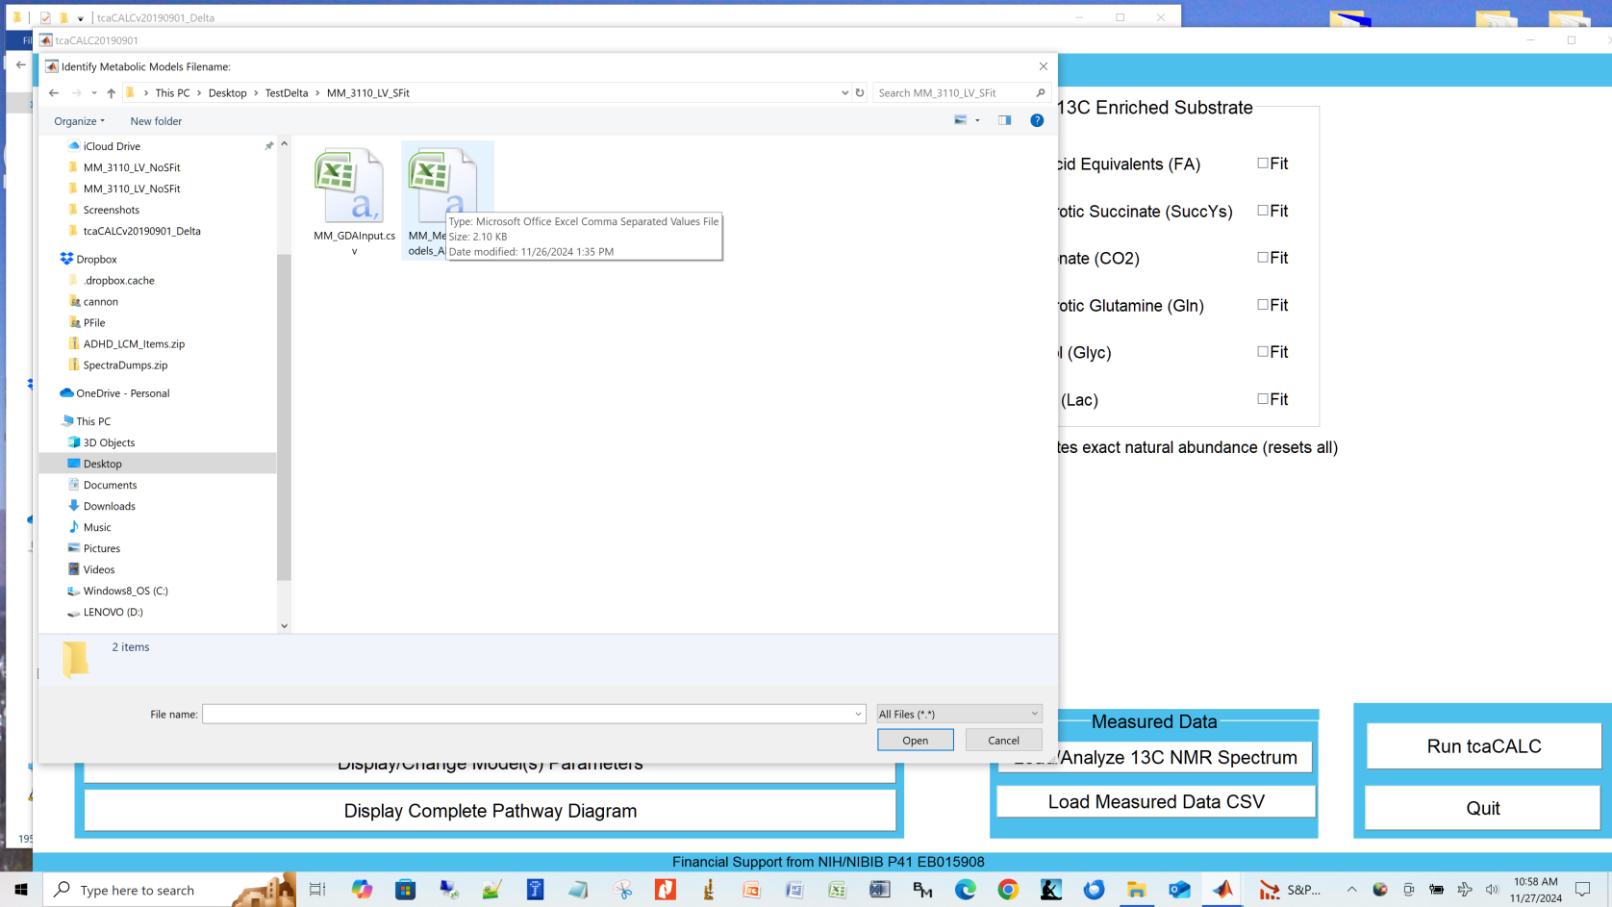
Input the Metabolic Models
Navigate to and select the metabolic models csv

Slide 10
Input the measured data
Select Load Measured Data CSV

Slide 11
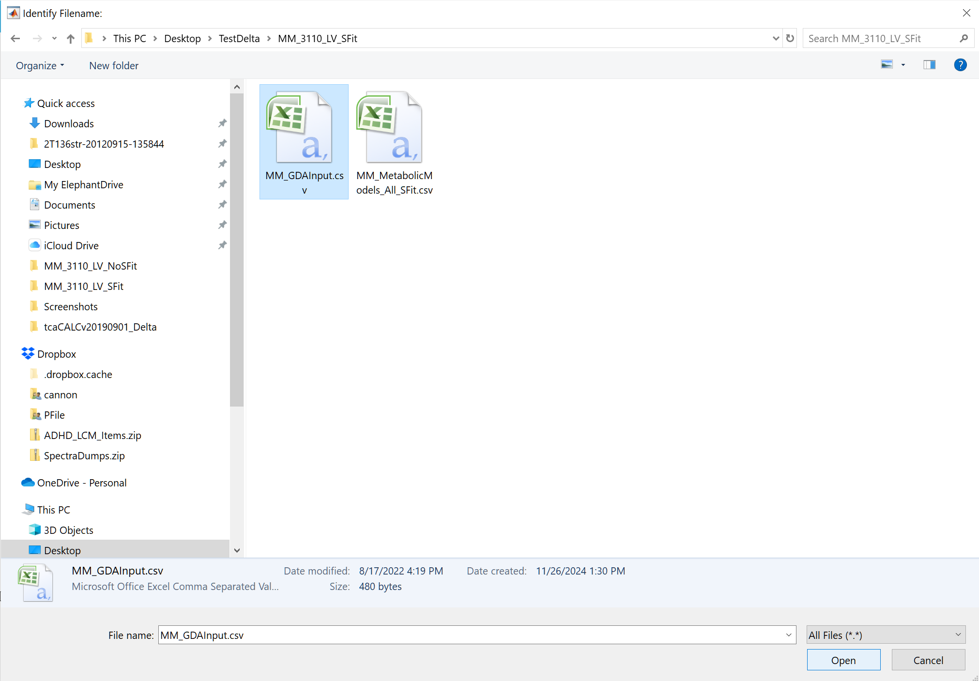
Input the measured data
Navigate to and select the measured data csv

Slide 12
Run tcaCALC
Select Run tcaCALC

Slide 13
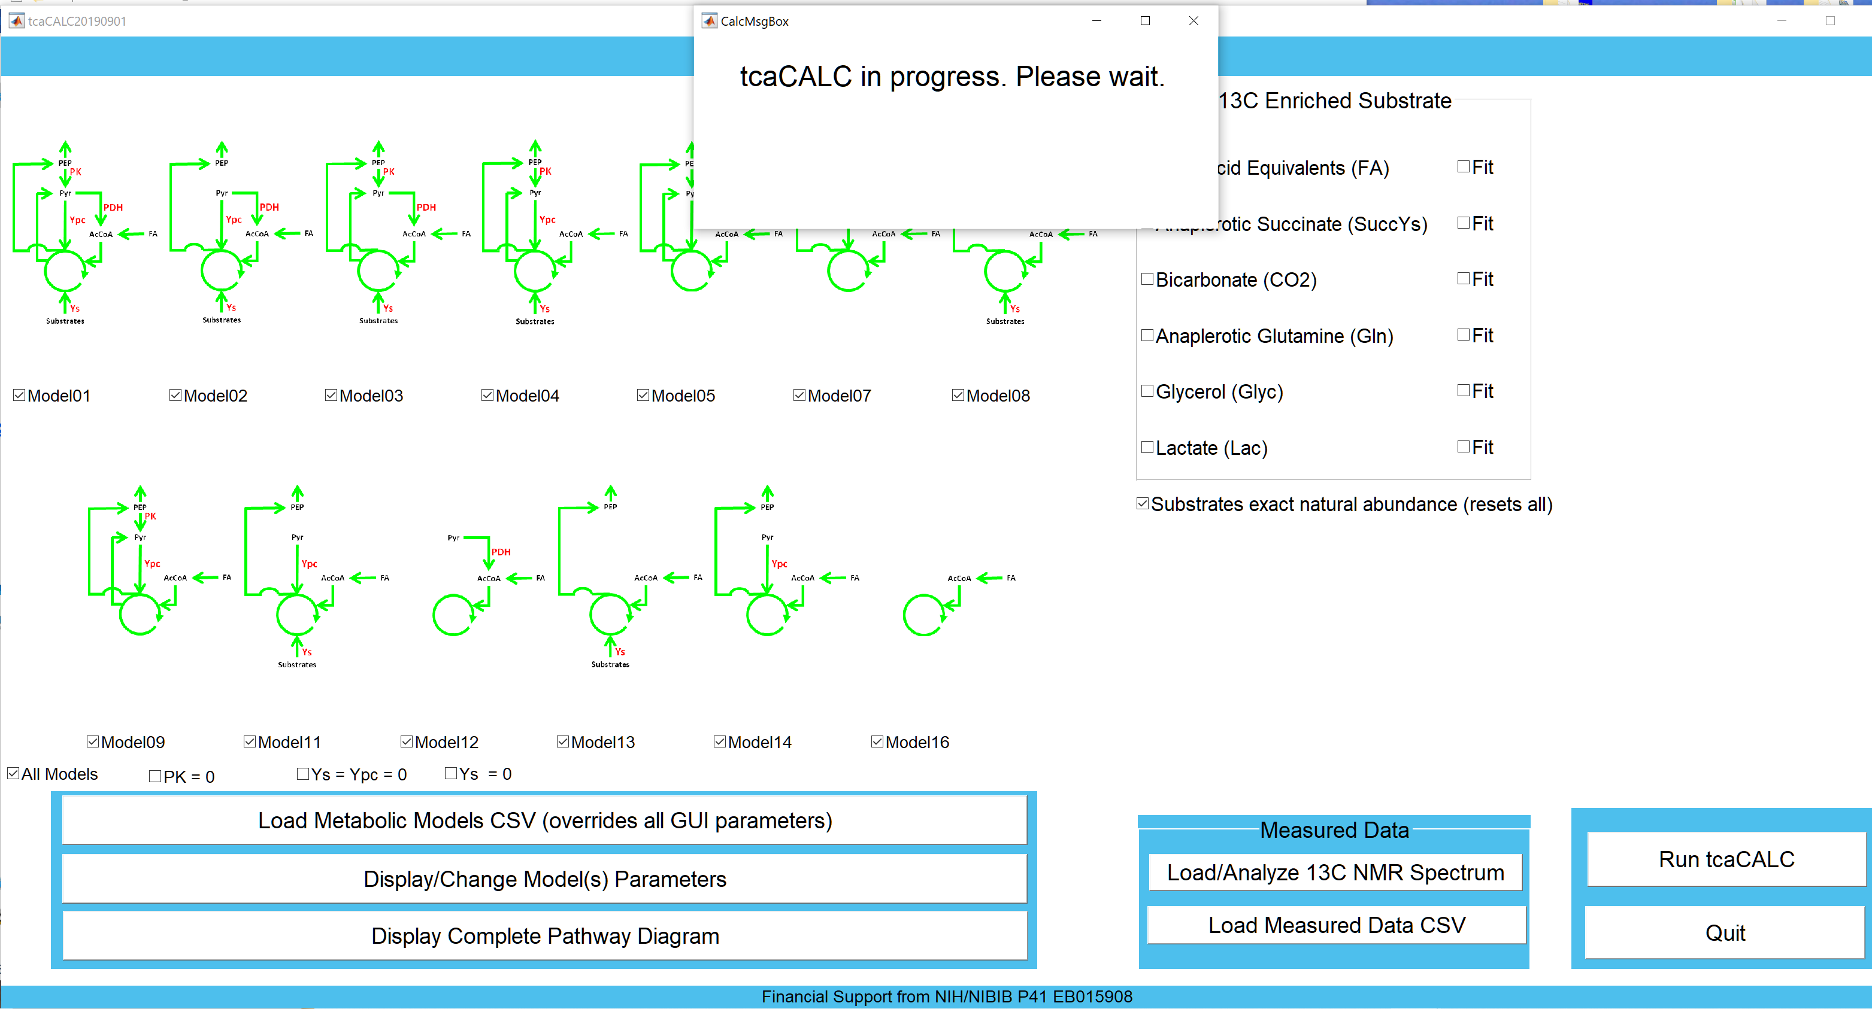
Run tcaCALC
tcaCALC in progress window appears

Slide 14
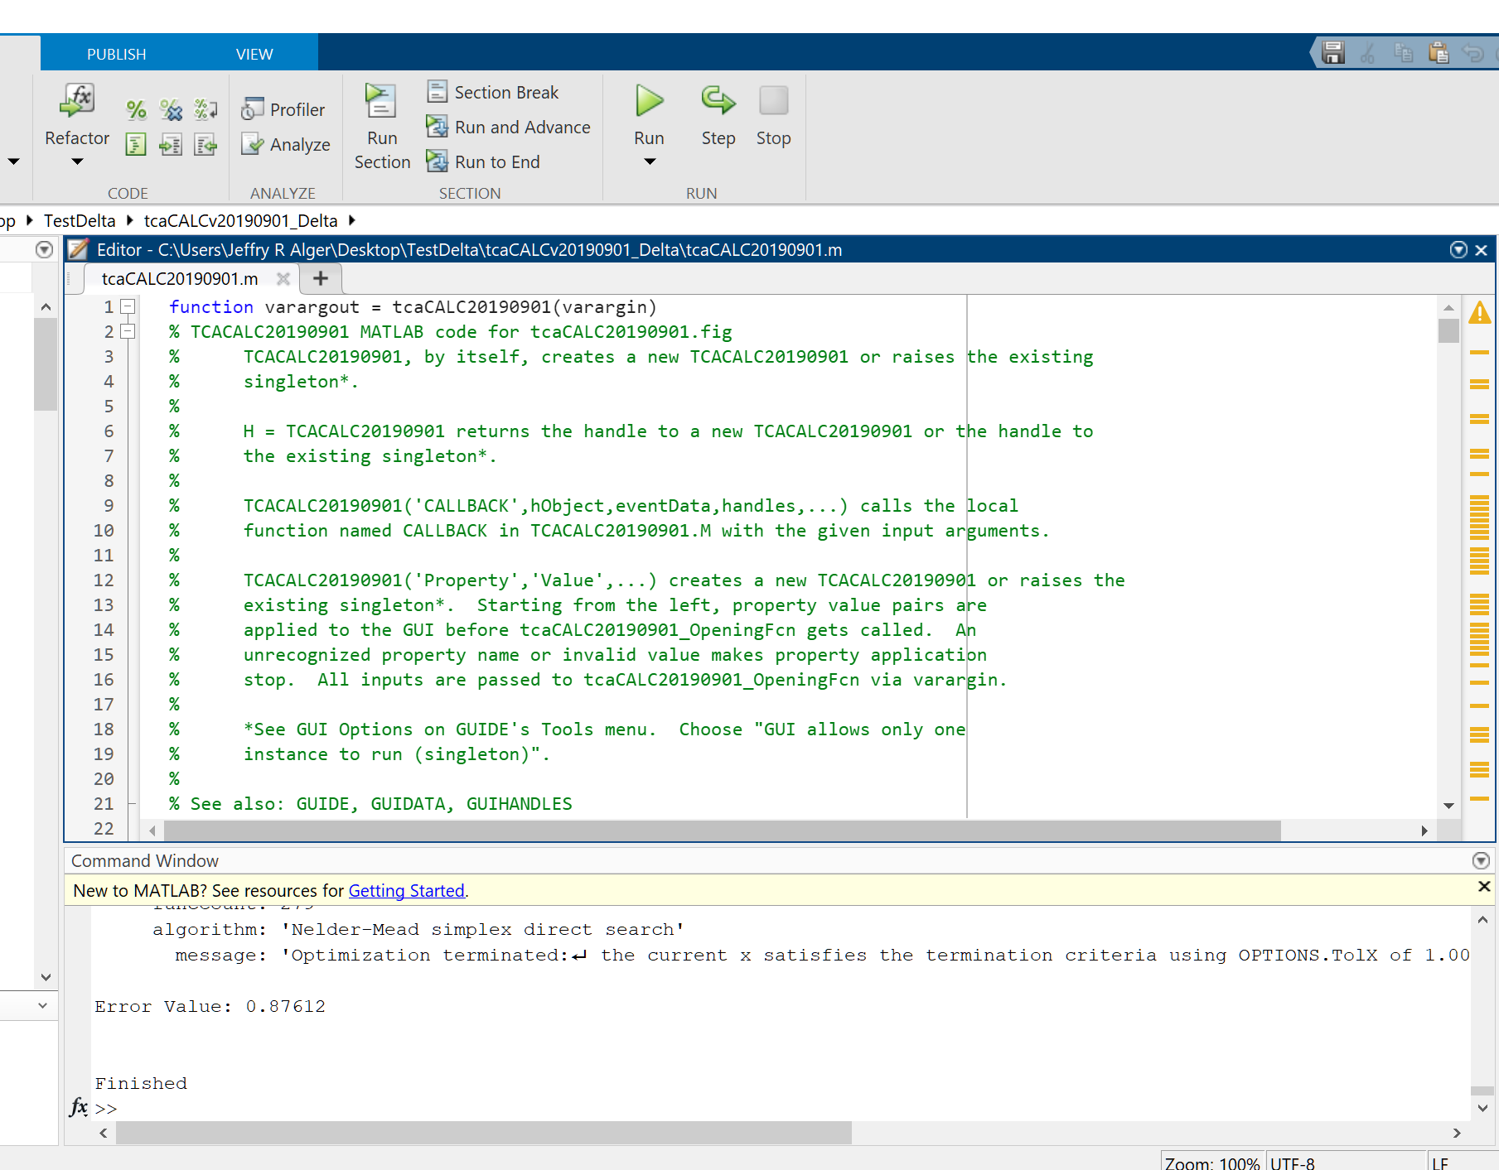
Run tcaCALC
Monitor tcaCALC in MATLAB window (if desired)

Slide 15
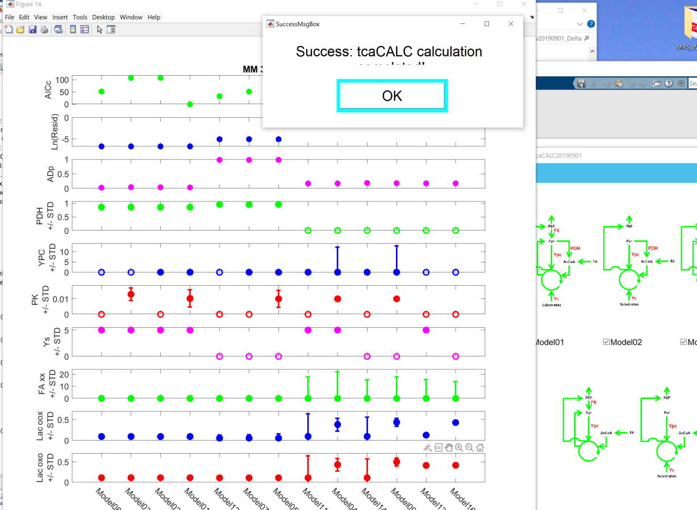
tcaCALC completion
On completion tcaCALC presents results as graphics

Slide 16
tcaCALC completion
Select OK to save and close all graphics output

Slide 17
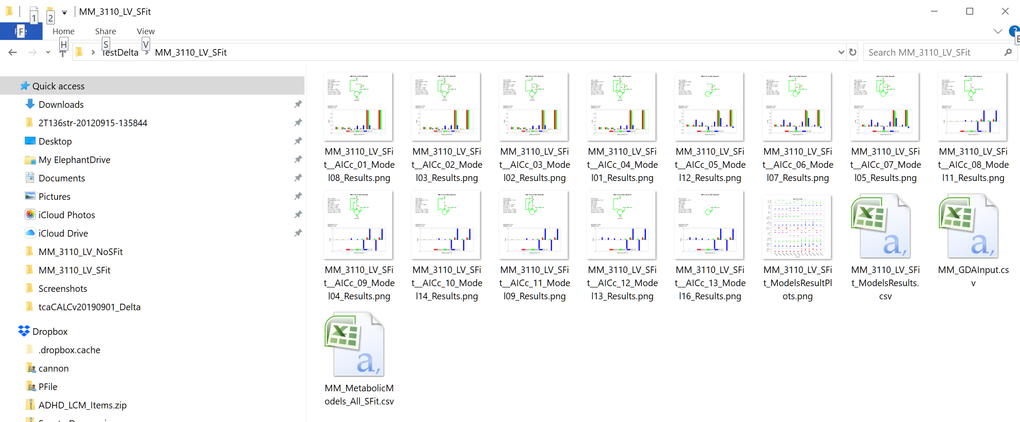
tcaCALC completion
tcaCALC graphics and numerical results are saved to the directory that contains the Metabolic Models .csv

Slide 18
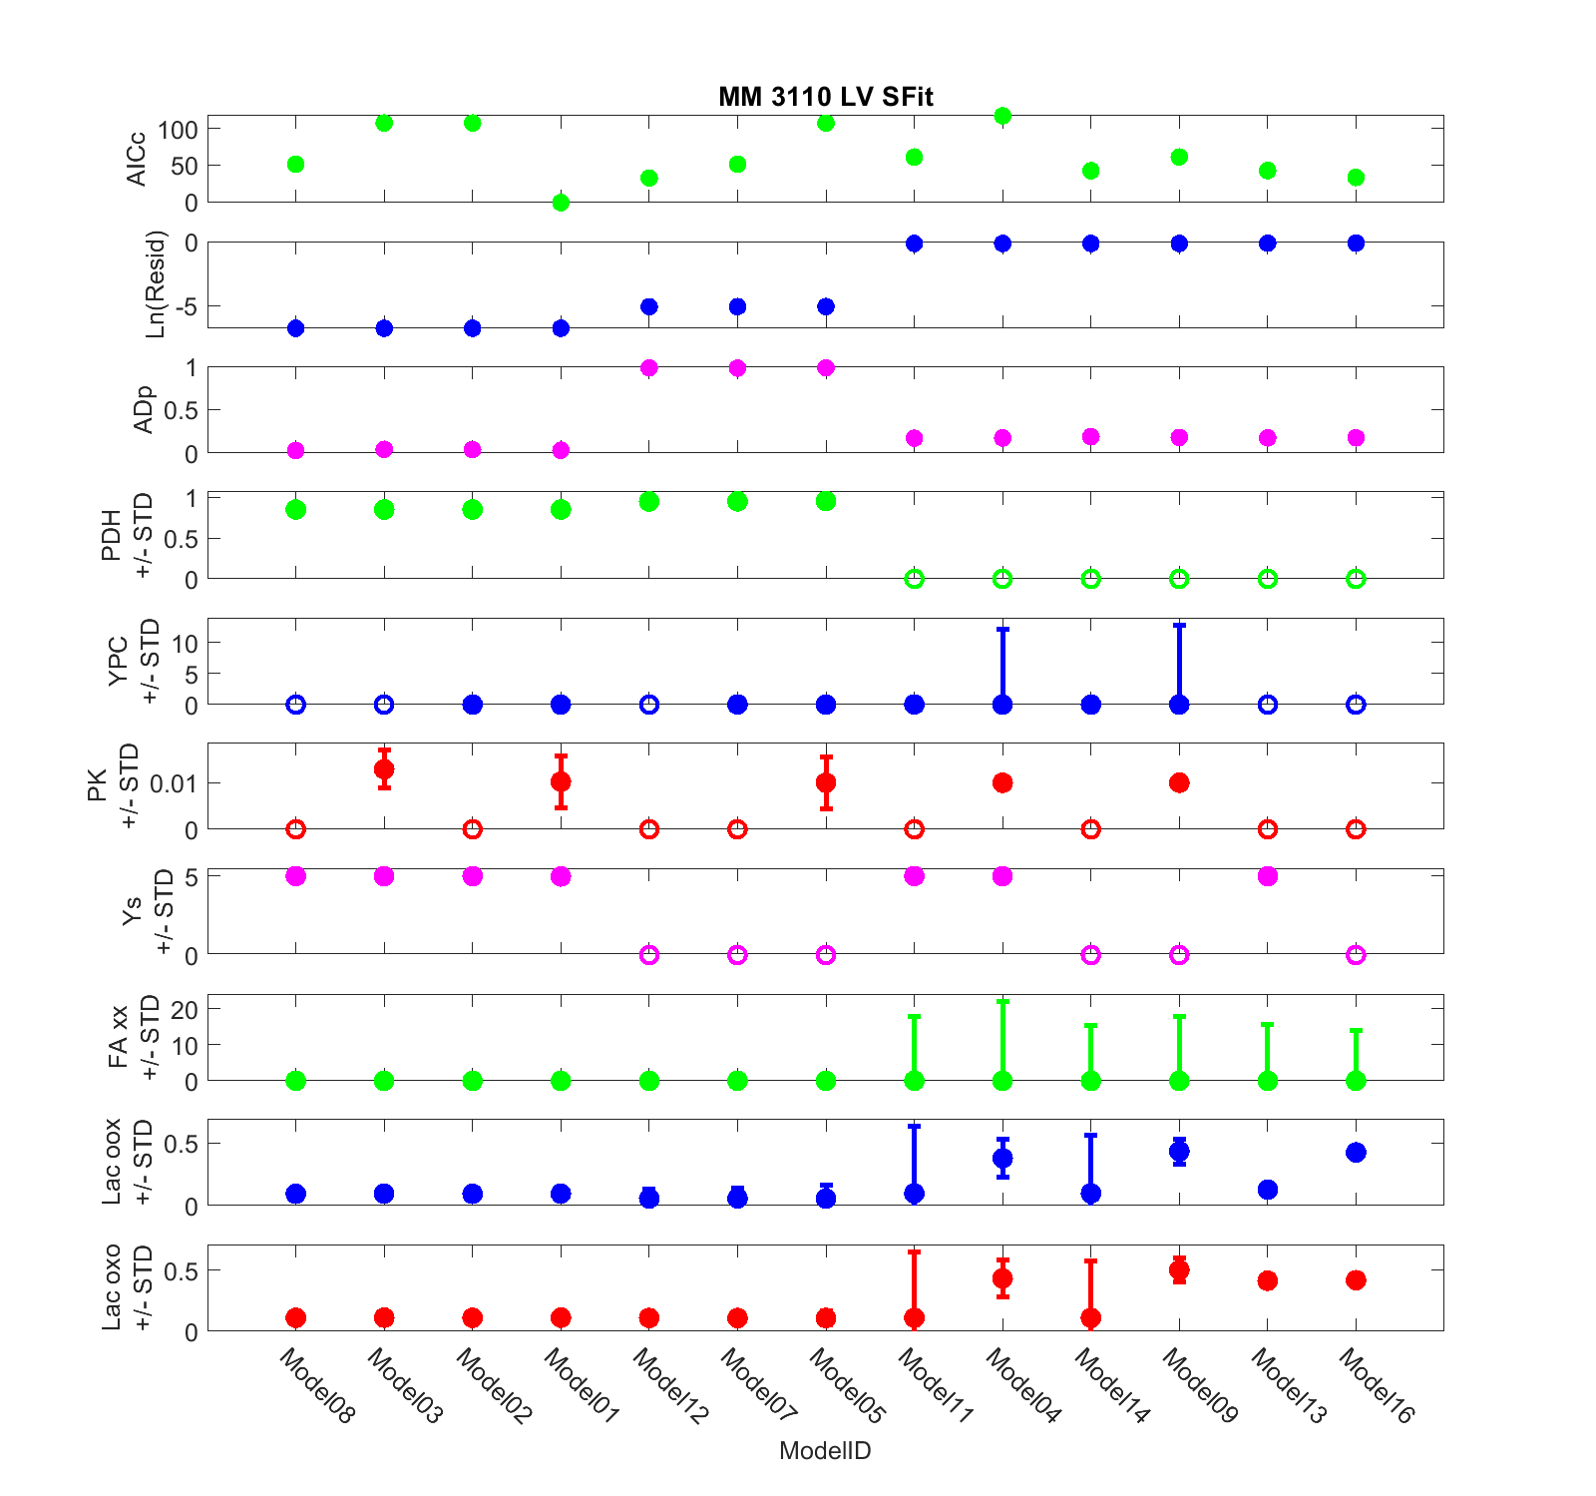
tcaCALC All Models Output Results (Graphics) Summary Plot

Slide 19
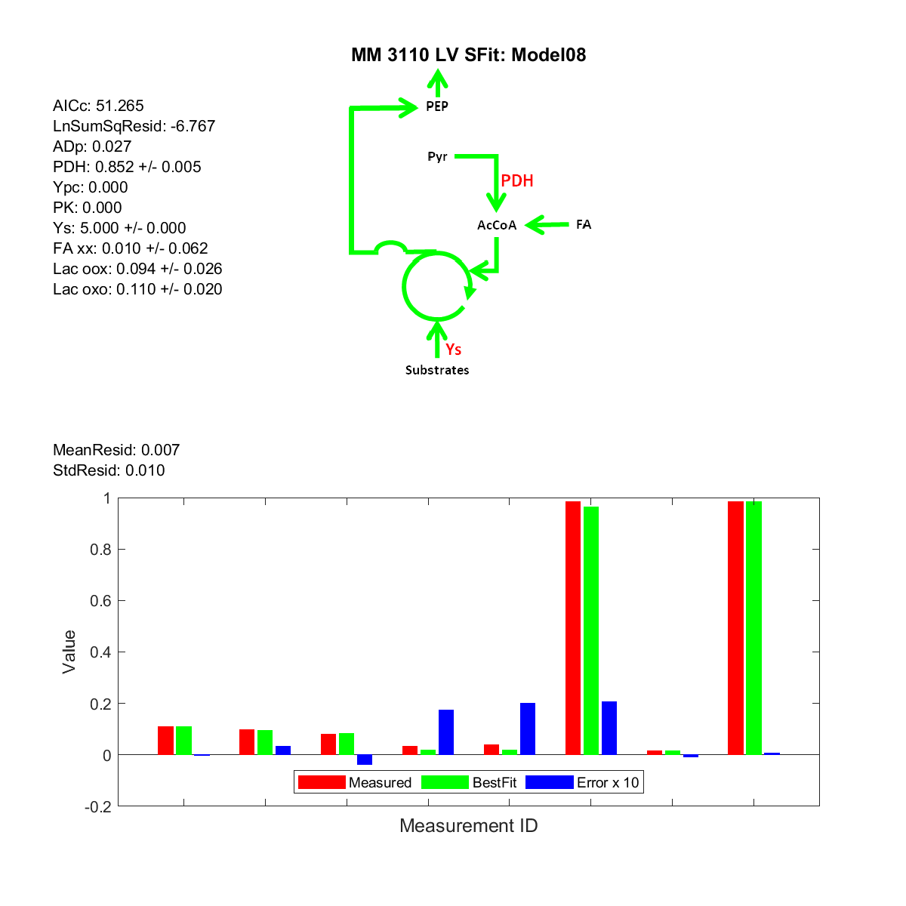
tcaCALC Model Output Results (Graphics) One produced for Each Model

Slide 20
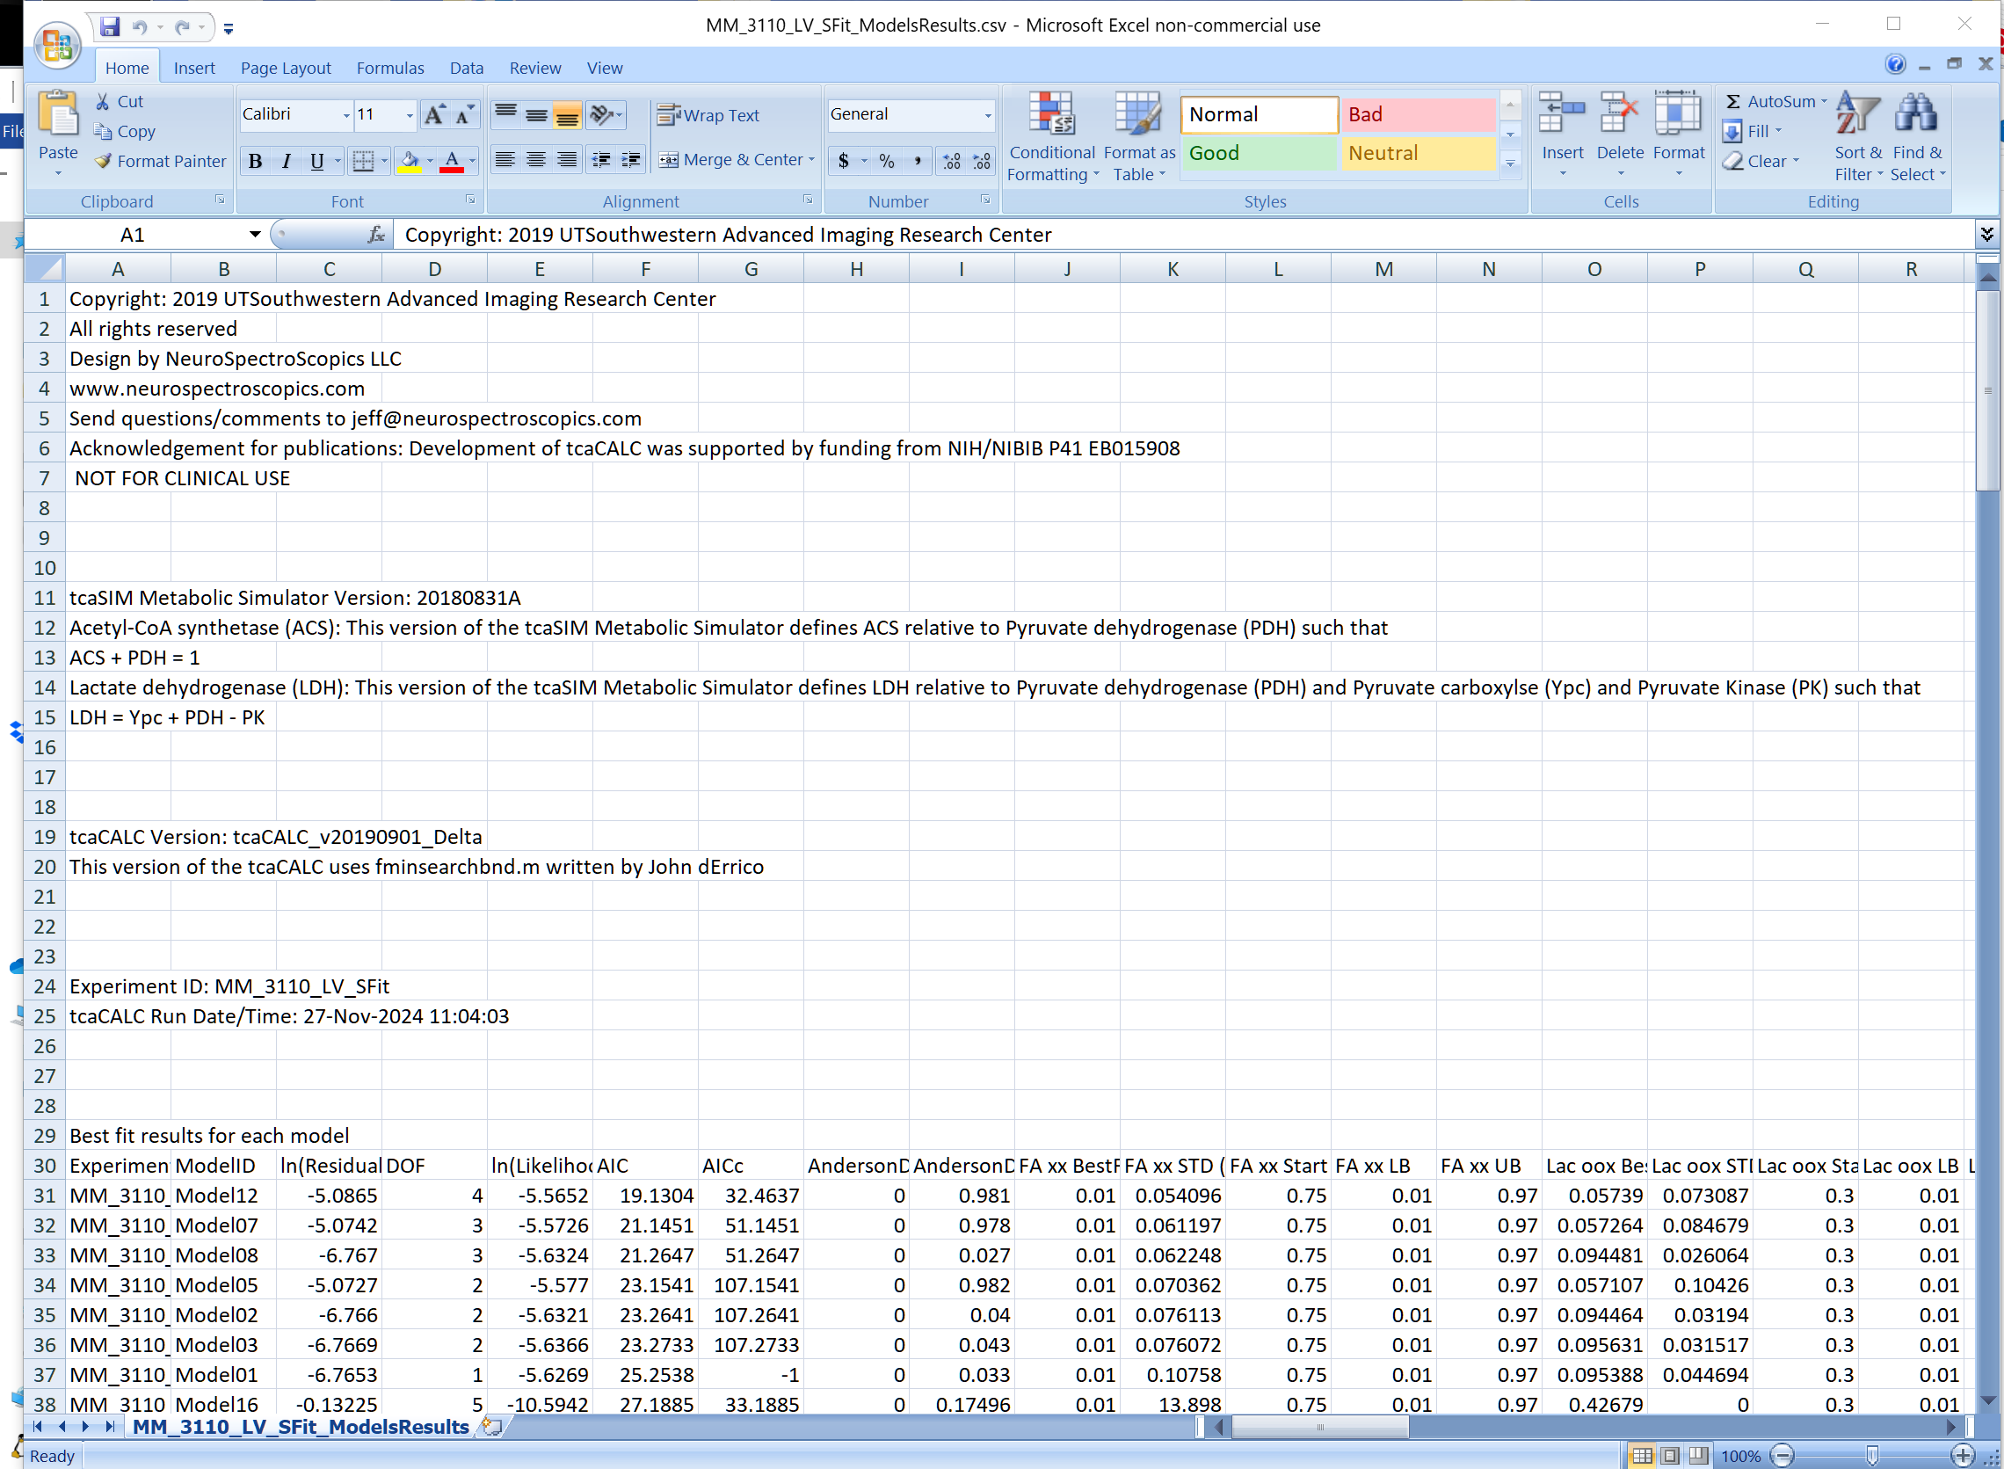
tcaCALC Models Output Results (Numerical)

