Slide 1
Data-Driven Insights for GTM, and Product
Javad Anaraki
2025.06.06

Slide 2
Data Exploration
The input data has 20 features and 5203 samples. Out of 20 feature, Churn is the target with two values of 0 and 1, and CustomerID include ids.
Based on the counts, the input dataset is unbalanced so should be mindful of this.
 | Churn
Labels | 0 | 1
Counts | 4329 | 874

Slide 3
Data Exploration (cont.)
Numerical features
  Churn, Tenure, CityTier, WarehouseToHome, HourSpendOnApp, NumberOfDeviceRegistered, SatisfactionScore, NumberOfAddress, Complain, OrderAmountHikeFromlastQuarter, CouponUsed, OrderCount, DaySinceLastOrder, CashbackAmount
Non-numerical features
  PreferredLoginDevice, PaymentMode, Gender, OrderCat, MaritalStatus
* Non-numerical features might need to be converted to categorical features or in some case to one-hot-enconding for specific models

Slide 4
Data Exploration (cont.)
Looking at the info() function results shows that the input dataset has missing values. Although there are models that can handle missing values but we would need to have an imputation strategy (for numerical and categorical) in case we need classification methods that can’t handle missing values.
  Tenure (239)
  WarehouseToHome (238)
  HourSpendOnApp (229)
  OrderAmountHikeFromlastQuarter (237)
  CouponUsed (237)
  OrderCount (251)
  DaySinceLastOrder (292)

Slide 5
Data Exploration (cont.)
In PreferredLoginDevice, there are three categories which two of them, namely, Mobile Phone and Phone should the same. Therefore, we need to handle this by setting the same value for both.
In PaymentMode, there are six categories where we have the same category but different names, such as Credit Card and CC, and COD and Cash on Delivery, which needs to be handled.
In OrderCat, Mobile Phone and Mobile can be merged.

Slide 6
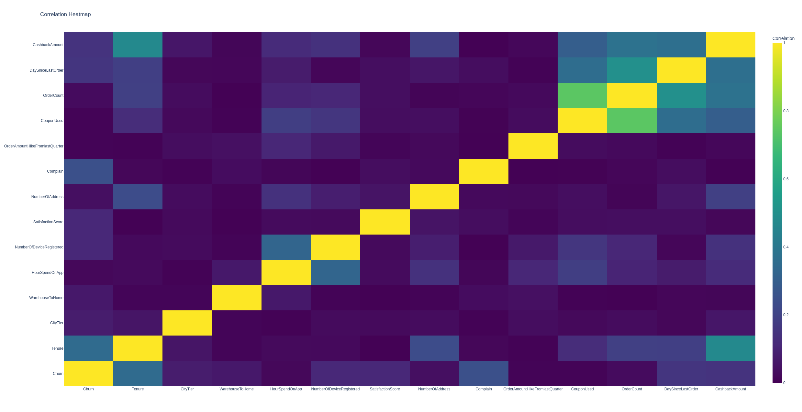
Analysis from CX perspectives

Slide 7
Analysis from CX perspectives (cont.)
Highly correlated features
  OrderCount & CashbackAmount
  OrderCount & DaySinceLastOrder
  OrderCount & CouponUsed
  Tenure & CashbackAmount
Highly correlated feature to the outcome
  Tenure
  Complain
  DaySinceLastOrder
  CashbackAmount

Slide 8
Insights and Recommendations
Generating model to predict churn probability would help us improve the CX and prevent customers leaving the company. To this goal, I trained to models, namely, RF and XGBoost. The reason for selecting these two models are:
  RF
    Robust churn prediction on structured data
    Handles missing values
    Reduces overfitting of single trees
  XGBoost
    Handles complex datasets with mixed types
    Handles missing values
    Handles class imbalance well

Slide 9
Insights and Recommendations (cont.)
For the metrics, I used f1-score and confusion matrix. The reason to select these methods are:
f1-score
  Good metric for datasets with imbalance outcome
  Useful when you want a balance between precision and recall
Confusion matrix
  Shows all types of classification outcomes (TP, TN, FP, FN)
  Help further analyze the results

Slide 10
Insights and Recommendations (cont.)
RF
  f1-score: 0.8456659619450317
  TN, FP, FN, TP: 1288, 11, 62, 200
  123 customers with probability > 70% are likely to churn
XGBoost
  f1-score: 0.9013539651837524
  TN, FP, FN, TP: 1277, 22, 29, 233
  240 customers with probability > 70% are likely to churn

Slide 11
Insights and Recommendations (cont.)
Providing higher Cashback and Coupon would positively impact customer churn
Providing higher Cashback and Coupon improves DaySinceLastOrder which would decrease Complains
Increasing warehouses to decrease WarehouseToHome would positively impact Complains and eventually help user’s retention

Slide 12
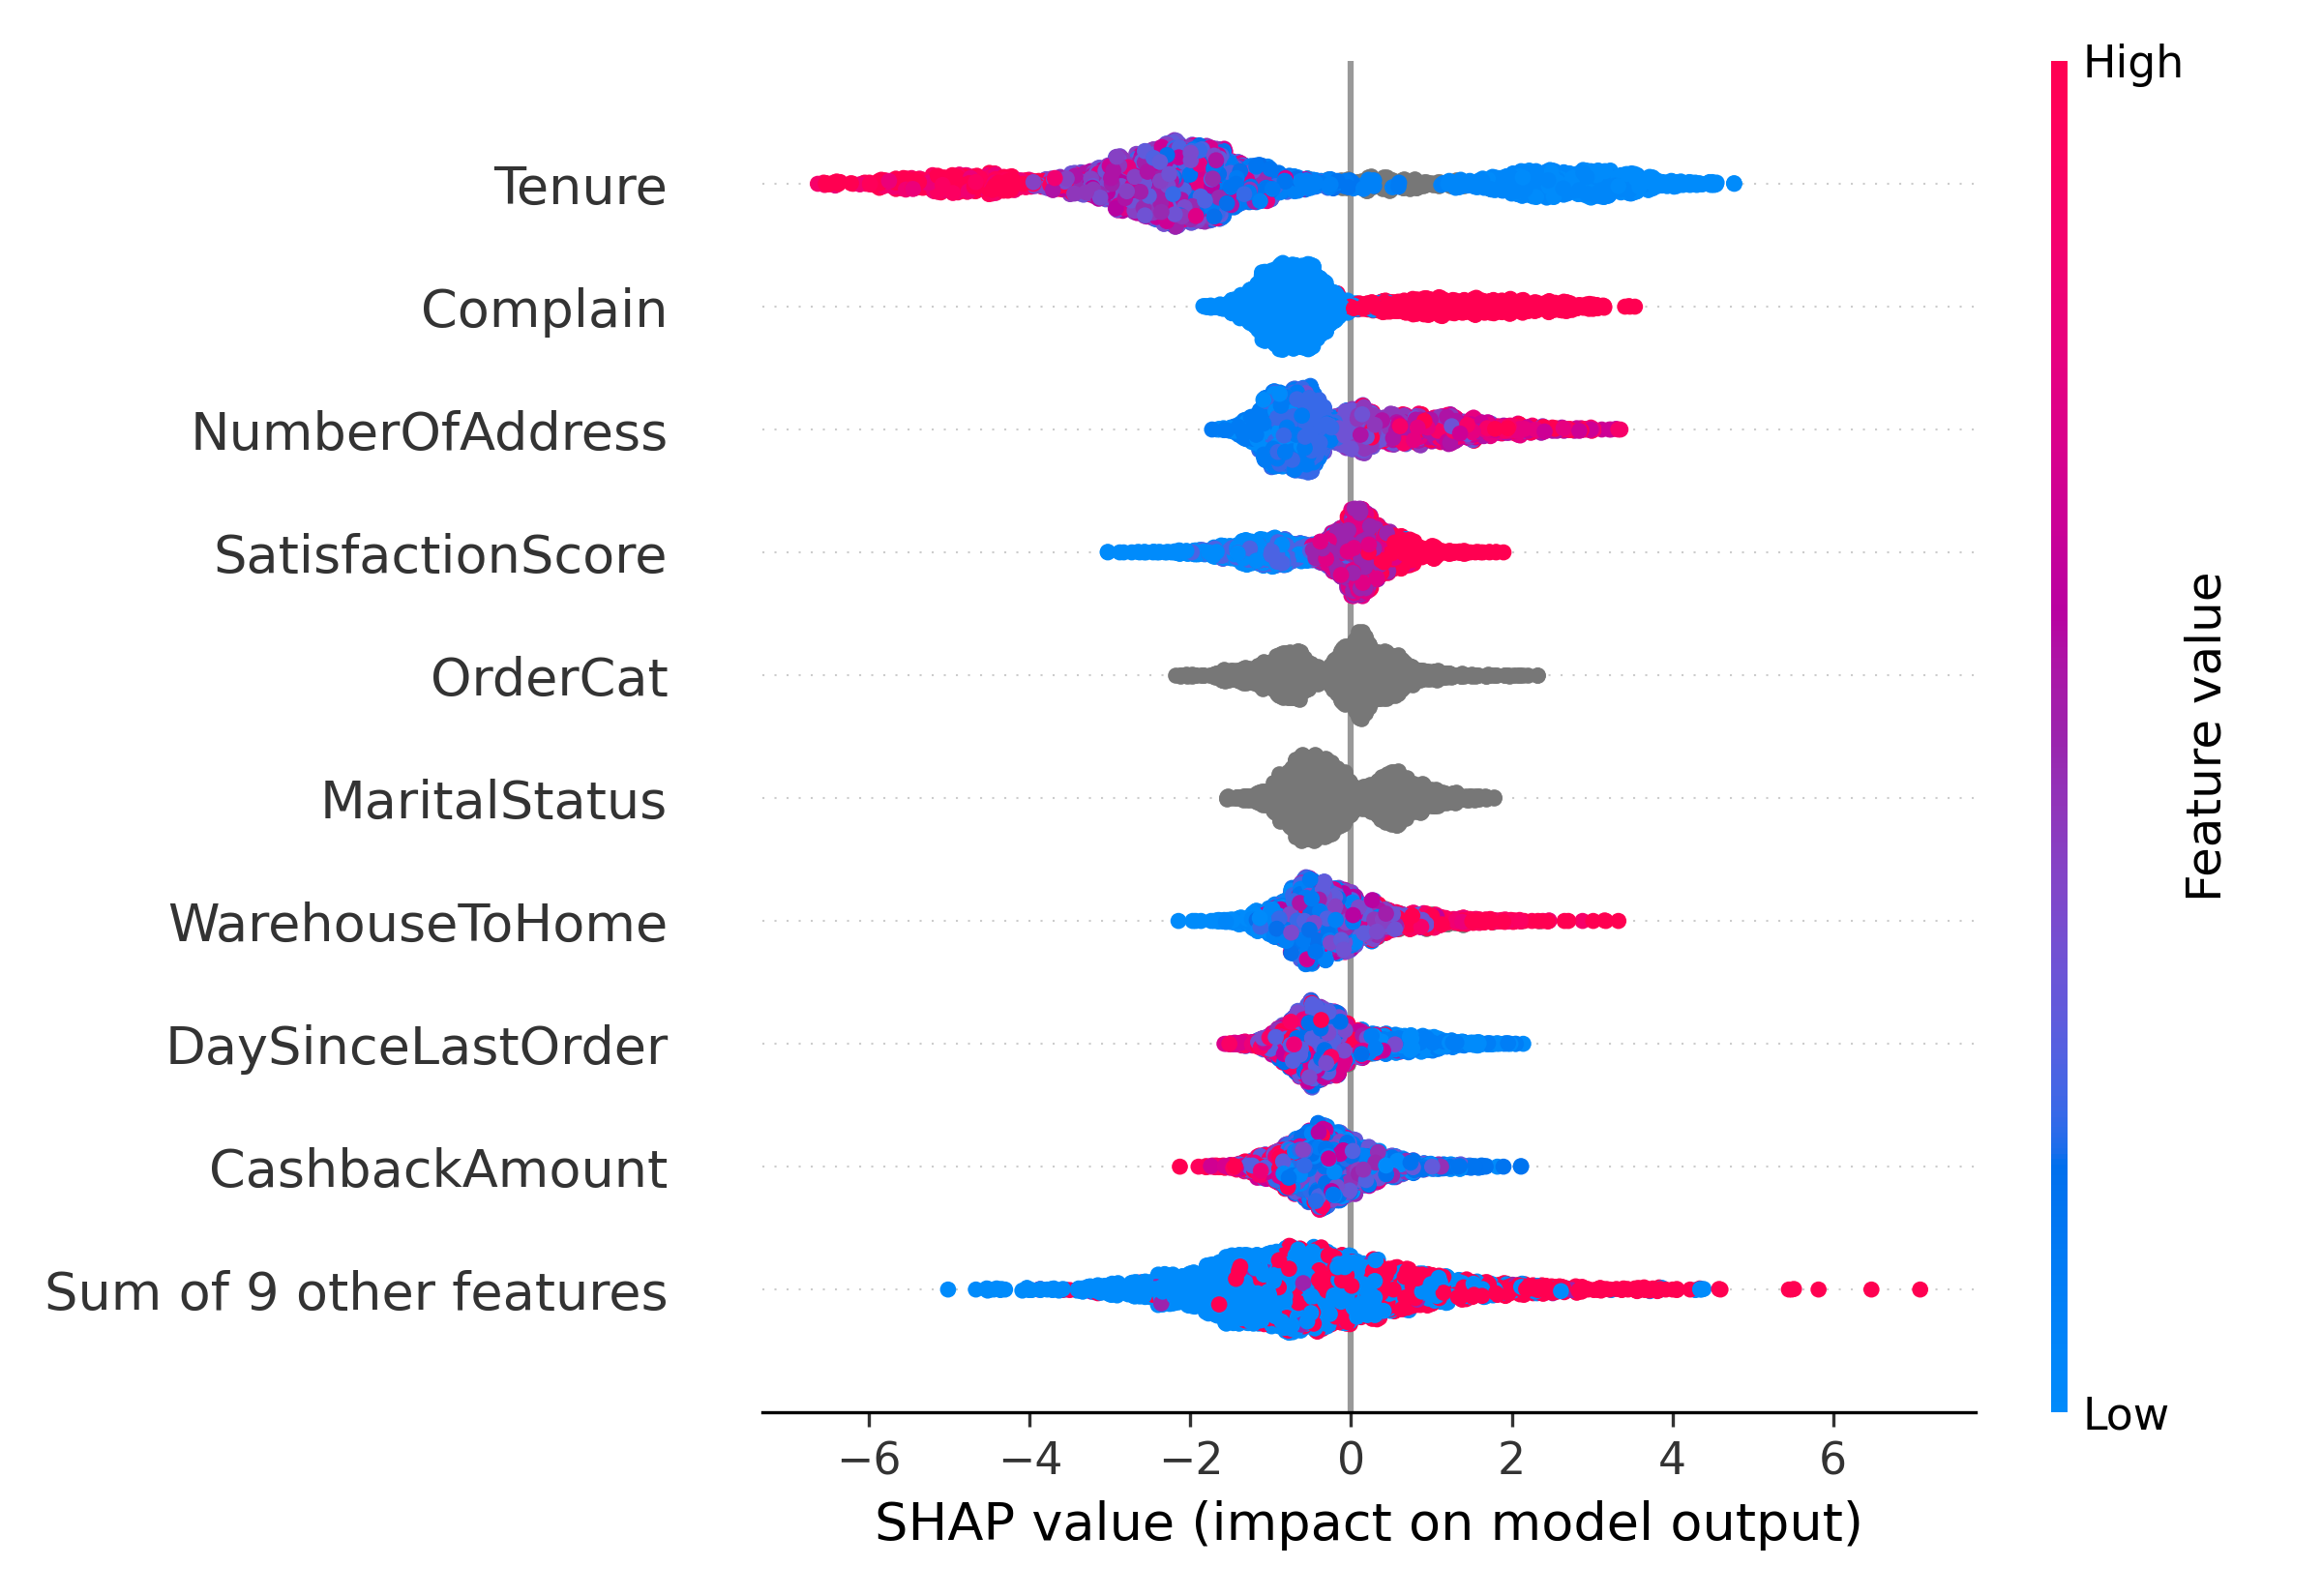
Analysis from CX perspectives (cont.)

Slide 13
Thank you!

